Slide 1


Anti-social Behaviour
Notes:
Learners who have successfully completed this lesson will be able to:
1.Recognise the different categories of ASB
2.Identify how ASB impacts on the community
3.Explain the term ‘Vulnerability’ and what constitutes vulnerability
4.Describe the powers available to deal with ASB
5.Explain the ‘Enhanced Powers’ that are available to deal with ASB
6. Explain the term “Victims Codes” and ‘GET OUT’

Slide 2

David Young
Notes:
Trainer to show ‘David Young’ DVD. Separate Health warning to be given here regarding the affective content of the video. (Video = 1 hour long)
Trainer to advise students not to make notes during the DVD and to concentrate on the topic and characters they will see during the clip.
Following the clip the Trainer will facilitate a discussion in open forum of each of the following characters.
Trainer to divide class into 4 groups and allocate Group tasks as follows;
1. Group 1 David Young.
(See Task Sheet 1)
2. Group 2 Jason Young
(See Task Sheet 2)
3. Group 3 Howard Barrett
(See Task Sheet 3)
4. Group 4 The Community
(See Task Sheet 4)

Slide 3

What is Anti-social Behaviour?
Conduct that has caused, or is likely to cause, harassment, alarm or distress to any person
In a housing related context it is:
Conduct capable of causing nuisance or annoyance to a person in relation to that person’s occupation of residential premises
Or
Conduct capable of causing housing-related nuisance or annoyance to any person
Notes:
QTS – What is meant by the term Anti-Social Behaviour?
The Anti-social Behaviour, Crime and Policing Act 2014 provides the meaning of “Anti-social Behaviour”
Between 2013-14 over 3.5 million calls made to police were about anti-social behaviour problems, in comparison to only 4.3 million crimes being recorded during the same period. This shows a growing importance of anti-social behaviour.
Anti-social Behaviour effects the quality of peoples lives and even though it is not a ‘crime’ as such, it is social disorder taking place in both public and private places.
Trainer to facilitate examples of behaviour that could amount to harassment.
Trainer to facilitate examples of behaviour that could amount to Alarm
Trainer to facilitate examples of behaviour that could amount to Distress.
The term 'harassment, alarm or distress' is not defined by the statute, therefore the words should be given their ordinary meaning;
harassment, means to subject someone to constant and repeated physical and / or verbal persecution;
alarm, means a frightened anticipation of danger and;
distress, means to cause trouble, pain, anguish or hardship.
These words should be seen in context with the term 'likely to be caused' may distress an old woman of 75 years may not distress a young man of 20 years. The conduct has to be seen in its full context. It has been held that the alarm caused to one person can be for the safety of someone else, and not necessarily for oneself.
Anti social behaviour powers are broadly categorized as housing related and non housing related.
Non-housing related Anti-social behaviour
Anti-social behaviour in a non-housing related context is conduct that has caused, or is likely to cause, harassment, alarm or distress to any person. This will apply, for example, where the anti-social behaviour has occurred in a public place, such as a town or city centre, shopping mall, or local park, and where the behaviour does not affect the housing management functions of a social landlord or people in their homes.
Housing-related Anti-social behaviour
Anti-social behaviour in a housing context is where the conduct is capable of causing nuisance or annoyance to a person in relation to that person’s occupation of residential premises or the conduct is capable of causing housing-related nuisance or annoyance to any person. Only social landlords, local councils or the police will be able to apply for an injunction under these provisions in the legislation. In the case of social landlords only, “housing-related” means directly or indirectly relating to their housing management function.

Slide 4
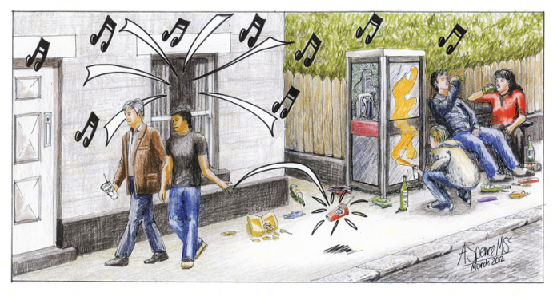
Categories of Anti-social Behaviour
Notes:
Anti-social behaviour is a broad term used to describe the day-to-day incidents of crime, nuisance and disorder that make many people’s lives a misery – from
litter and vandalism, to
public drunkenness or
aggressive dogs,
to noisy or abusive neighbours.
Such a wide range of behaviours means that responsibility for dealing with anti-social behaviour is shared between a number of agencies, particularly the Police, Local Authorities (or Councils) and Social Landlords (or Housing Associations).
Victims can feel helpless, bounced from one agency to another and then back again. In many cases, the behaviour is targeted against the most vulnerable in our society and even what is perceived as ‘low level’ anti-social behaviour, when targeted and persistent, can have devastating effects on a victim’s life.
The Anti-social Behaviour, Crime and Policing Act 2014 (enacted October 2014) replaced many of the provisions contained in the Crime and Disorder Act 1998 and the Anti-social Behaviour Act 2003.
The reforms introduced by parts 1-6 are designed to put victims at the heart of the response to anti-social behaviour, and give professionals the flexibility they need to deal with any given situation
Civil Injunction
Criminal Behaviour Order (CBO)
Community Protection Notice
Public Spaces Protection Order (PSPO)
Closure Power
Dispersal Power

Slide 5

Categories of Anti-social Behaviour
Misuse of Public Spaces
Drugs & Substances
Disregard for community/personal well-being
Rowdy behaviour
Street drinking
Begging
Prostitution
Sexual acts
Vehicle-related nuisance
Noise
Nuisance behaviour
Hoax calls
Animal-related problems
Notes:
Misuse of Public Spaces
Drugs
Taking drugs
Sniffing volatile substances
Discarding needles/drug paraphernalia
Crack houses
Presence of dealers or users
Street drinking/Begging
Prostitution/Kerb crawling
Soliciting
Cards in phone boxes
Discarded condoms
Loitering
Pestering residents
Sexual acts
Inappropriate sexual conduct
Indecent exposure
Vehicles – parking, abandoned vehicles, off-road cycling, noise, racing cars, car repairs, cycling/skateboarding

Slide 6
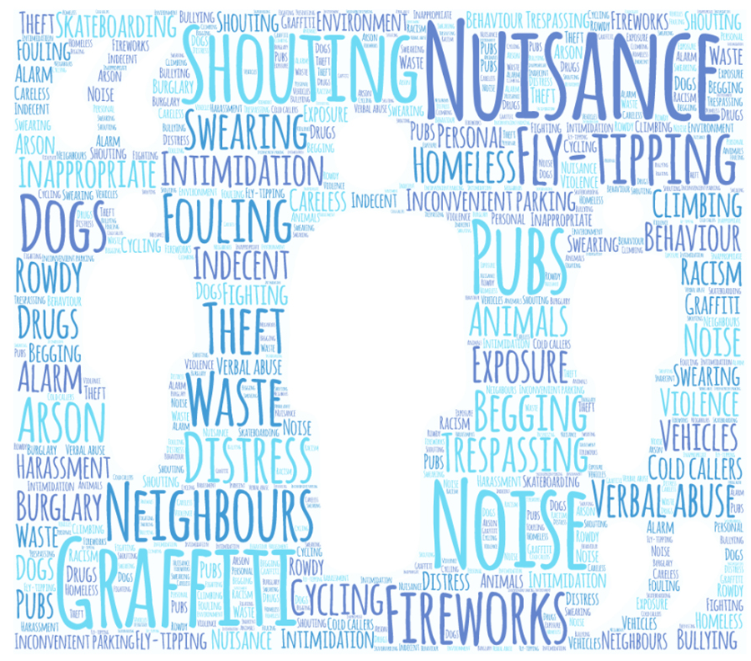
Categories of Anti-social Behaviour
Acts directed at people:
Intimidation
Environmental damage:
Criminal Damage
Harassment
Vandalism
Litter
Rubbish
Notes:
3. Acts directed towards people
Intimidation/ harassment
Groups or individuals making threats
Verbal abuse
Bullying
Following people
Pestering people
Voyeurism
Sending nasty/ offensive letters
Obscene/ nuisance phone calls
Menacing gestures
Intimidation/Harassment
Can be on the grounds of:
Race
Sexual Orientation
Gender
Religion
Disability

Slide 7
Potential Impact of Anti-social Behaviour
Fear of continued crime
Vulnerability & fear or a repeat attack
Psychological trauma
Self exclusion
Sense of powerlessness
Risk of ill-health
Fear of attending court
Lack of faith in the police/ other responsible authorities
Or possibly much worse…
Notes:
QTS – How does ASB impact the community?
We looked at this in the Neighbourhood Policing module in respect of drug dealing – but the same community impact is evidence when it comes to persistent ASB.
The ASB incidents amount to Signal Crimes
•Continued fear of crime
•Vulnerability to repeat attack
•Psychological trauma
•Risk of ill-health
•Sense of powerlessness
•Self exclusion by fear of going out
•Fear of attending court
•Fear of being targeted following giving statements
•Fear of becoming a repeat victim
Possibly much worse?

Slide 8
Repeat Victim
‘An individual that has been the subject of 3 similar occurrences of Anti-Social behaviour within the last 3 months & the ASB unit is required to risk assess the victim’
Notes:
This is the SWP definition, but it follows national recommendations on RVAPs.
For the purpose of effective management of Anti-Social Behaviour it is important to identify repeat and vulnerable victims.
Individuals identified as ‘vulnerable’ through the risk assessment process will receive an enhanced level of response to their call
Anti-Social Behaviour occurrences will not be finalised until the victim has been notified.

Slide 9
Vulnerable Victim
‘An individual that has been subject to an ASB Risk Assessment, & who has been recorded as medium or high risk for which there is a Vulnerable Victim Action Plan (VVAP) in place’
Notes:
For the purpose of effective management of Anti-Social Behaviour it is important to identify repeat and vulnerable victims.
Individuals identified as ‘vulnerable’ through the risk assessment process will receive an enhanced level of response to their call
Anti-Social Behaviour occurrences will not be finalised until the victim has been notified.

Slide 10
The Importance of Addressing the Needs of Victims & Witnesses
Community confidence & safety
Public Perception
Crime Reporting
Community Cohesion
Crime Solving
Information & Intelligence
Notes:
QTS – Why is it important to address the needs of victims & witnesses?
• Leads to more satisfaction when community is involved in creating solutions to problems
• Assists victims and witnesses to access help and assistance over and above what the police can provide
• Offences are dealt with in a more appropriate manner when listening to what the victim/witness needs
• Leads to more scrutiny/accountability of police and partners
• Allays any unreasonable fears the victim may have in terms of personal vulnerability and repeat attacks
•Reassures witnesses of their personal safety
• Helps explain the processes to both witnesses and victims should the matter come to court along with any compensation claim that could be made
• Safety and security advice (Crime Prevention)
• Maintain public safety and confidence and the police
• Leads to more crime/ASB being reported to police
• Leads to more community intelligence being reported to police
• Helps identify signal crimes
• Leads to narrowing the ‘reassurance gap’

Slide 11
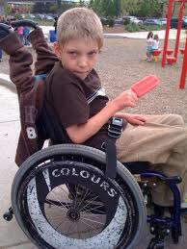

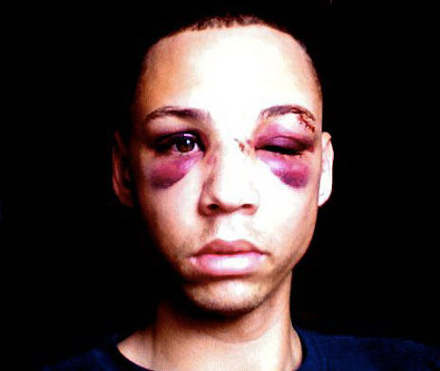

Notes:
Prior to revealing slide, pose the question:
QTS – What is meant by the term vulnerability and what factors would you consider may identify vulnerability?
Facilitate answers from group and ensure the following is addressed:
SWP itself may also be open to vulnerability in that any poor performance on our part may have adverse affects on the confidence of the public in our ability to provide a reliable and professional service.
Impact Factors – suggested considerations
Information provided by the informant that suggests vulnerability
Physical or Mental impairment whether short term or long term
Behavioral or language barriers
Consideration due to age
Mental Health Condition
Learning difficulties
Is in a highly emotional upset and distressed state
Victim of Domestic Violence
Victim of Hate Crime
Repeat Vicitm
This list is not definitive
MUST cover
Section 12 of the Domestic Violence, Crime and Victims Act 2004 (DVCVA 2004) came into force on 30 September 2009, amending section 5 of the Protection from Harassment Act 1997 (PHA 1997). Section 5 of the PHA 1997 previously permitted a criminal court to make a restraining order only when sentencing or otherwise dealing with a defendant convicted of an offence of harassment (contrary to section 2 PHA 1997) or an offence of putting someone in fear of violence (contrary to section 4 PHA 1997). Its amendment enables the court to impose a restraining order in a much wider range of circumstances.
Restraining orders are distinct from Criminal Behaviour Orders (CBOs) on conviction (section 1C of the Crime and Disorder Act 1998) in a number of ways. Restraining orders:
are used in domestic situations whereas CBOs on conviction relate to persons not of the same household;
are to protect named persons whereas CBOs on conviction are used to protect unnamed persons in any place in England and Wales; and
can be made on conviction and acquittal. CBOs on conviction cannot be made on acquittal.

Slide 12
Three Vital Questions….
1. Have you reported this problem before?
2. Why do you think this is happening to you or your family or others?
3. How is this affecting you/ your family/ others?
Notes:
Trainer to state that these questions are posed to the victim by PSC when the initial call is made.
Trainer to emphasise that it would be beneficial for attending officers to ask the questions at scene to ensure that the individuals vulnerabilities and/or differences are highlighted.

Slide 13
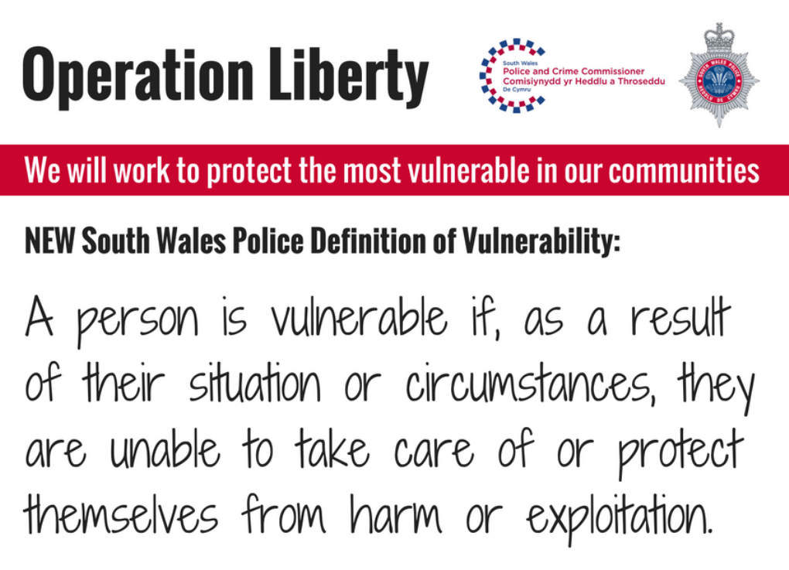
Notes:
SWP ONLY

Slide 14
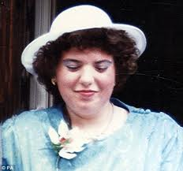

Fiona Pilkington Case Study 2009
Notes:
Following the video clip
QTS – what opportunities were missed to provide support?
QTS – How can vulnerable/ repeat victims be identified to prevent this type of incident from occurring again?
The bodies of Fiona Pilkington, 38, and her daughter Francecca Hardwick, 18, were found in a burnt-out car in a lay-by on the A47 near Earl Shilton in Leicestershire on 23 October 2007. An inquest into their deaths in September 2009 concluded Fiona committed suicide and unlawfully killed her daughter.
Fiona and her disabled daughter - Francecca Hardwick, who was 18 but had a mental age of about 4 lived with her son Anthony, who was 15 when they died.
‘A mother died alongside her mentally disabled daughter in a blazing car after suffering nearly ten years of abuse from yobs’
Fiona Pilkington, 38, made 21 calls to police in a bid to stop the gang abusing her daughter Francecca Hardwick, but they failed to act. She had even written to her local MP. On the day of her death she called police to complain of children trampling her garden hedge but was told to ignore them. The youths would also urinate in the garden and throw stones and eggs at the house. The council imposed a 300-yard exclusion zone for the youths around the family's house but that had failed to enforce it. Nobody was doing anything to help her, not the police, the council or the Neighbourhood Watch were doing anything.
At some point the entire family was subject to ASB and bullying – but the police never put the pieces together – they treated all incidents separately – there was no application of any of the processes such as NDM, NIM, Problem Analysis Triangle.
This incident was the one that prompted a significant change in how the police deal with ASB and in particular repeat and vulnerable victims.
Consider where opportunities were missed to provide support and how vulnerable/repeat victims could be identified to prevent this type of incident from occurring again. – Discuss

Slide 15
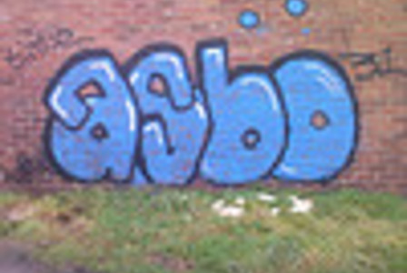
Dealing with Anti-social Behaviour
Notes:
Under the previous Acts, there was an onus on the police and partners to work together to deal with ASB – this is simply reinforced in the 2014 Act, but there are clearer guidelines as to who should do what – the main partners under this legislation are:
Police
Local Authorities (or Councils)
Registered Social Landlords (or Housing Associations)
The Criminal Justice System (CPS and Courts)
Failure to deal with ASB has a major impact on the way that people perceive the service provided by the police service.
This is true whether the behaviour complained about is actually the responsibility of the police or one of the other partners.
The key to success is working together because frankly, the main perpetrators of ASB tend to be those who are of interest to the police in one way or another.

Slide 16
Community Trigger
Gives victims the ability to demand action, starting with a review of their case
Multi-agency problem solving approach
3 complaints in 6 months
Action plan agreed
A victim of ASB or another person acting on behalf of the victim can make the request
Notes:
QTS – What is a community trigger?
The Anti-social Behaviour, Crime and Policing Act 2014 includes two new measures which are designed to give victims and communities a say in the way anti-social behaviour is dealt with
The Community Trigger, gives victims the ability to demand action, starting with a review of their case, where the locally defined threshold is met.
They will determine whether a certain threshold has been reached, which is usually 3 complaints over a six month period. The persistence and harm caused by the ASB will also be taken into account
Agencies inform the victim if the threshold has been met, and if it has not, a case review will take place with a problem solving approach. If an action plan is required it will be discussed wit the victim and a timeline for action will be agreed.
Gives victims and communities the right to request a review of their case and bring agencies together to take a joined up, problem-solving approach to find a solution.

Slide 17

Community Remedy
A list of agreed community resolutions are agreed by the Chief Constable
These are presented to the victim to ‘choose’ a remedy
Gives victims of low level crime & ASB a say in the punishment of the perpetrator out of court
Notes:
QTS – What is a community remedy?
The Community Remedy, gives victims a say in the out-of-court punishment of perpetrators for low-level crime and anti-social behaviour.
The Community Remedy document is a list of actions which may be chosen by the victim for the perpetrator to undertake in consequence of their behaviour or offending.
Some examples of community resolutions are: cleaning of graffiti, repairing damage, written apology, ABC contract, mediation, payment, unpaid work etc.
To invoke a Community Remedy there will need to be:
Evidence indicating that there person has committed an offence or ASB that would warrant the use of a caution or court proceedings or civil injunction
An admission from the perpetrator of the behaviour of the offence and agreement to participate in the community remedy
If the perpetrator fails to comply a youth or conditional caution /court proceedings can commence
A community resolution can only be agreed when an officer has obtained details about both the offence and the offender. The officer consults with the victim of the crime to reach a fair decision, in most cases endorsing the victim’s wishes, and, if the offender agrees to comply, the matter is regarded as resolved. If the resolution is not fulfilled by the offender the case goes to court.
Examples of community resolutions:
An officer advises an offender to stop Anti-social behaviour and outlines the implications of committing further offences
An offender agrees to give a formal apology to the victim
An offender agreeing to provide compensation to the victim
An offender undertakes to repair damage caused by a crime.

Slide 18
Enhanced Powers
e.g. on conviction for drug dealing, harassment
Issued by the Courts
Criminal Behaviour Order
e.g. neighbour disputes involving threatening behaviour
Crime Prevention Injunction
Issued by the Police, Local Authority, Social Landlord
Supportive Interventions
e.g. litter, graffiti, noise, crack house, street drinking, dangerous dogs
Community Protection Notice
Community Resolution
(Rehabilitative or Restorative Out-of-court Disposals)
e.g. cautioned for first offence, such as drunk and disorderly or minor damage
Issued by the Police, Local Authority, YOT, Social Landlord, N’hood Justice
Panel
e.g. persistent nuisance, shouting, swearing
Warning Letters and ABCs
e.g. one off incident (e.g. breaking a window), guilt admitted
Early and Informal Interventions
Notes:
QTS – what are the powers available to deal with ASB?
Early and informal interventions - also known as supportive interventions.
Early and informal interventions can establish clear standards of behaviour and reinforce the message that anti-social behaviour will not be tolerated. In many cases, awareness of the impact of their behaviour on victims, and the threat of more formal enforcement tools, can be a sufficient incentive for an individual to change their behaviour.
The problem with previous ASB legislation was that there were few options other than applying for a full-blown ASBO, which often meant they were issued for low-level behaviour and were overturned by higher courts.
The emphasis with the new legislation is to deal with incidents, where possible, with a proportionate response at the lowest possible level. Issues should only go to court where the behaviour is so unacceptable that there is no other way of dealing with it.
Verbal warnings: In deciding to use a verbal warning, the officer should still consider the evidence. For instance, the officer should have reason to believe that the anti-social behaviour has occurred, or is likely to occur, and that the individual’s behaviour could be considered to be unreasonable. In issuing a verbal warning, the police, council or housing officer should make clear to the individual what behaviour is causing the issue and what effect this is having on the victim or community and the consequences of non-compliance are explained clearly.
Written warnings: As with a verbal warning, a written warning should contain specifics about what behaviour has occurred and why this is not acceptable, including the impact on any victims or local community. Local agencies should alert each other that the warning has been given so that it can be effectively monitored.
Each agency needs to ensure that it keeps a record of any verbal or written warning given so that it may be used as evidence in court proceedings if required.
Local agencies may wish to consider what level of detail they go into at this stage regarding the consequences of further anti-social behaviour and more serious sanctions – for instance, an Acceptable Behaviour Contract, court proceedings for a civil injunction or even criminal proceedings if the behaviour escalates.
Acceptable behaviour contract – Acceptable behaviour contracts (ABCs), sometimes called acceptable behaviour agreements, can be an effective way of dealing with anti-social individuals, especially where there are a number of problem behaviours. They can also be very effective at dealing with young people early, to nip problem behaviours in the bud before they escalate.
ABCs are a written agreement between a perpetrator of anti-social behaviour and the agency or agencies acting locally to prevent that behaviour. The terms of an ABC can be discussed with the perpetrator before they are drafted and signed to encourage compliance. However, there is no formal sanction associated with refusing to sign an ABC, so if an individual does not wish to sign, they cannot be forced to do so. However, refusal to sign an ABC may persuade a court that only a civil injunction or a criminal behaviour order will prevent the anti-social behaviour.
While there are no formal sanctions associated with breaching the conditions of an ABC, agencies should consider further steps if the individual does not change their behaviour. Potential further action should be made clear in the ABC so that the perpetrator is aware of the consequences of failing to comply. In the case of graffiti, for example, this could be the issue of a community protection notice or an application for a civil injunction.
In cases where court proceedings are subsequently deemed necessary, the work undertaken as part of drafting an ABC can form part of the evidence pack. For instance, any discussion with victims and communities to assess the impact of the behaviour could form the basis of a community impact statement for the court.
Parenting contract – Where informal interventions are used against under 18s, the parents or guardians of the young person should be contacted in advance of the decision to take action. In many cases, the parents or guardians can play an important role in ensuring the individual changes their behaviour. While there are formal routes such as parenting orders, at this stage it may be appropriate to include a role for the parent in an ABC. In addition, if the behaviour of the parent is part of the issue (either because they are a bad influence on the child or fail to provide suitable supervision) agencies could consider a parenting contract. These are similar to an ABC but are signed by the parent or guardian. They could also be considered where the child in question is under 10 and so other interventions are not appropriate for the perpetrator themselves.
With a potentially troubled family, agencies should consider discussing the matter with other bodies with an interest – for instance the local youth offending team, social services and school to assess the scale of the problem. Family intervention programmes and the local Troubled Families Unit should also be contacted where appropriate to discuss potential interventions.
Mediation In many cases of anti-social behaviour, mediation can be an effective tool, solving the issue by bringing all parties to the table. This can be very effective in neighbour disputes, family conflicts, lifestyle differences such as noise nuisance complaints and similar situations where it can sometimes be difficult to identify the victim and the perpetrator.
Mediation does not work if it is forced on those involved. All parties must be willing to come to the table and discuss their issues and agencies should consider whether mediation is appropriate, who should attend and set clear ground rules for participation.
It is not for the mediator to establish a solution to the issue as, in most cases, they will have already tried this with each party unsuccessfully. For mediation to deliver long-term solutions, those in dispute should agree a solution. The mediator should facilitate this conversation and ensure all parties adhere to the ground rules. They can also draw up an agreement if required for all parties to sign to formalise what has been agreed.
Support & Counselling - In many cases, there are underlying causes of the anti-social behaviour. The new powers allow professionals to actively deal with these through the use of positive requirements. However, there is no need to wait until formal court action before offering help.
Substance misuse or alcohol dependency can drive anti-social behaviour and low-level crime, and support can have a positive impact. Catching someone before they fall into a criminal way of life by supporting them to escape addiction can save thousands of pounds in enforcement action over a person’s lifetime.
The Troubled Families Programme has already identified many of the issues faced by young people (https://www.gov.uk/government/policies/helping-troubled-families-turn-their-lives-around). The young person being dealt with may already be known by the Troubled Families Unit, but if not, it may be useful to discuss the issues with local experts to see whether there is a wider support programme that can be put in place.
Community resolution is the nationally recognised term for the resolution of a less serious offence or anti-social behaviour, through informal agreement between the parties involved as opposed to progression through the criminal justice process. A community resolution may be used with both youth and adult perpetrators. It enables the police to deal more proportionately with lower level crime and anti-social behaviour in a timely and transparent manner that takes into account the needs of the victim, perpetrator and wider community, outside the formal criminal justice system.
Community Protection Notice (CPN) – To stop a person aged 16 or over, business or organisation committing anti-social behaviour which spoils the community’s quality of life.
Is designed to stop ASB by an individual aged over 16 years and also by businesses and organisations. The ASB would need to have a detrimental effect on the quality of life for people in the locality and be unreasonable and persistent.
Who can issue a CPN? - Local Authority, Social Landlords and the police (including PCSOs).
Decisions on whether behaviour is persistent should be taken on a case by case basis by issuing officers. Where an individual is storing rubbish in their garden for many months, proving persistence may be simple, but there may be cases where behaviour is continuing over a very short time period. A written warning must be given first, stating the behaviour and the consequences if it continues.
Breaching a CPN is a criminal offence which may include the issue of a FPN of £100 on the spot fine, If the offender is found guilty at court, the court can impose remedial action for example to clear up rubbish from their front garden and items used to cause the ASB may be sized (e.g. spray painting equipment)
Civil Injunction – The injunction under Part 1 of the Anti-social Behaviour, Crime and Policing Act 2014 is a civil power which can be applied for to deal with anti-social individuals. The injunction can offer fast and effective protection for victims and communities and set a clear standard of behaviour for perpetrators, stopping the person’s behaviour from escalating.
Although the injunction is a civil power, it is still a formal sanction and many professionals will want to consider informal approaches before resorting to court action, especially in the case of under 18s. However, where informal approaches have not worked or professionals decide that a formal response is needed more quickly, they should be free to do so.
Can be used at an early stage to prevent individuals engaging in ASB before there is an escalation. They are used in
Non housing related ASB in which behaviour has caused harassment alarm or distress
Housing related ASB in which conduct is capable of causing nuisance and annoyance
A wide range of organisations can apply for a civil injunction such as local councils and police. They are issued by County Court, and there will be a need to prove by the organisation that the injunction is necessary as they are obtained on a civil standard of the proof (balance of probability)
The injunctions can include prohibitions.
Breaching an order is not a criminal offence – under 18 years penalty is a supervision order, over 18 years civil contempt of court with a fine or up to 2yrs in prison.

Slide 19

Enhanced Powers

Slide 20

Dispersal Power
Police Officer/PCSO (designated power) – Section 35
Requires a person committing or likely to commit anti-social behaviour, crime or disorder to leave an area for up to 48hours
Power to confiscate any item related to ASB
Breach is a criminal offence
Notes:
QTS – What is a Dispersal power?
The Dispersal Power can be used by police officers in uniform. Police Community Support Officers (PCSOs) can also use this power if designated by their chief constable. Use of the dispersal power must be authorised by an officer of at least the rank of inspector before use.
The officer must have reasonable grounds to suspect that the behaviour of the person has contributed, or is likely to contribute, to:
members of the public in the locality being harassed, alarmed or distressed; or
crime and disorder occurring in the locality.
The direction must be given in writing, unless that is not reasonably practicable and will specify for how long the person must leave the area.
The officer must first get the permission of an inspector or above.
The officer must specify the area and they can determine time and route to take when leaving the area.
The legislation says that anyone over 10 can be issued with section 35, however SWP have decided 16 years and over is applicable.
Examples of items that could be confiscated are spray cans, speakers, lazer pens etc
A major benefit is that a dispersal order can be issued to someone committing or likely to commit, harassment alarm or distress or crime and disorder in a public place – don’t have to wait for the behaviour to escalate.
Dispersal Powers only apply to Police Officers in SWP – it is a discretionary power for PCSOs which does not apply in SWP. Gwent PCSO’s do have this power and they use the age of 10 years as per the legislation
The officer must first get the permission of an Inspector or above.
The officer must specify the area and they can determine time and route to take when leaving the area.
The legislation says that anyone over 10 can be issued with section 35, however SWP have decided 16 years and over is applicable.
Question: Can anyone give some examples of items that could be confiscated?
Examples to look for are spray cans, speakers, laser pens etc.
A major benefit is that a dispersal order can be issued to someone committing or likely to commit, harassment alarm or distress or crime and disorder in a public place – don’t have to wait for the behaviour to escalate.

Slide 21
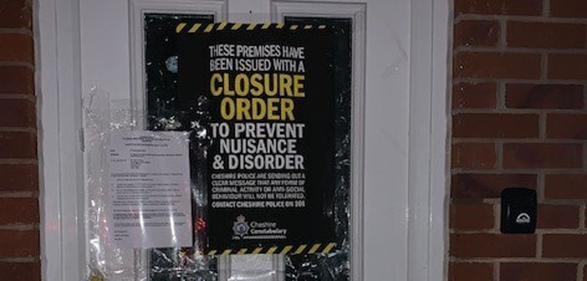
Closure Power
Close premises which are being used, or likely to be used to commit nuisance or disorder
Police or Council power
Closure Notice > Closure Order
Closure Order can be issued for 3 months but can be extended to 6 months
Breach is criminal offence
Notes:
QTS – What is a Closure power?
Closure Power
The closure notice can be issued by the council or a police inspector to close a premises down. Following the issuing of a closure notice, an application must be made to the magistrates’ court for a closure order within 24 hours (or 48 if on the weekend).
There is now only one closure order, to deal with premises associated with nuisance and/or disorder (previously there were 3 – ASB/Drugs/Licensing). The closure notice/order will state that no-one can enter the premises for a specified period of time (usually to allow the police or local authority to enter and deal with any issues.
It effectively evicts the person on the premises and they can’t return during the duration of the order…
Closure notice can be issued for 24 hours if the council or police officer (of at least the rank of inspector) is satisfied on reasonable grounds.
It can be issued out of court.
The closure notice can be extended from 24 to 48 hours by police superintendent or above or council’s chief executive officer
Following the issue of the notice, an application must be made to the magistrates court for closure order, unless the closure notice has been cancelled.
Breach can lead to imprisonment or a unlimited fine.
Examples: premises where ASB is causing nuisance or disorder such as noisy premises, environmental pollution, drug/alcohol-related ASB etc.
What to include in a closure notice?
The closure notice should:
• identify the premises;
• explain the effect of the notice;
• state that failure to comply with the notice is an offence;
• state that an application will be made for a closure order;
• specify when and where the application will be heard;
• explain the effect of the closure order; and
• give information about the names of, and means of contacting, persons and organisations in the area that provide advice about housing and legal matters.
Information should be displayed clearly in simple language, avoiding the use of jargon.

Slide 22
Community Protection Notice
To stop persistent anti- social individuals, businesses or organisation
Can be issued by Council/ Local Authority, Police & Social Landlords
Breach of the notice is a criminal offence
Notes:
QTS – What is a Community Protection Notice?
Community Protection Notice (CPN) – Is designed to stop ASB by an individual aged over 16 years and also by businesses and organisations. The ASB would need to have a detrimental effect on the quality of life for people in the locality and be unreasonable and persistent.
Who can issue a CPN? - Local Authority, Social Landlords and the police (including PCSOs).
Decisions on whether behaviour is persistent should be taken on a case by case basis by issuing officers. Where an individual is storing rubbish in their garden for many months, proving persistence may be simple, but there may be cases where behaviour is continuing over a very short time period. A written warning must be given first, stating the behaviour and the consequences if it continues.
Breaching a CPN is a criminal offence which may include the issue of a FPN of £100 on the spot fine, If the offender is found guilty at court, the court can impose remedial action for example to clear up rubbish from their front garden and items used to cause the ASB may be sized (e.g. spray painting equipment)
Notice to stop persistent ASB individuals/businesses/organisations whose behaviour is having a detrimental effect on the quality of life of others within the community and that behaviour is unreasonable, persistent and continuing.
Example – Overflowing skip, looks unsightly - issued notice - 28 days to rectify problem. Other examples of where CPN’s are used are dog fouling, graffiti , persistent begging
Breach of CPN is a criminal offence – Arrest/PND apply
To note: Civil Injunction – Can be used at an early stage to prevent individuals engaging in ASB before there is an escalation. They are used in
Non housing related ASB in which behaviour has caused harassment alarm or distress
Housing related ASB in which conduct is capable of causing nuisance and annoyance
A wide range of organisations can apply for a civil injunction such as local councils and police. They are issued by County Court, and there will be a need to prove by the organisation that the injunction is necessary as they are obtained on a civil standard of the proof (balance of probability)
The injunctions can include prohibitions.
Breaching an order is not a criminal offence – under 18 years penalty is a supervision order, over 18 years civil contempt of court with a fine or up to 2yrs in prison.

Slide 23
Public Spaces Protection Order (PSPO)
Protects public spaces from persistent Anti-Social individuals or groups
Issued by Council/ Local Authority
Replaces designated public spaces orders/ gating orders & dog control orders
Breach of an Order is a criminal offence
Notes:
QTS – What is a Public Spaces Protection Order?
Public Spaces Protection Order – Issues by the council and is designed to manage a specific problem that effects the local community and caused within a public space. Restrictions can be made to public spaces such as: dog walkers to keep dogs on leads, prohibiting the consumption of alcohol, alley ways to close to public except for residents only.
Designed to protect public spaces from persistent anti-social individuals and/or groups.
Behaviour has to be unreasonable, continuing and having a detrimental effect on others within the community.
Issued by the Council/Local Authority
Replaces ‘designated places’ – (Assigned designated areas will continue to exist for 3 years and will be completely replaced by the PSPO)
Covers things such as drugs/alcohol related issues; dog control offences.
Breach is a criminal offence – Arrest/PND applies
Purpose - Designed to stop individuals or groups committing anti-social behaviour in a public space
Who can make a PSPO - Councils issue a public spaces protection order (PSPO) after consultation with the
police, Police and Crime Commissioner and other relevant bodies.
Test - Behaviour being restricted has to:
• be having, or be likely to have, a detrimental effect on the quality of life of those in the locality;
• be persistent or continuing nature and be unreasonable.
Details - Restrictions and requirements set by the council.
• These can be blanket restrictions or requirements or can be targeted against
certain behaviours by certain groups at certain times.
• Can restrict access to public spaces (including certain types of highway) where that route is being used to commit anti-social behaviour.
• Can be enforced by a police officer, police community support officers and
council officers.
Penalty on breach - Breach is a criminal offence.
• Enforcement officers can issue a fixed penalty notice of up to £100 if appropriate.
• A fine of up to level 3 on prosecution.
Appeals - Anyone who lives in, or regularly works in or visits the area can appeal a PSPO in the High Court within six weeks of issue.
• Further appeal is available each time the PSPO is varied by the council.
Important changes/differences
• More than one restriction can be added to the same PSPO, meaning that a single PSPO can deal with a wider range of behaviours than the orders it replaces

Slide 24

Absolute Grounds for Possession
To expediate the eviction of landlord’s most anti-social tenants to bring faster relief to victims
Power for social landlords, councils, housing associations & private landlords
Notes:
Absolute Ground For Possession – this can be used by landlords to evict tenants where ASB or criminality has already been proven by another court. In can be used for tenancies both in the social and private sector. The landlord does not need to prove that it is reasonable to grant him possession of the property if the property has:
Been closed for more than 48hrs under a closure order for ASB
The tenant, a member of the tenants family or person visiting the property has been found guilty at court for a serious offence or have breached a civil injunction or CBO
The breach needs to have occurred in the locality of the property or affected a person who lives within the locality.
Anti-social behaviour or criminality has already been proven by another court. The only way police officers or the PCSO’s would be involved is to potentially provide statements to housing providers of the nature of the criminality or anti-social behaviour that has taken place at the address.
To get possession one of the following grounds has to be met: The tenant, a member of the tenant’s household, or a person visiting the property has:
Been convicted of a serious offence
Found by a court to have breached a civil injunction
Convicted for breaching a criminal behaviour order
Convicted for breaching a noise abatement notice or
The tenants property has been closed for more than 48 hours under a closure order for anti-social behaviour

Slide 25
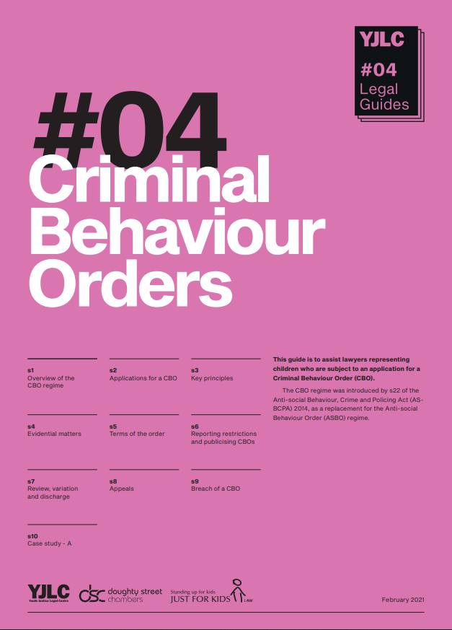
Criminal Behaviour Order
Used to deal with persistent offenders
Issued by a criminal court for any criminal offence
Notes:
Criminal Behaviour Order (CBO) – Used to deal with the most persistent offenders of ASB. Issued by a criminal court on conviction for any criminal offence. EG: The offender may be found guilty at court for causing criminal damage and providing additional evidence was available to show ASB had also occurred, the court may be asked to make a CBO. This may make the offender address the causes of their behaviour
Breaching a CBO is a criminal offence – summary only up to 6 moths imprisonment/fine – Indictable up to 5 years imprisonment/fine
General principles
• A CBO application differs from a post-conviction ASBO application in that the prosecution can apply for a CBO at its own initiative or following a request from the local authority or the police.
• The CPS can only accept a CBO file where the police have submitted a file to CPS either having charged the defendant with a criminal offence or seeking charging advice.
• Local authority officers wishing to submit a CBO file should consult with the police to confirm that a file has been submitted, and that there are no other pending applications for a CBO.
• Where the offender is under the age of 18, it will be necessary to find out the view of the local Youth Offending Team (YOT). The request for the view of the local YOT, and any response received must be included as part of the CBO file submitted to the CPS.
• The court may make a CBO against the offender only on the application of the prosecution.

Slide 26
5 Stage Approach
1st Stage
Trouble makers are written to & asked to stop offending behaviour
2nd Stage
Continued bad behaviour will result in a further letter & visit by the police
3rd Stage
A conference by police & other agencies. E.G housing & youth workers will lead to the 4th stage
4th Stage
5th Stage
Acceptable Behaviour Contract (ABC). If this is breached then….
Civil Injunction/ Criminal Behaviour Order
Notes:
5 Stage Approach to Civil Injunction/Criminal Behaviour Order
There are a number of responses to ASB which ranges from a letter of concern to an application to the courts for an civil injunction/criminal behaviour order.
On the first occasion the Partnership is notified of anti-social behaviour, a letter is sent to the person identified. In the case of under 16 year olds, a letter is also sent to their parent or guardian warning of the consequences of any further incidents. The incident and personal details are formally recorded on a computer database for monitoring and following-up.
A second incident results in a personal visit by the Partnership staff. This will reinforce the point that such behaviour is unacceptable and will not be tolerated. It will also assist in identifying the root cause of the problem and developing a solution.
The third referral generates a case conference involving the relevant partners acting as a problem-solving group. They discuss the anti-social behaviour and any surrounding issues. Any interventions required would be put into place at this stage to provide the subject with support and an opportunity to stop the unacceptable behaviour.
Trainer information
An example of 1st stage compliance is that of F Division where there is a 90% compliance rate in relation to the 1st stage letters.
Neighbourhood policing teams are responsible for these visits at this stage
Stage 2. There is a possibility of some 20 – 30 referrals here before moving to the next stage.
Example 1. 15year old male was subject to in excess of 20 referrals in one weekend from Friday evening until Monday Morning. Due to the numbers of referrals a case conference was held immediately between police and other agencies. It was established that his mother had died on the Friday and as his father was grieving himself and with other younger siblings he had been left to his own coping mechanisms. Once this had been established and that he himself wanted help Social Services put matters in place to aid him and from that day on there have been no further incidents involving this person.
Example 2. 19 year old male had moved into this force area with his parents who had moved to South Wales for work purposes. Both parents were working long hours and he was left to his own devices. He soon turned to drugs and despite numerous referrals he had nothing had seen to work for this person. A case conference was held and for the first time since he had moved here he was asked what he was looking to do. It was established that he wanted to work with his hands and had a want to be either a bricklayer or carpenter. After some time in the conference he agreed to sign an ABC. The Terms were that providing he was no longer in trouble and clean he would have a place on a course the following September as an apprentice Carpenter. This male stayed out of trouble and broke free from drugs, attended the course and has not been in trouble again since.

Slide 27
Notes:
The Police approach to all ASB incidents will always take into account the 3 P’s - Positive, Professional & Proud
SWP ONLY (please make this clear, however the same principle can be followed by GWENT)
We follow the GET OUT standards for every incident of ASB that we attend, which are:
G Go and speak to the victim/callers. If they have asked not to be visited then contact them by phone.
E Examine the scene and gather evidence; is this a repeat victim/offender/ location? Consider NICHE search.
T Take details of all victims, witnesses, offenders or suspects and forward relevant community intelligence.
O Offer advice on what to do if it happens again; provide a reference number and your calling card and if vulnerable make a referral to the ASB unit.
U Update the Occurrence Enquiry Log with the action you have taken.
T Take immediate action – ‘Area Search Negative’ is not an option! Tell the victim/caller what you have done and keep them informed and updated.

Slide 28
After the Incident …
Substantive OEL update
Pocket Note Book Entry
Complete ASB referral form
Task relevant community safety team
For ALL incidents of ASB
Notes:
SWP Only
OEL up date to include the OEL Template “ASB02 Responding Officer” (GETOUT) and other relevant templates with substantive update of the incident
ASB Referral Forms to be complete, REMEMBER two different forms: “offender known” or “offender not known”
Task Relevant Community Safety Team, refer to individual BCU procedures
THIS IS FOR ALL INCIDENTS OF ASB NO EXCEPTIONS for SWP ONLY
GWENT
No Forms nor is there a direct ASB template but comes under the general ICP01 template that is used for everything which then changes the way its displayed depending on the nature (ASB, DV, Crime, Non victim etc)
CADRO’s compile repeats and emerging issues and will then consider 115 joint meetings with partners etc
It will also be added to intel and generally CSO’s will attend repeat victims either as first point or follow up

Slide 29

Victim Codes
Victim Contact codes must be used in every occurrence where there is a victim, this allows early identification of those victims who require enhanced services.
VU01 Victim Needs Assessment
[Will determine if the victim needs enhanced services]
VU02 Initial Victim Contact
[To record preferred means of contact & referral to Victim Focus]
VU03 Victim Update
[To record all victim contact]
VU04 Victim Outcome update
[To record final outcome given to victim, opportunity to complete a VPS & the victim Right to Review]
Notes:
SWP ONLY
This is the new process (May 2020) to update victims and assess their needs. The new process replaces the old “TRICK” with Victim Update to ensure we fully meet the needs of all our victims.
The introduction of the Victims Needs Assessment and the replacement of TRICK with new VU codes was brought in early due to Coronavirus Pandemic. The pandemic pushed forward highlighting the importance more than ever to identify those victims who require additional support, and document what we are doing to help them. The introduction of the Victims Needs Assessment will help us to do this, and the new VU codes will help Officers to comply with the Victims Code of Practice.
The new codes are:
VU01 Victim Needs Assessment – Will determine if the victim needs enhanced services
VU02 Initial Victim Contact – To record preferred means of contact and referral to Victim Focus
VU03 Victim Update – To record all victim contact
VU04 Victim Outcome update – To record final outcome given to victim, opportunity to complete a VPS, and the Victim Right to Review
The Victim Needs Assessment is a requirement under the Victims Code of Practice. It means that we will be able to identify those victims who require early support, and provide an enhanced service for them. The Needs Assessment should be completed when an Officer makes first contact with the victim. It will identify if the victim is:
• A Victim of the most serious crime
• persistently targeted
• Vulnerable or Intimidated
If the victim fits into any of these categories they should receive an enhanced service. This means they should:
• Be referred to South Wales Victim Focus (also consider specialist services such as IDVA / ISVA)
• Be updated promptly (within one day) at key milestones in the investigation
• Be considered for Special Measures if the case is going to Court
• Be offered the opportunity to provide a Victim Personal Statement, if the case is going to Court
• Ensure that the victim is made aware of the Victims Right to Review scheme
There have also been changes to the Victim Contact codes, which need to be added when you:
• Have initial contact with the victim
• Update the victim
• Provide an update to the victim when their occurrence is finalised
Under the Victims code of Practice all victims are entitled to be updated within five days of key stages of the investigation and court process. For victim’s receiving an enhanced service, this should be within one day.

Slide 30
Dangerous Dogs & Anti-Social Behaviour
Keeping Dogs Under Control
Section 3 Dangerous Dogs Act 1991
Whether a dog is a danger to Public Safety
Section 4 Dangerous Dogs Act 1991
Notes:
A dog must be kept under control and prevented from injuring people or other dogs.
Section 3
The owner of the dog or person in charge at the time commits an offence under Section 3(1) of the Dangerous Dogs Act 1991 if the dog is dangerously out of control in any place , whether public or private. The offence becomes aggravated the dog injures a person.
The offence is not committed if the dog in inside a dwelling (in a building or part in it) and victim enters as a trespasser
14 years if a person dies as a result of being injured
5 years in any other case where a person is injured
3 years in any case where an assistance dog is injured (whether or not it dies).”
Section 4
In section 4 (destruction and disqualification orders) the court must decide whether a dog would constitute a danger to public safety.
They must consider
the temperament of the dog and its past behaviour, and
whether the owner of the dog, or the person for the time being in charge of it, is a fit and proper person to be in charge of the dog

Slide 31


Dog Control Orders
Local authorities can apply for a DCO to cover public places.
Clean Neighbourhoods and Environment Act 2005
Notes:
Under the legislation there are prescribed offences
Failing to remove dog faeces
Not keeping a dog on a lead
Not putting a dog on the lead when directed
Permitting a dog to enter excluded land
More than the specified number of dogs
Designated officers (Including PCSO’s) may issue fixed penalties for contravention of a DCO.

Slide 32


