Slide 1


GlowBox – Personalized Skincare for Sensitive Skin
Student: Kremena Petrova Nedelcheva 2336425
Programme: BA Business Management
Module: Entrepreneurship LCBB5013
Lecturer:Dr. Amer Kareem
Date: 14 December 2025

Slide 2
Business Idea
Subscription service for sensitive skin.
Short quiz → AI selects dermatologist-approved products.
Goal: simple, safe, sustainable skincare.
Notes:
Explain problem: sensitive skin confusion; GlowBox = trusted, personalised and convenient. Emphasise AI quiz and monthly curation.

Slide 3
Products & Services
Monthly box: 4–5 clinically tested items.
Mobile app: tips, routine tracking, feedback.
Pause/cancel anytime; recyclable packaging.
Notes:
Show how app + box work together; highlight trust via known brands and hypoallergenic focus.

Slide 4
Objectives
Short-term: launch + 500 subscribers (Year 1).
01
Partnerships with 5 brands; strong social presence.
02
Long-term: EU expansion; own product line; profitability Year 2.
03
Notes:
Tie objectives to metrics: subscribers, retention, partnerships, profitability.

Slide 5
Unique Selling Point (USP)
Sensitive-skin only focus (niche).
AI personalisation for accuracy.
Dermatology credibility + eco packaging.
Notes:
Contrast with general beauty boxes; stress trust and safety.

Slide 6
PESTEL – Summary
Political: UK cosmetic standards help trust.
Economic: demand resilient; mindful pricing.
Social: sensitivity concerns rising.
Technological: AI + app enable personalisation.
Environmental: recyclable packaging.
Legal: GDPR & consumer rights.
Notes:
Keep it high level; link each factor to GlowBox choices.

Slide 7
SWOT – Summary
Strength: niche + expert brands.
Weakness: new brand, limited budget.
Opportunity: clinics/pharmacies; EU reach.
Threat: strong rivals; subscription fatigue.
Notes:
Acknowledge risks and how strategy mitigates them.

Slide 8
Porter’s Five Forces
Rivalry: high (beauty subscriptions).
Buyer power: high (easy switching).
Substitutes: high (retail/clinics).
Suppliers: moderate (brand leverage).
New entrants: moderate (trust barrier).
Notes:
Explain niche-focus reduces direct rivalry; trust is moat.

Slide 9
Market Segmentation
Demographic: 18–40, UK, mixed gender.
Psychographic: eco‑conscious, health-focused.
Behavioural: digital, review‑driven, subscription‑ready.
Notes:
Describe 1–2 personas; emphasise reassurance need.

Slide 10
4Ps of Marketing
Product: personalised box + app.
Price: £25–£40 (value-based).
Place: online store + app.
Promotion: influencers, SEO, email.
Notes:
State why each P fits target expectations.

Slide 11
Online Strategies
Micro‑influencers; UGC MyGlowBox.
SEO blog + reviews for trust.
Referral + loyalty (GlowPoints).
In‑app nudges for retention.
Notes:
Mention KPIs: CAC, LTV, retention >70% after month 3.

Slide 12
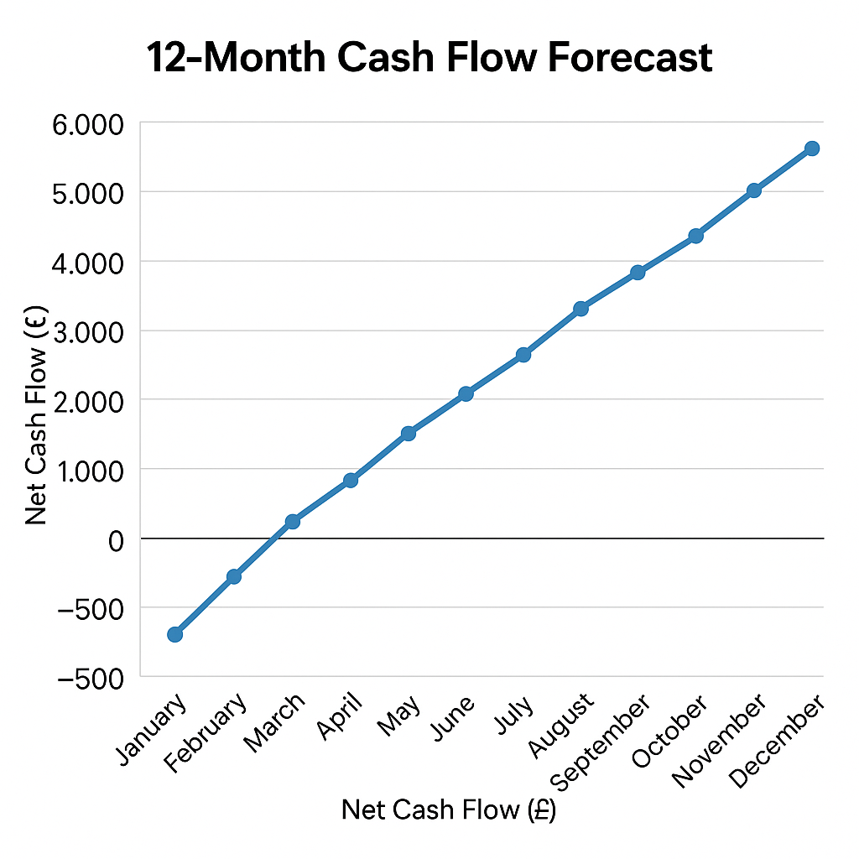
Legal & Finance
Legal: UK Ltd; GDPR compliant.
Start‑up: £8,000; break‑even 10 months.
Lean team: CEO, Marketing, Supplier, IT, Finance (PT).
Notes:
Reassure feasibility; note grants/Start Up Loan.

Slide 13
Conclusion
GlowBox blends skincare expertise, tech and sustainability.
Trusted, personalised value for sensitive skin users.
Ready to scale across the UK and EU.
Notes:
End with confidence and invite questions.

Slide 14
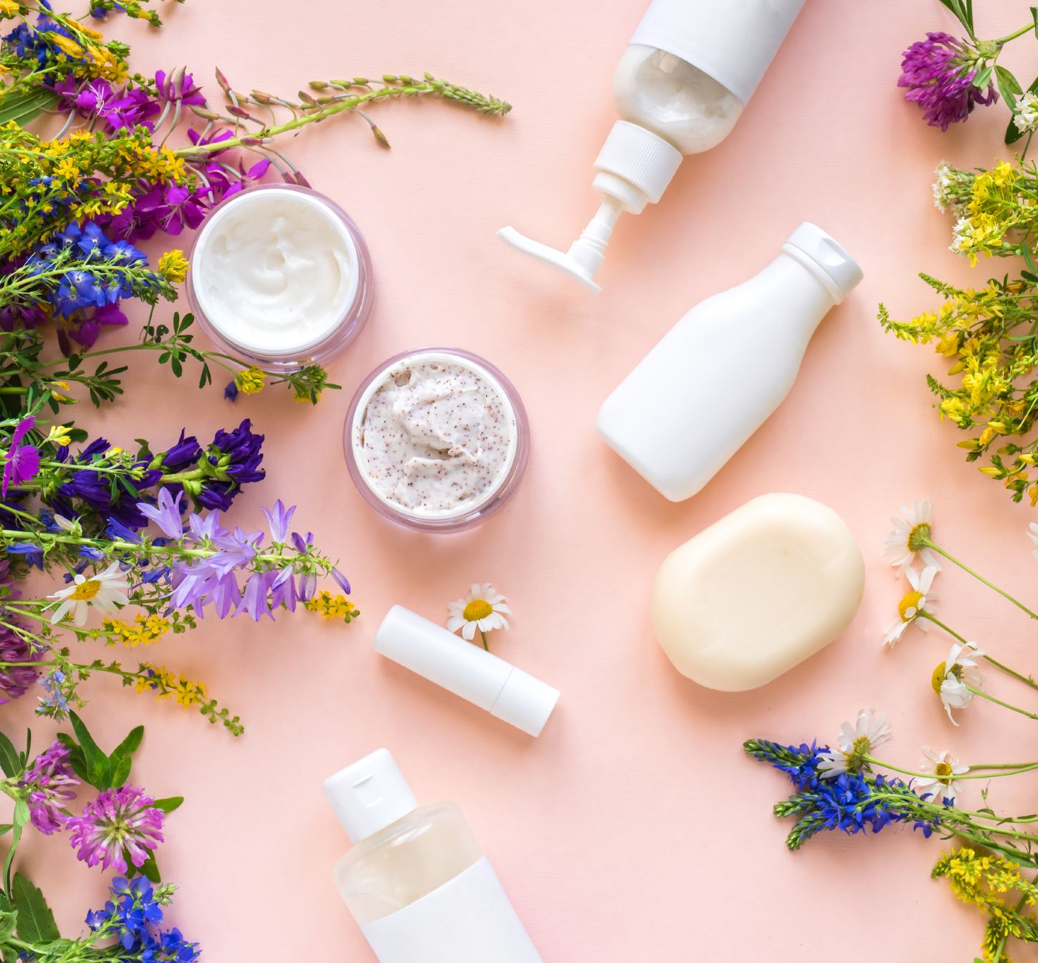
References
Allergy UK (2023) Sensitive Skin Statistics Report. Allergy UK.
British Skin Foundation (2022) Sensitive Skin Insights and Consumer Issues. British Skin Foundation.
Cosmetic, Toiletry and Perfumery Association (CTPA) (2023) UK Cosmetic Regulations Overview. CTPA.
European Commission (2023) Post-Brexit Trade Rules for Cosmetic Goods. European Commission.
Mintel (2023) Beauty and Personal Care Consumer Report UK. Mintel.
Nielsen (2022) Consumer Trust in Dermatological Skincare Products. Nielsen Global Insights.
Thank You ☺

