Slide 1
! Disclaimer !
Artificial Intelligence has been used in this piece of work for organising bibliography entries and fixing grammar.
I have not used AI for any other reason in this work

Slide 2
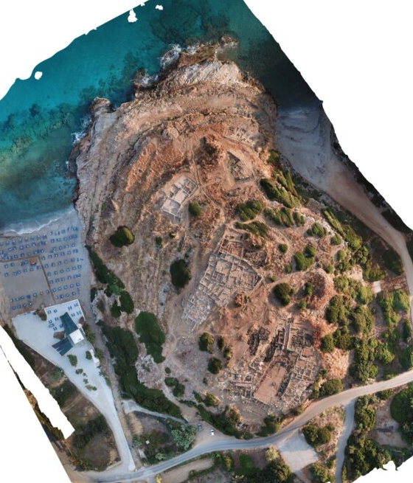
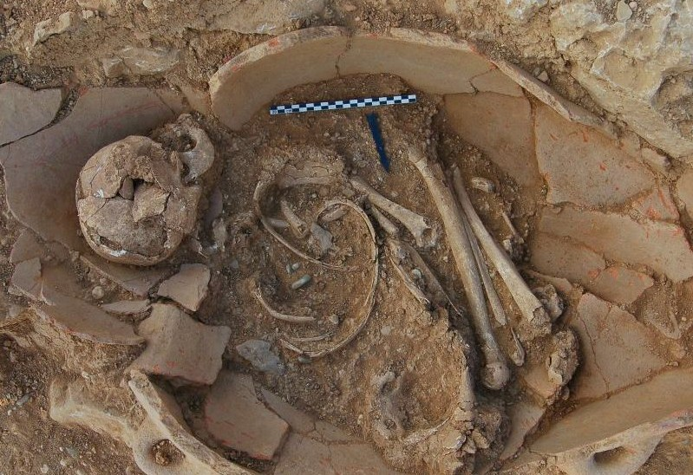
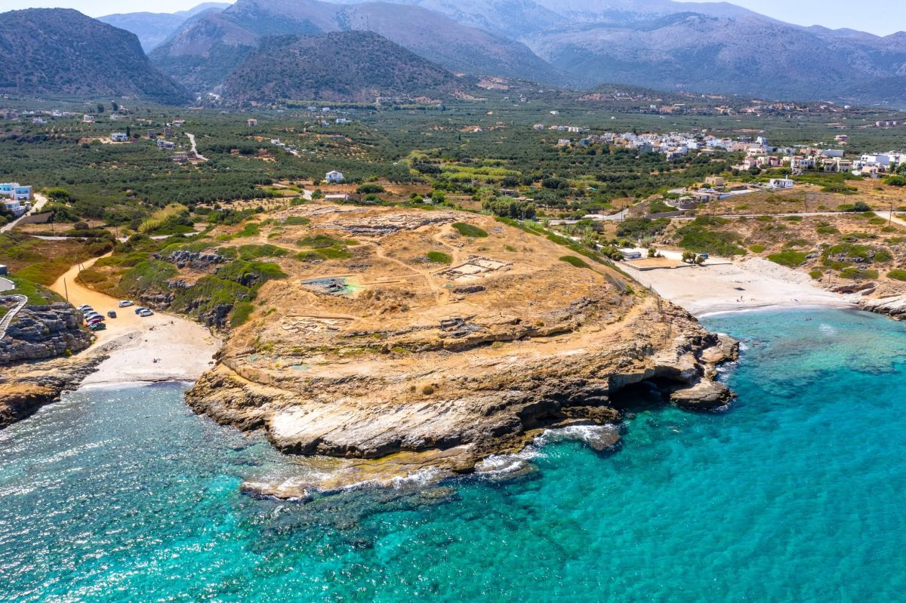
“Death is not the end”- Tracing the Manipulation of Bodies and Other Materials in the Early and Middle Minoan Cemetery at Sissi
By Ilse Schoep and Peter Tomkins
An Article Breakdown by Sam Bennett

Slide 3
Schoep and Tomkins
(authors of article)
- They acknowledge two decades of transformation in understanding of cognition and materiality
!HOWEVER!
- There must now be an acknowledgement in the wider archaeological community towards the limitations of modernist thought towards materiality and cognition.
How will there be and why
must change happen from
the now re-established ideas
of the human being and materiality?
?

Slide 4
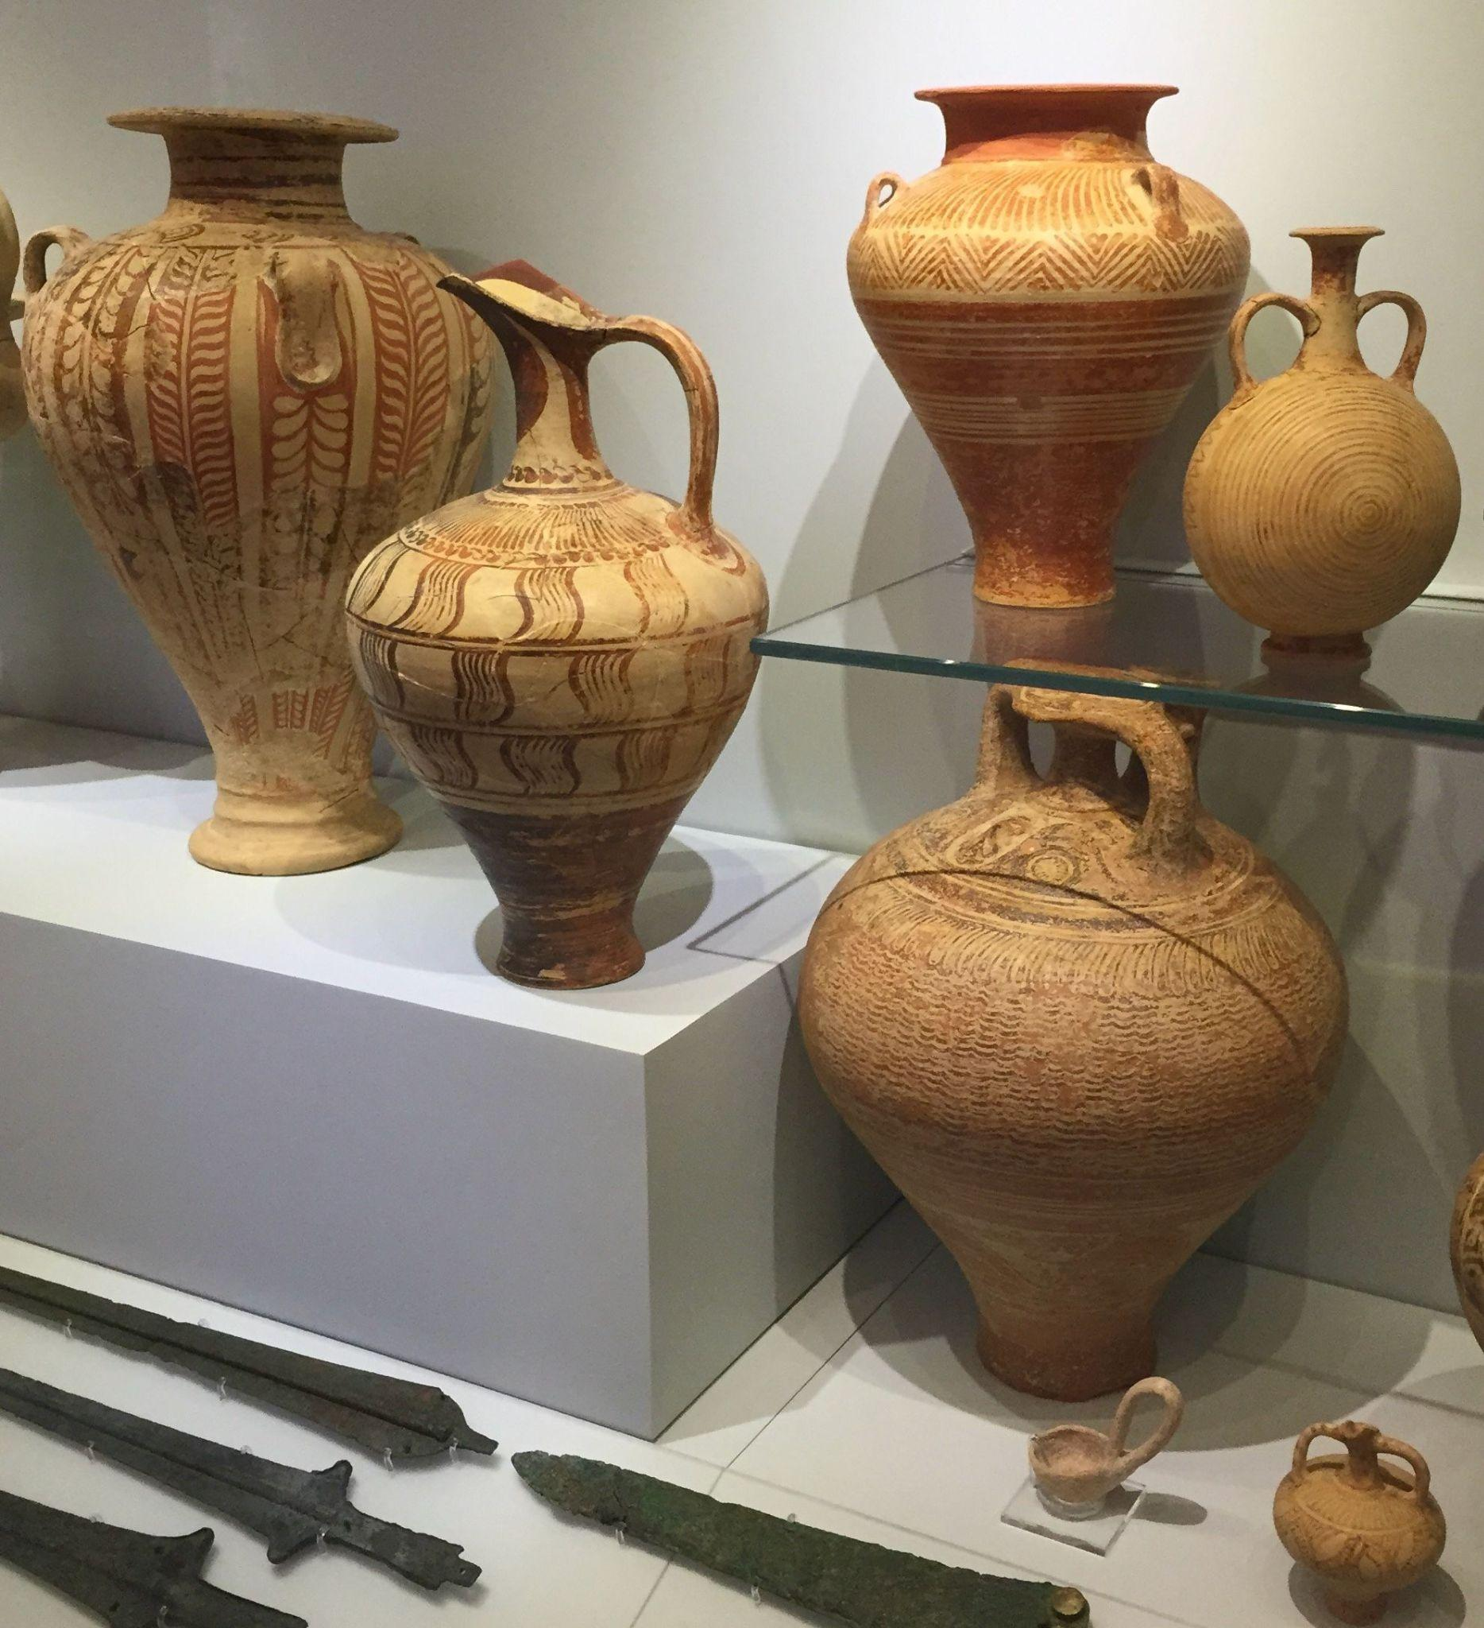

The Why?
Schoep and Tomkin suggest that modernist thought has encouraged a “fragmented conceptualisation” and subsequent investigation of the human being in the world through domains such as the:
- Economic
- Social
- Religious
- Political
They both additionally prescribe the same to occur to materials, being categorised in their own separate domains such as the:
- Ceramic
- Lithic
- Osteological
- Architectural

Slide 5
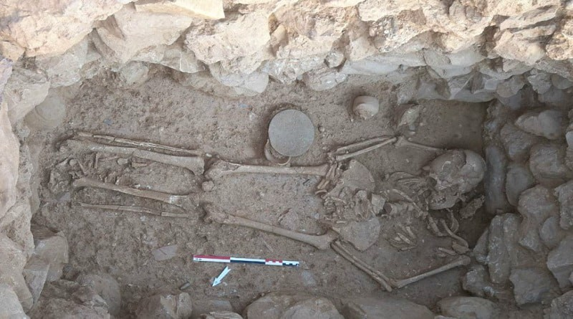
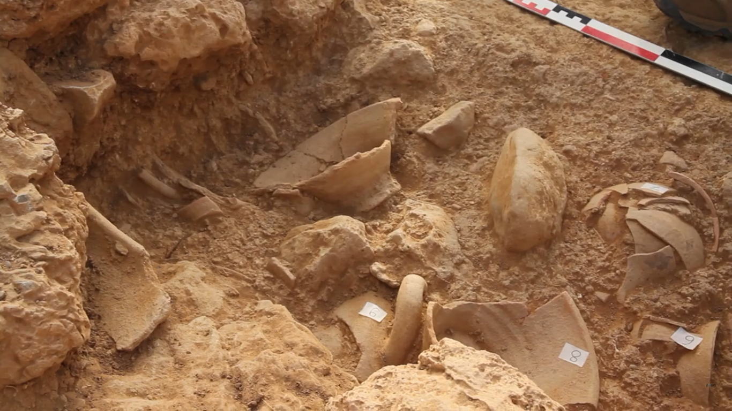
The How:
Schoep and Tomkin suggest that we must reflect more critically on the complete separation of the human experience and material residue causing a breakdown in the understanding the complex relations between people and things.
They believe this must remedied into the development of more effective methodologies of characterisation which are capable of outlining these relations between people and the objects they also vicariously exist through.

Slide 6
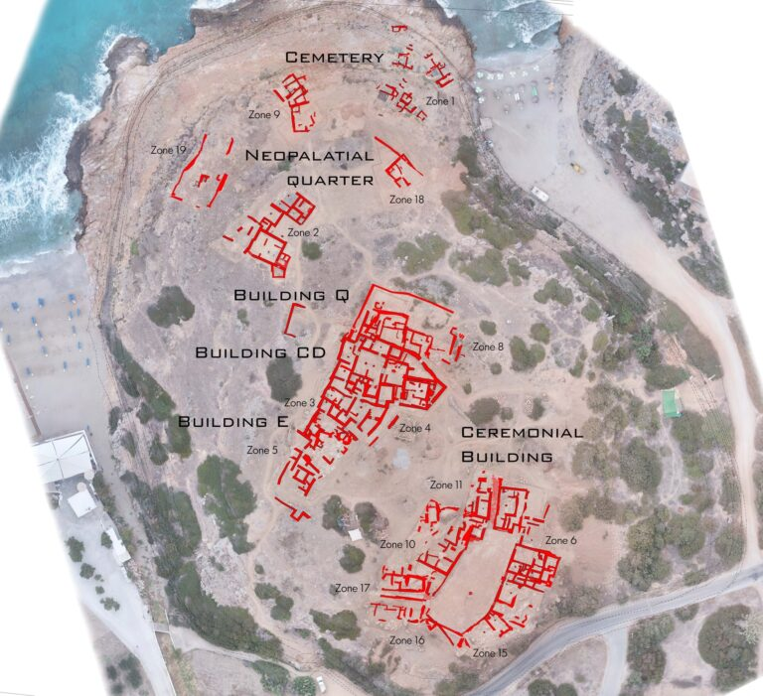
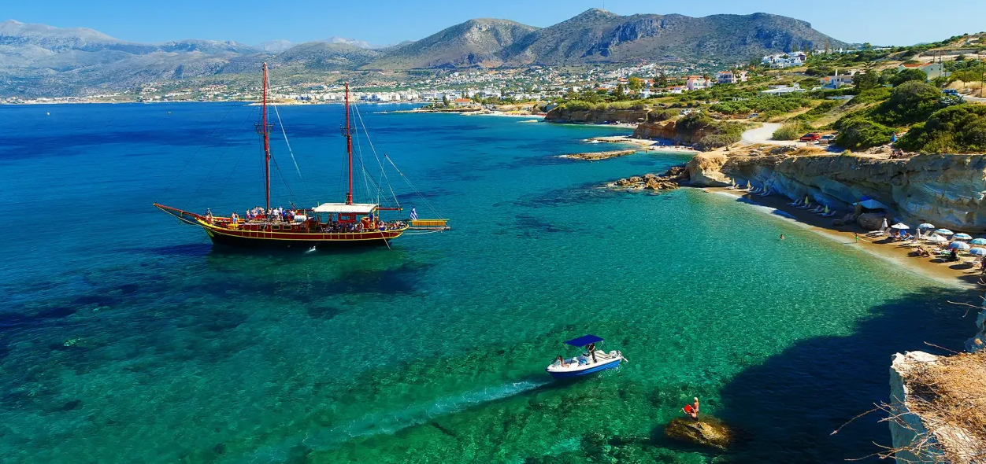
Sissi (Crete)
- Excavations recorded as a part of the article are central to the Minoan cemetery in Sissi, located in modern day Crete. (it is located at the top of the site and in what is known at site 9 on the projects site map)
Excavations included and referenced in the article began in 2007 and ended in 2011.
Schoep and Tomkins wish to use their research gathered from the excavation to show the developed contextual approach they see as being the next step from modernist thought on materiality and cognition towards Minoan archaeology.

Slide 7
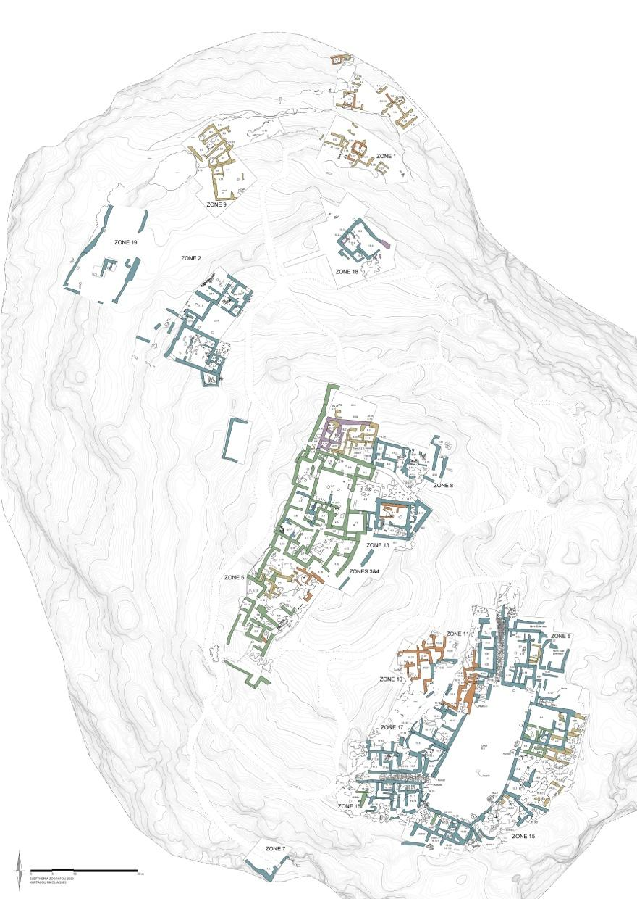
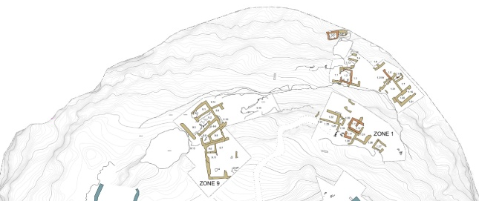
(Above)- Zoomed in image of the area that the Article is centred around, the cemetery.
(Left)- Full image of the complete Sissi excavation site as documented by the Sissi Archaeological Project

Slide 8
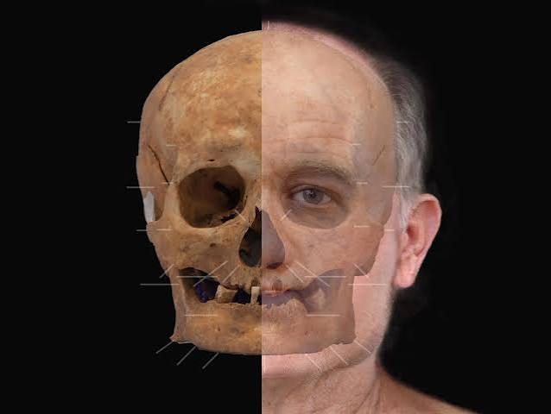
On Human Remains:
A key part of Schoep and Tompkins article is the argument of the “fragmented conceptualisation” of human remains and their relationship with materiality.
They outline the tensions we have between seeing the lifeless material bone and imagining within ourselves the living breathing, thinking bodies they once represented in the past.
However, this tension is not just isolated to “us” and “them”, it would have also been present in the past as it can play a role in these “open” burials in the past where the body is on display in a tomb, it could be reflected in how these people manipulated the materials of said tomb according to this tension they would have also had with human remains..

Slide 9
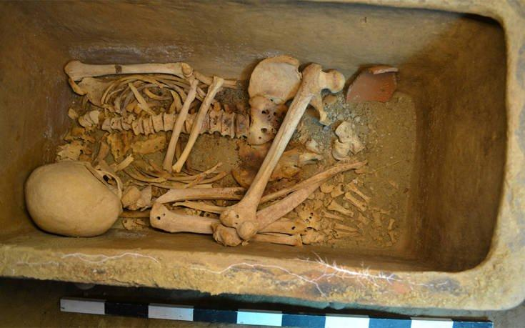
Manipulation of bodies:
- Schoep and Tomkins refer to Branigan (1987:45) when discussing the 5 forms of manipulation that occur in Minoan funerary ritual that will be part of forming their own understanding of modification to burials at Sissi.
Clearance of bones
Selected removal of specific bones
Fumigation of bones
Fragmentation of specific bones
Selected grouping of specific bones

Slide 10
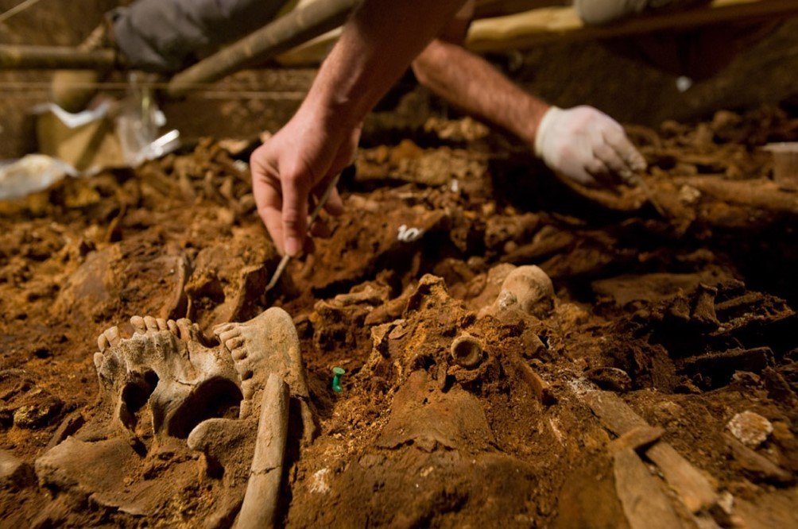
Key Methodology Change for the Excavation:
“Archaeothanatology”
Archaeothanatology is essentially where an anthropologist is overseeing the sites excavation directly as its being dug up from excavation itself to study afterwards.
This is the way that Schoep and Tomkins employ in their excavation work and they believe it helps improve the quality of the research as the anthropologist can use the actual field data as its occurring to form important interpretations of funerary settings that will increase the value of the write-up subsequently.

Slide 11
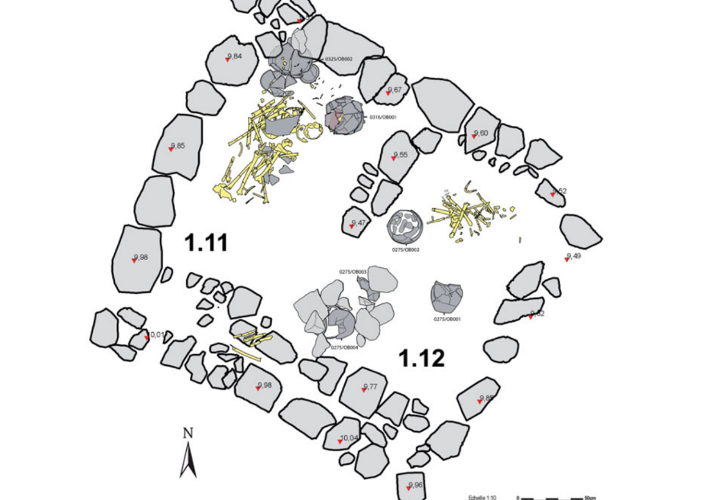
Findings: Primary Depositions
At Sissi, Schoep and Tomkins discovered that it was a cemetery primarily consisting of primary depositions of remains.
House tombs here generally have bodies prepared and laying out on the floors of tombs or in containers.
Noted materials deposited besides bone was few tableware (one or two bowls on occasion) actually inside the tomb.
The majority of items were discovered outside the main house tombs rather than inside, these were large cups and jugs.
Generally there is also no rule about orientation shared in the tombs.
Fetal and neonatal bones found in jars (most frequently 5 in one tomb instance).These were dated to the Early Minoan IIA period.
Examples of specific bones being removed during burial, what occurred to the bones is unclear
Fetal and neonatal bones were discovered in only 2 tombs total being out of containers. These dated to the Middle Minoan period.
The vast majority of the bones have been disturbed, only tomb 9.1 was found undisturbed.
Example of primary depositions at Sissi

Slide 12
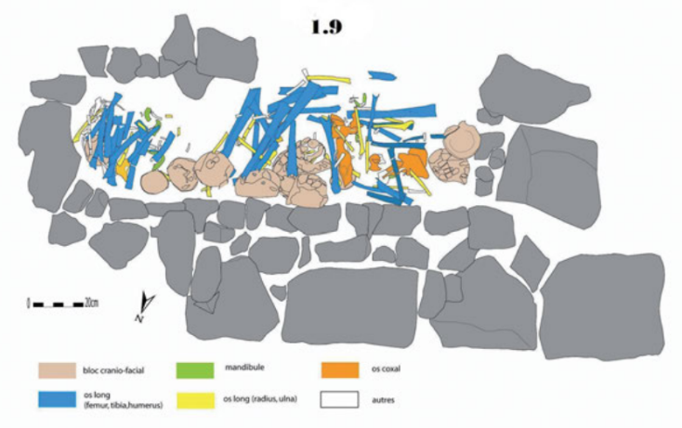
Findings: Secondary Depositions
Secondary depositions are not as common as primary ones in Sissi, however interesting instances of them were found in the articles research:
Bones apart of secondary burials were found not placed upon the floor and prepared but rather collected into a mass.
There is also evidence of purely artifactual deposits, They consisted of smashed pottery sherd that had been part of a prior primary deposit and carefully collected and burnt seemingly before being deposited again.
The evidence for the removed bones of other tombs is not the kind found in these secondary depositions, suggesting they may have held some kind of mnemonic use to the living.
It was found that a lot of the pottery found in secondary burial being definitely from prior primary depositions hinted at the fact that lots of clearance of artefacts and bones took place
Small cranial fragments were discovered in some pottery depositions and were only identified in pottery reconstruction after excavation. They too were burnt, suggesting fire was involved in their rituals.
Example of secondary burial of human remains at Sissi

Slide 13
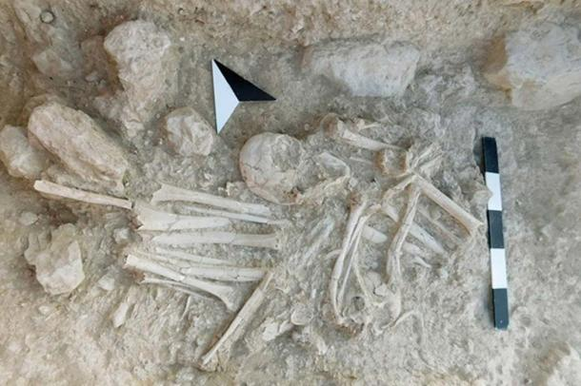

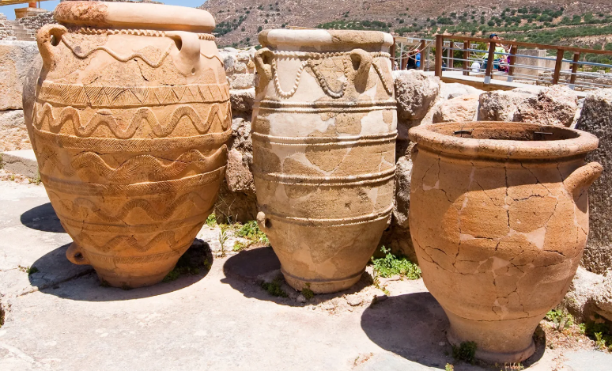
General Conclusion
The article shares that going into the excavation there was a belief in clear shared understandings of appropriate funerary practice, this was challenged at sissi and that in every tomb and every body laid down uncovered there began a diversity of potential outcomes that required the nuisance of their new theory on materiality to properly advance their study.
–Secondary burials play a large part in their conclusionary section, they suggest that in their findings secondary burials of pottery are much more common than secondary burials of people.
They conclude on the idea that MInoans across the early and middle periods may have had in some examples a greater care and respect for some pottery artefacts than the bones themselves. The article ends with the questions,
- Did the Minoans think that the essence of a person could exit its skeletal remains and thus explain why they discarded of it in secondary deposits so easily?
- Did they think that the essence could remain trapped in pottery as it decays less than bones do?

Slide 14
My Own Thoughts 1
The article is clearly attempting to address the self identified shortcomings in the theory and methodology of other archaeological studies on funerary practice through their own study.
The general notion of compiling skeletons as materials alongside ceramic pottery is something I can agree with the authors of the study on. In fact I do believe that it can help generate a better picture of the past by more closely tying the two together as was evident by the article.
The cemetery in Sissi is even the perfect backdrop to do this as the Minoans there in the past clearly had some respect for material remains and linked them closely with corporal remains and even in instances like in Sissi, buried more pottery in second burials than human remains!
I think additionally the viewpoint of the tension we have with seeing our own species skeletons being not completely discardable is very valuable in and of itself. They clearly get across this point of our own struggles with how to treat bones in the present reflecting past struggles of the same nature, possibly influencing the very funerary rituals we observe in the research.

Slide 15
My Own Thoughts 2
The Research itself- the data set that they show in the article as pictures and references only occasionally to specific examples of certain phenomena is slightly disappointing as they do just go into detail on specific examples of relations between ephemera in tombs (Which is very valuable to a reader in stressing their point).
I would have much preferred to have seen the fully data set alongside select (But very informative) examples.
Previous work was also highly utilised and referenced in this article to great effect, quotes from the works of Barrett and also direct reference to other Minoan sites which may reflect a finding or support the methodology.

Slide 16
My Own Thoughts- Conclusion
Overall, the whole Article is very well put together with lots of referencing and utilisations of past research on bodies and manipulation within the frame of the minoan civilisation.
The article serves as a very well structured critique of previous ways of studying burial practice though archaeothanatology is not a unique way of studying funerary ritual and is a tried and true technique since the creation of the research.
The article instead is very valuable as by using its findings to go into great detail and inform the reader of Early and Middle Minoan burial practices it proves the validity of its own suggestions at the start of the article: that its way of thinking with the materiality of burial practice is a better, but admittedly more difficult and exhausting process than what preceded it and the present (at the time the article was made).

Slide 17
Bibliography/Reference Page
ARTHA. (2025). About archaeothanatology :: ARTHA. Available at: https://www.artha.at/about-archaeothanatology/
Cretevillas4u.com. (2026). Sissi beach in Lassithi. Available at: https://www.cretevillas4u.com/en/blog/sissi-beach
Giordano, C. (2019). Face of medieval man reconstructed from 600-year-old skeleton | the Independent. The Independent. Available at: https://www.independent.co.uk/news/science/archaeology/medieval-man-skeleton-face-reconstruct-aberdeen-a9167111.html
Greeknewsagenda.gr. (2019). Sissi Archaeological Project in Crete. Available at: https://www.greeknewsagenda.gr/sissi/
Killgrove, K. (2018). Spectacular skeletons unearthed from bronze age chamber tomb on Crete. Forbes. 24 Aug. Available at: https://www.forbes.com/sites/kristinakillgrove/2018/08/24/spectacular-skeletons-unearthed-from-bronze-age-chamber-tomb-on-crete/
Sarpedon.be. (2016). The Sissi Archaeological Project | sarpedon. Available at: https://sarpedon.be/
SISSI excavations film HMB 15 mai. (2024). Uploaded by Minoan Aegis. YouTube. Available at: https://www.youtube.com/watch?v=gZn26Po68_A
Stefanos (2026). Sissi excavations 2026: Minoan secrets of Boufos Hill. Stefanos Tours. Available at: https://stefanostours.gr/sissi-excavations-boufos-hill-crete/
The Editors of Encyclopedia Britannica (2019). Minoan civilization. In: Encyclopædia Britannica. Available at: https://www.britannica.com/topic/Minoan-civilization
Whelan, E. (2018). Minoan cemetery reveals two early burials overflowing with grave goods. Ancient Origins Reconstructing the story of humanity’s past. Available at: https://www.ancient-origins.net/news-history-archaeology/minoan-cemetery-0010656

Slide 18
Thank you for Listening to my Presentation !
Open for any questions…
I'll try my best to answer them!

