Slide 1
Essential Research Methods
Research methodology
Dr Seena Joseph

Slide 2
Research methodology
A systematic approach to conduct research including the methods, techniques, and tools for collecting and analyzing data to solve a specific problem.
The Research Onion, developed by Saunders et al., [1] is a framework used to explain the various stages involved in developing a research.

Slide 3
Quick Poll: What's Your Gut Guess?
POLL
🗳️ Before we open up the “research onion,” a quick gut-check poll:
If you had to pick your final-year project's research strategy RIGHT NOW, what would you guess?
  Run an experiment · Build & test software · Send out a survey · Do a case study · Something else · No idea yet
Vote now - we'll come back to this at the end of the lecture and see if your answer's changed.
Spoiler: most computing students guess “survey” first. By the end of today you'll have five other strong options.

Slide 4
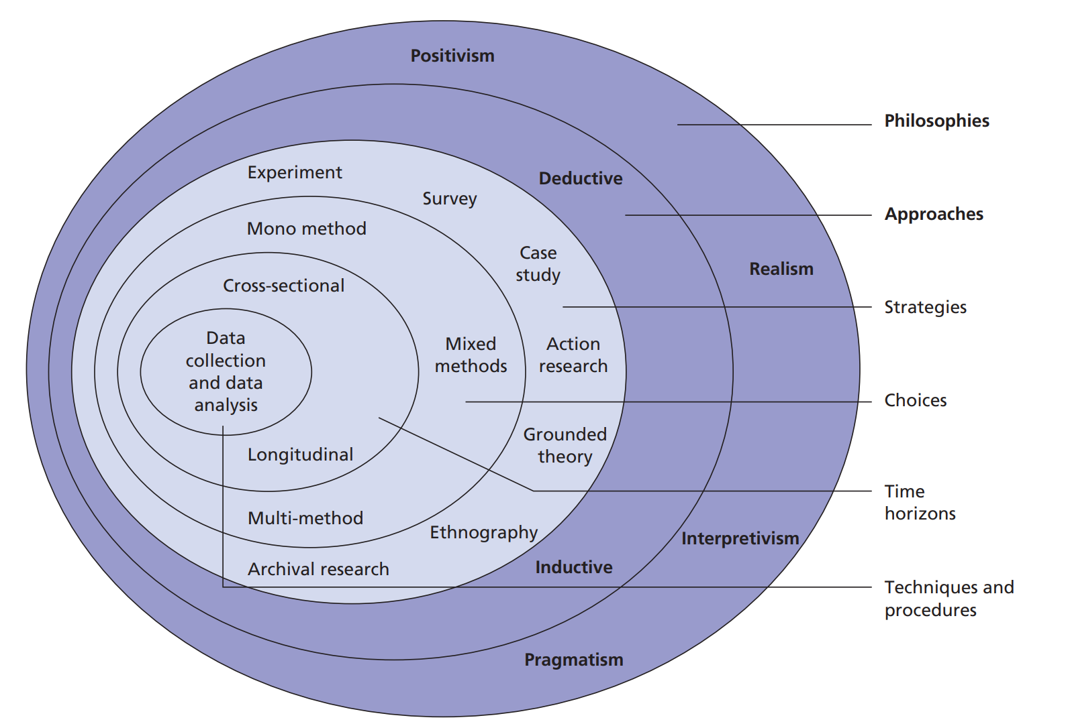
Selecting the methodology
Source : Saunders et al., [1]

Slide 5
Selecting the methodology
Research Philosophy
  Based on how knowledge is created.
Two common philosophies
  1. Positivism – Focuses on objective based and measurable reality.
    This is common in computer science when you use algorithms or mathematical models.
  2. Interpretivism – focuses on understanding human experience or behavior
    In computer science, this might apply in fields like user experience or human-computer interaction

Slide 6
Selecting the methodology
Research Approach
Deductive
Inductive
  Deductive approach
    Start with a theory or hypothesis and then design research strategy to test the hypothesis/theory.
    Eg: Hypothesise : Support Vector Machines (SVM) will perform better than Decision Trees in detecting malware.
  Is suitable when your research topic has a wealth of literature from which you can define a theoretical framework and a hypothesis
  Is about using theory to identify what data you need to collect

Slide 7
Selecting the methodology
Research Approach – Inductive
    Start with observing pattern or collecting and analysing data then developing a theory.
      Eg: You develop a description of how businesses use Facebook for advertising based upon a survey of local businesses
  Is suitable when the topic is new, has much debate and/or there is little existing literature
  Is about gathering data and trying to generate theories from it

Slide 8
Selecting the methodology
Research approach – Activity
For each of the nine projects, identify a suitable approach for the study. Is it obvious which one you ‘should’ use or could you perform the study in more than one way?
Investigating the factors responsible for network outages
Finding out how to make a website easier to use
Analyse how companies use social media for advertising
Investigating the Impact of Financial Literacy Programs on Personal Savings Rates
Exploring Patterns of Behavior in Online Gaming Communities
Studying Leadership Styles in Innovative Companies
Exploring Emerging Patterns in Social Media Usage Among Teenagers
Agile development will result in fewer bugs than the Waterfall methodology in software projects
An encryption algorithm using a 256-bit key will be more secure than one using a 128-bit key

Slide 9
Selecting the methodology
Research strategy
Experiment
Software development
Survey
Case study
Action research
Ethnography

Slide 10
Survey Isn't Always the Answer
DISCUSS
🗣️ A reality check before we go through all six strategies:
Final-year computing students often default to “I'll do a survey” - but a survey really fits when you're asking about people's opinions, experiences, or usage patterns.
If your project produces objective, measurable outputs - code, an algorithm, a system, an attack, a game mechanic - a different strategy usually fits better, and is usually valued more highly in computing dissertations.
Discuss with your neighbour: for YOUR project idea so far, is a survey genuinely the best fit - or are you reaching for it because it feels familiar?

Slide 11
Selecting the methodology
Research strategy - Experiment
Experimentation sets out to examine the relationship between two factors (or variables) by manipulating one whilst measuring changes in the other
Hypothesis : Your big question
  It must be phrased in a testable form
Experimental variables
The factors you are going to investigate
Independent variable (IV) – the thing you’re going to control or manipulate
Dependent variable (DV) – the thing you’re going to measure
Aim for: changes in the IV cause changes in the DV
Experiments are used to determine if a causal relationship exists - in other words, if the alteration of one variable ‘causes’ a change in another

Slide 12
Selecting the methodology
Research strategy - Experiment
Examples:
We may test out three different e-commerce website designs and measure the effect on usability.
A computer scientist conducts an experiment to evaluate the performance of different machine learning algorithms for sentiment analysis.
  The researcher manipulates variables such as algorithm type, training dataset size, and feature selection methods. By measuring accuracy, precision, and recall on a standardised dataset, the researcher can determine which algorithm performs best under various conditions.

Slide 13
Selecting the methodology
Research strategy – Software development
This strategy involves developing novel software and testing that, it works effectively
Software development projects
  Designing and building a database to act as a scheduling system
  Designing and building a game-playing robot
  Designing and building an educational website
  Designing and building a website to collect usability data
Not software development projects
  Using an existing website to collect questionnaire data

Slide 14
Beyond the Six: More Method Ideas
EXAMPLE
✏️ These aren't separate strategies from Saunders' six - they're computing-specific ways to DO experiment, software development, and case study that often fit final-year projects better than a survey:
[Cyber security] Simulated attack / penetration test on a controlled test system, measuring detection or defence performance - an Experiment.
[Software engineering] Benchmarking two versions of a system (e.g. before/after a refactor, or two algorithms) on speed, memory, or bug count - an Experiment.
[Game development] Build-and-evaluate: create a game mechanic or AI behaviour, then playtest it with real users - Software development + a mini Experiment.
[General computing] Log or telemetry analysis: study real usage data from an existing app or system instead of asking people what they do - a form of Case study, with none of a survey's response-rate problem.
Notice none of these need a questionnaire - they generate their own data.

Slide 15
Selecting the methodology
Research strategy – Survey
An investigation into opinions through questionnaires or interviews [ data collection tools]
The design of questionnaires and interviews is complex and must be prototyped before use
All questions must be written with great care
Respondents are questioned either verbally, in writing or via computer and their responses noted
May be able to generalise from small samples to large populations
Good for getting large amounts of subjective data in a short amount of time
Good for ‘what’ and ‘how’ questions
Example
A security team surveys staff about their password habits and phishing awareness before designing a training programme.
A software developer conducts a survey to gather feedback from users about the usability of a mobile application
Good fit when you need OPINIONS or self-reported behaviour - if you can measure the thing directly instead, an experiment or software-development strategy usually beats a survey.

Slide 16
Selecting the methodology
Research strategy – Case study
A case study is an intensive examination of a single instance of a phenomenon of interest
E.g. a company, an event, a process or a technology
Involves gathering very detailed data and using it to explain what is happening
Can be very time-consuming and requires good access to the phenomenon of interest
Example:
  Visiting schools to investigate the use of GenAI in the classroom.
  A cybersecurity analyst conducts a case study on a data breach incident to understand the root causes and mitigation strategies. The analyst examines the sequence of events, vulnerabilities exploited, and responses taken by the affected organization.

Slide 17
Activity: Match the Project to the Strategy
ACTIVITY
✏️ For each project idea below, pick the strategy that best fits: Experiment / Software development / Survey / Case study / Action research / Ethnography.
1. Compare page-load speed of a site built with React vs plain JavaScript.
2. Build an app to help students track deadlines, then test whether people actually finish work on time.
3. Investigate a real company's data breach to understand what went wrong.
4. Work alongside a small dev team for a semester, improving their code review process together.
5. Embed yourself in an open-source community for a month to understand how contributors collaborate.
6. Find out what makes players trust (or distrust) an AI opponent in a game.
Compare answers with a neighbour - for #6, is there more than one good answer? What would decide it?

Slide 18
Selecting the methodology
Research strategy –Action research
Action research is a process where the researcher is simultaneously trying to investigate and solve a problem.
The investigator should be part of the community impacted by the results of the research
Collaboration between researchers and practitioners to address practical problems or improve practices in real-world settings. It typically follows a cyclical process of planning, action, observation, and reflection.
Often used in education and business

Slide 19
Selecting the methodology
Research strategy –Action research
Example:
An educator collaborates with teachers to implement a new teaching method aimed at improving student engagement in the classroom. The educator observes the method in action, collects feedback from teachers and students, and adjusts the approach based on the results.
A network administrator collaborates with system users to address performance issues in a company's IT infrastructure. The administrator implements network monitoring tools to identify bottlenecks and performance bottlenecks.

Slide 20
Selecting the methodology
Research strategy – Ethnography
Ethnography involves immersive, long-term fieldwork in naturalistic settings to study cultural phenomena from the perspective of participants.
Ethnography is a qualitative research method where the researcher embeds themselves into an organization to study how that organization works.
Researchers engage in participant observation, interviews, and document analysis to understand the cultural context and practices of a group or community.
Example:
An anthropologist conducts ethnographic research in a rural village to study traditional farming practices. The researcher lives among the villagers, participates in daily activities, and documents agricultural techniques, rituals, and social dynamics.
A computer scientist conducts ethnographic research to study the culture and practices of software development teams in a large technology company

Slide 21
Revisit: Which Strategy Fits YOUR Project Now?
POLL
🗳️ Same question as our opening poll - but now you've seen all six:
Experiment / Software development / Survey / Case study / Action research / Ethnography - which one(s) fit your project idea best?
Vote again and compare with your first guess.
If you moved away from “survey,” what changed your mind? If you're still on survey, what makes it genuinely the right fit for your project - not just the familiar one?

Slide 22
Selecting the methodology
Research method
Methodological choice : Deals with the type of data that will be collected and anlaysed.
Qualitatively (Mono method)
Quantitatively (Mono method)
Mixed method - Combination of qualitative and quantitative methods
Multi method – one method either qualitative or quantitative; twice or more during the course of the research

Slide 23
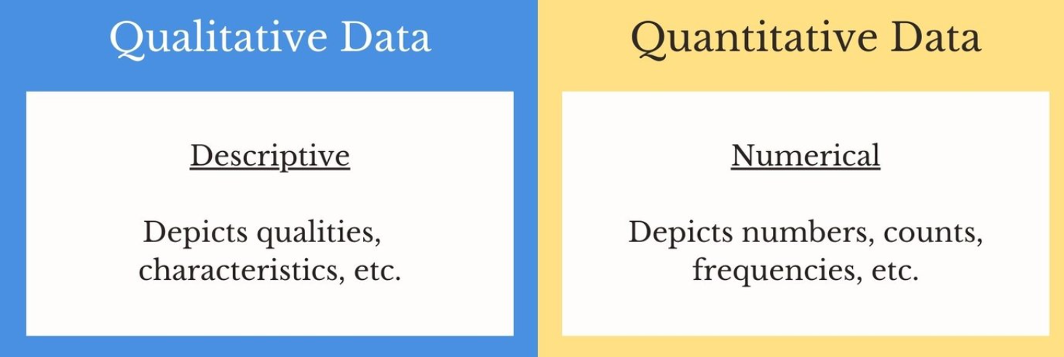
Selecting the methodology
Research method : Qualitative Vs Quantitative

Slide 24
Selecting the methodology
Research method
Qualitative research involves the collection of (soft) data that are open to interpretation, for example, people’s opinions which cannot be generalised in numerical terms.
Quantitative research – research that produces statistics (hard data)

Slide 25







Selecting the methodology
Data: Qualitative Vs Quantitative

Slide 26
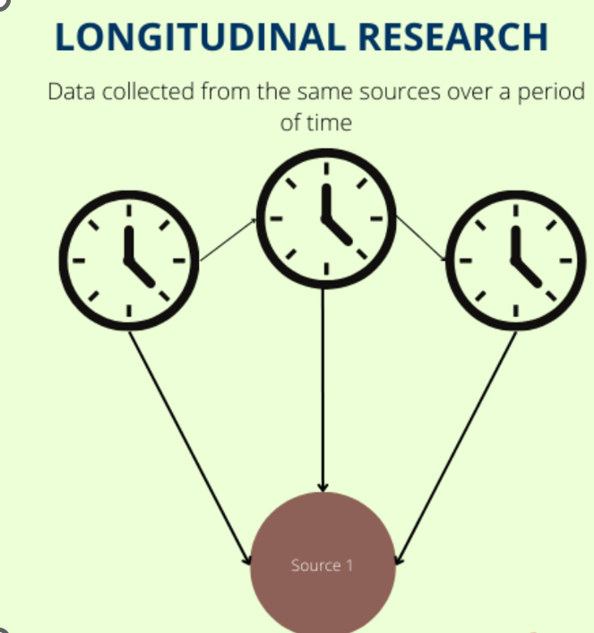
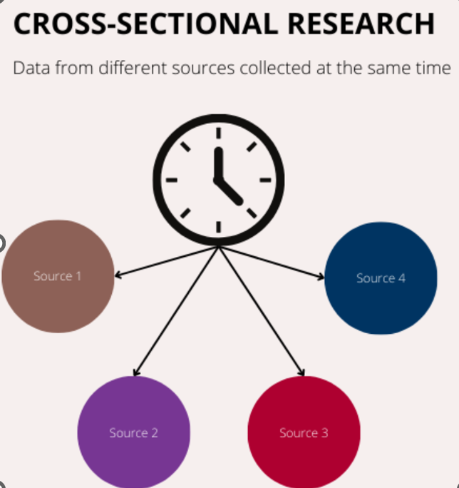
Selecting the methodology
Time Horizons – Longitudinal and Cross sectional

Slide 27
Selecting the methodology
Time Horizons - Longitudinal
Longitudinal research extends over a substantial period of time and involves studying changes over time.
Longitudinal research involves collecting data from the same group of subjects or participants over an extended period.
Example
A longitudinal study tracking a cohort of children from birth to adulthood to investigate the long-term effects of early childhood interventions on academic achievement, socio-emotional development, and health outcomes.
Tracking changes in software development practices or technology adoption over time within development teams or organizations
Technology usage among software developers at a specific point in time

Slide 28
Selecting the methodology
Time Horizons – Cross sectional
Cross-sectional research takes a 'snapshot' of a situation in time
Cross-sectional research involves collecting data from a sample of subjects at a single point in time.
Example
A cross-sectional study surveying adults of different age groups to examine the prevalence of mental health disorders and identify potential demographic, socioeconomic, or cultural factors associated with higher rates of mental illness.
Assess current trends and preferences in areas such as programming languages or technology usage among software developers at a specific point in time

Slide 29
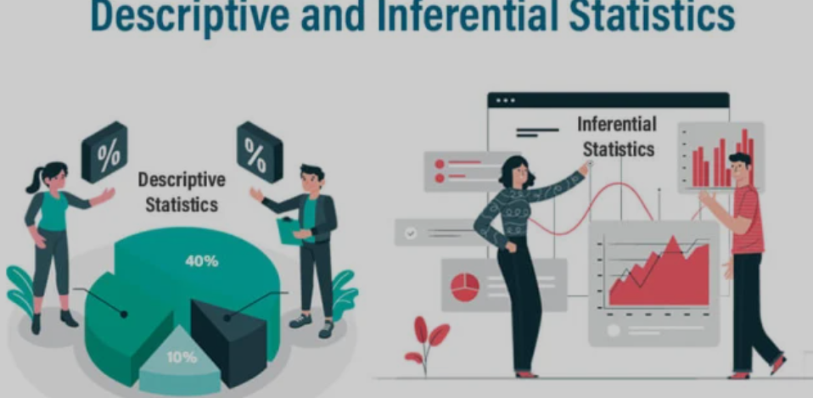

Selecting the methodology
Data collection and analysis
Data analysis involves the systematic examination and interpretation of collected data to derive meaningful insights, identify patterns or trends, and draw conclusions relevant to the research questions or objectives.
Data Cleaning: Raw data may need to be cleaned and organised to remove errors, inconsistencies, or missing values that could compromise the analysis.
Statistical Analysis: Quantitative data may be analysed using statistical techniques such as descriptive statistics, inferential statistics (e.g., t-tests, ANOVA, regression analysis), or multivariate analysis to test hypotheses, identify relationships, or make predictions.

Slide 30

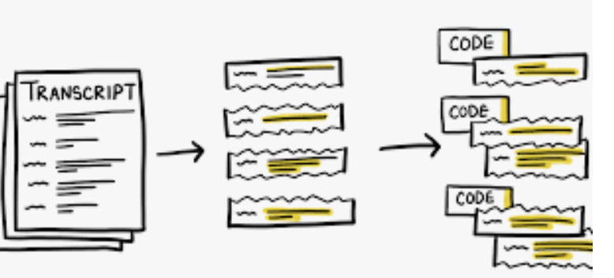
Selecting the methodology
Data collection and analysis
Qualitative Analysis: Qualitative data may be analysed using techniques such as thematic analysis, content analysis, or grounded theory to identify patterns, themes, or categories and generate explanations or theories.
Interpretation: Researchers interpret the findings of the data analysis in light of the research questions, existing literature, and theoretical frameworks. They draw conclusions, make recommendations, and discuss the implications of the findings for theory, practice, or policy

Slide 31
Selecting the methodology
  Selecting
Philosophy
Positivism
Interpretivism
Approach
Deductive
Inductive
Strategies
Experiment
Software Development
Document Review
Action Research
Ethnography
Case Study
Survey

Slide 32
references
[1]. M. Saunders, P. Lewis, and A. Thornhill, Research Methods for Business Students, 5th ed. Harlow, U.K.: Pearson Education, 2009.

Slide 33
Before You Go: 3-2-1
REFLECT
✍️ Take 3 minutes:
2-3 research strategies (of the six) that could realistically work for your project.
2 things about choosing a methodology you're still unsure about.
1 decision you'll make about your own project's methodology before next session.
Submit/discuss before you leave - we'll use these to shape the next session.

