Slide 1
The Nature versus Nurture concept
SJSI4017 Ass 2
Abi-Marie Grace
Student Number 1806352

Slide 2
Introduction
During this presentation I will discuss
The origin of the concept and argument.
The main argument provided.
The Nature argument and how it effects children.
The Nurture argument and how it effects children.
How it is seen today

Slide 3
The Origin
Originated in 1869
Coined by Francis Galton, founder of the science of Eugenics.
Inspired by his cousin Charles Darwins work.
Francis favoured the nature argument as with a quote from is publication Natural Inheritance .“the child does not on the average receive so much as on half of his personal qualities from each parents” (Galton, 1889)
Immanuel Kant believed in nature and believed there must be prior knowledge.
John Locke believed in nurture and the importance of experiences.

Slide 4
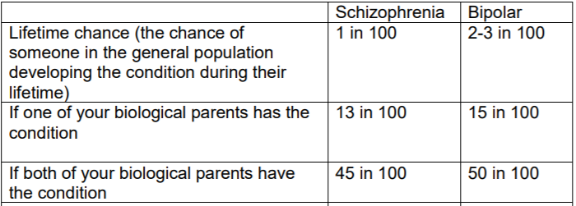
Nature Argument
Intelligence is predetermined by an individual's genetics alike eye and skin colour.
Mental Health issues can also be passed through genetics.
Rethink Mental Illness created a fact sheet showing the probability of mental health issues being passed through genetics.
(Does mental illness run in families., 2017)

Slide 5
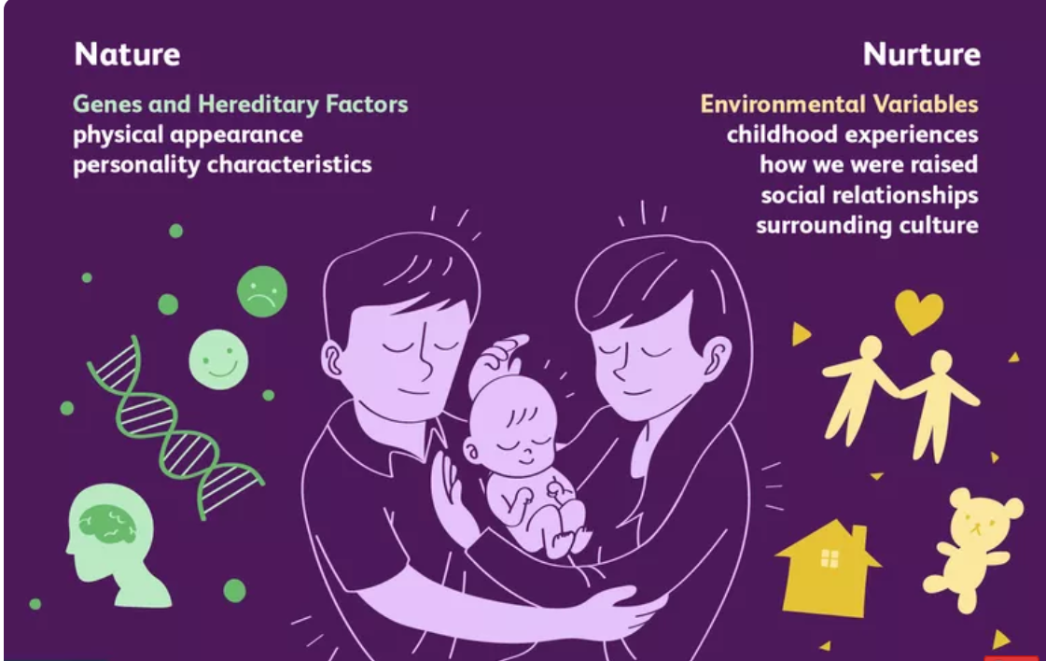
What it is
It is a concept that has been argued across decades.
Nature: The belief that intelligence and knowledge comes via parent's DNA.
Nurture: The belief that we begin life as a blank slate and develop through experiences and surrounding society.
(Cherry, 2019)

Slide 6
Nature Argument continued
A child's developments may be effected by their DNA.
Mental health issues may be passed along meaning parents with similar issues may struggle to provide a quality life.
The 1989 Children's Act provides a focus on the welfare of the child and will take into consideration how capable parents are to support the child.
This can result in a child being taking into care due to the parents being unable to adequately support their child and raise them.

Slide 7
Nurture Argument
A child Is born as a blank slate
Environmental and societal factors form the basis of who they become
The experiences they are exposed to shape them
A key emphasis on events occurring during the child's formative years.
The effect is clearly seen with individual who suffered from childhood abuse.
Investigation discovered that the wellbeing and happiness was lower than those who had not been abused as children.
4% more adults abused as children used drugs than those not abused.

Slide 8
Nurture argument continued
Cymru Well Wales has committed to providing earlier intervention.
To prevent children being exposed to harming expeirneces in developing years
NHS study discovered those who has four or more abuse childhood experiences had higher chances of misusing drink.
Social Services Well Being (Wales) Act 2014
Defines a child at risk as a child who “is experiencing or is at risk of abuse, neglect or other kinds of harm” (Legislation.gov.uk, 2014)

Slide 9
Present day
It is primarily considered that everyone is benefiting from nature and nurture events.
Intelligence is predetermined by genetics but the ability to apply it and develop is determined by the environment raised within
The ability of holding perfect pitch is determined by genetics but to develop the skill takes musical training and patience which is down to nature elements.

Slide 10
Conclusion
Nature versus nurture debate has spanned decades and will continue to do so.
There is a belief currently that it is a shared responsibility between both the arguments.
The government is showing the importance of a child formative years as seen with the social services wellbeing wales act 2014 and the 1989 children's act.
There is a clear desire for people to understand why they are who they are.
Societal standing is increasingly important to people.

Slide 11
References
References
Age-of-the-sage.org. (2019). The nature versus nurture debate or controversy. [online] Available at: https://www.age-of-the-sage.org/psychology/nature_nurture.html [Accessed 20 Apr. 2019].
Cherry, K. (2019). The Age Old Debate of Nature vs. Nurture. [online] Verywell Mind. Available at: https://www.verywellmind.com/what-is-nature-versus-nurture-2795392 [Accessed 20 Apr. 2019].
Does mental illness run in families. (2017). 2nd ed. ReThink Mental Illness, p.2.
Galton, F. (1889). Natural Inheritance by Francis Galton. [online] Galton.org. Available at: http://galton.org/books/natural-inheritance/index.html [Accessed 20 Apr. 2019].
Legislation.gov.uk. (2014). Social Services and Well-being (Wales) Act 2014. [online] Available at: https://www.legislation.gov.uk/anaw/2014/4/part/7 [Accessed 20 Apr. 2019].
Legislation.gov.uk. (2019). Children Act 1989. [online] Available at: https://www.legislation.gov.uk/ukpga/1989/41/section/1 [Accessed 20 Apr. 2019].

Slide 12
References
Locke, J. (2019). The Works of John Locke, vol. 2 (An Essay concerning Human Understanding Part 2 and Other Writings) - Online Library of Liberty. [online] Oll.libertyfund.org. Available at: https://oll.libertyfund.org/titles/locke-the-works-vol-2-an-essay-concerning-human-understanding-part-2-and-other-writings [Accessed 20 Apr. 2019].
Mcleod, S. (2018). Nature Nurture in Psychology | Simply Psychology. [online] Simplypsychology.org. Available at: https://www.simplypsychology.org/naturevsnurture.html [Accessed 20 Apr. 2019].
Ons.gov.uk. (2019). People who were abused as children are more likely to be abused as an adult - Office for National Statistics. [online] Available at: https://www.ons.gov.uk/peoplepopulationandcommunity/crimeandjustice/articles/peoplewhowereabusedaschildrenaremorelikelytobeabusedasanadult/2017-09-27 [Accessed 20 Apr. 2019].
ORIGINS. (2019). Nature vs Nurture. [online] Available at: http://experimental-origins.weebly.com/nature-vs-nurture.html [Accessed 20 Apr. 2019].
ScienceDaily. (2012). Perfect pitch: Knowing the note may be in your genes. [online] Available at: https://www.sciencedaily.com/releases/2012/10/121023124000.htm [Accessed 19 Apr. 2019].
The Chronicle of Higher Education. (2009). The Nature-Nurture Debate, Redux. [online] Available at: https://www.chronicle.com/article/The-Nature-Nurture-Debate/33480 [Accessed 20 Apr. 2019].
Wales.nhs.uk. (2016). Public Health Wales | Children who suffer abuse more likely to be involved in violence & misuse drugs & alcohol as adults. [online] Available at: http://www.wales.nhs.uk/sitesplus/888/news/40000/ [Accessed 17 Apr. 2019].
Wales.nhs.uk. (2018). Public Health Wales | Adverse Childhood Experiences (ACEs). [online] Available at: http://www.wales.nhs.uk/sitesplus/888/page/88524 [Accessed 20 Apr. 2019].

