Slide 1
Week 2
Writing and Reading for
Academic Purposes

Slide 2
Learning Outcomes
At the end of this session you should:
To understand the purpose of academic writing
To demonstrate key strategies for academic writing and reading

Slide 3
ACADEMIC READING SKILL
This skill helps you to:
Understand the key issues and debates on a topic
Identify supporting arguments and/or evidence / examples
Be a critical thinker because you can draw from what you have read to formulate conclusions (e.g., identifying whether the evidence in what you read supports the conclusion)

Slide 4
5-minute self test
What do you find difficult about reading at higher education?
Tick the boxes below:
Finding enough time and energy
Maintaining Concentration
Managing vocabulary
Selecting what to focus in texts
Understanding new, theoretical or detailed information
Identifying main points and arguments
Reading different types of text

Slide 5
What to read: Getting your material
You can access relevant material from different sources
Library (including UWTSD online library)
Academic databases such as Google Scholar
Most university libraries and databases also include citations, so you can start updating your references lists at the same time as you access/retrieve the material.

Slide 6
Credible Sources
Textbooks/Books recognised by relevant authors and publishers
Papers published in academic / scientific journals
Scholar and official websites that are regularly updated (e.g. .edu,.gov,.edu.sa,etc)
Scientific and Scholar databases (e.g. Scopus, ERIC, Web of Science, PubMed, IEEE Xplore, ScienceDirect, JSTOR, etc)
Other Search Engines (e.g. Google Scholar)
How do you read/understand what you’ve read – Some tips from real experience - https://www.youtube.com/watch?v=_AYrQEw2qQ0

Slide 7
ACADEMIC WRITING SKILL
Materials adapted from - BBC Go the Distance: Academic Writing
Available from https://www.bbc.co.uk/learningenglish/gothedistance/academicwriting

Slide 8
Academic Writing Skill & importance in Higher Education
The ability to write a clear and logical assignment or report is an important academic and professional skill.
Requirement for a variety of reports, dissertations, essays and papers.

Slide 9
Assignment Types
Written assignments fall into a number of different categories – find out if you have to write an essay, report, literature review or something else.
The first step in writing a successful assignment is understanding what you have to write – check the meanings of question words in assignment titles.
When you know what you have to write, make sure you answer the question completely! Don't miss out anything important.
If in doubt - ask for help! Your tutors and fellow students can be a great source of support if you're lost or confused.

Slide 10
Key Things to Consider When Writing
1. Vocabulary, including words not to use
2. Use paragraphs properly
- Topic Sentence
- Supporting sentence
- Concluding sentence
3. How to structure your report/essay
We will now look at each of these three key things in detail

Slide 11
1. Academic Writing - Vocabulary
Say exactly what you mean, in a suitable style – and choosing the right type of vocabulary is an important place to start.
You need to be careful that the words you're using aren't too informal, vague or emotive.

Slide 12
Words NOT use
informal words like 'big' or 'good'
many phrasal verbs, like 'give up' or 'put off' – these are too informal
some vague words with too many possible meanings, like 'thing' or 'get'
'emotive' words, which express personal feelings, like 'fantastic' or 'terrible

Slide 13
Activity
Each group of words and phrases here has ONE item that is NOT used in academic writing – find the odd one out
1. Which word is the odd one out?
a possible
b receive
c stuff

Slide 14
2. Which word or phrase is the odd one out?
a and
b as we all know
c also
3. Which word is the odd one out?
a understand
b heavy
c beautiful
4. Which word or phrase is the odd one out?
a come up with
b however
c large
Write down your answers, now let’s see how well you’ve done

Slide 15
Answers
C,B,C,A
C - The word 'stuff' is too vague and informal. Use a word like 'items' or 'substance' – or be more specific!
B - The phrase 'as we all know' is too personal and informal – use 'it is widely accepted that' instead.
C - The word 'beautiful' is too emotive and personal – best avoided unless it is part of a wider quote.
A. The phrase 'come up with' is a phrasal verb – too informal. Use a word like 'invent', 'propose' or 'suggest' instead.
Okay – lets do another round of practice!

Slide 16
In each of these sentences, one word or phrase is unsuitable for British academic writing. Can you identify these words?
1. 'By 2030, Indonesia is likely to become one of the world's biggest economies.' Which word is unsuitable?
a biggest
b likely
c economies
2. 'The increased incidence of inflammatory bowel disease was maybe due to dysfunctional Th1 regulation.' Which word is unsuitable?
a increased
b maybe
c dysfunctional

Slide 17
3. 'A collaborative global campaign of vaccination effectively got rid of smallpox by 1980.' Which word or phrase is unsuitable?
a vaccination
b got rid of
c smallpox
4. 'Sweet flavourings, and in particular cacao syrup, were used to hide the disgusting taste of drugs such as quinine.' Which word or phrase is unsuitable?
a disgusting
b such as
c particular
Write down your answers, now let’s see how well you’ve done

Slide 18
Answers
A,B,B,A
A - The word 'biggest' is too informal; instead, use 'largest’.
B - The word 'maybe' is too informal; instead, use 'possibly' or 'potentially’.
B - The phrase 'got rid of' is a phrasal verb; instead, use 'eradicated' or 'eliminated’.
A – Disgusting is a very “emotive” word
In sum, informal, vague or emotive should be avoided

Slide 19
2. Academic Writing - Use of Paragraphs
When you are writing essays and assignments, you need to organise your writing into paragraphs.
Good paragraphs usually follow a particular structure:
Topic sentence
Supporting sentence 1
Supporting sentence 2….
More supporting sentences (as required)
Concluding sentence(s)

Slide 20
The Topic Sentence
A good paragraph often starts with a topic sentence, which summarises the main idea of the paragraph.
The topic sentence sometimes includes 'signposting' words and phrases to show how it is connected to the paragraphs before it in the text.
Some examples of these are: 'As a result of this...', 'Another reason...' and 'However,...'

Slide 21
Activity
In the next slide, there is a paragraph from an assignment from an education management course.
Read the assignment title and the topic sentences 1- 3 below. Then read the paragraph and decide which topic sentence is the most suitable.

Slide 22
Assignment title
What strategies are available to educational leaders for managing institutional change?
Possible topic sentences
1. Before this question can be addressed, definitions of the terms 'educational leader' and ‘institutional change’ must be established.
2. When change is imminent, it is necessary for educational leaders to make appropriate preparations (Zimmerman, 2004).
3. According to Zimmerman (2004) there are four basic types of educational change.

Slide 23
Which topic sentence is best for this paragraph?
Firstly, leaders must ensure that their own understanding of the change process is clear and complete before they begin to implement change (Calabrese 2002). In particular, leaders must recognise that change almost inevitably results in some degree of resistance on the part of school staff, and must identify any issues which are likely to cause particular resistance. Having done this, leaders need to design communication strategies and any related CPD in order to minimize the effect of this resistance. Badely (2013) recommends that in any situation of major institutional change, educational leaders should always design and implement a series of dedicated training sessions.

Slide 24
Answer
The answer is No 2 - This is an appropriate topic sentence because the paragraph describes the preparations leaders can make – the paragraph develops the topic.

Slide 25
Get writing a good supporting sentence
After the topic sentence, good paragraphs contain one or more 'supporting sentences' which explain the topic sentence in more detail.
The supporting sentences might include reasons for the reader to agree with the topic sentence, or examples that explain or develop the topic sentence.
Supporting sentences often include ‘signposting’ language, to show the relationship between the ideas in the paragraph. Examples include:
Firstly… Secondly… Thirdly…
The first… The second… The third…
Furthermore, … However, … On the other hand, …

Slide 26
Activity
In the next slide, I will show you An Assignment Title for a music course and a paragraph from the assignment
Read the assignment title from the course about music and culture. Then look at the paragraph from the assignment and see if you can spot the supporting sentence that SHOULDN'T be there.

Slide 27
Assignment title
Choose a musical instrument which has moved beyond its original geographical location. Who has adopted this instrument, how have they done so, and why?
Paragraph
The three-stringed harp has also had a role in popular protests aimed at defending the indigenous peoples’ equality. One example is the single ‘Meim Yet’tu’, released in 1993 in support of the Five Rivers land rights movement. This pushed the Five Rivers movement to the front of the international stage, dramatically raising awareness of the harp as a symbol of the indigenous peoples’ tradition, and their stance in the nation’s land-rights politics (Gardise and Warhust, 2011). It is very common for musical instruments to be adopted by different cultures, and used for different purposes. The instrument has since taken on a clear role as a symbol of the indigenous political struggle.

Slide 28
Which sentences does not belong in the paragraph above?
A The three-stringed harp ... the indigenous peoples’ equality.
B One example is ... the Five Rivers land rights movement.
C It is very common for ... and used for different purposes.
D The instrument has since ... the indigenous political struggle.

Slide 29
Answer
The answer is C
This sentence is not appropriate here as the assignment and paragraph are only about one particular musical instrument and its use beyond its original geographical location - not the use of instruments in general.

Slide 30
Concluding the paragraph
The conclusion of a paragraph is really important.
It may explain why the writer has included the paragraph; summarise the argument(s) made and evidence given; relate the paragraph to the theme of the essay.
It may also signal to the reader what is coming next

Slide 31
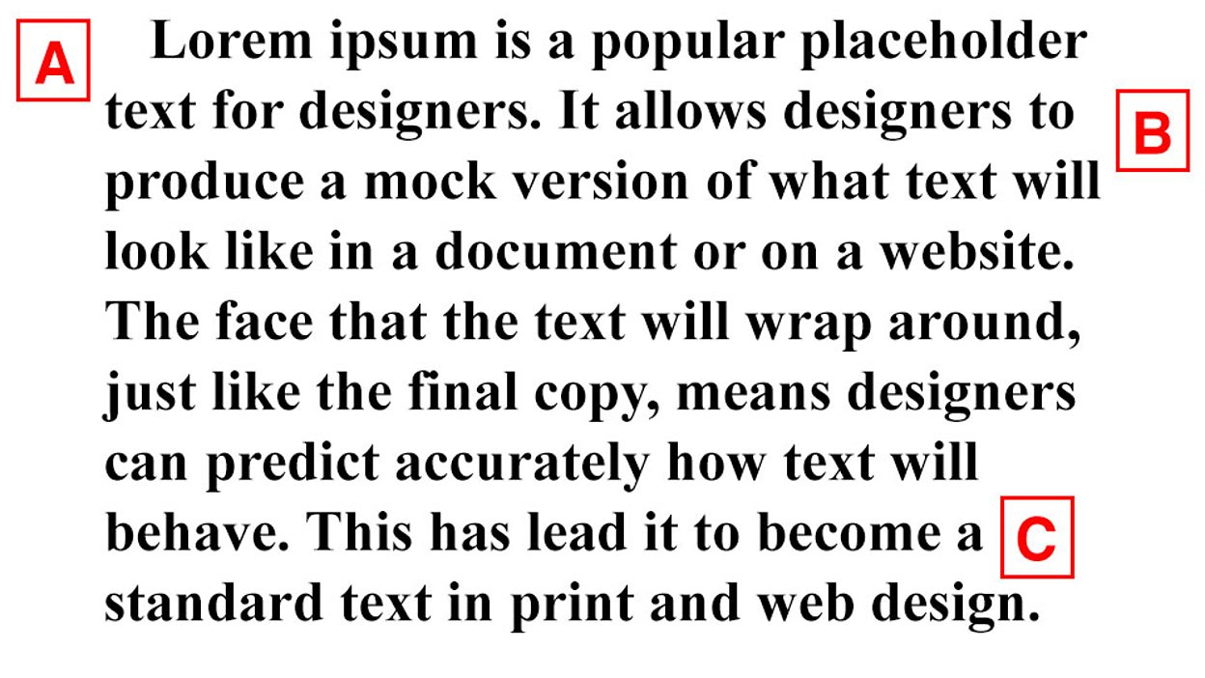

Slide 32
Recap on Paragraphs
Good academic writing is made up of paragraphs with one clear idea per paragraph.
Paragraphs usually start with a topic sentence – a sentence that gives the main focus of the paragraph.
The topic sentence sometimes includes 'signposting' language to link the paragraph to the previous paragraph.
Supporting sentences follow the topic sentence. They develop the topic by giving reasons, evidence and/or examples.
The concluding sentence usually comes at the end. It explains why the paragraph is important and relates it to the theme of the essay.

Slide 33
3. Academic Writing – Structure of your work
Most assignments that you will write should be structured as follows:
Introduction
Body
Conclusion
References

Slide 34
WRITING YOUR ASSIGNMENT
The most important step in assignment writing is making sure you understand the task.
You need to understand the 'question' or 'process' words – and pay close attention to the 'content' words.
Ask questions on the topic and provide answers
Break down the topic into levels - Clustering / Mapping
Produce a working outline

Slide 35
Components of a good Essay/Report – The Introduction
Sets the scene with a context, e.g. definition of key terms, introduction of key issues and point of departure of the essay
Clearly states the purpose/objective of the essay
Gives idea of the structure of the full paper, e.g., flags up the different parts/sections of the essay/report

Slide 36
Components of a good Essay/Report – The Main Body
Elaborates on that which is flagged up at the end of introduction as what the essay/report cover
These could include; definition of concepts, current viewpoint vs alternative theoretical viewpoints (major theories to answer questions), current state of research studies
Uses paragraphs to communicate key issues and in-citations to back up claims that are not original to the writer

Slide 37
Components of a good Essay/Report – Conclusion
The key here is draw sensible conclusions from the key issues discussed in the preceding section
Think of the conclusion/s as they main thing you want to convince the reader to accept as true.
In this case, you would normally summarise the key issues explored/discussed in preceding section, then make your concluding claims
This is where you show how smart your are!

Slide 38
OUTLINE / ESSAY MAP
Main idea 1
Supporting Details 1
Introduction
Main idea 2
Supporting Details 2
Conclusion
Main idea 3
Supporting Details 3

Slide 39
Reading
https://www.youtube.com/watch?v=zE-DvR91IrE – Student Life – Academic Reading 1
https://www.youtube.com/watch?v=_AYrQEw2qQ0 – Student Life – Academic Reading 2
https://www.youtube.com/watch?v=-qiKZhgnM3Q = Study Skills – Preparing for assignments
https://www.bbc.co.uk/learningenglish/gothedistance/academicwriting - Go the distance – Academic Writing

