Slide 1
Group Presentation
Name & ID
Chirag Arvind Kapadia 2521160
Rachitkumar Kalpeshbhai Barot 2531441
Nareshbhai Parmar 2531864
Ravikumar Mukeshbhai Bhadiyadra 2518462
Module Name: Human Capital Management
Module Code: LCMB7024
Lecturer’s Name: Gladius Kulothungan, Ejike Udeogu
Work Count:2500
Term 1

Slide 2
Topic: Retention and Succession Planning for NHS
Table of Contents
Introduction………………………………………………………………
NHS Benefits…………………………………………………………….
NHS Funding……………………………………………………………..
NHS Challenges in Human Capital Management (HCM)...
Threats of NHS…………………………………………………………...
Who to Improve HCM in NHS………………………………………
Root Causes of NHS England's Problems……………………..
Evidence-based recommendations and innovative solutions grounded in
HRM theory and practice…………………………………………….
Retention……………………………………………………………………
Successful Planning…………………………………………………..
Conclusion…………………………………………………………………
References………………………………………………………………….

Slide 3
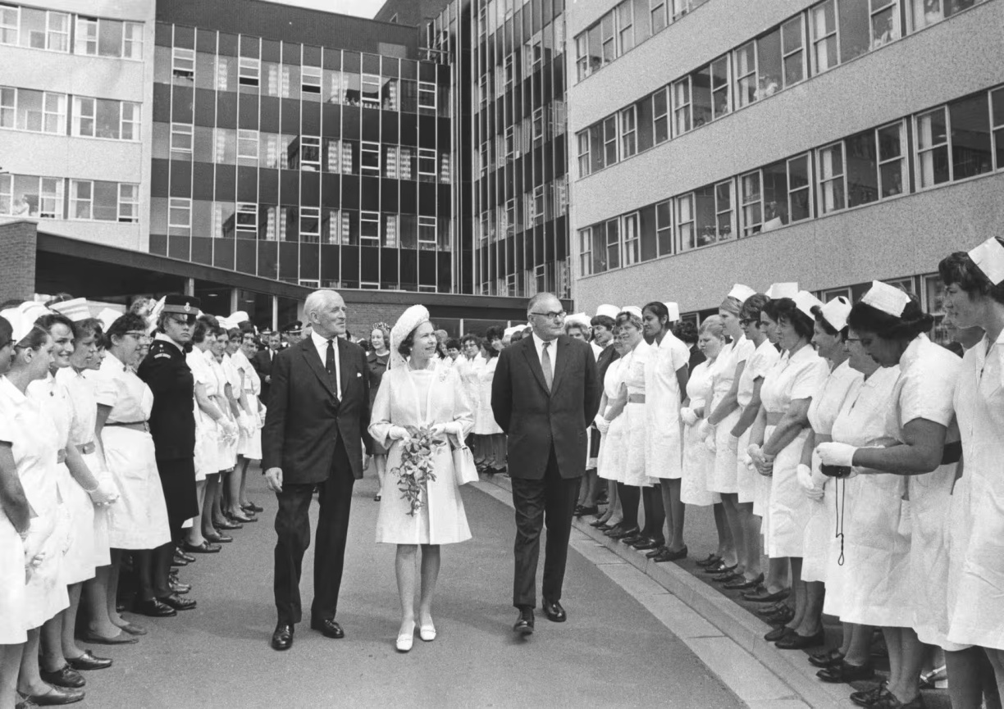
The National Health Service
What is the NHS?
NHS stands for National Health Service. It is the public healthcare system in the United Kingdom. It was created in 1948 and provides healthcare to everyone in the UK — completely free at the point of use, no matter who you are or how much money you have. It is funded by taxpayers.(NHS)
What does the NHS do?
It covers everything from GP appointments and hospital treatment to mental health services, maternity care, and emergency services. It is one of the largest employers in the world, with over 1.5 million staff.

Slide 4
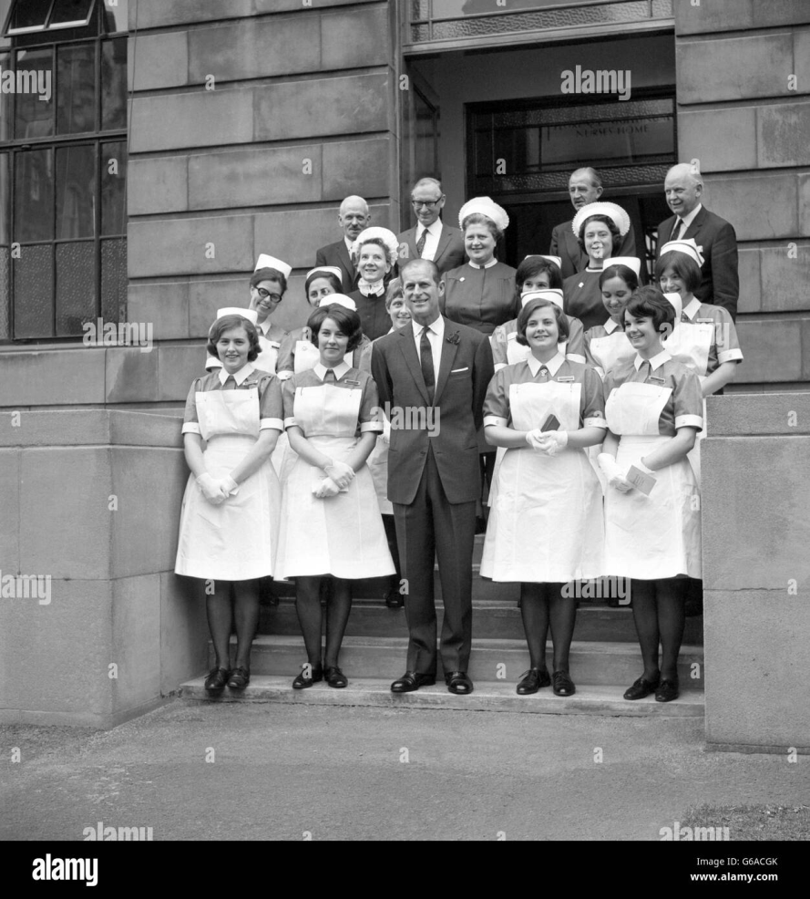
1. Free at point of use:
No fear of bills when you’re sick
2. University Coverage:
Everyone get care, rich or poor
3. Comprehensive:
Covers everything from birth to end of life
4. Financial Protection:
No medical bankruptcy
5. Efficient:
More money goes to doctors and nurses,
not insurers
6. Prevention Focused:
Free screening and vaccinations catch problems
early
7. Equal treatment :
Same care regardless of income
8. Coordinated:
One system responds to emergencies and
pandemics
9. Research driven:
Patients access world class trials and innovation
10. National Pride:
A symbol of fairness that unites people(The Commonwealth Fund)
NHS Benefits

Slide 5
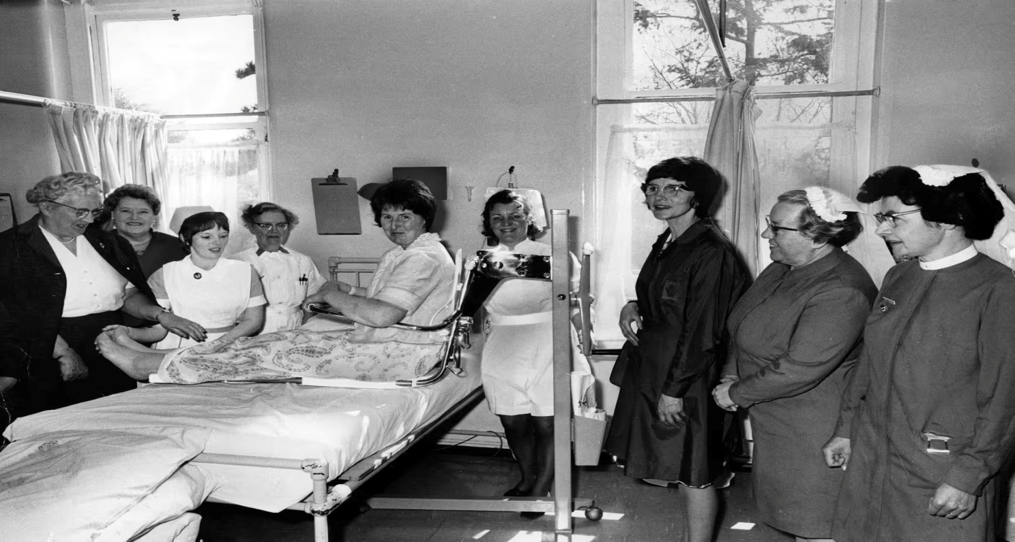
How is the NHS Funded?
Main Source — Taxes The NHS is mostly funded by the UK government through taxes paid by workers, businesses, and citizens. The more you earn, the more tax you pay, and part of that goes to the NHS.
National Insurance Every worker in the UK pays National Insurance contributions from their salary. A portion of this money goes directly to fund NHS services.
Government Budget Every year the government decides how much money the NHS receives. In 2024, the NHS budget was around £180 billion — making it one of the most expensive public services in the world.(NHS)

Slide 6
NHS Challenges in Human Capital Management (HCM)
Workforce Shortages: The NHS is experiencing a shortage of staff, including doctors, nurses
and support staff, which is impact the quality and safety of care.
Staffing Levels: High levels of staff turnover and unmanageable workloads are contributing
to a stressful work environment and low moral among staff.
Funding and Technology: The NHS is facing challenges with funding and technology, which
create barriers to delivering effective care.
Patient and Staff Experience: The NHS is struggling to meet the needs of patients and staff,
with many reporting poor communication and coordination issues.
Integrated Care Models: The NHS is working to evolve its approach to healthcare, focusing
on integrated care systems and better coordination of services.
These challenges are part of a broader trend of rapid change across health and care service,
Necessitating a shift in how the NHS operates and delivers care. (Health Foundation)

Slide 7
Threats of NHS
Running Out of Money:
The gap between demand and funding is growing. The NHS is getting less money than it needs each year. Demand keeps rising because people are living longer and have more long-term illnesses.
What it means for you: Longer waiting lists, fewer staff, of equipment and harder access to GPs and dentists.
Real risk: The system becomes so stretched that it can no longer provide safe, dignified care to everyone who needs it.
2. Staff Leaving in Drives
Burnout is driving away. Exhausted nurses, doctors and paramedics are quitting because they cannot cope with the pressure any longer.
What it means for you: Fewer staff means slower ambulances, cancelled operations and rushed care.
Real risk: A mass exodus of experienced staff leaves the NHS staffed by exhausted newcomers and agency workers, lowering quality and safety.
3. Digital Divide Leaves People Behind
The NHS App is becoming the main way to book appointment and access service
What it means for you: If you are elderly, poor, have a learning disability or don’t own a smartphone, you could be locked out of the system entirely.
Real risk: Millions of people become second-class patients, unable to book appointment or access their records, forced to rely on friends or family to navigate the system for them.

Slide 8
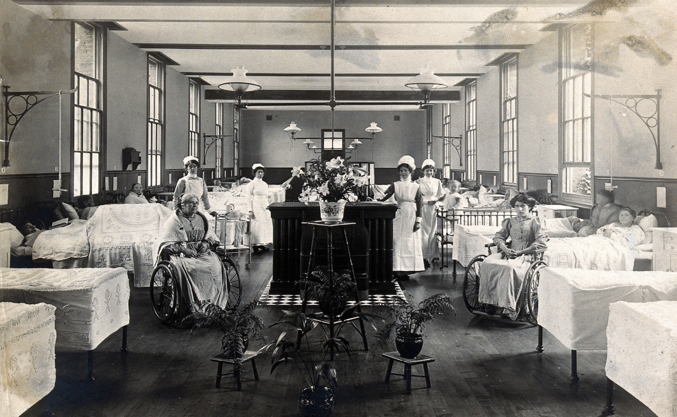
4. The Social Care Collapse
Social care (help with washing, dressing, housing) is broken. Elderly and disabled people cannot het care at home or find care home places.
What it mean for you: Those people end up stuck in hospital beds for weeks or month, blocking beds for new patients. Your emergency surgery or cancer treatment het delayed.
5. Preventable Deaths Continue Unchecked
Patients with learning disabilities and other vulnerable groups keep dying from avoidable causes. Families raise concerns, but staff ignore them.
What it means for you: If you or a loved one has a learning disability or complex need, you cannot trust that the NHS will listen to you or keep you safe.
Real risk: A culture of disregard for vulnerable patients becomes normalised. Avoidable deaths are treated as inevitable rather than unacceptable.(Freeguard, G. )

Slide 9
Who to Improve HCM in NHS
1. Prioritize retention over recruitment: It costa far less to keep a good employee than to hire
a new one. Focus on fixing the reasons people leave-burnout, poor management, lack of flexibility – rather than constantly trying to fill vacancies from outside.
2. Hold regular stay conversation: Do not wait for the resignation letter to ask questions. Managers should meet with staff every few months to ask what is bothering them and what world keep them happy. Fix small issues before they become big reasons to quit.
3. Make flexible working the default: Do not make staff beg part-time hours or adjusted shift. Offer flexibility from the start and trust staff to deliver their work. When people can balance work with family or health need, they stay longer.
4. Give Temporary staff a sense of belonging: Bank and agency works often feel like outside. Assign them to consistent wards or terms so they build relationships. Include them in meeting and training. When people feel part of a team, they give better care.
5. Protect recovery time after demanding shifts: Do not schedule training or meeting immediately after night shifts or long stretches of work. Staff need time to rest and process difficult experience. Forcing exhausted people to attend sessions is unsafe and disrespectful.

Slide 10
Root Causes of NHS England's Problems
1. Policy — "Not Enough Money, For Too Long"
The government simply did not put enough money into the NHS for over a decade. Budgets barely grew, while the number of sick people kept rising.
Hospital admissions grew by an average of 3.6% every year between 2003 and 2016, yet the NHS budget grew by only around 1% in real terms during the austerity years (The AI Journal, 2025).
By 2024/25, 31 out of 42 NHS regional systems submitted plans showing they would overspend, with a combined deficit of £2.2 billion (The AI Journal, 2025).
The government's own 10-year plan only commits to growing NHS spending by 2.8% a year — still well below the historic average of 3.7% (BMJ/PMC, 2025).
2. Leadership — "Too Many Reorganisations, Too Little Stability"
The NHS has been repeatedly restructured by politicians, leaving managers confused about who is in charge of what.
Root cause analyses done inside the NHS may generally fail to identify where there are organisational failures, as there is an inherent desire to protect institutional reputation rather than learn from mistakes.
National policy is vague about what new NHS objectives mean and how progress is measured, meaning greater clarity from national policymakers is needed to avoid risks at local level.

Slide 11
3. Structure — "A System Built for the Past, Not the Present“
The NHS was originally designed in 1948 for a population with acute, short-term illnesses. Today's patients are older and have multiple long-term conditions simultaneously.
The NHS's dependence on nursing homes and aged care facilities is a key contributor to the crisis — the shortage of care home beds means patients who are fit for discharge are occupying approximately one in seven acute hospital beds, causing long admission delays.
The main challenges the NHS now faces include an ageing population, lack of funding, increasing numbers of patients with complicated health needs, staff retention, primary healthcare issues, and backlogs in appointments worsened by COVID-19.
4. Culture — "Staff Are Exhausted and Not Being Listened To"
The people who work in the NHS are under enormous strain, and complaints — from both staff and patients — are too often ignored rather than acted upon.
Burnout and low morale due to pandemic-related exhaustion, combined with declining real wages, has led to decreases in the proportion of staff who feel adequately recognised and rewarded, or who would recommend the NHS as a place to work.
COVID-19 pushed the NHS into a serious staffing crisis and delay in patient care. This was made worse by significant underfunding over the past decade, the current inflation, and stagnation of salaries — resulting in many junior and senior staff migrating overseas. (P4H Network)

Slide 12
Evidence-based recommendations and innovative solutions grounded in
HRM theory and practice
01 · Sight — Staff Wellbeing
The 2024 NHS Staff Survey found that 42% of staff felt unwell due to work-related stress, and 30% often or always feel burnt out — a systemic failure of organisational sight.
Innovation: Real-time wellbeing dashboards (NHS Digital) allow boards to spot stress hotspots by ward and act before burnout takes hold.
02 · Scan — Workforce Planning
The NHS Hospital and Community Health Services workforce has nearly 103,000 vacancies — a rate of around 1 in 14 — and the annual turnover rate between March 2024 and March 2025 was 9.9%, with nearly 152,000 people leaving active service.
Leverage Integrated Care Systems for cross-trust workforce sharing.
03 · Shape — Learning & Development
Apply Senge's (1990) learning organisation model: continuous reflection must be systemic, not event-based.
The 70:20:10 model (Lombardo and Eichinger, 1996): 70% on-the-job, 20% peer learning, 10% formal training — NHS L&D spend must rebalance toward the 70%.
AI-personalised learning pathways adapting in real time to individual competency gaps.

Slide 13
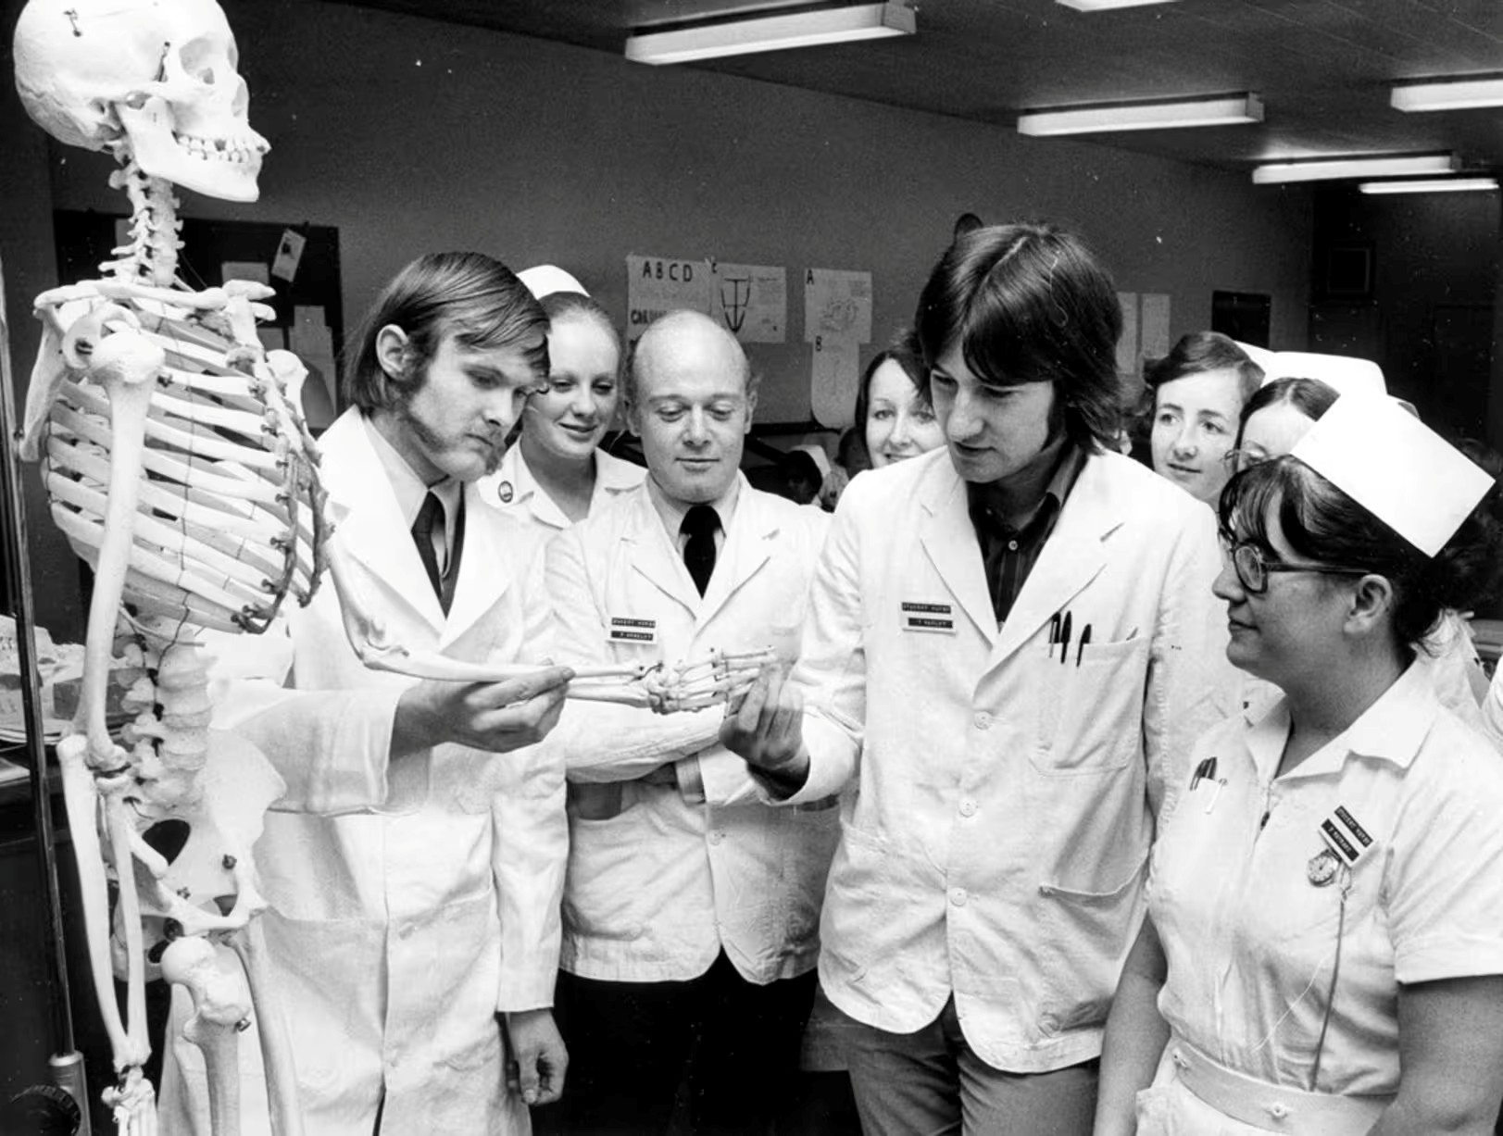
04 · Scrutinise — Equality, Diversity & Inclusion
18% of NHS staff reported bullying or harassment from colleagues, and over half of operational ambulance staff experienced harassment or abuse from the public in the past 12 months.
Apply Cox's (1993) multicultural organisation model as a structured pathway to full inclusion.
05 · Steady — Compassionate Leadership
Only 60.8% of NHS staff would recommend their organisation as a place to work in 2024 — six percentage points below 2020 levels.
West's (2021) compassionate leadership model — attending, understanding, empathising, helping — is the NHS Leadership Academy's evidence-based standard.(House of Commons Library)

Slide 14
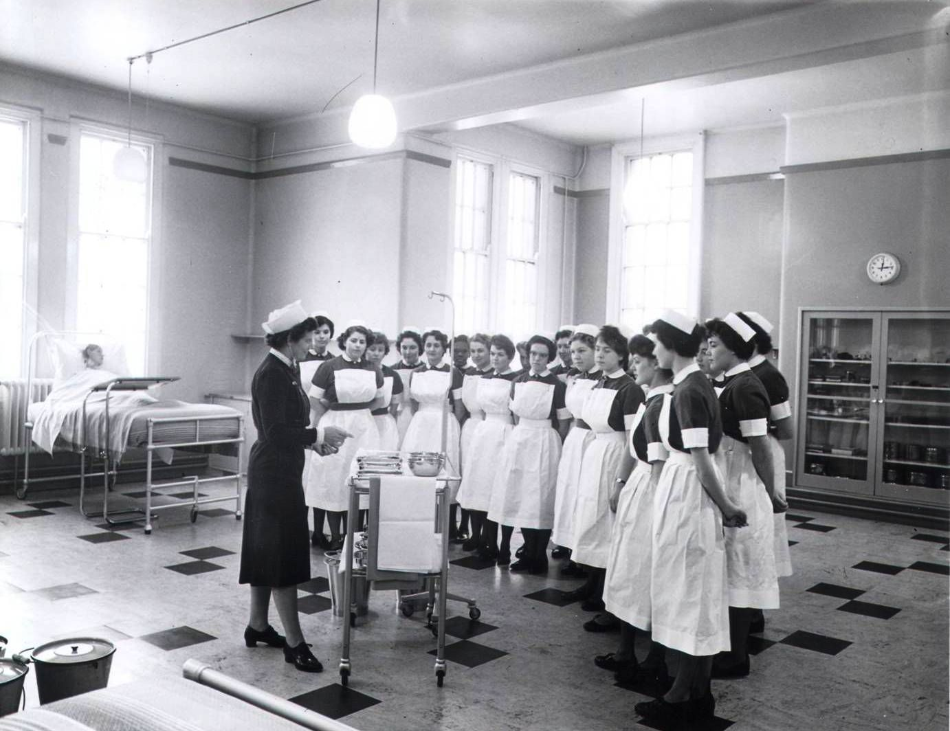
Retention: Keeping staff in the NHS
Focus on “Why They Stay”: Instead of just analysing why people leave, the NHS is encouraged to understand what makes staff stay, using a positive perspective to build effective solutions
Return to practice: The NHS actively supports professionals who have left to return, funding programmes that help them update their skills and reintegrate into the workforce..
Flexible Working: Promoting flexible working patterns and work life balance is key to accommodating staff with changing personal circumstances or caring responsibilities.
Health and Wellbeing: Programmes addressing burnout, stress and specific issue like the menopause help create a supportive culture that improves job satisfaction and reduces turnover.

Slide 15
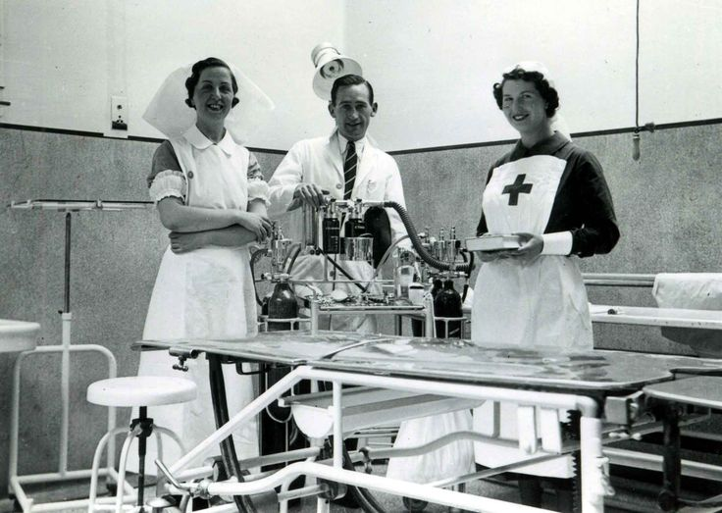
Succession Planning: Developing Future Leaders
Strategic Workforce Planning: This involves analysing the age profile of the workforce to predict where the biggest challenges will be and planning for future vacancies.
Talent Management: Implementing programmes to identify staff with high potential from all backgrounds to ensure they are ready for senior roles.
Legacy Mentoring: This involves pairing experienced late-career staff with new employees for coaching and support. This helps pass on valuable knowledge and skill and keeps experienced staff engaged.
Leadership Development: Expanding leadership programmes to include mid career staff and basing opportunities and skills and potential, not just linear career progression.

Slide 16

Conclusion
The NHS faces serious challenges including staff shortages, burnout, heavy workloads, and insufficient funding. Over the years, repeated restructuring and poor long-term planning have weakened its foundation. To overcome these issues, the NHS must focus on retaining skilled employees by improving working conditions, offering flexible hours, and genuinely valuing staff wellbeing. Strong leadership, smarter workforce planning, better use of technology, and increased government investment are essential to building a stronger, more sustainable NHS that continues to deliver fair, high-quality healthcare to every person in the UK, regardless of their background or income.

Slide 17
References
NHS Information and service NHS website for England – NHS
Commonwealth Fund (2020) England: International health care system profile. New York: Commonwealth Fund. Available at: https://www.commonwealthfund.org/international-health-policy-center/countries/england
P4H Network (2023) Universal health coverage in the United Kingdom. Available at: https://p4h.world/en/universal-health-coverage-in-the-united-kingdom/
Health Education England (2023) NHS long term workforce plan. London: NHS England. https://www.england.nhs.uk/long-read/nhs-long-term-workforce-plan-2/
Health Foundation Meeting the NHS workforce retention challenge. London: Health Foundation https://www.health.org.uk/
House of Commons Library The NHS workforce in England [Research Briefing CBP-9731]. London: House of Commons. https://commonslibrary.parliament.uk/research-briefings/cbp-9731/
Dunn, P., Allen, L., Buzelli, L., Ewbank, L. and Alderwick, H. (2025) 'NHS action on social and economic development in England: Vague national policy expectations', Health Policy, 151, p. NHS action on social and economic development in England: Vague national policy expectations – ScienceDirect
Freeguard, G. et al. (2025) 'NHS challenges 2025: Critical statistics reveal urgent need for change', The AI Journal, 24 April https://aijourn.com/nhs-challenges-2025/

Slide 18
Hunter, D.J. (2023) 'At breaking point or already broken? The National Health Service in the United Kingdom', New England Journal of Medicine, 388(5). https://www.nejm.org/doi/full/10.1056/NEJMp2301257
Khan, A. et al. (2023) 'The emerging challenges and strengths of the National Health Services: A physician perspective', https://claude.ai/chat/324ccd1c-27a2-4728-a3ca-7f9bfae7073f#:~:text=an%20external%20link%3A-,https%3A//pmc.ncbi.nlm.nih.gov/articles/PMC10240167/,-Cancel
Lowe, R. and Powell, M. (2024) 'Crisis in the UK National Health Service: What does it mean, and what are the consequences?', Social Policy & Administration, 58(1). https://doi.org/10.1111/spol.13001
King’s Fund(2025) Securing the NHS workforce for the future: recommendations for action. London: King’s Fund. https://www.kingsfund.org.uk/
The Heath Foundation. Meeting the NHS workforce retention challenge. https://www.health.org.uk/features-and-opinion/blogs/meeting-the-nhs-workforce-retention-challenge
Comprehensive modern history
Seaton, A. (2023) Our NHS: A history of Britain's best loved institution. New Haven and London: Yale University Press. ISBN: 9780300268270.
15. The most widely cited academic overview (most recommended)
Klein, R. and Powell, M. (2024) The new politics of the NHS: From creation to reinvention. 8th edn. London: Routledge. ISBN: 9781032793184.

Slide 19
Group Members
Chirag Kapadia | 2521160
Rachitkumar Kalpeshbhai Barot | 2531441
Nareshbhai Parmar | 2531864
Ravikumar Mukeshbhai Bhadiyadra | 2518462

