Slide 1


Slide 2

Foreign Languages & Cultural Awareness
German – Deutsch
BMIH5003
Lisa Bassler
International Hotel Management
l.bassler@uwtsd.ac.uk

Slide 3
As there are quite a few of us here, please ensure that your microphone is muted during all teaching until you are asked a question or there is a group discussion to prevent background noise.
You should attend every class and have a private space to work so that you can concentrate fully on the lesson.
You should not be at work, shopping, driving or caring for children.
Your camera must be always on during lectures please. -Use the Teams university background to protect your privacy.
YOU must join via a laptop or PC/MAC –No attendance permitted on phones or tablets
You will be removed from the session and logged as absent if you fail to adhere to these criteria.
This and all sessions will be recorded so that you can watch it again
Before we start
Notes:
Next week onwards there will be no excuse accepted……………………….

Slide 4
Why is this important?
-This is a Full Time University course and as such the University definitions of engagement and decorum apply as they would in a physical classroom.
-Your Cameras must remain ‘On’ for the duration of the session in order to ensure equal engagement and for your lecturers to observe your full attendance of the session which is a condition for student loans/maintenance to be authorised.
-You should be using a desktop or laptop device with a camera, speakers and a microphone so that you will be able to engage in the session on equal footing with your classmates.
-You will be asked to share your screen and “present” your work, access documents, engage in writing activities use websites and create presentations which are either difficult or impossible on a phone.

Slide 5
Recap
Last week gave an overview of…
Der Verkehr / the transport
Tickets / tickets
Neue Vokabeln und Grammatik / new vocabulary and grammar
Notes:
RECAP – the following.
This will be needed for the this lesson as purchases will be the last thing they do.

Slide 6

Dialogue and Exercise
A: Guten Morgen! Womit kann ich Ihnen behilflich sein?
B: Guten Morgen. Wir möchten bitte frühstücken.
A: Sehr gerne, hier ist die Frühstückskarte. Was möchten Sie essen?
B: Ich hätte gerne ein Brötchen mit Butter und Käse, und einen Kaffee.
A: Sehr gerne. Und Sie?
C: Ich hätte gerne ein Brot mit Wurst und einen Orangensaft.
A: Sehr gut, sonst noch etwas? (something more)
B: Nein, das ist alles. (that’s all)
A: Die Rechnung beträgt 20 Euro, bitte.
C: Bitteschön. Vielen Dank!
A: Danke!

Slide 7

German Transportation Vocabulary
bus | der Bus (Busse) | boos
subway | die U-Bahn (U-Bahnen) | oo-bahn
train | der Zug (Züge) | tsook
airplane | das Flugzeug (Flugzeuge) | flook-tsoyk
ship | das Schiff (Schiffe) | shiff
boat | das Boot (Boote) | boat
motorcycle | das Motorrad (Motorräder) | moh-toh-raht
automobile | das Auto (Autos) | ow-toh
streetcar | die Straßenbahn (Straßenbahnen) | shtrass-en-bahn
moped | das Moped (Mopeds) | mo-ped
bike | das Fahrrad (Fahrräder) | fah-raht
car | der Wagen (-) | vah-gen
on foot | zu Fuß | foos

Slide 8
Die Verkehrsmittel / The transport
We can use different verbs such as: gehen (to go/walk), fahren (to drive/ride), fliegen (to fly), etc.
Person Verb | Präposition | Transport | Ziel /Destination
Ich gehe| fahre | fliege
Du gehst | fährst | fliegst |  | Bus
Er / Sie / Es geht | fährt | fliegt |  | Zug
Wir (we) gehen | fahren | fliegen |  | Flugzeug
Ihr (you pl.) geht | fahrt | fliegt |  | Schiff
Sie (they pl.) gehen | fahren | fliegen |  | Boot
 |  | Fahrrad
 |  | Auto
 |  | zu Fuß (no preposition needed)
mit (dem)
nach…
Add the following to express your return:
zurück nach – back to
Beispiel / Example:
Ich fahre mit dem Auto zurück nach München.
Beispiel / Example:
Ich fahre mit dem Auto nach Berlin.
Du gehst zu Fuß nach Frankfurt.
Wir fliegen mit dem Flugzeug nach Benidorm.

Slide 9
Übung / Exercise:
Beispiel /Example:
1. Ich möchte gerne zwei Flugtickets nach Deutschland für den vierten August reservieren.
das Ticket (Tickets)
die Fahrkarte (Fahrkarten)
das Flugticket (Flugtickets)
das Zugticket (Zugtickets)
das Busticket (Bustickets)
Reserve 2 tickets by plane to Germany for the 4th August. (reservieren)
Reserve 4 tickets by train to Romania for the 3rd January. (reservieren)
Buy 1 ticket by bus to Berlin for tomorrow. (kaufen)
Buy 5 return tickets to Ghana by plane for today. (kaufen)
Reserve 8 tickets by ship to England for tomorrow. (reservieren)
Book 2 rooms at Hotel Berlin for the 9th July. (buchen)
Buy 2 tickets by train to London for today.
CREATE YOUR OWN SENTENCE.
reservieren (to reserve)
buchen (to book)
kaufen (to buy)
für (for)

Slide 10
Übersetzung / Translate:
Beispiel /Example:
1. Das Zugticket kostet drei Euro.
das Ticket (Tickets)
die Fahrkarte (Fahrkarten)
das Flugticket (Flugtickets)
das Zugticket (Zugtickets)
das Busticket (Bustickets)
The train ticket costs 3€.
The bus ticket costs 4€.
The breakfast costs 15€ per person.
The double room costs 60€ per night.
How much is the breakfast?
CREATE YOUR OWN SENTENCE.
kosten (to cost)
kostet (costs)
wie viel (how much)
pro Nacht (per night)
pro Person (per person)

Slide 11

German Lesson 8

Slide 12
German Cases
There are four cases in German: nominative (subject), accusative (direct object), dative (indirect object), and genitive (possessive).
These four German cases play distinct roles within the German language, and it is important that people learning German can use and understand them.
Understanding the cases is an essential factor when you are learning to speak German as they will determine the meaning of your sentences and inform your listening comprehension.
Moreover, they are essential for using and understanding written German. You cannot construct a German sentence without using the case system.

Slide 13
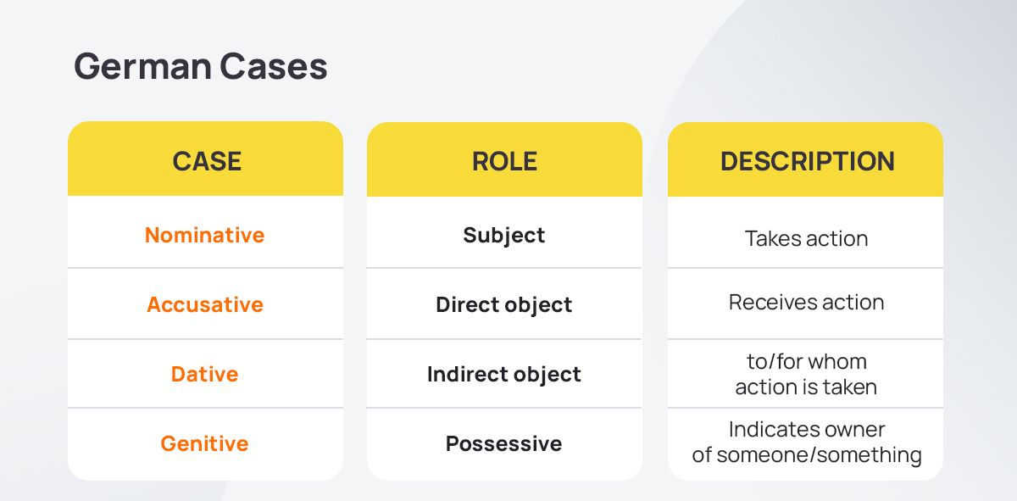
German Cases

Slide 14
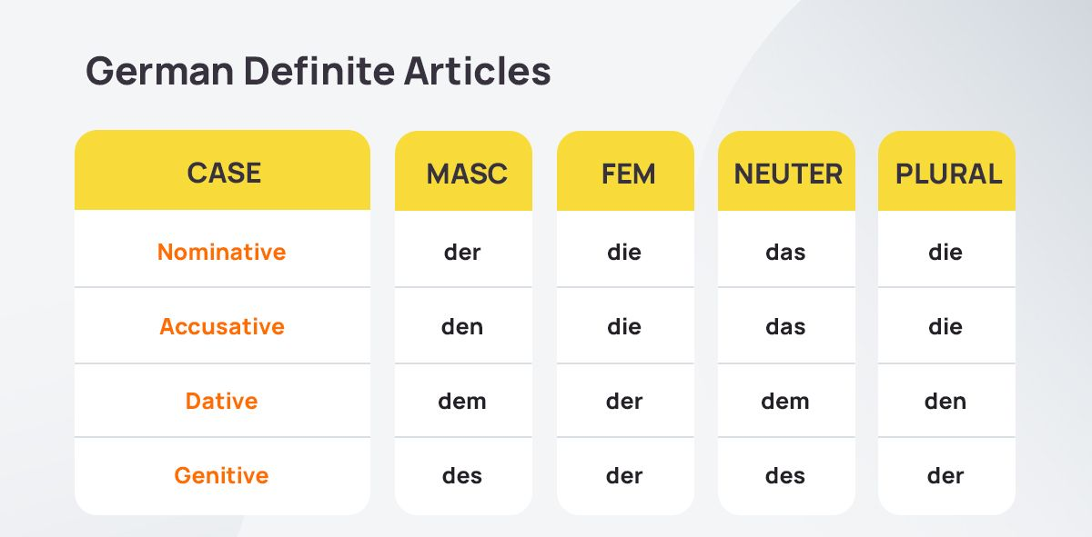
German Cases

Slide 15
Präpositionen / Prepositions
A preposition is a short word, or group of words, which links a noun phrase to the remainder of a sentence. More specifically, a preposition will typically describe a movement or direction, a location or position, or some other relationship between the object and the rest of the sentence.
There are a large number of prepositions and you use them all the time, often without noticing. For instance, some of the most common English prepositions include words like “at,” “on,” and “in”. By learning some of the most common German prepositions, you can improve your skills and better understand concepts like sentence structure.

Slide 16
Präpositionen / Prepositions
Prepositions are words that express the role played by the nouns in a sentence.
Beispiel / Example:
The cup is on the table/ She falls into the pool/ The baby is with his dad
Unfortunately, in German, they are a little complex due to the four German cases.
All prepositions belong to accusative, dative, and genitive cases, and some belong to both the accusative and dative cases.

Slide 17
Accusative Prepositions
The accusative case, or what is called the objective case in English, describes the direct object of a sentence (the thing the subject acts upon).
Common Accusative Prepositions:
Durch - Through
Ohne - Without
Gegen - Against
Für - For
Um - Around
So, when you use one of these prepositions, the noun's article must also be in the accusative case.
Beispiel / Example:
Ich gehe durch den Park - I walk through the park.
Wir fahren um einen Berg herum - We drive around a mountain.

Slide 18
Dative Prepositions
The dative case describes the indirect object of a sentence, which usually receives an action from the direct object (in the accusative case).
Common Dative Prepositions:
Aus - From/out of
Außer - Except for/ besides
Bei - At/ near/ with
Mit - With/by
Nach - After/ to
Seit - Since (time)/ for
Von - By/ from
Zu - At/ to
Beispiel / Example:
Sie kommt aus der Türkei - She comes from Turkey
Wir haben einen Brief von ihnen bekommen - We got a letter from them

Slide 19
Two-way Prepositions
Common Accusative or Dative Prepositions:
An - At/ alongside
Auf - On/ on top of
Hinter - Behind
In - In
Neben - Beside/ next to
Über - Over
Unter - Under
Vor - In front of
Zwischen - Between
When you use a verb of movement, such as gehen (to go) or laufen (to run), and the preposition refers to a destination, you must use the accusative case.
Beispiel / Example:
Wir gehen heute in die Schule - We are going to school today
When a static verb is used, like sein (to be) or arbeiten (to work) and the preposition refers to a location, you must use the dative case.
Beispiel / Example:
Ist es unter der Platte? - Is it under the plate?
Understanding this grammar rule will ensure you use the correct case with each of these two-way prepositions.

Slide 20
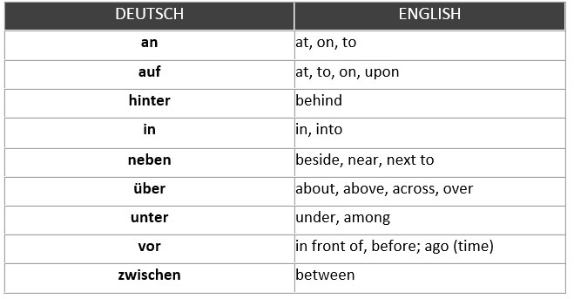
Präpositionen / Prepositions
ASK AND ANSWER:
Q. Wo ist die Polizeistation?
A. Die Polizeistation ist hinter der Universität.
Q. Wo ist die Bank?
A. Die Bank ist vor der Polizeistation.
Q. Wo ist das Krankenhaus?
A. Das Krankenhaus ist zwischen der Bank und dem Hotel.
Q. Wo ist das Hotel Berlin?
A. Das Hotel Berlin ist in der Parkstraße 12.

Slide 21
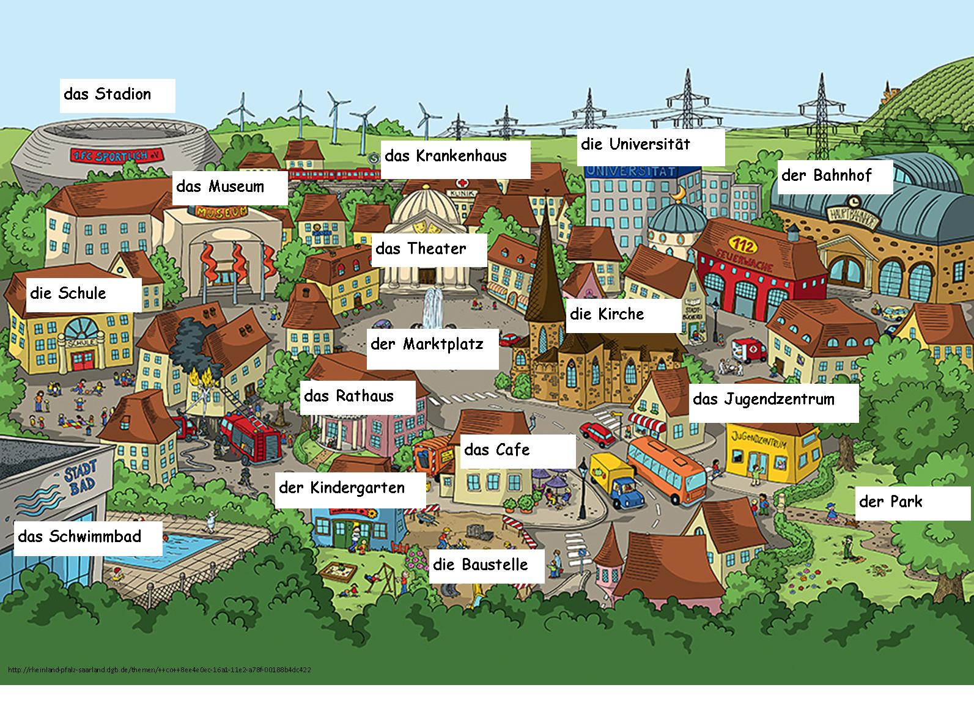
Wo ist das…? / Where is it?
Beispiel / Example:
A: Wo ist die Universität?
B: Die Universität ist neben dem Bahnhof.

Slide 22
RECAP
Through the medium of Mandarin, German, French or Spanish (or English for students from non-English speaking countries), develop basic language competency to communicate about the following:
  business entertaining – ordering food and drink; offering food and drink; prices and dealing with bills;
  in town – finding your way to a town; finding your way around town; reading tourist brochures about a town or area;
  on the telephone – making/dealing with calls; arranging meetings and appointments – days, dates, times;
  business and leisure travel – buying tickets and reservations for trains, planes, ferries; travelling by car;
  meeting guest needs within the hotel, – making and amending reservations; describing facilities; dealing with customer requests;
Notes:
Make them see how far they have come – even if its the basic they main goal of the languages is to
Communicate effectively in both written and spoken language within set hospitality, business and professional contexts;
Critically understand international consumer behaviour to enhance guest service delivery, through gaining a knowledge of global customs and culture.

Slide 23
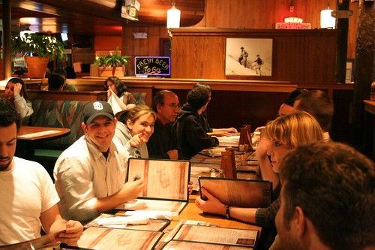
  1. Business entertaining – ordering food and drink; offering food and drink; prices and dealing with bills
TRANSLATE:
I would like to drink a beer.
I would like to eat a sandwich (das Butterbrot).
What would you like to eat?
What would you like to drink?
The bill (die Rechnung) please.
A table (einen Tisch) for two please!

Slide 24
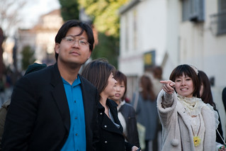
  2. In town – finding your way to a town; finding your way around town; reading tourist brochures about a town or area;
TRANSLATE:
Where is the hospital?
Where is the restaurant?
The hotel is on 12 Park Street.
The hotel is in front of the train station.
My university is behind the bank.

Slide 25
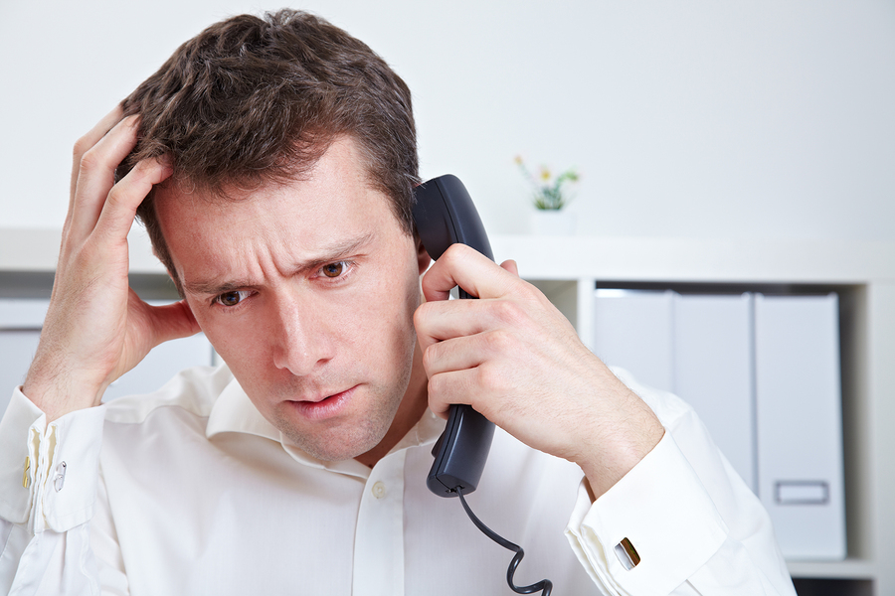
  3. On the telephone – making/dealing with calls; arranging meetings and appointments – days, dates, times;
TRANSLATE:
How can I help you?
I would like to book a room.
For how many people?
Where is the conference room? (der Konferenzraum)
The conference room is behind the restaurant.

Slide 26
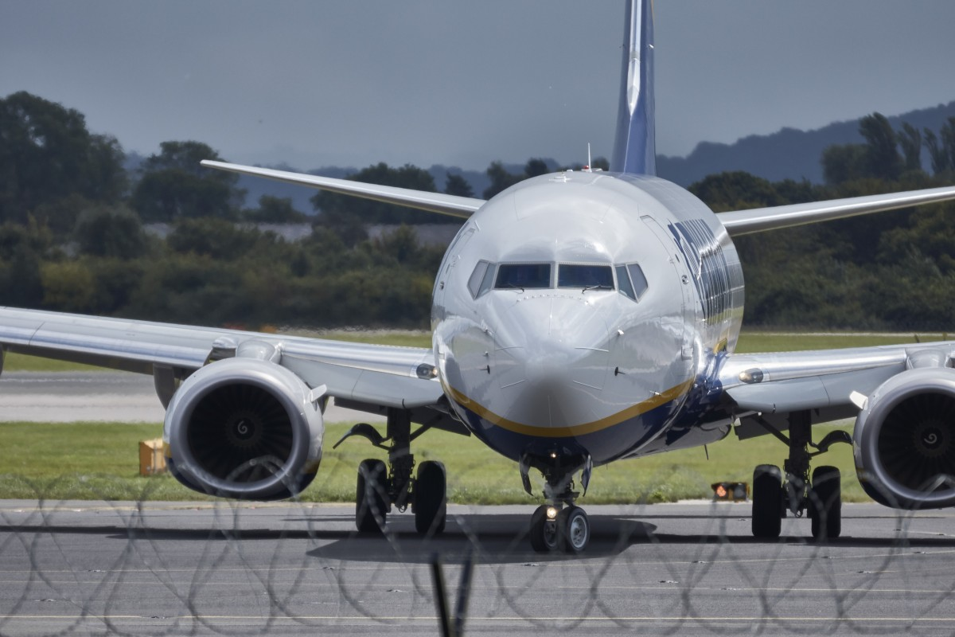
  4. Business and leisure travel – buying tickets and reservations for trains, planes, ferries; travelling by car;
TRANSLATE:
I would like to reserve a plane ticket to Germany.
For what date?
For how many people?
For the 3rd of July 2023.
How much is a bus ticket to Berlin?

Slide 27
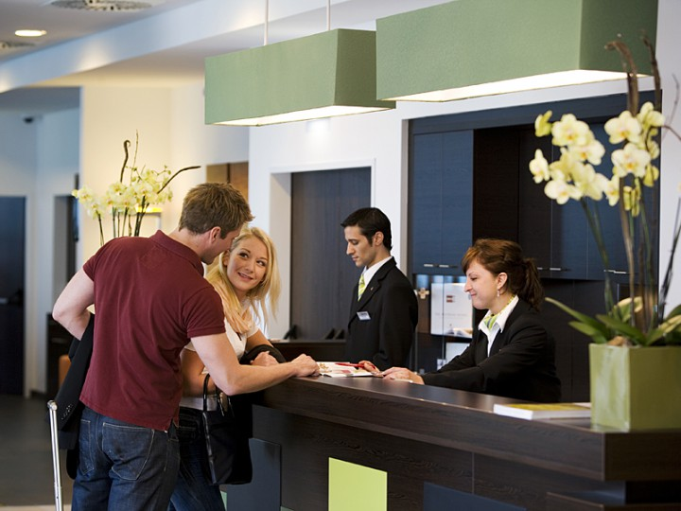
  5. Meeting guest needs within the hotel, – making and amending reservations; describing facilities; dealing with customer requests;
TRANSLATE:
Good morning! How may I help you?
Is there a swimming pool at the hotel?
When does the restaurant open?
At what time is breakfast?
What is my room number? (die Zimmernummer)

Slide 28

I hope you enjoyed and keep
studying German!!
Vielen Dank und auf Wiedersehen!
Notes:
Make them see how far they have come – even if its the basic they main goal of the languages is to
Communicate effectively in both written and spoken language within set hospitality, business and professional contexts;
Critically understand international consumer behaviour to enhance guest service delivery, through gaining a knowledge of global customs and culture.

Slide 29
I look forward to seeing you next week.
If you have any questions in the meantime, please send an email from your student account l.bassler@uwtsd.ac.uk

