Slide 1
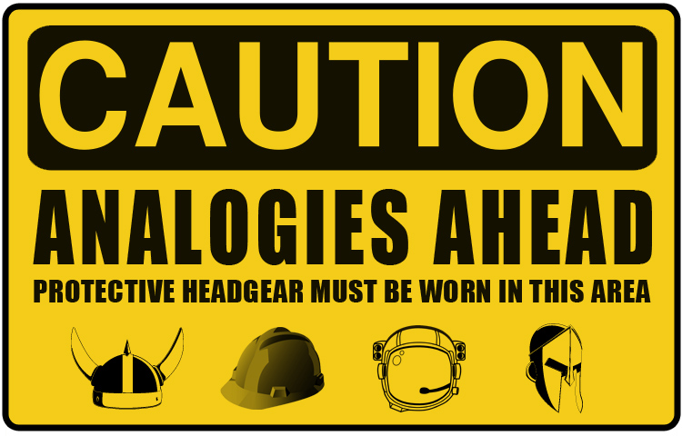
Analogy: using the present to understand the past?

Slide 2
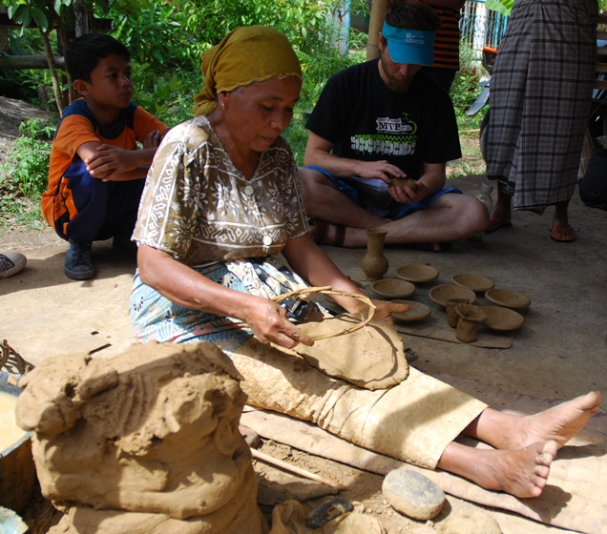
Ethno-archaeological premise -
Spending time in ‘field’ will
  Enrich understanding
  Enable inspiration (eureka moments?)
  Provide comparisons (direct analogy)
  Test validity (including limitations)
    (Issacs, 1966. Man the hunter conference, Chicago)
Notes:
But ethnoarchaeologists must be specially trained to do this. They would need to go into people’s worlds and measure them to try and find practice links to the past. Could, they asked, we see remnants of behaviour in the present that can help us understand remains from the past?

Slide 3
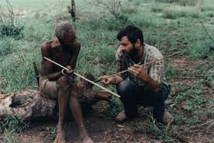
Ethno-arch 2
Ethnographic info can be used to indicate behaviour associated with
  Mobility
  Subsistence
  Settlements
And with this the mind/behaviours/ways of being can be made visible…
Notes:
We will look at various methods used that underpin this notion later in the course. Key to note here is that archaeologists think that quantitative data can be used to determine, repaint, the picture of human choices. Humans are thought to be one thing and that they will develop in one way, albeit with variations dependent on ecological conditions.

Slide 4
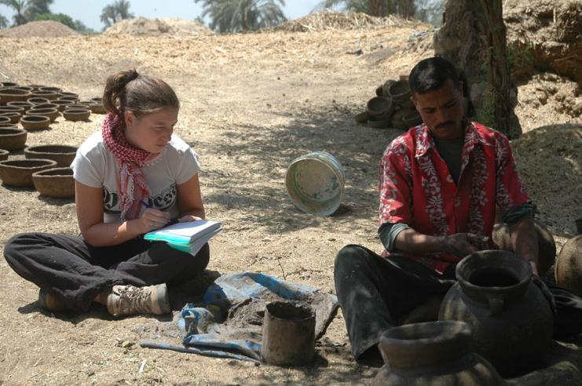
So, ethno-arch uses ethnographic method
with the aim of experiencing the past through present practices;
as a strategy to understand behaviours surrounding material culture in situ
So as to make analogies

Slide 5
Analogy – wot?
‘The transportation of information from one object to another on the basis of some realiton of comparability between them’ (Umeov 1970; Wylie 1980 cited by Hodder 1982: 16)
‘Analogy is a form of argument in which if two objects or events resemble one another in some features they are held to be likely to resemble each other in additional features’ (Barfield 1997: 156)
‘On a basic level, analogy is the relationship between two things which are similar in many ways, though not all respects’
(Beauchesne 2005: 24)

Slide 6
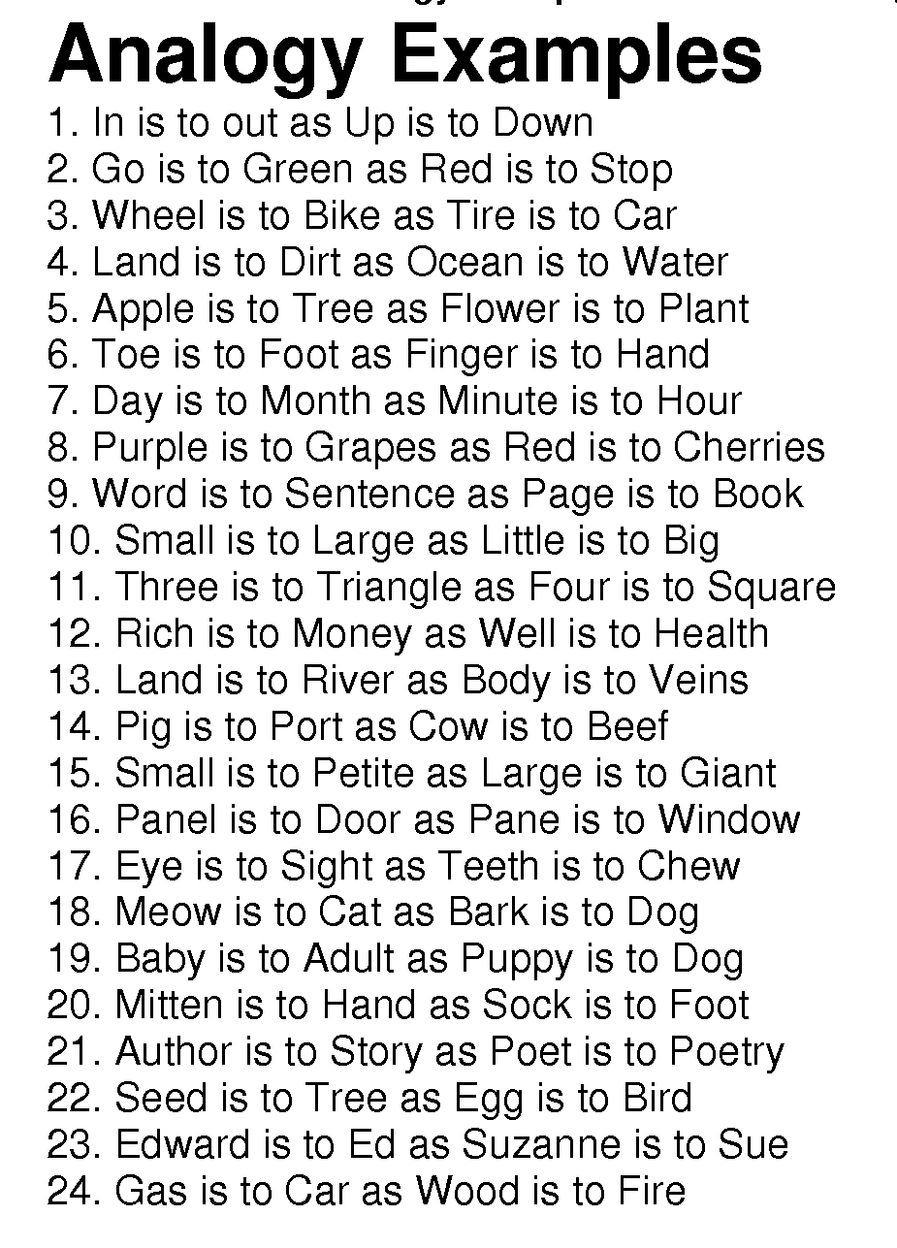
Resemblances and resonances
Similarities
Suggestions…
So as to make inferences

Slide 7
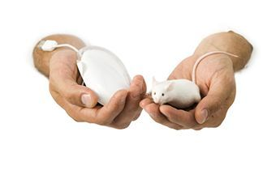
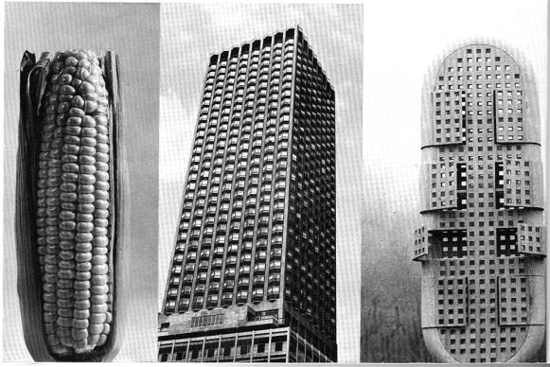
But how do we see similarity?
And can we see it because we are looking for it?

Slide 8
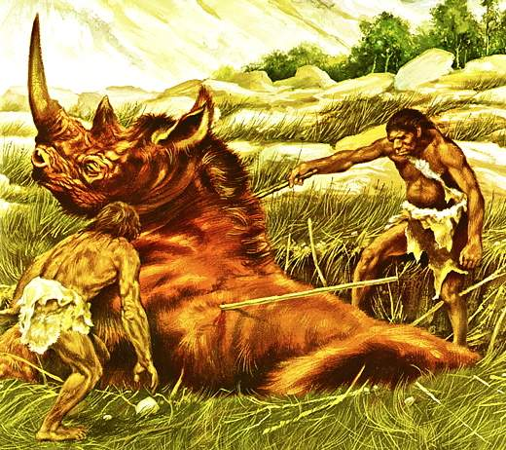
Representations
‘the iconography of this ‘race of progress’ fixes the skin colours and technologies associated with indigenous people at the prehistoric beginning of the ‘march’ and the skin colours and technologies associated with the west at the end...once such evolutionary reconstructions circulate they become entrenched as scientific documents: they authorise the use of ethnographic analogy, the primitive [sic] African proxy for the European past’ (Scott 2007: 52 – Rethinking Evolution in the Museum: envisioning African Origins Taylor and Francis)

Slide 9
The success of ethno-archaeology depends on epistemology.
Discuss.

Slide 10
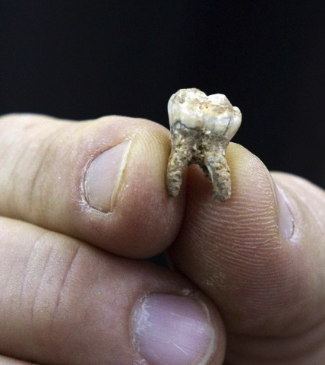
VBCD – very brief controlled digression
Can a footprint image the mind?
Can a pile of bones image the mind?
A tooth?
Walls?
Pots?
And so on…

Slide 11
Academics’ ideas about ethno-arch method and pursuit

Slide 12

Leach, 1973 (anthropologist)
Using ethnography is questionable
Too much cultural variation
Anthropology doesn’t use cultural practices to create laws of change so archaeologists shouldn’t – create theory not laws

Slide 13
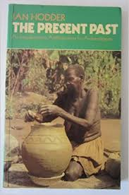
Hodder to combat criticisms offers distinctions between types of analogy
Formal
  If two objects have common properties they must have other similarities
  Hodder thinks this is weak
Relational
  ‘Seeks to determine some natural or cultural links between different aspects’ (1982:16)

Slide 14
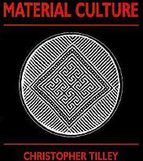
Tilley (archaeologist)
Concentrating on long- term use of stuff indicates transformations of social relations – and archaeology is in the business of understanding changes

Slide 15
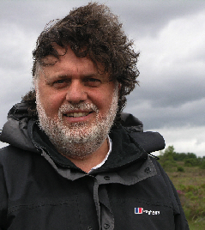
Tilley, 1996.
An ethnography of the Neolithic
Using analogies from the present is problematic because
  Interpreters are time-bounded
  Too positivistic
  Ethnoarchs always try and filter what they think is contemporary from traditional
But worth comes from ‘think[ing] through the evidence’ (p2, original emphasis) whilst using structural ideas
Notes:
Tilley thinks that material culture is the active principle here. Material culture, he says, is ‘active media’ page 3.

Slide 16
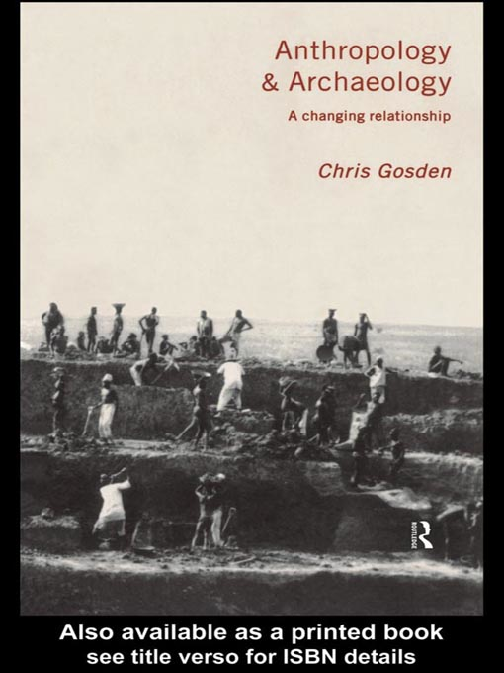
  Gosden, C. 1999. Anthropology and archaeology: a changing relationship. London: Routledge4
Using the present to populate the past may be immoral
  Societies should be studied in their own right
  ‘You can’t dig up a kinship system’ (p4)
Interpretation using the present only renders the past in the shape of today
Notes:
interpretation based on observation in the present could only render the past

Slide 17
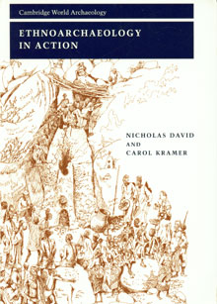
Nicolas and Kramer, 2001. Ethno-arch in action , CUP
Culture
  Exists because we make it
  It can be seen because of its effect.
  We experience the effects
  The structures and processes establish it
Ethno-arch activates material culture by seeing it ‘in action’
But behaviour is unpredictable, so no overarching theory possible to access pre-historical minds (e.g.: Binford’s camps)

Slide 18
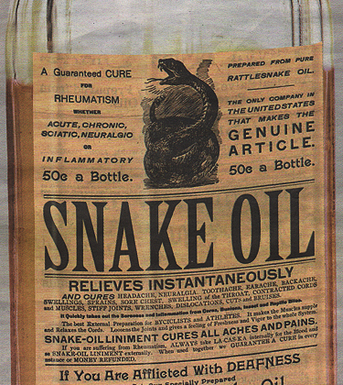
Sheehan’s response:
Refleshing the bones using ethnographic info is ‘seductive’ but problematic
Gives example of Great Plains Indians – horses/humans/buffalo (p165) – as example of bad direct analogy
2004 in Barnard, A (ed) Hunter gatherers in history, archaeology and anthropology
Notes:
Great Plains Indian example:
‘In an attempt to understand settlement and subsistence patterns, the horse was thought to represent a critical bridge between the human and the bison. ‘Therefore it was argued, prehistoric settlement of the Plains would have been impossible prior to the introduction of the horse because that bridge between consumer and resource was missing (Sterns 1918; Wissler 1914). In other words, indigenous Plains populations needed the horse to ensure adequate food supplies, in the form of bison, in the present; therefore they needed the horse in the past for the same reason. Needless to say, many scholars were shocked when archaeological sites, predating the horse and complete with bison bone, began popping up all over the Great Plains. Although this is but one example, it illustrates very clearly the pitfalls of using direct ethnographic analogy in archaeological interpretation’ (Sheehan, 2004: 165)

Slide 19
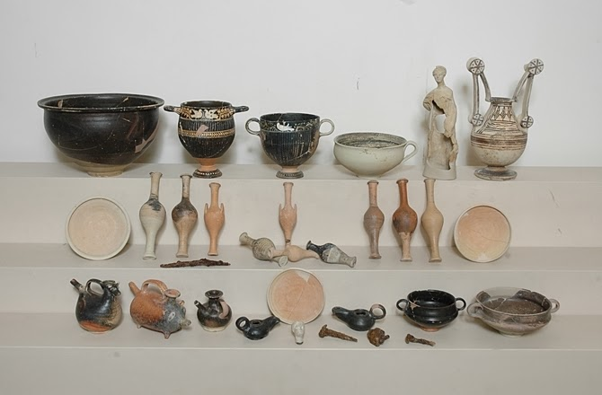
Another cautionary tale
Barker, 1981 Landscape and Society in Prehistoric Central Italy identified ‘big men’ in Italy because of grave goods...but PNG burials don’t show grave goods

Slide 20
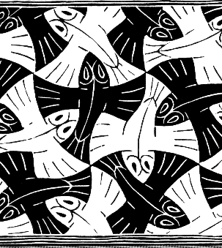
Anth approach
Meaning cannot be attributed if life is cut into bits (Ingold)
Abstracted things have no meaning; meaning is relational; to abstract is to do violence (Strathern)
= relations and webbed-ness can indicate transformations

Slide 21
So, is there worth in archaeology using anthropology’s method?

Slide 22
‘archaeology is anthropology, or it is nothing’
(Willey and Phillips, 1958:2)

Slide 23
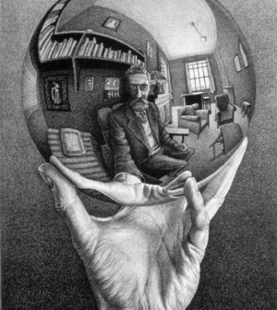
Ingold, T. 1992. ‘Editorial’, Man 27: 693–6
Social/cultural anthropology… and archaeology ‘form… a necessary unity’ (Ingold 1992: 694).
‘Thus anthropology needs archaeology if it is to substantiate its claim to be a genuinely historical science’ (Ibid).

Slide 24
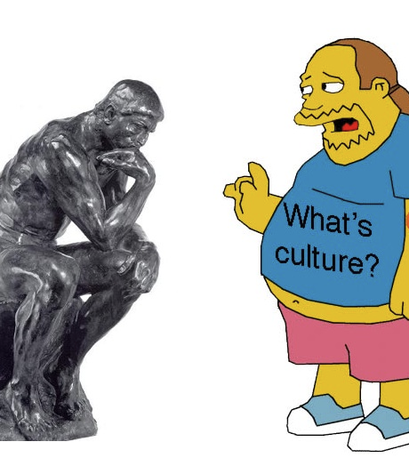
So, ethnoarchaeology’s worth has been debated for the last 60 years – and as all knowledge is situated the debate will go on

