Slide 1

Life course approach
Menna Davies (2224913)
BMNS4014

Slide 2
Introduction
Focus on the life course approach to health
Health is shaped across the lifespan (infancy → older age)
Influenced by multiple factors, not just one
Key factors: biological, psychological, social, environmental
These factors impact overall health and wellbeing

Slide 3
What is a life course approach?
Health is shaped over a lifetime
Early life experiences affect long term health
Life transitions and events influence wellbeing
Supports prevention and intervention
(EBSCO, 2026)

Slide 4
“A life course approach considers the critical stages and transitions”
(Public Health England, 2019).

Slide 5

Health across different life stages
Infancy
Childhood
Adolescence
Adulthood
Older age
“A life course approach recognizes how health trajectories are shaped over time by genetic, biological, psychosocial and environmental factors”
(World Health Organization, 2025)

Slide 6
Key factors affecting health
Biological factors
Psychological factors
Social factors
Environmental factors

Slide 7

Biological factors
Genetics (Viencelli, C., Edward, C.Y., 2022)
Age (Jazwinski, S.M. Kim, S. 2017)
Gender (D’Archivo et al,. 2024)
Physical health conditions
Body structure and Metabolism

Slide 8

Phycological factors
Mental health
Emotions
Behaviour & Lifestyle Factors (Cambridge Core, 2019).
Coping Skills (Taylor, S,E,. Stanton, A, L,. 2007)
Self esteem and attitude

Slide 9

Social factors
Family & Relationships (Holt-Lustad, J,. et al 2010)
Social support systems
Education level
Culture and traditions
Income and socioeconomic status (Galea, S,. 2011)

Slide 10

Environmental factors
Living conditions
Access to healthcare
Pollution (World Health Organisation, 2021.)
Work environment
Climate and geography of living area

Slide 11
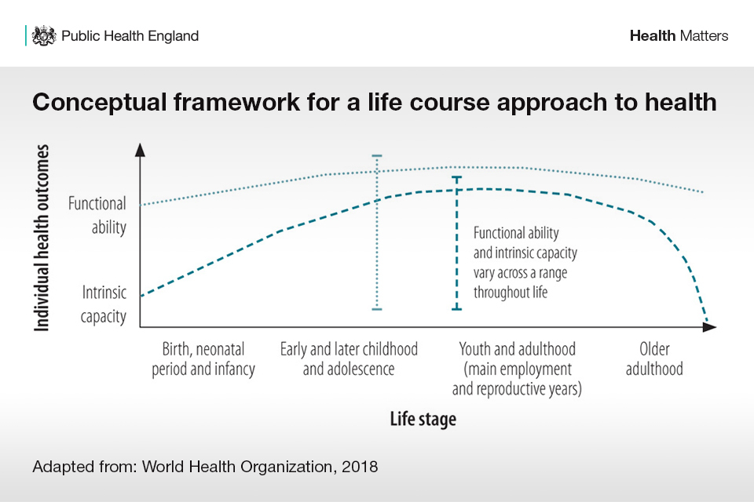
(Public Health England, 2019)

Slide 12
Prevention and healthy behaviours
(World Health Organisation)
(World Health Organisation)
(World Health Organisation)
Promoting healthy lifestyles
Social economic factors affect well being
Polices play a role in improving health
Access to healthcare services
Physical activity to prevent chronic diseases
Mental health awareness
Reducing harmful habits
Balanced Nutrition
Education
Community support
(World Health Organization, 2023.)

Slide 13
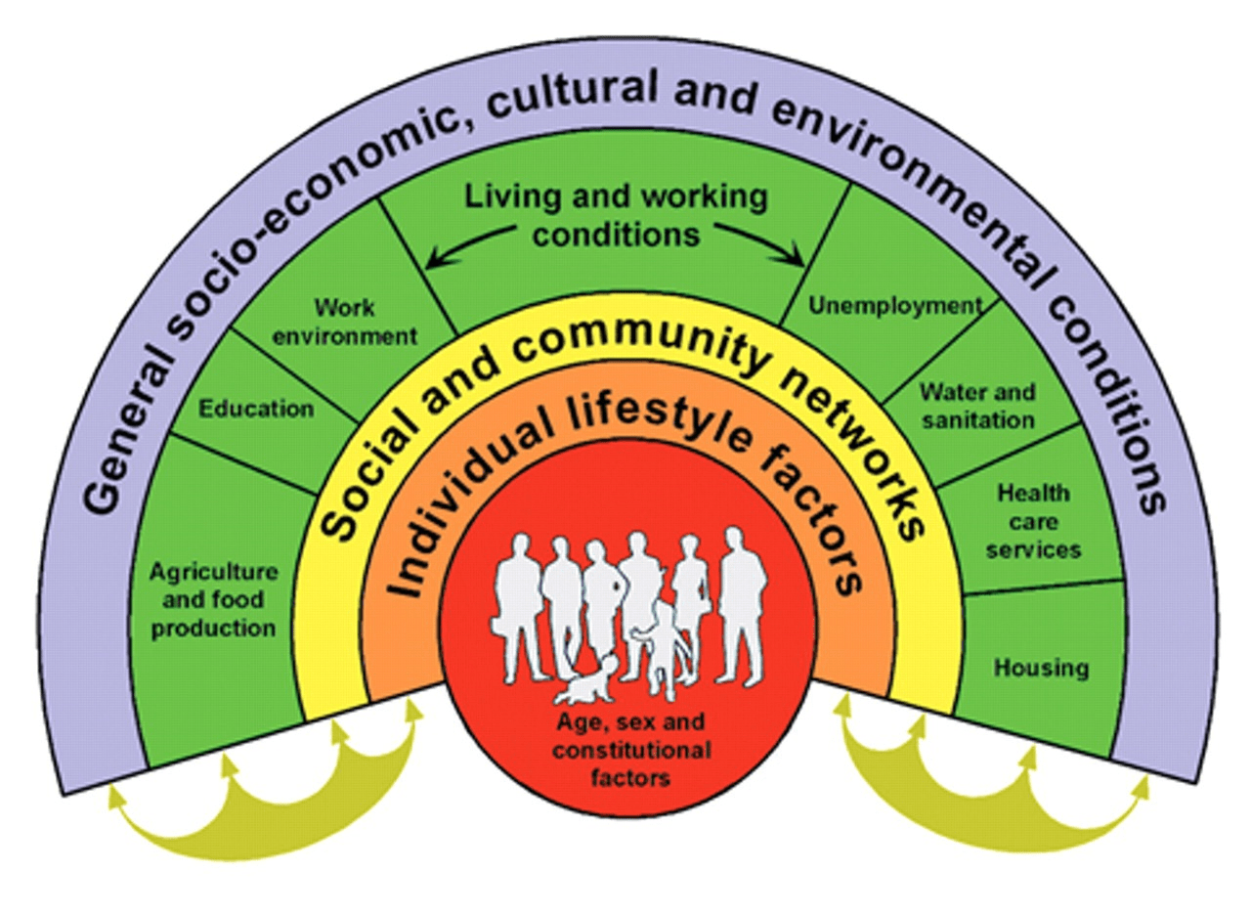
Determents of health and the life course approach

Slide 14
Conclusion
Health is influenced by a combination of factors over time
Includes biological, psychological, social, and environmental influences
Life course approach highlights long-term impact on health
Promoting healthy behaviours improves outcomes
Support at every life stage reduces disease risk

Slide 15
Reference list
D’Archivio, M., Coppola, L., Masella, R., Tammaro, A. and La Rocca, C. (2024). Sex and Gender Differences on the Impact of Metabolism-Disrupting Chemicals on Obesity: A Systematic Review. Nutrients,16(2), p.181. doi: https://doi.org/10.3390/nu16020181 (Accessed 19 March 2026).
Galea, S., Tracy, M., Hoggatt, K.J., DiMaggio, C. and Karpati, A. (2011). Estimated Deaths Attributable to Social Factors in the United States. American Journal of Public Health, 101(8), pp.1456–1465. doi: https://doi.org/10.2105/ajph.2010.300086 (Accessed 19 March 2026).
Holt-Lunstad, J., Smith, T.B. and Layton, J.B. (2010). Social Relationships and Mortality Risk: a Meta-analytic Review. PLoS Medicine, 7(7). doi: https://doi.org/10.1371/journal.pmed.1000316 (Accessed 19 March 2026).
Jazwinski, S.M. and Kim, S. (2017). Metabolic and Genetic Markers of Biological Age. Frontiers in Genetics, 8. doi: https://doi.org/10.3389/fgene.2017.00064
Psychological Aspects of Health and Illness. (2019). Cambridge Core, [online] pp.3–172. Available at: https://www.cambridge.org/core/books/abs/cambridge-handbook-of-psychology-health-and-medicine/psychological-aspects-of-health-and-illness/14E5D75DB33A6CE1F4BC0DB4D4897D22?utm (Accessed 19 March 2026).
Public Health England (2019a). Health matters: Prevention - a Life Course Approach. GOV.UK. Available at: https://www.gov.uk/government/publications/health-matters-life-course-approach-to-prevention/health-matters-prevention-a-life-course-approach. (Accessed 19 March 2026).
Public Health England (2019b). Health matters: Prevention - a Life Course Approach. GOV.UK. Available at: https://www.gov.uk/government/publications/health-matters-life-course-approach-to-prevention/health-matters-prevention-a-life-course-approach. (Accessed 19 March 2026).
Rashbrook, E. (2019). Health Matters: Prevention - A Life Course Approach - UK Health Security Agency. ukhsa.blog.gov.uk. Available at: https://ukhsa.blog.gov.uk/2019/05/23/health-matters-prevention-a-life-course-approach/. (Accessed 19 March 2026).
Taylor, S.E. and Stanton, A.L. (2007). Coping Resources, Coping Processes, and Mental Health. Annual Review of Clinical Psychology, 3(1), pp.377–401. doi: https://doi.org/10.1146/annurev.clinpsy.3.022806.091520 (Accessed 19 March 2026)
Ungvarsky, J. (2024). Life course approach | EBSCO. EBSCO Information Services, Inc. | www.ebsco.com. Available at: https://www.ebsco.com/research-starters/social-sciences-and-humanities/life-course-approach (Accessed 19 March 2026).
Viecelli, C. and Ewald, C.Y. (2022). The non-modifiable factors age, gender, and genetics influence resistance exercise. Frontiers in Aging, 3. doi: https://doi.org/10.3389/fragi.2022.1005848 (Accessed 19 March 2026).
Who.int. (2025). MCA: Policy & strategy. [online] Available at: https://www.who.int/teams/maternal-newborn-child-adolescent-health-and-ageing/life-course. (Accessed 19 March 2026).
World Health Organisation (2023). Our work: life course. www.who.int. Available at: https://www.who.int/our-work/life-course (Accessed 19 March 2026).
World Health Organization (2021). WHO global air quality guidelines: particulate matter (‎PM2.5 and PM10)‎, ozone, nitrogen dioxide, sulfur dioxide and carbon monoxide www.who.int. Available at: https://www.who.int/publications/i/item/9789240034228 (Accessed 19 March 2026).

