Slide 1
THE ROLE OF A SUPPORT WORKER
Presentation by Christiana Olagundoye

Slide 2
INTRODUCTION
A support worker is an individual who looks after the well being of people in their daily living and can be gainfully work across a variety of settings including people`s homes, also in health and social care setting such as supported living homes, care homes, and in the community.
Lifeways (2021)

Slide 3
Objectives
The role of a support worker
Working Sector
Types of service users
Training and Qualification
Communication
Conclusion
Reference

Slide 4
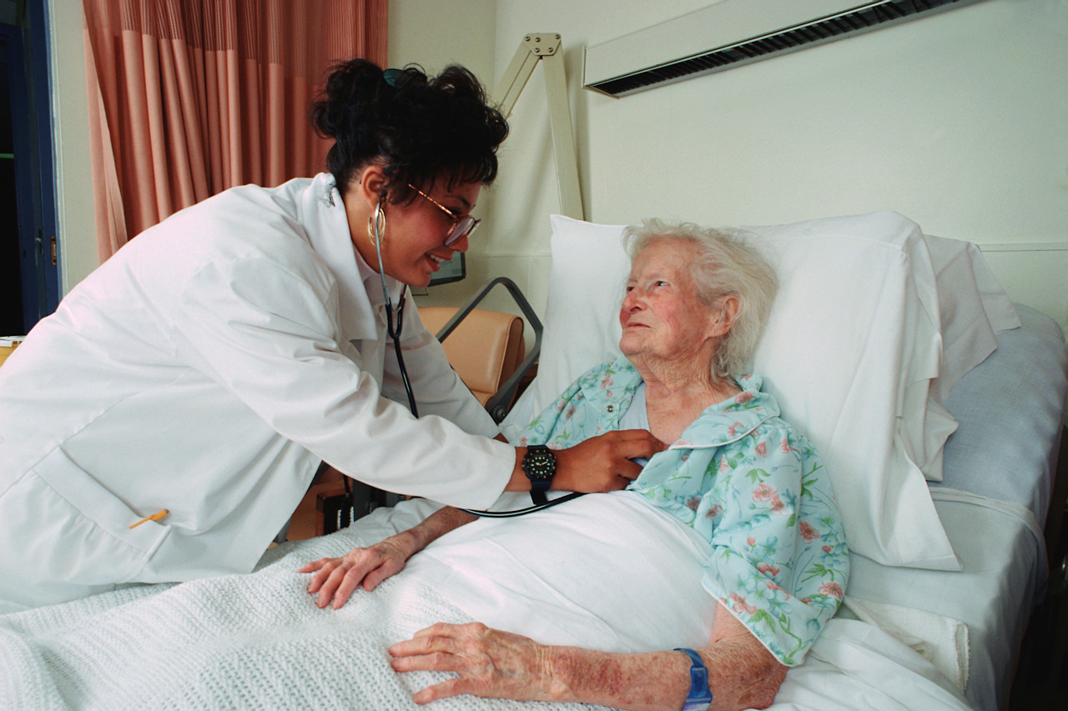
ROLES AND RESPONSIBILITIES
Providing physical support
Providing emotional support
Teaching life skills , such as shopping and paying bills
Encouraging and supporting the development of personal skills
( Lifeway. 2021)
This Photo by Unknown Author is licensed under CC BY-NC-ND

Slide 5
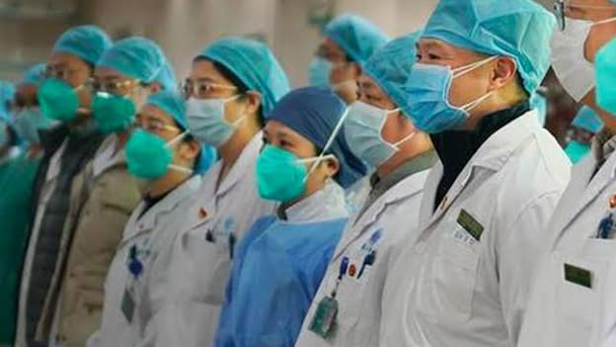
WORKING SECTOR
Community
Hospital
Schools
Residential Homes
People`s home

Slide 6

TYPES OF SERVICE USERS
+Adult
Children
Elderly

Slide 7

TRAINING AND QUALIFICATION
Relative training and qualification in health and social care
Level 2 qualification in health and social care
Employers plan training
Good literacy and numeracy is essential
Neville (2009)

Slide 8
COMMUNICATION
Must be effective
Open, accurate and understandable
Build relationship and enable service user to have a choice
Speed and sequence of speech
The Care certificate workbook standard. (2021)
Scie (2020)

Slide 9
CONCLUSION
Excellence means sustaining good quality practice not just providing something innovative` as one off`
Aim to achieve high standard of care by acquiring more knowledge to show competence .

Slide 10
References
The care certificate workbook standard (2021)
Stella Cottrell , Study skill book (2008)
Scie , 2020.
Neville

