Slide 1

BloomWell ✦
Women's Wellbeing and Fitness Community Platform
Sahyra Khan | Student ID: 2237641
BSc (Hons) Applied Computing | IICL, UWTSD Birmingham
Supervised by: MD Shantanu Islam | Final Viva | 2026
Prifysgol Cymru | University of Wales | Trinity Saint David | UWTSD Birmingham
Notes:
Good afternoon, my name is Sahyra Khan, and today I will be presenting my final year project, BloomWell.
This project focuses on using technology to improve access to fitness and wellbeing in a way that is more inclusive and user-focused.

Slide 2
01
Introduction & Problem Statement
06
User Roles & Features
BloomWell
Agenda
02
Literature Review & Research Gap
07
Testing & Results
03
Aims & Objectives
08
Gantt Chart
04
Methodology & Technology Stack
09
Conclusion & Future Work
05
System Architecture
10
References
Final Viva Presentation
ACCA6020 Independent Project
2026
Notes:
This slide gives a quick overview of how my presentation will flow.
I will start by setting the context, looking at the problem and the research behind it.
Then I will move on to how I designed and built the system, including the technologies and overall structure.
After that, I will highlight the main features and how the platform performs.
Finally, I will bring everything together by discussing the results and future direction of the project..

Slide 3
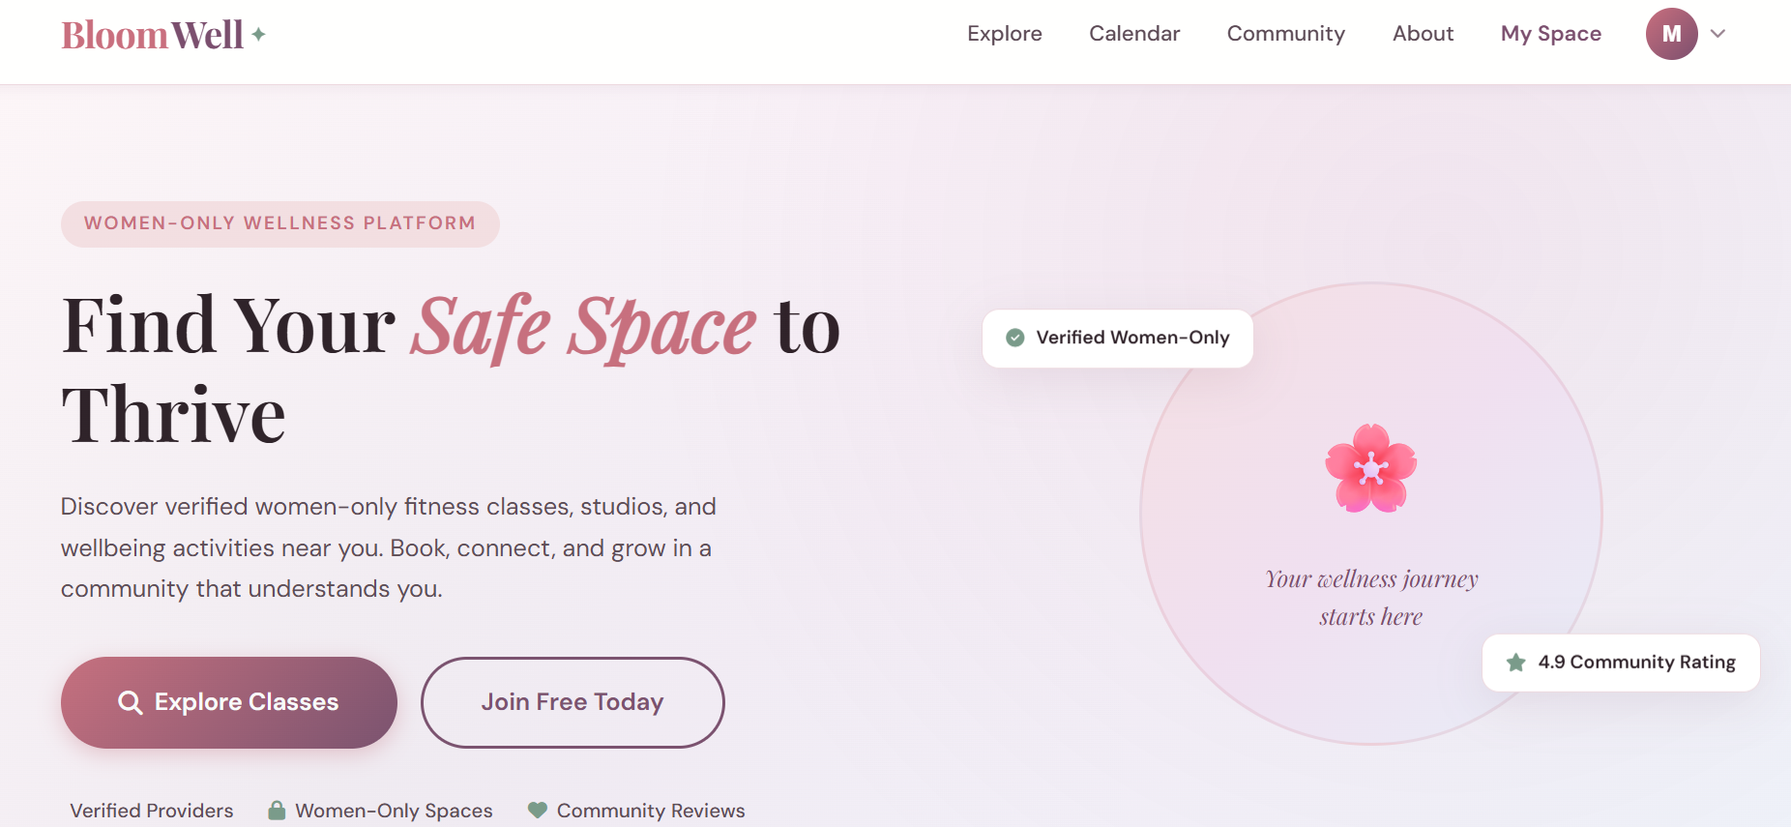


Introduction & Problem Statement
The Problem
The Solution: BloomWell
Women face significant barriers accessing safe fitness & wellbeing activities [1].
BloomWell is a centralised, women-focused digital platform connecting women to safe, inclusive, and verified fitness and wellbeing opportunities.
Limited women-only options and safety concerns in mixed environments [2].
Cultural and family responsibilities restrict participation [3].
Mainstream fitness apps target general audiences — women's specific needs are not addressed [4].
No centralised platform combines safety, trust, and women-focused class discovery in one place.
BloomWell ✦ Sahyra Khan | 2237641 | BSc (Hons) Applied Computing | UWTSD Birmingham | 2026
Notes:
This highlights that the challenge is not just access to fitness, but whether women feel comfortable and supported in those spaces. Many existing platforms overlook these needs, focusing on general users rather than specific experiences. BloomWell responds to this by creating a platform designed entirely around women, bringing together safety, inclusivity, and trusted opportunities in one place.

Slide 4
Literature Review & Research Gap
Academic research and the identified gap
Academic Research
Related Work
Research Gap
Women experience a greater long-term health burden — physical activity is one of the most effective interventions [1].
Mainstream platforms (Mindbody, ClassPass) target general audiences — no women-specific focus [6].
No centralised system combines safety verification, community trust, and women-focused discovery.
Digital platforms significantly improve access when designed inclusively for diverse communities [2].
NHS and community providers still rely on manual, paper-based booking systems.
Gap identified: culturally sensitive, inclusive, local wellness platform for women.
Users are more likely to engage with a platform when it is easy to use, reliable, and actually useful to them.[3].
No existing platform combines safety verification, community trust, and local class discovery [7].
BloomWell fills this gap — operating at the individual level.
Inclusive design is critical for community-based systems serving users with diverse backgrounds [5].
Existing apps lack culturally sensitive access features for diverse women's communities [8,9].
Connecting specific women to specific verified providers based on safety, location, and preference.
BloomWell ✦ Sahyra Khan | 2237641 | BSc (Hons) Applied Computing | UWTSD Birmingham | 2026
Notes:
This slide shows how research informed the project. Evidence from Sport England and the World Health Organization shows that women have lower participation in physical activity, often due to barriers such as safety and inclusivity. Studies also highlight that trust and user-focused design are key to engagement in digital platforms. Platforms such as Mindbody, ClassPass, Gympass, and WellnessLiving are built for general fitness users, offering booking and membership services across a wide range of activities, rather than focusing on women-specific needs.This creates a clear gap, which BloomWell addresses by offering a more inclusive and tailored solution.

Slide 5
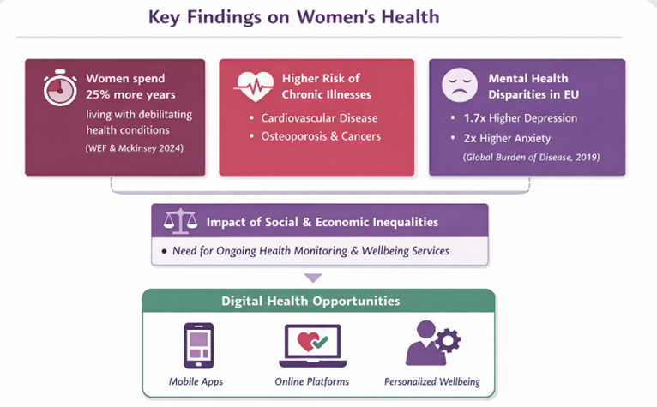

Slide 6
Aims & Objectives
AIM
To design and develop a centralised digital platform that helps women easily discover and access local women-only fitness and wellbeing opportunities, while promoting safety, inclusivity, and regular participation in physical and mental wellness activities.
01
02
03
04
05
Research &
Requirements
Design &
Build
Core
Features
Evaluate
& Test
Agile
Development
Investigate social, functional, and technical requirements through literature review.
Develop a full-stack web app with registration, booking, and role-based dashboards.
Build secure booking, women-only verification, RBAC, notifications, and analytics.
Measure success through feature delivery, usability testing, and user feedback.
Use Agile methodology to iteratively design, develop, and refine the system.
BloomWell ✦ Sahyra Khan | 2237641 | BSc (Hons) Applied Computing | UWTSD Birmingham | 2026
Notes:
The goal of this project is to build a platform that makes it easier for women to discover and take part in local fitness and wellbeing activities in a safe and supportive environment.
To achieve this, I focused on five key objectives that guided the design and development of the system..
All five objectives were successfully completed.

Slide 7
Methodology & Technology Stack
Agile iterative development with continuous testing
Agile Methodology
Technology Stack
Short iterative sprints: implement → test → refine [10].
Backend
Python · Flask · Flask-Login · Flask-WTF [12].
Each feature tested immediately after implementation.
Database
SQLite · Flask-SQL · Flask-Migrate
Defects resolved before moving to the next sprint.
Frontend
HTML · CSS · JavaScript · Jinja2
Flexibility to adapt features as user needs emerged.
Platform kept aligned with original research objectives throughout [11].
Security
Werkzeug hashing · CSRF protection · Session mgmt
Plan
Build
Test
Review
Other
Pillow · qrcode · email-validator · Flask-Mail
→
→
→
BloomWell ✦ Sahyra Khan | 2237641 | BSc (Hons) Applied Computing | UWTSD Birmingham | 2026
Notes:
I used Agile methodology throughout the project, working in short development cycles.
This allowed me to plan, build, test, and refine the system continuously.
For the technology stack, I used Python and Flask for the backend, and SQLite for the database.
For the frontend, I used Jinja2 templating, Bootstrap for responsive design, and CSS and JavaScript for styling and interaction.
I also used Flask Login for authentication and Werkzeug for secure password hashing.
These technologies were chosen because they are efficient, lightweight, and suitable for a full stack application.

Slide 8
System Architecture
Three-layer web application structure
USER
▼
PRESENTATION LAYER
HTML · CSS · JavaScript · Jinja2 Templates [13].
Role-based dashboards · Responsive UI · Flash messages
▼
APPLICATION LAYER
Flask Backend · Routing · Authentication · Business Logic
Flask-Login · Flask-WTF (CSRF) · Role-based access control · Session management [14].
▼
DATA LAYER
SQLite Database · Flask-SQLAlchemy ORM
Users · Classes · Bookings · Reviews · Notifications · Messages [15].
BloomWell ✦ Sahyra Khan | 2237641 | BSc (Hons) Applied Computing | UWTSD Birmingham | 2026
Notes:
The system follows a three-tier architecture.
The first layer is the presentation layer, which is the user interface.
The second layer is the application layer, which handles business logic and system functionality.
The third layer is the data layer, which stores all platform data in the database.
This structure ensures that the system is organised, secure, and easy to maintain.

Slide 9
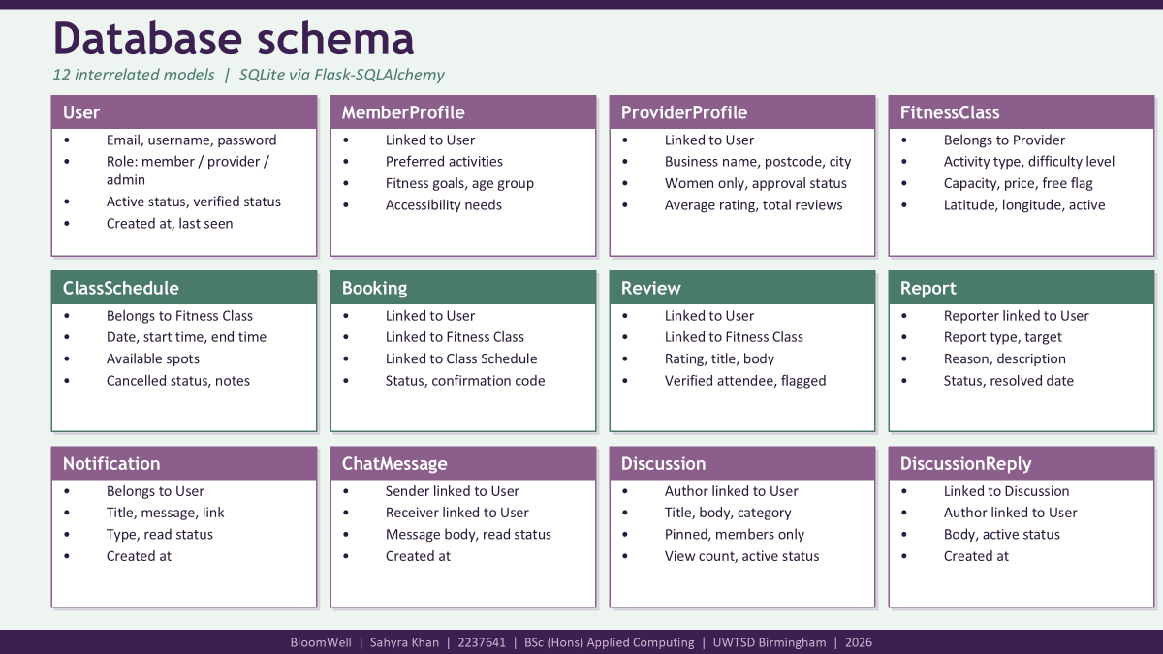
Notes:
This slide shows the database structure of BloomWell. It includes twelve connected models that manage all platform data. The user model handles login and roles, while profiles store role-specific details. Other models manage classes, bookings, reviews, and communication features. Together, they are all linked, allowing the system to function as one complete platform.

Slide 10
User Roles & Features
Three distinct interfaces with role-based access control
Member
Provider
Admin
Class discovery, booking & community
Studio management & analytics
Platform moderation & oversight
Register and create a wellness profile
Register studio and await admin approval
Approve and verify provider profiles
Search & filter classes by type, location, price
Create and manage class listings
Manage all users and roles
Book classes — get unique confirmation codes
Set schedules, pricing, and capacity
Moderate community discussions
Cancel bookings and join waitlists
View and manage member bookings
Handle flagged content and reports
Leave reviews and star ratings
Respond to member reviews
View platform-wide analytics
Join community discussions and forums
View earnings and payout settings
Manage reviews and ratings
Receive real-time notifications
Access analytics dashboard
Monitor booking activity
Save favourite classes
Manage waitlists
Send platform notifications
Track sessions and wellness goals
Chat with members
BloomWell ✦ Sahyra Khan | 2237641 | BSc (Hons) Applied Computing | UWTSD Birmingham | 2026
Notes:
There are three main user roles in the platform: members, providers, and administrators.
Members can search for classes, make bookings, leave reviews, and participate in discussions.
Providers can create and manage classes, view bookings, and monitor performance.
Administrators manage users, approve providers, and oversee the entire platform.
Access to features is controlled using role-based access control, ensuring that users can only access what they are authorised to use.

Slide 11
Testing & Results
Continuous testing throughout the Agile lifecycle [16].
Functional Testing
Security Testing
All 3 roles tested: registration, login, booking, cancellation, reviews.
Unauthorised URL access blocked by role-based access control.
Admin moderation: approve/suspend users, flag content — verified.
CSRF protection verified on all forms via Flask-WTF.
Community forum: create, reply, pin, report tested end-to-end.
Password hashing confirmed — no plain text stored in database.
Notifications: delivery, read/unread tracking, action links verified.
Members cannot access provider or admin routes — verified.
Edge Case Testing
Key Results
Booking full classes — waitlist triggers correctly.
All 5 objectives successfully delivered and verified.
Cancellation of already-cancelled bookings handled gracefully.
Platform fully functional across all 3 user roles.
Invalid form inputs caught and validated by WTForms.
Research findings translated into working technical features.
Empty search results show appropriate empty-state messages.
Secure, accessible, and community-ready platform achieved.
"The results demonstrate that the research findings were successfully translated into technical features."
BloomWell ✦ Sahyra Khan | 2237641 | BSc (Hons) Applied Computing | UWTSD Birmingham | 2026
Notes:
This slide summarises the testing carried out and the results. Functional testing ensured all features worked correctly across user roles, while security testing confirmed access control and data protection. Edge case testing checked how the system handled unusual situations to ensure stability. Overall, the results show that the platform is reliable, secure, and successfully meets all project objectives.

Slide 12
Gantt Chart
Agile development timeline · Oct 2025 – Mar 2026
Oct
Nov
Dec
Jan
Feb
Mar
Planning & Literature Review
100%
Requirements Analysis
100%
System Design
100%
Core Features (Auth, Roles)
100%
Booking & Class System
100%
Community & Notifications
100%
Admin & Analytics
100%
Testing & Evaluation
100%
Report & Submission
100%
BloomWell | Sahyra Khan | 2237641 | BSc (Hons) Applied Computing | UWTSD Birmingham | 2026
Notes:
This slide shows the project timeline from October to March.
The project progressed through research, design, development, and testing phases.
Using Agile methodology helped me stay organised and complete each phase on time.

Slide 13
WCAG & Usability
Accessibility and inclusivity as a core design principle in BloomWell [17].
📱
Responsive Design
⌨
Keyboard & Focus Navigation
Bootstrap 5 with 3 breakpoints: 992px desktop, 768px tablet, 576px mobile
Navigation, stat cards, class grids and booking tables all adapt to screen size
Provider and member dashboards tested across device widths [18].
Bootstrap 5 ensures all buttons, forms and nav links are keyboard-accessible
Visible focus indicators on interactive elements via browser defaults
Flash message alerts are keyboard-dismissible and screen-reader compatible [20].
</>
Semantic HTML & Accessibility Fields
❤
Inclusive Platform Design
Jinja2 templates use semantic tags: <main>, <nav>, <section>, <footer>
MemberProfile stores accessibility needs — providers can tailor class info
lang='en' set on base template; ARIA-compatible Bootstrap components used [19].
Women-only filter on classes and providers (women only flag in database)
Language preference stored per member for culturally inclusive experience
Age group and cultural preferences captured to support diverse user needs
Compliant with WCAG 2.2 guidelines | Bootstrap 5 accessibility built-in | Inclusive design informed by MemberProfile data model
WCAG = Web Content Accessibility Guidelines | ARIA = Accessible Rich Internet Applications
BloomWell | Sahyra Khan | 2237641 | BSc (Hons) Applied Computing | UWTSD Birmingham | 2026
Notes:
This slide highlights how accessibility and usability were integrated into the platform. Responsive design ensures the system works across different screen sizes, while keyboard and focus navigation allow all users to interact with the platform easily. Semantic HyperText Markup Language and accessibility fields support screen readers and structured content. Overall, the design focuses on inclusivity, allowing the platform to better support diverse user needs.

Slide 14
Conclusion & Future Work
Key Achievements
Future Work
All 5 objectives fully achieved
Mobile Application
Fully functional multi-role platform (Member, Provider, Admin)
React Native app for on-the-go access to classes and bookings.
Secure booking with confirmation codes & waitlists
Live Payment Integration
Role-based access control protecting all routes
Stripe payment gateway for secure, real-time class bookings.
Community forum, reviews, and real-time notifications
AI Recommendation Engine
Personalised class suggestions based on history and preferences.
Admin analytics, moderation, and provider approval
Women-only verification and safety features implemented
Map-Based Search
Geolocation-powered class discovery showing local providers.
Real-Time Chat
"The results demonstrate that research findings were successfully translated into technical features."
WebSocket-based live messaging between members and providers.
BloomWell ✦ Sahyra Khan | 2237641 | BSc (Hons) Applied Computing | UWTSD Birmingham | 2026
Notes:
In conclusion, BloomWell successfully addresses a real-world problem by providing a safe and inclusive platform for women.
All project objectives were achieved, and the system is fully functional.
For future development, I would include a mobile application, payment integration, artificial intelligence-based recommendations, map-based search, and real time communication features.
These improvements would make the platform more suitable for real world deployment.

Slide 15
References
[1] Sport England, Active Lives Survey 2023: Adult Report, 2023.
[2] World Economic Forum and McKinsey Health Institute, Closing the Women’s Health Gap: A $1 Trillion Opportunity to Improve Lives and Economies, 2024.
[3] Care Learning, “1.2 Identify factors that may affect the level of involvement of family members,” CareLearning.org.uk, 2025. [Online]. Available: https://carelearning.org.uk/qualifications/level-3-diploma-care/an-41-partnership-families/1-2-identify-factors-that-may-affect-the-level-of-involvement-of-family-members
[4] Institute for Health Metrics and Evaluation, Global Burden of Disease Study 2019: European Union Results, 2019.
[5] R. Pramadihanto, A. Yuniarti, and F. Yunita, “The effect of inclusive design on easy accessibility for disabled e-commerce users in Indonesia,” in Proceedings of the IEEE International Conference on Informatics, Multimedia, Cyber and Information System (ICIMCIS), Jakarta, Indonesia, 2022, pp. 1–6, doi: 10.1109/ICIMCIS56361.2022.10035640.
[6] Mindbody, “How ClassPass works for businesses,” Mindbody Online, 2025. [Online]. Available: https://www.mindbodyonline.com/business/education/blog/how-classpass-works-for-businesses
[7]H. Koehle et al., “Digital health equity: addressing power, usability, and trust,” Journal of Medical Internet Research, 2022.
[8]A. Naderbagi et al., “Cultural and contextual adaptation of digital health interventions: Narrative review,” Journal of Medical Internet Research, vol. 26, 2024, doi: 10.2196/55130.
[9]K. Denecke, “Toward inclusive design heuristics for digital health interventions,” Journal of Medical Internet Research, 2025.
[10] M. S. Farooq and F. Ahmed, “A blockchain-based framework for distributed agile software testing life cycle,” arXiv preprint arXiv:2307.07212, 2023.
[11] S. Shekhar and linkedin.com, Carpenteria, CA. Agile Software Development: Cloud Architecture., (2021). [Online Video]. Available at: https://www.linkedin.com/learning/agile-software-development-cloud-architecture?u=77966930&auth=true
[12]R. Pandey, Birmingham, England. Build full-stack projects with FARM Stack, (2022).
[13] M. Varga, “Web Programming and Multi-Tier Architecture of Web Applications,” TEM Journal, vol. 13, no. 4, pp. 3286–3294, Nov. 2024, doi: 10.18421/TEM134-63.
[14] K. Bardhan and C. Sarkar, “DGEAR: a web-based application for differential gene expression analysis and downstream functional insights,” Functional & integrative genomics, vol. 25, no. 1, Art. no. 264, Dec. 2025, doi: 10.1007/s10142-025-01764-1.
[15] L. Reznik, Intelligent security systems : how artificial intelligence, machine learning and data science work for and against computer security. Hoboken, New Jersey: Wiley, 2022.
[16] I. Yanjari, B. Marin, and G. Giachetti, “An open-source framework for cross-platform testing in agile projects,” in Proceedings - International Conference of the Chilean Computer Science Society, IEEE, Nov. 2022, pp. 1–8. doi: 10.1109/SCCC57464.2022.10000346.
[17] Błażej BADZIO et al., “ANALYSIS OF THE USABILITY AND ACCESSIBILITY OF WEBSITES IN VIEW OF THEIR UNIVERSAL DESIGN PRINCIPLES,” Applied Computer Science (Lublin), vol. 18, no. 3, pp. 63–85, Sept. 2022, doi: 10.35784/acs-2022-22.
[18] B. Frain, Responsive Web Design with HTML5 and CSS : Develop future-proof responsive websites using the latest HTML5 and CSS techniques, Third edition. Warsaw ; Packt Publishing Limited, 2021.
[19] J. Ara and C. Sik-Lanyi, “Automated evaluation of accessibility issues of webpage content: tool and evaluation,” Scientific reports, vol. 15, no. 1, Art. no. 9516, Mar. 2025, doi: 10.1038/s41598-025-92192-5.
[20] A. H. Amjad, M. Danish, B. Jah, and M. A. Gulzar, “Accessibility Issues in Ad-Driven Web Applications,” in Proceedings / International Conference on Software Engineering, Piscataway, NJ, USA: IEEE Press, Apr. 2025, pp. 2393–2405. doi: 10.1109/ICSE55347.2025.00171.
BloomWell ✦ Sahyra Khan | 2237641 | BSc (Hons) Applied Computing | UWTSD Birmingham | 2026
Notes:
The references used in this project support both the research and the technical implementation.
Each source directly influenced design decisions, particularly in areas such as safety, inclusivity, and system functionality.

Slide 16
BloomWell ✦
Thank You
Questions & Answers
Sahyra Khan | 2237641
BSc (Hons) Applied Computing | IICL, UWTSD Birmingham

