Slide 1
LCBB4006
Academic Skills
Referencing

Slide 2
Aims of the session
To understand referencing and citation and their importance for success in higher education.
To practice referencing various academic sources, such as, books, journals and websites.
To understand the various kinds of academic misconduct.

Slide 3

Discuss
What is referencing?
Why is referencing important?

Slide 4

What is referencing?

Slide 5
Referencing
Referencing is an important part of academic work.
To write an assignment, you will have to read a range of sources (e.g., books, journal articles). This will allow you to understand a topic better.
If you use someone else’s work, you must acknowledge your original source or sources. This is what we mean by referencing.
You should acknowledge your sources twice:
in the body of your work (in-text citation or short referencing)
In the reference list (full reference)

Slide 6
Importance of referencing
Referencing correctly is an essential skill. When writing an assignment, you will be expected to acknowledge other people’s work by referencing them in a recognized and consistent format.
When you reference your assignment correctly you are demonstrating that you have read widely on a topic and can support the theme of your work with evidence and comments from experts.
Referencing your sources will also ensure that you are not accused of plagiarism, i.e. copying, using or misusing another person’s ideas without acknowledging the source.

Slide 7
Avoiding Plagiarism
So, can I copy what someone has said as long as I reference it?
You can use the exact words from a source, and this is called a quotation.
Pureheart (2018, p.11) states that “managing your time reduces your stress level”.
Please remember that a quotation must be contained within quotation marks and must not be more than two, three lines long.
There are two other ways that you can use a source without committing plagiarism. These are:
Paraphrasing
Summarising (both will be taught next week)
For now, you should understand that these are two acceptable ways in which a source can be changed without changing its meaning and referenced to avoid plagiarism.

Slide 8
How to reference
There are different ways to reference your sources. On this programme you are expected to use Harvard referencing system (sometimes called the author/date system)
You can find a full and detailed guide on the UWTSD website by following this link: https://www.uwtsd.ac.uk/library/student-essentials/referencing-handbooks/ (you can also find it on the Moodle page of this course).
There is also a handy guide ‘Cite them Right’ which is available in the library and online: http://www.citethemrightonline.com/

Slide 9
How to reference
REFERENCING
In-text citation
Reference list

Slide 10
In-text citation (short reference)
You need to provide an in-text citation in the main body of your assignment, every time you mention an idea or theme from an external source in your work.
You have to provide an in-text citation every time you paraphrase, summarize or quote another author/authors.
When you provide an in-text citation, you have to include the surname of the author and the year of publication.
When you take the exact wording as used by another author (quoting) and insert it in your work, you should also provide a page number.

Slide 11
Example of an in-text citation from a student’s work
Time-management is one of the most important skills an individual will develop. According to Pureheart (2018, p.11) “Time management is simply the process of organising and planning how to divide and arrange schedules amongst specific undertakings in order to maximise effectiveness in an efficient manner”. Using your time effectively will increase productivity and focus and reduce stress (Lawani, 2016).

Slide 12
Using in-text citations – more examples
According to Jones (1998), students found referencing difficult, especially if they had never referenced external materials before.
or
Jones (1998) claimed that students found referencing difficult, especially if they had never referenced external materials before.
Jones’s (1998, p.4) stated that students struggle with referencing because they “fail to purchase a style manual or ask their teacher for help”.

Slide 13
Expressions to introduce in-text citation
According to author’s surname (year of publication)…..
The author (year of publication) states that……
The author (year of publication) argues that……
The authors (year of publication) examined….
The authors (year of publication) suggested…….
Malley (1998, p.28) found that “study skills are increasingly used by Higher education institutions”.

Slide 14
Reference list
The list at the end of your assignment has all the information about the sources used in the main body of your work.
Your reference list should be in a new page and should list all the sources used in alphabetical order.
In the reference list you need to provide:
Author’s surname and initials
Year of publication
Title of book, paper or article
Place of publication
Publisher
You may need to provide more information depending on the type of your source. Please always check the Harvard referencing guide.

Slide 15
Example of a reference list
Examples of full references:
Smith, J. (2008) Academic Writing Can Be Fun. Cambridge: Cambridge University Press.
Jones, M. (2006) ‘The Effects of Globalisation on the Chinese Economy’, The Economist, vol. 23, no.2, pp. 108-125.
Robins, J. (2008) ‘Positive effects of globalisation’. Available at: http://www.port.ac.uk/eco/global (Accessed 12 January 2009).
Hofmeyr, I., Lavery, C. (2020) ‘Exploring the Indian Ocean as a rich archive of history – above and below the water line’. Available at: https://theconversation.com/exploring-the-indian-ocean-as-a-rich-archive-of-history-above-and-below-the-water-line-133817 (Accessed 8 November 2021).

Slide 16
Referencing a book (one author) – full reference
Surname/ comma
Initial/full stop
Year of Publication
Title in italics
Edition if applicable
Bell, J. (2010) Doing your research project. 5th edn. Maidenhead: Open University Press
Place of publication
colon
Publisher

Slide 17
Referencing an edited book – full reference
Author’s surname and initial
Title of the chapter in Editor’s single quotations
surname and initial
Hardy, P.T. (2015) ‘Outdoor play and how it can help learning’, in Walker, E. (ed.) A new approach to teaching in the primary school. London: Todcaster and Frome.
Title of the book in italics

Slide 18
Referencing a journal article – full reference
Author’s name and initial Title of the article
Price, S. (2014) ‘Planning for change’, Leadership and Business Planning, 15(3), pp. 154-166.
Name of the journal volume and issue page number

Slide 19
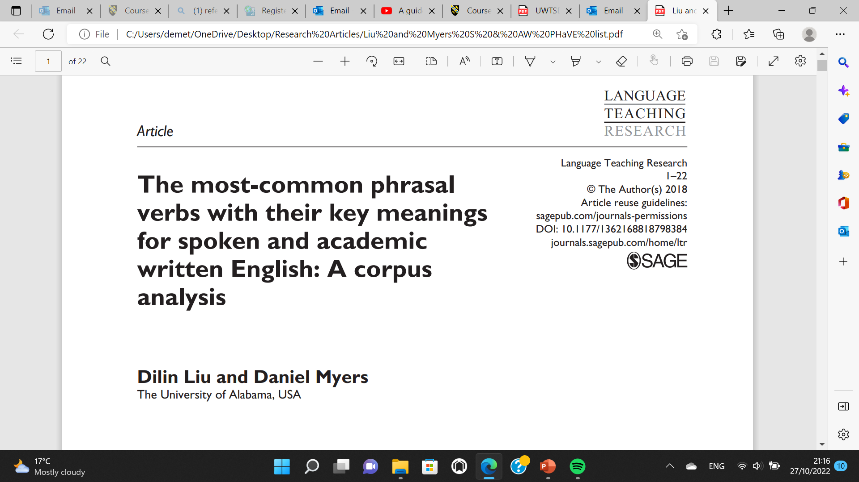
Journal articles

Slide 20
Referencing Quiz
Question:
When you quote an author or give a summary or paraphrase in your essays, how many times do you need to acknowledge it?
Answer: Twice
Once in the text (short reference)
Once in the list of references (full reference)

Slide 21
Referencing
Question:
Suppose you have written a quotation from page 27 of the following book:
Smith, J. (2008) Academic Writing Can Be Fun. Cambridge: Cambridge University Press.
How do you provide the in-text reference?
Answer:
(Smith, 2008, p.27) OR
According to Smith (2008, p.27)…

Slide 22
Referencing
Question:
Suppose you have written a paraphrase from the following book:
Baker, E., Barrett, M. & Roberts, L. (2002) Working Communication. Milton: John Wiley and Sons.
How do you provide the in-text reference?
Answer:
(Baker, Barrett and Roberts, 2002) indirect
Baker, Barrett and Roberts (2002) discuss…. direct

Slide 23
Referencing
Question:
Suppose you have written a paraphrase from the following journal article:
Jones, M. (2006) ‘The Effects of Globalisation on the Chinese Economy’, The Economist, vol. 23, no.2, pp. 108-125.
How do you provide the in-text reference?
Answer:
(Jones, 2006)
According to Jones (2006) …

Slide 24
Referencing
Question:
Suppose you have written a paraphrase from the following newspaper article:
Simpson, C. (2009) ‘The Crunch’, The Financial Times, 18 February.
How do you provide the in-text reference?
Answer:
(Simpson, 2009)
In his recent article, Simpson (2009) says that….

Slide 25
Referencing
Question:
Suppose you have written a paraphrase from the following website:
Robins, J. (2008) Positive effects of globalisation, http://www.port.ac.uk/eco/global [accessed January 12, 2009]
How do you provide the in-text reference?
Answer:
(Robins, 2008)
According to Robins (2008)….

Slide 26
Referencing
Question:
What do you do if the website has no date on it?
Answer:
Consider if you still want to use it
Use ‘no date’ or ‘date unknown’
Use n.d. (to stand for ‘no date’)
    E.g. (Smith, n.d.)

Slide 27
Referencing
The list of references at the end of the report for this module should show at least 8 sources which have been cited in-text.
These should be a variety of books and articles from your essential reading list or a few websites. A list of only websites or sources you have not read is not acceptable.

Slide 28
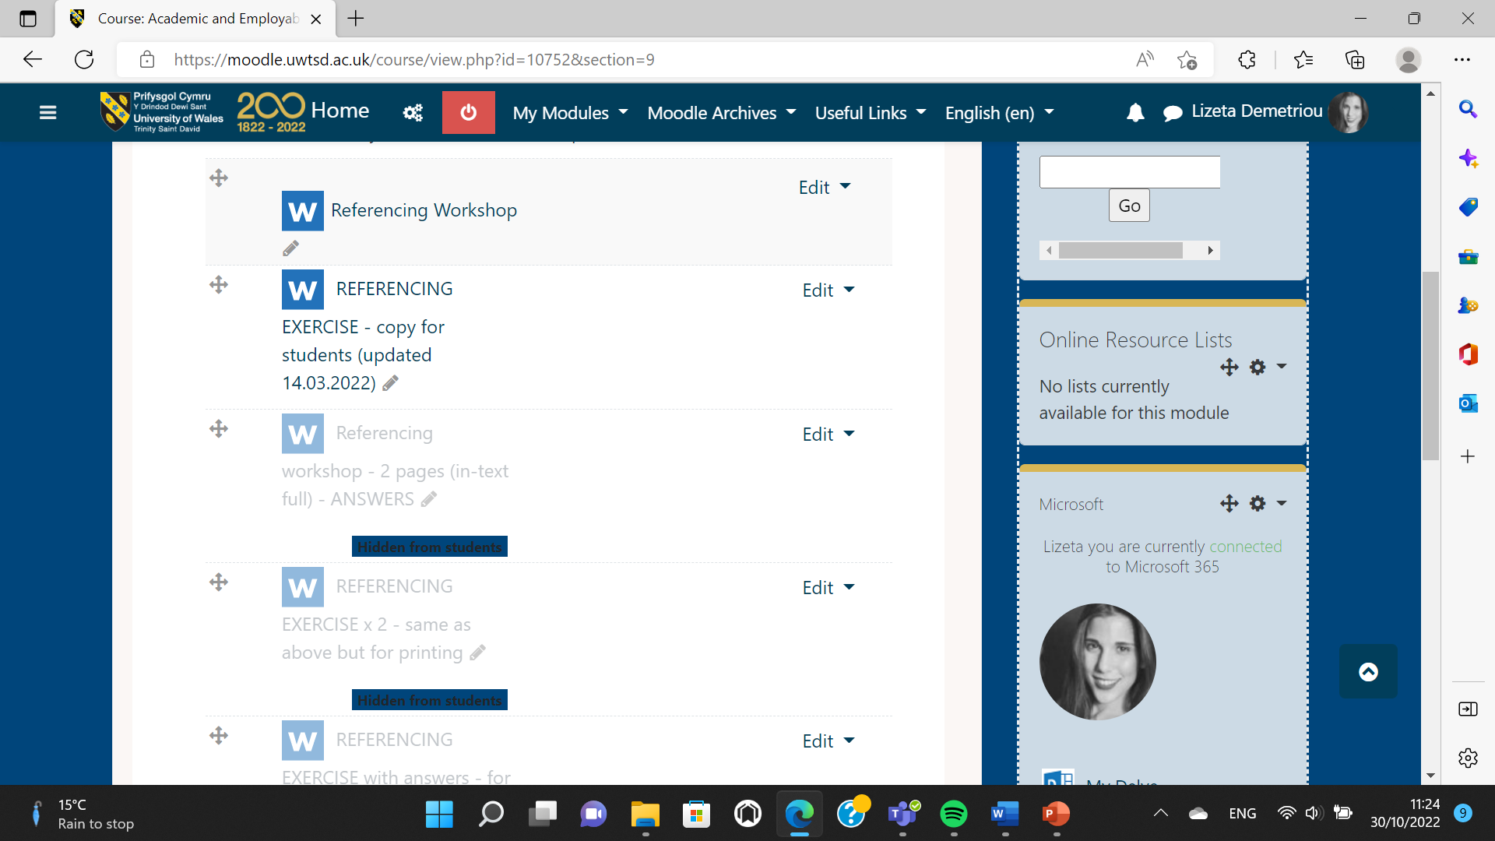
Activity 1
Find the Academic and Employability skills module on Moodle and scroll down to week 4a Referencing.
Download the referencing exercise.

Slide 29
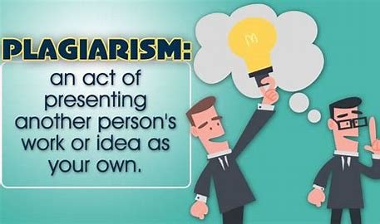
What is plagiarism?
Understanding Plagiarism – YouTube
Watch the video below to learn what plagiarism is.

Slide 30
What is plagiarism?
Plagiarism is presenting someone else’s work as your own.
Students often use incorporate into their work someone else’s ideas without acknowledging the source. This is an academic offence and students can fail.
To avoid being accused of plagiarism you need to
    Summarize
    Paraphrase
    Always reference your sources

Slide 31
What is plagiarism?
You must be able to show which ideas come from you and which belong to other authors.
How can you do that?
    reference everything that does not come from you
    everything that you write without a reference is considered to be your own

Slide 32
Match the different kinds of academic misconduct to their definitions:
Kind of misconduct | Definition
1. Failing to reference | A. the use of sections of verbatim copied text often from a variety of sources, linked together with additional sentences
2. Poor paraphrasing | B. copying text and /or ideas without indicating that this is the work of another author
3. Self-plagiarism | C. the partial rewording or reordering of words of another person’s work
4. Submitting work for which you cannot legitimately claim credit | D. the recycling of a student’s own work from other assessments without reference
5. Patchwriting | E. the unauthorised collaboration of students (or others) in a piece of work
6. Collusion | F. Use of a ghostwriting firm or another person to produce work

Slide 33

Review
Is your essay like patchwork?
Image source: http://www.planetjune.com/blog/patchwork-embellished-tote

Slide 34
ANSWERS:
Kind of misconduct | Definition
1. Failing to reference | B. copying text and /or ideas without indicating that this is the work of another author
2. Poor paraphrasing | C. the partial rewording or reordering of words of another person’s work
3. Self-plagiarism | D. the recycling of a student’s own work from other assessments without reference
4. Submitting work for which you cannot legitimately claim credit | F. Use of a ghostwriting firm or another person to produce work
5. Patchwriting | A. the use of sections of verbatim copied text often from a variety of sources, linked together with additional sentences
6. Collusion | E. the unauthorised collaboration of students (or others) in a piece of work

Slide 35
Additional Practice
https://skillshub.northampton.ac.uk/2013/04/18/harvard-referencing-interactive-tutorial/

Slide 36
Useful links
https://www.uwtsd.ac.uk/library/student-essentials/referencing-handbooks/

