Slide 1

Understanding Organisational Structure and Culture
Three Ways of Designing an Organisational Structure
Morrisons
Student name: Cristian Mihai Florescu
Student ID: 2515139
Module:
Understanding Organisational Structure and Culture (LCBB4009)

Slide 2
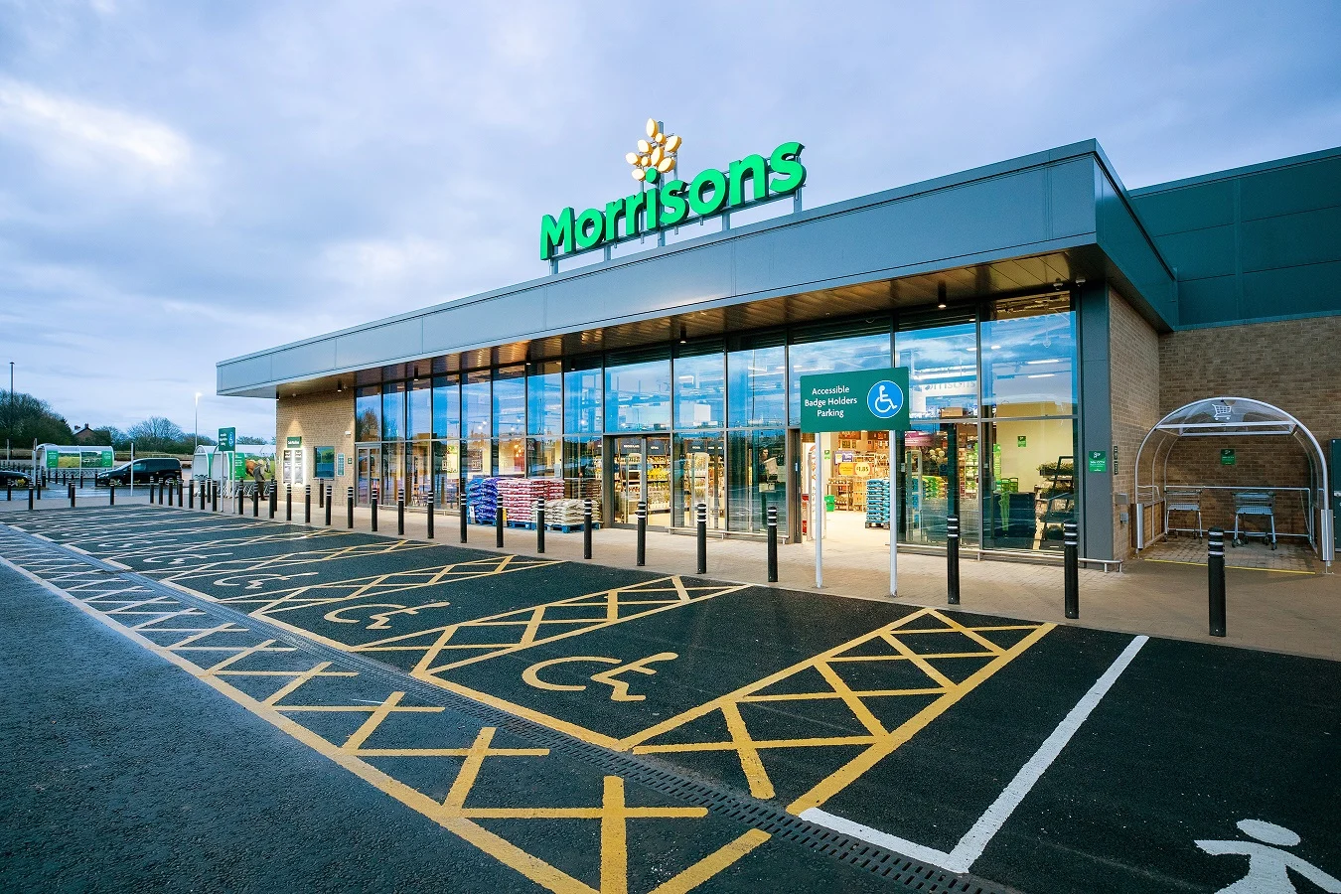
Introduction
Every business needs a good organisational structure to work effectively. It helps employees understand their responsibilities and who they report to.
For this presentation, I have chosen Morrisons, one of the largest supermarket chains in the UK.
In this presentation, I will explain three different organisational structures:
Functional Structure
Divisional Structure
Matrix Structure
I will also explain why these structures are important and how they can be used in Morrisons.

Slide 3
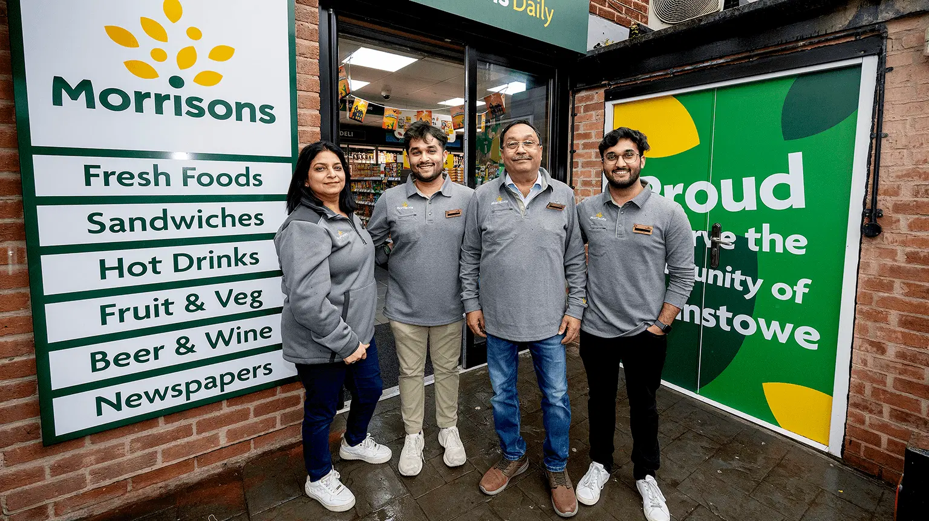
What is an Organisational Structure?
An organisational structure is the way a company organises its employees, departments and managers. It shows who is responsible for different tasks and how people work together.
Why is it important?
Gives employees clear responsibilities.
Improves communication.
Helps managers organise work.
Supports better decision-making.
Helps the business achieve its goals.

Slide 4
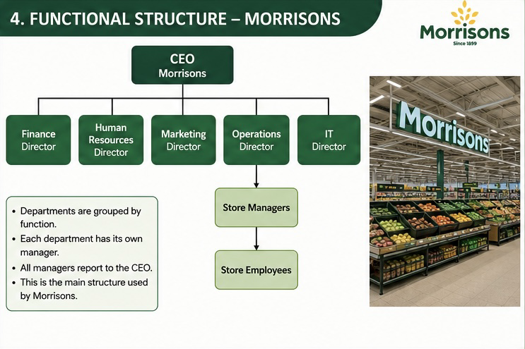
Functional Structure
A functional structure groups employees based on the type of work they do.
At Morrisons, different departments have different responsibilities.
Examples include:
Finance
Human Resources
Marketing
Operations
IT
Advantages
✔ Employees develop specialist skills.
✔ Clear responsibilities.
✔ Easy for managers to supervise staff.
Disadvantages
✖ Communication between departments may be slower.
✖ Departments may focus only on their own objectives.
Morrisons mainly uses this structure because each department has its own manager who reports directly to senior management.

Slide 5
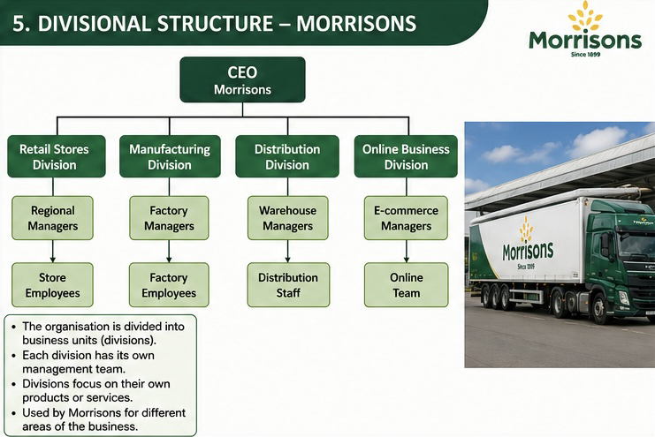
Divisional Structure
A divisional structure organises a business into separate divisions.
For Morrisons these divisions could include:
Retail Stores
Manufacturing
Distribution
Online Business
Advantages
✔ Faster decision-making.
✔ Better focus on customers.
✔ More flexibility.
Disadvantages
✖ Higher operating costs.
✖ Some activities may be duplicated.
This structure helps Morrisons manage different parts of the business more efficiently.

Slide 6
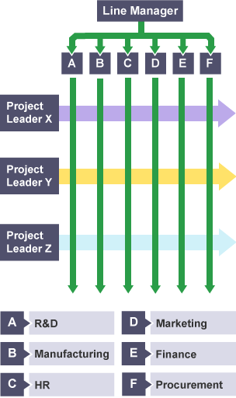
Matrix Structure
A matrix structure allows employees to work in teams across different departments.
Employees may report to both:
their department manager
a project manager
Advantages
✔ Better teamwork.
✔ Different departments share ideas.
✔ Useful for special projects.
Disadvantages
✖ Employees may receive instructions from two managers.
✖ This can sometimes create confusion.
Morrisons could use this structure when developing a new online service or introducing new technology in its stores.

Slide 7

Conclusion
To conclude, organisational structure is very important because it helps businesses work efficiently.
The functional structure is the main structure used by Morrisons because it provides clear responsibilities and supports day-to-day operations.
The divisional structure helps manage different areas of the business, while the matrix structure is useful for projects that require collaboration between departments.
Choosing the right organisational structure can improve communication, productivity and overall business performance.

Slide 8
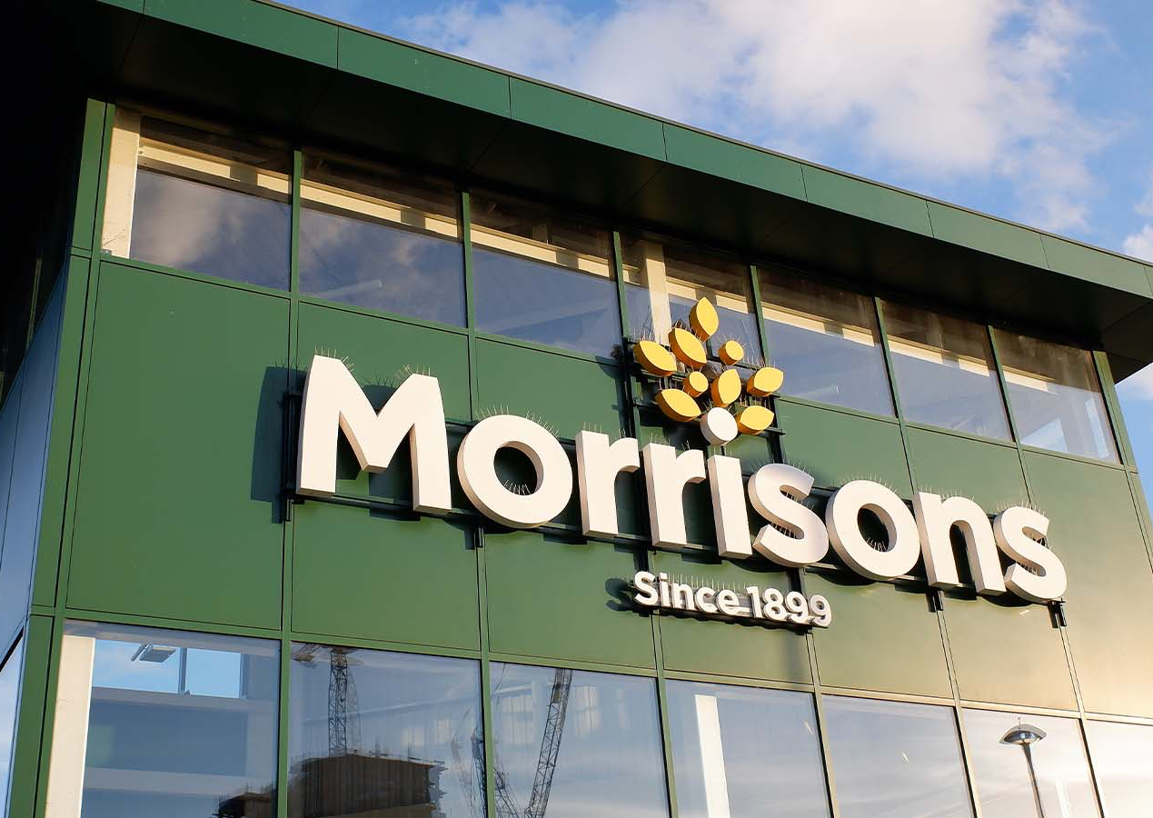
References
Daft, R. L. (2022). Organization Theory and Design. Cengage.
Johnson, G., Whittington, R., Scholes, K., Angwin, D. and Regnér, P. (2023). Exploring Strategy. Pearson.
Robbins, S. P. and Coulter, M. (2022). Management. Pearson.
Morrisons. (2024). Annual Report and Financial Statements.
Morrisons. (2024). Corporate Website.

