Slide 1
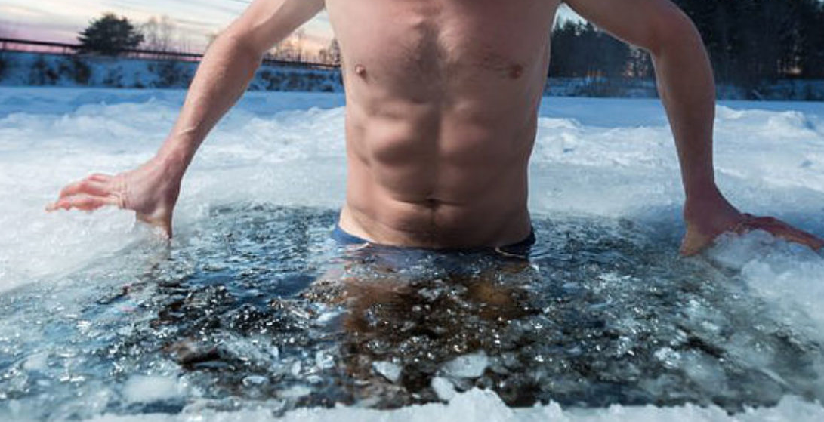
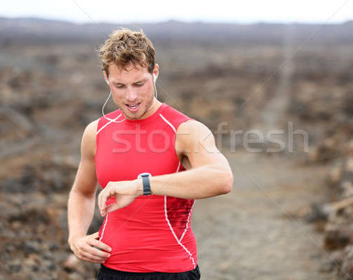
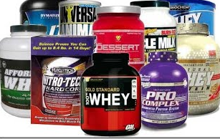
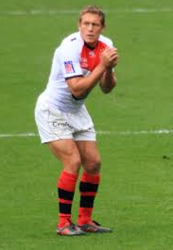
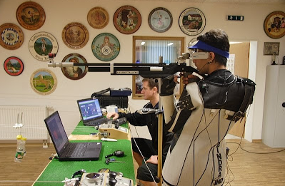
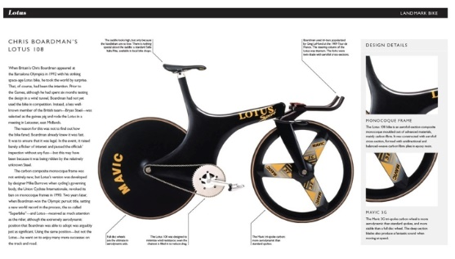
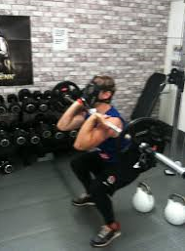

Ergogenic Aid
any substance or technique that is used to enhance physical performance .

Slide 2
Classification of Ergogenic Aids
Classified the prohibited ergogenic aids in to five types.
Nutritional
Physiological
Psychological
Mechanical
Pharmacological
A physical, mechanical, nutritional, psychological, or pharmacological substance or treatment that either directly improves physiological variables associated with exercise performance or removes subjective restraints which may limit physiological capacity.

Slide 3
Nature of Ergogenic Aid
Direct action on the development and or functioning of the muscle fibre.
Delays the onset of fatigue.
Improves the delivery and or use of nutrients.
Improves the capacity and or efficiency the systems of the body.
Improve the control by C.N.S and limits its fatigue.
Improves the efficiency of performance.

Slide 4
Nutritional Ergogenic Aid
The use of those substances found naturally in foods.
Carbohydrates,
protein,
Fats
vitamins,
minerals,
water
Electrolytes
Mostly legal

Slide 5
Physiological Ergogenic Aid
Something that alters the physiological functioning of body organs or systems.
Acupuncture Physiotherapy,
Blood Doping EPO,
Herbal Medicines Homeopathy,
Human growth H, Sports Massage,
Sauna, Ultra-violet rays,
Oxygen etc.
Mixed legal and illegal

Slide 6
Psychological Ergogenic Aid
Psychology,
Cheering Relaxation
Hypnosis Suggestion
Imagery Rehearsal
Meditation, Music
Autogenic training Placebo
Almost all Legal

Slide 7
Mechanical Ergogenic Aid
Improved body mechanics,
Clothing
Equipment
Skill training
Biofeedback / technology
Some legal some illegal

Slide 8
Pharmacological Ergogenic Aid
Stimulants
Narcotics
Anabolic Steroids
Beta Blockers
Diuretic
EPO
Almost all Illegal
Unless for medical reasons!

Slide 9
Ethics and Issues in Ergogenic Performance
Discuss
Professional sport is about winning no matter the cost?
Use of drugs v nutritional supplements?
Is competitive sport unethical?
Debate the following topics
Banning of innovative equipment?
Use of video referees and playback?
Banning of coaching support during performance?
Use of technical equipment during performance?

