Slide 1
Student Name: Mario Cotiga
Student ID: 2527265
Lecturer’s Name: Chijoke Uba
Module Code: LCLM 4004
Module Name: Problem Solving and Decision-Making
Component 1: Basil’s Bakery

Slide 2
Good afternoon. My name is Mario Cotiga
In my presentation I will:
  Provide an overview of Basil’s Bakery and the nature and scope of the problems they are encountering.
  Provide a critique and application of the PESTEL framework.
  Provide a critique and application of the Cause-and-Effect model.
  And, finally, provide a summary of the key findings.

Slide 3
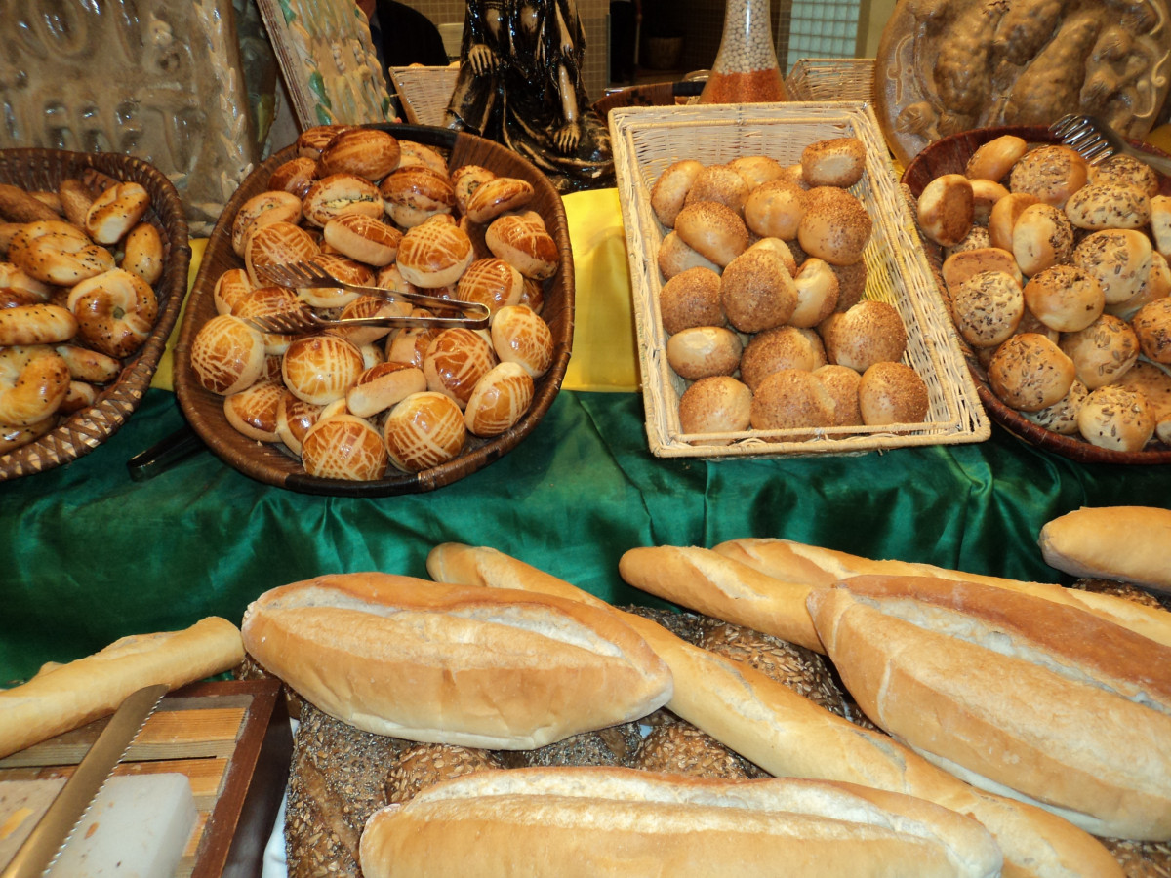
What is basils bakery
Basil’s Bakery is an independent, family‑run artisan business based in Coventry, England. Bakery & UK Food Context Food Standards Agency (2024).
It focuses on making fresh breads, pastries, cakes and savoury items, always choosing premium‑grade ingredients.
Blending time‑honoured baking methods with strong attention to quality and care for customers, it has earned a trusted name locally.
As a small operator in a crowded market, the bakery works to win and keep customers through fresh produce, distinctive ranges, and a warm, tailored service.

Slide 4
Root Problem: Sales expansion at Basil’s Bakery has slowed down, caused by a mix of internal and outside influences.
Factor | Category | Degree control
Insufficient advertising and promotional activity | Internal | High
Current offerings do not fully align with shifting customer preferences | Internal | High
Intense rivalry from large supermarkets and nearby bakeries | External | Low
Higher costs for raw materials, power and staff wages | External | Very Low

Slide 5
Critique of the PESTEL Framework
What is it?
It examines outside influences across six areas: political, economic, social, technological, environmental, and legal. Johnson, G., Whittington, R., Scholes, K., Angwin, D. & Regnér, P. (2023).
Why apply it?
To spot potential opportunities and risks within the wider business setting.
Key strengths:
• Straightforward and easy to use
• Provides a broad, high‑level view
Helps guide planning and decisions
Common limitations:
• Often too broad or generalised
• Information can become outdated quickly
• Does not rank factors by importance
• Does not take internal strengths or weaknesses into account

Slide 6
PASTEL Framework
Political Factors | Economic Factors | Social Factors | Technological Factors | Legal Factors | Environmental Factors
Government food standards influence ingredient selection Tax adjustments lead to higher selling prices | Rising inflation increases flour, energy and running costs Reduced household earnings limit customer spending power. Kotler, & Armstrong. (2021). | Shift toward supporting fresh, local food businesses More customers looking for plant‑based and vegan products | Digital sales channels and home delivery services Modern, high‑performance baking equipment available | Compliance requirements for food safety and hygiene Regulations regarding staff pay and employment terms | Demand for less packaging and less waste Need for ethical, eco‑friendly ingredient sourcing

Slide 7
The Cause and effect model
What is it?
Also known as the Ishikawa or fishbone diagram, it creates a visual map of potential causes behind an issue, based on clear cause‑and‑effect links. Fishbone Diagram Ishikawa, K. (1990).
What is it used for?
Identifying underlying root causes in quality control, business management, healthcare settings and group problem‑solving work.
Key advantages :
Easy to understand, supports teamwork, and directs attention to deeper problems rather than just visible symptoms.
Main limitations :
Reduces complex, connected systems to something simpler
Does not account for feedback loops or overlapping influences
Relies on opinion rather than proven cause‑effect proof
Often misses the bigger picture or wider background factors

Slide 8
Bakery – inconsistent / poor product quality
Methods
Machines
People
No consistent recipe measurements or standards
Uneven heat spread inside ovens
Insufficient training for baking staff
Unregulated rising and fermentation periods
Unreliable or inaccurate temperature regulation
Unclear job boundaries and duties
Root problem : Low Quality
Expired or low‑activity yeast
No precise weighing of raw materials
Unstable kitchen temperature levels
Improper ingredient storage practices
Missing quality checks before baking starts
Unsuitable storage conditions for supplies
Materials
Measurement
Environment

Slide 9
Key Findings
                • Basil’s Bakery’s slow sales come from internal gaps (weak marketing, outdated range, inconsistent quality) plus external pressures (inflation, competition, rising costs).
                • Quality problems stem from failures across methods, equipment, staffing, materials, checks, and environment all can be improved internally.
                • PESTEL shows major outside shifts: stricter food laws, higher costs, demand for local/vegan options, digital ordering, sustainability rules.
                • Cause‑and‑Effect is clear and team‑friendly but simplifies complex links. PESTEL gives a full outside view but does not rank issues or cover internal strengths.
                • Growth needs balancing internal fixes with fast responses to market trends and cost pressures. Federation of Small Businesses (2025).

Slide 10
Reference List:
Cause‑and‑Effect / Fishbone Diagram Ishikawa, K. (1990). Introduction to Quality Control. 3rd ed. Tokyo: Asian Productivity Organization.
ASQ (2025). Cause‑and‑Effect Diagram (Fishbone). Milwaukee: American Society for Quality.
PESTEL Framework
Johnson, G., Whittington, R., Scholes, K., Angwin, D. & Regnér, P. (2023). Exploring Strategy. 13th ed. Harlow: Pearson.
Kotler, P. & Armstrong, G. (2021). Principles of Marketing. 18th ed. New York: Pearson.
Bakery & UK Food Context Food Standards Agency (2024). Food Business Compliance Guidance.
London: FSA. Office for National Statistics (2025). Inflation & Household Spending Trends. London: The Stationery Office.
Federation of Small Businesses (2025). Independent Food & Drink Sector Report. London: FSB.

Slide 11
Thank you for listening

Slide 12


