Slide 1
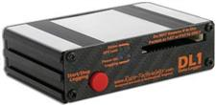
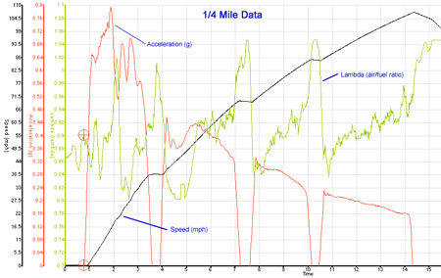
Data Acquisition Hardware
Level : Bsc Level 3
Lecturer :Tim Tudor
Email : timothy.tudor@sm.uwtsd.ac.uk

Slide 2
Sensors
Sensor Topics
      Purpose
      Parameters for measurement
      Rules of sensing
      What sensors should I use for each parameter?
      How do these sensors work?
        Position
        Temperature
        Pressure
        Acceleration
        Speed sensors
        Strain Gauges
        Load cells / Torque sensors
        Gyros
      Typical Sensor Data Sheet

Slide 3
Sensors
Purpose of sensors
Sensors convert a physical or chemical (or sometimes electrical) quantity into an electrical quantity.
This electrical quantity may be input into a logger and saved against time in memory.
Data can then be viewed and analysed

Slide 4
Sensors
Parameters for measurement which require external sensors
Parameter
Vehicle Speed
Acceleration in x,y & z
Suspension (Damper) Position
Steering Position
Throttle %
Engine Speed
Water & Oil Temperature
Oil Pressure
Air Speed
Push Rod Load
Yaw / Pitch / Roll
Sensor
Trigger
Accelerometers
Linear Potentiometers
Rotary Potentiometer
Linear or Rotary Potentiometer
Current pulse
Temperature Sensor
Pressure Sensor
Pitot-static Sensor
Strain Gauge
Gyrometer

Slide 5
Sensors
Rules of sensing
Whatever we measure:
  We must not affect the very nature of what we are measuring
  We must ensure that we have adequate range
  We must ensure that we have adequate resolution
  We must ensure that we have adequate dynamic response to follow the changes in what we are measuring

Slide 6
Sensors
Rules of sensing
The sensor must survive within the application we put it in.
  Temperature
  Vibration
  Physical object ingress
The sensor output should be robust against disturbances
  Light
  Temperature
  Vibration
  Supply voltage fluctuations

Slide 7
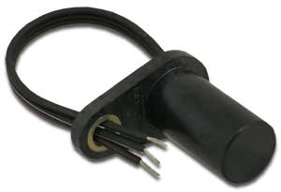
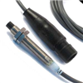
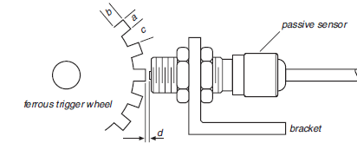
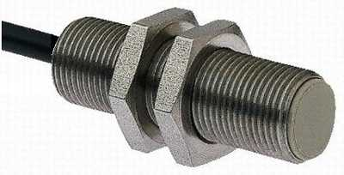
Sensors
Vehicle Speed Sensors
      2 types
        Hall effect
        Variable reluctance
      Both types require a ferrite trigger
        Once per rev
        Multiple times per Rev
        Usually purpose made trigger wheel
        Or bolt heads on hub

Slide 8
Sensors
Vehicle Speed Sensors – Hall Effect
Transducer element detects target-induced flux changes between magnet and target
Sensitive of magnitude of flux not its rate of change
So can pick up slow speeds
Onboard signal processing - temperature limitations

Slide 9
Sensors
Vehicle Speed Sensors – Variable Reluctance
Sensor detect movement of ferrite target
Target induces voltage into coil
Signal magnitude proportional to change of magnetic flux produced in coil by target moving through magnetic flux
No onboard electronics so higher temperature applications ok.

Slide 10
Sensors
Vehicle Speed Sensors – Calculation
How do we turn pulses into vehicle speed?
Logger usually does calculation but requires information
C = Circumference of tyre D = Rolling Diameter of Tyre (Loaded)
N_{s} = Number of triggers sensed N_{t} = Total numer of triggers per revolution
t = time

Slide 11
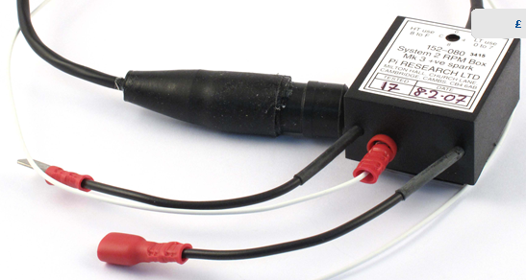
Sensors
Engine Speed (RPM)
RPM box either picks up
  Current pulses from the LT side of the ignition coil
  Voltage pulses from the master HT lead on 4-stroke engines.
Wire pick-up physically wrapped around LT or HT lead

Slide 12
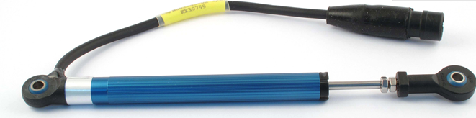
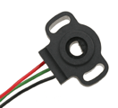
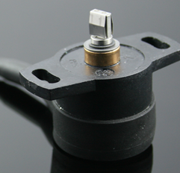
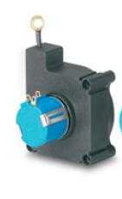
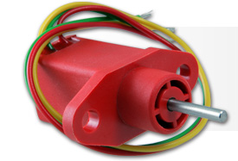
Sensors
Position Sensors
Linear
Rotary
String Pot
Plunger

Slide 13
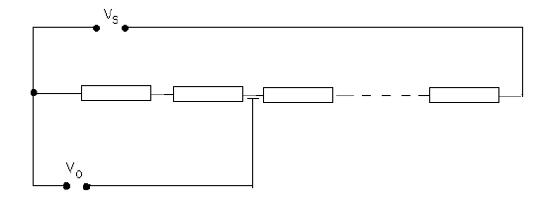
Sensors
Linear Position Sensors
Linear position sensors have a resistance which changes with position of slider
Feed voltage in e.g. 5V
Voltage drop over resistance
Output voltage varies with resistance which varies with position.

Slide 14
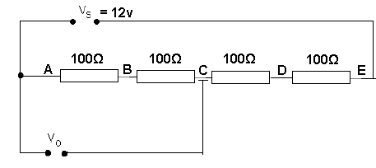
Sensors
Linear Position Sensors
Circuit below represents linear pot – Slider moves along resistive strip to 5 points.
Calculate output voltage at A, B, C, D and E
Ohms Law! V = I R_{T} → I = V/R = 12/400 = 0.03 A
Voltage at A = 12 – (0.03 x 0) = 12V
Voltage at B = 12 – (0.03 x 100) = 9 V
Voltage at C = 12 – (2 x 0.03 x100) = 6 V
Voltage at D = 12 – (3 x 0.03 *100) = 3 V
Voltage at E = 12 – (4 x 0.03 *100) = 0 V

Slide 15
Sensors
Linear Position Sensors
If physical distance is equal between each point A, B, C, D, and E is 5mm
Plot Voltage versus displacement
Point | Distance (mm) | Output Voltage (V)
A | 0 | 12
B | 5 | 9
C | 10 | 6
D | 15 | 3
E | 20 | 0

Slide 16
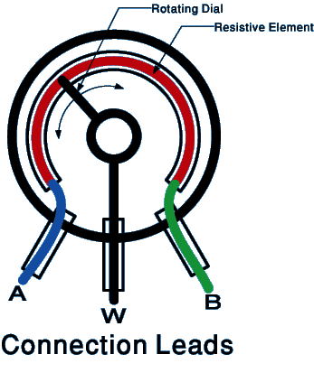
Sensors
Rotary Position Sensors
Rotary position sensors are like linear potentiometers
Slider moves along resistive element
More resistive element in circuit = more resistance
For given voltage in more resistance = smaller output voltage

Slide 17
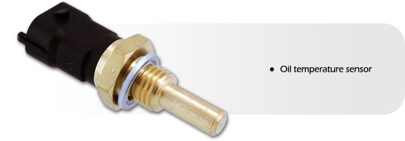
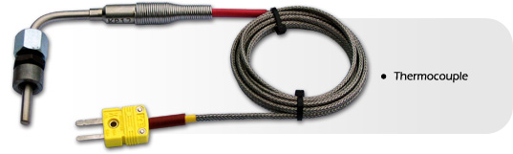
Sensors
Temperature Sensors
Two types (Contact)
    Thermistors
    Thermocouples

Slide 18
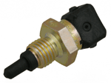
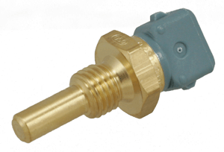
Sensors
Temperature Sensors
Thermistors
  Solid temperature sensors that behave like temperature-sensitive electrical resistors.
  There are basically two broad types,
    A NTC thermistor is one whose resistance decreases with an increase in temperature.
    A PTC thermistor is one whose resistance increases with an increase in temperature.
We generally use NTCs

Slide 19
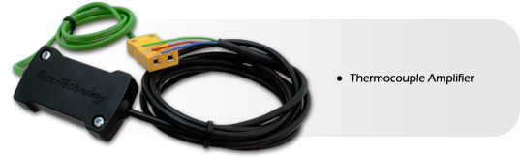
Sensors
Temperature Sensors
Thermocouples
Pairs of dissimilar metal wires joined at least at one end
Generate a net thermoelectric voltage between the open pair according to the size of the temperature difference between the ends
Usually require amplification

Slide 20
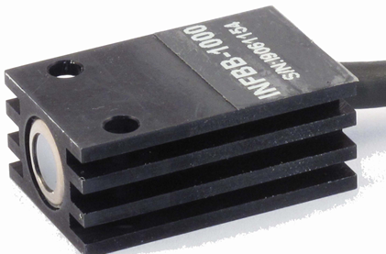
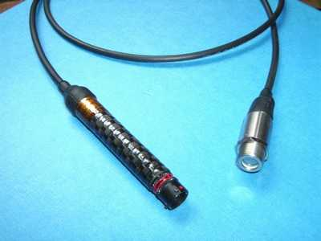
Sensors
Temperature Sensors
Also have Non-contact sensors
  Usually measure the infra-red radiation given off by component
  Used to measure
    Tyre temps
    Brake disc temps
    Exhaust surface temps

Slide 21
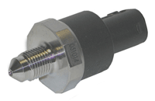

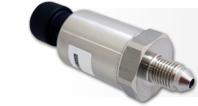

Sensors
Pressure Sensors
Diaphragm Strain
  Uses strain gauges either bonded to , or diffused into a diaphragm, acting as resistive elements.
  Under the pressure-induced strain, the resistive values change.
Capacitance Based
  The pressure diaphragm is one plate of a capacitor that changes its value under pressure-induced displacement.

Slide 22
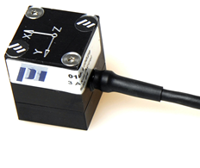
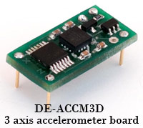
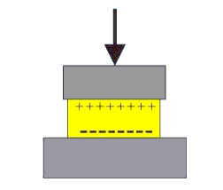
Sensors
Accelerometers
An accelerometer is an electromechanical device that will measure acceleration forces.
These forces may be static/constant force e.g gravity or dynamic - caused by moving or vibrating the accelerometer.
How do they work?
  Piezoelectric effect - contain microscopic crystal structures that get stressed by accelerative forces, which causes a voltage to be generated
  Capacitance - Two microstructures next to each other have a certain capacitance between them. If an accelerative force moves one of the structures, then the capacitance will change. C onvert from capacitance to voltage

Slide 23
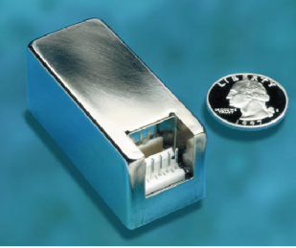
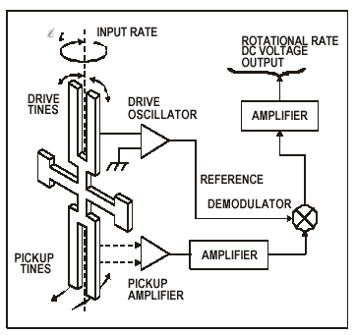
Sensors
Gyros
Used to measure rate or rotation (Deg/s)
E.g. Roll, Pitch and Yaw
Integrate once wrt → total angle
Differentiate wrt → rotational acceleration
Can be various types such as piezo-electric based
  Tuning fork shaped. Upper forks leave plane under rotation and produce proportional voltage

Slide 24
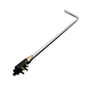
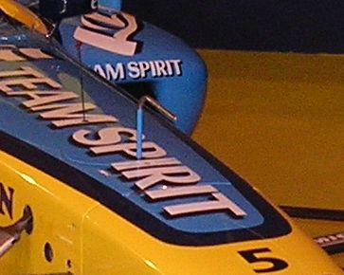
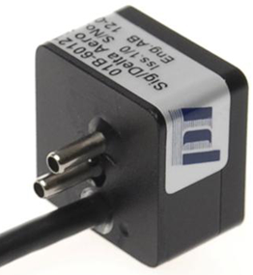
Aerodynamics – The Physics
Pitot-static tubes
Pitot-tubes measure a differential in pressures
Air speed may be calculated
Air Speed may not be equal to vehicle speed
    Head wind
    Tail wind
    Or localised flow acceleration
Data required so that aerodynamic flow around vehicle can be studied.

Slide 25
Aerodynamics – The Physics
Pitot-static tubes – How they work
We need to first grasp the concept that pressure describes the energy of a fluid
In fact it follows the relationship
Pressure = Energy/Volume
Units show that the above statements hold
Energy/Volume = Jm⁻³
= N m m⁻³
= N m⁻²
= Force/Area
= Pressure

Slide 26
Aerodynamics – The Physics
Pitot-static tubes – How they work
Dutch-Swiss mathematician Daniel Bernoulli published his book Hydrodynamica in 1738 and suggested
3 forms of energy in a fluid–
  Kinetic energy – ½ m v² → ½ ρ v²
  Potential Energy – mgh → ρgh
  Pressure energy
  (Convert per unit volume changes masses to densities)

Slide 27
Aerodynamics – The Physics
Pitot-static tubes – How they work
1st law of thermodynamics states that energy is constant.
Therefore, the sum of these three forms of energy must be constant.
P_{Static} + ½ rV² + ρgh is constant
OR
P_{static 0} + ½ ρ V₀² + ρgh₀ = P_{Static 1} + ½ ρ V₁² + ρgh₁

Slide 28
Aerodynamics – The Physics
Pitot-static tubes – How they work
In normal vehicle aerodynamics there is no major change of height, therefore potential energy is negligible.
For vehicle aerodynamics we can approximate Benoullis equation as :
P_{Static} + ½ rV² = Constant
P_{Static} + ½ rV² = P_{Total}
P_{Static} = The pressure measured by a gauge on an aerodynamic surface
P_{Total} = The pressure measured by a gauge where the air is stationary
½ rV² is also known as dynamic pressure

Slide 29
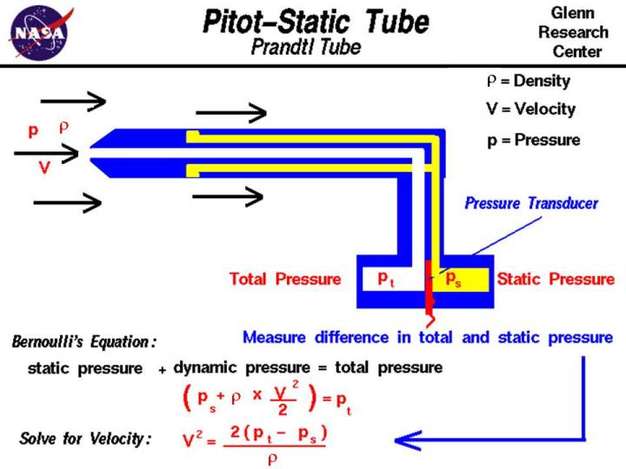
Aerodynamics – The Physics
Pitot-static tubes – How they work

