Slide 1
CLSK6002
Achieving criticism I

Slide 2
Criticism of ancient sources: Don’t forget the basics
Do your background on life, situation and biases, strengths and weaknesses of all your sources.
Don’t just dump it all in the introduction and then forget about it in the rest of your work.
Make sure that with every source you are using, you are aware of any problems/difficulties, etc.

Slide 3
The wonderful commentary
For literary sources (and sometimes inscriptions), commentaries can often be your best friend.
Not only can they potentially cover the bit of the source that you want to use but also will usually give you a good introduction to the author and the main issues/biases/weaknesses/strengths involved. As well as scholarship on the subject.

Slide 4
Multiple sources
When your argument is supported by evidence from multiple sources, then you often do not have the space to discuss each and every one individually.
However, you have to make certain that you are aware and clearly aware in your text of any weaknesses or issues.

Slide 5
Issues with multiple sources 1: Lateness
What happens if all the sources for a specific argument (or part of argument) are late?
Then you have to discuss the issue rather than simply let it be as being from multiple source.

Slide 6
Issues with multiple sources 2: one source in reality
What happens if all the sources are essentially copying each other?
Then you need to mention that possibility and then discuss any possible issues with the “original” source (if we know what it is – if not then what we can get at).

Slide 7
Discuss to the point
It is extremely important that you do not follow things by rote:
  Not all inscriptions are fragmentary
  Not all coins are unadatable
  Bias cannot be seen in every word of an author

Slide 8
Practice

Slide 9
Res Gestae
In groups work through and analyse the Res Gestae as if you were going to use it for a dissertation on:
What makes an Emperor? How Augustus’ holding of offices subverts the Republican form.

Slide 10
An example

Slide 11
Close read and comment
For my part I have always held that the constitution of a state reflects the character of the leading politicians. But some of the leading men at Athens have stated that they recognize justice as clearly as other men; “but,” they have said, “owing to the poverty of the masses, we are forced to be somewhat unjust in our treatment of the cities.” This set me thinking whether by any means the citizens might obtain food entirely from their own soil, which would certainly be the fairest way. I felt that, were this so, they would be relieved of their poverty, and also of the suspicion with which they are regarded by the Greek world. Xenophon Poroi 1.1.

Slide 12
The importance of nuance
Your discussion regarding the problem of a source must be nuanced.
It is not enough to simply reject or support a source.
Modern scholarship is your friend there as you should be able to find scholarship that supports your interpretation of a source.
If you can’t, then you need to make a strong argument (which is very good because that gives you better chances for originality)

Slide 13
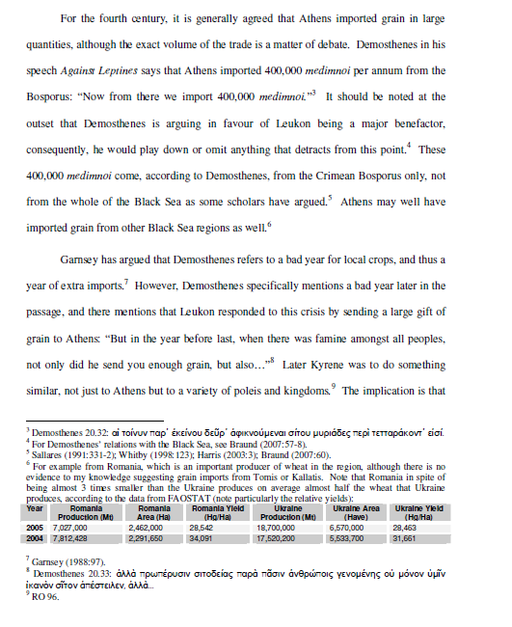

Slide 14
Too much and too little
How much discussion and nuance you provide for your sources depends on their importance to your argument and on the general issue you are trying to cover.
There are pieces of evidence that are very important – they should receive lots of attention.
There are pieces of evidence that are supportive of your argument.
Everything depends on the argument that you are trying to make

Slide 15


