Slide 1

Referencing, Paraphrasing and avoiding plagiarism

Slide 2
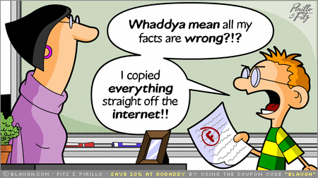
Aims of the Lecture
To define Plagiarism.
Tips to Overcome Plagiarism.
A brief reminder/recap of turnitin
Introduction to referencing.

Slide 3
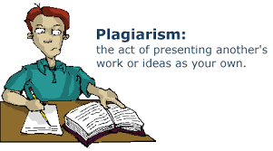
What is Plagiarism?
Plagiarism has been defined as is ‘using the work of others without acknowledging your source of information or inspiration’.
Cottrell (2008: p 128)
Types of Plagiarism include:

Slide 4
What is Plagairism
Using words more or less exactly as they have been used in articles, lectures, television programmes, books or anywhere else.
Using other people’s ideas or theories without saying whose ideas they are.
Paraphrasing what you read or hear without stating where it comes from.
Even if you change words or sentences you have ‘borrowed’ or put in a different order, the result is still plagiarism.

Slide 5

Plagiarism is an Academic Offence.
Plagiarism is seen as a serious academic offence in British Universities.
Work considered to be plagiarised will invariably be disqualified and awarded 0.
Please see your Student Handbook (located on your home page Moodle).

Slide 6
Avoiding Plagiarism
WHAT SHOULD I READ?
Books
Journals
Government Publications
Websites
E-mails
Lecture notes
You MUST reference these to avoid plagiarism.

Slide 7
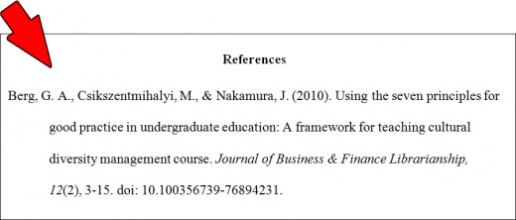
Do I have to reference EVERY source of information?
Essentially yes!
Even as much as comments made by the lecturer or lecture slides you must reference.
Only your own original ideas you do not reference.

Slide 8
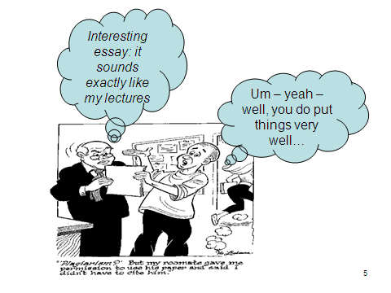

Slide 9

How can I avoid plagiarism?

Slide 10

To avoid plagiarism you have to be METICULOUS in your work
Use your own words!
Write all notes in your own words.
Note down exactly where you read the information you put in your notes.
In your assignment, write out where ideas and information come from:
Reference your work.

Slide 11
Make clear when you are using a direct quotation by using quotation marks, and include the source in your list of references (doing none or only one of these is not acceptable).
Write a full reference list (all the books and other material you used).
It is best to write/note down and save your references as you use them.
Referencing is NOT difficult, but takes time and patience.

Slide 12
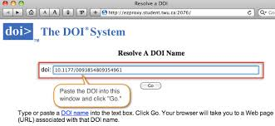
When using material on the internet, make a note of the source (author, title, URL and so on) and the date that you accessed the page. DOI usage is good practise (see later).
Avoid using someone else’s work with only minor cosmetic changes, for example using ‘strong’ for ‘robust’ or changing a sentence around

Slide 13
When paraphrasing, use words or a sentence structure different from the original work and acknowledge the source through in-text citation immediately following the paraphrase. E.g.
According to Freud (1925) the personality consists of three components; Id, Ego and Superego.
The third component; the Superego, develops as the child internalises parental roles (Freud, 1925).

Slide 14

A rule of thumb:
As a student you may only have just started to study a particular subject so the material you are reading is new information to you.
Ask yourself the following questions
  Did I know this information before I started my course?
  Did this information/? idea come from my own brain?
  If the answer to either or both is ‘no’, then the information is not common knowledge to you and in these cases you need to cite and reference your source(s).

Slide 15
Can unintentional plagiarism occur.
Unfortunately yes.
You might have thought of a fantastic idea – not read around the subject, but then you find out its been thought of before.
It might sound cruel, but this would still be seen as a plagiarism offence.
This does happen, therefore you need to check the literature thoroughly as you formulate your ideas.

Slide 16
Turnitin
Try not to “outsmart” Turnitin….
When you read around your topic of study, make sure you place the notes in your own words, do not be tempted to copy and paste and substitute words; turnitin will invariably pick this up!

Slide 17
An example
Direct quote from www.psychologytoday.com
Freudian Psychology is based on the work of Sigmund Freud (1856-1939). He is considered the Father of Psychoanalysis and is largely credited with establishing the field of verbal psychotherapy. Originally trained as a neurologist, Freud is best known for his theories of the unconscious mind, dreams, infantile sexuality, libido, repression, and transference—all of which continue to influence the field of psychology to varying degrees.
Freudian Psychology is based on the work of Sigmund Freud (1856-1939). He is regarded as the Father of Psychoanalysis and is largely attributed with establishing the field of verbal psychotherapy. Originally, Freud trained as a neurologist and is best known for his theories of the unconscious mind, dreams, infantile sexuality, libido, repression, and transference—all of which continue to impact the field of psychology to variable degrees.
The number of SAME words will be picked up by Turnitin and the student would be put forward for unfair practice.

Slide 18

A guide to referencing

Slide 19
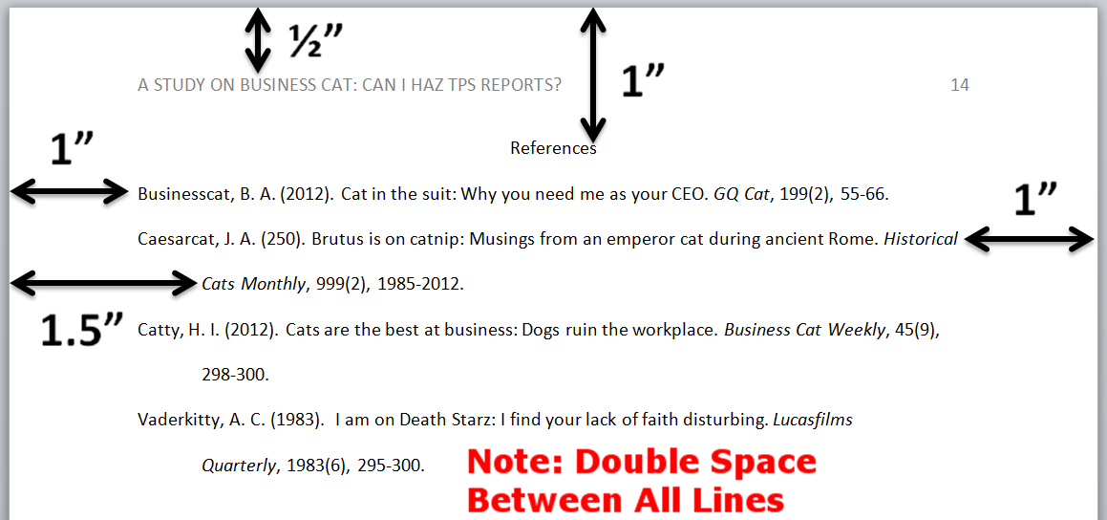
What is Referencing?
In academic writing it is essential that you make clear which are your thoughts and which are other people’s ideas, to avoid plagiarism and being accused of unfair practice.
‘Referencing’ or ‘citing’ means showing where you have got your ideas and information from.

Slide 20
Why use references
Main reasons for providing references
  Acknowledgment
  Plagiarism
  Helps your reader
  Helps the writer
  Increase in confidence
  Strengthens your writing and helps you attain better marks or grades

Slide 21
Referencing
Adds weight to your discussion and arguments.
References also show you have read widely on the subject and considered and analysed the writings of others.
Shows the tutor/reader what you have read and allow them to appreciate your contribution to the subject.
Establish the credibility and authority of your ideas and arguments.
Demonstrates that you have spent time in locating, reading and analysing material and formed your own views and opinions.

Slide 22
Why use the existing literature
To show you have grasped the major ideas in your field of study.
To show you have read widely around a topic - being a student is an apprenticeship which requires you to study topics.
To illustrate the points you are making - the literature provides evidence for your viewpoint.

Slide 23
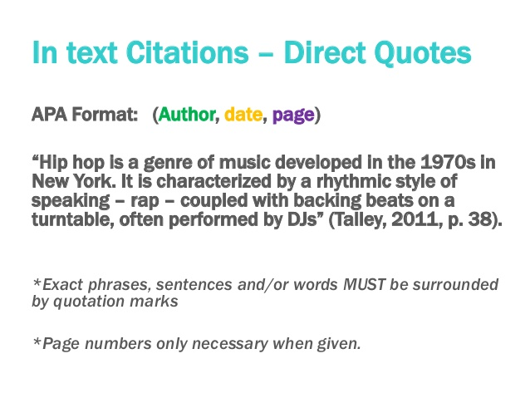
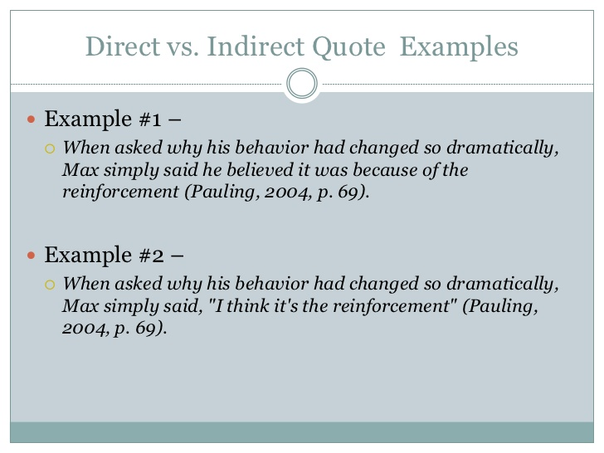
Using the Literature
2 ways
Quote directly from a source.
Report what another writer has written.

Slide 24
Quotations
should be relative to the topic
can be used to emphasise your views
are an effective way of introducing a topic or concluding an essay
can be exceptionally good ways of wording the point being made
should be used sparingly
should not be used just because you cannot summarise the writer’s words

Slide 25
In writing quotations you should
Copy words and punctuation exactly
use three dots(…) to indicate omitted words
put ‘quotation marks’ around the words you quote (thus: ‘stunning,’ wrote the artist.)
say exactly where the quotation comes from
`Life is full of hazards…No one makes the journey without some bumps and bruises, mental and physical`. (Fernald, 2015, p.103).

Slide 26
Another important point
How you include direct quotes within your work depends upon their length (30 words or more is considered a long quote).
Difference between short and long quotes.
Short quotes: Up to two or three lines in your assignment:
Can be set in quotation marks (single or double – be consistent) and included in the body of text.
Longer quotations: Should be entered as a separate paragraph and indented from the main text.
1cm each side.
Quotation marks are not required.

Slide 27
Example of short directed quote
Example
‘You will in no doubt be aware that plagiarism is a hot topic of discussion in higher education” (Neville, 2007, p. 27).
OR
Neville believes that students should be ‘aware that plagiarism is a hot topic of discussion in higher education’ (2007, p. 27)

Slide 28

Example of longer quotation.
leave a space before and after the quote
indent left and right margins by 1 cm
you do not need inverted commas
Example
Detailed observations of children at play show that,
there are many similarities between the play of
young boys and girls and many differences that
can be explained by a child’s individual
temperament (Lindon, 2001, p. 89).
Therefore we can assume that………..

Slide 29
Paraphrasing -
Putting something you have read in your own words
indirect, e.g. Jones (1995) argues that…
paraphrase or summarise what Jones has written
summarise or paraphrase in your own words –remember it is Jones’s ideas you are using
make clear which are Jones’s ideas and where you found them- this is recorded in the reference list at the end of your work.

Slide 30
Paraphrasing
Even if you paraphrase writers (i.e. do not quote them directly, but weave their ideas into what you are saying), you must show from whom you got the idea.
In an interview, students should always be aware of their non verbal behaviour, as this can provide a valuable indicator of their state of mind (Edwards, 2001).

Slide 31

Secondary Sources
Material that is not in the original manuscript, contemporary record or document associated with an event, but which critiques, comments on or builds upon primary sources.
In your first year you will probably come across a lot of secondary sources…
Examples?

Slide 32
Secondary Referencing.
It is critical that you use cite the resource that you are using when writing your assignment or making a presentation.
As an example, if you found out about Vygotsky’s theory from reading an introductory text. Then you must cite the text book also.
Citing directly
Vygotsky (1978 cited in Daniels, 2005, p.56) discussed the Zone of Proximal Development.
or
Citing Indirectly
Discussion of learning and development is highlighted in the Zone of Proximal Development theory (Vygotsky 1978 cited in Daniels, 2005, p.56).

Slide 33
References and Bibliography
References
- The full details of a book/journal/ electronic resource cited in the essay.
- Reader must be able to know full details of EVERY source cited in the essay.
- Even if you only read part of the article/book or it was from a secondary source.
Bibliography
- The full details of a book/journal/electronic resource read but not cited in essay.
No “shame” in not having a Bibliography.

Slide 34
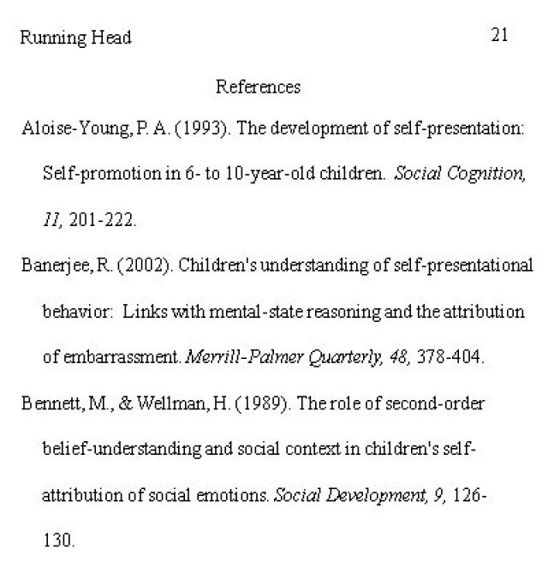
Our referencing system is known as the APA System
In the APA (author-date) system, your references link with your in-text citations so that the reader can confirm the full publication details of the work cited in your text and to be able to locate it.
Always in alphabetical order.

Slide 35
Reference section – Books.
BOOKS, JOURNALS AND WEBSITES
IN ALPHABETICAL ORDER BY AUTHOR’S NAME
Author – surname first, followed by initial, e.g. Ryder, N.
Year of publication (in brackets) full stop.
Book title – in italics followed by a full stop.
If applicable: edition number (in brackets) followed by a full stop.
Place of publication, e.g. Carmarthen followed by a colon:
Name of publishers, e.g. Nelson Thornes, followed by a full stop.

Slide 36
Examples – References Book.
Crème, P. and Lea, R. (2003). Writing at University – a Guide for Students. Maidenhead: Open University Press.
Bartlett, S., Burton, D.M. and Peim, N. (2007). Introduction to education studies. London: Paul Chapman.
Cottrell, S. (2003). The study skills handbook (2nd edition), Hampshire: Palgrave MacMillan.
Koshy, V. (2005). Action Research for Improving Practice. London: Paul Chapman Publishing.
Neville, C. (2007). The Complete Guide to Referencing and Avoiding Plagiarism, Maidenhead: Open University Press.

Slide 37
Referencing – Journal Articles
1. Author – surname first, followed by initial, e.g. Ryder, N. If multiple authors use ampersand (&) before last author.
2. Year of publication (in brackets) followed by a period.
3. Title of article, comma,
4. Name of journal in italics, comma,
5. Volume number in italics comma, e.g. 5,
6. Issue number in parentheses (if given) comma, e.g. (84),
7. First page to last page of article, end with a period e.g. 234-256.
E.g. British Journal of Psychology, 5(84), 234-256.

Slide 38
Example
Example
Joshee, R. (2003). A Framework for Understanding Diversity in Indian Education. Race Ethnicity and Education, 6(3), 283-297.
Mildenberger, P., Eichelberg, M., & Martin, E. (2002). Introduction to the DICOM standard. European radiology, 12(4), 920-927.

Slide 39
Books with Editors
Books may sometimes be edited, which means that different authors have written different chapters in the book. If a book has editor(s) you add (Ed.) or (Eds.) after the name.
For example:
Harrison, R. and Wise, C. (Eds.). (2005). Working with young people. London: Sage.

Slide 40
When using an edited book if you have only used specific chapters these are what are referenced in your Reference List.
For example:
The chapter:
Ingram, G. & Harris, J. (2007). Defining Good Youth Work. In R. Harrison. and C. Wise (Eds.), Working with young people (pp. 11–15). London: Sage.
The book:

Slide 41
Referencing E-Mail
NB you need to see correspondence before quoting their work.
Sender
Year of communication (in round brackets)
Medium of communication
Receiver of communication
Day / month of communication
Walters, F. (2009). Email to John Stephens, 14 August.

Slide 42
Referencing Lecture Notes
Author / Speaker followed by a full stop.
Year (in brackets).
Title of Communication (in italics)
Medium [in squared brackets]
Day Month.
For example:
Brown, T. (2008). Contemporary furniture [Lecture to Bsc Design Year 4]. 21 April.

Slide 43
Secondary citation.
Several text books use examples from other sources. For example if you have read about Vygotsky it is likely that you have read accounts of his work from text books or articles rather than from his original writing.
You should make this clear in your text:-
For example:
Vygotsky (1978 cited in Daniels, 2005, p.56) discussed the Zone of Proximal Development.

Slide 44
Referencing electronic books
The author, date and page number (if appropriate) are placed in text in the same way as a conventional book.
For example:
(Dean, 2002, p. 56)
The Reference List citing for an electronic book follows the same format as any book but you record retrieval date of the book and the relevant URL or DOI details, as well as indicating the book is an e-book.

Slide 45
For example:
Dean, J. (2002). Managing the primary school: Educational management series. London: Routledge. [e-book]. Retrieved 7 April 2004 from http://www.netLibrary.com/Reader
NB: the use of capitalization in titles applies as follows:
  For Journals you use both upper and lower case as indicated in the title.
  For Books and reports you only capitalize the first letter of the title and of the subtitle (if there is one).

Slide 46
E journals
E-journals are referenced in the same way as conventional paper based journals but you add to the end of article details:
Retrieved
From name of collection (e.g. psycharticles, proquest) or internet site (in italics)
Url of collection (or website address) or use DOI

Slide 47
For example:
Fuller, M., Bradley, A. and Healey, M. (2004). Incorporating disabled students within an inclusive higher education environment, Disability and Society: The Leading Journal in Disability Studies, 19 (5), 455-468. Retrieved 2 December 2014, from Disability and Society Uk website http://www.disability and society.uk.
Or:
Bauer, J. J. and McAdams, D. P. (2010). Eudaimonic growth: Narrative growth goals predict increases in ego development and subjective well-being 3 years later. Developmental Psychology, 46, 761-772. DOI: 10.1037/a0019654.

Slide 48
For example:
Fuller, M., Bradley, A. & Healey, M. (2004). Incorporating disabled students within an inclusive higher education environment, Disability and Society: The Leading Journal in Disability Studies, 19(5), 455-468. Retrieved from Disability and Society Uk website http://www.disability and society.uk.
Or:
Bauer, J. J. & McAdams, D. P. (2010). Eudaimonic growth: Narrative growth goals predict increases in ego development and subjective well-being 3 years later. Developmental Psychology, 46, 761-772. DOI: 10.1037/a0019654.

Slide 49
Using a DOI
An acceptable alternative is to use the digital object identifier (DOI) of the electronic document instead retrieval date and URL. A DOI is a unique alphanumeric string assigned by a registration agency (the International DOI Foundation) to identify content and provide a persistent link to its location on the Internet. The DOI is like a digital fingerprint: Each article receives a unique one at birth, and it can be used to identify the article throughout its lifespan, no matter where it goes.
All DOI numbers begin with a 10 and contain a prefix and a suffix separated by a slash. The prefix is a unique number of four or more digits assigned to organizations; the suffix is assigned by the publisher and was designed to be flexible with publisher identification standards.

Slide 50
Reference List Example: Using DOI in an electronic journal.
Herbst, D. M., Griffith, N. R., and Slama, K. M. (2014). Rodeo cowboys: Conforming to masculine norms and help-seeking behaviors for depression. Journal of Rural Mental Health, 38 (1), 20–35. doi:10.1037/rmh0000008

Slide 51
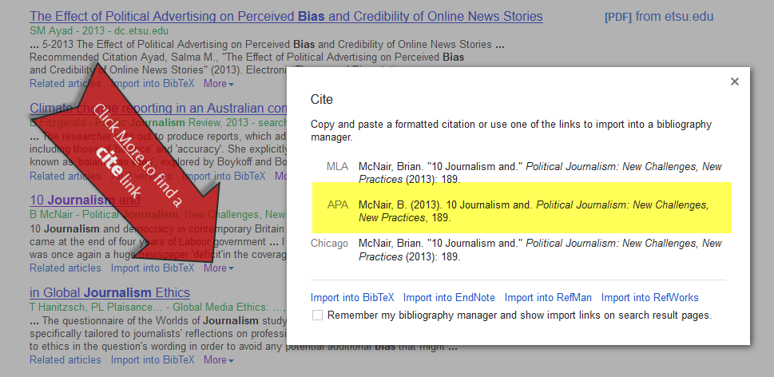
Ohh…. This reference list takes such an age to compile and write up.
Well it DID –
BEFORE the amazing, wonderful invention known as google cite (part of google scholar).
You may also have come across Neil`s toolbox…
BUT, be careful, you still have to check that your references are accurate because there are so many similar referencing systems out there…

Slide 52
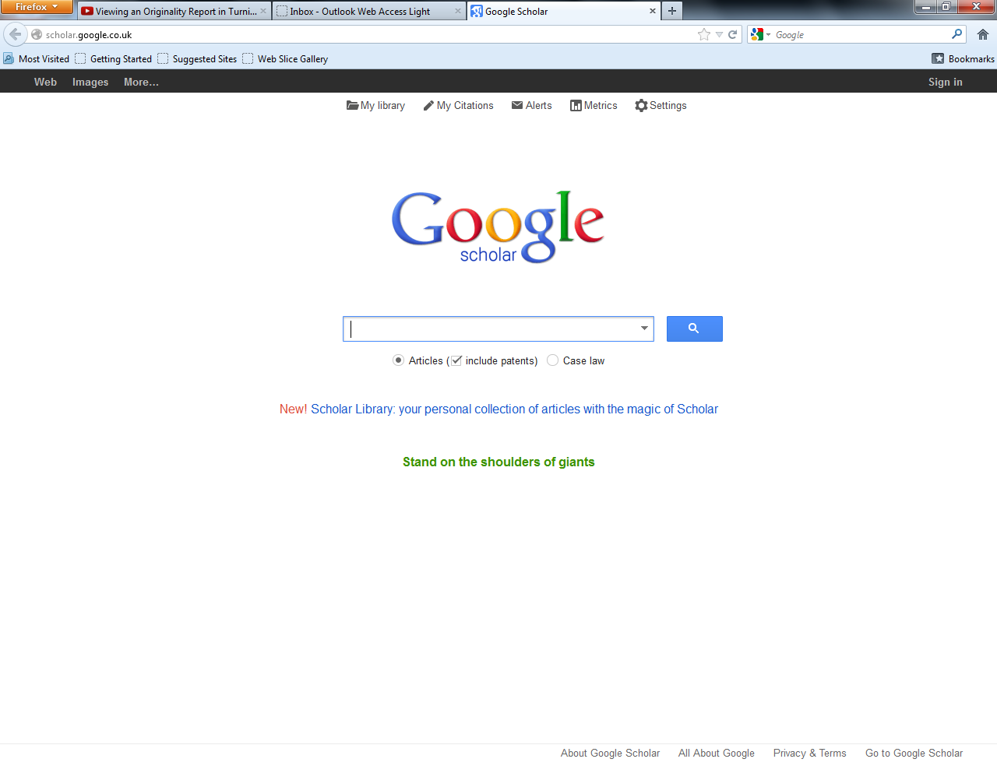

Slide 54
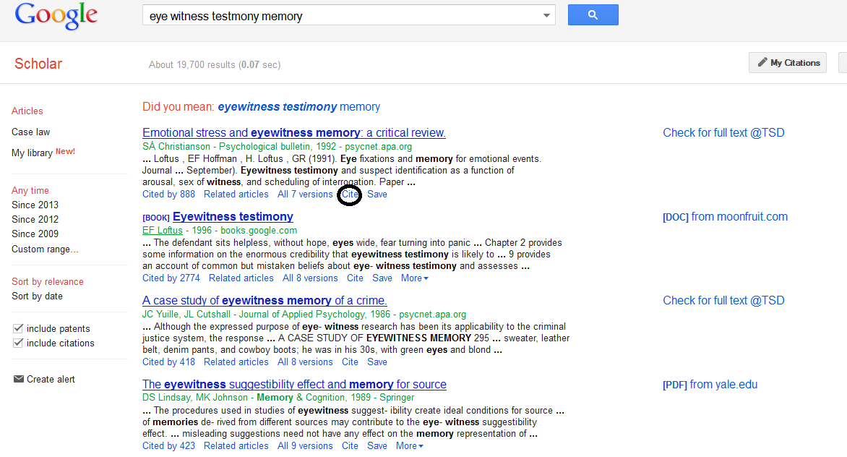

Slide 55
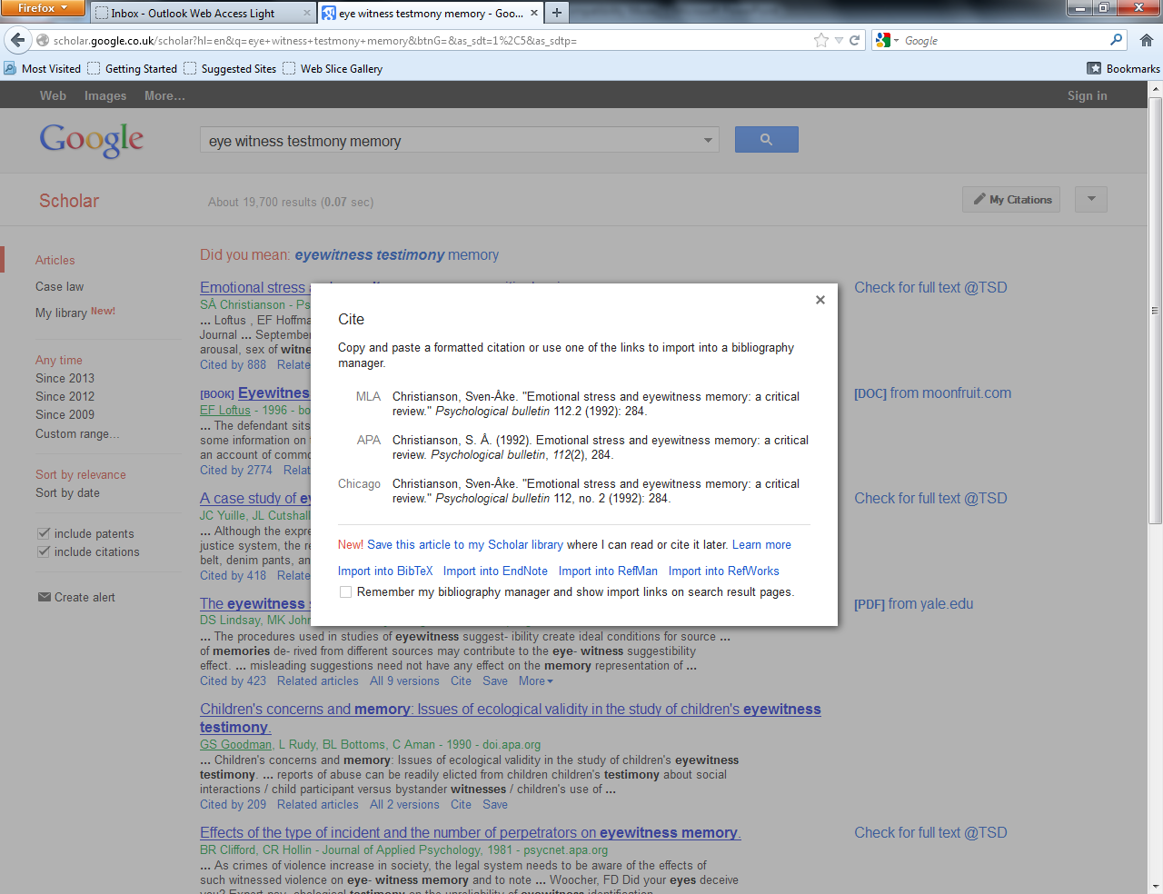

Slide 56
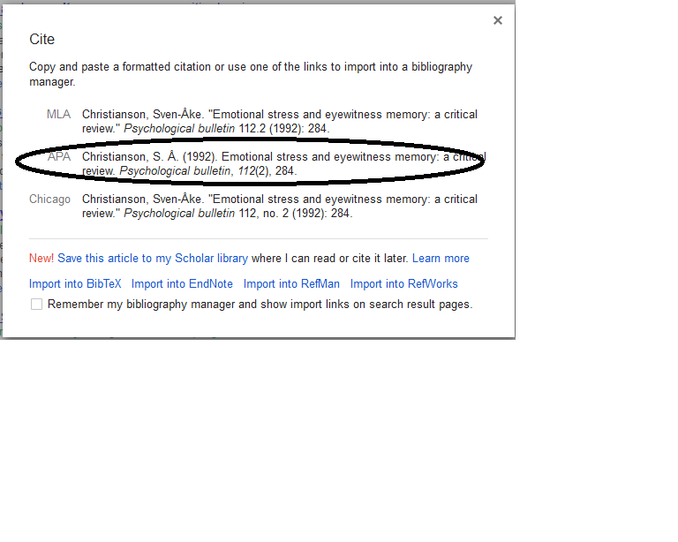
And then copy and paste…

Slide 57
Find the faults:
Blasi, A. (1998) Loevinger`s theory of ego development and its relationship to the cognitive developmental approach. In P. N. Westenberg A. Blasi. and L. D. Cohn. (Eds), Personality development: Theoretical clinical and empirical investigations of Loevinger`s conception of ego development (pp13-25). Mahwah, NJ.. Erlbaum.
Bornstein, R. F. (1992). The Dependent Personality: Developmental, Social and Clinical Perspectives. Psychological Bulletin, pages 112, 3-23.
Cauffman, E, Steinberg, L. and Piquero, A. R., (2005). Psychological , Neuropsychological and physiological correlates of serious antisocial behaviour in adolescence: the role of self-control. Criminology, 43, 133-176.

Slide 58
Find the faults:
Blasi, A. (1998). Loevinger`s theory of ego development and it`s relationship to the cognitive developmental approach. In P. N. Westenberg, A. Blasi. and L. D. Cohn. (Eds),. Personality Development: Theoretical Clinical and Empirical Investigations of Loevinger`s conception of ego development (pp13-25). Mahwah, NJ: Erlbaum.
Bornstein, R. F. (1992). The Dependent Personality: Developmental, Social and Clinical Perspectives. Psychological Bulletin, 112, 3-23.
Cauffman, E., Steinberg, L. and Piquero, A. R., (2005). Psychological , Neuropsychological and physiological correlates of serious antisocial behaviour in adolescence: the role of self-control. Criminology, 43, 133-176.

Slide 59
Remember – the Take home message
For all assignment submissions you must reference in APA format – APA stands for American Psychological Association. Follow their guidelines – its is NOT HARVARD, MLA, Chicago or Vancoover.
Use the APA Publication Manual (6th edition).
School of Psychology Referencing Guidelines.
Cite them right (but make sure you are adhering to the APA section of that book).

