Slide 1

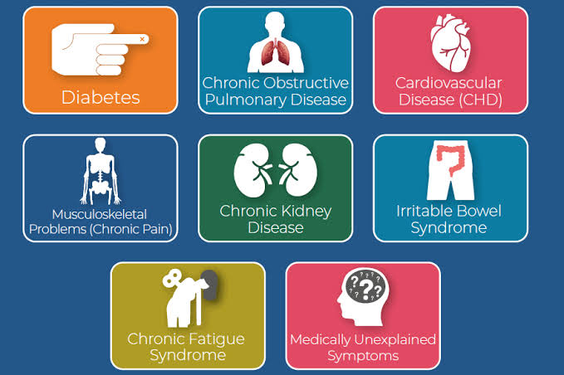
Community Care and Management of Longer-term Conditions -Presentation
Module code: LCHS7003
Student name: Sharon McDermott
Student DI: 2243145
Lecturer: Muhammad Khan

Slide 2

Introduction
Type 2 diabetes is a progressive condition that impairs blood glucose control.
Early diagnosis, risk-factor management, appropriate medication, and ongoing support can slow its progression.
Effective care should follow evidence-based guidance, encourage patient self-management, foster collaboration with healthcare professionals, and address behavioural, social, and environmental barriers equitably. (O’Riordan, B. and Haseldine, et al. 2017) Alberti, K.G.M.M., Zimmet, P. and Shaw, J. (2007)
(Sargeant, J.A. et al., 2020)

Slide 3
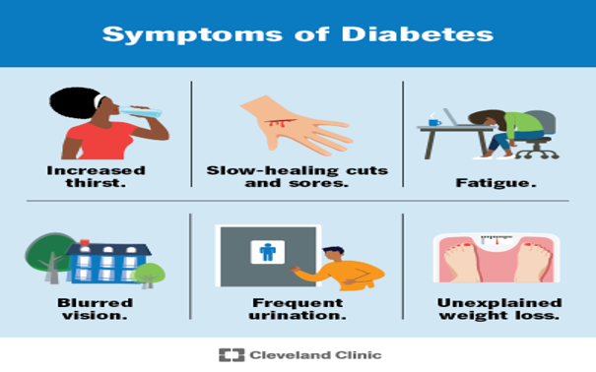
Type Two Diabetes Causes
Aetiology (Causes)
Definition
Genetic and biological factors:
Type 2 diabetes develops through a combination of genetic susceptibility, ageing, insulin resistance, and progressive pancreatic β-cell dysfunction. Risk is higher among people with a family history of the condition, a history of gestational diabetes, or polycystic ovary syndrome (PCOS), and among South Asian, Black African, and African Caribbean populations. (Tahir et al., 2025)
Lifestyle, health, and socioeconomic factors:
Abdominal obesity, physical inactivity, an unhealthy diet, certain medications, and hormonal conditions can increase the risk of type 2 diabetes by disrupting glucose regulation and appetite. Food insecurity, chronic stress, and wider social and economic inequalities may also contribute to its development (Silva et al., 2021).
Type 2 diabetes causes persistently high blood glucose due to insulin resistance and declining β-cell function. (Lu, X. et al. ,2024) Lu, X. et al. (2024)
The pancreas initially produces extra insulin but may eventually fail to meet the body’s needs.
“Adult-onset” and “non-insulin-dependent” are inaccurate because it can affect young people and may require insulin treatment. (Bergman, R.N., Finegood, D.T., et al. 2002)
(Cleveland Clinic, 2025)
Symptoms
Symptoms include increased thirst, frequent urination, tiredness, blurred vision, recurrent infections, and slow wound healing (Alrashed et al., 2024). Some people may have no symptoms for years (Bondzie et al., 2025).
Prolonged high blood sugar can damage blood vessels and nerves, causing heart, kidney, eye, and nerve problems.

Slide 4
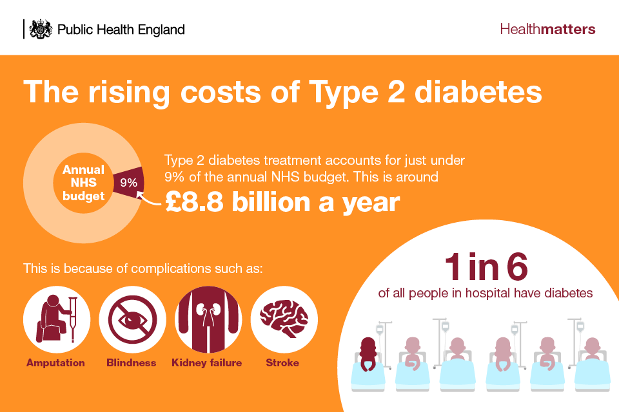

Most spending follows preventable complications
Economic burden
Diabetes costs the UK healthcare system an estimated £10.7 billion annually, placing a heavy financial burden on the NHS. (Diabetes UK, 2024).
Managing diabetes-related complications accounts for over 60% of healthcare spending.
If current trends continue, NHS diabetes-related expenses could reach £18 billion by 2035. (Harding, J.L. et al. (2019)
Wider economic effects include increased workplace absence, reduced earnings and productivity, greater reliance on unpaid carers, and costs associated with early mortality. (Vries, S.A.G. et al. 2023)
(Diabetes GOV.UK, 2018)
Social burden
Ongoing medical care, medication, monitoring, and lifestyle management.
Emotional challenges, including distress, anxiety, depression, and stigma.(Joseph, L. et al. (2024)
Financial pressure from treatment, healthy food, medication, and transport costs. (Hex, N. et al. (2024) )
Reduced quality of life and unequal outcomes, especially in disadvantaged and minority communities. (Lu, J.B. et al. 2018)
(Thomason Bunn, CDCES, et al.,2025)

Slide 5
Diabetes is common, rising and substantially underdiagnosed
Diabetes Is a Common Long-Term Condition:
Diabetes affects millions of people in the UK and worldwide, and its prevalence is increasing. (Gregg, E.W. et al. (2025)
Prevalence
Around 6 million people in the UK have diabetes: 4.7 million are diagnosed, while 1.3 million may have undiagnosed type 2 diabetes.
Type 2 diabetes accounts for approximately 90% of diagnosed UK cases. (Whicher, C.A., O’Neill, S. et al., 2020)
Globally, estimates vary by methodology: 589 million adults aged 20–79 had diabetes in 2024, projected to reach 853 million by 2050, while WHO estimated 830 million people in 2022. Comparisons should state the age groups, population denominators and diagnostic methods used. (Davis, W.A. et al. 2018)
(Official Statistics,2025)

Slide 6

Diagnostic Thresholds & Initial Evaluation
Diagnose diabetes with fasting plasma glucose ≥7.0 mmol/L, HbA1c ≥48 mmol/mol (6.5%), or two-hour OGTT glucose ≥11.1 mmol/L; repeat testing on another day if asymptomatic. (Wang, Y. et al. (2026)
Do not rely solely on HbA1c in pregnancy, acute illness, abnormal red-cell turnover, rapidly worsening symptoms, or suspected type 1 diabetes. (Xue, X. et al. (2025)
Initial Assessment
Assess glycaemia, acute risks, complications, cardiovascular–renal health, and the patient’s priorities.
Review symptoms, medications, family history, lifestyle, smoking, and psychological wellbeing; examine BMI/waist, blood pressure, feet, and relevant injection sites. (Cardoso, C.R.L. et al. (2018)
Check HbA1c, eGFR, urinary albumin-to-creatinine ratio, lipids, and liver function when indicated; confirm retinopathy screening and evaluate cardiovascular disease, heart failure, chronic kidney disease, and atypical diabetes. (Zhang, D., Shi, L. and Wang, et al. 2026)
Diagnosis and Initial Assessment
(Diseases & Disorders 2019)

Slide 7
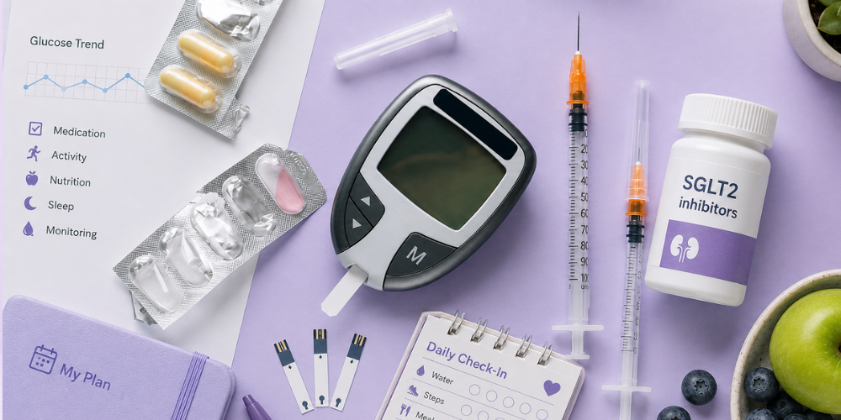
Understand and assess:
Management starts with person-centred goals
Explore priorities, frailty, life expectancy,
Explore priorities, frailty, life expectancy, treatment burden, and health literacy; assess HbA1c, cardiovascular and kidney disease, heart failure, weight, and hypoglycaemia risk. (McCoy, R.G. et al. 2020)
Agre
Use shared decision-making to set personalised HbA1c and broader risk-factor goals. (Brockamp, C. et al. (2023)
Treat
Integrate lifestyle support and cardiovascular–renal protection with glucose-lowering medicines, balancing benefits, safety, and preferences. (Bain, S.C. et al. 2016)
Review, educate and reassess:
Monitor response, side effects, adherence, and complications; provide structured education and revisit goals as health or priorities change. (Bartlett Ellis, R.J., Haase, J.E. et al. 2023)
(Willis RGN, 2026)

Slide 8
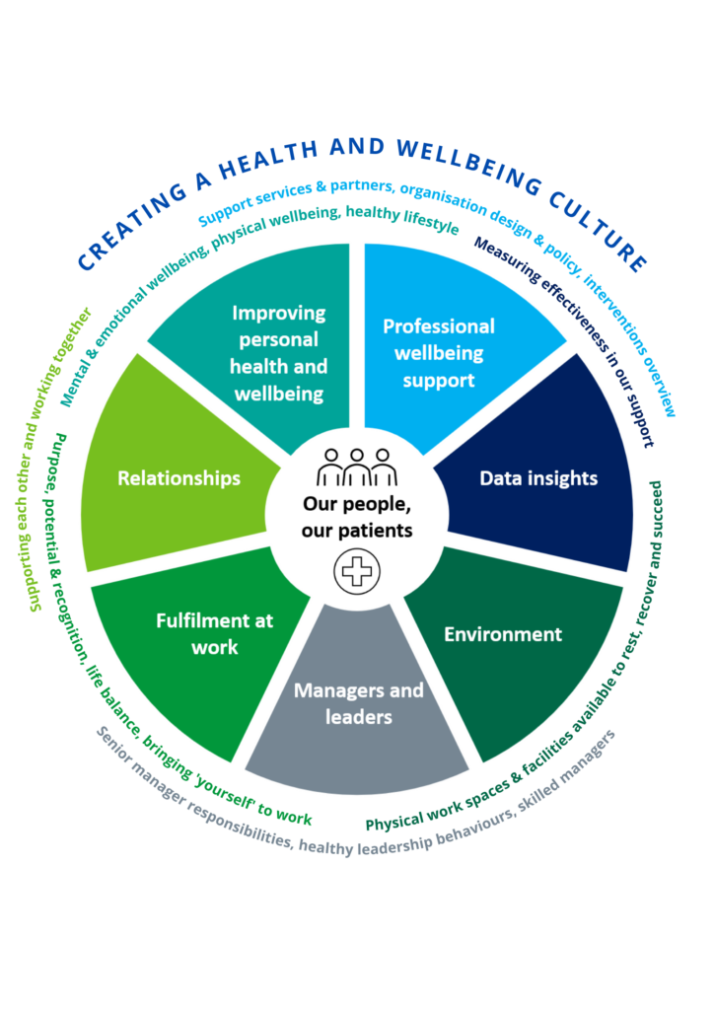
Integrated frameworks turn guidelines into reliable practice
Models of care:
The House of Care and Chronic Care Model connect engaged people with prepared professionals, supported by effective systems, decision tools, registries and community resources. (Gudlavalleti, A.G. et al. 2024).
Quality improvement:
PDSA cycles, audit and feedback, and co-designed measures help identify and close gaps across nine core care processes and related outcomes. (Astrup, K., Rolving, et al. 2025)
Population health management:
Primary care networks can use risk stratification, proactive recall, and equity-focused case-finding to improve access and target support. (Elston, J., Gradinger, et al. 2026)
Critical test:
The model should strengthen continuity, reach underserved groups, reduce treatment workload and improve health outcomes—not simply introduce new labels.(Kanumilli, N. et al. 2023)
(NHS Trust, England, 2023)

Slide 9
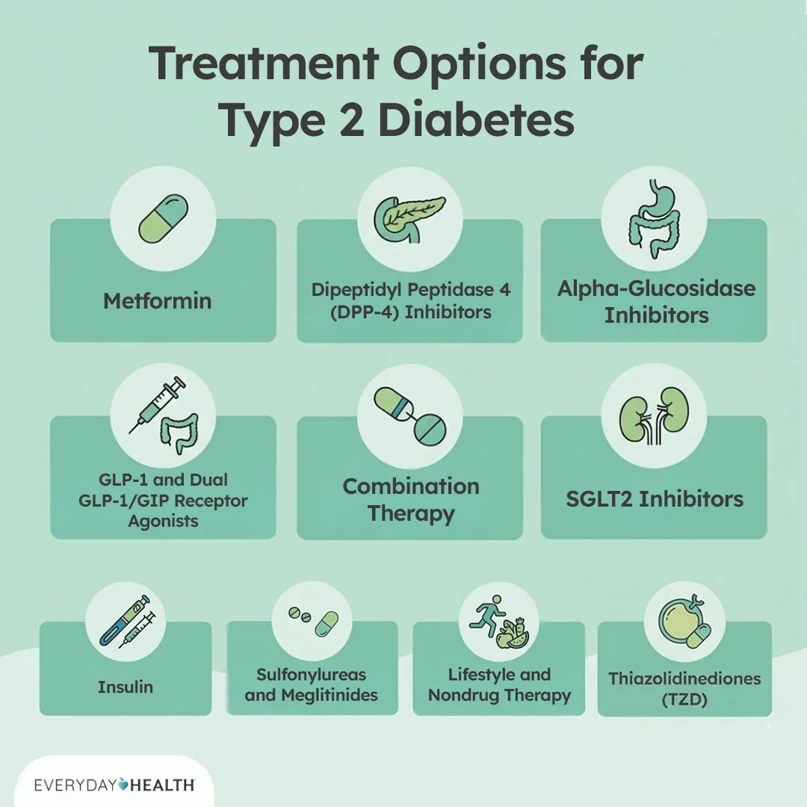
Treatment choice balances glucose, organ protection and burden
Foundation of care
Individualise treatment according to comorbidities, kidney function, hypoglycaemia risk, weight goals, cost and personal preferences. (Araki, A. (2024)
Support culturally appropriate diet, physical activity, weight management, smoking cessation and structured education. (Manikam, L. et al. 2024)
Medication options
Metformin is commonly first-line; SGLT-2 inhibitors, GLP-1 receptor agonists or tirzepatide may offer additional heart, kidney, glucose or weight benefits, depending on eligibility and tolerability. (Yepes-Cortés, C.A. et al. 2025).
Other options include DPP-4 inhibitors, sulfonylureas, pioglitazone and insulin, selected according to effectiveness, side effects, contraindications and the severity of hyperglycaemia. (Chai, S. et al. 2024).
( Jara, Golmam, DM, etal.2026)

Slide 10
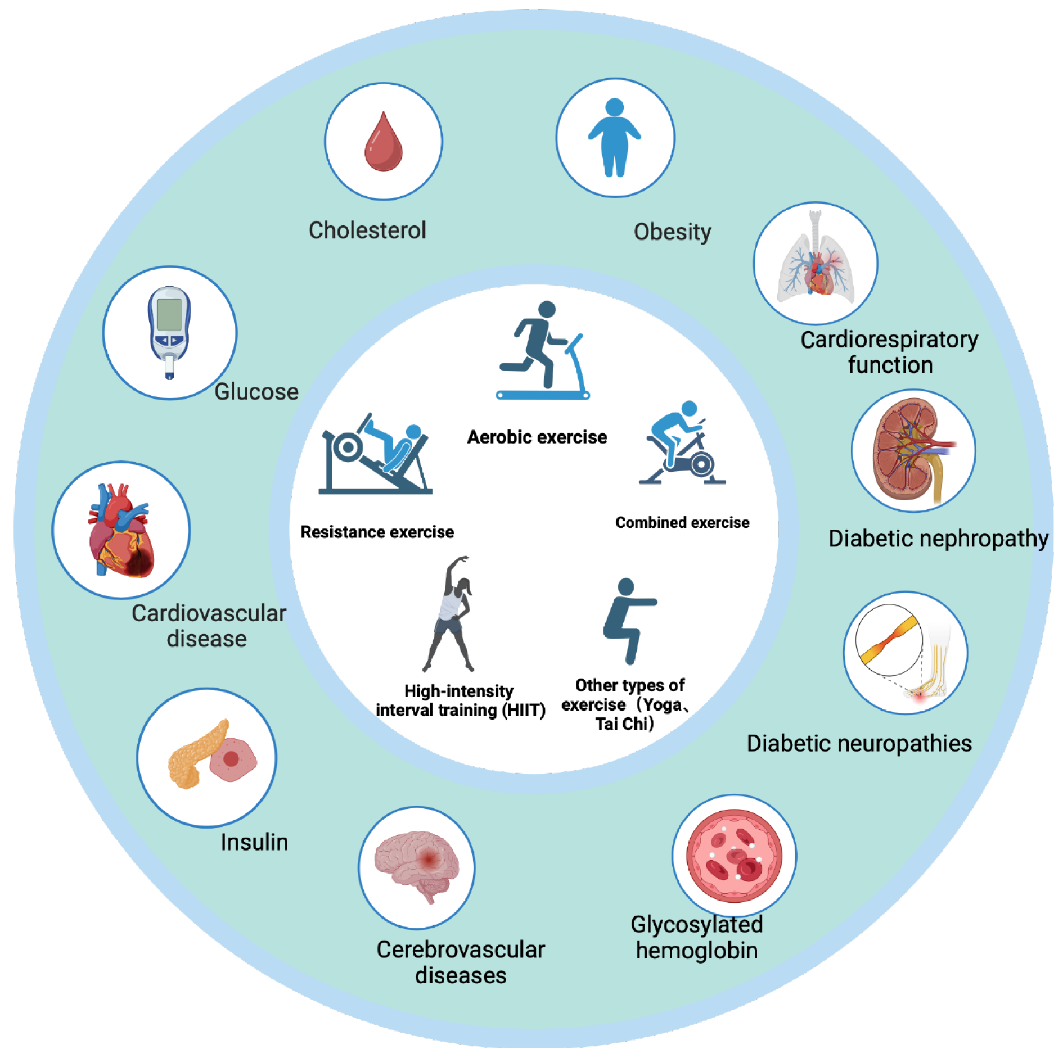
Comorbidity should reshape the care plan
Major Associated with Type 2 Diabetes
Cardiovascular Disease:
Coronary heart disease, stroke, peripheral arterial disease, and heart failure. (Pagano, E. et al. (2021)
Metabolic and Renal Disorders:
Obesity, hypertension, dyslipidaemia, metabolic liver disease, chronic kidney disease, and albuminuria. (Yun, J.-S. et al. 2022)
Psychological and Cognitive Conditions: Depression, anxiety, diabetes-related distress, disordered eating, and cognitive impairment. (Kintzoglanakis, K. et al. 2022)
Diabetes-Related Complications and Management Implications
Type 2 diabetes increases the risk of microvascular complications, including retinopathy, neuropathy, foot ulcers, and autonomic dysfunction. (Zhang, Z. et al. 2025)
Other associated conditions include sleep apnoea, sexual dysfunction, recurrent infections, and musculoskeletal limitations. (Arshad, M.F. et al. 2024)
Holistic, person-centred care should reduce treatment burden and prioritise outcomes that matter most.(Rodbard, H.W. et al. 2024)
(Baishideng Publishing Group. 2024)

Slide 11
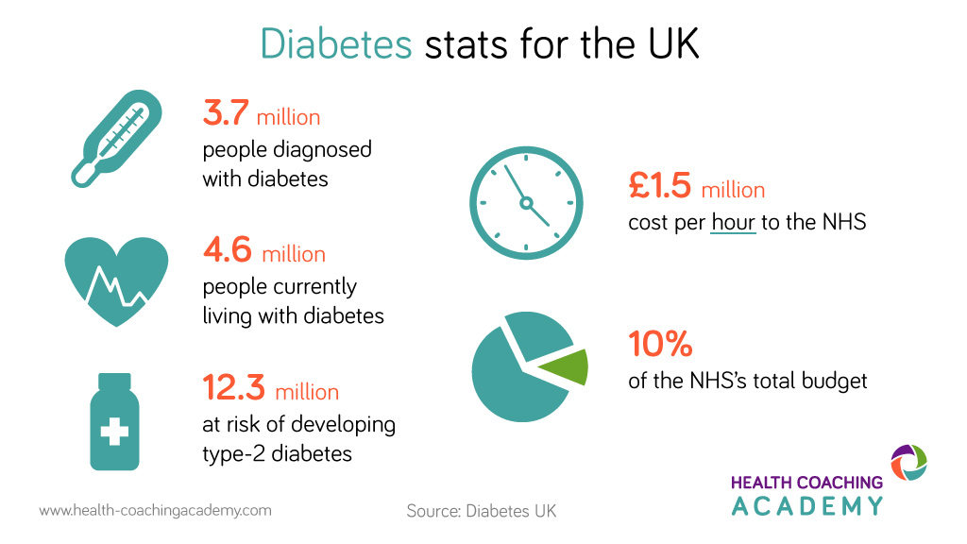
Monitoring should prevent harm, not merely record HbA1c
Clinical Monitoring and Quality & Safety
Conduct a comprehensive annual diabetes review covering glycaemic, cardiovascular, renal, ocular, foot, and psychological health. (Elbalshy, M. et al. 2022)
Monitor HbA1c every 3–6 months until controlled, then approximately every 6 months; also assess blood pressure, weight, BMI, medications, kidney function, urinary ACR, lipids, and cardiovascular risk. (Termannsen, A. et al. 2025)
Ensure retinal screening and regular foot assessments, with prompt referral for active foot complications. (Stedman, M. et al. 2023)
Quality, safety and equitable care
Regularly discuss hypoglycaemia, driving and occupational risks, sick-day rules, injection technique, and glucose-monitoring data. (ElSayed, N.A. et al. 2025)
Review adherence supportively, simplify treatment where appropriate, and screen for diabetes distress and depression.
Monitor recommended care processes and outcomes across ethnic and socioeconomic groups to identify and reduce inequalities. (Goff, L.M., 2019)
(Burnett, 2025)

Slide 12
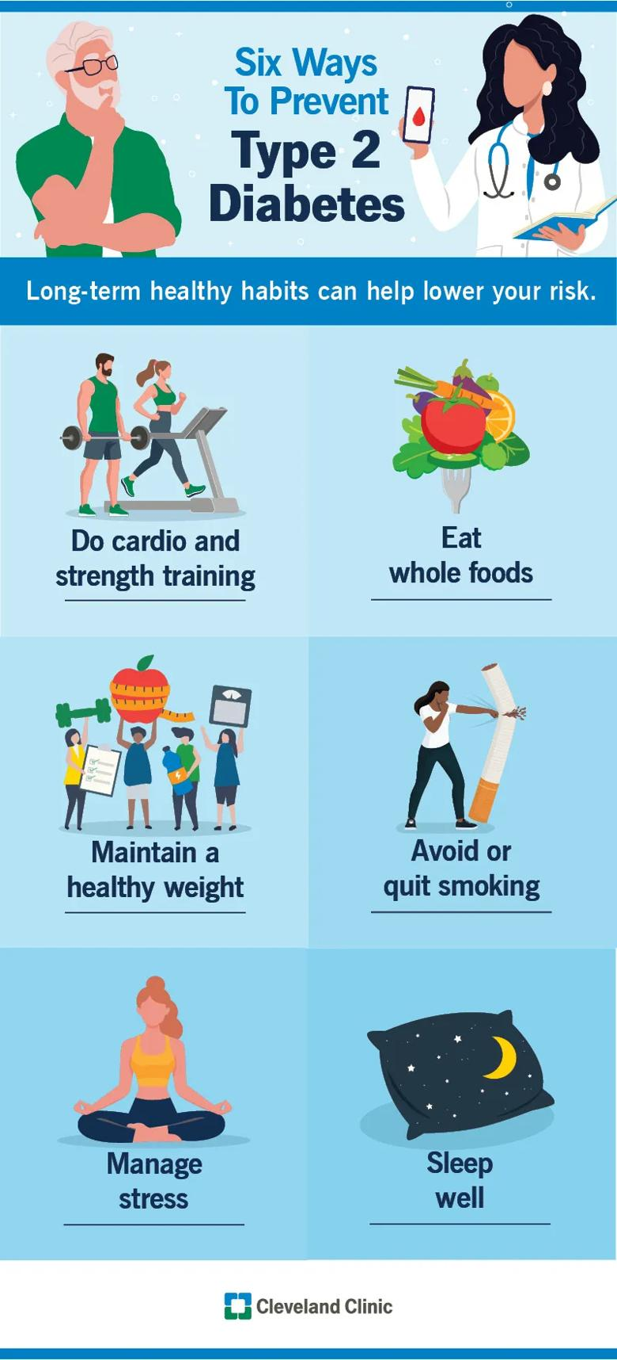
Type Two Diabetes prevention
Steps for a Healthy Lifestyle
Maintain a healthy weight and get at least 150 minutes of moderate activity each week, including strength training twice a week. (Raben, A. et al.2021)
Eat a balanced, high-fibre diet with vegetables, fruits, wholegrains, lean protein, beans, and lentils. Limit sugary drinks and heavily processed foods.
Avoid smoking, moderate alcohol intake, prioritise quality sleep, and make sustainable, long-term lifestyle changes. (Song, Z. et al. 2021)
(Cleveland Clinic, 2026)

Slide 13
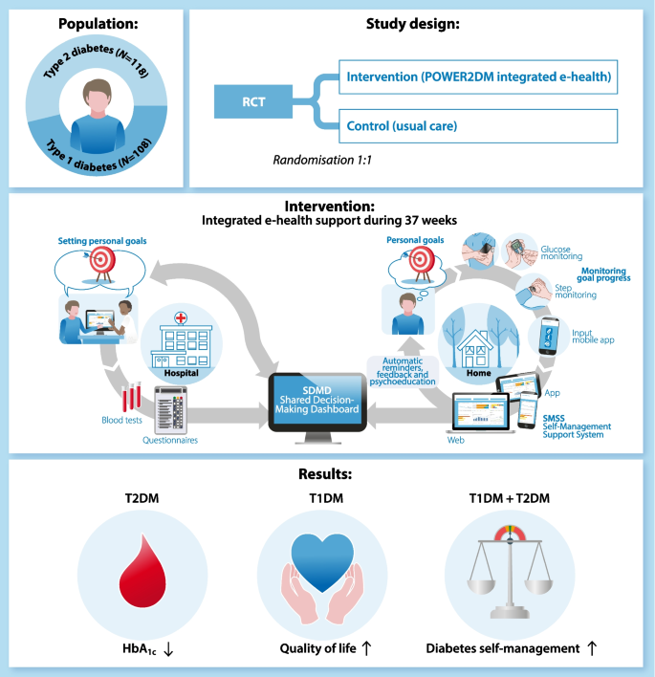
Co-production changes who holds power in care
Skills
Build a collaborative partnership that combines clinical expertise with the person’s experiences, priorities and Diabetes treatment preferences.
Use active listening, open-ended questions, accessible language, teach-back, cultural sensitivity, and trauma-informed communication. (Sørensen, M., Groven, et al., 2020)
Support shared decision-making through goal setting, motivational interviewing, strengths-based coaching, teamwork, and clear safety-netting to manage diabetes. (Zhang, W. et al., 2024)
Values and Behaviours
Respect individual autonomy, including each person’s right to accept or decline treatment, and involve carers—with consent—while maintaining confidentiality. (Rehackova, L. et al.,2020)
Provide curious, non-judgemental and non-stigmatising care, recognising power imbalances and wider social factors affecting health outcomes. (Creevy, N. and Boocock, R. 2026).
Build trust through transparency, shared decision-making, reliable follow-through and prompt action to rebuild confidence when problems occur. (Park, K. and Yoon, H.Y. 2025)
(Baishideng Publishing Group 2024)

Slide 14
All six personalised-care components should work together
5. Supported Self-Management
Helps people build the knowledge, confidence, and skills to manage diabetes through education, coaching, peer support, and tailored digital resources.
Works best when integrated with other components of personalised care and adapted to individual needs and engagement levels. (Carvalho, M. et al. 2024)
6. Personal health
Personal health budgets give people greater control over resources to achieve agreed health outcomes. (Carvalho, M. et al. 2024)
When used transparently and collaboratively alongside shared decision-making, care planning, choice, social prescribing and self-management support, they help meet personal goals, improve outcomes and avoid unfairly transferring responsibility or risk.
1. Shared Decision-Making
Collaborate with individuals to explore Diabetes treatment options and make informed choices. (Yu, C. et al. 2020)
Ensure decisions reflect their preferences, values, and health goals.
Use decision aids and option grids to discuss glycaemic targets, medications, and diabetes management
2. Personalised Care and Support Planning
Create one tailored care plan that is clear and accessible. (Spencer, E. et al. 2024)
Include agreed goals, warning signs, and review schedules.
Set out contingency arrangements to keep care coordinated and responsive.
3. Enabling Choice
Offer flexible education and appointment formats that suit individual circumstances and preferences.
Provide evidence-based treatment options to support personalised care in medicine options, diet control, blood sugar monitoring, etc. (Olesen, K. et al. 2020)
4. Social Prescribing
Recognises how social and environmental factors affect health and wellbeing.
Connects individuals with community support, including physical activity, welfare, nutrition, housing, peer networks, and culturally appropriate programmes. (Olesen, K. et al. 2020)

Slide 15

A practical recommendation: build one coordinated pathway
Co-design: Involve and pay diverse people with diabetes and carers to shape equitable services and review inequalities. (Jordan, J.E. et al. 2026)
Connect: Provide clear access to multidisciplinary, psychological and community support through social prescribing.
Learn: Review experience, wellbeing, clinical outcomes, treatment burden and inequalities quarterly.
Target support: Combine universal access with targeted outreach and intensive care for people with greater needs. (Grimshaw, J.M. et al. 2023)
Enable choice: Support shared decisions, personal health budgets, education, peer support, healthy activity and timely psychological help.
  Plan: Create one personalised plan covering goals, treatment, medication, self-management, coping strategies and escalation advice. (Avari, P. et al .2025)
A coordinated, person-centred pathway for type 2 diabetes, integrating lifestyle modification, weight and glycaemic management, cardiovascular risk reduction and cardiorenal protection. AI-generated using OpenAI (2026) illustration informed by Davies et al. (2022).

Slide 16
THANK YOU
ANY?

Slide 17
Reference
Araki, A. (2024) “Individualised treatment of diabetes mellitus in older adults,” Geriatrics & gerontology international, 24(12), pp. 1257–1268. Available at: https://doi.org/10.1111/ggi.14979.
Alrashed, F.A. et al. (2024) “Exploring determinants of sex and family history-based disparity in type 2 diabetes mellitus prevalence among clinical patients,” BMC Public Health, 24(1). Available at: https://doi.org/10.1186/s12889-024-18170-0.
Arshad, M.F. et al. (2024) “Diabetic autonomic neuropathy does not impede improvement in hypoglycaemia awareness in adults: Sub‐study results from the HypoCOMPaSS trial,” Diabetic medicine, 41(9), pp. e15340–e15340. Available at: https://doi.org/10.1111/dme.15340.
Astrup, K., Rolving, N. and Sørensen, L. (2025) “Improving quality of physical function assessment in intensive care units through routine use of the Danish Chelsea Critical Care Physical Assessment Tool (CPAx-D),” Disability and Rehabilitation, 47(21), pp. 5594–5601. Available at: https://doi.org/10.1080/09638288.2025.2463629.
Avari, P. et al. (2025) “Using technology to support diabetes care in hospital: Guidelines from the Joint British Diabetes Societies for Inpatient Care (JBDS‐IP) group and Diabetes Technology Network (DTN) UK,” Diabetic medicine, 42(3), pp. e15452-n/a. Available at: https://doi.org/10.1111/dme.15452.
Bain, S.C. et al. (2016) “Management of type 2 diabetes: the current situation and key opportunities to improve care in the UK,” Diabetes, obesity & metabolism, 18(12), pp. 1157–1166. Available at: https://doi.org/10.1111/dom.12760
Bartlett Ellis, R.J., Haase, J.E. and Ruppar, T.M. (2023) “Understanding Processes, Outcomes, and Contexts in Medication Adherence: The Medication Adherence Context and Outcomes (MACO) Framework,” Patient Preference and Adherence, 17, pp. 239–248. Available at: https://doi.org/10.2147/PPA.S387813.
Bergman, R.N., Finegood, D.T. and Kahn, S.E. (2002) “The evolution of β-cell dysfunction and insulin resistance in type 2 diabetes,” European journal of clinical investigation, 32(s3), pp. 35–45. Available at: https://doi.org/10.1046/j.1365-2362.32.s3.5.x.
Bondzie, E.P.K. et al. (2025) “Impact of health systems interventions in primary health settings on type 2 diabetes care and health outcomes among adults in West Africa: A systematic review,” PLoS one, 20(4), p. e0319478. Available at: https://doi.org/10.1371/journal.pone.0319478.
Booth, K. and Morelli, A. (2026) “Speaking Quality Improvement: Leveraging the PDSA Framework to Improve Dialysis Outcomes,” Nephrology nursing journal: journal of the American Nephrology Nurses’ Association, 53(3), pp. 227–233. Available at: https://doi.org/10.37526/1526-744X.2026.53.3.227
Brockamp, C. et al. (2023) “Clinical Practice Guideline: Shared Decision Making, Diagnostic Evaluation, and Pharmacotherapy in Type 2 Diabetes,” Deutsches Ärzteblatt international, 120(47), p. 804. Available at: https://doi.org/10.3238/arztebl.m2023.0219.
Calderón-Larrañaga, S. et al. (2023) “Unravelling the potential of social prescribing in individual-level type 2 diabetes prevention: a mixed-methods realist evaluation,” BMC Medicine, 21(1). Available at: https://doi.org/10.1186/s12916-023-02796-9

Slide 18
Cardoso, C.R.L. et al. (2018) “Long-term visit-to-visit glycemic variability as predictor of micro- and macrovascular complications in patients with type 2 diabetes: The Rio de Janeiro Type 2 Diabetes Cohort Study,” Cardiovascular Diabetology, 17(1). Available at: https://doi.org/10.1186/s12933-018-0677-0.
Cardoso, C.R.L. et al. (2018) “Long-term visit-to-visit glycemic variability as predictor of micro- and macrovascular complications in patients with type 2 diabetes: The Rio de Janeiro Type 2 Diabetes Cohort Study,” Cardiovascular diabetology, 17(1). Available at: https://doi.org/10.1186/s12933-018-0677-0.
Carvalho, M. et al. (2024) “Barriers and enablers to maintaining self-management behaviours after attending a self-management support intervention for type 2 diabetes: a systematic review and qualitative evidence synthesis,” Health Psychology Review, 18(3), pp. 478–507. Available at: https://doi.org/10.1080/17437199.2023.2268731
CDC Diabetes (2024) About "On Your Way to Preventing Type 2 Diabetes. Available at: https://www.cdc.gov/diabetes/prevention-type-2/type-2-diabetes-prevention-guide.html (Accessed 7August
Chai, S. et al. (2024) “Comparison of GLP-1 Receptor Agonists, SGLT-2 Inhibitors, and DPP-4 Inhibitors as an Add-On Drug to Insulin Combined with Oral Hypoglycemic Drugs: Umbrella Review,” Journal of Diabetes Research. Edited by M. Yorek, 2024(1), p. 8145388. Available at: https://doi.org/10.1155/2024/8145388.
Cleveland Clinic (2025) Type 1 Diabetes. Available at: https://my.clevelandclinic.org/health/diseases/21500-type-1-diabetes (Accessed 7 August 2026)
Cleveland Clinic Health Essentials (2026) Steps To Take Toward Diabetes Prevention. Available at: https://health.clevelandclinic.org/how-to-prevent-diabetes (Accessed 8 August 2026)
Creevy, N. and Boocock, R. (2026) “Information and Support Needs of Clinicians and Food‐Insecure Adults with Type 2 Diabetes: A Systematic Review,” Journal of Human Nutrition and Dietetics, 39(1), pp. e70191-n/a. Available at: https://doi.org/10.1111/jhn.70191.
Davies, M.J., Aroda, V.R., Collins, B.S. et al. (2022) ‘Management of hyperglycemia in type 2 diabetes, 2022: A consensus report by the American Diabetes Association and the European Association for the Study of Diabetes’, Diabetes Care, 45(11), pp. 2753–2786. Available at: https://doi.org/10.2337/dci22-0034
Davis, W.A., Peters, K.E., Makepeace, A., et al. (2018) “Prevalence of diabetes in Australia: insights from the Fremantle Diabetes Study Phase II,” Internal Medicine Journal, 48(7), pp. 803–809. Available at: https://doi.org/10.1111/imj.13792.
Elbalshy, M. et al. (2022) “Effect of divergent continuous glucose monitoring technologies on glycaemic control in type 1 diabetes mellitus: A systematic review and meta‐analysis of randomised controlled trials,” Diabetic Medicine, 39(8), pp. e14854-n/a. Available at: https://doi.org/10.1111/dme.14854
ElSayed, N.A. et al. (2025) “6. Glycemic Goals and Hypoglycemia: Standards of Care in Diabetes—2025,” Diabetes care, 48(Supplement_1), pp. S128–S145. Available at: https://doi.org/10.2337/dc25-S006.

Slide 19
Elston, J., Gradinger, F. and Asthana, S. (2026) “Implementing Population Health Management across Primary Care in a UK Integrated Care System (April 2022-2024),” International Journal of Integrated Care, 26(S1), p. 231. Available at: https://doi.org/10.5334/ijic.ICIC25231.
Fernandes Silva, L., Vangipurapu, J. and Laakso, M. (2021) “The ‘Common Soil Hypothesis’ Revisited—Risk Factors for Type 2 Diabetes and Cardiovascular Disease,” Metabolites, 11(10), p. 691. Available at: https://doi.org/10.3390/metabo11100691. (Accessed 3 August 2026)
Goff, L.M. (2019) “Ethnicity and Type 2 diabetes in the UK,” Diabetic Medicine, 36(8), pp. 927–938. Available at: https://doi.org/10.1111/dme.13895.
Gregg, E.W. et al. (2025) “Multiple long-term conditions as the next transition in the global diabetes epidemic,” Communications Medicine, 5(1). Available at: https://doi.org/10.1038/s43856-025-00742-9.
Grimshaw, J.M. et al. (2023) “Quality improvement strategies for diabetes care: Effects on outcomes for adults living with diabetes,” Cochrane Database of Systematic Reviews, 2023(6), p. CD014513. Available at: https://doi.org/10.1002/14651858.CD014513.
Gudlavalleti, A.G. et al. (2024) “Training of Community Health Workers in Diabetes Leads to Improved Outcomes for Diabetes Screening and Management in Low- and
Middle-Income Countries: Protocol for a Systematic Review,” JMIR Research Protocols, 13, p. e57313. Available at: https://doi.org/10.2196/57313.
Harding, J.L. et al. (2019) “Global trends in diabetes complications: a review of current evidence,” Diabetologia, 62(1), pp. 3–16. Available at: https://doi.org/10.1007/s00125-018-4711-2.
Hex, N. et al. (2024) “Estimation of the direct health and indirect societal costs of diabetes in the UK using a cost of illness model,” Diabetic Medicine, 41(9), pp. e15326-n/a. Available at: https://doi.org/10.1111/dme.15326.
Jara, S. (2026) “Switching medication: What to do when your type 2 diabetes treatment is not working” EveryDay Health [image]. Available at: https://www.everydayhealth.com/diabetes/switching-medications-if-type-2-diabetes-medication-isnt-working/ (Accessed 8 August 2026)
Jordan, J.E. et al. (2026) “Meaningful engagement of lived experience in diabetes research and health service improvement: A rapid review of barriers to and enablers for community involvement among adults with type 2 diabetes,” Diabetic Medicine, p. e70274. Available at: https://doi.org/10.1111/dme.70274
Joseph, L. et al. (2024) “Experiences and challenges of people living with multiple long-term conditions in managing their care in primary care settings in Kerala, India: A qualitative study,” PLoS ONE, 19(6), p. e0305430. Available at: https://doi.org/10.1371/journal.pone.0305430.
Kanumilli, N. et al. (2023) “Guardians For Health: A Practical Approach to Improving Quality of Life and Longevity in People with Type 2 Diabetes,” Diabetes Therapy, 14(7), pp. 1093–1110. Available at: https://doi.org/10.1007/s13300-023-01418-0.

Slide 20
Kintzoglanakis, K. et al. (2022) “Depression, anxiety, and diabetes-related distress in type 2 diabetes in primary care in Greece: Different roles for glycemic control and self-care,” SAGE Open Medicine, 10, p. 20503121221096605. Available at: https://doi.org/10.1177/20503121221096605.
Lu, J.B. et al. (2018) “Do quality improvement initiatives for diabetes care address social inequities? Secondary analysis of a systematic review,” BMJ Open, 8(2), p. e018826. Available at: https://doi.org/10.1136/bmjopen-2017-018826.
Lu, X. et al. (2024) “Type 2 diabetes mellitus in adults: pathogenesis, prevention and therapy,” Signal transduction and targeted therapy, 9(1). Available at: https://doi.org/10.1038/s41392-024-01951-9.
Mackenzie, S.C. et al. (2021) “Massive open online course for type 2 diabetes self-management: adapting education in the COVID-19 era,” BMJ innovations, 7(1), pp. 141–147. Available at: https://doi.org/10.1136/bmjinnov-2020-000526
McCoy, R.G. et al. (2020) “Development and evaluation of a patient-centred quality indicator for the appropriateness of type 2 diabetes management,” BMJ open diabetes research & Care, 8(2), p. e001878. Available at: https://doi.org/10.1136/bmjdrc-2020-001878.
O’Riordan, B. and Haseldine, C. (2017) “Implementing a community-based diabetes prevention programme in Ireland,” International Journal of Integrated Care, 17(5), p. 241. Available at: https://doi.org/10.5334/ijic.3552.
Office for Health Improvement & Disparities. (2025) Diabetes profile: statistical commentary, March 2025. Available at: https://www.gov.uk/government/statistics/diabetes-profile-update-march-2025/diabetes-profile-statistical-commentary-march-2025 (Accessed 4 August 2026)
Olesen, K. et al. (2020) “Impact of patient‐centred diabetes self‐management education targeting people with type 2 diabetes: an integrative review,” Diabetic Medicine, 37(6), pp. 909–923. Available at: https://doi.org/10.1111/dme.14284.
Pagano, E. et al. (2021) “Prediction of mortality and major cardiovascular complications in type 2 diabetes: External validation of UK Prospective Diabetes Study outcomes model version 2 in two European observational cohorts,” Diabetes, obesity & metabolism, 23(5), pp. 1084–1091. Available at: https://doi.org/10.1111/dom.14311.
Park, K. and Yoon, H.Y. (2025) “AI algorithm transparency, pipelines for trust not prisms: mitigating general negative attitudes and enhancing trust toward AI,” Humanities & Social Sciences Communications, 12(1). Available at: https://doi.org/10.1057/s41599-025-05116-z.
Peng CJ, Chen S, Yan SY, Zhao JN, Luo ZW, Qian Y, Zhao GL. Mechanism underlying the effects of exercise against type 2 diabetes: A review on research progress. World J Diabetes 2024; 15(8): 1704-1711. DOI: 10.4239/wjd. v15.i8.1704
Raben, A. et al. (2021) “The PREVIEW intervention study: Results from a 3‐year randomised 2 x 2 factorial multinational trial investigating the role of protein, glycaemic index and physical activity for prevention of type 2 diabetes,” Diabetes, obesity & metabolism, 23(2), pp. 324–337. Available at: https://doi.org/10.1111/dom.14219

Slide 21
Rehackova, L. et al. (2020) “Behaviour change during dietary Type 2 diabetes remission: a longitudinal qualitative evaluation of an intervention using a very low energy diet,” Diabetic Medicine, 37(6), pp. 953–962. Available at: https://doi.org/10.1111/dme.14066.
Rodbard, H.W. et al. (2024) “Practical strategies to manage obesity in type 2 diabetes,” Diabetes, obesity & metabolism, 26(6), pp. 2029–2045. Available at: https://doi.org/10.1111/dom.15556.
Sargeant, J.A. et al. (2020) “Adults with early-onset type 2 diabetes (aged 18–39 years) are severely underrepresented in diabetes clinical research trials,” Diabetologia, 63(8), pp. 1516–1520. Available at: https://doi.org/10.1007/s00125-020-05174-9.
Song, Z. et al. (2021) “Association of healthy lifestyle including a healthy sleep pattern with incident type 2 diabetes mellitus among individuals with hypertension,” Cardiovascular Diabetology, 20(1). Available at: https://doi.org/10.1186/s12933-021-01434-z.
Sørensen, M., Groven, et al. (2020) ‘The roles of healthcare professionals in diabetes care: a qualitative study in Norwegian general practice’, Scandinavian Journal of Primary Health Care, 38(1), pp. 12–23. doi: 10.1080/02813432.2020.1714145.
Sorensen, M., Groven, K.S., Gjelsvik, B., Almendingen, K. and Garnweidner-Holme, L. (2020) ‘The roles of healthcare professionals in diabetes care: a qualitative study in Norwegian general practice’, Scandinavian Journal of Primary Health Care, 38(1), pp. 12–23. doi: 10.1080/02813432.2020.1714145.
Spencer, E. et al. (2024) “Access to personalised dementia care planning in primary care: a mixed methods evaluation of the PriDem intervention,” BMJ Open, 14(7), p. e082083. Available at: https://doi.org/10.1136/bmjopen-2023-082083.
Stedman, M. et al. (2023) “Diabetes foot complications and standardised mortality rate in type 2 diabetes,” Diabetes, obesity & metabolism, 25(12), pp. 3662–3670. Available at: https://doi.org/10.1111/dom.15260.
Tahir, W. et al. (2025) “Expert consensus on solutions to improve implementation of NICE type 2 diabetes guideline (NG28) by health systems in England: a Delphi panel by the INNOVATE-28 Working Group,” BMJ Open, 15(6), p. e093955. Available at: https://doi.org/10.1136/bmjopen-2024-093955.
Termannsen, A. et al. (2025) “Protocol for a 1‐year randomised, controlled, parallel group, open‐label trial on the effects and feasibility of time‐restricted eating in individuals with type 2 diabetes‐ The REStricted Eating Time in the treatment of type 2 diabetes (RESET2) trial,” Diabetic medicine, 42(5), pp. e15506-n/a. Available at: https://doi.org/10.1111/dme.15506.
Vries, S.A.G. et al. (2023) “Use of hospital care among Dutch diabetes patients,” Diabetes, obesity & metabolism, 25(8), pp. 2268–2278. Available at: https://doi.org/10.1111/dom.15105
Wang, Y. et al. (2026) “Superiority of 1 h plasma glucose vs fasting plasma glucose, 2 h plasma glucose and HbA1c for the diagnosis of type 2 diabetes,” Diabetologia, 69(4), pp. 911–916. Available at: https://doi.org/10.1007/s00125-025-06632-y.

Slide 22
Wang, Y. et al. (2026) “Superiority of 1 h plasma glucose vs fasting plasma glucose, 2 h plasma glucose and HbA1c for the diagnosis of type 2 diabetes,” Diabetologia, 69(4), pp. 911–916. Available at: https://doi.org/10.1007/s00125-025-06632-y.
Whicher, C.A., O’Neill, S. and Holt, R.I.G. (2020) “Diabetes in the UK: 2019,” Diabetic Medicine, 37(2), pp. 242–247. Available at: https://doi.org/10.1111/dme.14225.
Xue, X. et al. (2025) “Contributions of 2‐h post‐load glucose, fasting blood glucose and glycosylated haemoglobin elevations to the prevalence of diabetes and pre‐diabetes in adults: A systematic analysis of global data,” Diabetes, obesity & metabolism, 27(12), pp. 7285–7298. Available at: https://doi.org/10.1111/dom.70130.
Yepes-Cortés, C.A. et al. (2025) “Combining GLP-1 Receptor Agonists and SGLT2 Inhibitors in Type 2 Diabetes Mellitus: A Scoping Review and Expert Insights for Clinical Practice Utilising the Nominal Group Technique,” Diabetes Therapy, 16(5), pp. 813–849. Available at: https://doi.org/10.1007/s13300-025-01722-x.
Yu, C. et al. (2020) “Impact of MyDiabetesPlan, a Web-Based Patient Decision Aid on Decisional Conflict, Diabetes Distress, Quality of Life, and Chronic Illness Care in Patients With Diabetes: Cluster Randomised Controlled Trial,” Journal of Medical Internet Research, 22(9), p. e16984. Available at: https://doi.org/10.2196/16984.
Yun, J.-S. et al. (2022) “Polygenic risk for type 2 diabetes, lifestyle, metabolic health, and cardiovascular disease: a prospective UK Biobank study,” Cardiovascular Diabetology, 21(1). Available at: https://doi.org/10.1186/s12933-022-01560-2.
Zhang, D., Shi, L. and Wang, J. (2026) “Comparison of different glycemic control indicators on incidence of acute kidney injury and long-term mortality in critically ill patients with atherosclerotic cardiovascular disease: A retrospective cohort study,” PLoS ONE, 21(2), p. e0343234. Available at: https://doi.org/10.1371/journal.pone.0343234.
Zhang, W. et al. (2024) “The effects of shared decision-making informed dietary intervention based on digital health technology in older adults with type 2 diabetes mellitus: A randomised controlled trial,” Digital Health, 10, p. 20552076241272514. Available at: https://doi.org/10.1177/20552076241272514.
Zhang, Z., Huang, Z., Xi, Y., Han, S., et al. (2025) “Association between adherence to the EAT‐Lancet diet and risk of microvascular complications in type 2 diabetes: A cohort study,” Diabetes, obesity & metabolism, 27(7), pp. 3858–3868. Available at: https://doi.org/10.1111/dom.16414

