Slide 1
MA Youth and Community
SJYW7011 Researching and reflection on Youth Work Practice
What is Research?

Slide 2
Aims Of Session 1
Overview of Module and Assessment
Explore Social Science Research
Research Design
Research and Youth Work : Participatory Approaches
Research proposals
Introduce the importance of ethics
Address any issues questions

Slide 3
Module Learning Outcomes
Upon the successful completion of this module, the student should be able to demonstrate the ability to:
  Critically evaluate the nature of concepts in qualitative research and how they differ from concepts of quantitative research.
  Critically discuss and apply participatory research methodology and methods with young people.
  Evaluate ethical issues when carrying out research in a non-formal educational context, with young people.
  Reflect on potential connections and discontinuities between each of the aspects of subject knowledge and their application in policies and contexts.
  Organise their knowledge and learning through the use of information resources, present their work at the appropriate level and reflect upon sustainable literacy skills developed.

Slide 4
Module Aims
To critically explore quantitative and qualitative research methods and to equip students with the necessary skills and knowledge to design a small scale research project focused in the area of youth work.
To develop an in-depth knowledge, understanding and skills of social research methodologies and research methods appropriate to youth work.

Slide 5
Assessment
Assessment Component 1 – 25%
  Coursework: Research Proposal Based on youth work Practice (2500 words)
Develop a research proposal—rationale for a small scale participatory research project that includes:
  the choice of focus and its potential impact on the student’s practice,
  methodology and methods to be adopted,
  outline of literature,
  ethical considerations.
Submission 7th November

Slide 6
Assessment
Assessment Component 2 – 75%
  Coursework: Case Study of a Small Scale participatory research project carried out in a Practice Setting (5000 words)
Present a case study of research carried out in a practice setting, the case study should include:
  The context of the research
  An outline of how you implemented your methodology and methods
  The impact
  A reflective / reflexive account of the process

Slide 7
Your Expectations
???????
Best way of working?

Slide 8





Research – your first thoughts?

Slide 9




Research – First thoughts (cont’d)
9

Slide 10
Discuss as a group any previous experience of being involved in any research, either as a participant or researcher.
            Where?
            When?
            What?
            How?
            Why?
Your
Experiences

Slide 11
Resources
Resources to support you
  notes will be available on moodle..
  key books (see slides)
  UWTSD Library has a very good selection of research methodology / methods books available hardcopies and e-books.
  There are also some good resources available on-line

Slide 12
Postgraduate
Research
  An opportunity to take part in a research day 21st October
    This will be a very valuable session that will enhance your knowledge and understanding as well as an opportunity to get together with other postgraduate students in the university.
UWTSD postgraduate conference Summer : July 2017
Student conferences?
BERA Youth work and Informal Education SIG group

Slide 13

  Punch K, Introduction to Social Research Methods: Quantitative and Qualitative Approaches, London: Sage, 2005.

Slide 14

Oliver P, (2003)The Students' Guide to Research Ethics, Buckingham: Open University Press.

Slide 15
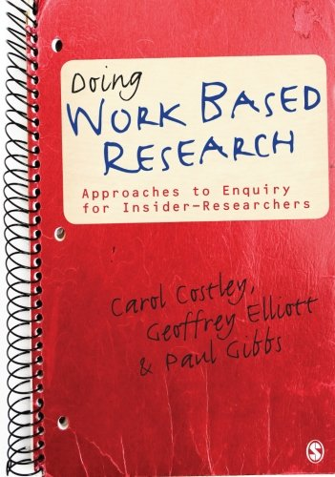
Costley, C; Elliott, C,G; Gibbs, P (2010) Doing Work Based Research: Approaches to Enquiry for Insider-Researchers. London: Sage

Slide 16
Inform Policy?
  Political slant
To Inform Practice….
  your own…
  Youth Work,
  Social Work,
  Education,
  Nursing,
  Community Development,
  Evidence based practice etc……….
Why Research in the Social Context?

Slide 17
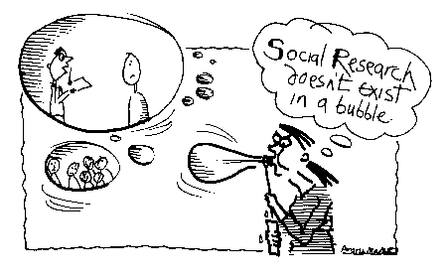
Real world enquiry
‘Social research does not exist in a bubble’ (Bryman 2001)

Slide 18
Sut beth yw Ymchwil Cymdeithasol?
What does Social Research Look like?
Practical Considerations
Ethics
Methodology
Research Design
Context
Philosophy
Methods
Values
Theory

Slide 19
Your Research
Using the diagram as a guide, think about your own ideas for research and the relevance of each heading….

Slide 20
Methodology vs. Method
Methodology
The theoretical framework that outlines the rules to follow in a study.
Method
The actual tools/steps taken by which you conduct research into a subject or a topic.

Slide 21
A Paradigm Constitutes the following:
Ontology The fundamental beliefs we have about the world. These can be: | Objectivism Social phenomena and their meanings have an existence independent of social actors Constructivism Social phenomena and their meanings are constructed through social interaction and therefore are in a constant state of revision
Epistomology The theory and study of knowledge | There is a distinction between ‘true’ and ‘false’ knowledge – what standard of evidence is sufficient to make a judgement? This also encompasses issues of validity and reliability which are discussed later. The types of evidence can include faith, trust, experience, logic, empiricism – depending on what philosophy you subscribe to.
Ontology The fundamental beliefs we have about the world. These can be: | Objectivism Social phenomena and their meanings have an existence independent of social actors Constructivism Social phenomena and their meanings are constructed through social interaction and therefore are in a constant state of revision
Epistomology The theory and study of knowledge | There is a distinction between ‘true’ and ‘false’ knowledge – what standard of evidence is sufficient to make a judgement? This also encompasses issues of validity and reliability which are discussed later. The types of evidence can include faith, trust, experience, logic, empiricism – depending on what philosophy you subscribe to.
Ontology The fundamental beliefs we have about the world. These can be: | Objectivism Social phenomena and their meanings have an existence independent of social actors Constructivism Social phenomena and their meanings are constructed through social interaction and therefore are in a constant state of revision
Epistomology The theory and study of knowledge | There is a distinction between ‘true’ and ‘false’ knowledge – what standard of evidence is sufficient to make a judgement? This also encompasses issues of validity and reliability which are discussed later. The types of evidence can include faith, trust, experience, logic, empiricism – depending on what philosophy you subscribe to.

Slide 22
Qualitative versus Quantitative
https://youtu.be/MlU22hTyIs4

Slide 23
A Background to Research Methods
Which ontological position do you think you come from?
How might this impact on your research?
Our fundamental beliefs are likely to impact on our research choices

Slide 24
Combining Quantitative and Qualitative Methodologies
Mixed methodology and mixed approaches often regarded as a practical solution to research.
E.g Often you may engage in a Qualitative research design but use some quantitative data and vice versa

Slide 25
What is research?
???

Slide 26





Philosophy
Research Strategy
Methods
Epistemology
Axiology
Philosophical Alignment
Ontology

