Slide 1
Evidence-Based Practice in Exercise Science (Amonette, 2016)

Slide 2
Six Steps of Evidence Based Practice
Develop a Question
Search for Evidence
Evaluate the Evidence
Incorporate Evidence into Practice
Confirm Evidence in Individual
Re-evaluate the Evidence

Slide 3
1. Developing a Question
Be specific - consider PICOT
  Population
  Intervention
  Comparison
  Outcome
  Time

Slide 4
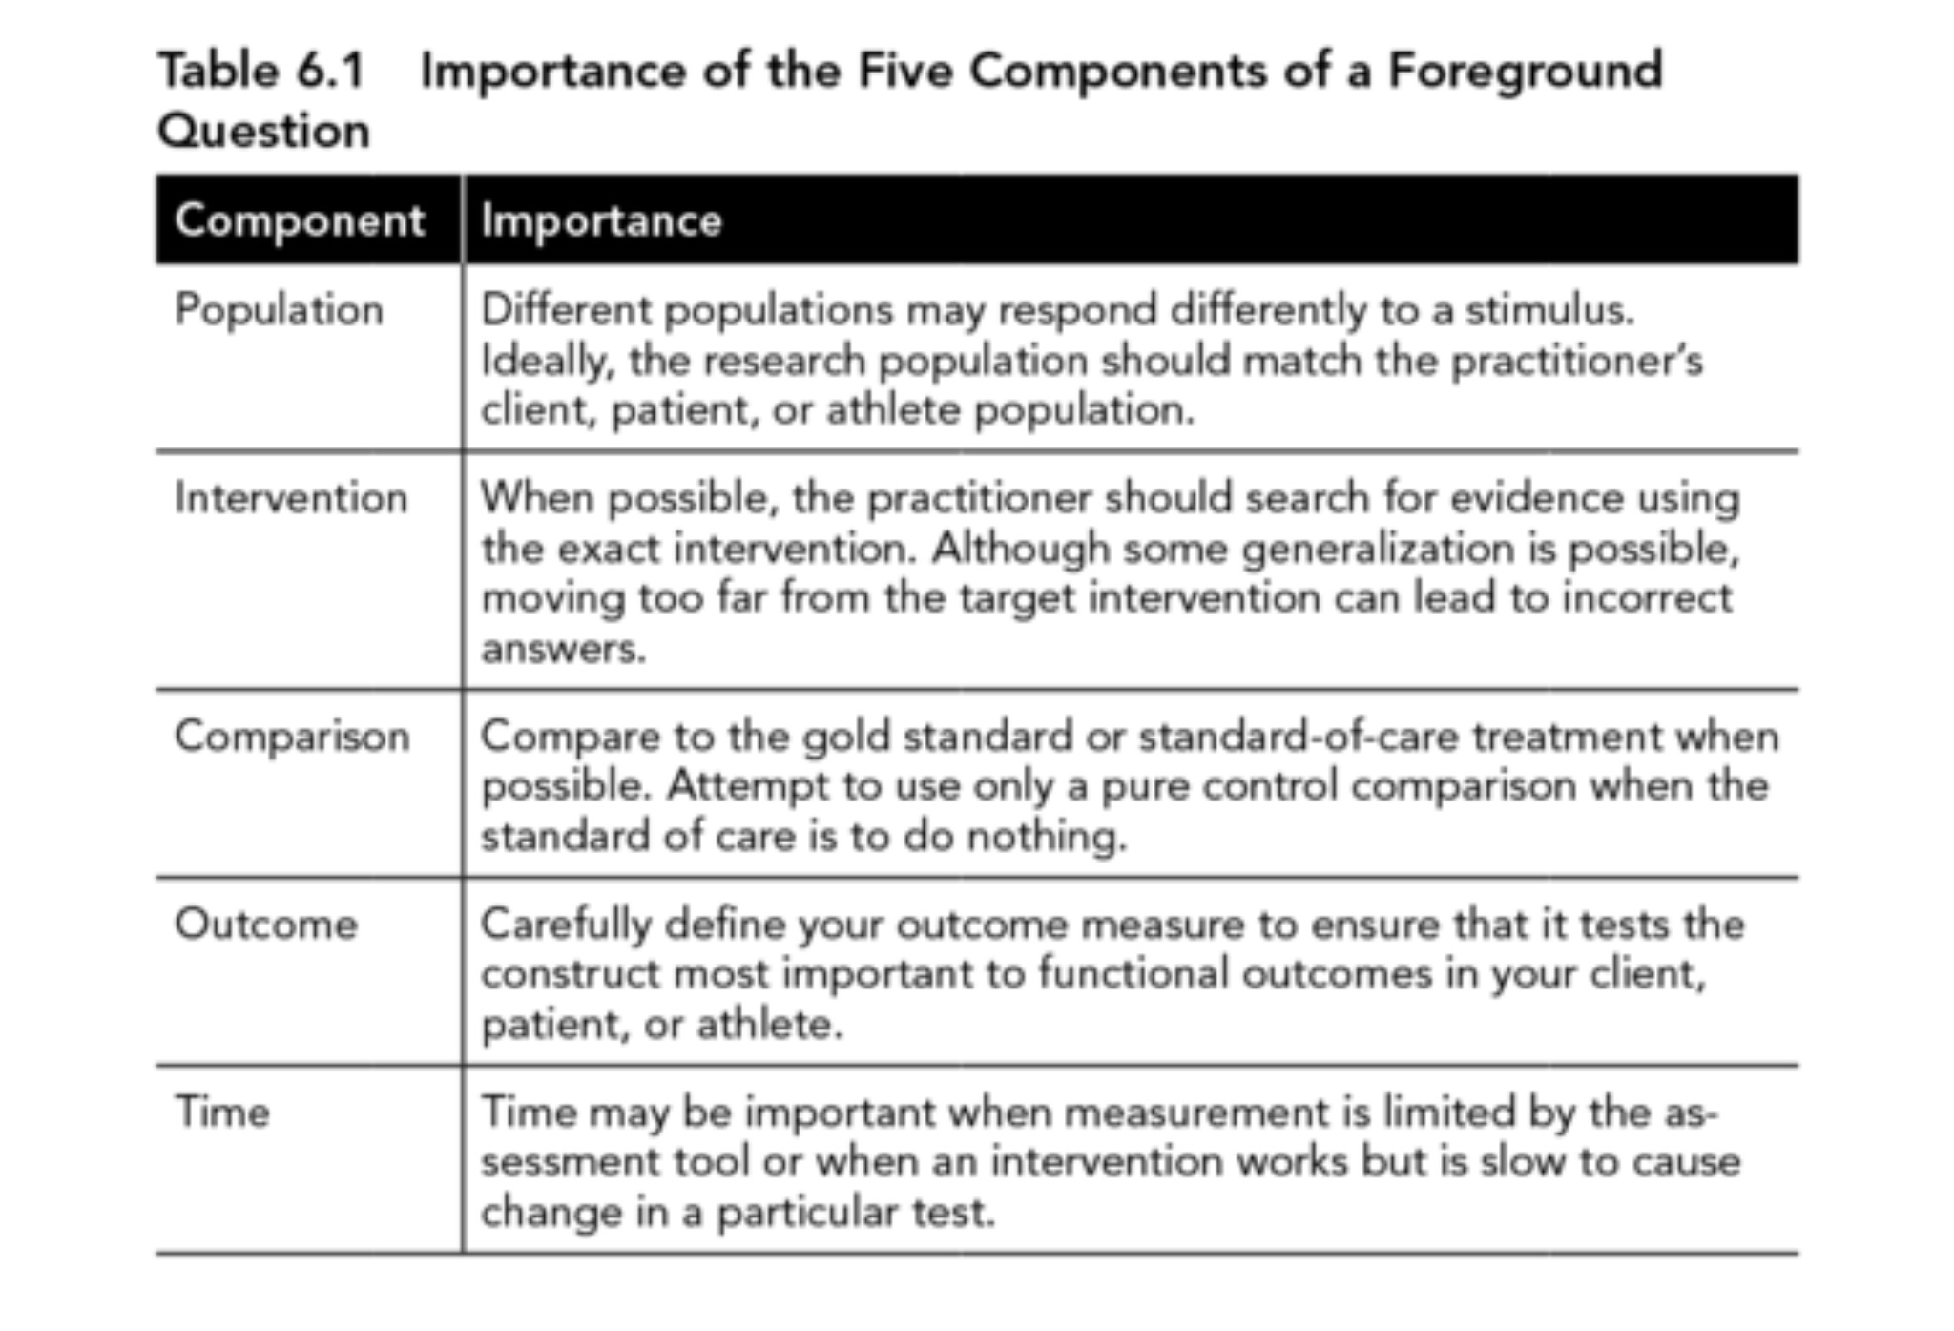

Slide 5
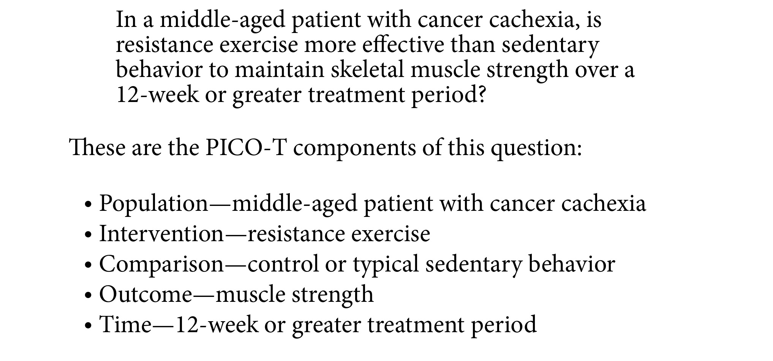
Example

Slide 6
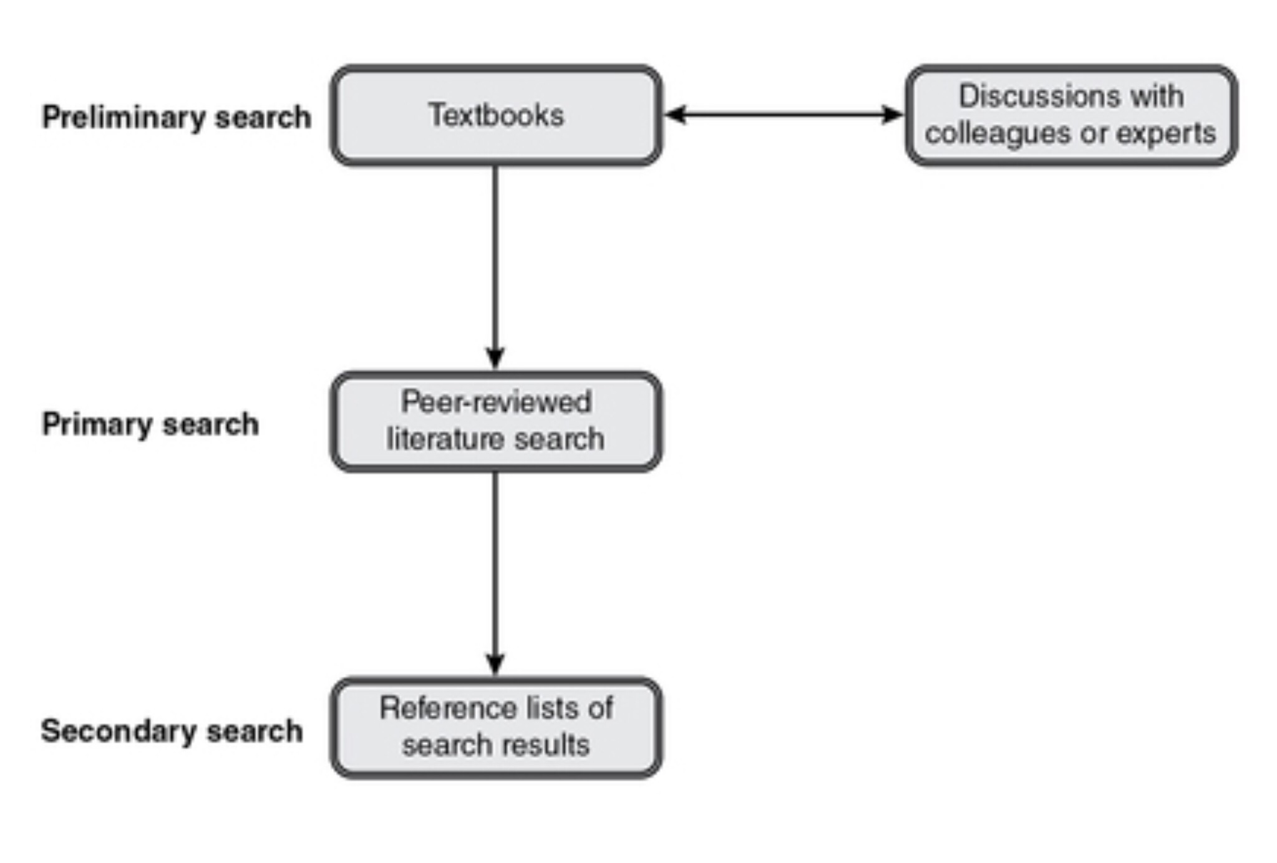
2. Search for Evidence

Slide 7
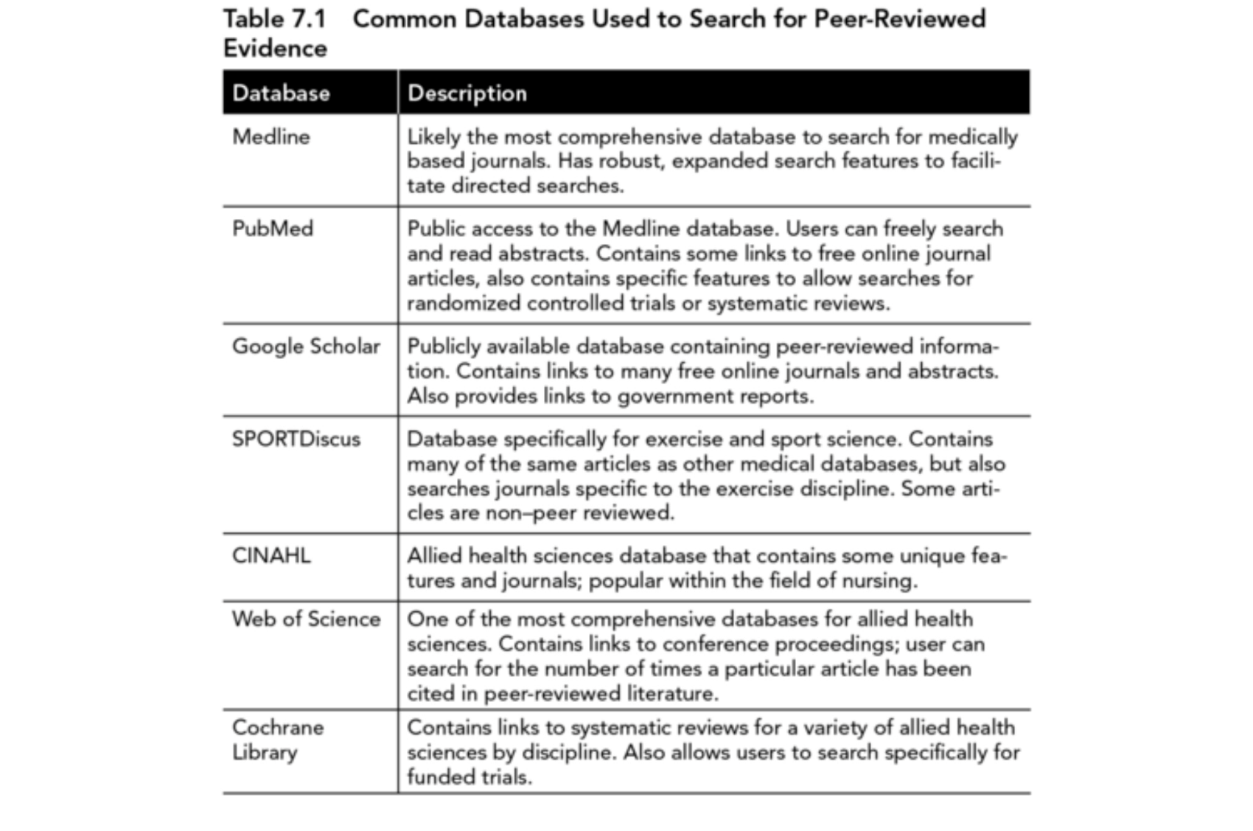
Finding Peer-reviewed articles
ProQuest

Slide 8
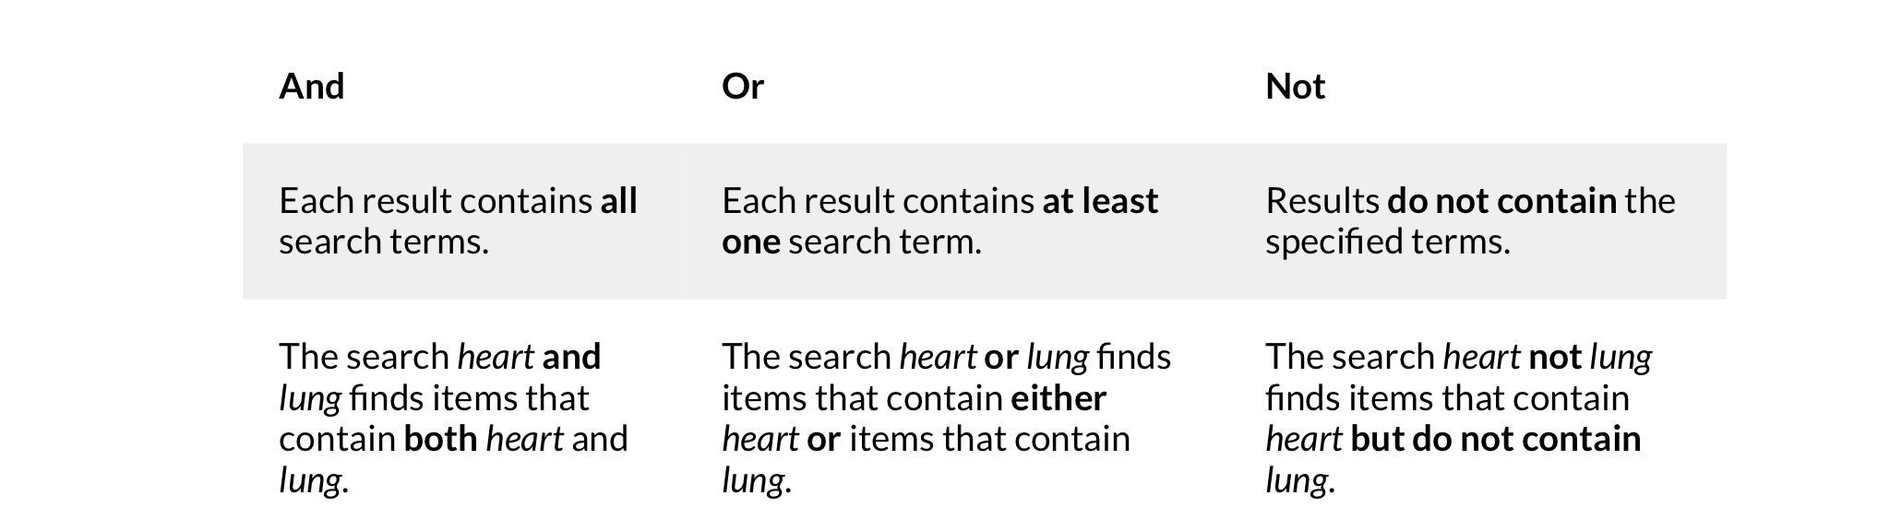
Tips for searching
Use specific Keywords
Truncations e.g. Physiolog*
Boolean searches e.g.

Slide 9
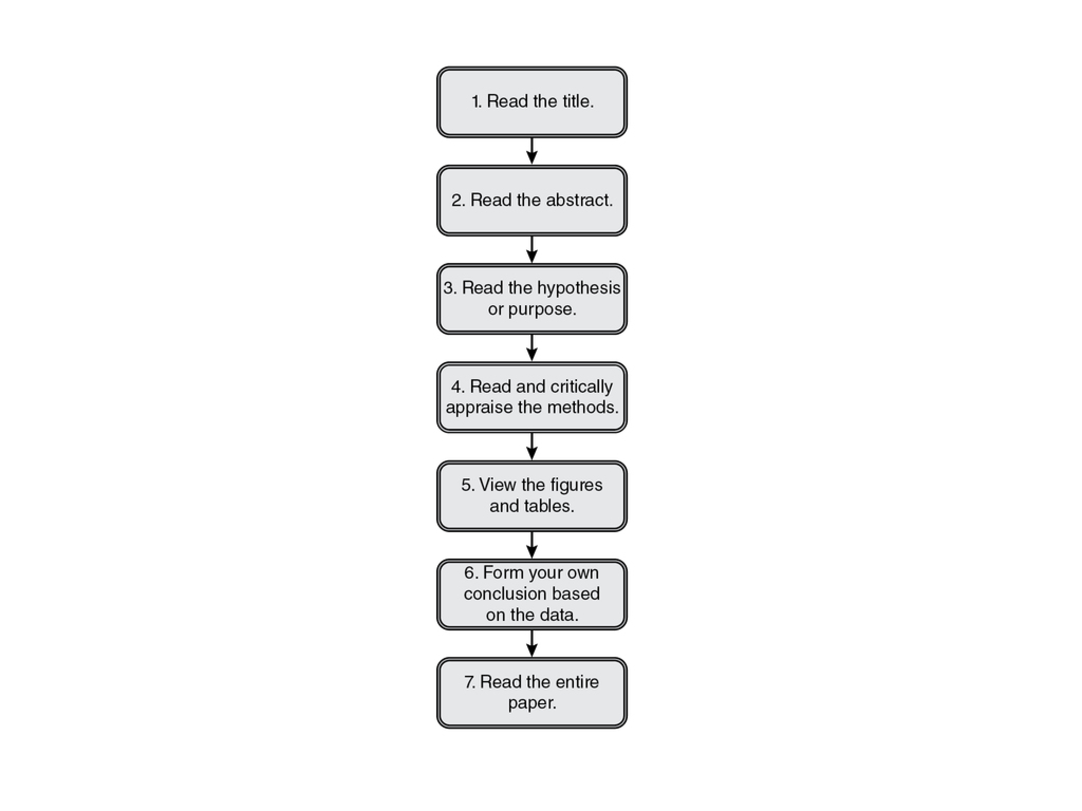
Tips for reading research papers

Slide 10
3. Evaluate the Evidence
Rank the evidence you have found in order to judge the strength of evidence.
Critically appraise individual papers

Slide 11
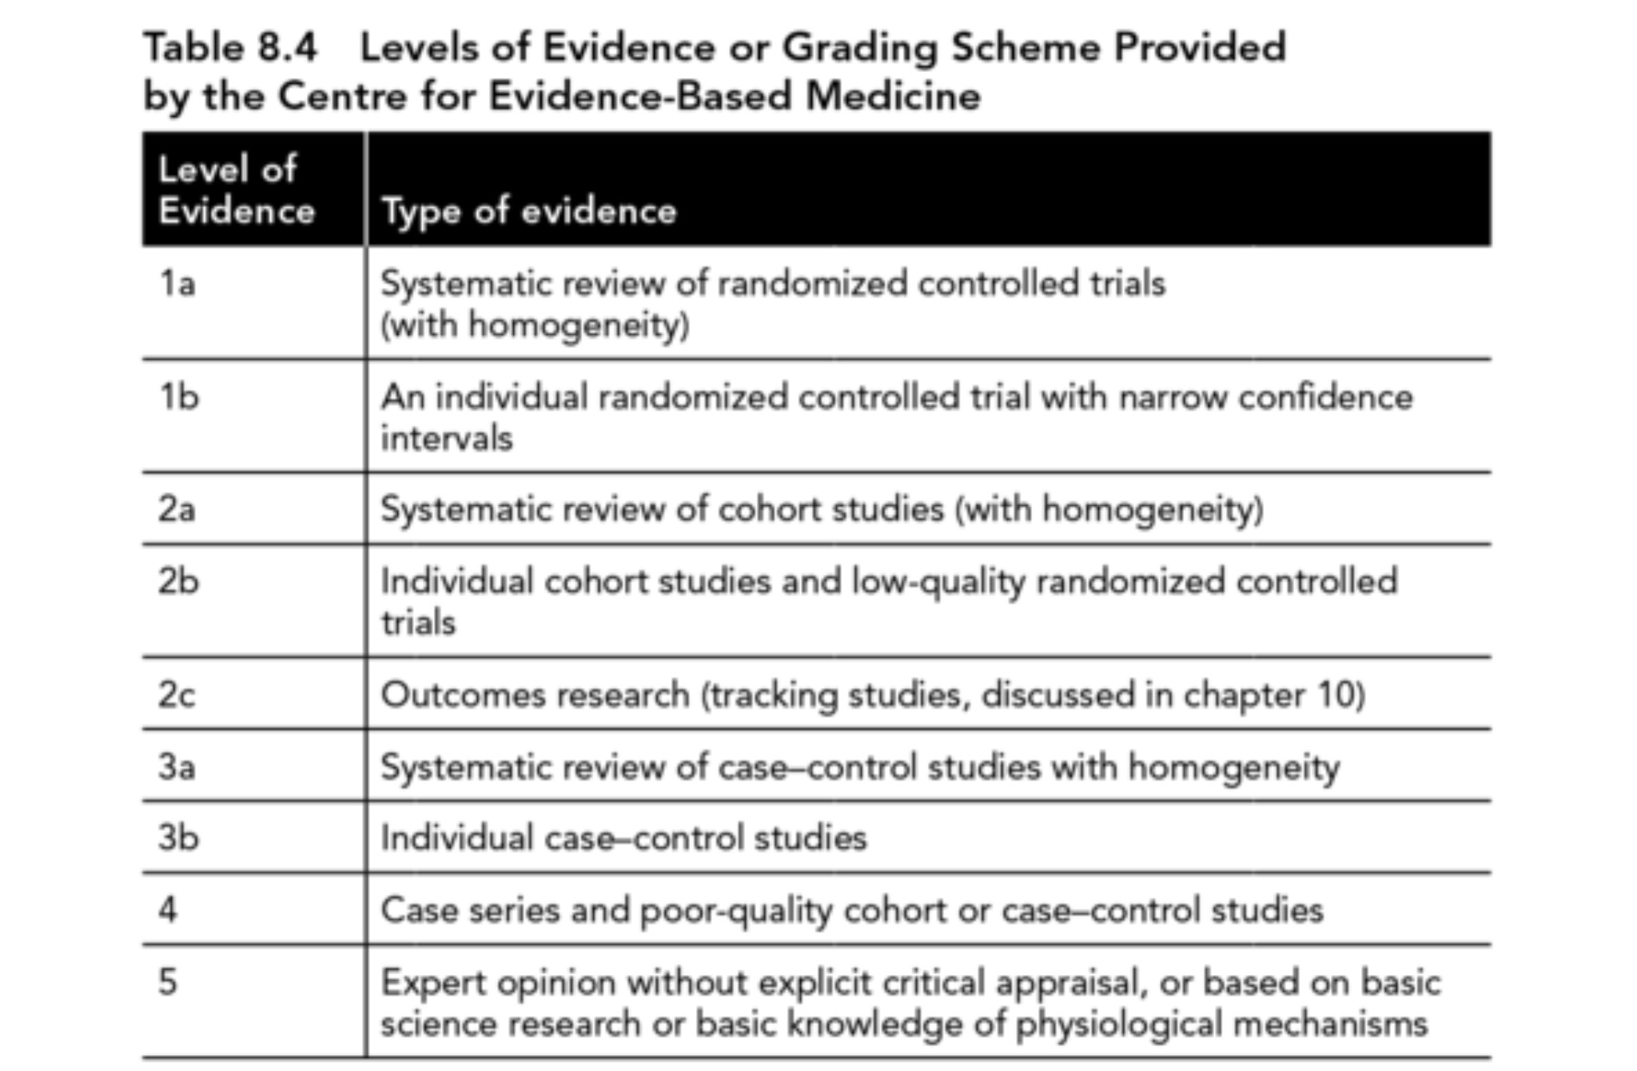

Slide 12
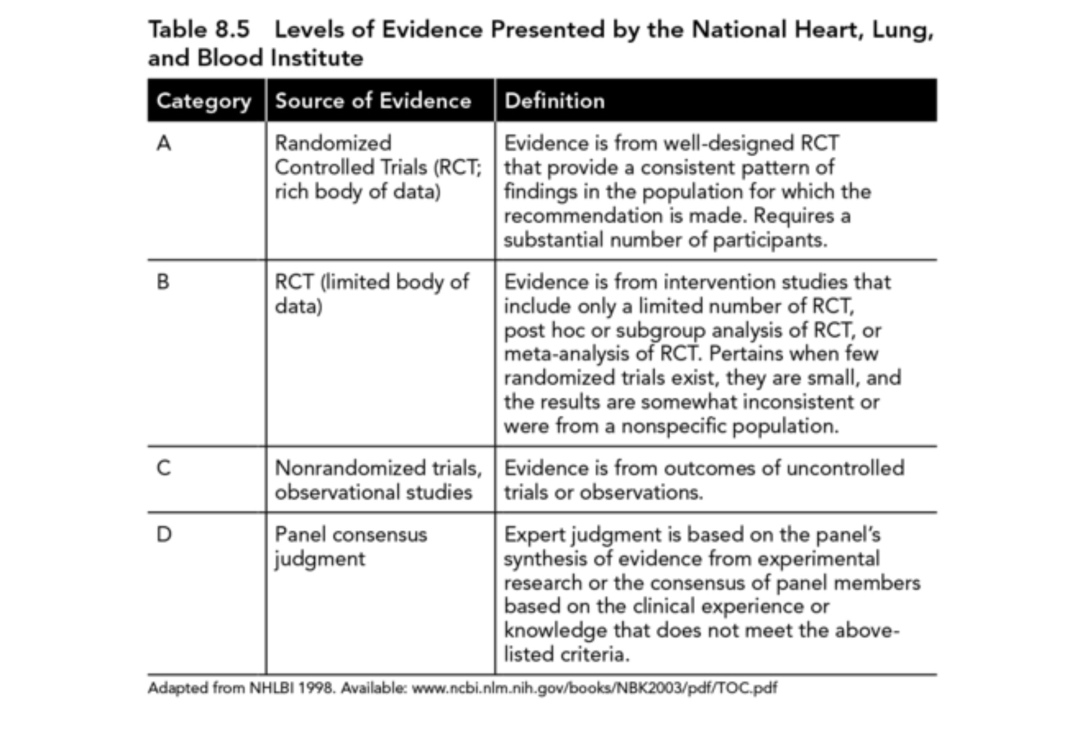

Slide 13
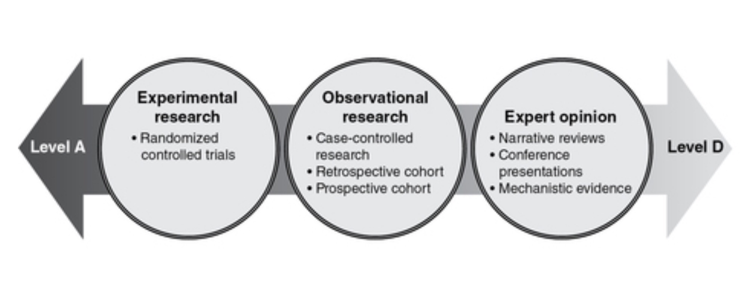

Slide 14
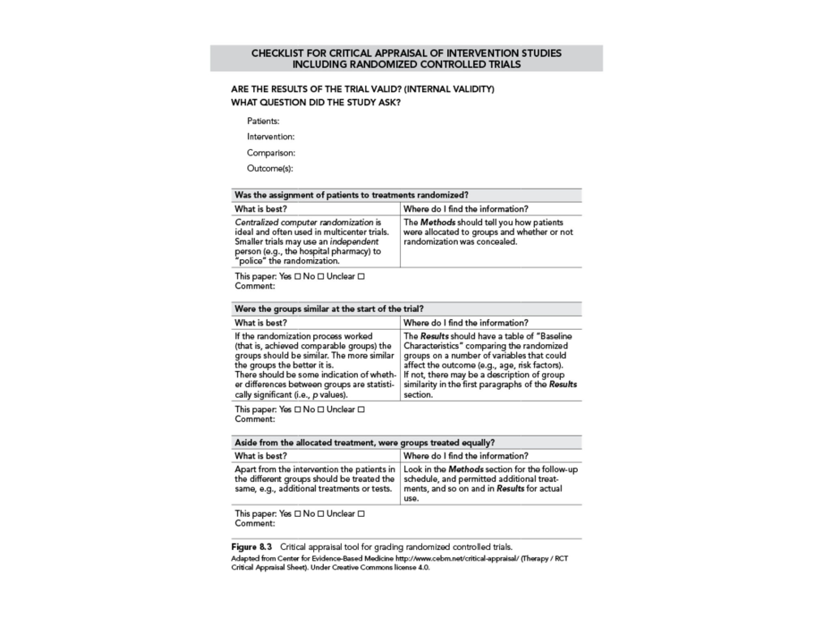

Slide 15
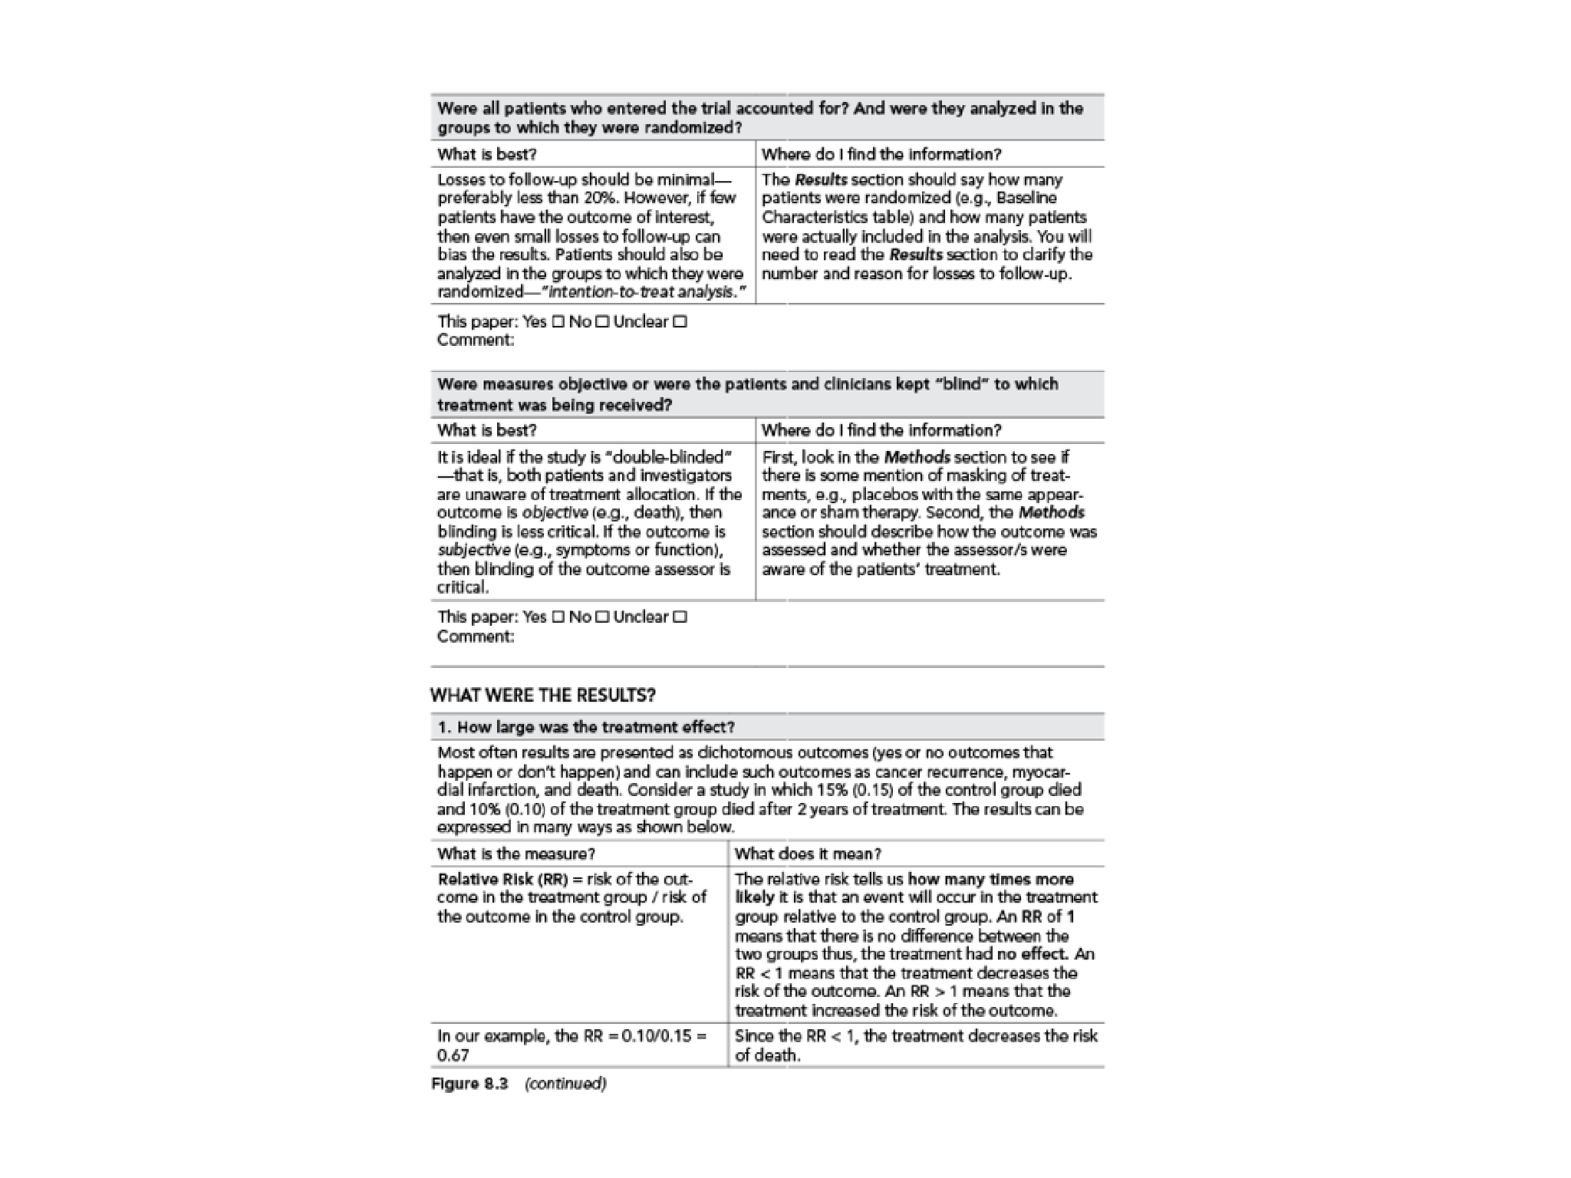

Slide 16
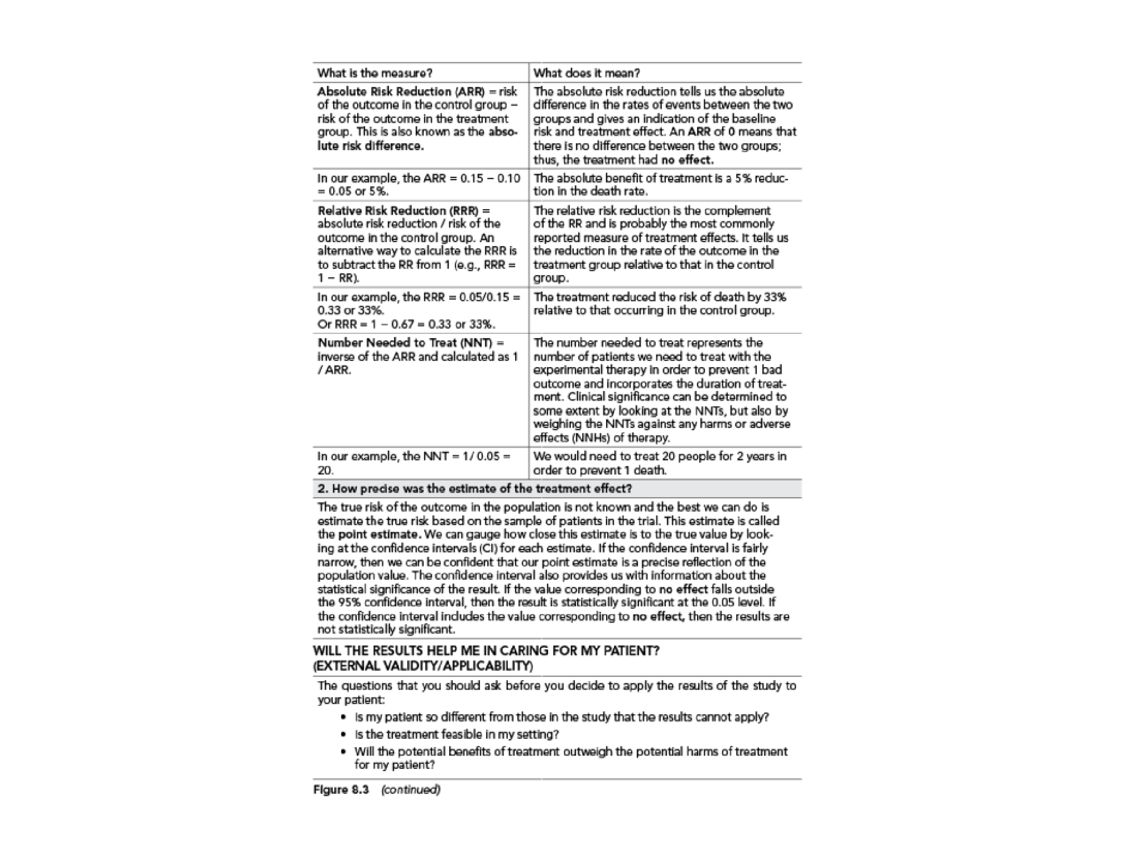

Slide 17
4. Incorporate Evidence into Practice
Deciding when to act on evidence?
  will it significantly improve outcomes?
  will client adhere to new intervention?
  Is intervention time-effective?
  Is intervention cost-effective?

Slide 18
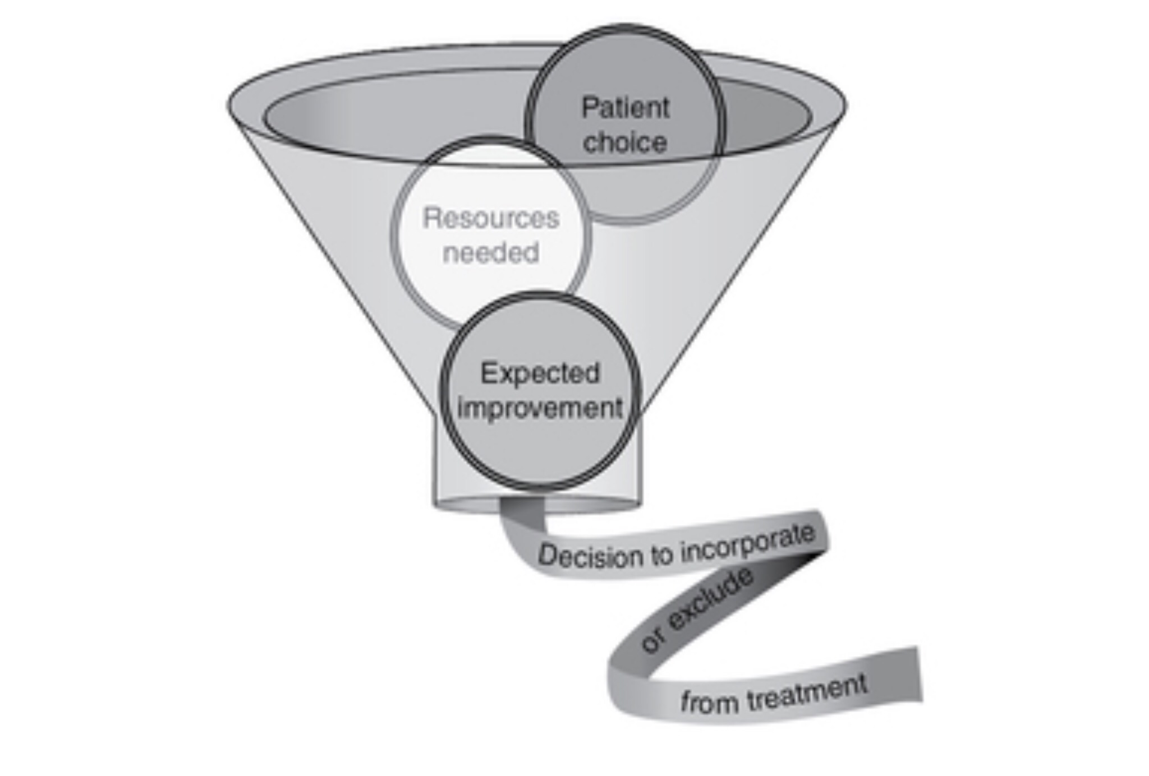

Slide 19
Influence of evidence
Confirmation of practice
Modification or addition to practice
Wholesale change (paradigm shift)

Slide 20
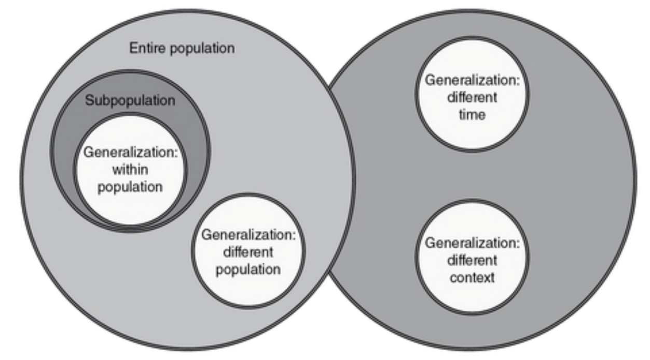
5. Confirming the evidence in the individual
Remember the principle of individuality
Research studies involve generalising

Slide 21
How do we confirm evidence in individual?
Systematic testing
Choice of test will have impact on results – tests must be reliable and valid

Slide 22
6. Re-evaluate the evidence
Prompts to re-evaluate
  New research evidence
  New industry trends
  Passage of time
  New athlete/client
  Long-term effects and safety
  Technological advances

Slide 23
How to stay current
Membership of professional bodies
Updates from journals
Www.researchgate.net – follow researchers in your area of interest
LinkedIn
Twitter
Conferences e.g. BASES student conference, UKSCA conference

Slide 24
Case study example – single set vs multiple set

Slide 25
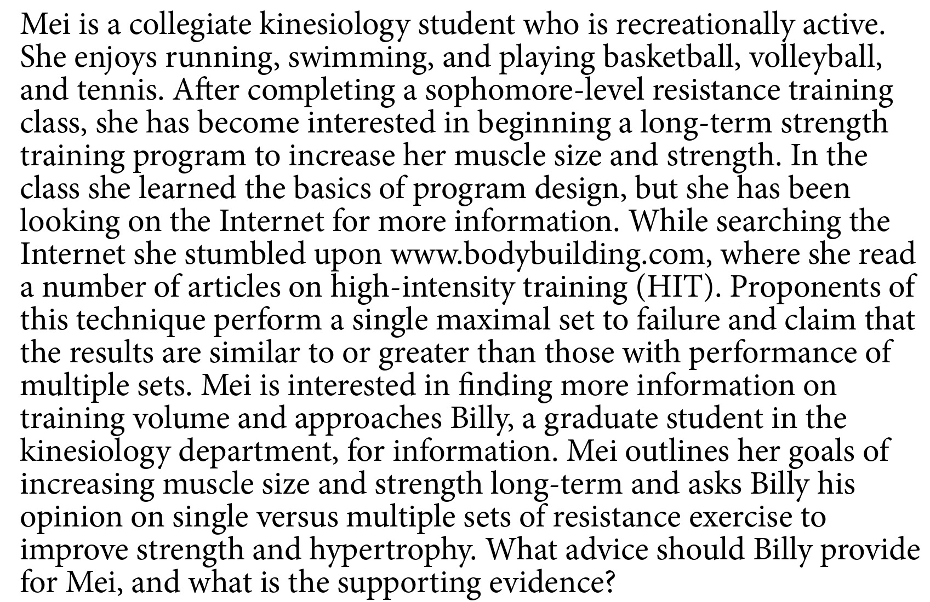

Slide 26
1. Develop a question
In a college-aged female recreational athlete, is single- or multiple-set resistance exercise more effective to improve muscle strength and hypertrophy during a >12-week period?

Slide 27
2. Search for evidence
Initially the position stand from the American College of Sports Medicine (ACSM) on exercise progressions was obtained (Ratamess et al., 2009) – this exhaustively reviewed the literature up to the year 2009.
PubMed was then searched using the phrase “single versus multiple sets and resistance training.”

Slide 28
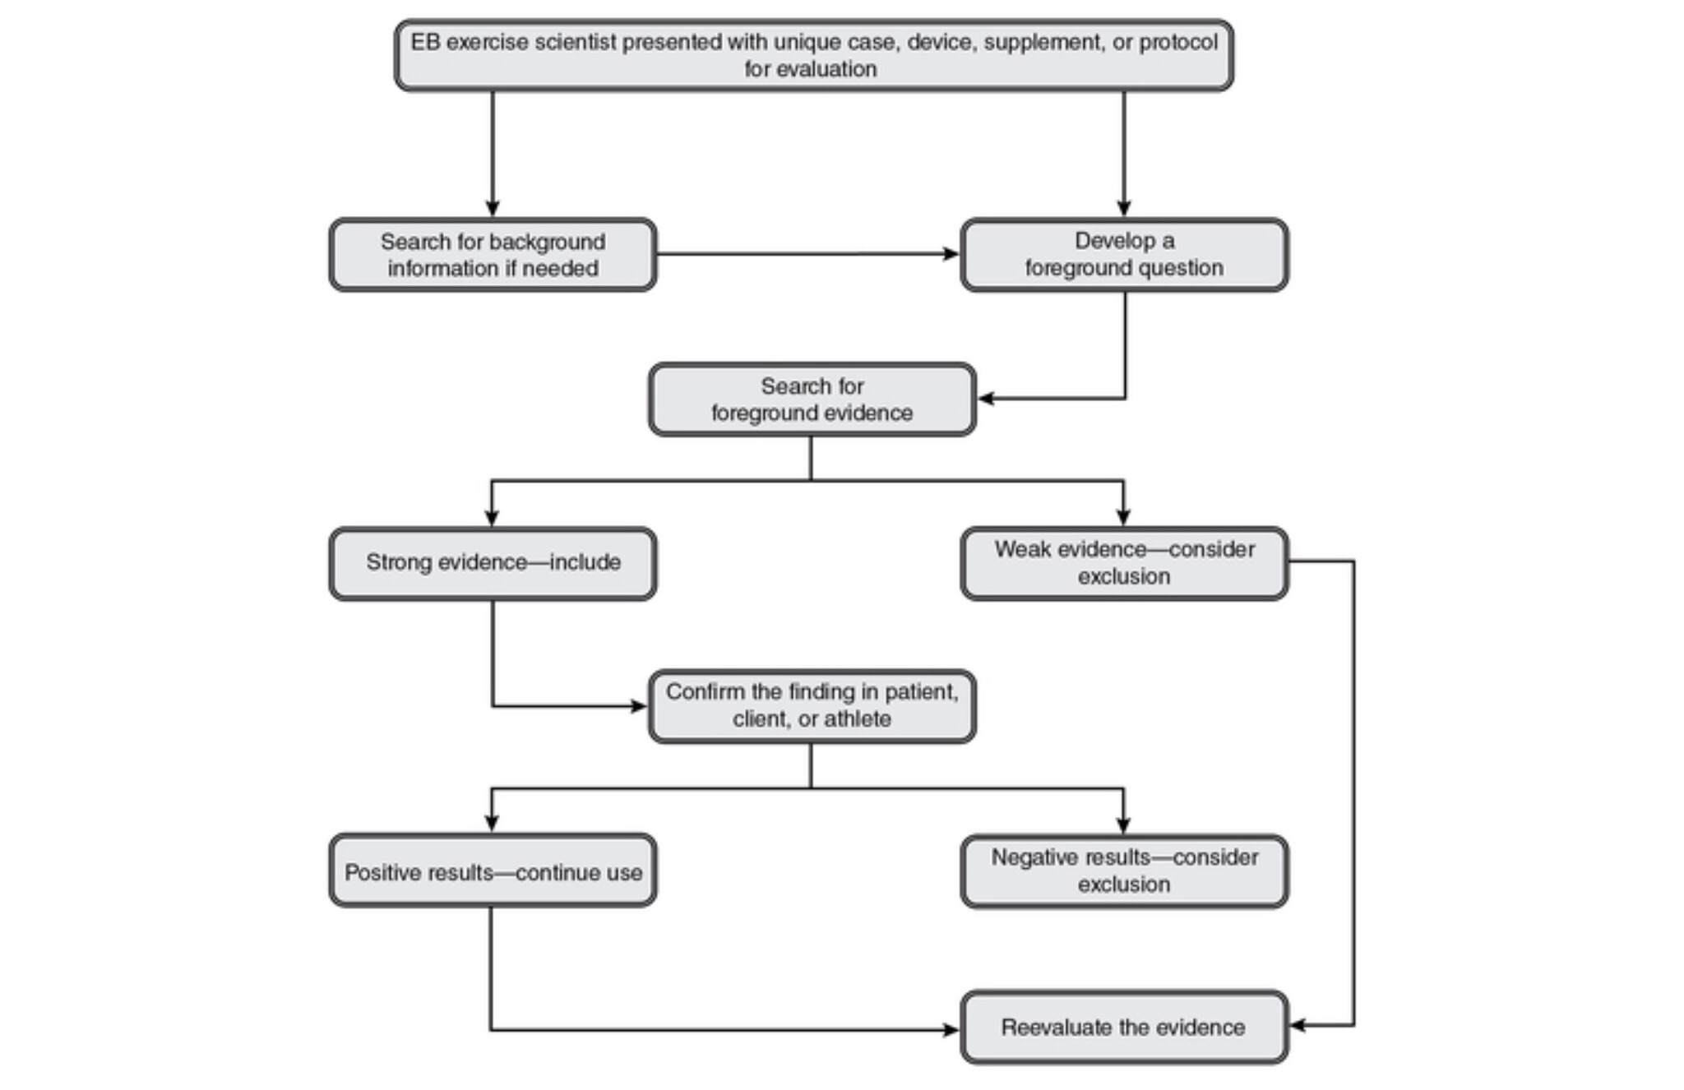

Slide 29
Search findings produced two meta-analyses
These two meta-analyses compared muscle strength (Krieger, 2009) and hypertrophy outcomes (Krieger, 2010) from single versus multiple sets, providing a quantitative analysis of the different treatments

Slide 30
3. Evaluate the evidence
ACSM recommendations : one to three sets is effective for immediate strength gains in novices (level A), but higher-volume programs with systematic variation are required for optimal gains in intermediate and advanced athletes (level A).

Slide 31
Krieger (2009) strength meta analysis
Multiple vs single sets on strength
14 different studies on trained and untrained subjects
Used 1RM strength test, used healthy subjects, minimum 4 weeks.
Findings: 2 or 3 sets resulted in 46% greater strength gains than 1 set, >3 sets = no change

Slide 32
Krieger (2010) Hypertrophy meta-analysis
Single vs multiple sets on hypertrophy
Same inclusion characteristics
8 studies included
Findings: 2 or 3 sets resulted in 40% greater gains in hypertrophy compared to 1 set

Slide 33
Conclusions based on evidence
Level A evidence supports the use of multiple versus single sets to improve muscular strength and hypertrophy in college-aged recreational athletes.

Slide 34
4. Incorporating evidence into practice
On the basis of the evidence, Billy should recommend that Mei perform approximately three sets per exercise, as the outcome from multiple sets is clearly better. However, if Mei’s time is limited, she may use single sets for the first month of the training program, as novices may see gains from such programs before progressing to higher-volume multiple-set programs.

