Slide 1
BMST4004
Cartilage Healing

Slide 2


Learning Outcomes
Describe types of Cartilage found in the body
Discuss cartilage healing including timescales and timeframes
that facilitate appropriate cartilage healing
Discuss cartilage tolerance to loading and types of cartilage injury
Daniel Martin
MSc BSc MHCPC MCSP MAACP

Slide 3
Articular Cartilage
Thin layer of hydrated soft tissue covers end of bones of diarthrodial joints
‘perform their functions so well that we are often not aware of their existence nor their function until injury strikes or arthritis develops’ (Mow, Ratcliffe & Poole. 1992)
Type II collagen principal fibrous protein in hyaline cartilage
These collagen fibres are recruited as a tensile load is applied
Cartilage is made up of about 70% water and less than 5% cells called chondrocytes, which produce the molecules that make up the tissue
Daniel Martin
MSc BSc MHCPC MCSP MAACP
Notes:
Articular – of or relating to a joint

Slide 4
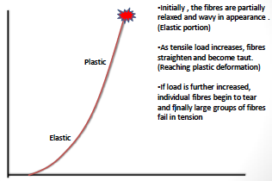
Hyaline Cartilage and Tensile Load
Daniel Martin
MSc BSc MHCPC MCSP MAACP
Notes:
Hyaline cartilage is Articular Cartilage, they are the same thing.

Slide 5
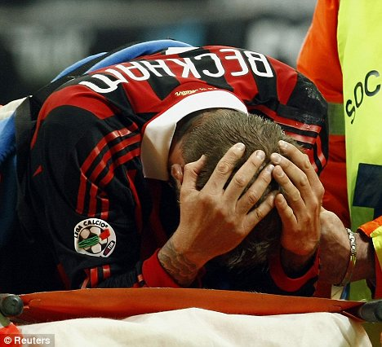
Cartilage Loading
Cartilage has a natural tendency to swell
Deformed cartilage draws water into the extracellular matrix
Cartilage also susceptible to creep (constant load)
Cyclic loading required for normal matrix and cell health
Excessive loading can be destructive to matrix
Constant pressure will cause fluid to exude from matrix: stable compressive deformation
Cyclic loading and unloading of cartilage allows for dynamic flow of fluids (with nutrients and waste products) in to and out of the tissue
Daniel Martin
MSc BSc MHCPC MCSP MAACP
Notes:
Creep is a concept that we will be using next year as part of your mobilisations/manual therapy module
What this means? Cyclic loading, load, off load, load, off load etc

Slide 6
Cartilage and Lubrication
Coefficient of friction for Articular cartilage reported as 0.01 to 0.04
Sliding on ice: 0.01-0.10
2 hypotheses
                Boundary lubrication
                Layer of molecules adhere to each of the two surfaces as they glide past each other
  Fluid-film lubrication
  2 non-parallel surfaces move past each other on a thin layer of fluid
  Fluid maintains a distance between two surfaces ‘hydrodynamic lubrication’ ‘elastohydrodynamic lubrication
Daniel Martin
MSc BSc MHCPC MCSP MAACP
Notes:
Lubrication is key, think of your cars!
Some studies report it as low as 0.001

Slide 7
Articular Cartilage Adaptations
Activities of Daily Living should provide enough load to provide adaptation for optimal function
Too much or too little leads to breakdown in quality of cartilage
Loading facilitates exudate (fluid) mobilisation
Cartilage adaptations tend to be degenerative!
Daniel Martin
MSc BSc MHCPC MCSP MAACP
Notes:
Too little? Sedentary, Older population
Too much? Long distance runners, endurance athletes
Who of these cohorts do you typically think of as having Osteoarthritis?
Exudate mobilisation – exudate is the fluid in blood made up of white blood cells, protein and plasma

Slide 8
Cartilage Use v Disuse
Exercise produces swelling
Prolonged exercise:
- chondrocyte hypertrophy
- Increase in the pericellular matrix
- Increase in cells per unit of cartilage (Engelmark, 1961)
Changes already evident after brief burst of exercise
Long Term exercise produces more lasting change
- Increased proteoglycans (Sammanen et al 1986)
- Wear and tear changes (Vasan, 1983)
Daniel Martin
MSc BSc MHCPC MCSP MAACP

Slide 9
Cartilage Use v Disuse
Excessive Loading
- Decreased synthesis
- Degradation of Cartilage
- Leading to OA
Reduced Loading
- Decreased proteoglycans (Sammanen et al 1986)
- Decreased synthesis
- Increased fibrillation of cartilage surface
Changes are greater with immobilisation
Daniel Martin
MSc BSc MHCPC MCSP MAACP
Notes:
Where is the balance?

Slide 10
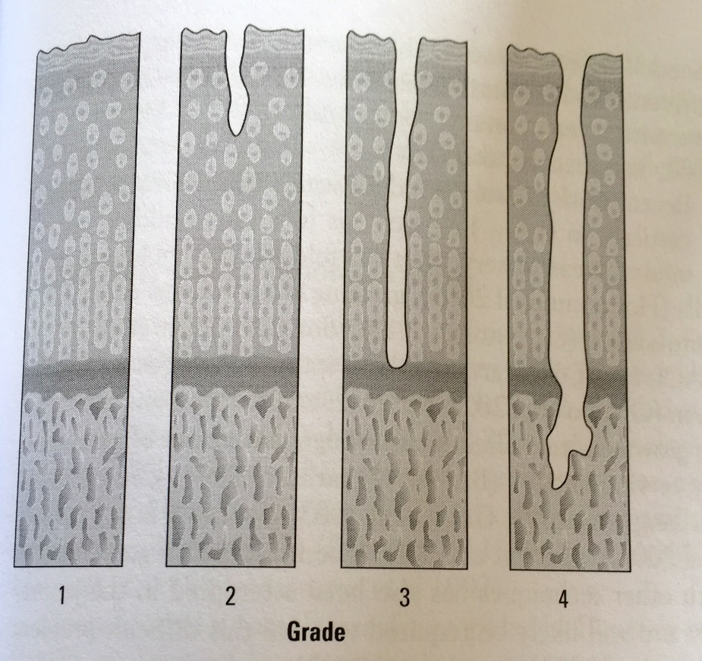
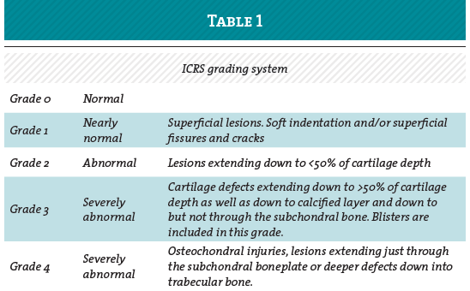
Cartilage injury classification
Daniel Martin
MSc BSc MHCPC MCSP MAACP

Slide 11
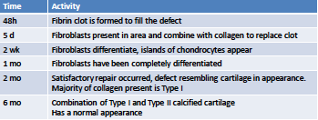
Articular Cartilage Healing
Daniel Martin
MSc BSc MHCPC MCSP MAACP

Slide 12
Task
Find 2 peer-reviewed studies each discussing Cartilage healing,
Summarise the key findings or your take homes and share with class
Remember you will need to reference the paper so others can find it
Ideally we will need all different papers but if you have the same we can compare summaries and take homes
Daniel Martin
MSc BSc MHCPC MCSP MAACP

