Slide 1

Developing an academic poster
in PowerPoint

Slide 2
Developing an Academic Poster
Academic posters
Content and presentation
Planning
Using PowerPoint
  Layout
  Background
  Images
  Text
Final preparation
subjectguides.york.ac.uk/posters

Slide 3

PhD Spotlight competition
Deadline: Monday 29 November 2021
Contact rett@york.ac.uk for more details.

Slide 4
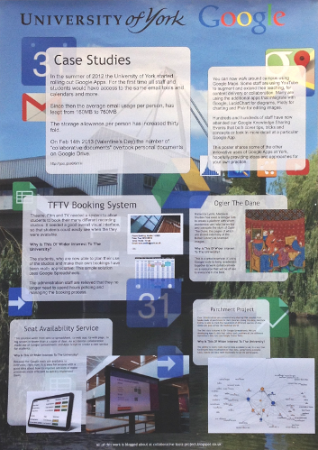

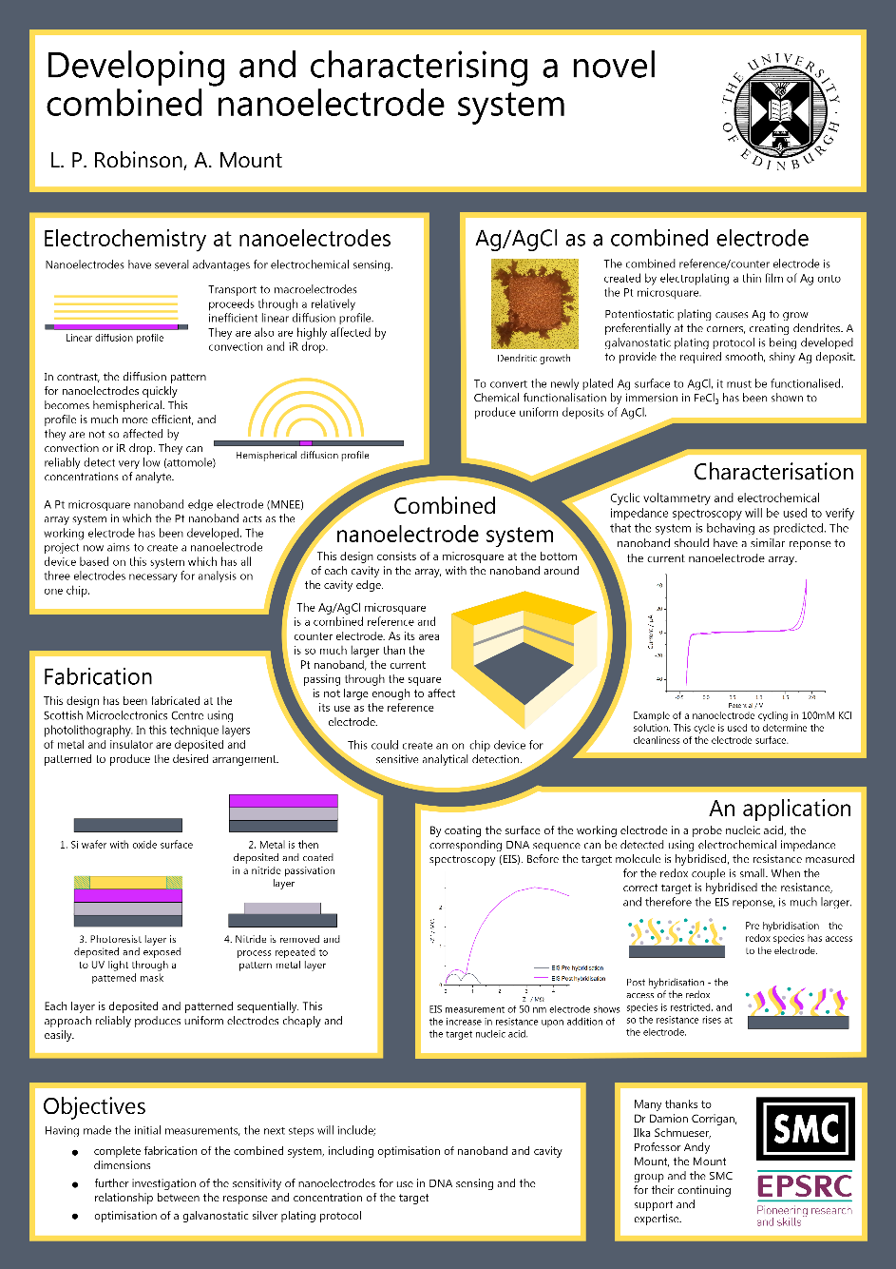
What is an academic poster?
Notes:
There are all sorts of different types of poster

Slide 5
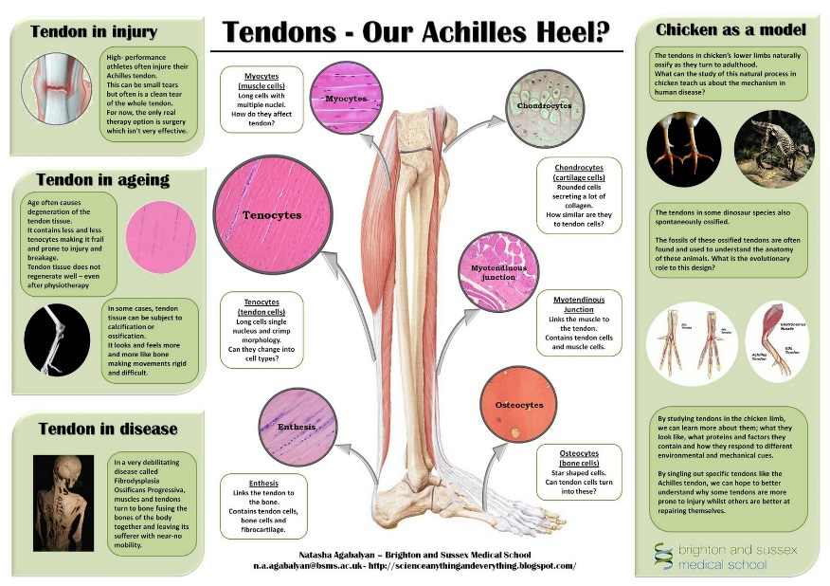
What is an academic poster?
Visual summary or precis
Highlights
Extended illustrated abstract
NOT a large essay on the wall
Notes:
What’s an academic poster?
Should be a summary of a topic/area or research, but using visual communication
A bit like a visual abstract, with a bit more content
Should be a complete ‘story’ by itself
It should not be just lots and lots of words

Slide 6
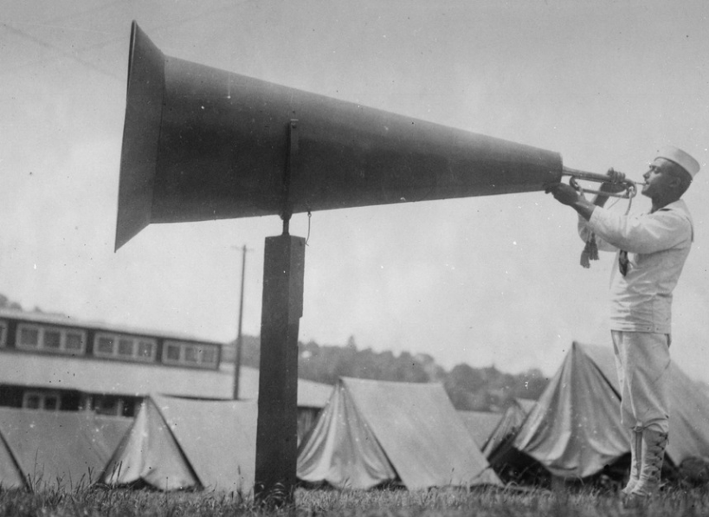
What is your key message?
(There won’t be room for everything)
prioritise
must know – would be incomplete without it
good to know – expands the ‘story’ but isn’t essential
nice to know – adds interest and context
‘Getting ‘em up’ US National Archives. Public Domain
https://commons.wikimedia.org/wiki/File:%22Getting_em_up%22_at_U.S.Naval_Training_Camp,_Seattle,_Washington._Webster_%26_Stevens._-_NARA_-_533698.tif
Notes:
When thinking about the content of a poster, ask yourself:
“What is the main message I want to communicate?”
You won’t always be able to include everything you want, so break it down into:
What the reader MUST get to know from the poster – ‘story’ would be incomplete without it
What it would be GOOD for the reader to know
What would be NICE to include
Make sure you include all the MUSTs, as much of the GOODs and, if there’s still room, some NICEs

Slide 7

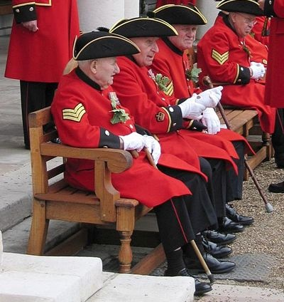
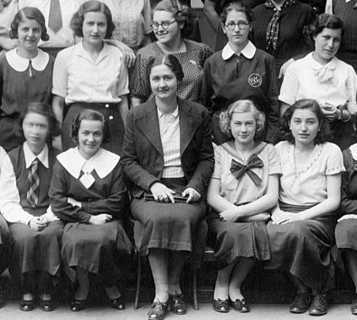
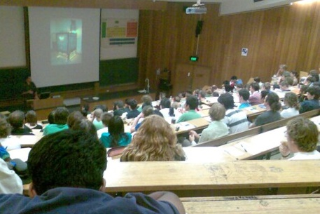
Who is your message aimed at?
This will affect content and style!
Class Photo: CCA SA 3.0
https://commons.wikimedia.org/wiki/File:Tableau,_class_photo_Fortepan_74010.jpg
Chelsea Pensioners: CCA SA 3.0
https://commons.wikimedia.org/wiki/File:Chelsea-pensioners.jpg
Notes:
Also ask: “Who is my message aimed at?” Adults? Children? Academics? Public?
The answer to this will affect the content and the style
Do you need to explain subject-specific terms and ideas?

Slide 8
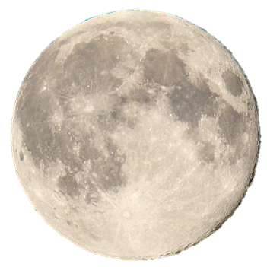
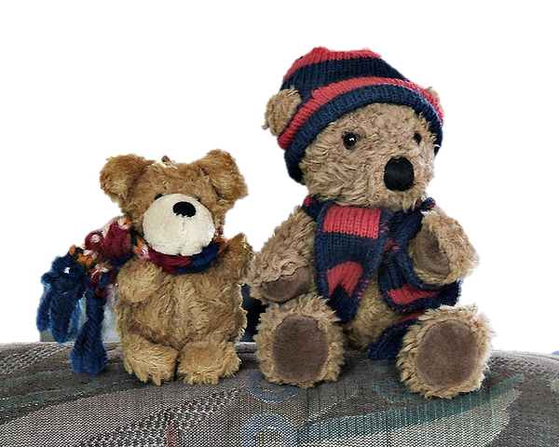
Lunar eclipses
The moon sometimes looks like a big face in the sky
Some people say it’s made of cheese, but it’s not really!
Who is the target audience?
https://commons.wikimedia.org/wiki/File:OurLittleTeddies.jpg
https://commons.wikimedia.org/wiki/File:FullMoonHauknes.jpg
licensed under the Creative Commons Attribution-Share Alike 3.0
Notes:
This example poster is going to be about calculating when lunar eclipses will occur
Who is it aimed at? Academic community?!

Slide 9

Think in pictures...
Be concise with words...
“Let’s have a brew!”
Notes:
Posters need to convey ideas visually, so try and think in pictures
What do these images mean to you?

Slide 10
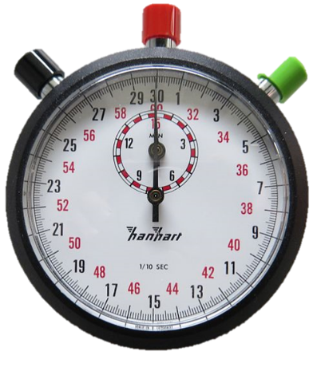


You have a few seconds to
grab and hold attention
That looks interesting
Topic needs to be clear from ~3m
Text needs to be readable from ~1m
Well, I never knew that!

Slide 11
Planning a poster

Slide 12


Planning
methods
Plan the content
Use structure
Doesn’t have to be linear!
Write the content
(300-500 words?)
References
Introduction
discussion
results
Notes:
Plan a structure for the content
Break it down into sections – these may be obvious and ‘standard’ for an academic poster
Although you would write with a linear structure, a poster doesn’t have to be linear

Slide 13
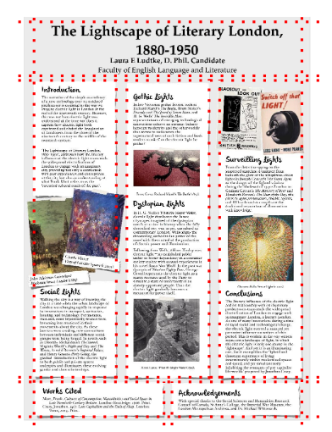
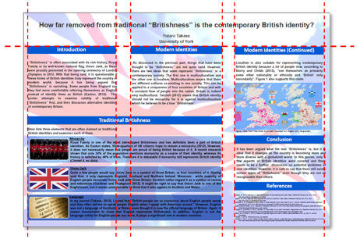
Layout
Often use one or columns
Notes:
Many academic posters are based around columns for layout
Blocks of text and pictures occupy one or more columns
You don’t have to do this, but it’s a good starting point

Slide 14
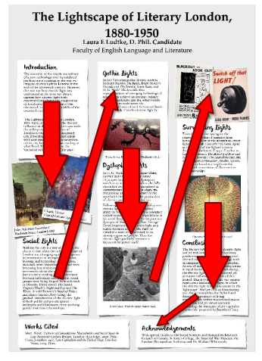
Reading order
People tend to read down columns
If it isn’t clear, add arrows or numbers
Notes:
When planning the content, use the ‘natural’ reading order
If you choose not to, you may need to find a way to show people what order to read in
This could be arrows, numbers etc
Some posters are written so it doesn’t matter what order you read in

Slide 15
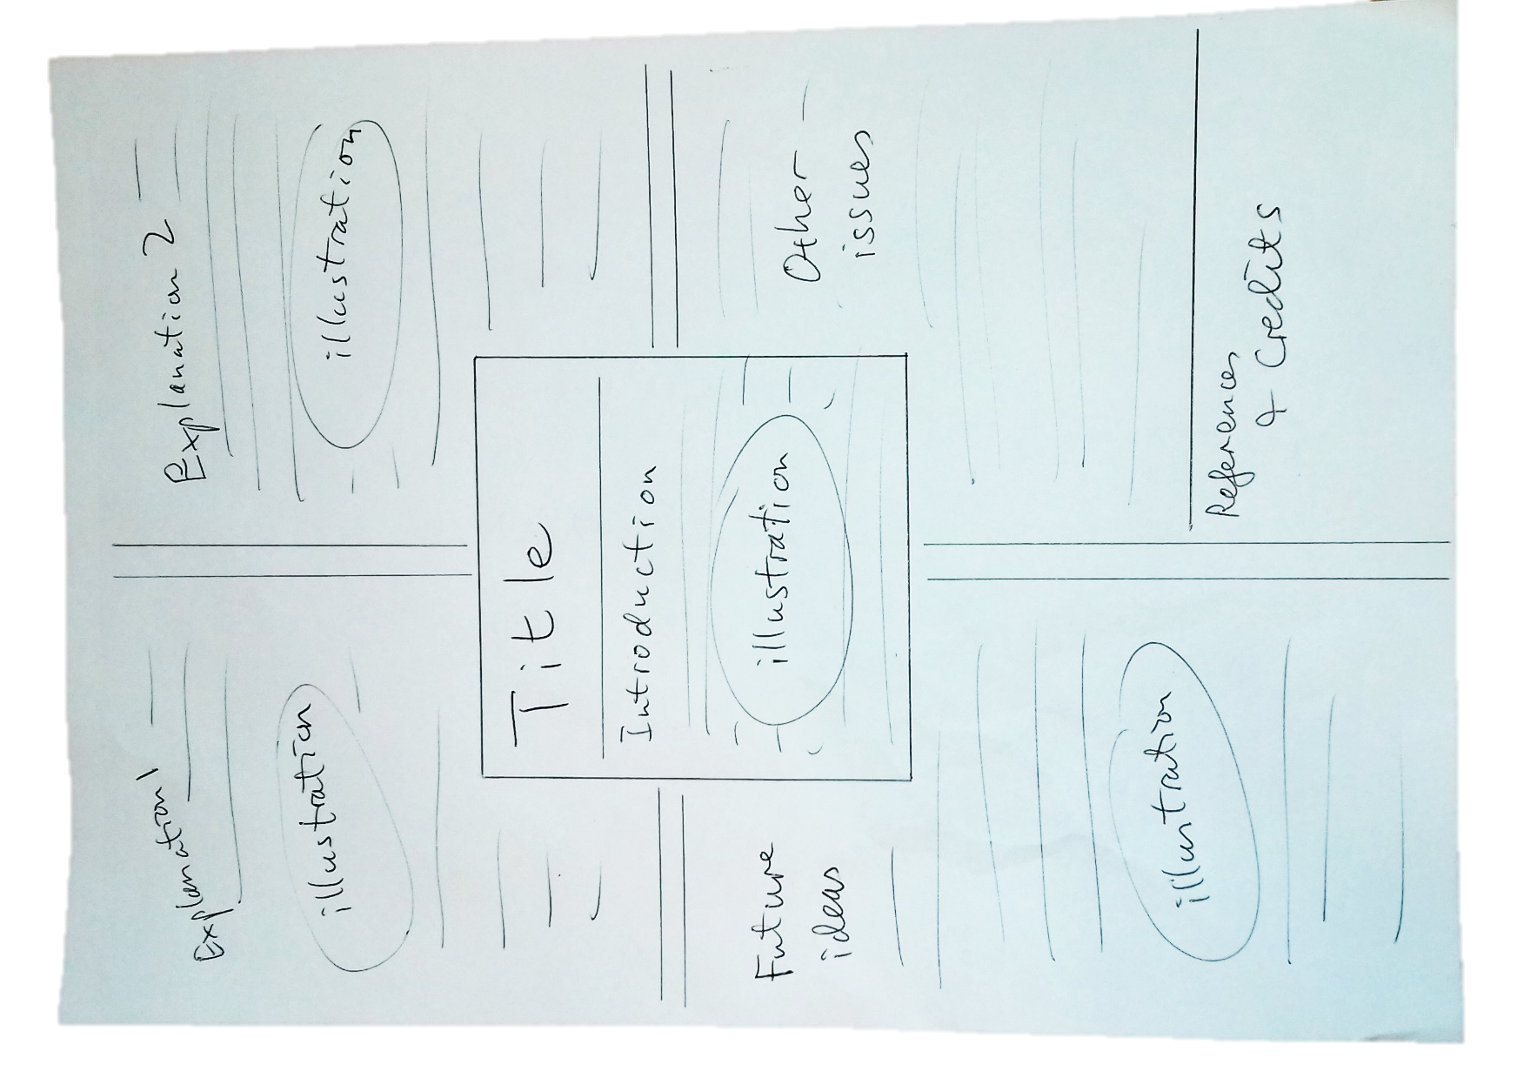
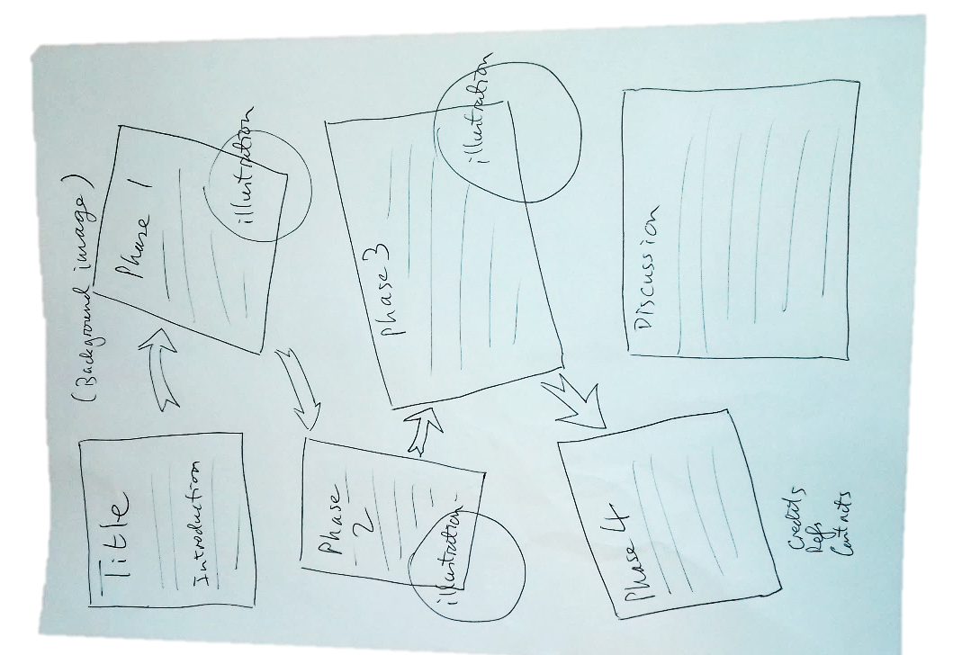
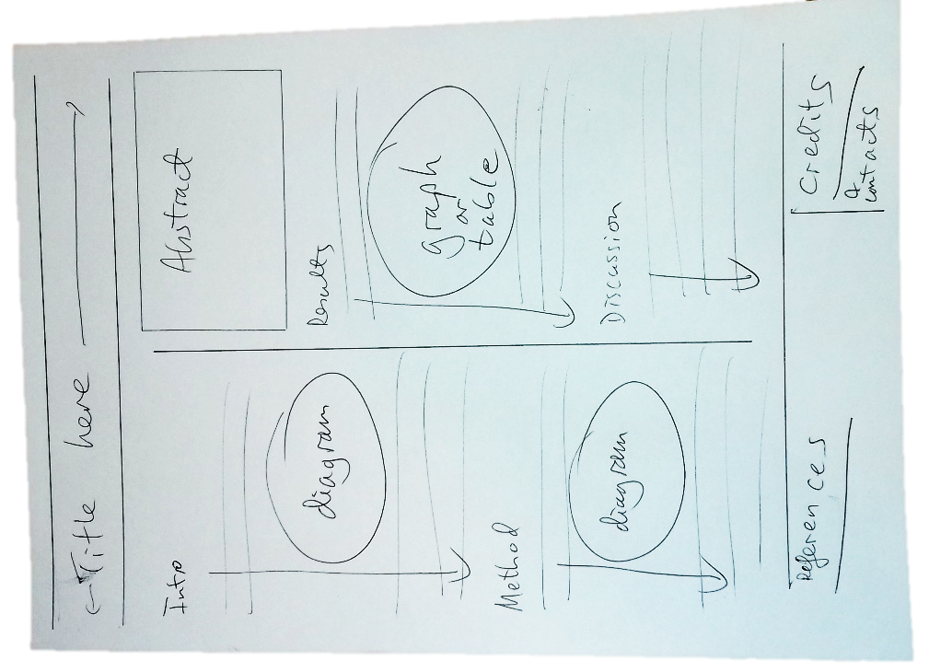
Plan your layout
Plan on paper
Remember actual size of poster too
Try multiple layouts
Notes:
There are lots of possibilities for layout
Use paper to sketch out possible ideas

Slide 16
Using PowerPoint for posters

Slide 17
Size
Set the size first
Design > Slide Size > Custom Slide Size
Size | Dimensions (cm)
A0 | 118.9 x 84.1
A1 | 84.1 x 59.4
A2 | 59.4 x 42.0
A3 | 42.0 x 29.7
A4 | 29.7 x 21.0
59.4cm
84.1cm
84.1cm
A3 Landscape
59.4cm
A2 Portrait
A2 Landscape
A4
Portrait
A1 Portrait
A1 Landscape
Notes:
First, you must work at the size your poster will be when it’s finished
You CAN’T just make a standard size and then ask for it to be printed bigger
Unless you have special requirements, use an ‘A’ size

Slide 18
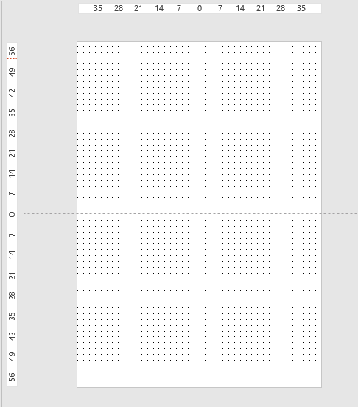
Guides
View > Show
Ruler
Guides
Gridlines

Slide 19
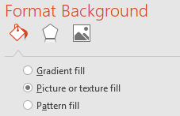
Background
Image or colour
Keep it subtle
Add transparency to images
Check you can still read all text clearly
Notes:
Backgrounds can be plain, coloured or a subtle image
Keep contrast

Slide 20
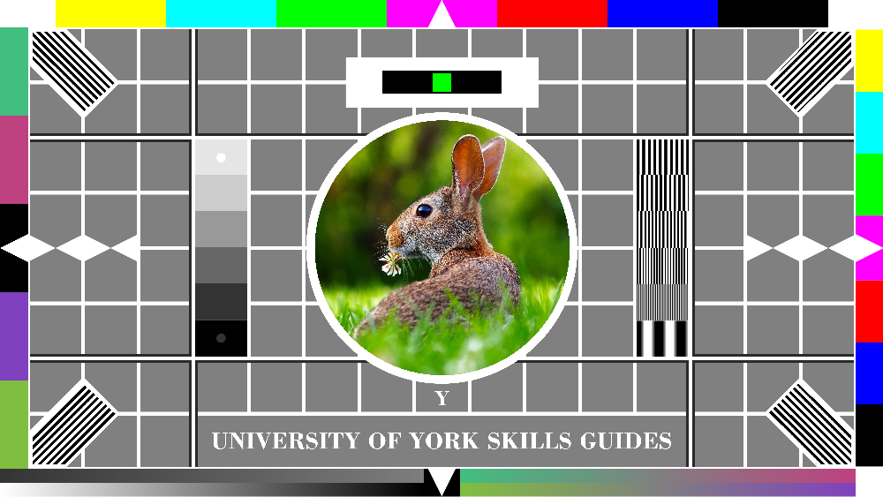


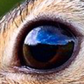
Photographs
300 dpi
120 pixels per cm
250 pixels wide
1000 pixels wide
Notes:
Images need to be big enough to not be crumby

Slide 21
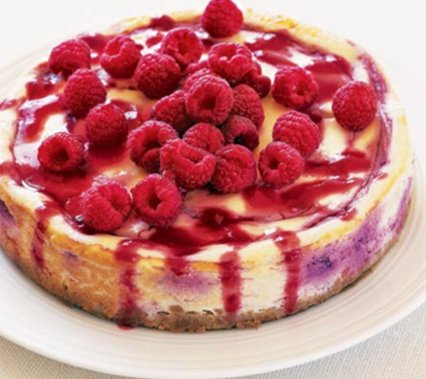
Image resolution
Suppose I want the image to be 6cm wide
At 120 dots per cm,
each 1cm needs 120px
Calculation:
6 x 120 = 720
The image must be 720px wide
720px
Notes:
Photographs must be chosen so they will look OK at the size they will be printed
Small photographs may look fuzzy if printed too large
Very large photographs will make the poster file too large
Ideally you should work out the correct dimensions and re-size the photograph
Pixlr is a free online image editor
Works well with large images as all the processing is done on your computer
Pixlr is a free online image editor
Works well with large images as all the processing is done on your computer

Slide 22
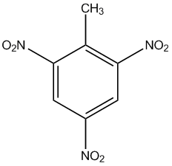
Diagrams
Use PNG or SVG
Time for tea?
Get up
Go to bed
eat
Yes or no?
eat
work
Go to café
Carry on working
SmartArt
PowerPoint drawing tools
Export from other apps
Notes:
Diagrams can be produced in PowerPoint:
Drawing tools
SmartArt
Or created in other apps and exported as image files – use PNG or SVG

Slide 23
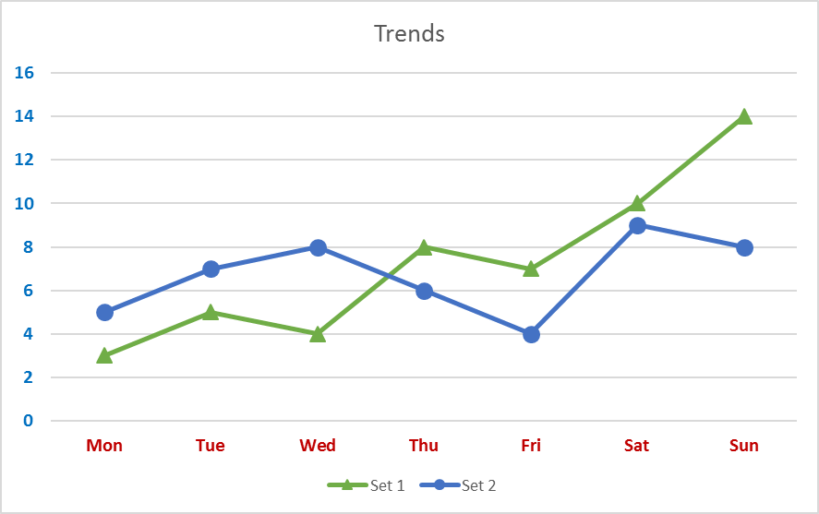
Graphs
From Excel
Embed – puts whole spreadsheet into PowerPoint doc
Link – generates graph from connected Excel file
Image – graph is an image, separate from Excel document
Notes:
Graphs can be constructed in PowerPoint or in Excel
If copying from Excel, be aware of results of different paste methods

Slide 24

Text
Add text in shapes rather than text boxes
Pay attention to line spacing and space between paragraphs, not just font size!
Mary had a little lamb, its fleece was white as snow, and everywhere that Mary went, the lamb was sure to go.
It followed her to school one day, which was against the rule. It made the children laugh and play to see a lamb at school.
Mary had a little lamb, its fleece was white as snow, and everywhere that Mary went, the lamb was sure to go.
It followed her to school one day, which was against the rule. It made the children laugh and play to see a lamb at school.
‘normal’ line and paragraph spacing
smaller font, increased line-spacing and space between paragraphs
Notes:
Text is added in shapes and boxes
You need to set colours and text to make sure it can be read clearly from a reasonable distance
Line-spacing for ‘body’ text should be increased slightly
Include subtle spaces between paragraphs

Slide 25
Text Headings
Mary and the lamb
Introduction
Mary had a little lamb
Its fleece was white as snow
And everywhere that Mary went
The lamb was sure to go
A school day
He followed her to school one day
Which was against the rule
It made the children laugh and play
To see a lamb at school
And so the teacher turned him out
But still he lingered near
And waited patiently about
Till Mary did appear
Mary and the lamb
Introduction
Mary had a little lamb
Its fleece was white as snow
And everywhere that Mary went
The lamb was sure to go
A school day
He followed her to school one day
Which was against the rule
It made the children laugh and play
To see a lamb at school
And so the teacher turned him out
But still he lingered near
And waited patiently about
Till Mary did appear
Increased line-spacing, decreased font size
Heading closer to following text
Space between paragraphs
Notes:
Headings should be closer to the text to which they relate

Slide 26
The final poster

Slide 27
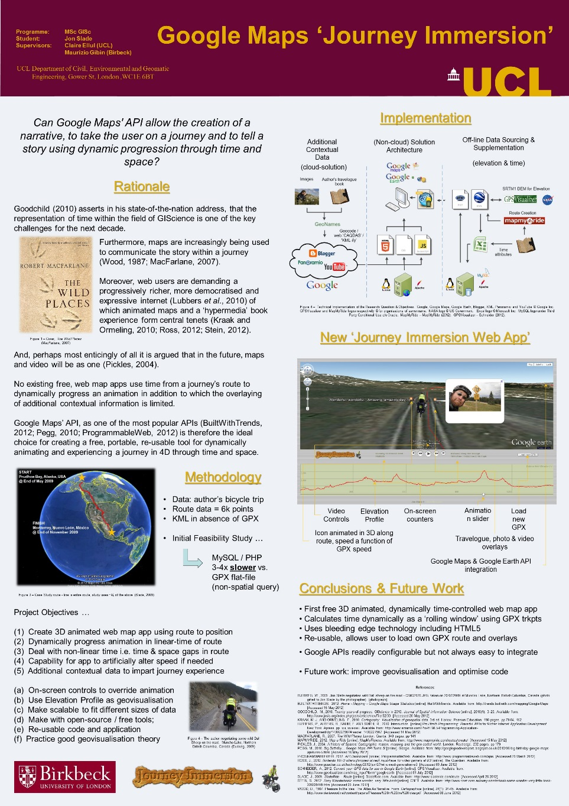
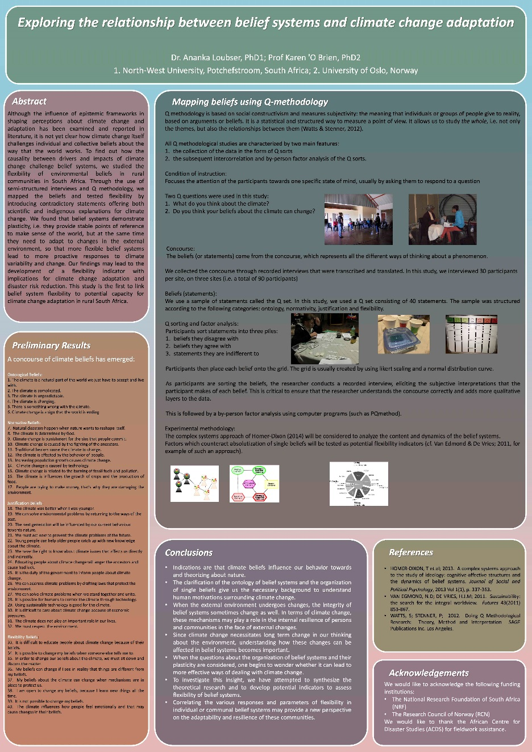
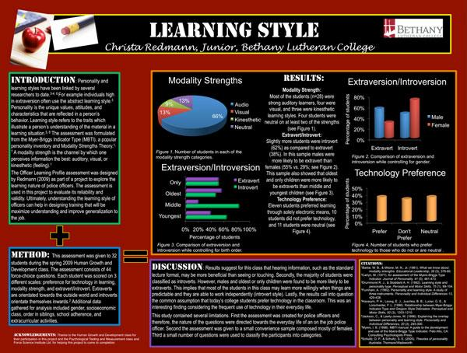
Some example posters

Slide 28
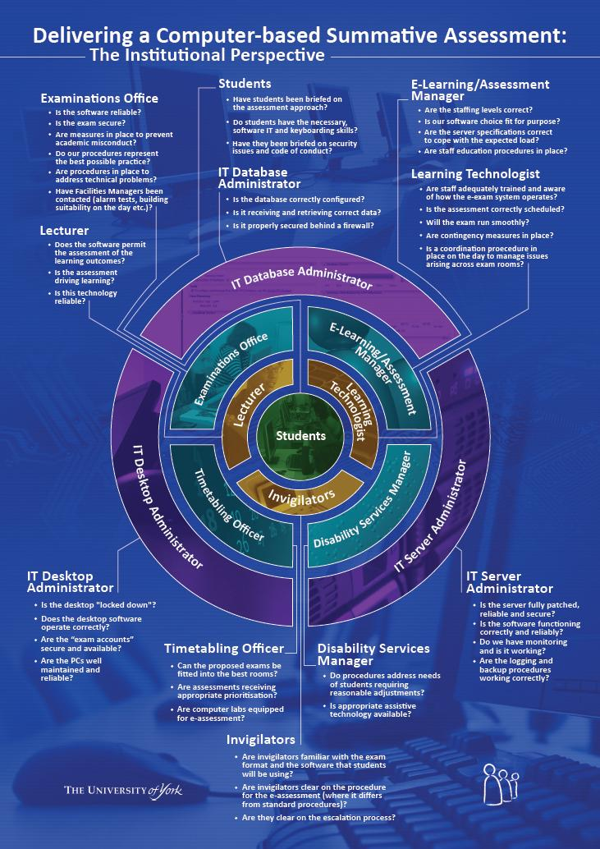
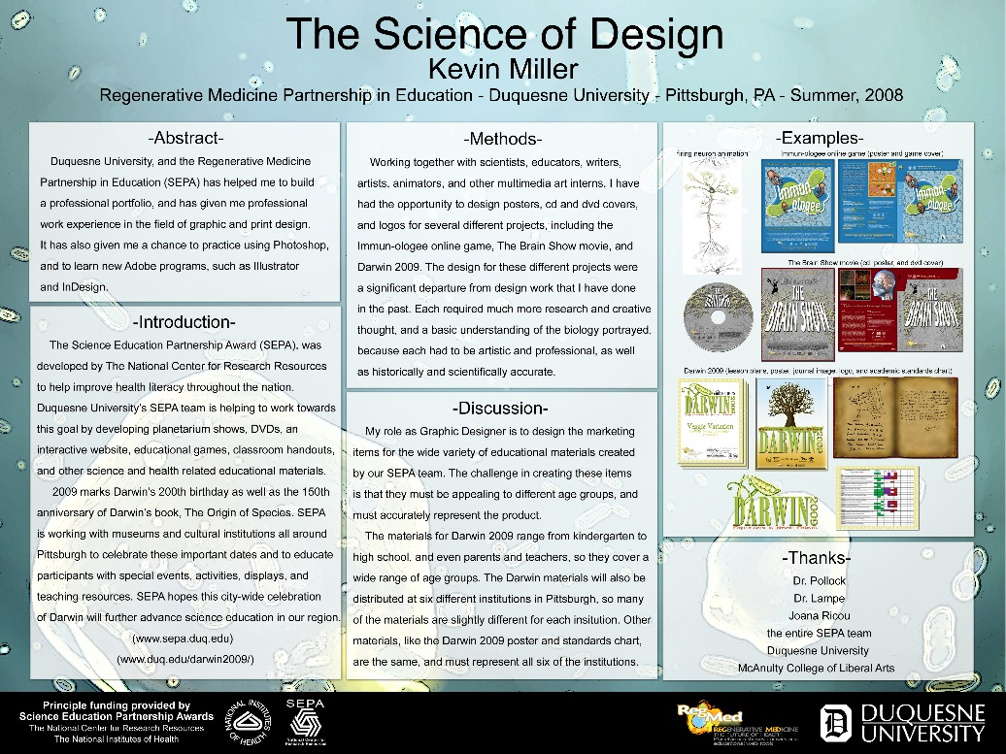


Slide 29


The final step
Export poster from PowerPoint to PDF format
Can print a section from the PDF to test what it would look like full size in terms of font size etc.

Slide 30
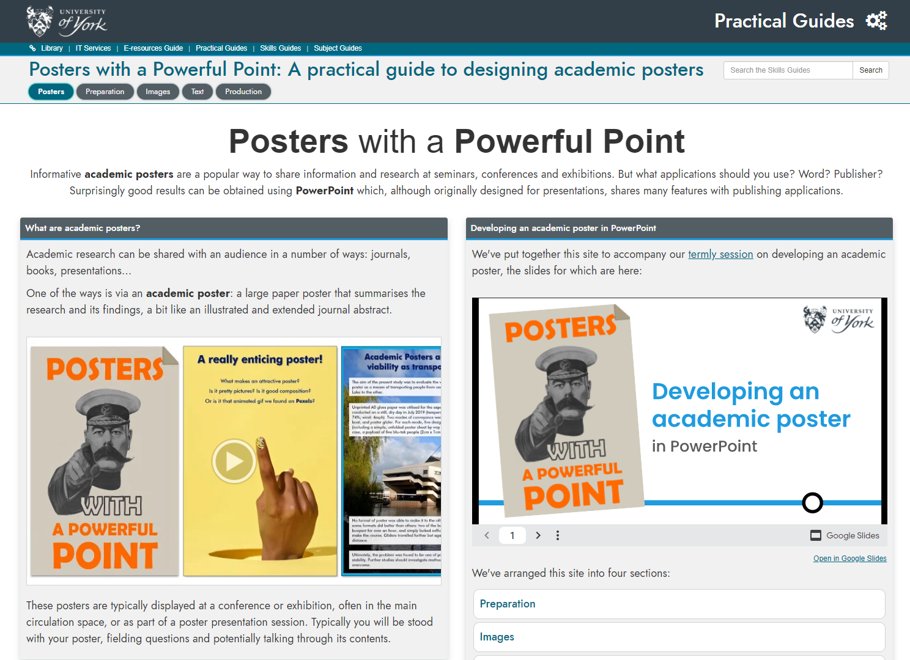
Academic posters
Practical Guide
subjectguides.york.ac.uk/posters

