Slide 1

Digital Strategy
Chris Thomas
christopher.thomas2@uwtsd.ac.uk

Slide 2
Have you all registered for your submission of the Digital Strategy Assessment (you should have received an email with link)
https://cimsubmissions.awardsplatform.com

Slide 3
Lecture content and draft deadlines
Date | Time | Lecture | Drafts Deadline
20.09.17 | 5:00pm - 8:00pm (W) | Introduction/Assignment Digital Disruption
04.10.17 | 5:00pm - 8:00pm (W) | Digital Disruption
21.10.17 | 10:00am - 4:00pm (S) | Digital Planning | Task 1 23.10.17 (M)
08.11.17 | 5:00pm – 8:00pm (W) | Digital Planning
15.11.17 | 5:00pm - 8:00pm (W) | Delivering Success | Task 2 13.11.17 (M)
18.11.17 | 10:00am - 4:00pm (S) | Delivering Success
22.11.17 | 5:00pm - 8:00pm (W) | Re-cap. Queries answered. | Task 3 24.11.17(F)
DONE
DONE

Slide 4
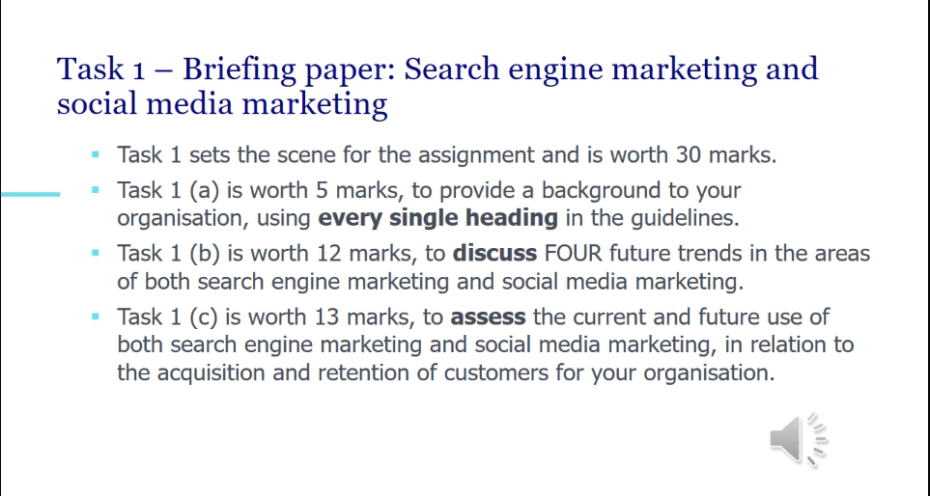
Assessment Question 1
Discuss: investigate/examine reasons for and against. Some trends more relevant to your orgn than others. Digital PESTEL could be useful
Assess: evaluate/judge: acquisition and retention: range of techniques: parts of RACE and possibly Hofacker’s 5 stages

Slide 5
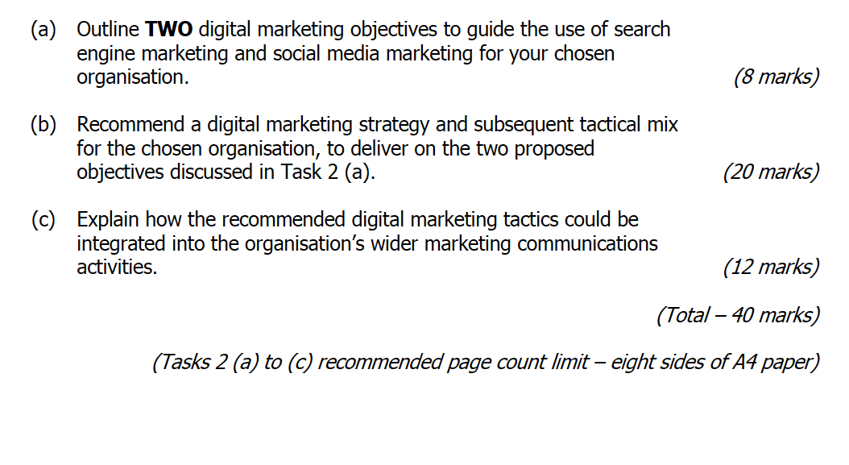
Assessment Question 2
For the strategy document: formal style and write in the third person.
Use RACE model or similar to identify the focus for each objective
SMART
Outline: selectively identify valid and relevant information from a range of sources making judgements where information may be limited

Slide 6
Strategy: overall direction the orgn may take. Use a strategy model: McKinsey consumer decision journey/ Ansoff/ RACE strategy must relate back to objectives. A clear strategy not a descriptive list.
Use the 7 P’s focusses on customer acquisition and retention

Slide 7
Explain: present complex info evidencing comprehensive knowledge understanding and application of ley principles.
Integration NOT implementation. Every aspect of an orgns acquisition and retention processes are coordinated, consistent and coherent both online and offline.
Models: 4C’s of marketing communication.
Clarity, Credibility, Consistency and Competitiveness or parts of the 10C’s of Marketing for the Modern Economy (adapted). Support your recommendation and explanations with strong academic material : MyCIM

Slide 8
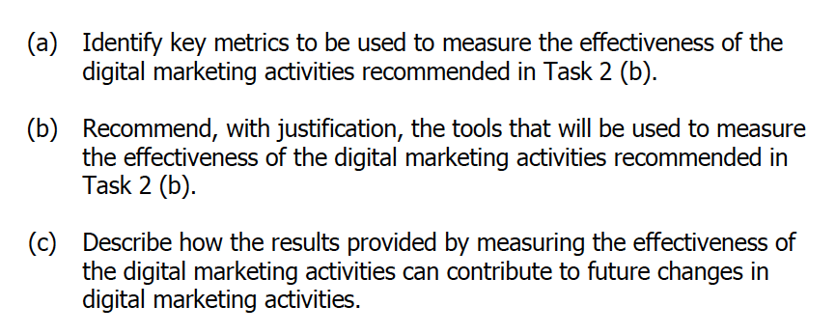
Assessment Question 3
Critically identify key metrics based on evidence
Acquisition metrics
Retention metrics
Google analytics
Facebook insights
Sentiment analysis tools

Slide 9
We will cover metrics in detail in our Saturday session
Mastering Metrics lecture notes available on Moodle

Slide 10
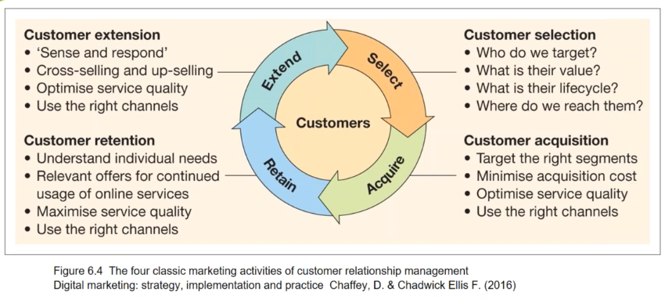
Look at Chaffey’s Book!

Slide 11
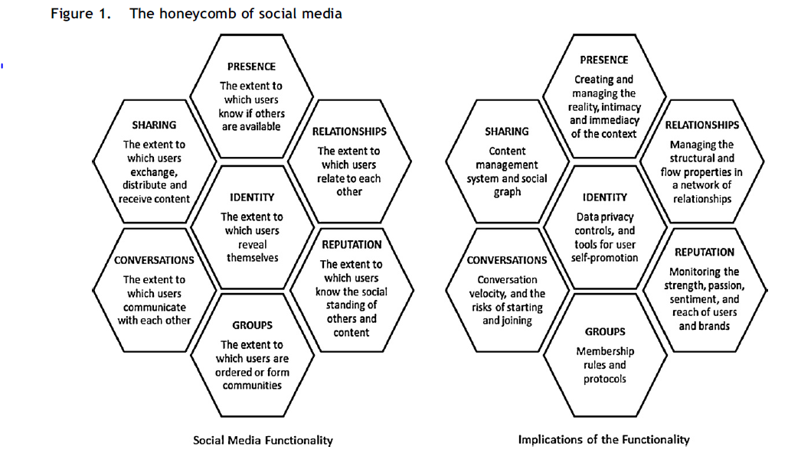
Honeycomb – Social media functionality
Source: Kietzmann et al (2011) Social media? Get Serious?

Slide 12
Social Media Honeycomb explained

Slide 13
What is Social Media Marketing?
“Monitoring and facilitating customer interaction and participation throughout the web to encourage positive engagement with a company and its brands. Interactions may occur on a company site, on social networks and other third-party sites”.
Digital marketing: strategy, implementation and practice Chaffey, D., & Chadwick Ellis F. (2016)

Slide 14
Social Media
You need a good broad understanding of all social media platforms, even ones not right for your organisation
Main social media platform stats are here
Senior examiner states NOT to focus on the advertising side of social media
The social media landscape (explanation here!)

Slide 15
Where is social media going?
https://www.brandwatch.com/blog/social-media-trends-2017/

Slide 16
Trends
How to find trends on social media

Slide 17
Choose a social media platform and research how it can be used for marketing purposes
Look at the characteristics of the platform
Look at number of users
Metrics that can be used
How best to engage
How engage with your target audience: for free and paid.
Any other interesting facts…

Slide 18
Power of Social Media
Social Media is taking over from PR , sharing links via social media more important than using press releases
Instantaneous with the increasing use of mobile.
Can inspire people Tim Peake
Can enrage people Tesco’s Xmas Ads
Can influence elections Labour; Trump

Slide 19
Used at every stage of the Customer Journey
Social Media Marketing for Acquisition
Social Media Marketing for Retention

Slide 20
Facebook Marketing
https://blog.hootsuite.com/facebook-marketing-tips/
https://www.hubspot.com/facebook-marketing

Slide 21
Twitter Marketing
https://blog.hootsuite.com/twitter-marketing/
https://sproutsocial.com/insights/twitter-marketing/

Slide 22
LinkedIn Marketing
https://blog.hubspot.com/marketing/linkedin-content-marketing
https://blog.hootsuite.com/topic/linkedin-marketing/

Slide 23
Instagram…? Snapchat...?etc

Slide 24
Social Media Case studies
Lots online

Slide 25
Social CRM
What is Social CRM

Slide 26
5 M’s of a Social CRM strategy

Slide 27
Customer Engagement:
  Repeated interactions that strengthen the emotional, psychological or physical investment a customer has in a brand
  CHALLENGED BY
Media fragmentation:
  Describes a trend to increasing choice and consumption of a range of media in terms of different channels such as web and mobile and also within channels eg tv channels, radio stations, more websites

Slide 28
Forrester (2007) has developed a framework to measure online engagement through the customer lifecycle and away from a brands own site:
  Involvement: website visits, time spent, pages viewed
  Interaction: comments, reviews
  Intimacy: sentiment tracking on third party sites including blogs and reviews
  Influence: advocacy indicated by such measures as likelihood to recommend to a friend

Slide 29
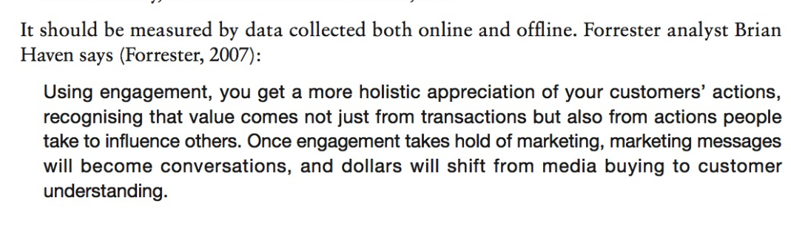

Slide 30
Social media…
Engagement metrics
Engagement Tools

Slide 31
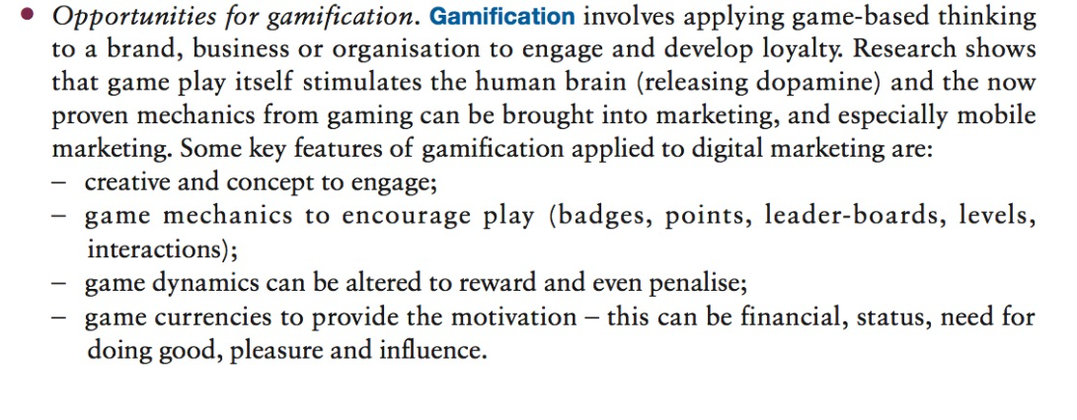
Delivering of loyalty programmes (which encourage customer extension and retention).
Opportunities for gamification:

Slide 32
Gamification strategies
Social media loyalty (retention strategies)

Slide 33
5 I’s
Peppers and Rogers (1997) stages for customer retention:
Identification – can the customer be recognised for different channel contacts?
Individualisation – can communications and products be tailored?
Interaction – are communications two-way?
Integration – is there a 360 degree view of the customer?
Integrity – is the relationship built on trust?

Slide 34
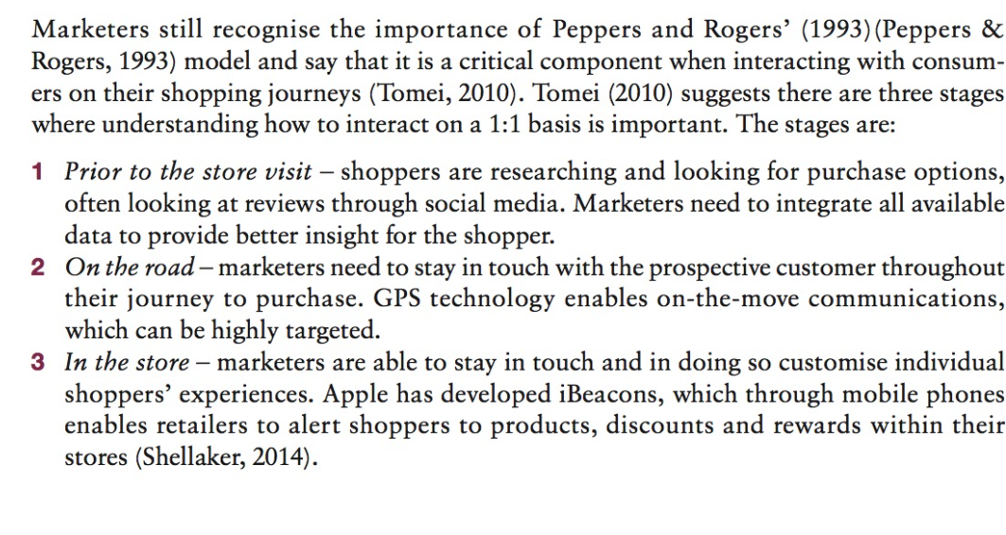

Slide 35
Delliotte

Slide 36
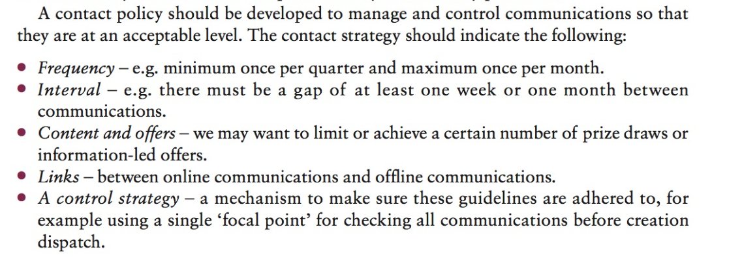
Contact strategy

