Slide 1
LCMB7034
International Business Concept
Week 1
International Business and Globalisation

Slide 2
Learning Objectives
To define international business (IB) and explain why and how the study of IB is important
To assess the major reasons companies seek to create value by engaging in IB
To understand the relationship between globalization and IB
To explain globalization and grasp the forces driving globalization and IB
To discuss the major criticisms of globalization
To identify the types of companies active in IB
UWTSD - Copyright 2023

Slide 3

International Business (IB)
Why study IB?
What to study in IB
How to study IB to develop a critical set of skills
UWTSD - Copyright 2023

Slide 4
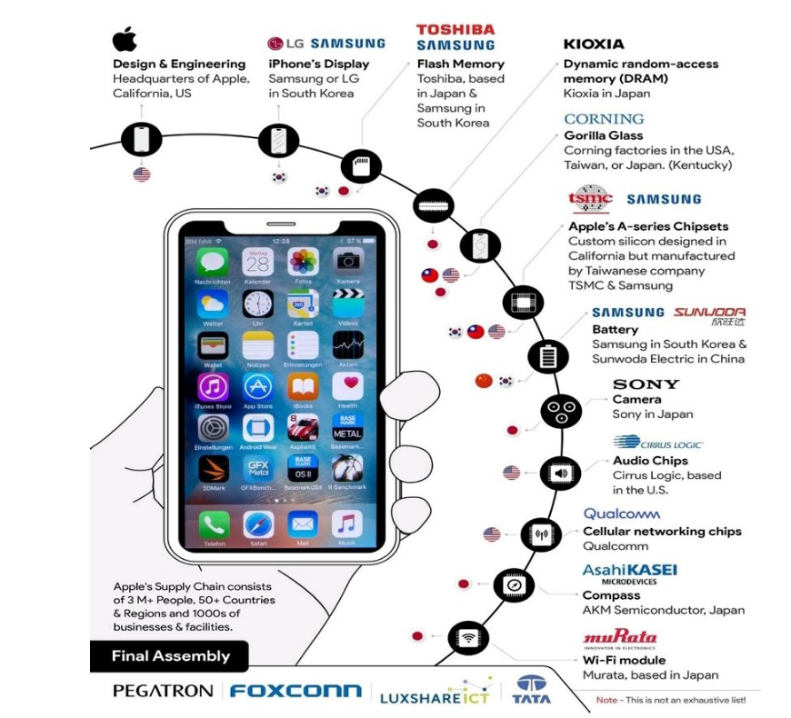
Before Starting the lesson today, Just think, how did the phone on your hand manufacture?
Notes:
Gaurav Dalmia on X: "iPhone's supply chain and production process. https://t.co/YNqqhfFdZ6" / X

Slide 5

What is International Business?
International business consists of all commercial transactions - including sales, investments, and transportation - that take place between two or more countries
  Increasingly foreign countries are a source of both production and sales for domestic companies
    The ‘Made in’ label is no more correct
  The private businesses seek profit
  The governments seek profit and/or politics
  According to international business journal, International business is a commercial enterprise that performs economics activity beyond the bounds of its location, has branches in two or more foreign countries and makes use of economic cultural political legal and other differences between countries.
UWTSD - Copyright 2023
Notes:
What is international business? International business consists of all commercial transactions that take place between two or more countries. International business activities allow us to get more variety, better quality, and/or lower prices.
International business activities may be performed by private companies motivated by profit, or by governments that undertake them either for profit or for political reasons.

Slide 6
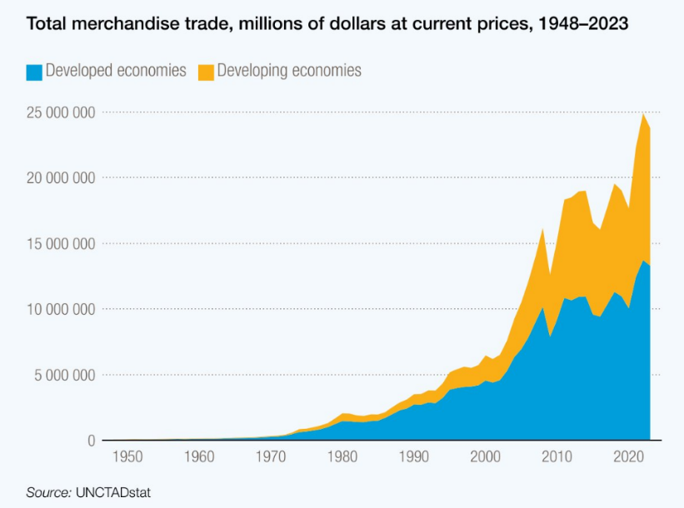

Slide 7
Why Study International Business?
It is important to study international business because IB is now a large proportion of world’s total business
  Most companies are either international or compete with international companies (secure supplies, sell output, compete)
  Global events and competition affect almost all companies, regardless of industry (need to approach operating strategies from international standpoint)
  International companies have more complex environments than domestic firms.
  An understanding of IB helps you make better and informed career decisions
  An understanding helps you decide what government policies to support
UWTSD - Copyright 2023
Notes:
Why should you study international business? There are many reasons. One of the most important is because global events affect companies of all sizes and in all industries. In fact, managers today need to consider where in the world to obtain the inputs they need of the required quality and at the best possible price and also where they can best sell the product or service that they’ve put together from those inputs. In many cases, managers may find that they can be more competitive by engaging in global business transactions.
It’s also important to recognize that the best way of doing business abroad may not be the same as the best way at home. When a company operates internationally, it engage in modes of business such as exporting and importing that differ from those in which it engages domestically. In addition, physical, social, and competitive conditions differ among countries and affect the optimum ways to conduct business. So, we often find that companies operating internationally have more diverse and complex operating environments than those that conduct business only at home.
Even if you aren’t working at an international company it’s important to understand international business complexities because overall national conditions— things like profits, employment security and wages, consumer prices, and national security are all affected by the international operations of companies and by government regulations of those operations.

Slide 8
International Business
Doing business at home may not be the same as doing it in another country
Differences:
  Modes of business
  Physical, social, competitive conditions
  Diverse and complex operating environments
Effects:
  Profits
  Employment security and wages
  Consumer prices
  National security

Slide 9
Why IB is Different
The external environment affects a company’s international operations
Managers must understand social science disciplines and how they affect functional business fields
Consider
  Physical factors (geography, availability of resources)
  Social factors (politics, law, culture, economics)
  Competitive factors (number and strength of suppliers, customers, and competitors)
Notes:
Companies involved in international business need to explore how the external environment will affect their operations. In particular, it’s important for managers to understand the social science disciplines and how they affect all functional business fields.

Slide 10
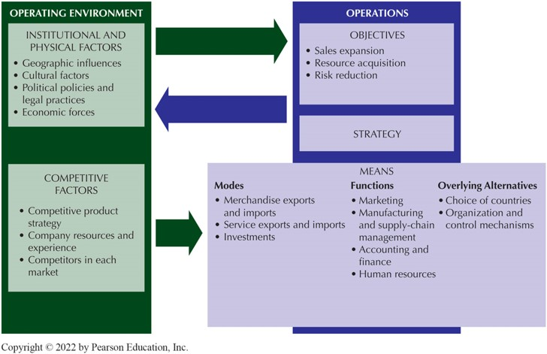
Factors in IB Operations
Notes:
Daniels, J.D., Radebaugh, L.H. and Sullivan, D.P., 2019. International business: Environments and operations. Pearson.

Slide 11
Physical and Social Factors
Geographic influences
  Natural conditions influence business locations
Political policies
  Countries determine where and how business occurs within their borders
Legal policies
  Influence how a company operates
Behavioral factors
  May require adaptation into local conditions
  High individualist are competitive and high masculine people ‘live to work’
Economic forces
  Explain differences in costs, currency values, market size
Notes:
We can organize physical and social factors into five groups. The first is geographic influences or how natural conditions influence the choice of production locations. The second group is political policies which impacts how, and even if, business takes place within a country. Related to this are legal policies. Firms must follow the laws in each country. The fourth group, behavioral factors, may also force a company to alter its operations to better fit with local cultural norms and values. Finally, economic forces affect costs, currency values, market size, and so on. Together, these factors influence how companies produce and market their products, how they staff their operations, and so on. Keep in mind that the factors may require a company to use a different method of operation internationally than is used domestically.

Slide 12
The Competitive Environment
Competitive strategy for products
  Cost strategy
  Differentiation strategy
  Focus strategy
Company resources and experience
  Market leaders have more resources for international operations
Competitors faced in each market
  Local or international
So, a company’s competitive strategy influences how and where it can best operate
Its competitive situation may differ from country to country in terms of its relative strength and which competitors it faces
Notes:
Managers also need to understand how the competitive environment will affect their operations. A company’s competitive strategy - low cost, differentiation, or focus - will influence its international strategy, as will its resources and experience. Companies with greater resources and experience will have more opportunities open to them than companies with more limited resources or experience. Finally, the competitors a firm faces in each market will dictate to some degree a company’s international strategy.
In summary, a firm’s competitive strategy influences how and where it operates. Firms might find that their competitive situation differs from market to market.

Slide 13
Is an Interdependent Global Economy a Good Thing?
Supporters believe that increased trade and cross-border investment mean
  Lower prices for goods and services
  Greater economic growth
  Higher consumer income, and more jobs
Critics worry that globalization will cause
  Job losses
  Environmental degradation
  Cultural imperialism of global media and MNEs
Anti-globalization protesters now regularly show up at most major meetings of global institutions

Slide 14
How Does The Global Marketplace Affect Managers?
Managing an international business differs from managing a domestic business because
  Countries are different
  The range of problems confronted in an international business is wider and the problems more complex than those in a domestic business
  Firms have to find ways to work within the limits imposed by government intervention in international trade and investment systems
  International transactions involve converting money into different currencies

Slide 15

Why Companies Engage in IB?
Sales expansion
Resource acquisition
Risk reduction
UWTSD - Copyright 2023
Notes:
Pursuing international sales usually increases the potential sales and potential profits. Obviously, there are more potential consumers in the world than in any single country.
Foreign locations may give companies lower costs, new or better products and components, and additional operating knowledge.
International operations may reduce operating risk by smoothing sales, profits, and supplies and preventing competitors from gaining advantage. Selling in countries with different timing of business cycles can decrease swings in sales and profits. Moreover, by obtaining supplies of products or components both domestically and internationally, companies may be able to soften the impact of price swings or shortages in any one country. Finally, companies often go international for defensive reasons. Perhaps they want to counter competitors’ advantage in foreign markets that might hurt them elsewhere.

Slide 16
Why Companies Engage in IB
To expand sales (depends on consumer interests and willingness)
  Pursuing international sales increases the potential market and potential profits
To acquire resources
  May give companies lower costs, new and better products, and additional operating knowledge (services, resources, and components)
To diversify or reduce risks
  International operations may reduce operating risk by smoothing sales and profits, preventing competitors from gaining advantage
  Different business cycles; price swings and shortages from place to place
Advanced communication systems have enabled better control and supervision of global operations
Notes:
Why should companies engage in international business? A general answer is that going international can help firms create value. More specifically, going global can help firms expand sales, acquire resources, and diversify or even reduce risks.
All three of these can influence decisions about whether, where, and how to go global.

Slide 17
What Is Globalization?
1
Globalization - the shift toward a more integrated and interdependent world economy
The world is moving away from self-contained national economies toward an interdependent, integrated global economic system
Globalization is the broad set of interdependent relationships among people from different parts of a world divided into nations
UWTSD - Copyright 2023
Notes:
What is globalization? Globalization refers to the widening set of interdependent relationships among people from different parts of a world that is divided into nations.
The term also refers to the integration of world economies through the reduction of barriers to the movement of trade, capital, technology, and people. Throughout history, human contacts over ever-wider geographic areas have expanded the variety of available resources, products, services, and markets.
Today, so many different components, ingredients, and specialized business activities go into products that we’re often challenged to say exactly where they were made. For example Apple’s iPhones are shipped from China and seem to be Chinese, yet less than four percent of their value is actually performed in China!
Globalization is the widening and deepening of interdependent relationships among people from different nations. The term sometimes refers to the elimination of barriers to international movements of goods, services, capital, technology, and people that influence the integration of world economies.

Slide 18

What Is Globalization?
2
https://www.youtube.com/watch?v=p6u9m5FK0IQ
UWTSD - Copyright 2023
Notes:
Globalization 101 – Trends, Impacts & Insights is an excellent resource to learn more about globalization and its impact on modern society!

Slide 19
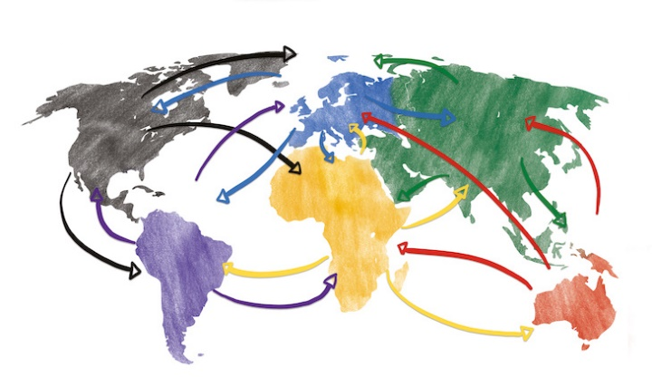
The Connection Between Globalization and IB
Human contacts expanded variety of resources, products, services, and markets
We have altered the way we want and expect to live
We buy products from all over the world
Enables variety, better quality, and lower prices
Enables products availability all round the year (even out of seasons)
Due to consumer demands, many countries have removed restrictions on international movement of goods and services
UWTSD - Copyright 2023
Notes:
Globalization enables us to get more variety, better quality, or lower prices. The global connections between supplies and markets result from the activities of international business, which are all commercial transactions that take place among countries.
The global connections between supplies and markets result from the activities of international business (IB), which are all commercial transactions that take place among countries. Private companies undertake such transactions for profit; governments may undertake them either for profit or for other reasons.

Slide 20


Do you think Globalisation is a good or a bad thing?
Question?
Discuss benefits and costs of globalisation
UWTSD - Copyright 2023

Slide 21
Costs of Globalization
Threats to national sovereignty
  Lose freedom to “act locally”
  Threat to national interests, objectives, and policies
  Cultural homogeneity (customs, traditions, values, language)
Economic growth and environmental stress
  Growth consumes non-renewable natural resources and increases environmental damage
Growing income inequality and personal stress
  Promotes global superstars at the expense of others
Offshoring, a type of outsourcing, involves the transferring of production abroad
  It can be beneficial because it reduces costs but, it also means that jobs move abroad
UWTSD - Copyright 2023
Notes:
While there are many benefits to globalization, it remains controversial. Anti-globalization protests have become common at international conferences, and the reaction to government policies is sometimes violent.
Three issues are of particular concern. First, the threat the globalization poses to national sovereignty. According to critics, globalization undermines the ability of a country to act in its own best interests and can make smaller economies overly dependent on larger ones. Moreover, critics contend that even a country’s cultural sovereignty is threatened as products, companies, work methods, social structures and language are homogenized as a result of globalization.
A second concern is the effect of globalization on economic growth and the environment. Because globalization brings growth, more non-renewable natural resources are consumed and damage to the environment increases. You might think of despoliation through toxic and pesticide runoffs into rivers and oceans, air pollution from factory and vehicle emissions, and deforestation that can affect weather and climate for example. However, others argue that global cooperation actually fosters superior and uniform standards for combating environmental problems, and that companies are encouraged to seek resource-saving and environmentally friendly technologies.
Finally, critics are concerned about the effect of globalization on income equality and personal stress. According to critics the income inequality that is present in many countries today is a result of the global superstar system that has emerged as a consequence of globalization. Critics contend that globalization has facilitated access to a greater supply of low-skilled and low-cost labor and encouraged competition that leads to winners and losers. There is also some evidence that the growth in globalization goes hand in hand not only with increased insecurity about job and social status, but also with costly social unrest.
Critics of globalization also worry that the practice of offshoring is shifting too many jobs abroad. But keep in mind, that the practice allows companies to keep costs down, and can actually help create high value jobs at home. IBM’s offshoring strategy for example, allows the company to not only save money and boost sales, but also to create new jobs.

Slide 22
Is an Interdependent Global Economy a Good Thing?
Supporters believe that increased trade and cross-border investment mean
  Lower prices for goods and services
  Greater economic growth
  Higher consumer income, and more jobs
Critics worry that globalization will cause
  Job losses
  Environmental degradation
  The cultural imperialism of global media and MNEs
Anti-globalization protesters now regularly show up at most major meetings of global institutions
UWTSD - Copyright 2023

Slide 23
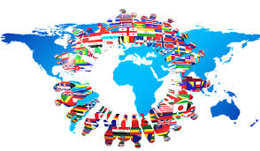
Forces Driving Globalization
Increase in and application of technology
  Developing and not just producing; innovations
  Improving pace of production and transport of perishable goods
Liberalization of cross-border trade and resource movements
  Reasons: reduce uncertainty, more variety at lower prices, competition increases efficiency, other countries remove barriers in return
Development of services that support international business
  Bank credits, currency exchanges, insurances; Universal Postal Union
Growth of consumer pressures
  Demand more, newer, better, differentiated products and services
UWTSD - Copyright 2023
Notes:
Most analysts cite these interrelated factors as contributing to the growth of globalization. These factors include the rise in and application of technology. Many of the proverbial “modern marvels” and efficient means of production have come about fairly recently. These include new products, such as handheld mobile communications devices, as well as new applications of old products, such as Indian guar beans in oil and natural gas mining. Thus, much of what we trade today either did not exist or was unimportant in trade a decade or two ago. Strides in communications and transportation now allow us to discover, desire, and demand goods and services from abroad.
To protect its own industries, every country restricts the entry and exit of not only goods and services but also the resources—workers, capital, tools, and so on—needed to produce them. Over time, however, most governments have reduced such restrictions, primarily for three reasons: their citizens want a greater variety of goods and services at lower prices, competition spurs domestic producers to become more efficient, and they hope to induce other countries to lower their barriers in turn.
Companies and governments have developed services that facilitate global commerce. For example, because of bank credit agreements—clearing arrangements that convert one currency into another and insurance that covers such risks as nonpayment and damage en route—most producers can be paid relatively easily for their sales abroad.
More consumers know more today about products and services available in other countries, can afford to buy them, and want the greater variety, better quality, and lower prices offered by access to them. However, this demand is spread unevenly because of uneven affluence, both among and within countries as well as from year to year.
Increased competitive pressures can persuade companies to buy or sell abroad. For example, a firm might introduce products into markets where competitors are already gaining sales, or seek supplies where competitors are getting cheaper or more attractive products.
Today, only a few countries are heavily isolated economically or do business almost entirely within a political bloc. In fact, political changes sometimes open new frontiers. And governments support programs, such as improving airport and seaport facilities, to foster efficiencies for delivering goods internationally.
Governments have come to realize that their own interests can be addressed through international cooperation by means of treaties, agreements, and consultation. The willingness to pursue such policies is due largely to three needs: to gain reciprocal advantages, to attack problems jointly that one country acting alone cannot solve, and to deal with areas of concern that lie outside the territory of any nation

Slide 24
Forces Driving Globalization
Increased global competition
  Some businesses are ‘Born Global’
Changing political situations and government policies
  Transformation of policies, bridging countries (communists and non-communists), open seaports and airports and other transport channels
Expanded cross-national cooperation
  Treaties, agreements, and consultations
  To gain reciprocal advantage, seek joint problem solving, deal with concerns that are outside country boundaries (e.g., “COVID 19” diseases and natural disasters)
UWTSD - Copyright 2023
Notes:
Most analysts cite these interrelated factors as contributing to the growth of globalization. These factors include the rise in and application of technology. Many of the proverbial “modern marvels” and efficient means of production have come about fairly recently. These include new products, such as handheld mobile communications devices, as well as new applications of old products, such as Indian guar beans in oil and natural gas mining. Thus, much of what we trade today either did not exist or was unimportant in trade a decade or two ago. Strides in communications and transportation now allow us to discover, desire, and demand goods and services from abroad.
To protect its own industries, every country restricts the entry and exit of not only goods and services but also the resources—workers, capital, tools, and so on—needed to produce them. Over time, however, most governments have reduced such restrictions, primarily for three reasons: their citizens want a greater variety of goods and services at lower prices, competition spurs domestic producers to become more efficient, and they hope to induce other countries to lower their barriers in turn.
Companies and governments have developed services that facilitate global commerce. For example, because of bank credit agreements—clearing arrangements that convert one currency into another and insurance that covers such risks as nonpayment and damage en route—most producers can be paid relatively easily for their sales abroad.
More consumers know more today about products and services available in other countries, can afford to buy them, and want the greater variety, better quality, and lower prices offered by access to them. However, this demand is spread unevenly because of uneven affluence, both among and within countries as well as from year to year.
Increased competitive pressures can persuade companies to buy or sell abroad. For example, a firm might introduce products into markets where competitors are already gaining sales, or seek supplies where competitors are getting cheaper or more attractive products.
Today, only a few countries are heavily isolated economically or do business almost entirely within a political bloc. In fact, political changes sometimes open new frontiers. And governments support programs, such as improving airport and seaport facilities, to foster efficiencies for delivering goods internationally.
Governments have come to realize that their own interests can be addressed through international cooperation by means of treaties, agreements, and consultation. The willingness to pursue such policies is due largely to three needs: to gain reciprocal advantages, to attack problems jointly that one country acting alone cannot solve, and to deal with areas of concern that lie outside the territory of any nation

Slide 25
In future…
Three major perspectives on the future of international business and globalization
  Further globalization is inevitable
  International business will grow primarily along regional rather than global lines
  Forces working against further globalization and international business will slow down both trends

Slide 26
Types of International Organizations
Multinational enterprises (MNEs)
    Usually BIG size
    Take a global approach to markets and production or have operations in more than one country
    Typically uses most of the modes of international business
Sometimes they are referred to as
  Multinational Corporations (MNCs)
  Multinational Companies (MNCs)
  Transnational Companies (TNCs)
UWTSD - Copyright 2023
Notes:
Any company with foreign direct investments is known as a multinational enterprise. Other terms used for these types of companies include multinational company, multinational corporation, or transnational corporation.

Slide 27
Summary
Globalization is the widening set of interdependent relationships among people from different parts of a world divided into nations
International business consists of all commercial transactions—including sales, investments, and transportation—that take place between two or more countries

Slide 28
Summary
It is important to study international business because
  Most companies are either international or compete with international companies
  Global events and competition affect almost all companies, regardless of industry
  International companies have more complex environments than domestic firms.
  An understanding helps you make better career decisions
  An understanding helps you decide what government policies to support

Slide 29
Summary
The factors of International Business include:
  Geographic influences
  Political policies
  Legal policies
  Behavioral factors
  Economic forces

Slide 30

Any Questions?
Thank You ☺
UWTSD - Copyright 2023

Slide 31
Sources:
Collinson, S., Narula, R., Qamar, A. and Rugman, A.M., 2020. International business. Pearson UK.
Daniels, J.D., Radebaugh, L.H. and Sullivan, D.P., 2019. International business: Environments and operations. Pearson.
Hill, C. W. L., 2023. International Business: Competing in the global marketplace. McGraw-Hill.
Wild, J. J. and Wild, K. L., 2023. International Business: The Challenges of Globalization. Pearson Education Limited.
UWTSD - Copyright 2023

