Slide 1

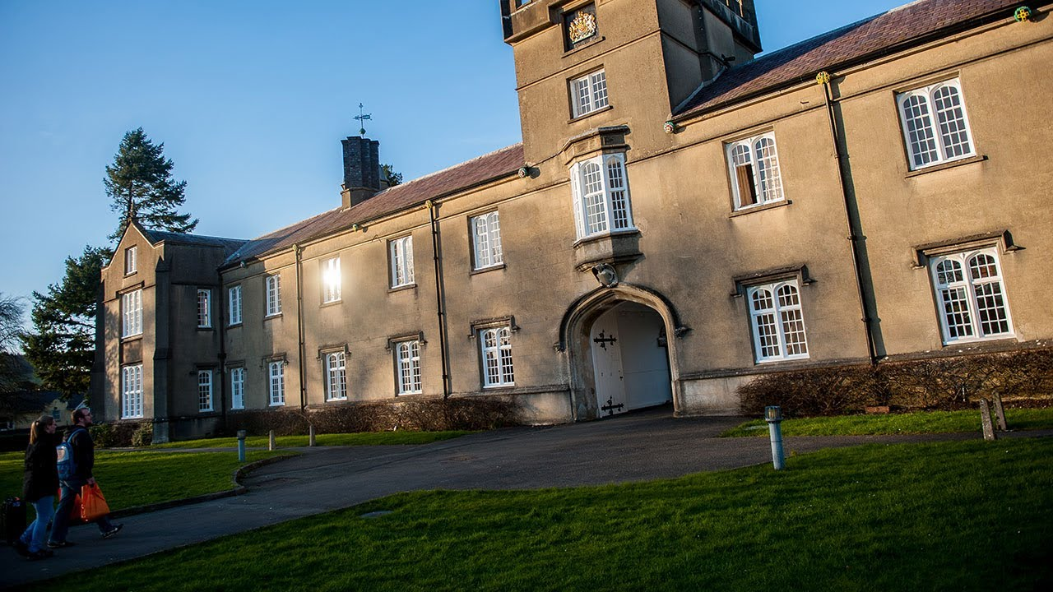
Strategic& Agile Business Management
BMMB7027D

Slide 2
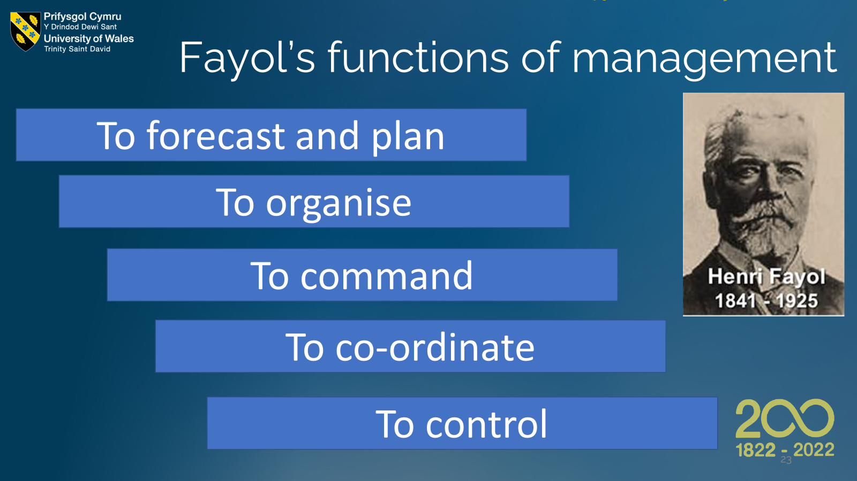

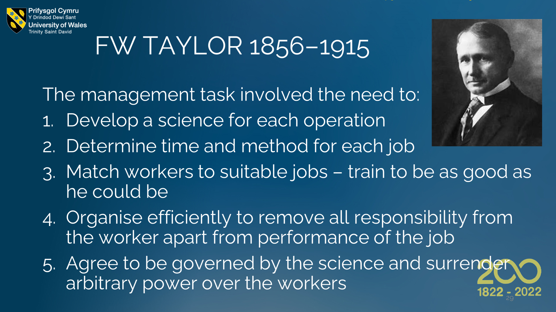

Slide 3
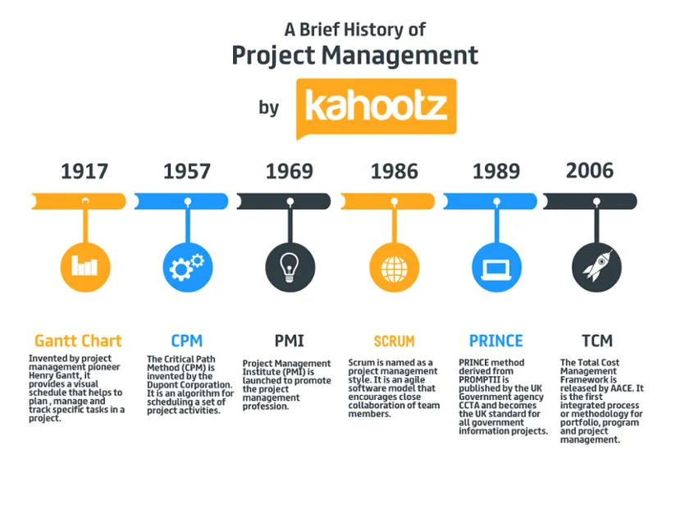
Aims
Modern management systems
Lean
Six Sigma
Agile management

Slide 4
The Four Lean Principles
Pull – Check first then process, do not just push into the system
One-Piece Flow – Deal one at a time in order, not in batches
Takt – Pace of customer demand
Zero Defects – error prevention and avoiding the cost of rework (and disappointment)

Slide 5
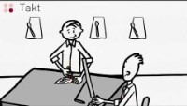
Lean Philosophy

Slide 6
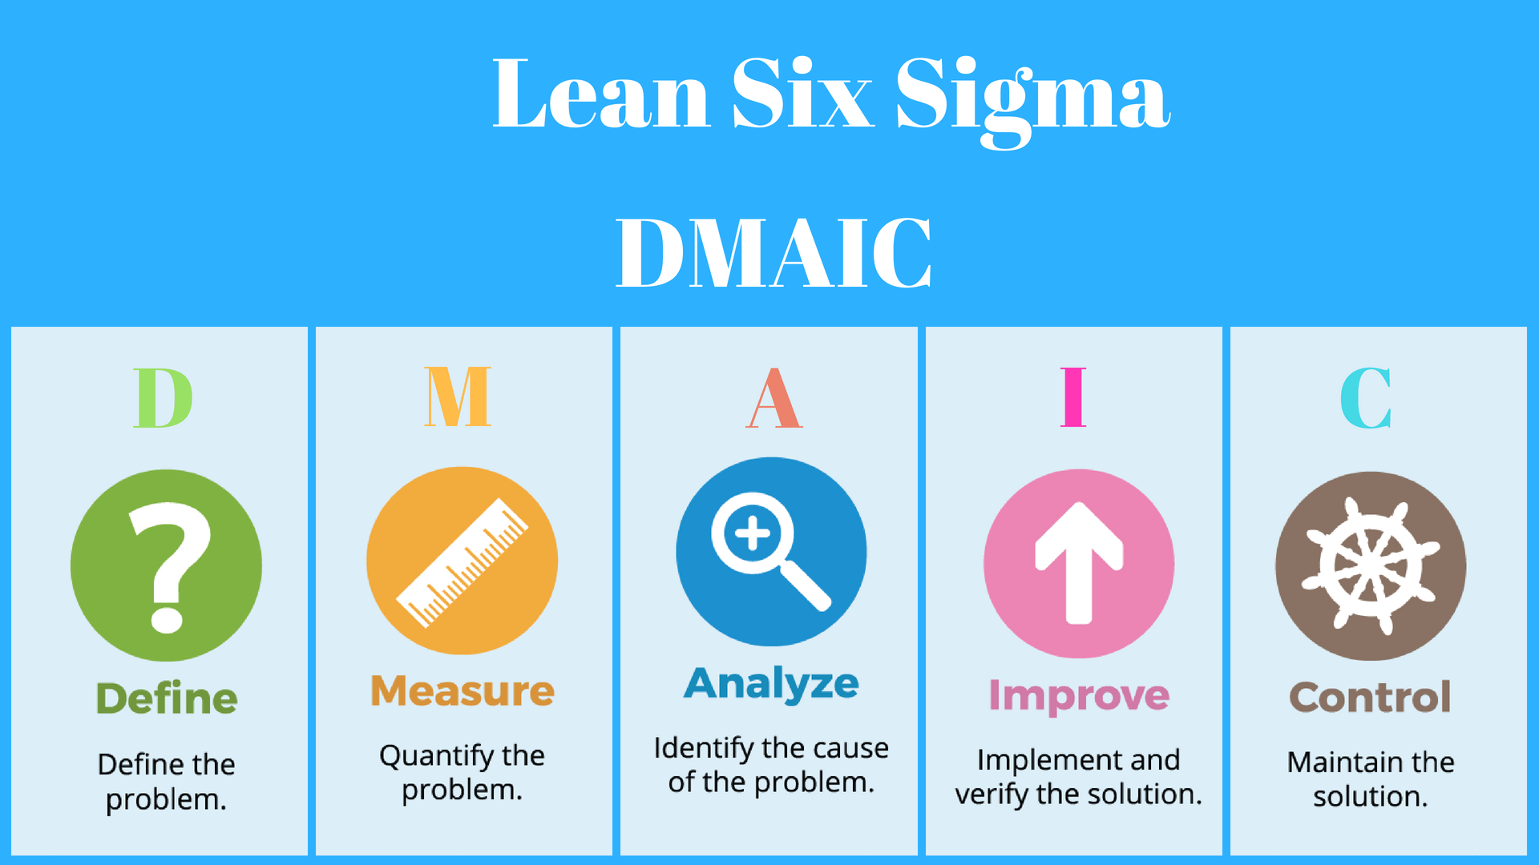
Six Sigma

Slide 7
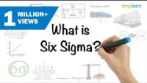
Six Sigma

Slide 8
Agile History
13th November 2001: The desire to step away from heavy software design saw 17 people meet to chat, ski and think at a ski resort in Utah
Many specialisms: Extreme Programming, SCRUM, DSDM, Adaptive Software Development, Crystal, Feature-Driven Development, Pragmatic Programming
Result: a Manifesto for Agile Software Development
Agile Methodology is about the mushy stuff of values and culture against a backdrop of intense bureaucracy and the complex machinery of innovation
Agile scared the corporate bureaucrats

Slide 9
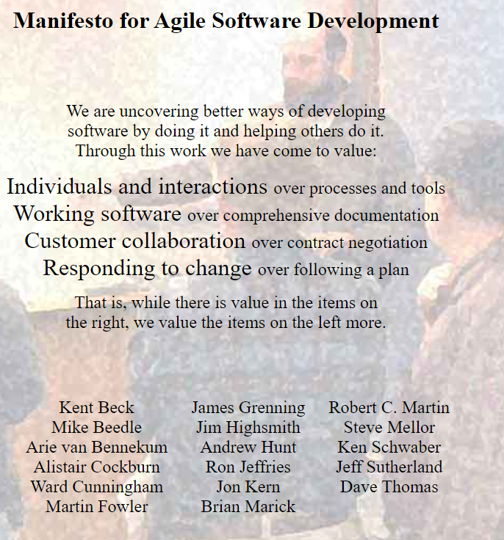

Slide 10
Principles behind the Agile Manifesto
Our highest priority is to satisfy the customer through early and continuous delivery of valuable software.
Welcome changing requirements, even late in development. Agile processes harness change for the customer's competitive advantage.
Deliver working software frequently, from a couple of weeks to a couple of months, with a preference to the shorter timescale.
Business people and developers must work together daily throughout the project.
Build projects around motivated individuals. Give them the environment and support they need and trust them to get the job done.
The most efficient and effective method of conveying information to and within a development team is face-to-face conversation.
Customer satisfaction
Welcome
change
Shorter timescales
Working
together
Utilise motivated people
Facework is fundamental

Slide 11
Principles behind the Agile Manifesto
Be led by what works
Working software is the primary measure of progress.
Agile processes promote sustainable development. The sponsors, developers, and users should be able to maintain a constant pace indefinitely.
Continuous attention to technical excellence and good design enhances agility.
Simplicity--the art of maximizing the amount of work not done--is essential.
The best architectures, requirements, and designs emerge from self-organizing teams.
At regular intervals, the team reflects on how to become more effective, then tunes and adjusts its behaviour accordingly.
Sustainable development
Design enhances agility
Keep it simple, no needless tasks
Self-organising teams
Team Collaboration

Slide 12
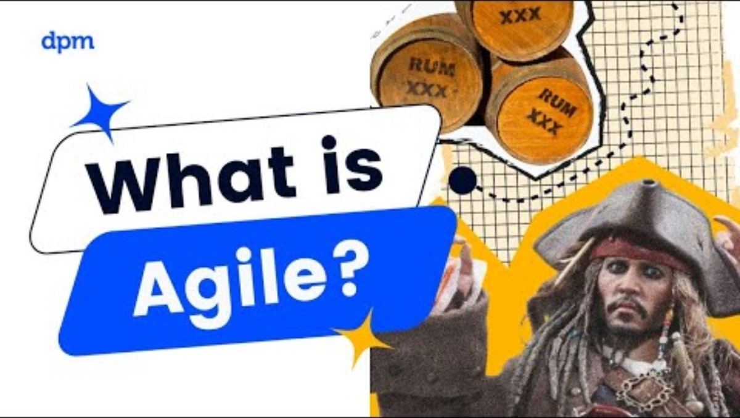

Slide 13
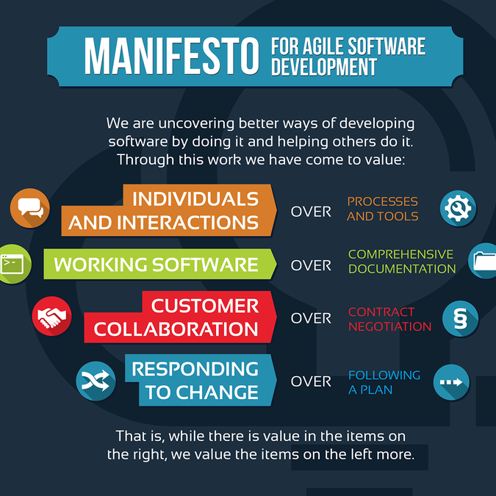
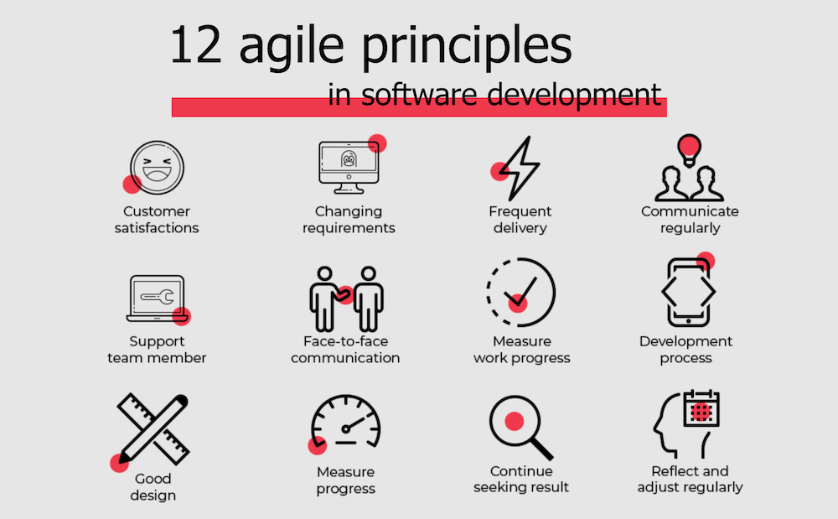

Slide 14
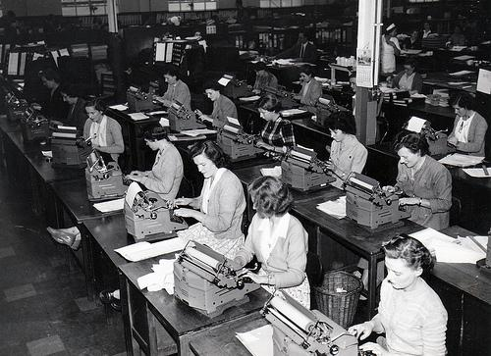
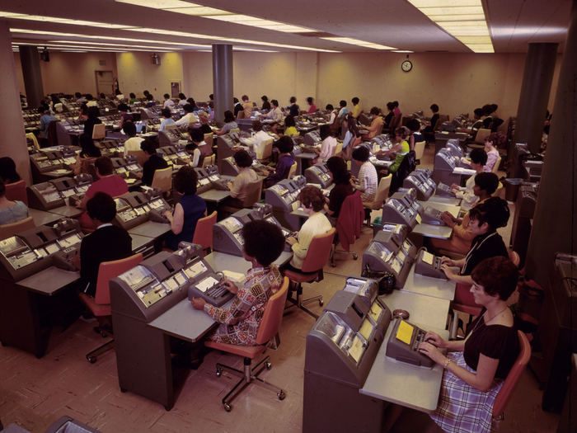
A response to turbulence
What if we could draw on people’s talents in an engaging, dynamic way?
What if those talents were totally focused on delivering extraordinary value to the customers and other stakeholders?
What would these workplaces look like?
How would they operate?
Denning 2016

Slide 15


Slide 16

Steady growth and expansion
Some felt this fad would pass and we would end up back with traditional hierarchies
Over time goals, principles and values came to be seen as demonstrably more productive
Agile seemed more responsive to customer needs than traditional management
Denning 2016

Slide 17
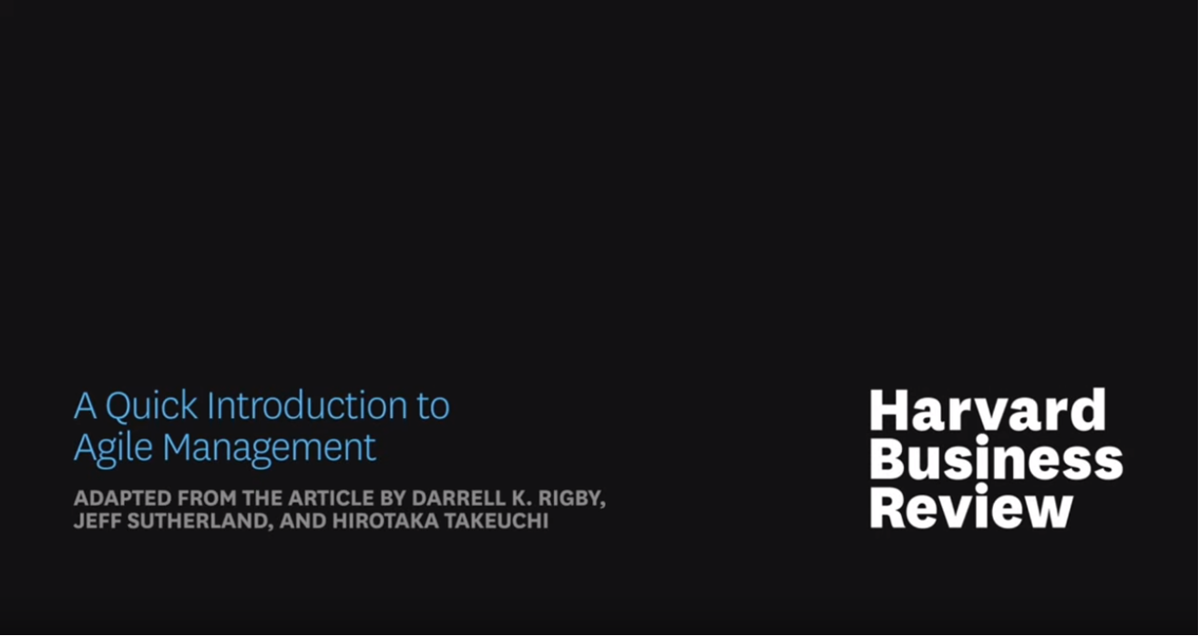

Slide 18
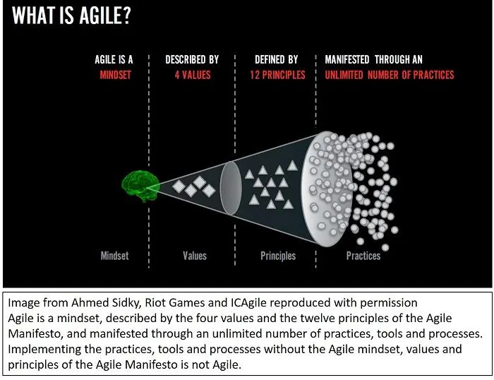
Agile Thinking
Radical alternative to command and control
New radio programming
John Deere and new machines
Saab and new fighter jets
Human resources
Mission Bell Winery – wine production to warehousing

Slide 19
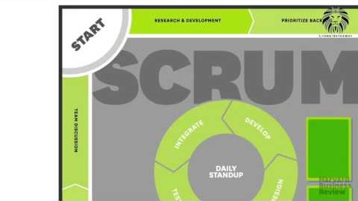

Slide 20
Innovate
Agile provides freedom with structure
Self-governing teams
Grassroots and scaled upwards
CEO’s may create agile teams to drive innovation
Vision, roadmap, achievement

Slide 21
Agile Structure
Initiative owner
Process facilitator: trains, coaches, visibility
3-9 team multi-disciplinary members
Highly collaborative
Team members list ideas, estimating each idea’s value to customers
Which are highest in value?

Slide 22
Dynamism
Sprints enable each key idea to be explored and tested
Task and activity tracking
Structured and visualised
Reprioritise and limit as they go
Fixed 1–4-week deadlines increases velocity
Daily 15-minute stand-up sessions
Team spirit and progress
We finish with a model to be tested

Slide 23


Slide 24
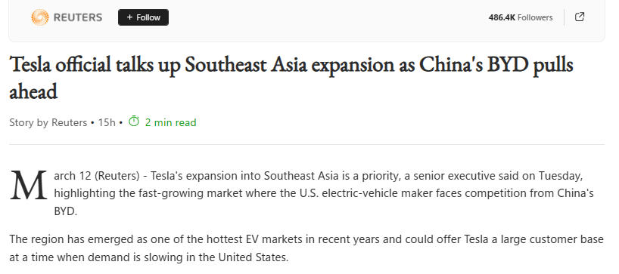
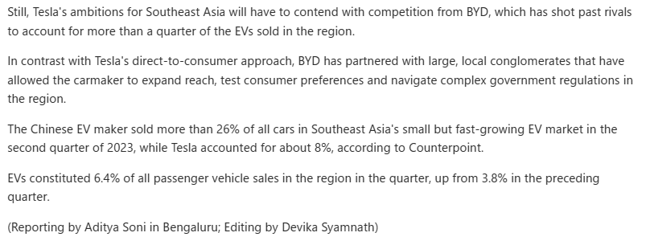

Slide 25
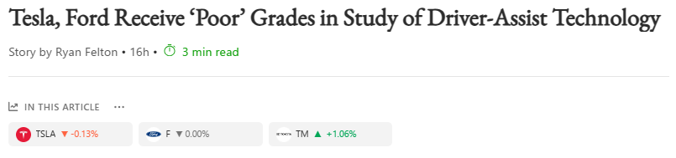
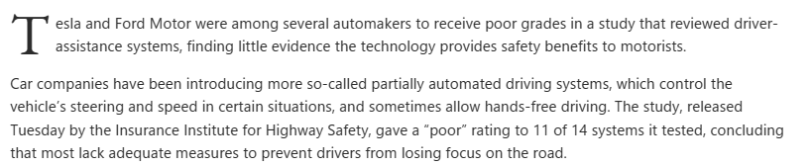
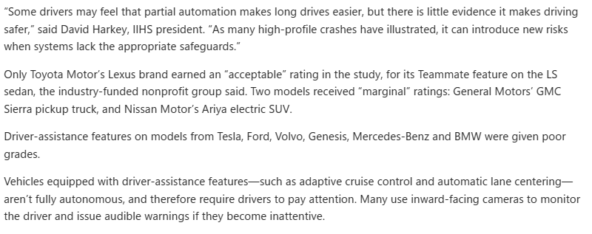
13/3/24

Slide 26
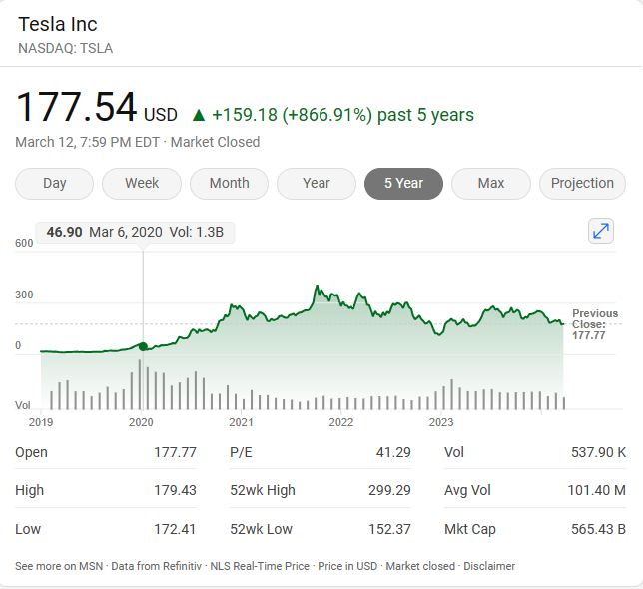
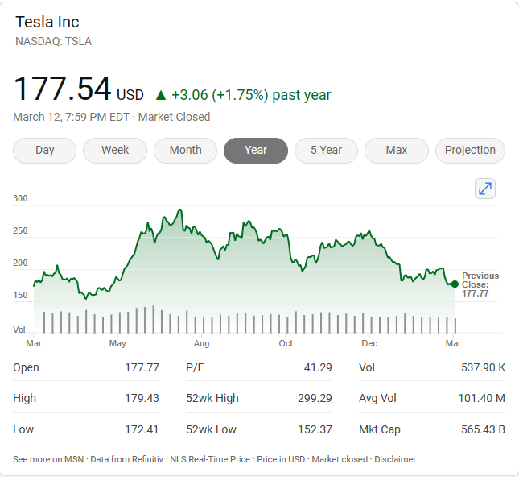
Tesla Share Price
5 Years
Last Year

Slide 27
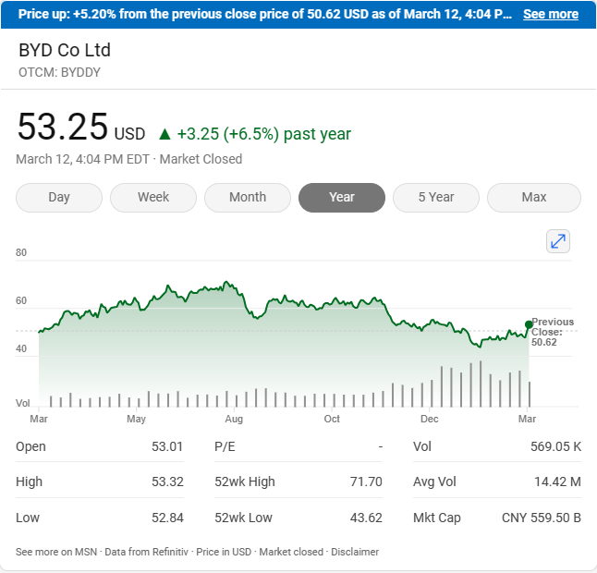

Slide 28
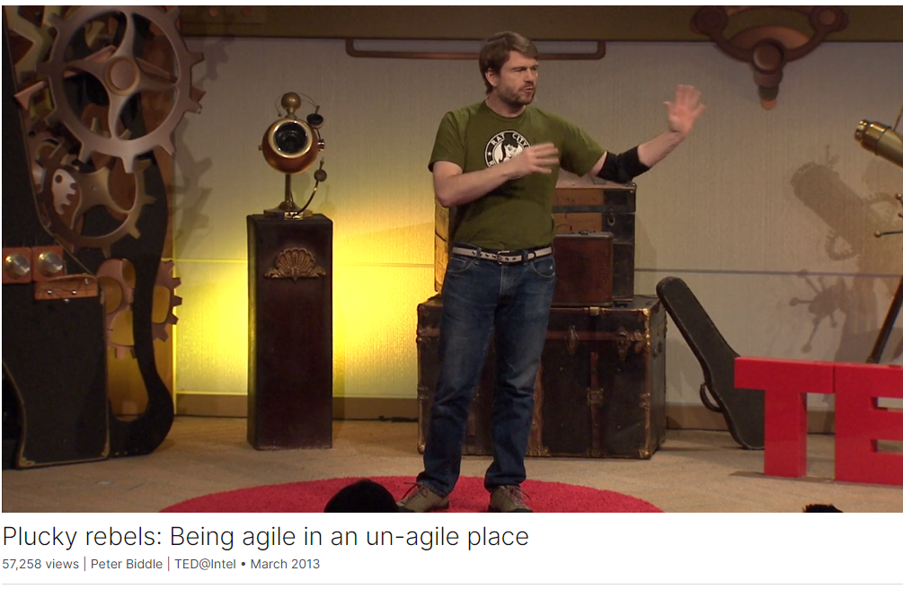
Product development expert.
Intel Corporation, Software products from idea to reality.
Trampoline Systems
Microsoft Corporation where he founded the company’s Hypervisor team. His Microsoft team also built BitLocker, a key enterprise-focused feature in Windows Vista and Windows 7.

Slide 29
References
Beck et al (2001) The Agile Manifesto, available at https://agilemanifesto.org/
Denning, S. (2016) What is agile? available at What Is Agile? (forbes.com)
Rigby, D.K., Sutherland, J. and Takeuchi, H. (2016) Embracing Agile, available at https://hbr.org/2016/05/embracing-agile

