Slide 1

Analysing the process of targeted cybersecurity attacks
Ross Van Den Eeckhaute-Jones
31/03/20

Slide 2
Introduction
Network security has become incredibly important for both large/small businesses as well as the home user.
Cybersecurity attacks are becoming an increasing threat, with 32% of businesses experiencing cybersecurity breaches/attacks in 2019. [1]
Many home users are still unaware of the threats to their home network as well as personal devices

Slide 3
Introduction
This project will use penetration tools available in Kali Linux such as Metasploit, SET (social engineering toolkit) and Aircrack to perform or simulate cyber attacks including:
Phishing (Spear phishing)
Man in the middle attacks (Data interception/monitoring)
DoS (Denial of Service)
The process will be documented and analysed throughout the project

Slide 4
Why did I chose this project?
General lack of knowledge surrounding network security around the world
Enjoy keeping up to date with latest methods of attack and defence in the cybersecurity world
Further improve my penetration testing knowledge as well as gain more insight into preventing various attacks.
Increasing cybersecurity attacks warrants a need to be able protect from current and future cyberattacks

Slide 5
What do I plan to achieve from this project?
Gain more experience and knowledge in using and analysing penetration testing tools.
Further increase my network security skills.
Improve job opportunities

Slide 6
Aims and objectives
Aim: To analyse and document the process of user/device targeted cyber attacks such as Phishing, Man-in-the-middle attacks and Denial of service attacks
Objectives:
Provide an in-depth literature review covering cybersecurity attacks that target specific users/devices
Perform or simulate penetration testing using the methods mentioned above using tools available inside Kali Linux
Provide detailed documentation of results created throughout the project

Slide 7
Literature Review
Network users and devices around the world are being targeted by malicious hackers every day.
Hackers are usually motivated by personal gain.
There are a range of methods that hackers use to reach their end goals.
The risks to businesses of varying sizes and home users can vary from minor inconveniences to absolute data loss, and potential identity theft/Intellectual property theft.

Slide 8
Literature review – Types of attacks
Phishing (Spearphishing) [2,3]
Malicious targeted attacks with the aim to infect users through deceptive tactics
Man in the middle attack [4,5]
A form of digital eavesdropping
DoS attack [6-8]
Sabotages network performance of the targeted network

Slide 9
Literature review – Penetration testing tools
Kali Linux [8,9]
Houses a range of different penetration testing tools
Metasploit [10]
Allows use of custom payloads using languages such as perl, ruby and python
SET Social Engineering Toolkit [11]
Offers a wide range of tools that are suited to attacks focused on the social engineering
Aircrack-ng [9]
Used to attack Wi-Fi network security

Slide 10
Methodology
Data
No personal data will be accessed or stored during this project.
Strategy
Multiple penetration testing tools will be used to carry out a range of attacks on an isolated network/hardware setup
Limitations
Penetration testing can cause harmful results in the real world. However, all tests will be carried out in an isolated environment free of any personal data or hardware.
Results created during penetration testing will be analysed and documented

Slide 11
Design Explanation
The penetration testing will focus on single user environments for example laptop connected to public or unsecure home Wi-Fi
The user could be expected to be anyone from a child, student or business executive with a wide range of exploitable data that will be discussed

Slide 12
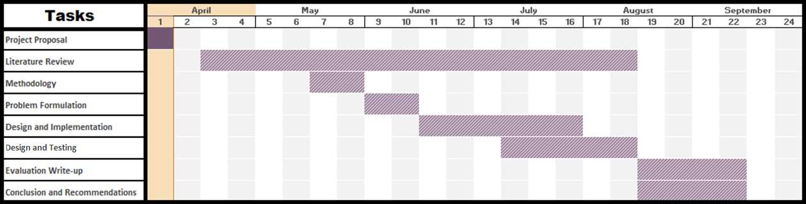
How I plan to complete the project on time

Slide 13
Summary
Introduction
Aims & Objectives
Literature review
Methodology
Design explanation
Gantt Chart

Slide 14
References
[1] R. Vaidya, “Cyber Security Breaches Survey 2019 - GOV.UK,” 2019 - https://www.gov.uk/government/statistics/cyber-security-breaches-survey-2019
[2] M. J. Miranda, “Enhancing Cybersecurity Awareness Training: A Comprehensive Phishing Exercise Approach,” Int. Manag. Rev., vol. 14, no. 2, p. 5, 2018.
[3] K. L. Chiew, K. S. C. Yong, and C. L. Tan, “A survey of phishing attacks: Their types, vectors and technical approaches,” Expert Systems with Applications, vol. 106. pp. 1–20, 2018.
[4] M. Cai, Z. Wu, and J. Zhang, “Research and prevention of Rogue AP based MitM in wireless network,” in Proceedings - 2014 9th International Conference on P2P, Parallel, Grid, Cloud and Internet Computing, 3PGCIC 2014, 2014, vol. 183, pp. 538–542.
[5] J. J. Kang, K. Fahd, and S. Venkatraman, “Trusted Time-Based Verification Model for Automatic Man-in-the-Middle Attack Detection in Cybersecurity,” Cryptography, vol. 2, no. 4, p. 38, Dec. 2018.
[6] C. Anand and R. K. Gnanamurthy, “Localized DoS Attack Detection Architecture for Reliable Data Transmission Over Wireless Sensor Network,” Wirel. Pers. Commun., vol. 90, no. 2, pp. 847–859, 2016.
[7] M. Bogdanoski, T. Shuminoski, and A. Risteski, “Analysis of the SYN Flood DoS Attack,” Int. J. Comput. Netw. Inf. Secur., vol. 5, no. 8, pp. 15–11, 2013.
[8] D. Vuletić and N. Nojković, “Realization of a TCP Syn Flood Attack using Kali Linux,” Vojnoteh. Glas., vol. 66, no. 3, pp. 640–649, 2018.
[9] S. M. Čisar, P; Čisar, “ETHICAL HACKING OF WIRELESS NETWORKS IN KALI LINUX ENVIRONMENT,” Ann. Fac. Eng. Hunedoara; Hunedoara, vol. 16, no. 3, pp. 181–186, 2018.
[10] Y. Stefinko, A. Piskozub, and R. Banakh, “Manual and automated penetration testing. Benefits and drawbacks. Modern tendency,” in Modern Problems of Radio Engineering, Telecommunications and Computer Science, Proceedings of the 13th International Conference on TCSET 2016, 2016, vol. 1, pp. 488–491.
[11] “Kali: Get SET for phishing! - ProQuest.” [Online]. Available: https://search-proquest-com.ezproxy.uwtsd.ac.uk/docview/2051229770?accountid=130472&rfr_id=info%3Axri%2Fsid%3Aprimo. [Accessed: 26-Mar-2020].

