Slide 1

LEADERSHIP AND MANAGEMENT, THEORY AND PRACTICE
Module code : LCBB6003
Lecturer: Dr. Laila Maazouz
Students: Alice Ana maria Casota 2117332
Constantin Gabriel Casota 2122369
Sebastian Sorin Patrascu 2122706
Olga Andronic 2119164

Slide 2

Introduction
Leadership is mainly a set of behaviour
Leadership helps people to align their collective direction (Luedi, 2022).
Leadership is all about executing strategic plans
Notes:
Leadership is mainly the set of behaviour that is used by individuals to help people for aligning their collective direction and for executing strategic plans. In order to define leadership it can be stated that there are some kind of abilities in people that need to be used for guiding and influencing people and in this way organisations get to achieve success. This presentation will be thoroughly discussing some key leadership aspects and the way some leaders have provided organisation success with their leadership skills. Not only that but also four specific leaders will be critically analysed. They are leadership styles. The leadership behaviour and followers' appeal will be analysed in this presentation as well. Most importantly it will identify some similarities among the chosen leaders and the difference is in the characteristics or leadership styles of these leaders.

Slide 3
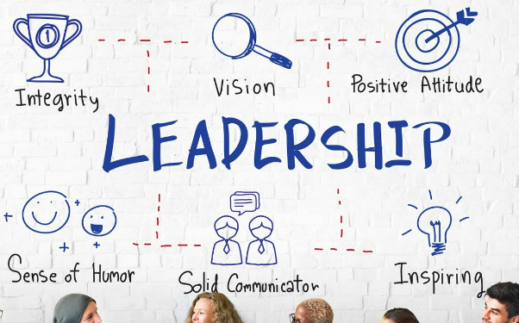
Definition of leadership
“Leadership is the ability of an individual or a group of people to influence and guide followers or members of an organisation, society or team” (Gardner et al. 2020).
Leadership is also considered as an attribute.
Leadership influences and guides people.
Notes:
In order to define leadership it can be stated that leadership is nothing but the ability of an individual for influencing as well as guiding the followers of an organisation or a team. Leadership and also be considered as a particular attribute that helps people in establishing the desires of an organisation or a business. It is expected that a strong leadership can effectively influence as well as guide people, encourage them and keep them motivated for producing the best work. Leadership is all about problem solving skill and creativity skill and these skills are found to be extremely essential for becoming a successful leader.

Slide 4

Purpose of the presentation
To evaluate the core aspects of leadership
To analyse specific leaders
To identify similarities between 2 leaders of the 20th century with 2 leaders from 21st century
To identify differences between 2 leaders of the 20th century with 2 leaders from 21st century.
Notes:
One of the main purposes of this presentation is to highlight the core aspects of leadership and analyse four specific leaders that are Reed Hasting, Henry Ford, Elon Musk and Walt Disney. Along with that this presentation will be identifying some of the similarities between two leaders within the 28th century and it will also identify some differences between the two leaders of the 20th century. It is important to identify the similarities and differences because it helps in differentiating leaders from each other.

Slide 5
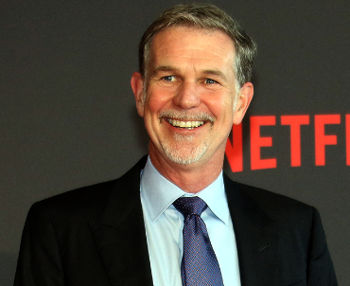
Reed Hastings
The American billionaire businessman.
“The co-founder and executive chairman of Netflix” (Manu, 2022)
Reed Hastings revolutionised the world of entertainment.
Notes:
Read Hastings is unknown to be the co-founder as well as the chairman of Netflix company who has taken part in revolutionising the world of entertainment. According to sources he owns about 2% share of Netflix and it also went public in 2002. Hastings is the one who founded Netflix in 1995 after he sold his first and foremost organisation Pure Software. Netflix is nothing but a video streaming platform that offers different types of TV shows as well as films and it also produces original content currently it has 222 million members across the globe.

Slide 6

Critical analysis of the leadership
Hastings follows a “decentralised decision-making approach” (Challa and Jena, 2024).
Leadership behaviour: Delegating authority
Fulfil followers' appeal with Innovative visionary leadership
Notes:
In order to analyse the leadership style of Hastings it can be stated that he follows the decentralised decision making approach not only that but also the leadership behaviour used by this leader is delegating leadership. This leader believes in encouraging the team members to make their decisions independently and also fostering the sense of ownership as well as responsibility among the team members. The strategic decision capability in this leader has helped him developing a collaborative environment within the organisation

Slide 7
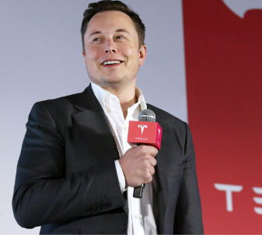
Elon Musk
CEO of Tesla Motors.
“A businessman and investor known for his key roles in space company SpaceX and automotive company Tesla” (Khan, 2021).
Co-founder of the electronic payment company PayPal
Notes:
Elon Musk is one of the biggest Businessman as well as and a well known investor this world has he is known to be the CEO or founder of a Tesla Motors. She has played his role efficiently for the space company named species and also established the automotive organisation Tesla in an effective way. Elon Musk is also known to be the co founder of the electronic payment organisation named PayPal. By analysing the leadership of this leader it has been understood that he believes in spreading arms across different industries rather than operating in a particular industry.

Slide 8
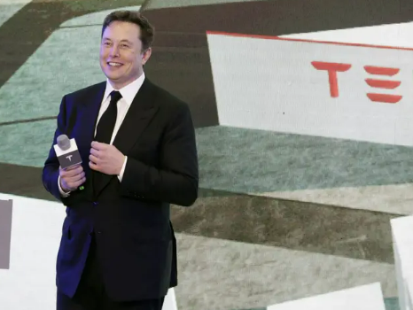
Critical analysis of the leadership
Musk uses visionary approach as a leadership style
His leadership behaviour includes “relentless pursuit of innovation and willingness to take significant risks” (Muwara and Uddin, 2020).
Elon Musk drives his team hard to achieve goals.
Notes:
The leadership style of Elon Musk is extremely efficient. By analysing his approaches he has understood that Elon Musk uses the visionary approach in a leadership style for achieving success not only that but also he is a leader with a relentless pursuit for Innovation and always has a willingness for taking different types of risks. Elon Musk has always driven its team members very hard so that they can achieve their goals in an effective way. Elon Musk is known for his ambitions and some unattainable goals.

Slide 9
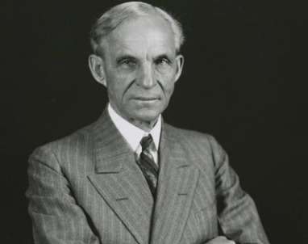
Henry Ford
The founder of Ford Motor Company.
Made Ford Company one of the wealthiest organisations
Ford is an industrialist who has revolutionised factory production (Van Hoek, 2022).
Notes:
This presentation has considered the leader Henry Ford and also analysed his leadership Henry Ford is mainly known for Ford motor company which is one of the wealthiest automobile organisations in this world. It is mainly the leadership of Henry Ford and his approach for revolutionising factory production that has helped this organisation to achieve such huge success.

Slide 10
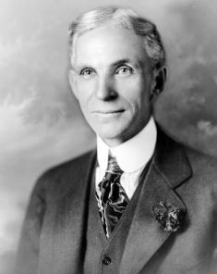
Critical analysis of the leadership
Leadership style includes “Empathy, Diversity and Inclusion” (Watt, 2021).
Leadership behaviour includes appreciation for team members on a consistent basis.
This leader understands the struggles and needs of the team members.
Notes:
In order to define the leadership style of Henry Ford it can be stated that he is a very empathetic leader. He believes in workplace diversity and also tries to implement inclusion so that he can create a sense of belonging among all its employees. Henry Ford is a leader who understands the struggles and needs of his employees and also tries to provide them with opportunities that can fulfil their needs.

Slide 11
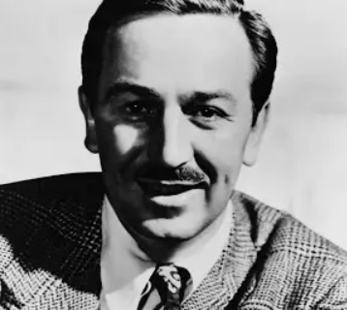
Walt Disney
“Walter Elias Disney was an American animator, film producer, voice actor, and entrepreneur”.
He has pioneered the animation industry (Adigwe, 2024).
Walt Disney achieved the success in the television programming filed.
Notes:
Walt Disney is mainly the CEO and founder of Disney which is one of the effective animation organisations. Walt Disney is a leader who is known to be the founder of world's largest animation organisation as well as a television programming company not only that but also he is known to be a creator of animated cartoon films to start the business and “the creator of such cartoon characters as Mickey Mouse and Donald Duck”.

Slide 12
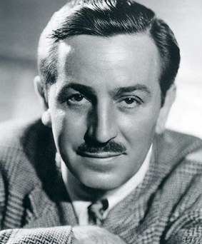
Critical analysis of the leadership
The leadership style of Walt Disney is an autocratic leadership style.
Leadership behaviour includes overruling “a lot of decisions, even among the top minds on his team” (KUMAR, 2023).
He uses transformational leadership for followers.
Notes:
In order to discuss the leadership style of Walt Disney it can be stated that he is partially an autocratic leader but he has other characteristics of a transformational leader as well. For example Walt Disney exhibits some straightforward science that shows he is an autocratic leader because sometimes he overrules decisions on a frequent basis. However when it comes to handling his team members he always uses the transformational leadership style.

Slide 13
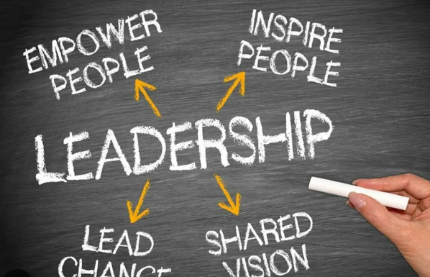
Success of the leaders in the business world
Elon Musk achieved success because of imaginative thinking (Saxena, 2021).
Henry Ford succeeded because of his dedication towards innovation (Collier and Horowitz, 2021).
Hastings succeeded because he has mixed technology with entertainment
Walt Disney successed for his motivational leadership style.
Notes:
All these leaders are successful in their own ways and they have achieved success using their specific capabilities. For example, Elon Musk is one of the successful leaders and his imaginative thinking capability has provided him with necessary success. On the other hand Henry Ford is also a successful leader however his dedication for implementing innovation has helped him achieve success.

Slide 14

Similarities between 2 leaders from the 20th century with 2 others leaders from the 21st century
Hastings and Disney are quite close to each other in leadership.
Both use imaginative thinking in leadership (Watt, 2021).
Both believe in innovation
Notes:
The leadership style in the 20th century is very autocratic in nature. It is commonly found that leaders make their decisions on their own unilaterally. This presentation identified the similarities between the leaders of Hastings and Disney. It has been identified that these leaders have quite similar thinking as they use imaginative thinking in their leadership styles. Another similarity in the leadership of these two leaders are their beliefs on innovation.

Slide 15

Differences between the 2 leaders from the 20th century with the 2 leaders from the 21st century
Walt Disney is partially autocratic but Reed Hastings is a totally empathetic leader (Maccoby and Cortina, 2022).
There is a difference in characteristics
The morale also differ in both leaders
Notes:
One of the main purposes of this presentation is to identify the differences between the leaders of the 20th century and 21st century that have been selected in this presentation. For example Walt Disney is mainly an autocratic leader however Reed Hastings is found to be an empathetic leader. There are huge differences in the characteristics of both these leaders. A difference in the morale of these two leaders have also been identified by critically analysing their leadership styles.

Slide 16

Differences between the 2 leaders from the 20th century with the 2 leaders from the 21st century
Ford and Musk differ from the perspective of employee management (Laker et al. 2021).
Ford motivates the team members very hard.
Musk is more about doing the hard work by himself.
Notes:
This presentation has also identified the difference between the leadership of Musk and Ford. It has been identified that they both manage Their employees in a very different way: one believes in motivating the team members and another one believes in doing all the hard work by themselves. It has been understood that Ford is a very hard-working leader and always makes his team members work hard to achieve their own goals. On the other hand, Musk takes his decisions by himself and prefers to execute most of the tasks by himself.

Slide 17

Conclusion
Leadership is the core of achieving organisational success.
Leadership can keep employees motivated.
There are some similarities and differences among the leadership styles.
Notes:
In conclusion it can be stated that a leadership is the foundation of organisational success the more efficient a leader will be the more success an organisation will be able to achieve. The hard works leaders like Elon Musk, Henry Ford, Walt Disney and Reed Hastings has done, has helps them to achieve success for their businesses.

Slide 18
References
Adigwe, C.S., (2024). Transformational Leadership: A Comparative Exploration of the Leadership Prowess of Walt Disney and Steve Jobs. Asian Journal of Economics, Business and Accounting, 24(3), pp.68-89.
Challa, S.D. and Jena, L.K., (2024). Navigating Change and Adversity: A Case Study of Netflix’s Journey. Business Perspectives and Research, p.22785337241233035.
Collier, P. and Horowitz, D., (2021). The fords: An american epic. Encounter Books.
Gardner, W.L., Lowe, K.B., Meuser, J.D., Noghani, F., Gullifor, D.P. and Cogliser, C.C., (2020). The leadership trilogy: A review of the third decade of the leadership quarterly. The Leadership Quarterly, 31(1), p.101379.
Khan, M.R., (2021). A critical analysis of Elon Musk’s leadership in Tesla motors. Journal of Global Entrepreneurship Research, 11(1), pp.213-222.
KUMAR, A., (2023). Walt Disney: The Entrepreneur with a Difference. International Journal of Applied Social Science, 10(5), pp.397-401.
Laker, B., Cobb, D. and Trehan, R., (2021). Too proud to lead: how hubris can destroy effective leadership and what to do about it. Bloomsbury Publishing.
Luedi, M.M., (2022). Leadership in 2022: A perspective. Best Practice & Research Clinical Anaesthesiology, 36(2), pp.229-235.
Maccoby, M. and Cortina, M. eds., (2022). Leadership, Psychoanalysis, and Society. Routledge.
Manu, A., (2022). Transformational leadership. In The Philosophy of Disruption: From Transition to Transformational Change (pp. 67-77). Emerald Publishing Limited.
Muwara, D. and Uddin, K., (2020). A Critical review on Leadership: A Case Study on Elon Musk’s Leadership Style.
Prud'homme van Reine, P.R., (2022). Innovation Culture: learning from the history of innovation. Innovation Culture.
Saxena, A.K., (2021). Innovation, Creativity, Entrepreneurship Management: An Analytical Approach. In Handbook of Research on Future Opportunities for Technology Management Education (pp. 313-330). IGI Global.
van Hoek, R., (2022). Lessons from CSCMP Supply Chain Hall of Famer Henry Ford and the research that they call for in modern supply chains. International Journal of Physical Distribution & Logistics Management, 52(1), pp.88-102.
Watt, P., (2021). Ford’s metaphysics: On the Transcendental origins of Henry Ford’s Fordism. Organization, 28(4), pp.577-603.
Watt, P., (2021). Ford’s metaphysics: On the Transcendental origins of Henry Ford’s Fordism. Organization, 28(4), pp.577-603.

