Slide 1

BA (Hons) International Hotel Management
Module Title: Contemporary Themes in the Hotel and Hospitality Sector
Module code: BMIH6001
Assignment Theme: Artificial Intelligence
Student Name: Syed Jahangir Bakth
Student ID: 2026520
Lecturer Name: Dr Ernest Balutie Wavei
AI Declaration
I confirm that I have not used any AI tools in the research and creation of this assignment. I confirm that I have not presented any AI-generated materials as my own work. I confirm I have copies of my drafts, notes, and other resources I used, which I may be asked to provide in evidence

Slide 2
Table of contents
Introduction
Literature review
Method and Theme impact analysis
Conclusion
Recommendations
References

Slide 3

Introduction
Artificial intelligence is a machine which learns, reasons, and self-corrects like humans (Chan et AI., 2022).
AI improves visitor experiences, operational efficiency, and resource management in hotels.
Chatbots, recommendation engines, and prediction algorithms let companies personalise services, speed up responses, and satisfy customers.
AI adoption is necessary for competitiveness and customer satisfaction.

Slide 4
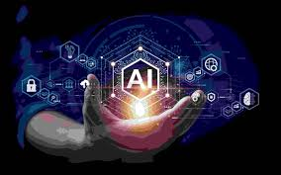
Literature Review
Chatbots, predictive analytics, and smart room automation increase hospitality productivity.
Innovations boost visitor satisfaction and cut staffing.
Bowen and Morosan (2018) highlight Hilton's AI-powered concierge, "Connie," who makes personalised recommendations.
Robotic receptionists boost service at Japan's Henn-na Hotel.
Despite these advances, privacy, job loss, and personal connection persist.

Slide 5
Literature Review
Continued…
To tailor hospitality, machine learning algorithms analyse guest behaviour and preferences.
Voice-controlled room modifications and concierge recommendations differ for Marriott and Hilton guests.
Hotels must address AI privacy issues under GDPR (Malone, 2024).
Industry balances privacy and hyper-personalisation.

Slide 6
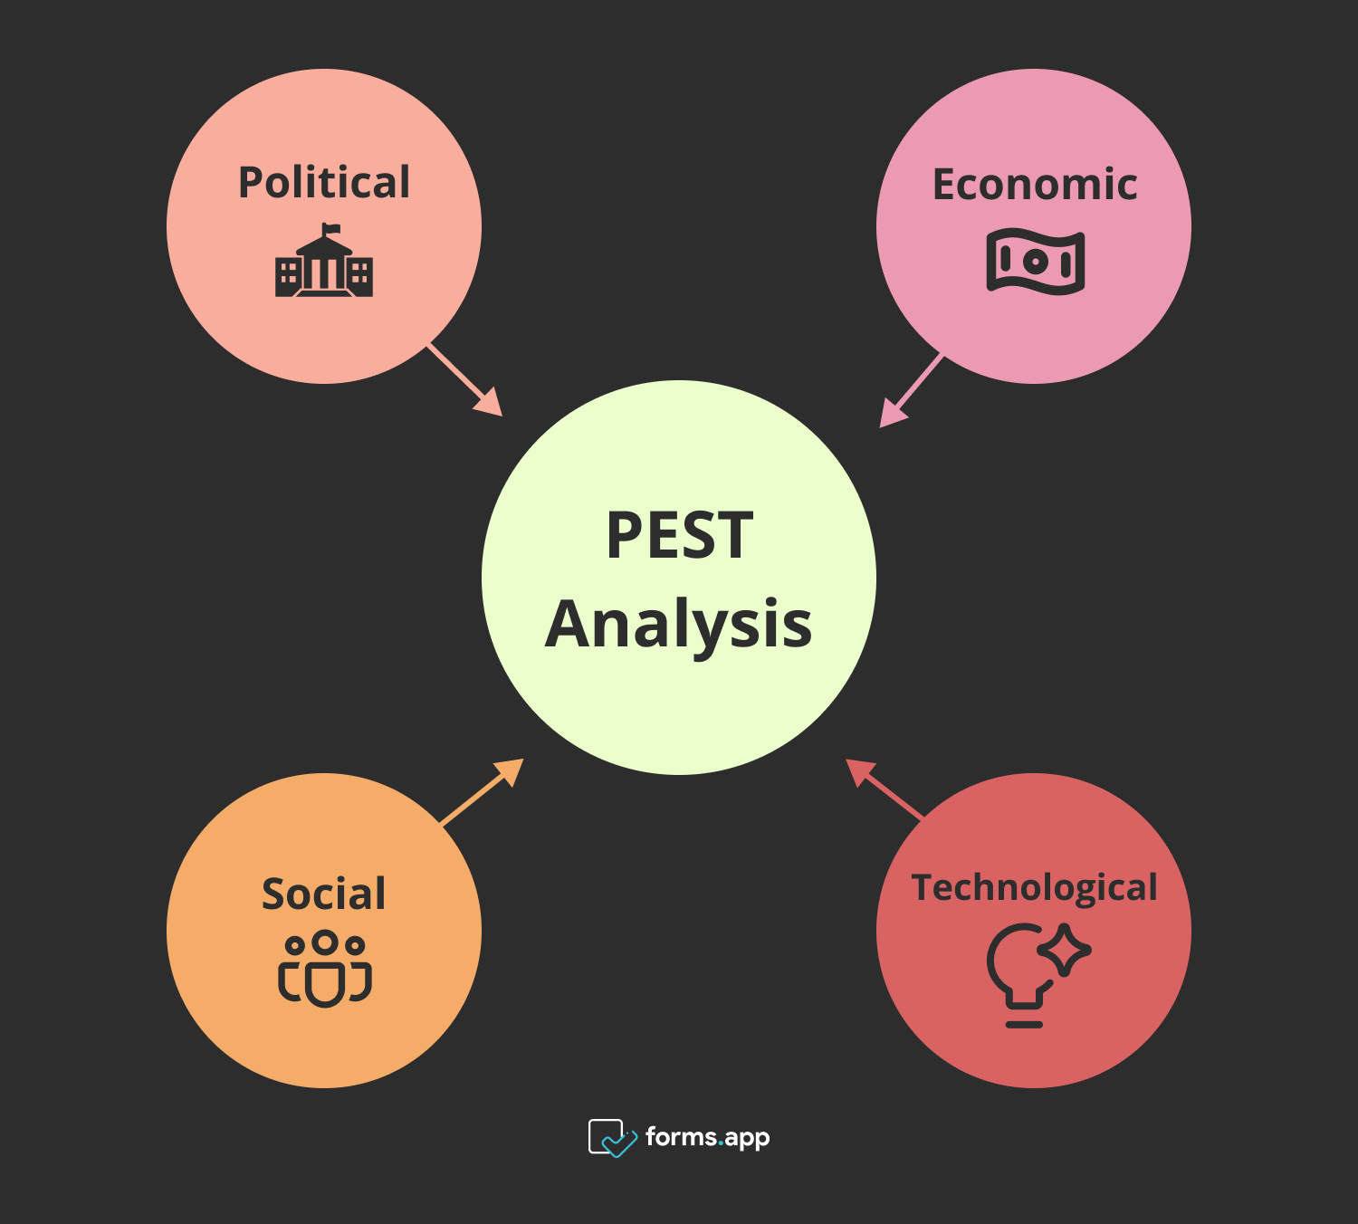
Method and Theme Impact Analysis
Method
This qualitative AI-tourism and hospitality study analyses secondary data.
AI's effects were assessed using PEST and organised literature.
Eight peer-reviewed journals were chosen for citation frequency, quality, relevance, publisher repute, and author credentials.
The conclusions were trustworthy and transparent since content analysis used data from government websites, industry reports, and respected sources like the EU and Forbes (Revfine, 2025).

Slide 7

Continued…
(Theme Impact Analysis)
Political
Government support for AI innovation.
Strict regulations like GDPR compliance (Khanachivskyi, 2024).
Accor Hotels using AI chatbots.
Economic
AI reduces operational costs by 25%.
Dynamic pricing increases hotel revenue (Elphick, 2025).
SMEs face high AI investment barriers.
Social
Personalised services improve guest experience.
AI adoption raises job displacement concerns (Sahota, 2025).
Marriott’s “TakeCare” upskills employees.
Technological
Voice control tech improves convenience.
Rapid tech updates are costly (Tunggal, 2023).
IHG collaborates for AI cybersecurity.

Slide 8
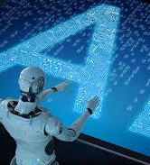
Conclusion
AI can improve hospitality and tourist efficiency, guest satisfaction, and service.
AI has advanced despite worker adaptation, data security, and high deployment costs.
AI advances and strategic management could change the industry and service quality.

Slide 9
Recommendations
Invest in Workforce Training and Upskilling
Enhance Crisis Management Through AI
Strengthen Cybersecurity Measures (Sharma et al., 2024).
Foster Collaboration Between Industry Stakeholders
Promote Guest Education and Engagement

Slide 10

References
Bowen, J. and Morosan, C. (2018). Beware the hospitality industry: the robots are coming. Worldwide Hospitality and Tourism Themes, [online] 10(6), pp.726–733. doi:https://doi.org/10.1108/whatt-07-2018-0045.
Chan, L., Hogaboam, L., & Cao, R. (2022). Artificial Intelligence in Tourism and Hospitality. In Applied Artificial Intelligence in Business (pp. 213–229). Springer, Cham. https://doi.org/10.1007/978-3-031-05740-3_14
Elphick, D. (2025). Hotel dynamic pricing: Full guide with examples. [online] SiteMinder. Available at: https://www.siteminder.com/r/hotel-dynamic-pricing/ [Accessed 3 Feb. 2025].
Ford, R.C. and Sturman, M.C. (2020) Managing Hospitality Organizations, 2nd Edn. Sage, London.
Khanachivskyi, O. (2024). AI in Hospitality Industry: Benefits, Use Cases and Successful Stories. [online] Litslink. Available at: https://litslink.com/blog/ai-in-hospitality-industry-benefits-use-cases-and-successful-stories [Accessed 3 Feb. 2025].
Malone, C. (2024). Artificial Intelligence in the Hotel Industry: The Benefits and Effects on Corporations. Human Nutrition and Hospitality Management Undergraduate Honors Theses Retrieved from https://scholarworks.uark.edu/hnhiuht/33
Revfine, N. (2025). How Can Voice Control Benefit the Hospitality Industry? | Revfine.com. [online] Revfine.com. Available at: https://www.revfine.com/voice-control-hospitality-industry/ [Accessed 3 Feb. 2025].
Sahota, N. (2025). AI In Hospitality: Elevating The Hotel Guest Experience Through Innovation. [online] Forbes. Available at: https://www.forbes.com/sites/neilsahota/2024/03/06/ai-in-hospitality-elevating-the-hotel-guest-experience-through-innovation/ [Accessed 3 Feb. 2025].
Sharma, M., Singh, A.K., and Tyagi, P. (2024) Proceedings of the International Conference on Innovation and Regenerative Trends in Tourism and Hospitality Industry (IRTTHI 2024). Atlantis Press.
Tunggal, A.T. (2025). What is the Cost of a Data Breach in 2020? [online] www.upguard.com. Available at: https://www.upguard.com/blog/cost-of-data-breach [Accessed 3 Feb. 2025].

