Slide 1

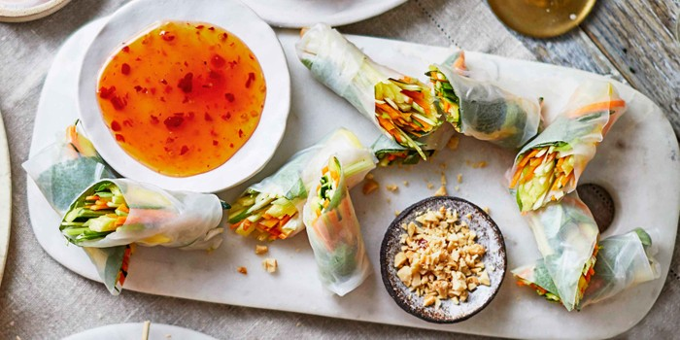
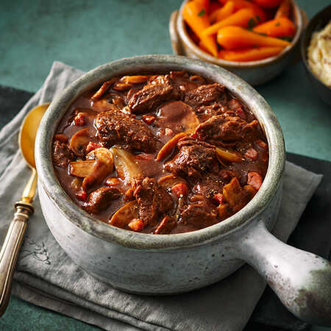
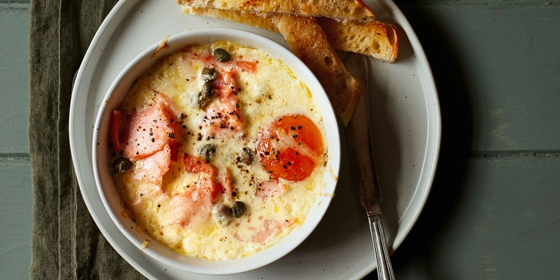
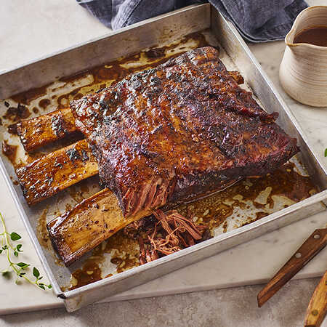
hotel Trinity ​
Christmas Menu​
Weekday menu
Starters
Cauliflower cheese soup with crispy sage & hazelnuts |10
Vegan rainbow spring rolls |9
Smoked salmon coddled eggs |7
platters
Cumin-crusted chicken with kale salad |20
British outdoor bred pork porchetta |18
Korean fried cauli rice |17
Slow cooked rib of beef |15
Weekend menu
Starters
Coquilles St Jacques |13
Scottish smoked salmon terrines |14
Crab & Lemon Mousse Pots |12
Platters
Korean fried cauli rice |23
Turkey stir-fry |19
Vegan trimmings selection |22
British Ultimate Christmas Turkey Crown |25
DISHES MAY CONTAIN ALLERGENS,IF YOU HAVEANY DIETARY REQUIREMENTS PLEASE SPEAK WITH A MEMBER OF STAFF OR CALL THE RESTAURANT.

Slide 2
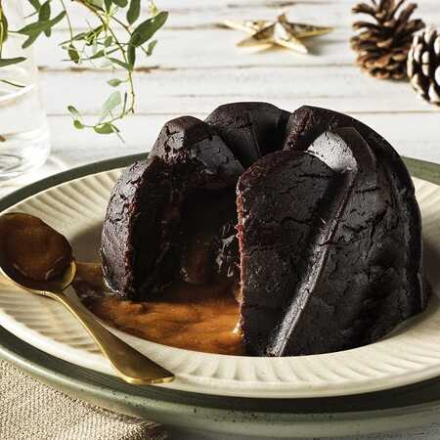
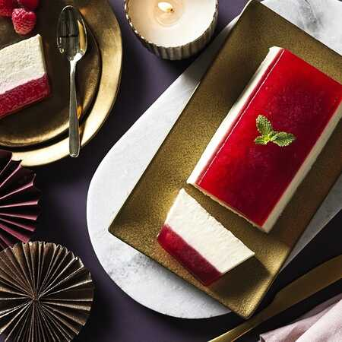
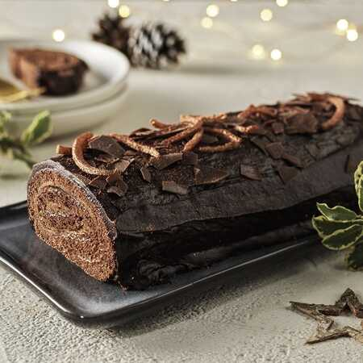


Dessert
Belgian chocolate and clementine yule log
| 12
Raspberry & Vanilla Panna Cotta |10
Melting Middle Star Pudding | 8
SOFT DRINKS
Coca cola sugar free |4
Pepsi |3
Diet coke |5
Mountain dew |4
Fanta | 3
Sprite |4
WINES
Pinot Noir | 28
Bouvet Ladubay |24 Saumur Brut |26
Chardonnay |28
Malbec |22
Address:
11 Coleridge Road
Northampton
NN1 3DA
Live music available

