Slide 1
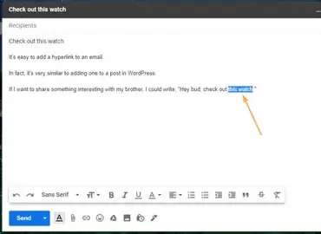
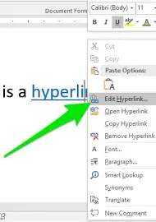
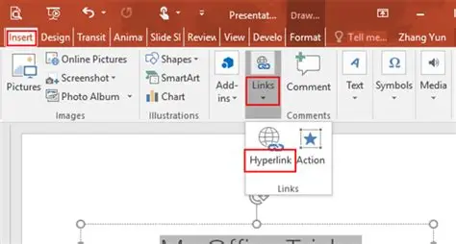
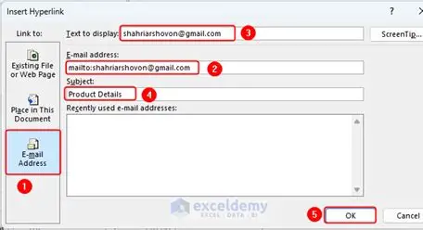
How to insert hyperlinks in a powerpoint.
the Highlight text or image you want to link
Right click and select from the menu
In the insert hyperlink box post or type url in the address field
Click ok to insert hyperlink
Press ctrl and click to follow link

