Slide 1
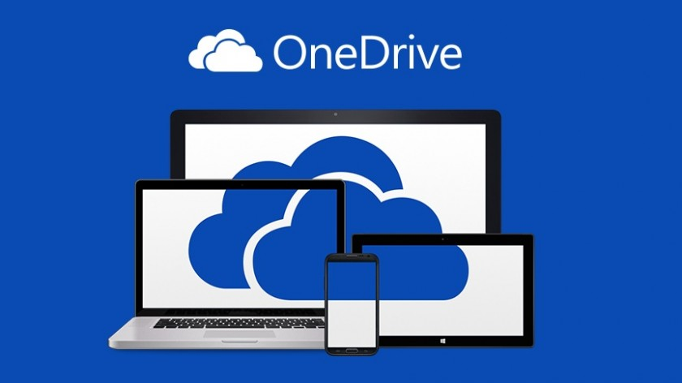
How to share a file via the one drive
Share via Link: Generate a link that can be shared via email, Teams, or other messagingt apps.
Specific People: Enter names or email addresses for targeted access.
Permission Control:
Can edit: Recipients can make changes.
Can view: Recipients can only read or download the file.
Advanced Settings: Set expiration dates, add passwords for security, or block downloads.
How to Share (by Platform)
Web Browser: Select the file/folder and click "Share" at the top, or click the share icon next to the file name.
Windows/File Explorer: Right-click the file, select "Share", and configure the link settings.
Mobile App: Tap the file/folder, select the "Share" icon, enter the email address, and select "Send".
.

