Slide 1
Curriculum Studies
Assignment two

Slide 2
Title
Critically analyse the strategies for promoting inclusivity in a given UK curriculum.
Choose a curriculum of your choice from the list below, e.g Free Schools:
-Foundation Stage in England or Northern Ireland
-The Scottish Curriculum (3-18 years)
-The National Curriculum (Primary, Secondary, Faith Schools)
-Free Schools
-The Vocational Curriculum (Further Education)
-Pathways Training and Work Based Learning (Further Education)
-AS/A levels (Further Education)
-Degree Programmes (Higher Education)

Slide 3
Hand in date
4th December 2017
Electronic copy only through turn it in
3000 word +/- 10%

Slide 4
Assignment Criteria
A critical analysis of the strategies use to promote inclusivity in the chosen curriculum
A thorough treatment of the topic with in-depth analysis and critical evaluation backed up with extensive reading. Evidence of referencing books, articles and or websites.
Structure and Argument: Effective and clear introduction; Breadth of issues covered; Ability to answer the question; Structure and coherence of argument; Usefulness of the conclusion.
Understanding and Application of Theories: Appropriate use of relevant theoretical framework.
Evidence of Additional Reading: Appropriate use of references and quotations; Use of supporting evidence.
Style and Presentation: Fluency of writing; Spelling/grammar/punctuation; Presentation; Degree of conformity to required word limit.

Slide 5
Introduction
Capture the reader’s interest
Set the scene
Explain how you interpret the question set
Define or explain key terms if necessary
Identify the issues that you are going to explore
Give a brief outline of how you will deal with each issue, and in which order

Slide 6
Main Body
Contains the points outlined in your introduction, divided into paragraphs
These paragraphs will be specific to your chosen curriculum and the chosen strategies
Eg. National Curriculum England – one possible strategy = ‘Responding to pupils’ needs and overcoming potential barriers for individuals and groups of pupils’ – critically analyse this in the paragraph.

Slide 7
Conclusion
Do not introduce any NEW material here.
Summarise your ideas/argument (you might also have done this in your introduction)
Restate what you consider to be the main points
Make it clear why those conclusions are important or significant.
In your last sentence: link your conclusions or recommendations back to the title

Slide 8
Reference list
Harvard referencing
You need a reference list and you need to cite work throughout e.g According to Davies (2015) or : People with autism face many barriers in secondary schools (Jones and Smith 2015).
Only use reliable references

Slide 9
Critical Analysis
critical analysis means considering the claims of theorists, governments, authorities and so on, what they are based on, and how far they seem to apply or be relevant to a given situation’.
Notes:
Presenting an overall ‘case’ – a reasoned argument which expresses the writer's evaluation of several pieces of text.
Remember to specifically answer the question!!

Slide 10
Be critical
Being ‘critical’ does not mean just being negative, or pointing out what is wrong about something.
Being critical is about:
thinking carefully about what you read and why: judging what resources are credible
not just repeating the ideas of others, but looking for connections (or disparities), and constructing your own arguments supported by a range carefully considered viewpoints
being inquisitive, and asking good questions - of others, and of yourself
Notes:
Careful thinking,
Using reliable sources
Constructing a reliable argument (using a range of sources)
DOES NOT mean criticising the work of others

Slide 11
Critical ‘Stairway’
Process - Take in the information (i.e. in what you have read, heard, seen or done).
Understand - Comprehend the key points, assumptions, arguments and evidence presented.
Analyse - Examine how these key components fit together and relate to each other.
Compare - Explore the similarities, differences between the ideas you are reading about.
Synthesise - Bring together different sources of information to serve an argument or idea you are constructing. Make logical connections between the different sources that help you shape and support your ideas.
Evaluate - Assess the worth of an idea in terms of its relevance to your needs, the evidence on which it is based and how it relates to other pertinent ideas.
Apply - Transfer the understanding you have gained from your critical evaluation and use in response to questions, assignments and projects.
Justify - Use critical thinking to develop arguments, draw conclusions, make inferences and identify implications Open University (2009)
Notes:
Open university – steps to being critical
Read – take the info in and understand it (look at main arguments and key points)
Then – analyse – how key points relate to each other
Compare- similarities and differences in key points
Synthesise – begin constructing your argument
Evaluate – how relievable is an idea in comparison to others?
Apply your knowledge to the question (the info you have found out by conducting the process so far)
Justify (putting all your knowledge together and forming an argument)

Slide 12
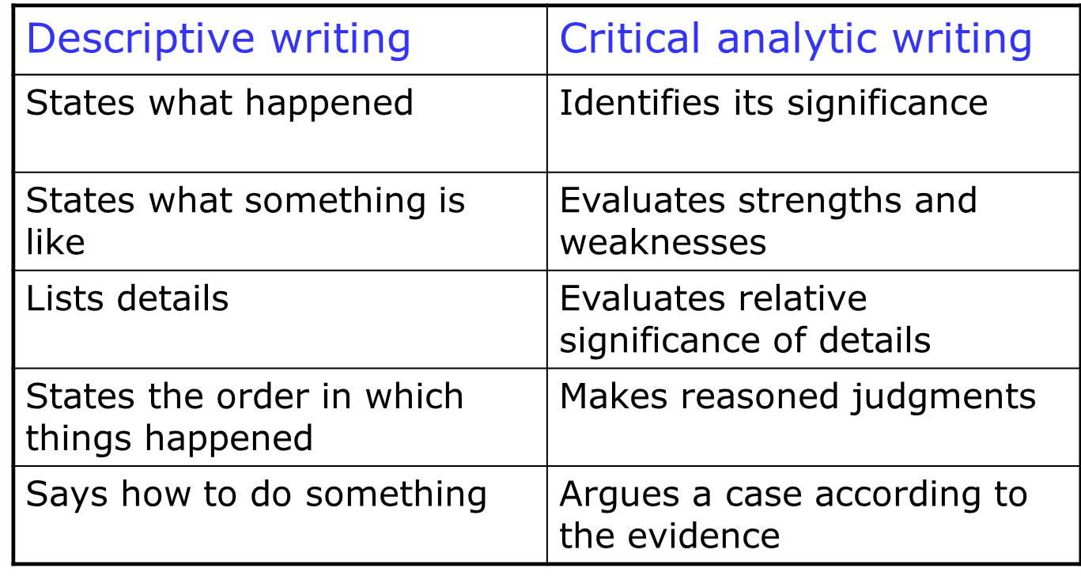
Continued

Slide 13
Any questions?
I will be available in my office until 2:30 to answer any further questions

