Slide 1
Prepared by:
Beatris Gelkova , Ashfaq Ahmed,
Mohammed Samad and Monika Aujla
University of Wales Trinity Saint David

Slide 2
In this group project we are going to talk about different types of barriers that can prevent effective communication, communications benefits, we are going to use theories relating to models of communications and what are the channels of communications at UWTSD
Introduction

Slide 3



Pictures of UWTSD

Slide 4
Benefits of effective communication
Increased access to job opportunity
Preparations for a specialized career
Increased marketability
Personal growth and improved self-esteem
Networking opportunities
Trust
Team building
Better relationship
Problem solving

Slide 5
Channels that can be used to improve communications
Communication channels can be categorized into three principal channels, each of these channels have different strengths and weaknesses
Channel
Verbal
Written
Non-verbal

Slide 6
The types of barriers for effective communications
Language barriers
Common barriers to effective communication are verbal, non-verbal, written, listening or visual.
If we do not communicate effectively we put ourself and others at risk
Cultural barriers
Physical barriers
Psychological barriers
Technological barriers
Organizational barriers

Slide 7
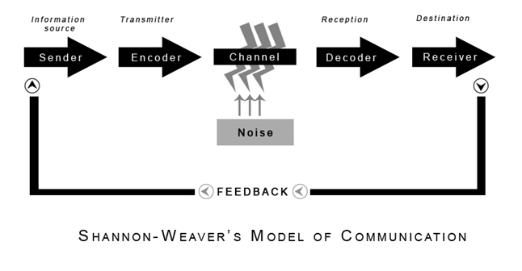
Model of communication

Slide 8
Conclusion
Good communications skills can play an important role in positive work experiences for your team.
Effective communication involves how to trust your team, handle conflict, problem-solving or better relationships.
Communication channels can be categorized into three principal channels verbal, non-verbal and written.
Common barriers to effective communication are Language barriers, Cultural barriers or Organizational barriers

Slide 9
Reference
Dingwall,J.R. labrie, C. ,McLennon,T. , Underwood,L. (2022) "Communication Channel" Available at: https://ecampusontario.pressbooks.pub/profcommsontario/chapter/communication-channel/
IHASCO(2022) "What are the benefits of effective communication skills?" Available at: https://www.ihasco.co.uk/blog/entry/3234/what-are-the-benefits-of-effective-communication-skills
Toppr(2022) "Barriers in Communication" Available at: https://www.toppr.com/guides/business-correspondence-and-reporting/communication/barriers-in-communication/
AMOS(2022) "Shannon and Weaver Model of Communication" Available at: https://www.communicationtheory.org/shannon-and-weaver-model-of-communication/

Slide 10


