Slide 1
Supply Chain Vulnerability
Andrew Thorn

Slide 2
Supply Chain Vulnerability
Is a point of weakness and/or possible threat to the supply chain network

Slide 3
Business Factors Contributing to Supply Chain Vulnerability
A focus on efficiency rather than effectiveness
The globalisation of supply chains
Focused factories and centralised distribution
The trend to outsourcing
Reduction in the supplier base
Volatility of demand
Lack of transparency and control procedures
Notes:
Focus on efficiency Opportunities for inventory reduction
JIT practices widely adopted
Organisations more dependent on suppliers
Volatility of demand increases
Globalisation
Move from ‘local for local’
Offshore sourcing
Global supply chains, for example components sourced in Taiwan, sub-assembled in Singapore final assembly U.S.
Motivation behind offshore sourcing in manufacturing cost
Rarely are total supply chain costs considered
cost based decisions result in higher levels of risk
- Extended lead times
- Greater buffer stocks
- Higher levels of obsolescence
Cross border mergers and acquisitions
Focused factories
Economies of scale if greater quantities are produced at fewer sites
Focus factories- produce fewer products exclusively at a single site
Production costs lower product has to travel further
Volatility
Shorter life cycles
Technology change means higher risk of obsolescence
Higher levels of competitive activity
Increasing variety within product range
Forecasting more difficult
Visibility
Problems arise when:
Disturbances are not recognised in time
Time lag for the action to take effect
Action taken makes situation worse

Slide 4
Business Factors Contributing to Supply Chain Vulnerability
Just-in-time
Stockless production
Lean manufacturing/operations
Increasingly complex SCNs
ERP Systems
partnerships

Slide 5
Other Factors Contributing to Supply Chain Vulnerability
Corruption (fraud, counterfeit products)
Quality failures
Quotas, Taxes
Lack of visibility in the SC
Difficulties in forecasting demand and planning
Capacities in supply chain/network

Slide 6
Supply Chain Vulnerability
Disruptions arise from
Japanese Tsunami
Thailand floods
Icelandic volcanic ash
Natural disasters - foot and mouth 2001
Terrorist incidents - 9/11
Industrial action
Operational difficulties

Slide 7
Supply Chain Vulnerability
Disruptions arise from
Climate change effects
Demand fluctuations
Misguided investments
Cyber espionage
Political risk

Slide 8
Supply Chain Vulnerability
Modern supply chain complex
Move towards leaner supply networks, increased vulnerability
Little safety stock in system
Disruptions have rapid impact

Slide 9
Managing Risks in the Supply Chains
Four standard ways:
Diversification
Stockpiling
Building redundancy- maintaining excess production or transport capacity
Insurance - against loss caused by supply chain disruption

Slide 10
Managing Risks in Supply Chains
Other measures
Supplier selection- capability and risk of dealing with certain supplier
Supplier development- working closely, sharing information, collaborative initiatives
Contractual obligation- penalties for non-delivery
Collaborative initiatives- joint continuity plans
Rationalisation of the product range-
Localised sourcing- reduces risk of delivery being disrupted or delayed

Slide 11
Risks in Supply Chains
Supply chain risks- arising from interactions between organisations within the supply chain
External risks- risks “to” the various links in the supply chains.

Slide 12
Improving Supply Chain Vulnerability
Learn from experiences of failures
Gain better knowledge and understanding of markets and suppliers
Learn from experiences of others
Perform risk evaluation
Assess the impact of supply chain vulnerability

Slide 13
Improving Supply Chain Vulnerability
Ensure effective resourcing
Consider alternative supply chain solutions (Agile or fully flexible)
Get rid of silos (department focus)
Consider the effects of specification on downstream supply

Slide 14
Activity 1
Select a product of your choice that is purchased from a central African country. Examine the potential issues that could lead to supply chain vulnerability and how they could be mitigated.

Slide 15
Activity 2
Using a logistics service of your choice that imports fresh produce from overseas examine the potential issues that could lead to supply chain vulnerability and how they could be mitigated.

Slide 16
Supply Chain Resilience
By
Andrew Thorn

Slide 17
What is Supply Chain Resilience
The ability and time needed to recover the supply chain’s original shape and level of performance following a disruption
It implies a capacity to absorb and bend with impact, and to bounce back
Issues of flexibility and adaptability

Slide 18
Evolving Landscape
Systemic risks are created or magnified by the way supply chain systems are configured
Problems are not resolved by individuals actions
Major disruptions have the potential to cascade through supply chains and other systems

Slide 19
Supply Chain Risk
These issues can be treated as supply chain risks, but supply chain set up can concentrate or amplify disruptions

Slide 20
Issues to Consider
Has outsourcing exacerbated risks by creating hidden pools of risk concentration?
Has government security efforts over react to issues and made supply chain less able to respond to disruptions?
Organisational risk profiles have changed

Slide 21
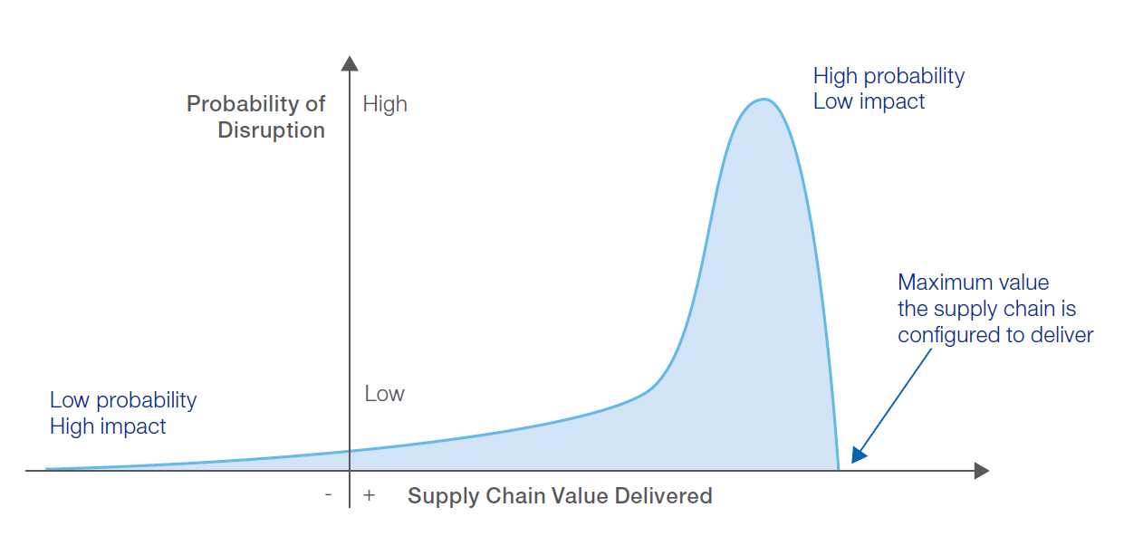

Slide 22
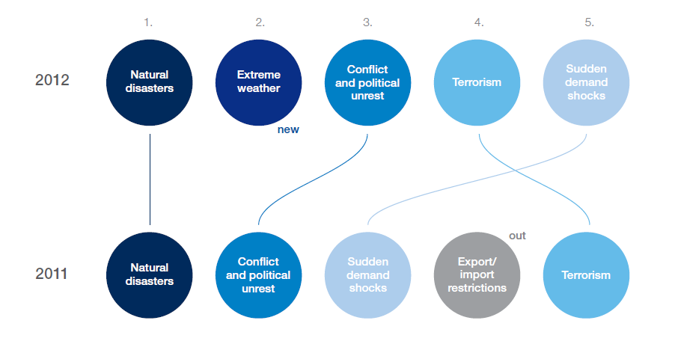
Top Five Disruption Triggers

Slide 23
Risk Management
The way forward: -
Shared responsibility between public and private sectors and functional decision makers in companies
Align organisational agendas around the most important challenges to address

Slide 24
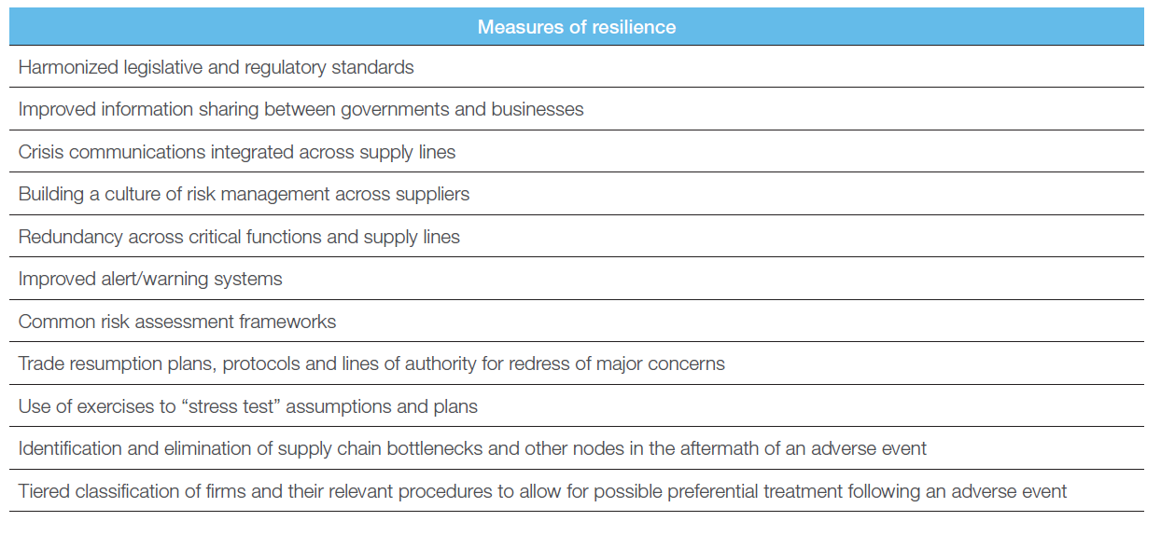

Slide 25
Building Resilient Supply Chains
Issues to Consider
Determine the interconnecting pipeline of suppliers through which information, products and cash must travel to the end user
Predict the time it would take to re-establish service in the event of disruption

Slide 26
Building Resilient Supply Chains
Issues to Consider
Better assessment of risk
More clear communication and discussion of vulnerability
Highlight over reliance on particular suppliers

Slide 27
Building Resilient Supply Chains
Issues to Consider
Supplier failure – where it can occur
Collaboration
Supply base rationalisation
Postponement
Supply chain agility
Supply chain visibility
Supply chain velocity
Acceleration

Slide 28
Supply Chain Agility and Visibility
Supply Chain Agility: - is the ability to respond to changes in demand or supply
Supply Chain Visibility: - is the ability to see all stages of the supply chain from one end to the other (both upstream and downstream)

Slide 29
Supply Chain Velocity and Acceleration
Supply Chain Velocity: - is the time taken for the initial inputs to the supply chain to reach the end-user
In reality the organisation will be more interested in the time taken from when it places the order until it receives the goods or service specified
Acceleration: - measures how rapidly the supply chain reacts to changes in demand, whether upwards or downwards

