Slide 1



ASSIGNMENT ONE CONFERENCE RESEARCH PAPER
Student Name: Gabriela Iuliana Giurgiu
Student ID: 2240417

Slide 2

Table of Contents
Introduction
Literature Review
Method
Conclusion
Recommendations
References
Thank You

Slide 3

Introduction
Chosen topic for the Presentation is Sustainability in terms of Food waste and its efficacy
The purpose of this Presentation:
  Assessment of the contemporary challenges in the UK -based hospitality industry
  Evaluation of the environmental, operational, and consumer satisfaction standards of the industry
Notes:
In this presentation, our group has selected the topic of sustainability in terms of food waste and its efficacy in the UK hospitality industry. The bakery and freshly produced food industry is found to generate the most waste in the UK hospitality sector. Assessing contemporary challenges in this industry can be effective in understanding consumers’ satisfaction standards. This can enable hospitality organisations to stay more consumer-centric. Moreover, this study will evaluate the macroeconomic standards of the industry to enhance consumer satisfaction and loyalty over time.

Slide 4
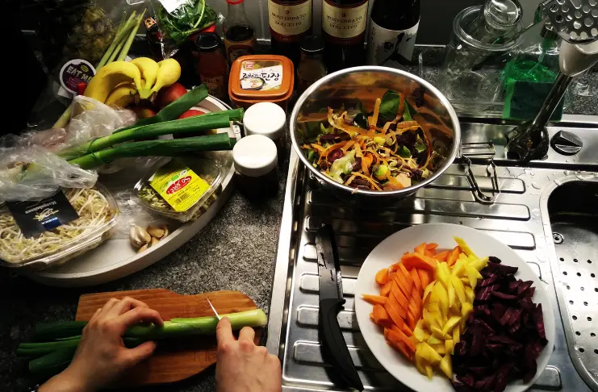
Contd.
Approximately 199,100 tonnes every year of food waste in UK come from restaurants (McCarthy, 2025)
The UK household has generated 16 million tons of carbon dioxide due to wasted food and drinks in 2022 (WRAP, 2022)
The chosen hospitality brand: Splendid Hospitality Group
Notes:
The UK hospitality sector is considered one of the most important sectors in contributing to the employment standards and economic development. As noted by McCarthy (2025), high amounts of waste have been generated in the UK hospitality and restaurant industry. This has resulted in a high level of CO2 emissions. Splendid Hospitality Group has been selected in this study to reflect sustainability, leading to effective waste management at large.

Slide 5


Literature Review
The food waste issues challenge the industry’s sustainability standards
Bakery items are found to be the major source of carbon emissions due to waste (Goryńska-Goldmann, 2022)
Detrimental environmental standard is also linked with food waste levels in the UK
Sustainability can be achieved only with high-quality food waste management and consumer centricity
Notes:
This literature review has effectively detailed the food waste challenge in the UK hospitality industry, with a critical focus on Splendid Hospitality Group. Since bakery items are one of the most relevant food waste generators in the UK due to their perishability, a critical focus must be on this segment of hospitality to reduce food waste-based carbon emissions in the future (Adesilu, 2021). Also, in achieving sustainable practices, the industry needs to reduce the detrimental impacts of food waste on the environment.

Slide 6
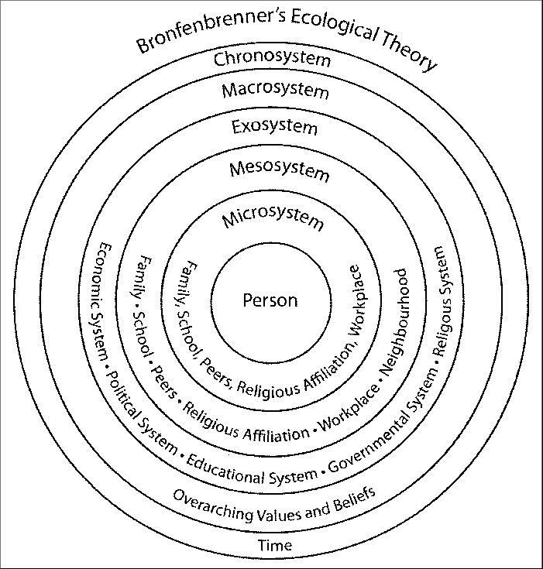
Contd.
Theoretical perspective
  Systems Theory of Sustainability
  Developed by Urie Bronfenbrenner in 1979 (Guy-Evans, 2025).
  Provides an integrated approach to protect the environment and manage lands
  Promotes interconnectedness between socio-economic and environmental metrics
  Fosters sustainability in reducing food wastes
Notes:
The systems theory has been developed by Urie Bronfenbrenner to explain human quality development in the interconnected socio-economic and environmental contexts. In the UK, the hospitality industry, food waste reduction can lead to a more sustainable integration of stakeholders and improvement of the overall business performance. According to this theory, the impact of sustainable food waste has been noted to promote consumer satisfaction standards and industry-based profitability. Thus, companies like Splendid Hospitality Group can reduce the environmental challenges in the operational phenomenon in the long run.

Slide 7
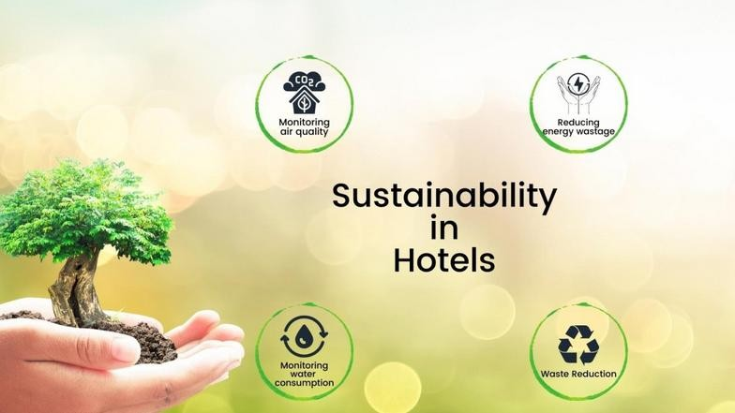
Contd.
Consumers’ focus on sustainability showcases their inclination towards brands that have limited food waste (dos Santos et al., 2022)
Mixed response from consumers has been noted regarding food waste in the industry
A positive impact has been fostered on the stakeholder confidence improvement with sustainability measures (Costa and Costa, 2022)
AI tools reduce food waste in the UK hospitality industry with relevant governmental support (Chkoniya, 2021)
Notes:
Studies like Mucha and Oravecz (2025) found that consumers are more focused on those hospitality brands that prioritise limited food waste. This promotes accountability and future purchase intentions among consumers. On the one hand, it improves the environmental sustainability standard, and on the other, it enhances the hospitality organisation’s performance, sustainability and resilience. Furthermore, Chkoniya (2021) highlighted that the use of AI is effective in reducing food waste to promote sustainability policies and lowering carbon emission standards to a great extent. Thus, with these initiatives, it is expected that Splendid Hospitality Group can maintain its long-term sustainable competitive advantage in the market.

Slide 8
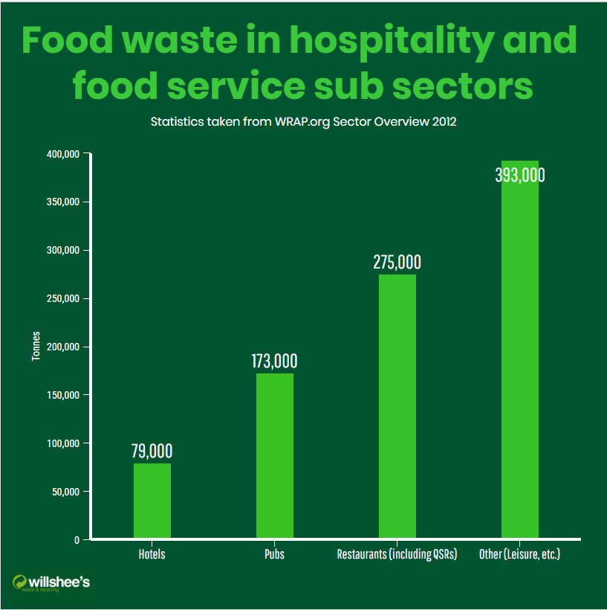
Method
PEST Analysis Summary
Political: High political pressure in the UK hospitality industry regarding the low-carbon economy and regulatory compliance
Economic: Increased inflationary pressure reduces consumers’ attraction to the hospitality industry and associated profitability measures
Social: Climate change is a concern for adults in the UK (Ons.gov.uk, 2026)
Technological: UK hotels have already adopted AI for food waste management, with even distribution and accessibility
Notes:
The PEST analysis summary has shown a potential analysis of the macroeconomic factors and their impact on the UK hospitality industry. Politically, the low-carbon policy pressure is significant in the industry in terms of maintaining environmental sustainability. Economically, the ongoing pressure of inflation often reduces consumers’ ability to adopt sustainable policies and design their leisure due to economic limitations (Karvounidi et al., 2024). Furthermore, the social concerns of climate change have also affected adults in the UK, although the growing use of AI in the industry has been promising for the company to reduce food waste in the future.

Slide 9
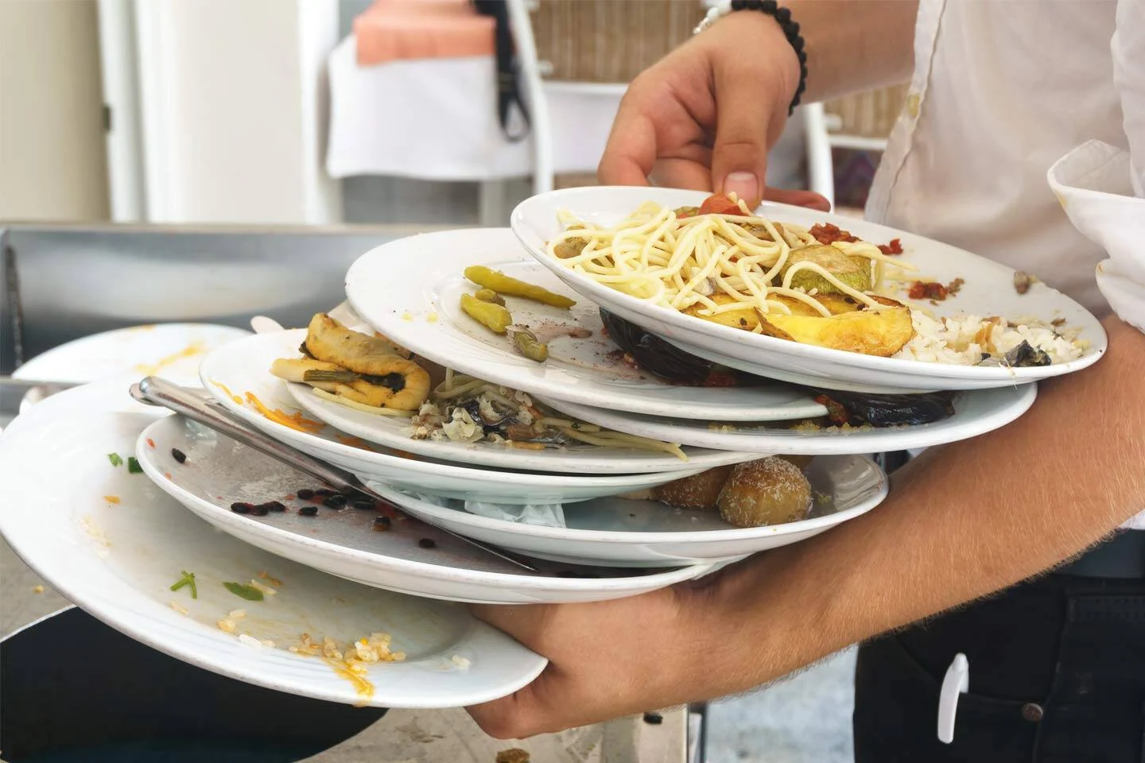
Contd.
Food Waste impact in the UK hospitality industry
  Food waste standards
  Increases carbon emission limits in the UK
  Tampers with consumer trust and reliability in the brand and its brand image (Batabyal and Das, 2019)
  Detrimentally impacts business profitability
  Reduces the firm’s competitiveness across intense market rivalry
Notes:
Food waste is considered one of the most relevant issues in the UK hospitality industry. On the one hand, it reduces the brand image, and on the other, limits consumer reliability to a significant extent. According to Cardenas et al. (2024), the business profitability standard is often limited by a tampered consumer trust. Ongoing financial pressure has also been a constraint in this industry that limits its competitiveness across intense competitive rivalry in the UK hospitality industry.

Slide 10


Contd.
Industry Responses and Examples
Premier Inn has targeted to reduce carbon emissions by 50% in 2030 (Sprackett, 2026)
IHG has developed a high-quality supplier partnership for organic food sourcing and procurement (Procurement.ihg.com, 2026)
Use of techniques, including temperature-controlled preservation and biodegradable composting
Notes:
These case examples have highlighted how organisations have been dealing with food waste management. For instance, Premier Inn has aimed to reduce its carbon emissions by 50% by the end of 2030, while IHG has planned to develop a high-end, efficient supplier network to manage surplus food and maintain high-end sustainable procurement procedures. Furthermore, the use of AI has been effective in preventing food waste by guiding hospitality organisations improve operational efficiency and performance resilience in the long term.

Slide 11
Contd.
Summary of Strengths and Weaknesses
The major strengths of the UK hospitality industry are: effective procurement and the reduction of carbon emissions , improved stakeholder interest for investment in the industry
The significant weaknesses are: limited employee training and developmental scopes (Cooper and Hall, 2023), financial constraints to maintain sustainable practices
Notes:
Based on the current scenario of food waste management in the UK hospitality industry, the strengths and weaknesses of this industry have been determined. For strength, organic procurement and food management principles can allow organisations like Splendid Hospitality Group the feasibility of improving stakeholder interests and reduce carbon emissions. For limitations, however, the employee training and development scope has been limited. Moreover, financial constraints have been significant, which need to be improved in the future.

Slide 12

Conclusion
Food waste is a significant problem in the UK hospitality industry
The presentation identified environmental, social and economic impacts for Splendid Hospitality Group
Accountability is found essential to improve consumer-brand engagement and performance sustainability
Notes:
This research has managed to conclude that food waste management is a potential challenge in the UK hospitality industry, which requires potential surveillance and recommendations. This presentation, by using high-end, effective secondary literature, has revealed the macroeconomic status of the hospitality industry of the UK. Finally, this study revealed that firms like Splendid Hospitality Group need to maintain high-end operational synergies to improve brand reputation in the long term.

Slide 13

Recommendations
Improvement of training and development programs for UK hospitality staff
Enhancement of the sustainability mindset among staff to manage perishable food (Lu and Ko, 2023)
Embodiment of a sustainable and green operational approach in the industry
Effective AI management to reduce excess inventory
Notes:
Depending on the core findings of this presentation, it can be noted that the UK hospitality industry needs to improve training and development activities to help it manage perishable food from waste generation. With a sustainable and green operational method of circulating the surplus food through a high-end supplier network management, the food waste metrics can be reduced. Also, AI can be an efficient method to manage food waste more responsibly in the UK hospitality environment.

Slide 14

Contd.
Adoption of innovative food preservation techniques by applying renewable mechanisms
Expansion of the composting technique of surplus with a food redistribution approach
Integration of AI with food waste reduction and promotion of sustainability
Notes:
Hotels have, over the years, adopted multiple innovative preservation methods, including temperature-controlled preservation, although it needs potential expansion to meet current industry needs and standards. AI integration can be beneficial to redistribute surplus and manage inventory to a significant extent.

Slide 15
References
Adesilu, S. (2021) Five ways bakeries are tackling food waste. [online] British Baker. Available at: https://bakeryinfo.co.uk/retail/five-ways-bakeries-are-tackling-food-waste/653017.article (Accessed: 17 January 2026).
Batabyal, D. and Das, D.K. (eds). (2019) Global trends, practices, and challenges in contemporary tourism and hospitality management. Hershey, Pennsylvania: Business Science Reference, an imprint of IGI Global.
Cardenas, M., Schivinski, B. and Brennan, L. (2024) CIRCULAR PRACTICES IN THE HOSPITALITY SECTOR REGARDING FOOD WASTE. Journal of Cleaner Production, [online] 472, pp.143452–143452. Available at: https://www.sciencedirect.com/science/article/pii/S0959652624029019 (Accessed: 20 January 2026).
Chkoniya, V. (ed.). (2021) Handbook of research on applied data science and artificial intelligence in business and industry. Hershey, Pennsylvania: IGI Global.
Cooper, C. and Hall, C.M. (2023) Contemporary tourism: an international approach. 5th ed. Oxford: Goodfellow Publishers Limited.
Costa, V. and Costa, C. (eds). (2022) Sustainability and competitiveness in the hospitality industry. Hershey, Pennsylvania: Business Science Reference.
Dos Santos, J.I.A.S., da Silveira, D.S., da Costa, M.F. and Duarte, R.B. (2022) ‘Consumer behaviour in relation to food waste’: A systematic literature review. British Food Journal, 124(12), pp.4420-4439. DOI: https://doi.org/10.1108/BFJ-09-2021-1075
Goryńska-Goldmann, E. (2022) BREAD AND OTHER BAKERY AND CONFECTIONERY PRODUCTS WASTE IN SELECTED RETAIL STORES. Annals of the Polish Association of Agricultural and Agribusiness Economists, [online] XXIV(4), pp.65–79. Available at: https://www.researchgate.net/publication/366242644_BREAD_AND_OTHER_BAKERY_AND_CONFECTIONERY_PRODUCTS_WASTE_IN_SELECTED_RETAIL_STORES (Accessed: 17 January 2026).
Guy-Evans, O. (2025) Bronfenbrenner’s Ecological Systems Theory. [online] Simply Psychology. Available at: https://www.simplypsychology.org/Bronfenbrenner.html (Accessed: 18 January 2026).
Karvounidi, M.D., Alexandropoulou, A.P. and Fousteris, A.E. (2024) Sustainable Food Waste Management in the Hospitality Industry: Innovations and Best Practices. IOSR Journal of Environmental Science, Toxicology and Food Technology, [online] 18(6), pp.26–34. Available at: https://www.researchgate.net/publication/387090179_Sustainable_Food_Waste_Management_in_the_Hospitality_Industry_Innovations_and_Best_Practices (Accessed: 19 January 2026).
Lu, M.-Y. and Ko, W.-H. (2023) Sustainable Preparation Behaviour for Kitchen Staff to Limit Food Waste. Foods, [online] 12(16), pp.3028–3028. Available at: https://pmc.ncbi.nlm.nih.gov/articles/PMC10453843/ (Accessed: 21 January 2026).
McCarthy, D. (2025) Restaurant Food Waste Statistics UK – Data, Impact & Waste Reduction Trends. [online] Restroworks. Available at: https://www.restroworks.com/blog/restaurant-food-waste-statistics-uk/ (Accessed: 17 January 2026).
Mucha, L. and Oravecz, T. (2025) Assumptions and perceptions of food wasting behaviour and intention to reduce food waste in the case of Generation Y and Generation X. Scientific Reports, [online] 15(1). Available at: https://www.nature.com/articles/s41598-025-86252-z (Accessed: 19 January 2026).
Ons.gov.uk. (2026) Public and business attitudes to the environment and climate change, Great Britain: 2024. Available at: https://www.ons.gov.uk/economy/environmentalaccounts/articles/publicandbusinessattitudestotheenvironmentandclimatechangegreatbritain/2024 (Accessed: 17 January 2026).
Procurement.ihg.com. (2026) How IHG Hotels in the UK & Ireland are Saving on F&B Costs. Available at: https://procurement.ihg.com/w/ihg-procurement-program-uk-ireland-fb-savings (Accessed: 17 January 2026).
Sprackett, R. (2026) Waste, Recycling and Food Waste. Available at: https://www.linkedin.com/posts/premier-inn_premierinn-foodwaste-zerofoodwaste-activity-7222508780226252800-7VQl (Accessed: 15 January 2026).
WRAP. (2022) Household Food and Drink Waste in the UK 2022. [online] WRAP. Available at: https://www.wrap.ngo/resources/report/household-food-and-drink-waste-uk-2022 (Accessed: 17 January 2026).

Slide 16


