Slide 1
Selective systems of education
“In your considered opinion, what are the benefits and disadvantages of educating children in a selective system of education in the 21st Century?”
By Elizabeth Langshaw

Slide 2
Contents
What is a selective system of education?
Creativity within education
Benefits of creativity
Limitations of creativity
Inclusivity within education
Limitations of inclusive education
Benefits of inclusive education
Summary
Bibliography
Images
Questions

Slide 3
What is a Selective System of Education?
A selective system of education is commonly referred to when discussing grammar schools, where children at age 11 take an exam, and the results determine whether the child has met the requirements to attend a grammar school, if they did not, they would attend a lower level secondary school (1)
However, it can be argued that ALL systems of education are selective, where learners, parents/guardians have the choice in which system they partake in
(1)- Jorn-Steffen Pischke and Alan Manning, "Comprehensive Versus Selective Schooling In England In Wales: What Do We Know?", National Bureau Of Economic Research, 121.128 (2006), 1.

Slide 4

Creativity
Creativity is responsible for our greatest achievements (2)
It is associated with personal fulfilment and self-actualization
Creativity is beneficial to learning
It promotes skills essential to contemporary society
Originality
Motivation
Problem Solving (3)
(2)- Liane Gabora and Simon Tseng, "The Social Benefits Of Balancing Creativity And Imitation: Evidence From An Agent-Based Model", Psychology Of Aesthetics, Creativity, And The Arts, 11.4 (2017), 403.
(3)- Julie Ann Kirkham and Evan Kidd, "The Effect Of Steiner, Montessori, And National Curriculum Education Upon Children’s Pretence And Creativity", Journal Of Creative Behavior, 51.1 (2017), 28-29.
Img1

Slide 5
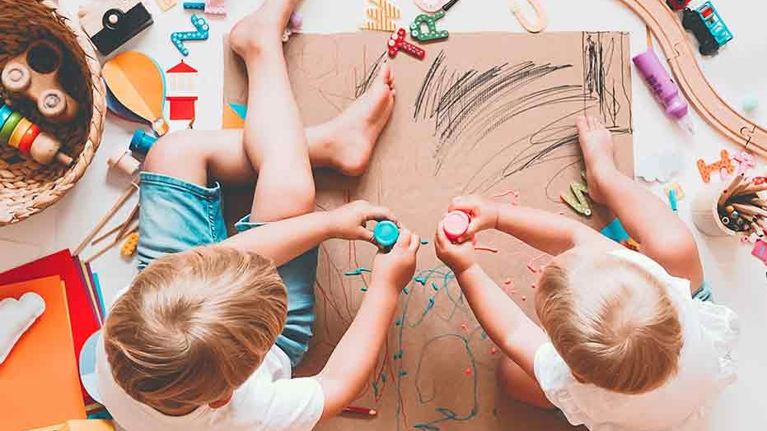
Steiner Schools
The curriculum’ is equally focused on both creative and academic subjects
Enables learners to develop experience and confidence in new areas of learning
Kirkham and Kidd’s research findings show that learners at Steiner schools displayed the highest level of creativity when compared to learners from Montessori and Mainstream schools (4),(5)
(4)- Julie Ann Kirkham and Evan Kidd, "The Effect Of Steiner, Montessori, And National Curriculum Education Upon Children's Pretence And Creativity", Journal Of Creative Behavior, 51.1 (2017), 28-29.
(5)- Peter Kraftl, "Ecological Architecture As Performed Art: Nant-Ycwm Steiner School, Pembrokeshire", Social And Cultural Geography, 7.6 (2006), 935.
Img2

Slide 6
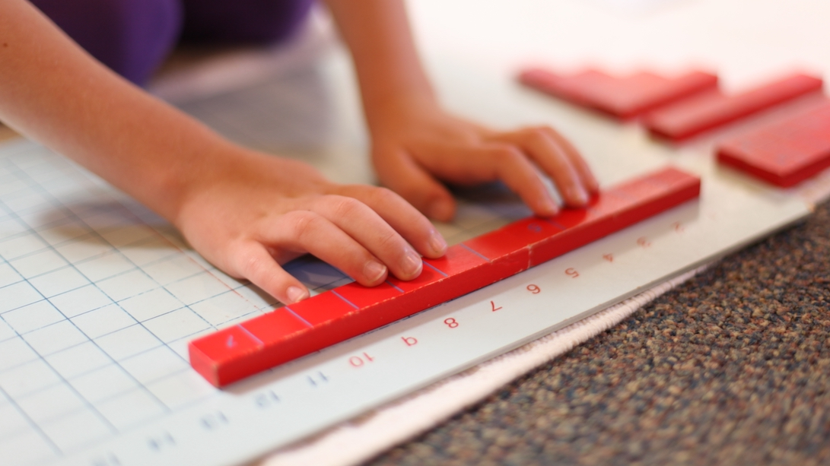
Montessori Schools
Focuses on real objects and real experiences
Lack of opportunities for role-play activities
Criticised for not promoting imagination and creativity
Learner’s guide their own learning which can encourage creative tendencies (6)
(6)- Barbara Isaacs, Understanding The Montessori Approach (Oxon: Routledge, 2012), p. 100.
Img3

Slide 7

Inclusivity
Inclusive education involves celebrating and valuing difference and diversity (7)
All pupils are to have access to common activities that are relevant to their needs
Inclusive curriculum – engagement with differing learning styles will enhance learning (8)
The United Nations Convention on the Rights of the Child (UNCRC), states seven core aims which ensure that all children and young people have inclusive rights (9)
Img4
(7) Garry Hornby, "Inclusive Special Education: Development Of A New Theory For The Education Of Children With Special Educational Needs And Disabilities", British Journal Of Special Education, 42.3 (2015), 247.
(8)- Welsh Government, "Inclusion And Pupil Support", Gov.Wales, 2016 <https://gov.wales/sites/default/files/publications/2018-05/guidance-inclusion-and-pupil-support_0.pdf> [Accessed 15 December 2020].
(9)- Jane Hutt and Jane Davidson, "Children And Young People: Rights To Action", Senedd.Wales <https://senedd.wales/Committee%20Documents/HSS(2)-02-04%20Paper%201%20%20Children%20and%20Young%20People%20Rights%20to%20Action04022004-14558/n0000000000000000000000000016990-English.pdf> [Accessed 15 December 2020].

Slide 8

Special Educational Needs and Disabilities (SEND) in Mainstream Schools
It is impossible for the teach to meet every child’s need
1 in 100 children are on the autism spectrum, 70% of those children attend mainstream schools
60% of teachers reported feeling like they were not adequately trained to teach autistic children (10)
A teacher’s mind-set presents as a barrier for supporting children and young people with SEND
LSA’s can have a negative impact on SEND pupil’s learning (11)
Img5
(10)- “Professional Practice", Autism.Org.Uk <https://www.autism.org.uk/advice-and-guidance/professional-practice> [Accessed 16 December 2020].
(11)- Jacqui Ver Loren Van Themaat, "Thinking Together Changes The Educational Experiences, Provision And Outcomes For SEND Pupils - Professional Learning Communities Enhancing Practice, Pedagogy And Innovation.", Support For Learning, 34.3 (2019), 295.

Slide 9
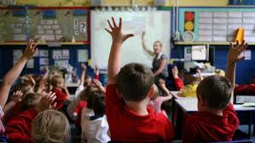
Continued..
Pupil’s with SEND can benefit academically and emotionally with support from their peers
Social benefits when peer’s and teachers are understanding and accepting of SEND (12)
There are alternative educational settings. Those learner’s who feel limited at a mainstream school have the choice to engage in an education that best suits their needs (13)
Img6
(12)- Alison Kington, "The Development Of Inclusive Learning Relationships In Mainstream Settings: A Multimodal Perspective", Cogent Education, 4.1 (2017).
(13)- Garry Hornby, "Inclusive Special Education: Development Of A New Theory For The Education Of Children With Special Educational Needs And Disabilities", British Journal Of Special Education, 42.3 (2015), 247.

Slide 10
Summary
Each selective educational system comes with its own benefits and limitations
The choice of system can be made based on what system supports a learner’s needs most efficiently and effectively
Creativity is often overlooked within education, however it plays an important role in a child’s learning and development and should be considered in their learning process
Inclusivity is an important principle which has to be followed within educational systems. How this is demonstrated can effect a child’s learning and well-being. If an educational system a child attends does not meet their needs, another educational setting may offer a more inclusive environment that would better attend to their needs.

Slide 11
Bibliography
Gabora, Liane, and Simon Tseng, "The Social Benefits Of Balancing Creativity And Imitation: Evidence From An Agent-Based Model", Psychology Of Aesthetics, Creativity, And The Arts, 11 (2017)
Hornby, Garry, "Inclusive Special Education: Development Of A New Theory For The Education Of Children With Special Educational Needs And Disabilities", British Journal Of Special Education, (2015)
Hutt, Jane, and Jane Davidson, "Children And Young People: Rights To Action", Senedd.Wales <https://senedd.wales/Committee%20Documents/HSS(2)-02-04%20Paper%201%20%20Children%20and%20Young%20People%20Rights%20to%20Action-04022004-14558/n0000000000000000000000000016990-English.pdf> [Accessed 15 December 2020]
Isaacs, Barbara, Understanding The Montessori Approach (Oxon: Routledge, 2012)
Kington, Alison, "The Development Of Inclusive Learning Relationships In Mainstream Settings: A Multimodal Perspective", Cogent Education, (2017)
Kirkham, Julie Ann, and Evan Kidd, "The Effect Of Steiner, Montessori, And National Curriculum Education Upon Children’s Pretence And Creativity", Journal Of Creative Behavior, 51 (2017)
Kraftl, Peter, "Ecological Architecture As Performed Art: Nant-Ycwm Steiner School, Pembrokeshire", Social And Cultural Geography, (2006)
Pischke, Jorn-Steffen, and Alan Manning, "Comprehensive Versus Selective Schooling In England In Wales: What Do We Know?", National Bureau Of Economic Research, 121 (2006)
"Professional Practice", Autism.Org.Uk <https://www.autism.org.uk/advice-and-guidance/professional-practice> [Accessed 16 December 2020]
Van Themaat, Jacqui Ver Loren, "Thinking Together Changes The Educational Experiences, Provision And Outcomes For SEND Pupils - Professional Learning Communities Enhancing Practice, Pedagogy And Innovation.", Support For Learning, (2019)
Welsh Government, "Inclusion And Pupil Support", Gov.Wales, 2016 <https://gov.wales/sites/default/files/publications/2018-05/guidance-inclusion-and-pupil-support_0.pdf> [Accessed 15 December 2020]

Slide 12
Images
Img1- https://jjrmarketing.com/channel-a-new-outlook-up-your-workplace-creativity/
Img2- https://parenting.firstcry.com/articles/waldorf-education-everything-that-parents-need-to-know/
Img3- https://hollismontessori.org/blog/2018/3/19/montessori-basics-how-math-progresses-through-the-levels
Img4- https://study.com/academy/lesson/inclusive-practices-in-education-definition-examples.html
Img5- https://www.whitehall.bristol.sch.uk/key-information/send-special-education-needs-and-disability-information
Img6 - http://home.bt.com/news/uk-news/more-children-with-special-needs-missing-mainstream-education-data-shows-11364169361908

Slide 13
Thankyou for listening
Are there any questions?

