Slide 1
Data Warehousing for Business Intelligence
M3XCP4
Lecture 12
Introduction to Data Mining
Dr Nik Whitehead

Slide 2
Introduction
In this lecture we will:
  Explain the process of data mining
  Examine different approaches to data mining
  Examine the main categories of data mining problems
  Recognise output patterns of information
  Discuss the importance of evaluation

Slide 3
Data Mining Process
Input
Data
Preparing
Input Data
Mining
Patterns
Post-processing
Patterns
Output
Patterns
A data mining stage
Flow of control from one stage to the next stage
Flow of control from one stage to the previous stage
Repetition of the tasks at one stage

Slide 4
Data Mining Process
Preparation
Selecting relevant features
Selecting relevant records
Data cleaning
Deal with unknown data
Data transformation
Target Data set
Collected Data set
Pre-Processed Data set
Integrating data
Getting necessary data details
Formatted
Data set
Formatting data into acceptable form by the mining tool
Original Data sets

Slide 5
Data Mining Process
Mining
  Determining data mining tasks
  Assigning roles for data for certain tasks
  Selecting data mining solution(s) to each task
  Setting necessary parameters for the solution
  Collecting result patterns
Formatted
Data set
Solution₃
(w₁, w₂, …, w_{m})
Solution₂
(t₁, t₂, …, t_{r})
Parameter settings
Solution₁
(p₁, p₂, …, p_{n})
Mining solutions
Patterns

Slide 6
Data Mining Process
Post-processing
  Pattern evaluation
  Pattern selection
  Pattern interpretation
Knowledge learnt
Pattern
Interpretation
Patterns
Evaluation
criteria
accept
Valid
Patterns
Selection
criteria
Valid
Patterns
reject
Selected
Patterns

Slide 7
Data Mining Process
Roles of participants in data mining
  Participants include:
    Data miners / data analysts: main participant of a DM project
    Domain expert: main collaborators of DM project
    Decision makers: clients of a DM project
  Risk of human bias in the discovery process
  Important roles of domain expert
    Pattern interpretation (for usefulness)
    Pattern evaluation (for significance)
    Mining options (for suitable tasks, limited)
    Advisory on data pre-processing (for suitable operations, limited)
  Balancing the strength of human and machine

Slide 8
Data Mining Approaches
Hypothesis testing approach
  Top-down lead by a hypothesis statement
  Procedure:
    Forming a hypothesis statement
    Collecting and selecting data of relevance
    Conducting data analysis and collecting patterns
    Interpreting the patterns to accept/reject the hypothesis
Discovery approach
  Bottom-up without a hypothesis in mind
  Procedure:
    Collecting and preparing data of interest
    Conducting data analysis and discovering possible patterns
    Evaluating the importance and interestingness

Slide 9
Data Mining Approaches
Discovery approach (cont’d)
  Directed discovery (supervised learning):
    Certain aspects of the outcome, i.e. the goal, of the discovery have been specified. The discovery is to find those patterns satisfying the goal.
    e.g. patterns relating to the outcome of a class variable
  Undirected discovery (unsupervised learning):
    There is no specification of the goal of the discovery. The discovery is to find those patterns of some kind of significance.
    e.g. associative links among some attribute values

Slide 10
Data Mining: Problems & Patterns
Classification
  Construct a classification model to determine the class of a given record
Model
Construction
Method
Classification
Model
Example Data Set
(a) Model Development Phase
Unseen Data Record with undetermined class
Classification
Model
Data Record with the determined class
(b) Model Use Phase

Slide 11
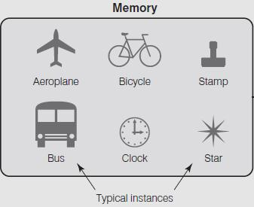
Data Mining: Problems & Patterns
Various forms of classification models
Instance space
Neural network
Decision tree
Many more …
List of ordered classification rules
Function (linear regression)

Slide 12
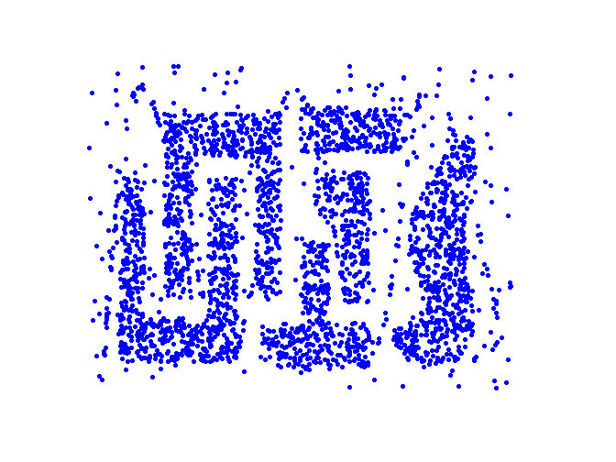

Data Mining: Problems & Patterns
Cluster detection
  Measure similarity among data objects and group them into clusters accordingly
Input data points
Cluster Memberships of Data Points
Clustering
Method

Slide 13
Data Mining: Problems & Patterns
Forms of clustering results
Clusters of various shapes
Hierarchical clustering results
Eclipse shaped clusters

Slide 14
Data Mining: Problems & Patterns
Association rule mining
  Discover significant relationships between data objects
Association
Mining Method
X ⇒ Y
Various associations
  Between values, e.g. Apple ⇒ Coke
  Between categories of values, e.g. Food ⇒ Magazine
  Between values of attributes, e.g. Married:yes ⇒ OwnHouse:yes
  Over time period, e.g. year 1: Database ⇒ year 2: Data Mining

Slide 15
Data Mining: Problems & Patterns
An example
Classification model?
Clusters?
Association rules?

Slide 16
Data Mining Solutions: An Overview
Classification solutions
  Decision tree e.g. ID3
  k nearest neighbour (kNN) e.g. PEBLS
  Rules e.g. Sequential Cover
  Bayesian theorem e.g. Naïve Bayes
  Artificial neural network
Clustering Solutions
  Partition-based methods e.g. K-means
  Hierarchical methods e.g. agglomeration
  Density-based methods e.g. DBScan
  Model-based methods e.g. Expectation-Maximisation
  Graph-based methods e.g. Chameleon

Slide 17
Data Mining Solutions: An Overview
Association rule solutions
  Greedy methods e.g. Apriori
  Graph-based methods e.g. FP-Growth
  Methods for various associations
    Boolean associations
    Generalised associations (multi-level associations)
    Quantitative associations (multidimensional associations)
    Sequential associations (sequential patterns)
Since one type of data mining problems can be transformed to another type of data mining problems, some solutions for one type can also be applied to another type.

Slide 18
Evaluation of Patterns
Importance of evaluating result patterns
  Classification model must be accurate enough to be creditable
  Clusters must genuinely exist
  Association rules must have enough strengths to be believed
  Data descriptions must be general enough to cover a large part of the data set
How do we evaluate the discovered patterns ?

Slide 19
Evaluation of Patterns
Possible measures of interestingness
  Objective measures based on data and pattern
    Conciseness of pattern, e.g. minimum description length
    Coverage, e.g. coverage for classification rules
    Reliability, e.g. accuracy of a classification model
    Peculiarity, e.g. measures of difference from the norm
    Diversity, e.g. tendency of clusters
  Subjective measures based on domain knowledge
    Novelty
    Surprisingness
    Usefulness
    Applicability

Slide 20
Evaluation of Patterns
Commonly used measures
  Accuracy rate or error rate for classification models
    True positive
    False positive
    False negative (see section 6.5.1)
  Quality of clusters
    Quality of a cluster
    Overall quality of all clusters (see section 4.5.1)
  Strengths of associations
    Support
    Confidence
    Lift (see section 8.1.2 and 8.6)

Slide 21
Summary
In this lecture we have:
  Explained the process of data mining
  Examined different approaches to data mining
  Examined the main categories of data mining problems
  Recognised output patterns of information
  Discussed the importance of evaluation

Slide 22
References
Read Chapter 2, sections 2.1 to 2.5 of Data Mining Techniques and Applications
Next session: Data Mining in WEKA

