Slide 1
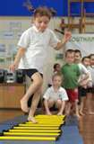

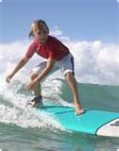
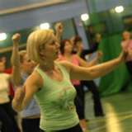
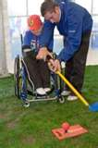
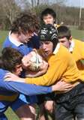
Acquisition of Skill – Lecture 2 Defining Skill
Steven Osborne

Slide 2
Aims:
To understand what makes a skill-full performance.
To know and Understand the skill classification continuum.
Be able to relate the classification continuum to sporting examples.

Slide 3
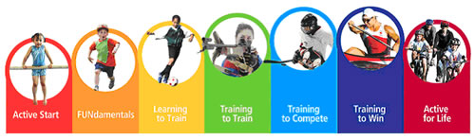
Long Term Athlete Development (LTAD)

Slide 4
‘SKILL IS THE LEARNED ABILITY TO BRING ABOUT PREDETERMINED RESULTS WITH MAXIMUM CERTAINTY, OFTEN WITH THE MINIMUM AMOUNT OF TIME OR ENERGY OR BOTH’
B.KNAPP

Slide 5
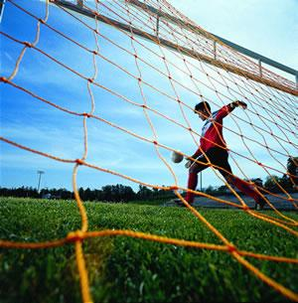

Slide 6
SKILL
LEARNED
FLUENT
AESTHETIC
FOLLOWS
A
TECHNICAL
MODEL
GOAL
DIRECTED
EFFICIENT

Slide 7
What are Motor Skills?
Motor skills
Fundamental skills
Fundamental motor skills
DIFFERENT TERMS, SAME THING!!

Slide 8

Definitions

Slide 9
What are Motor Skills?
Fundamental skills are those utilitarian skills that children need for living & being” (Pangrazi & Dauer, 1992, p. 291)
“Fundamental motor skills (FMS) are the foundation movements or precursor patterns to more specialised, complex skills in games, sports, dance, aquatics, gymnastics and recreational activities” (DECCD, 1997, p. 4)
Current research indicates that the current level of FMS development in a child’s early years is inadequate

Slide 10
What are Motor Skills cont.
Early development of FMS is an important step towards ensuring an individual’s involvement in physical activity is lifelong, safe and healthy
Without competence in a range of skills such as running, skipping and balancing, students are less likely to access the range of options available to establish an active lifestyle
Research has indicated that the improvements in self esteem and confidence that are associated with a sound development in FMS has a flow on effect to other areas of a child’s education

Slide 11
Skill vs Ability

Slide 12
SKILL VERSUS ABILITY
ABILITY is
      Genetic, stable, enduring,
      E.g. speed, strength, coordination
      Can be improved to a certain degree but not drastically
      The foundation for strong performance

Slide 13
The Terms Ability and Motor Ability
Ability
  A general trait or capacity of a person
  Relatively enduring characteristic
  Serves as a determinant of a person’s achievement potential for the performance of specific skills
Motor Ability
  An ability that is specifically related to the performance of a motor skill
  Each person has a variety of motor abilities

Slide 14
ABILITIES
INNATE
STABLE
SUPPORT
SKILLS

Slide 15
ABILITIES
ARE INNATE OR GENETICALLY DETERMINED - we are born with abilities determined by the genes we inherit from our parents.
ARE STABLE AND ENDURING – abilities remain throughout our lives but can be developed through our experiences and maturation.
SUPPORT SKILLS – each skill needs to have several supporting or underpinning abilities in order to learn skills effectively. They are thought to be the foundation blocks on which skills are built.

Slide 16
Abilities as Individual Difference Variables
Motor abilities establish achievement potentials for specific motor skills
Each motor skill requires specific motor abilities to successfully perform it
If 2 people have the same
  Amount of practice
  Level and amount of instruction
  Motivation to perform the skill
Then - Motor abilities will influence the level of performance success each person can/will achieve

Slide 17
Identifying Motor Abilities
One example of an attempt to identify motor abilities
Fleishman’s Taxonomy of Motor Abilities
  Described 11 perceptual-motor abilities
  Identified 9 physical proficiency abilities

Slide 18
Perceptual Motor Abilities
Multilimb coordination
Control precision – ability to make movement adjustments
Response orientation
Reaction time
Speed of arm movement
Rate control – ability to time continuous anticipatory movement
Manual dexterity – ability to make skillful arm-hand movements
Finger dexterity
Arm-hand steadiness
Aiming

Slide 19
Physical Proficiency Abilities
Static strength
Dynamic strength
Explosive strength
Trunk strength
Dynamic flexibility
Gross body coordination
Gross body equilibrium
Stamina

Slide 20
Additional Physical Motor Abilities
Static balance
Dynamic balance
Visual acuity ability to see clearly and precisely
Visual tracking follow a moving object
Eye-hand or eye-foot coordination

Slide 21
Important Assumptions of Taxonomy of Motor Abilities
All individuals possess these motor abilities
It is possible to measure them
It is possible to quantified the level of each ability in a person
low
average
high
1 2 3 4 5 6 7 8 9 10

Slide 22
Relating Motor Abilities to Motor Skill Performance
Task Analysis
The motor skill
The components of the skill
The motor abilities underlying the performance of the skill’s components

Slide 23
What Abilities do you need?

Slide 25
SPORT
SPECIFIC SKILLS
FUNDAMENTAL
MOTOR
SKILLS
BASIC MOVEMENT SKILLS
ABILITIES

Slide 26
DEVELOPING SKILLS
ABILITIES –ARE THE BUILDING BLOCKS ON WHICH WE DEVELOP SKILLS
CHILDREN THEN LEARN BASIC MOVEMENT SKILLS eg. walking, running, jumping, stretching
AGE 4-9 YEARS CHILDREN LEARN FUNDAMENTAL MOTOR SKILLS –eg. Catching, kicking, throwing, striking, running and jumping.
WHEN CORRECTLY LEARNED FMS CAN BE DEVELOPED INTO SPORT SPECIFIC SKILLS BY ADAPTING THEM TO MEET THE REQUIREMENTS OF PARTICULAR SPORTS.eg. The FMS of catching is developed so that it can be used in netball, basketball, rounders, cricket and rugby.

Slide 27
SKILL is
Learned
Developed
Taught
Underpinned by ability

Slide 28
Characteristics of Skill
Efficiency
Accuracy
Certainty of outcome
Aesthetic quality
Coordinated

Slide 29
Types of Skill

Slide 30
TYPES OF SKILL
Cognitive skills – Skill which involves thought process. E.g.?
Perceptual skills – Skill which involves interpreting information from the environment. E.g.?
MOTOR SKILLS – Skill which involves physical movement and muscular control

Slide 31
3 Motor Skill Categories
Locomotor
Nonlocomotor (body management)
Manipulative

Slide 32
Locomotor Skills
Are used to move the body from 1 place to another or to project the body upward, eg. walking, skipping, jumping & landing, hopping, running, leaping, galloping, & dodging
Form the foundation of gross motor coordination & involve large muscle movement

Slide 33
Nonlocomotor or Body Management Skills
Are performed without appreciable movement from place to place, eg. bending, stretching, pushing & pulling, twisting & turning, balancing, & rolling

Slide 34
Manipulative Skills
Are involved when a child handles some object
Usually involve the hands & feet but other parts of the body can also be used
Leads to better hand-eye & foot-eye coordination
Form the foundation for many game skills
Eg. catching, throwing, striking, dribbling, kicking

Slide 35
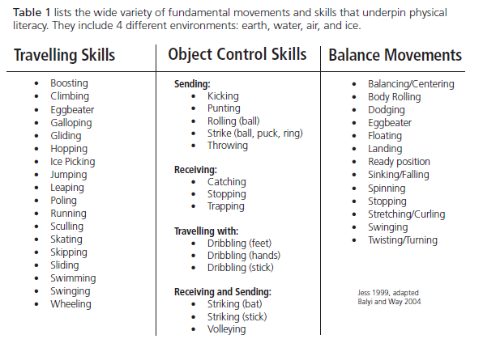
http://www.sasksport.sk.ca/CS4L/pdf/LTAD_ResourcePaper.pdf
Screen clipping taken: 18/02/2010, 16:14

Slide 39
Lateralisation Activities
Ability to control two sides of the body together or separately.
Bilateral movements (Simultaneous or parallel).
Unilateral movements (one side of the body)
Cross lateral movements (Simultaneous movement of different limbs on opposite sides of the body e.g. crawling)
Directional awareness.

Slide 40
Difficulty

Slide 41
Classification of motor skills.
Muscular involvement GROSS – FINE
Environmental influence OPEN – CLOSED
Continuity DESCRETE – SERIAL – CONTINUOUS
Pacing EXTERNALLY PACED – SELF PACED
Difficulty SIMPLE – COMPLEX
Organisation LOW - HIGH

Slide 42
One-Dimensional Classifications
DISTINCTIVENESS OF MOVEMENT
Discrete Serial Continuous

Slide 43
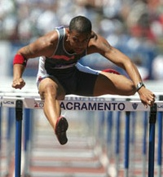
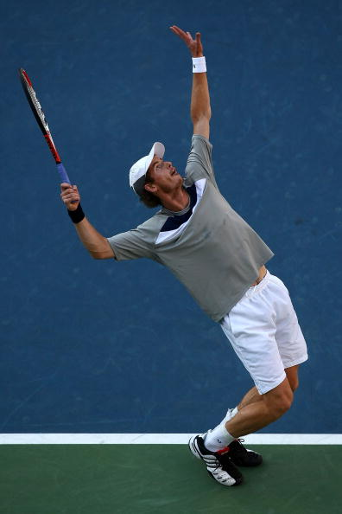
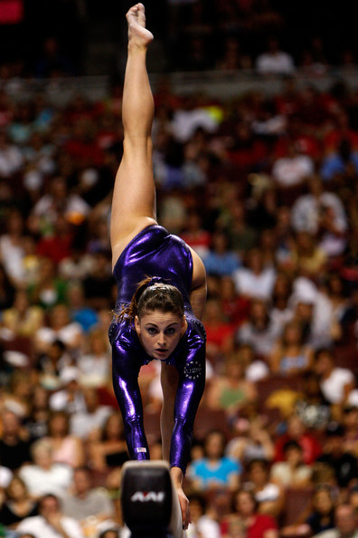
http://www.youtube.com/watch?v=0zou5somI7A
http://www.youtube.com/watch?v=2GFkqD7GBZQ
http://www.youtube.com/watch?v=pms6UggU9Ak&feature=PlayList&p=0C62A686B765E8D6&index=39

Slide 44
Discrete, Continuous and Serial skills:
This classification shows how clearly defined are the start and completion of the movement.
Discrete
A discrete skill has a definite beginning and a end. They are usually performed in one single exertion and would include such skills as a tennis serve, a shot in netball or a tackle in rugby.
Discrete skills are important to sports performances; hitting, kicking, throwing and catching skills make up many of the countries most popular sporting activities.
Continuous
A continuous skill which has no real clear beginning or end and is a constant ongoing action. An example of this is running or swimming.
The end of one action is the start of another, Therefore continuous skills tend to be regular and rhythmical in nature. One important continuous skill is tracking, in which the performer’s limb movements control a lever, a wheel, a handle or some other device to the movements of a target or track.
Serial
serial skills, which are often thought as a group of discrete skills strung together to make up a new, more complicated skilled action.
Serial skills differ from discrete skills in that the movement duration are somewhat longer, yet each movement retains a discrete beginning and end. Serial skills would include a gymnastics floor routine, an ice dance display and the triple jump.

Slide 45
One-Dimensional Classifications
Pace of Movement
Externally Paced Self Paced

Slide 46
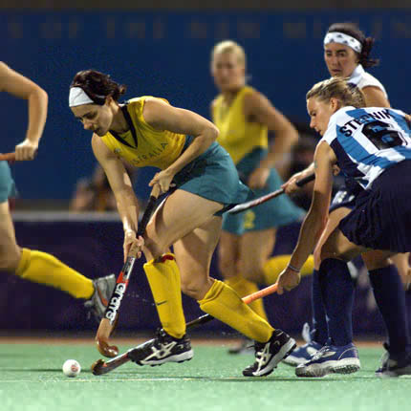
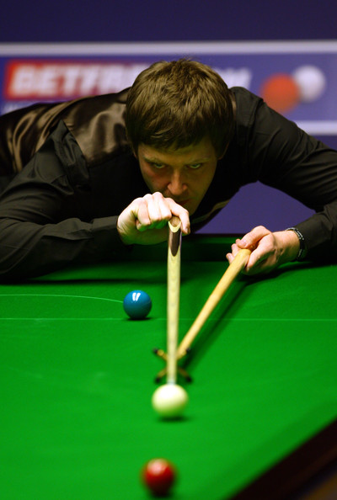
http://www.youtube.com/watch?v=BmddkiaB9rY&feature=related
http://www.youtube.com/watch?v=V1s9oC5ebFs

Slide 47
The Pacing Continuum
The pacing continuum is concerned with the extent to which the performer has control over the timing of the action.
Actions are said to be 'self - paced' or 'externally'. According to the extent to which the performer can decide when to start the action.
Self paced skills
When the performer has control over the timing of the skill.
A badminton player determines the timing of the action of the serve.
High jumper has complete control over when they start to perform the skill.
Externally paced
Skills are when the performer is reliant on the actions of other players and situation to time the skill.
A tennis player facing the server is dependant upon external factors such as when the other player is going to serve the ball, the speed of the ball and the effect of the serve on the ball.

Slide 48
One-Dimensional Classifications
SIZE OF MUSCULATURE INVOLVED
Gross motor Fine motor

Slide 49
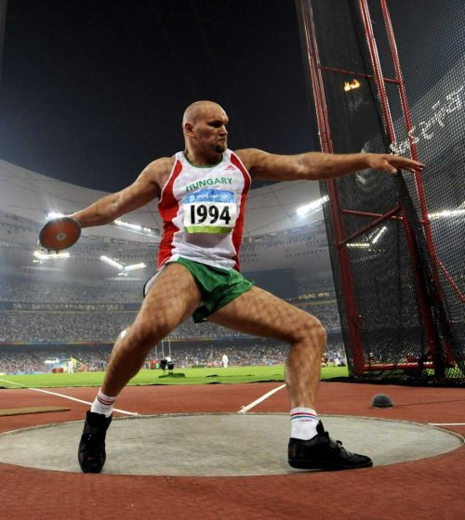
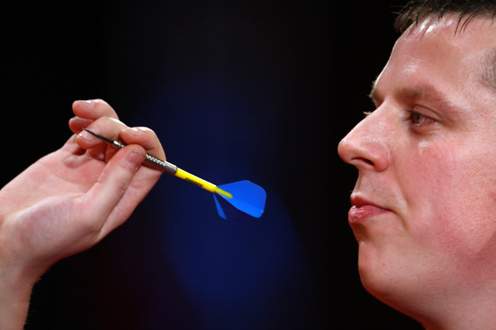
http://www.youtube.com/watch?v=-E0jmXWiccE
http://www.youtube.com/watch?v=AvpwbG3dRFI

Slide 50
Gross and fine skills:
This continuum is based on how much movement or body involvement is involved.
Fine Skills
Involve small movement of specific body parts.
For example; rifle shooting.
Gross skill.
These skills involve large muscle groups and movements of the whole body.
An example of this would be; Long jump. Where you have to run up jump and land.
Mix
Require a bit of both fine and gross skills,
For example a basketball or netball free shot.

Slide 51
One-Dimensional Classifications
STABILITY OF ENVIRONMENT
Closed Open

Slide 52
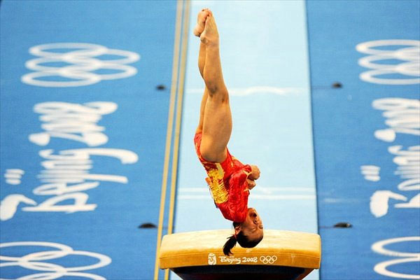
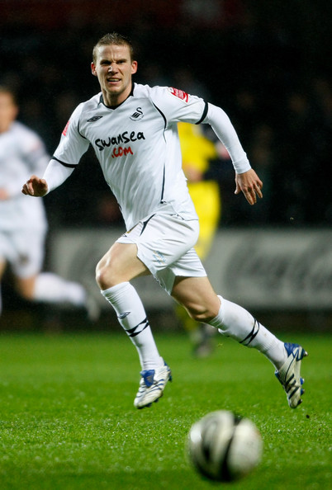
http://www.youtube.com/watch?v=J-XpzkAnhYg&feature=related
http://www.youtube.com/watch?v=KHiAYzr8zb8

Slide 53
Open and Closed skill
An open and closed continuum is based on the predictability of a skill action and can be affected by things such as the weather, surface type and playing against opposition teams where it is difficult to predict the move of that team.
A closed skill is one where the environment is stable, and an open skill is one where the environment is unpredictable.
This classification outlines a specifically important feature for skills, it defines the performers need to respond to moment to moment variations in the environment.
This introduces the process associated with perception, pattern, recognition and decision-making, these processes need to be performed quickly so that the skill action can be adapted for the environment.

Slide 54
Open skills:
Environment is constantly changing
Skill needs constant modification
Needs practice in a range conditions
E.g dribbling in basketball, tackling in football, passing in netball.
Closed skills:
Environment is stable
Skill is predictable
A movement pattern can be established
E.g qymnastics, routine throwing darts, weightlifting.

Slide 55
MOTOR SKILL CONTINUUM
Locomotor
Non Locomotor
Manipulative
GROSS---------------------------------------------------------FINE
OPEN----------------------------------------------------------CLOSE
DISCRETE--------------------SERIAL-----------------------CONTINUOUS
SELF-PACED--------------------------------------------------EXTERNALLY PACED

Slide 56
Assess a skill

Slide 57
MOTOR SKILL CONTINUUM
Locomotor
Non Locomotor
Manipulative
GROSS---------------------------------------------------------FINE
OPEN----------------------------------------------------------CLOSE
DISCRETE--------------------SERIAL-----------------------CONTINUOUS
SELF-PACED--------------------------------------------------EXTERNALLY PACED

Slide 58
Perceptual Motor Abilities
Multilimb coordination
Control precision – ability to make movement adjustments
Response orientation
Reaction time
Speed of arm movement
Rate control – ability to time continuous anticipatory movement
Manual dexterity – ability to make skillful arm-hand movements
Finger dexterity
Arm-hand steadiness
Aiming
Physical Proficiency Abilities
Static strength
Dynamic strength
Explosive strength
Trunk strength
Dynamic flexibility
Gross body coordination
Gross body equilibrium
Stamina

Slide 59
MOTOR SKILL CONTINUUM
Locomotor
Non Locomotor
Manipulative
GROSS---------------------------------------------------------FINE
OPEN----------------------------------------------------------CLOSE
DISCRETE--------------------SERIAL-----------------------CONTINUOUS
SELF-PACED--------------------------------------------------EXTERNALLY PACED

Slide 60
Two-Dimensional Classification
Stationary Motion
No variability Variability
Regulatory conditions
CONTEXT

Slide 61
Batting Tee
Same height
Pitch Machine
Same speed/place
Batting Tee
Various heights
Live Pitch
Stationary
No variability
Stationary
Variability
In Motion
No Variability
In Motion
Variability

Slide 62
Two-Dimensional Classification
FUNCTION
Body Stability Object
Body Transport No Object

Slide 63
Two-Dimensional Classification
Stationary Motion
No variability Variability
Body Stability Object
Body Transport No Object
CONTEXT
FUNCTION

