Slide 1
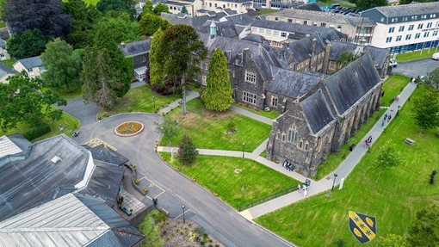
Welcome to…
Ancient History
& Ancient Civilisations

Slide 2
BA Ancient History
BA Ancient Civilisations
BA Ancient History and Archaeology

Slide 3
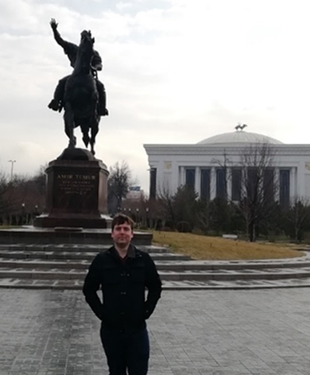
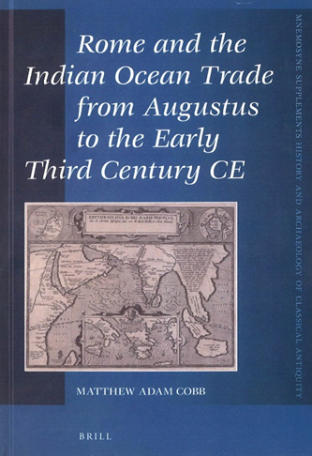
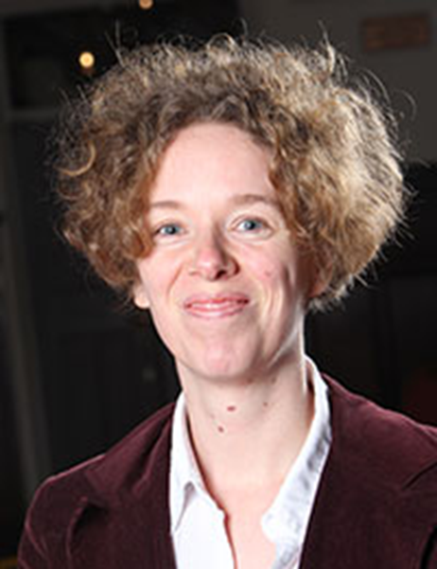
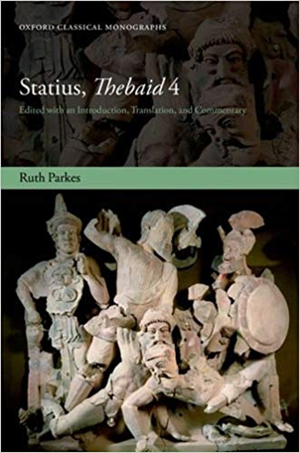
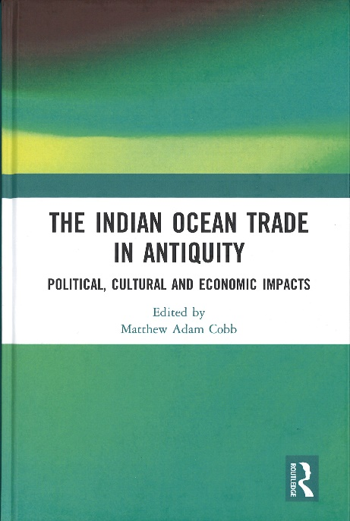
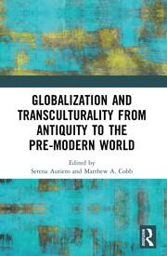
Our staff – learn from experts in the field (1)
Dr Matthew Cobb
Dr Ruth Parkes

Slide 4
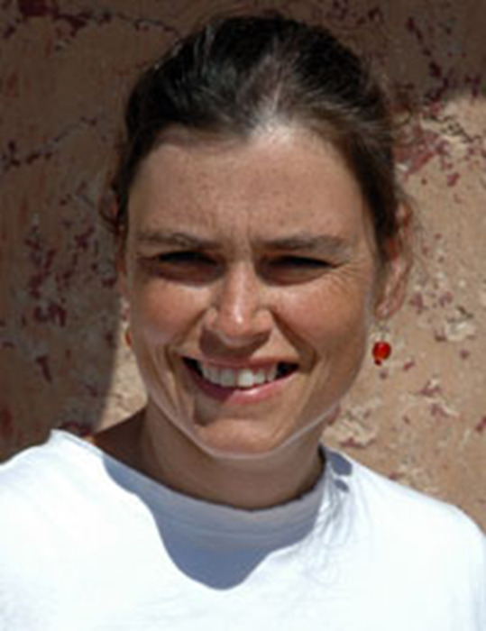
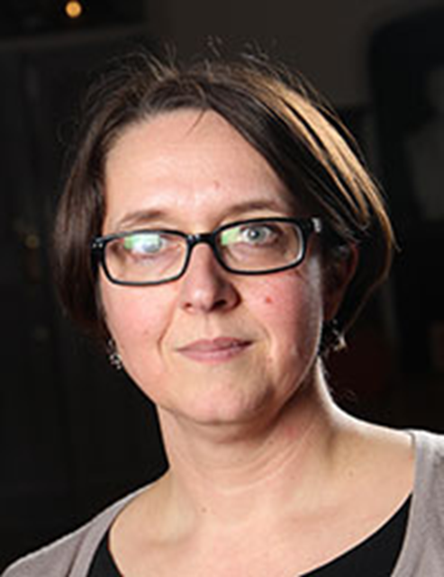
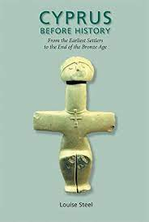
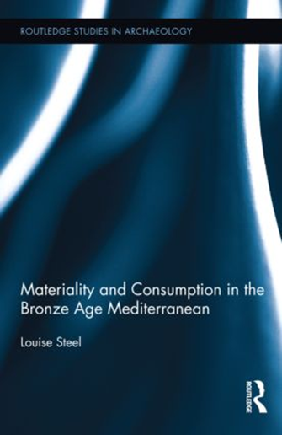
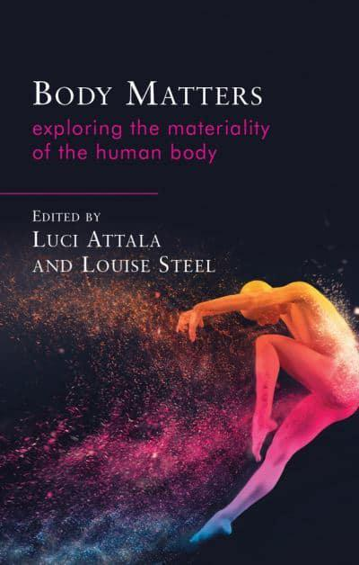
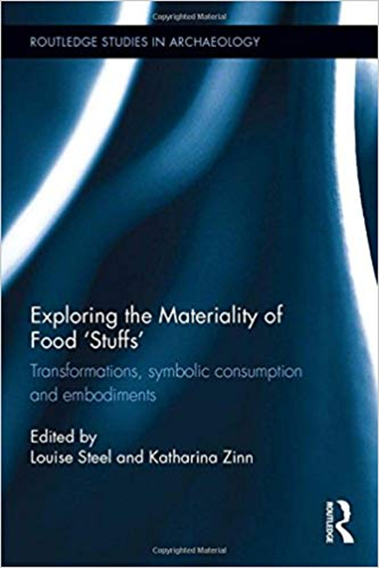
Our Staff – learn from experts in the field (2)
Dr Katharina Zinn
Prof Louise Steel

Slide 5
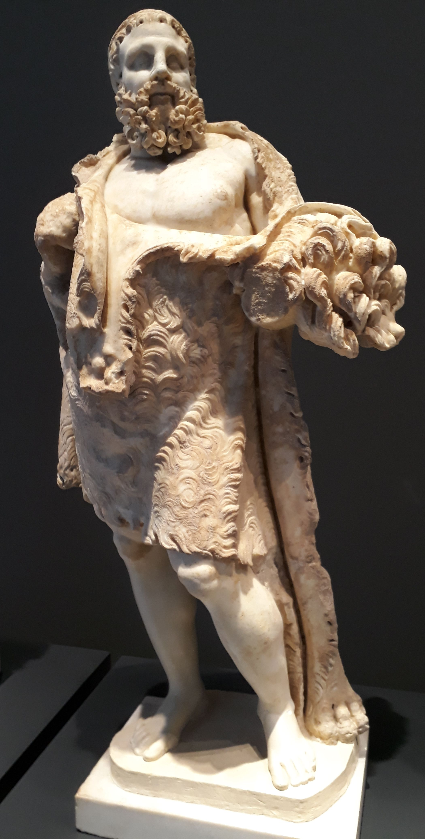
Your subject, in context
Our first year of study includes:
  A dedicated introductory module builds subject-specific skills and methods…
  A range of 1st-year modules taught by subject specialists – including ancient historians/Classicists, archaeologist, and philosophers…
Ancient History | Ancient Civs
Everyday Life in Athens and Rome | What makes civilisation?
Myth and mythology: How Stories Shape the World | From Egypt to the Near East
Ancient Greek Philosophy | Death, Burial and the Afterlife
Among other options!

Slide 6
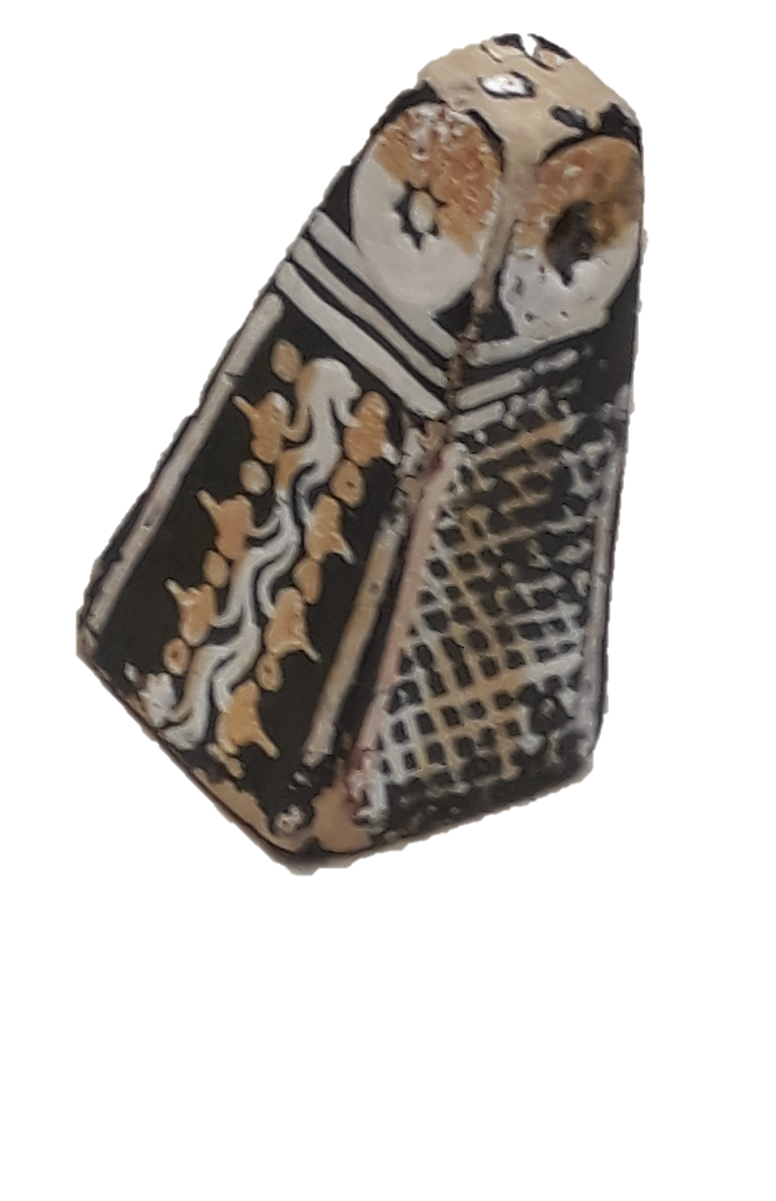
Ancient History: your subject, in depth
Our 2nd and 3rd year allow you to specialise in your selected area of interest
Dedicated modules on the ancient world, its culture and history e.g.
  Pompeii: The life, death and rediscovery of a Roman town
  Rome Transformed: The World of Late Antiquity
  Classical Mythology and Legends in Roman and Medieval Times
  The Life and Times of Caesar and Cicero
  Among others
Ancient History and archaeology
A range of Ancient History and Archaeology modules to choose from.
Opportunities for fieldwork experience.

Slide 7
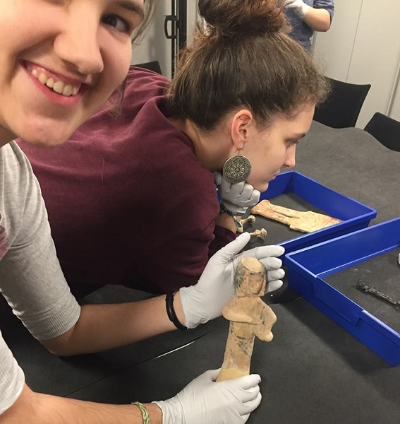
Ancient Civilisations: your subject, in depth
Dedicated modules on diverse ancient civilisations, with a focus on materiality and handling things:
  Ancestors, Death and Burial
  Entanglements: Exploring Interactions Between the Aegean and the Near East
  Exhibiting the Past: Ancient Egypt, death and modern representation
  Households in the Ancient World
  Thinking with Things
  Among others

Slide 8
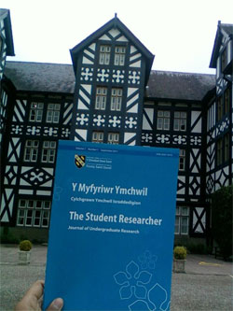
Dissertations
From Monster to Maiden: The Literary and Iconographic Evolution of Medusa.
Cultural Interaction and Cultural Assimilation in Hellenistic Baktria and India.
Rituals, rites, and cosmology of the Bronze Age Yamnaya (3300-2600 BCE): Re-interpreting the material culture of the Yamnaya through burial kurgans and stone stelae across the Pontic-steppes of Ukraine
Research Active Students

Slide 9
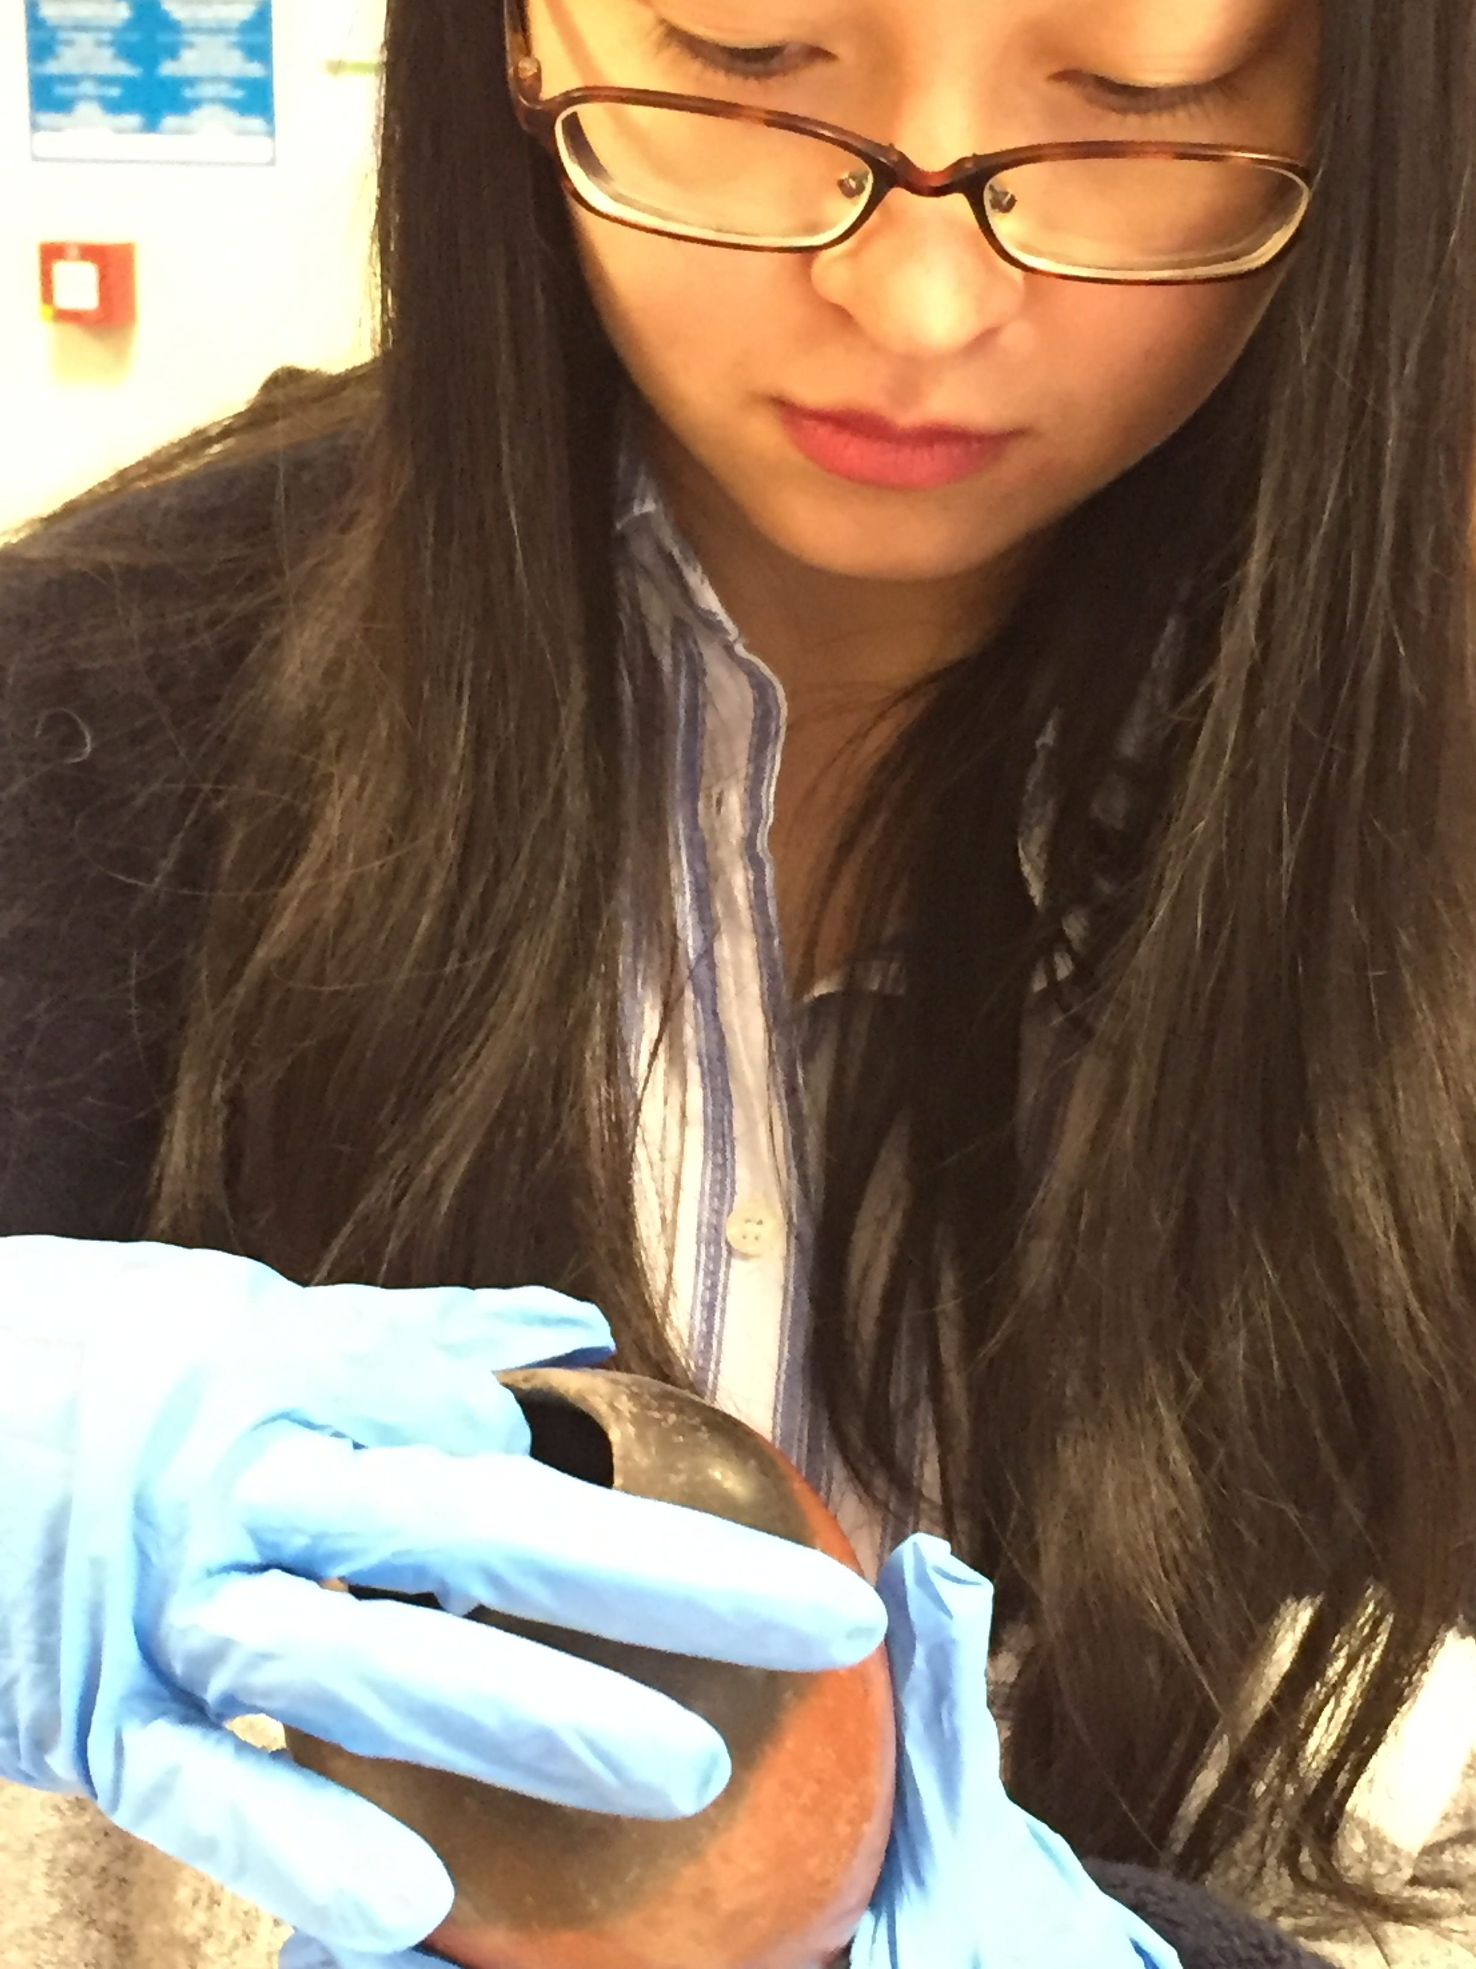
Archaeological and Museum Experience at UWTSD
Opportunity to work on excavations locally: no prior experience needed.
Exhibition work on unpublished Egyptian collection

Slide 10
Block teaching
Six teaching blocks across the year
  Four-week block
    Three weeks of teaching – 12 hours each week.
    Week 4 – as assessment week.
      This can vary for archaeology modules.
One block, one module: sense of completion builds confidence
One block, many ways of working: lectures, seminars, and workshops

Slide 11
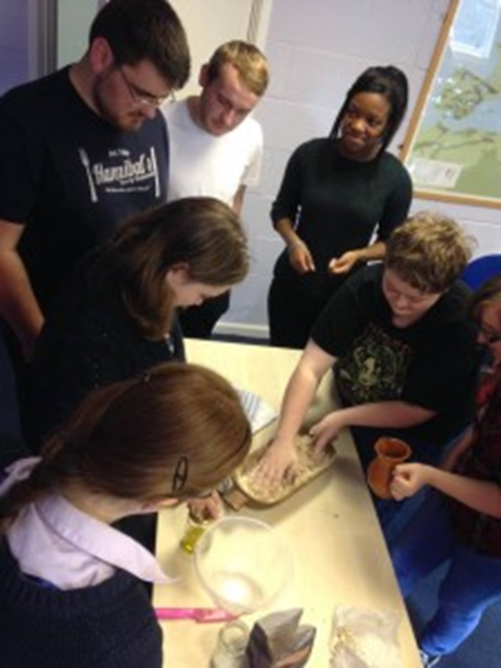
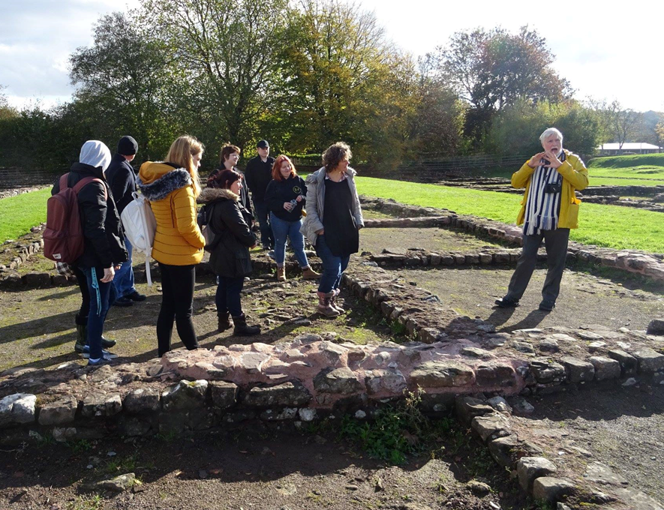
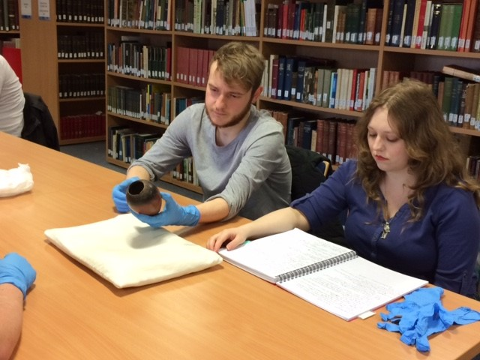
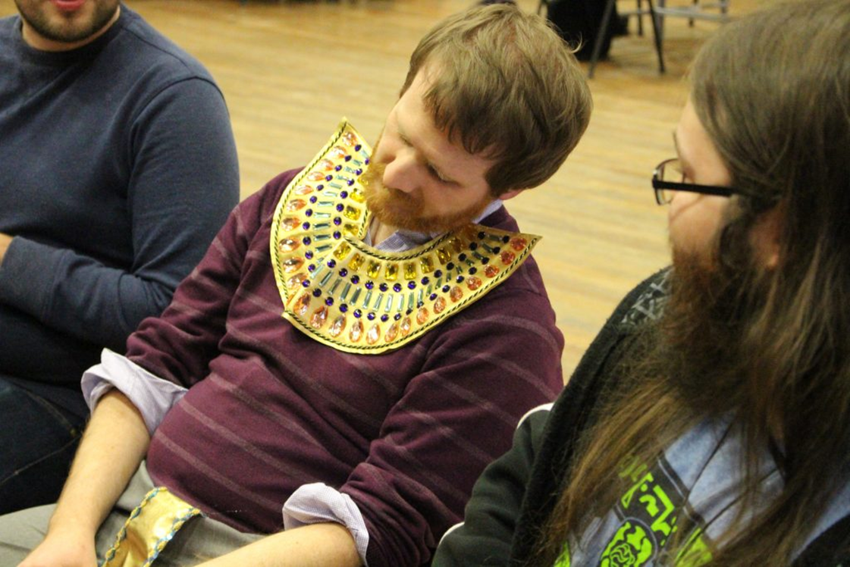
Small classes, big opportunities
Students working with ancient Egyptian objects from the unpublished collection at Cyfarthfa Castle Museum in Merthyr Tydfil
Fieldtrip to Roman Legionary Town of Caerleon
Recreating Minoan Bread
King Ptolemy VI is dead, it appears he was poisoned during the games.
Role-playing module – Courts and Society

Slide 12
“UWTSD Classics students have access to a fantastic range of modules, covering fascinating and often less-well-known aspects of the Classical world; they are taught by dedicated and professional staff.”
BA Classical Civilisation External Examiner’s Report 2018
“The use of online tests for Greek and Latin assessment remains among the best I have seen in the sector”
BA Classics External Examiner’s Report 2020
“Students showed an excellent grasp of theoretical approaches to objects, sites and peoples, and skilfully combined this with more pragmatic archaeological methodologies”
BA Ancient Civilisations External Examiner’s Report 2022
“The variety of skills and knowledge tested is superb.”
BA Classical Civilisation External Examiner’s Report 2020
“I was also impressed with the constructive and bespoke feedback provided by tutors.”
BA Ancient History External Examiner’s Report 2018

