Slide 1
Genetic Algorithms

Slide 2
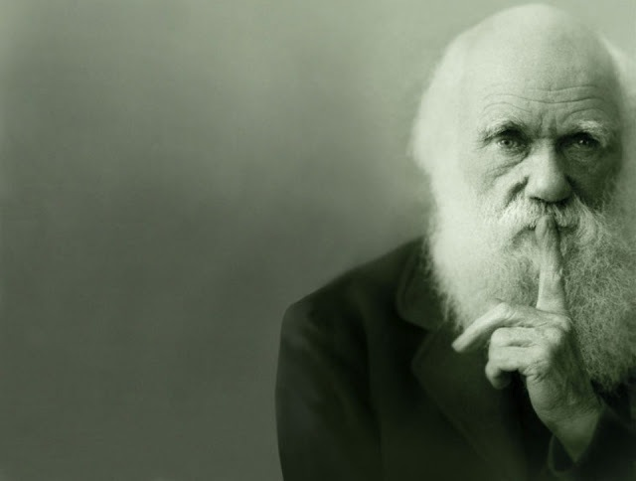
Genetic Algorithms
Inspired by evolutionary theory. In particular, Darwin’s theory of evolution introduced the idea of the selection of the fittest.

Slide 3
Genetic Algorithms:
Genetic Algorithms(GA) are a type of optimization algorithm,
The GA is based on evolutionary theory and genetics,
A population of individuals is created,
These individuals are placed in an environment,
The fittest individuals are selected for preproduction using a “fitness function,”
New offspring are produced from these chosen ones and replace the poorest performing individuals,
This process is repeated a set number of times until a suitable solution is found.

Slide 4
Genetic Algorithms:
Gas are very good at finding good solutions to some “smaller” problems, for example, turbine blades but not complete aeroplanes!
Some early examples are[1]:-
• Adaptive antenna arrays and radar absorbers
• Aero-foil and aircraft geometries
• Analogue filters
• Building heating systems
• Floorplans
• Sizes of gas pipes
• Hydraulic networks
• Microwave absorbing materials
• Satellite Booms

Slide 5
Genetic Algorithms: Kinds of Genetic Algorithms [1]:
Parallel GAs, where multiple processors are used in parallel to run the GA,
Distributed GAs, where multiple populations are separately evolved with few interactions between them,
GAs with niching and speciation, where the population within the GA is segregated into separate ’species,’
Messy GAs (mGA), which use a number of ’exotic’ techniques such as variable-length chromosomes and a two-stage evolution process,
Multiobjective GAs (MOGAs), which allow multiple objectives to be optimised with Gas,
Hybrid GAs (hGAs), where GAs are combined with local search algorithms.

Slide 6
Genetic Algorithms: Kinds of Genetic Algorithms [1]:
• Structured GAs (sGAs), which allow parts of chromosomes to be switched on and off using evolveable ’control genes’
• GAs with diploidy and dominance, which can improve variation and diversity in addition to performance
• Mutation-driven GAs, such as Harvey’s SAGA, which uses converged populations modified primarily by mutation to allow the constant ’incremental evolution’ of new solutions to varying fitness functions.
• GAs with ‘genetic engineering’, which identify beneficial genetic material during evolution and prevent its disruption by the genetic operators

Slide 7
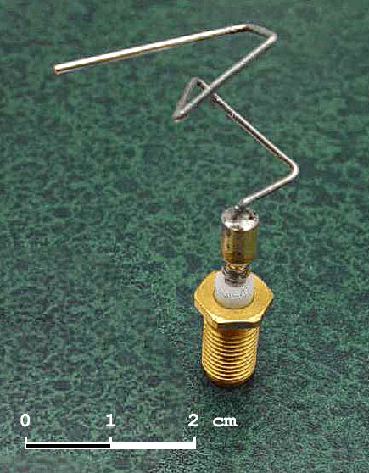
Genetic Algorithms:
GAs are very good at finding good solutions to some “smaller” problems, for example, turbine blades but not complete aeroplanes!
Evolved Coffee Tsble Design [1]
The 2006 NASA ST5 spacecraft antenna.

Slide 8
Genetic Algorithms:
As in genetics the term genotype is used to describe the combination of information which is used to generate the individual.
Typically a genotype is a string of characters describing a structure.
The structure that is described and ultimately built from that genotype is termed the phenotype.
So:
A genotype encodes the phenotype.
Eg, Human DNA encodes a human being.

Slide 9
There are 5 important features od GAs:
A Fitness Function that represents the main requirements of the desired solution (i.e. cheapest price, shortest route, most compact arrangement, etc). This function returns the fitness of an individual.
Individuals of a population are represented as Encodings of possible solutions of a problem. If a solution (an individual) can be divided into a series of small parts/steps (building blocks), then these are represented by genes and a series of genes (a chromosome) encodes the whole solution.

Slide 10
There are 5 important features of GAs:
The Selection operator defines the way individuals in the current population are selected for reproduction. Strategies include roulette wheel, ranking, tournament selection, etc) but typically higher fitness individuals are selected.
Crossover operators define how chromosomes of parents are mixed to obtain genetic codes of their offspring This operator implements the inheritance.
Mutation operator creates random changes in genetic codes of the off spring. This operator is needed to bring some random diversity into the genetic code. In some cases GA cannot find the optimal solution without mutation operator (local maximum problem).

Slide 11
Genetic Algorithms:
A genotype can be represented as an n-ary string. For example if n is 2 we have a binary string:
1 | 1 | 0 | 0 | 1 | 1 | 0 | 1 | 0 | 0
A gene location
Allele: instance of a gene.
Eg: Eye colour is the gene. Alleles are 1=blue eyed, 2=brown eyed.

Slide 12
Genetic Algorithms:
Genetic Operators:
Crossover: One point, two point, uniform
Cut points are chosen at random (2 points in this example).
Chosen cut points
Parent 1 | 1 | 0 | 1 | 1 | 1 | 0 | 1 | 0 | 1 | 1 | 1 | 0 | 1 | 0 | 1 | 0 | 1 | 1
Parent 2 | 0 | 1 | 1 | 0 | 1 | 0 | 1 | 1 | 1 | 0 | 0 | 0 | 0 | 1 | 1 | 1 | 1 | 0
Child 1 | 1 | 0 | 1 | 1 | 1 | 0 | 1 | 1 | 1 | 0 | 0 | 0 | 1 | 0 | 1 | 0 | 1 | 1
Child 2 | 0 | 1 | 1 | 0 | 1 | 0 | 1 | 0 | 1 | 1 | 1 | 0 | 0 | 1 | 1 | 1 | 1 | 0
A uniform cross over is just the swapping of random genes between parents.

Slide 13
Genetic Algorithms:
Genetic Operators:
Mutation:
One gene is randomly chosen (with low probability) and its allele is flipped
Before | 1 | 0 | 1 | 1 | 1 | 0 | 1 | 0 | 1 | 1 | 1 | 0 | 1 | 0 | 1 | 0 | 1 | 1
After | 0 | 1 | 1 | 0 | 1 | 1 | 1 | 1 | 1 | 0 | 0 | 0 | 0 | 1 | 1 | 1 | 1 | 0

Slide 14
Genetic Algorithms:
Terminating Conditions:
A solution is found that satisfies minimum criteria
Fixed number of generations reached
Allocated budget (computation time/money) reached
The highest ranking solution's fitness is reaching or has reached a plateau such that successive iterations no longer produce better results
Manual inspection
Combinations of the above.

Slide 15
Genetic Algorithms:
How to encode a problem?
The answer depends upon the problem. Recall each gene is a building block so try to think in terms of a problem’s components.
The Travelling Sales person problem (TSP) is a good example.

Slide 16
The travelling salesperson problem (TSP)
Given a list of cities and the distances between each pair of cities, what is the shortest possible route that visits each city exactly once and returns to the origin city?
The number of permutations is (n-1)!/2 That is exponential in its complexity.
The problem requires finding the minimum “tour” distance, which is composed of the sum of distances between cities in the tour. So a gene needs to encode the path between a pair of cities.
Given 10 cities, how many genes are required?
Answer : Think about it.

Slide 17
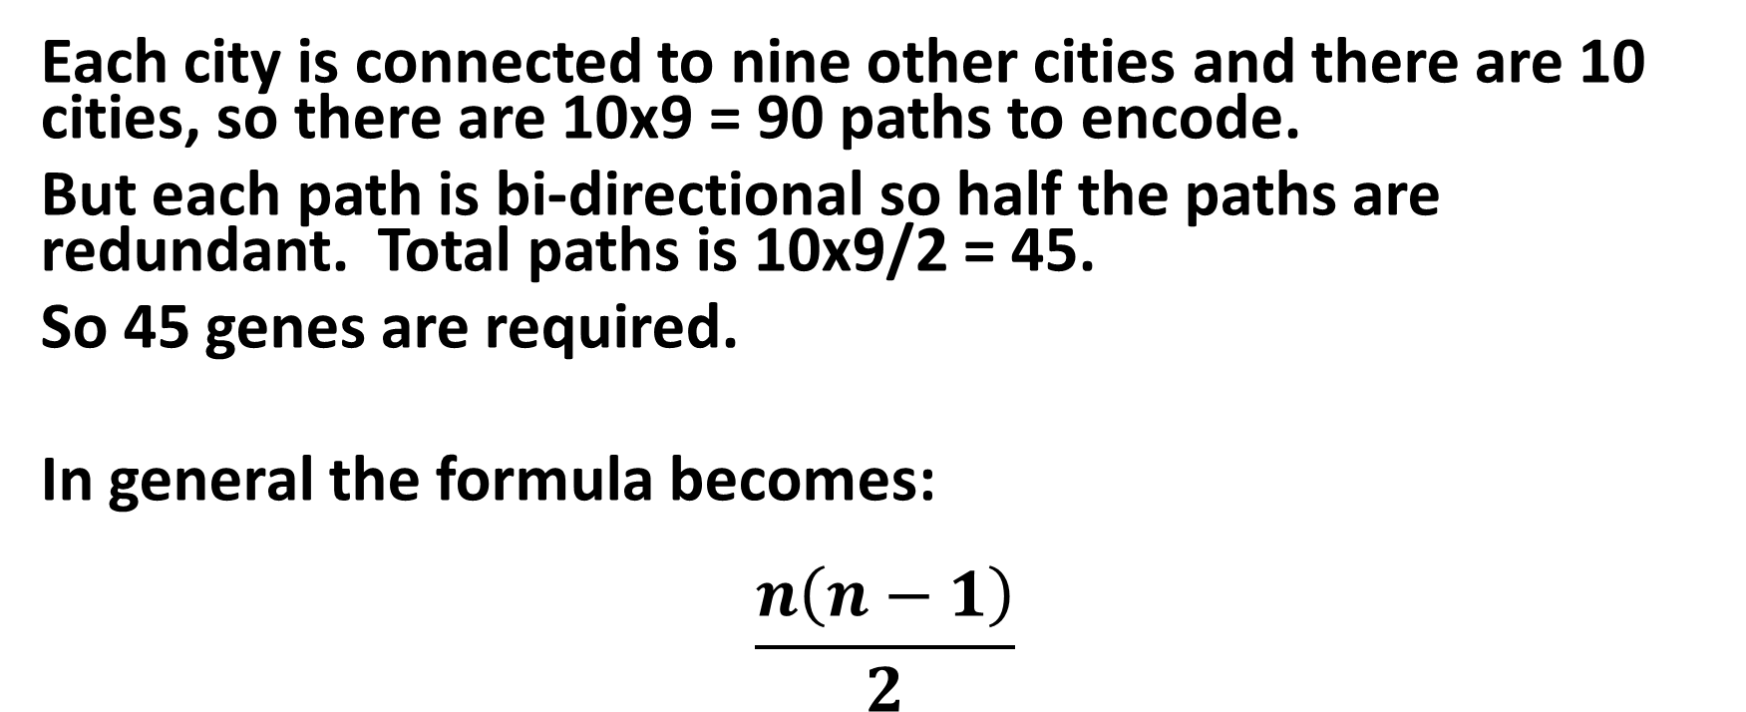
Genetic Algorithms:
Each city is connected to nine other cities and there are 10 cities, so there are 10x9 = 90 paths to encode.
But each path is bi-directional so half the paths are redundant. Total paths is 10x9/2 = 45.
So 45 genes are required.
In general the formula becomes:
$$\frac{n\left(n−1\right)}{2}$$

Slide 18
Fitness Functions
For the TSP we need to find the sum of the city pair distances.
We need to also consider how we order genes as not all chromosomes are going to be valid. The fitness function will need to reject invalid chromosome arrangements.
Sometimes a fitness function might use a mathematical function to assess fitness. Here’s an example:

Slide 19
Fitness Functions
A fixed length chromosome (labelled, x) is composed of 6 genes each representing an algebraic variable q,w,e,r,t and y. The chromosome is represented by the string, x=qwerty. Each variable can be a digit between 0 and 9.
The fitness of an individual is calculated by the function:
f(x)= (q + w) – (e + r) + t – y
If the initial population comprises of 4 individuals:
X1=613347
X2=167864
X3=325667
X4=708542
Evaluate the fitness of each individual and arrange them in order of fitness stating any assumptions you make.

Slide 20
Fitness Functions
Evaluate the fitness of each individual and arrange them in order of fitness stating any assumptions you make.
The fitness of individual x is calculated by the function:
f(x)= (q + w) – (e + r) + t – y
X1=613347
f(x1) = (6 + 1) – (3 + 3) + 4 – 7; f(x1) = -2
X2=167864
f(x2) = (1 + 6) – (7 + 8) + 6 – 4; f(x2) = 10
X3=325667
f(x3) = (3 + 2) – (5 + 6) + 6 – 7; f(x3) = -7
X4=708542
f(x4) = (7 + 0) – (8 + 5) + 4 – 2; f(x4) = -4
Order of fitness is: x2, x1, x4, x3

Slide 21
Fitness Functions
Question:
A fixed length chromosome (labelled, x) is composed of 6 genes each representing an algebraic variable a,b,c,d,e and f. The chromosome is represented by the string of variables, x=abcdef. Each variable can be a digit between 0 and 9.
If the initial population comprises of 4 individuals:
X1=158347
X2=921865
X3=283745
X4=304257

Slide 22
Fitness Functions
X=abcdef
X1=158347
X2=921865
X3=283745
X4=304257
i) Apply a one point crossover operation at the midpoint of pair X1 and X2, and repeat this for the chromosome pair X3 and X4.

Slide 23
Fitness Functions
X=abcdef
X1=158347
X2=921865
X3=283745
X4=304257
ii) The fitness of an individual is calculated by the function:
f(x)= (a + b) - (e + f) - c + d
Evaluate the fitness of each of the offspring in part i) of this question stating any assumptions you make.
iii) What would be the value of the chromosome’s gene alleles if the chromosome had maximum fitness?

Slide 24
The TSP problem revisited
First define the environment. Here there are 20 cities, their position defined by points on a 2D square of dimensions 1 x 1. This means the distance between cities can be found using pythagorus’ theorem.
There are other ways to encode the chromosomes for this problem. Car[3] suggests encoding cities of the tour in the chromosome directly and in their visited order.
c₁-> c₂-> c₃->…-> c_{n} where n = 20

Slide 25
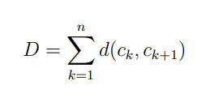
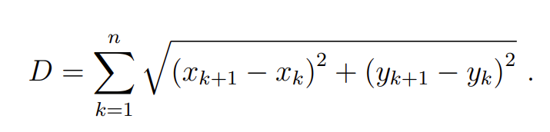
The TSP problem revisited
The fitness function will the total distance of a tour, D where,
and d(c_{k,} c_{k+1}) is the distance between two cities.We aim to minimize D. If cities are represented as (x,y) co-ordinates then D becomes,

Slide 26
The TSP problem revisited
The selection of the fittest chromosomes can be done in several ways.
We define an initial population size – Car uses 20.
We could take the top 10 fittest individuals (the fittest half of the population) but it would be fairer to let the most fit individuals of these 10 candidates appear more often in the following generation.
Typically a probability of selection is attributed to each of the top ten individuals with the most fit having a higher probability of selection than less fit individuals. This has the effect of selecting multiple copies of the most fit individual at the expense of including the least fit of the 10 candidates.

Slide 27
The TSP problem revisited
We set the number of iterations. Here we set it to 10,000 but please see previous slides for other choices.
We apply our chosen crossover operators and include a small amount of mutation.
Run the algorithm multiple times as we don’t know the best solution, a priori.

Slide 28
The TSP problem revisited

Slide 29
The TSP problem revisited
popsize=20
mutrate=0.05
Cities =40
best cost=7.5044
best solution
11 40 3 35 17 25 31 23 1 14 28 34 32 22 30 38 5 29 37 15 20 18 36 2 39 10 4 26 33 6 16 8 21 24 9 12 13 19 27 7
popsize=40
mutrate=0.05
Cities=40
best cost=5.5805
best solution
2 39 13 12 24 9 10 4 26 17 33 35 3 6 40 32 22 34 16 7 11 30 38 28 14 5 29 37 1 23 19 31 25 21 8 27 36 15 20 18

Slide 30
References
Bentley, P.J., “The Revolution of Evolution in Design: From Coffee Tables to Hospitals”, Computer Science, 1999.
Jones,A, “Evolutionary Computing, Notes on Genetic Algorithms,” Cardiff University, 2000.
Car, J, “An Introduction to Genetic Algorithms,” 2014

