Slide 1




Business PLAN
Fusion
Where east meets west
Shazia cousear AYUB : 2008734
Luminita marinela cunescu : 2015625
Alberto Castillo rodriguez : 2020319
Aalia ali raja : 2016494
Nicolae-catalin perca : 2016470
Group :
Lecturer name : dr oluwaseun Adegbite
Module : bmSw4006

Slide 2


Fusion where EAST MEETS WEST
(Unknown, n.d.)

Slide 3
CONTENTS
SUMMARY
Business/COMPANY OVERVIEW
PRUDUCTS AND SERVICES
MARKET AUDIT
  Swot
  Competitors
  Pestel analysis
Target plan
market PLAN
  incentives
  Leaflets
  Implementation Plan
Management TEAM
Financial REPORT
  Cash Flow
  Profit /Loss
conclusion

Slide 4

SUMMARY
This business plan spots the gap in the fashion industry. After pondering upon the idea and observing the clothing sector closely, this report presents a unique idea for a refined product. This plan covers the product with potential of its sustainability, target market, analyses for the factors affecting the business, managerial roles and forecast financial plan.

Slide 5
BUSiNESS / COMPANY OVERVIEW
Legal Structure
Fusion is a shared ownership business in the form of partnership. All profit, loss and liabilities are shared among five partners, irrespective of the nature of their roles and responsibilities.
Fusion’s Vision
Setting a trend of planet friendly choices in clothing sector
Aiming to have recycling points to deter landfill
Repair service for making fashion a conscious choice
Potential for expansion and high street presence
Moving to become a limited company and vat registered business

Slide 6
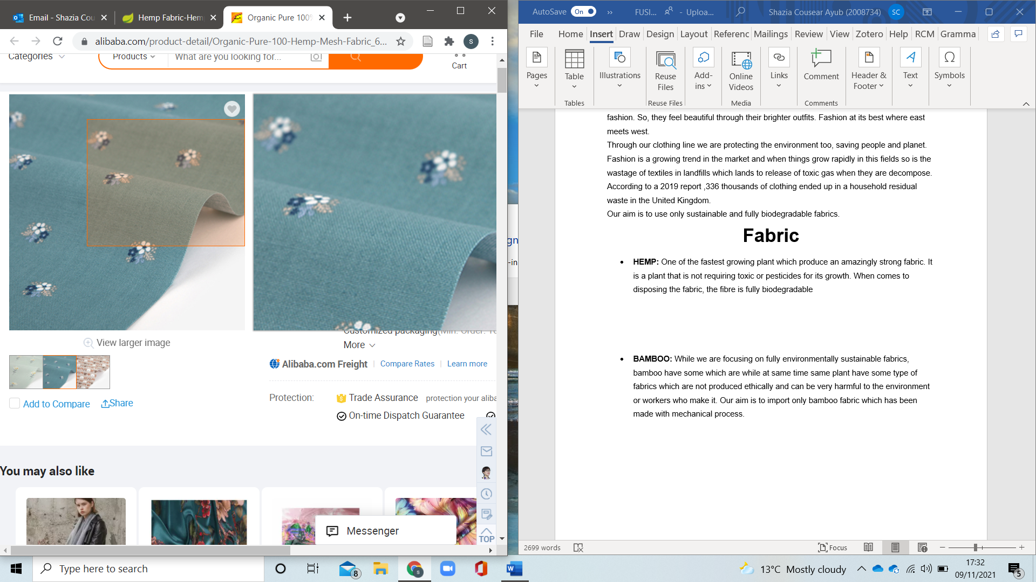
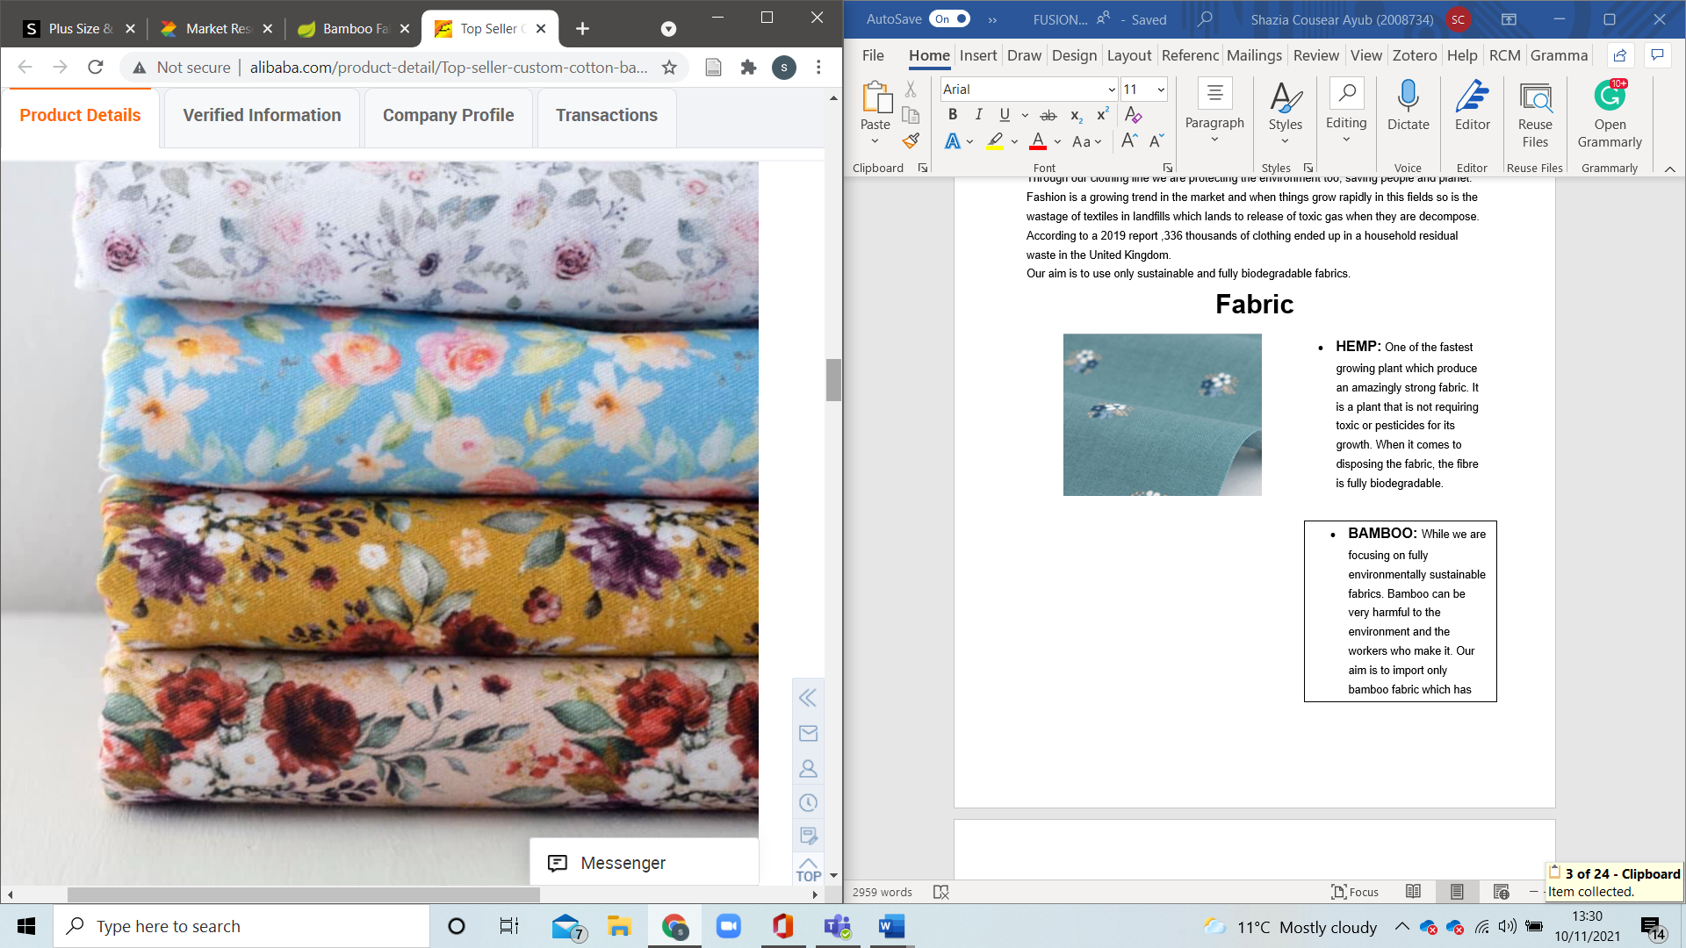
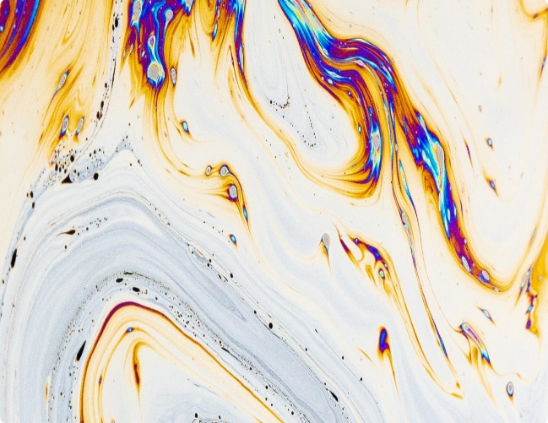
PRODUCT
FABRIC / COLOUR
HEMP: One of the fastest growing plant which produce an amazingly strong fabric. It is a plant that does not require toxics or pesticides for its growth.
BAMBOO: While we are focusing on fully environmentally sustainable fabrics. Bamboo can be very harmful to the environment and the worker who make it. Our aim is to import only bamboo fabric which has been made ethically.
(Alibaba, 2021)
NON-TOXIC dye for colouring fabrics. Great for the eco-system and 68% less water used, no contaminated water which bad for health.
(colorifix, 2021)
Notes:
HEMP: One of the fastest growing plant which produce an amazingly strong fabric. It is a plant that is not requiring toxic or pesticides for its growth. When comes to disposing the fabric, the fibre is fully biodegradable
BAMBOO: While we are focusing on fully environmentally sustainable fabrics, bamboo have some which are while at same time same plant have some type of fabrics which are not produced ethically and can be very harmful to the environment or workers who make it. Our aim is to import only bamboo fabric which has been made with mechanical process

Slide 7
Services
FASHIONABLE MEN AND WOMENS CLOTHING LIGHT BIODEGRADEABLE
What makes us special?
Unique material that’s super comfy biodegradable
What are we selling?
Clothes that make the world a brighter, colourful place with an Asian mix
What service do we offer?
Cost effective, contribution to efficiency and sustainability in the fashion world
Non-toxic dye

Slide 8
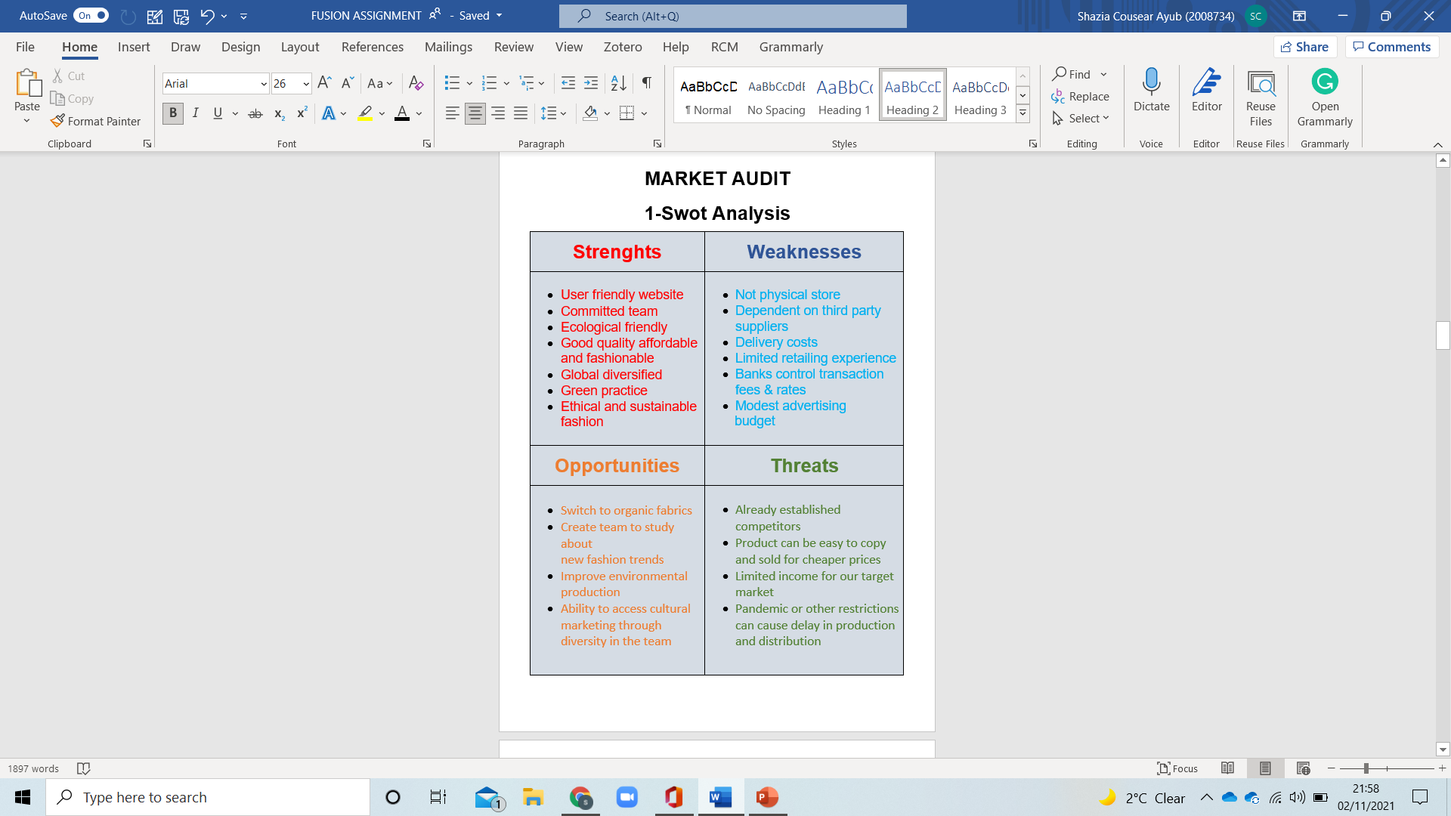
Swot
Analysis
MARKET AUDIT

Slide 9
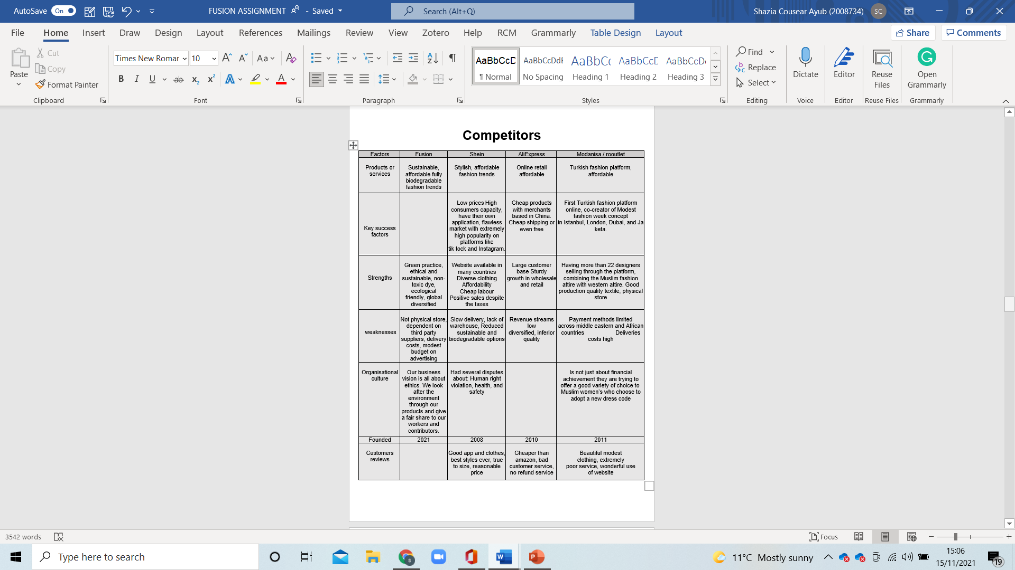
Competitors

Slide 10
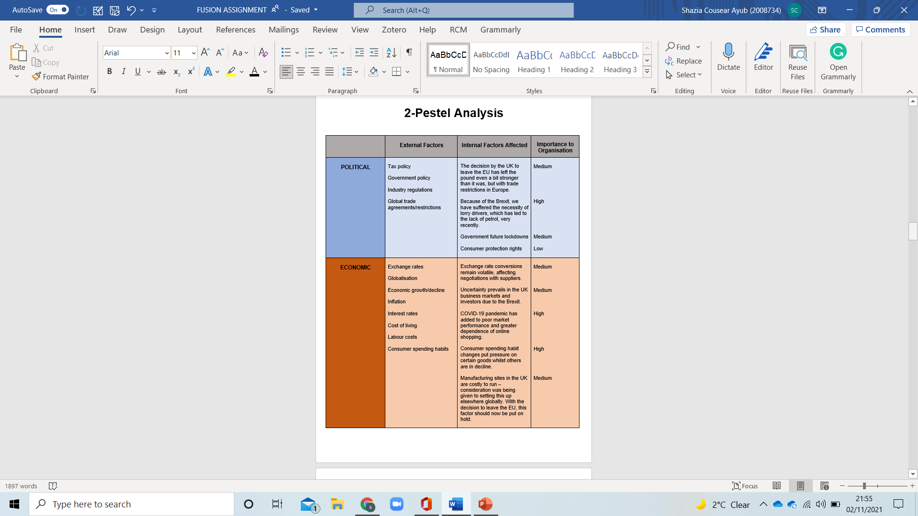
Pestel
Analysis

Slide 11
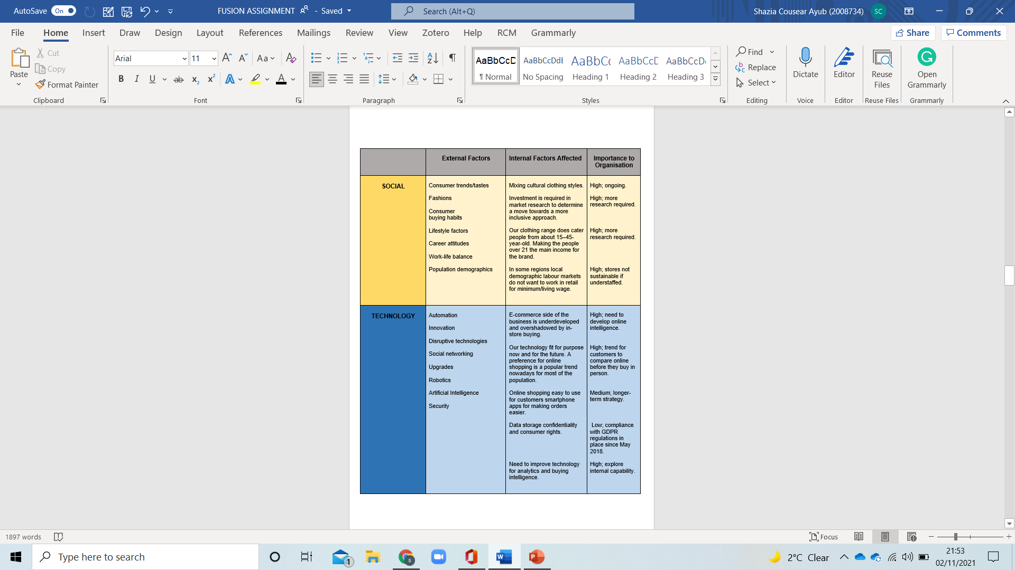
Pestel
Analysis

Slide 12
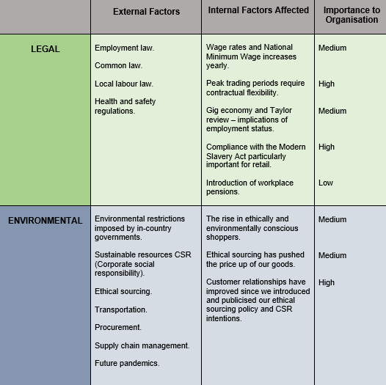
Pestel
Analysis

Slide 13

TARGET MARKET
Notes:
“Target market segments are the (a) ability to reach byers in the market, (b) competitive positioning are the (c) ability to reach buyers in the market, (d) compatibility of the market with the objectives and resources of the company, (e) profitability, and (f) expected market growth.” (Robert Mora Cortez, 2021) . Our target market is 21+ the younger outgoing working class, while we do not discriminate and anyone is welcome to buy regardless of race, age or gender.

Slide 14
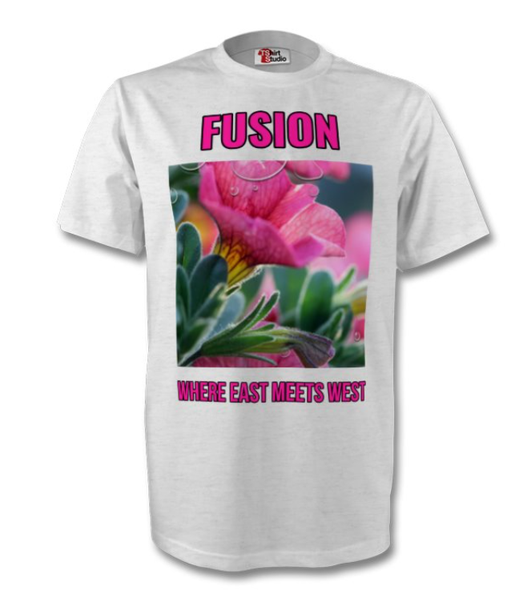
MARKET PLAN
Incentives
SPEND £100 GET
FREE T-SHIRT
Promotion | Advertising
Spend £100 or over receive a free T-Shirt In app offers sign up to get discounts Answer surveys get a 10% Discount Sending loyal customers offers to encourage to purchase again Spread the cost interest free Free delivery on orders over £60 Keeping prices lower than competitors | Distribution of leaflets in a few different areas Using free advertising on platforms like social media (Instagram, Facebook,) Paying for advertising on tv/radio at peak times pop-up ads on YouTube, Google, Gumtree, Shpock, Ebay
Notes:
Marketing strategies, tactics, and measurements should be aligned with the needs and behaviours of consumers at each of the decision journey stages. This pushes the customer decision journey beyond abstraction and into the world of practical application-the world of digital marketing analytics”. (Matthew D. Vollrath, 2021)
Planning a selling strategy to get ahead of the competition giving offers like free T-Shirt, posting colourful leaflets and money off offers.
Many companies only supply non-degradable products or use materials that are not anti-allergy, like polyester. Even the ones that have a line of clothing like this use cheap material producing low quality and have high prices. Our aim is to keep prices lower than the competition produce better quality, vibrant, fashionable clothes that will give us the edge in the market.

Slide 15
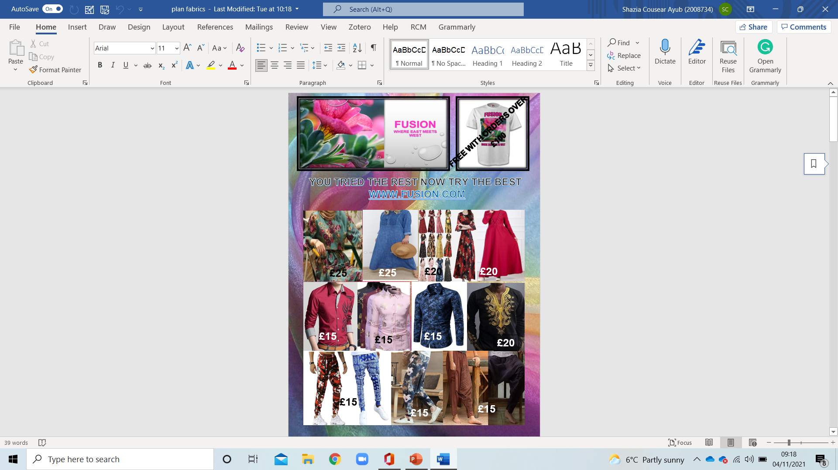
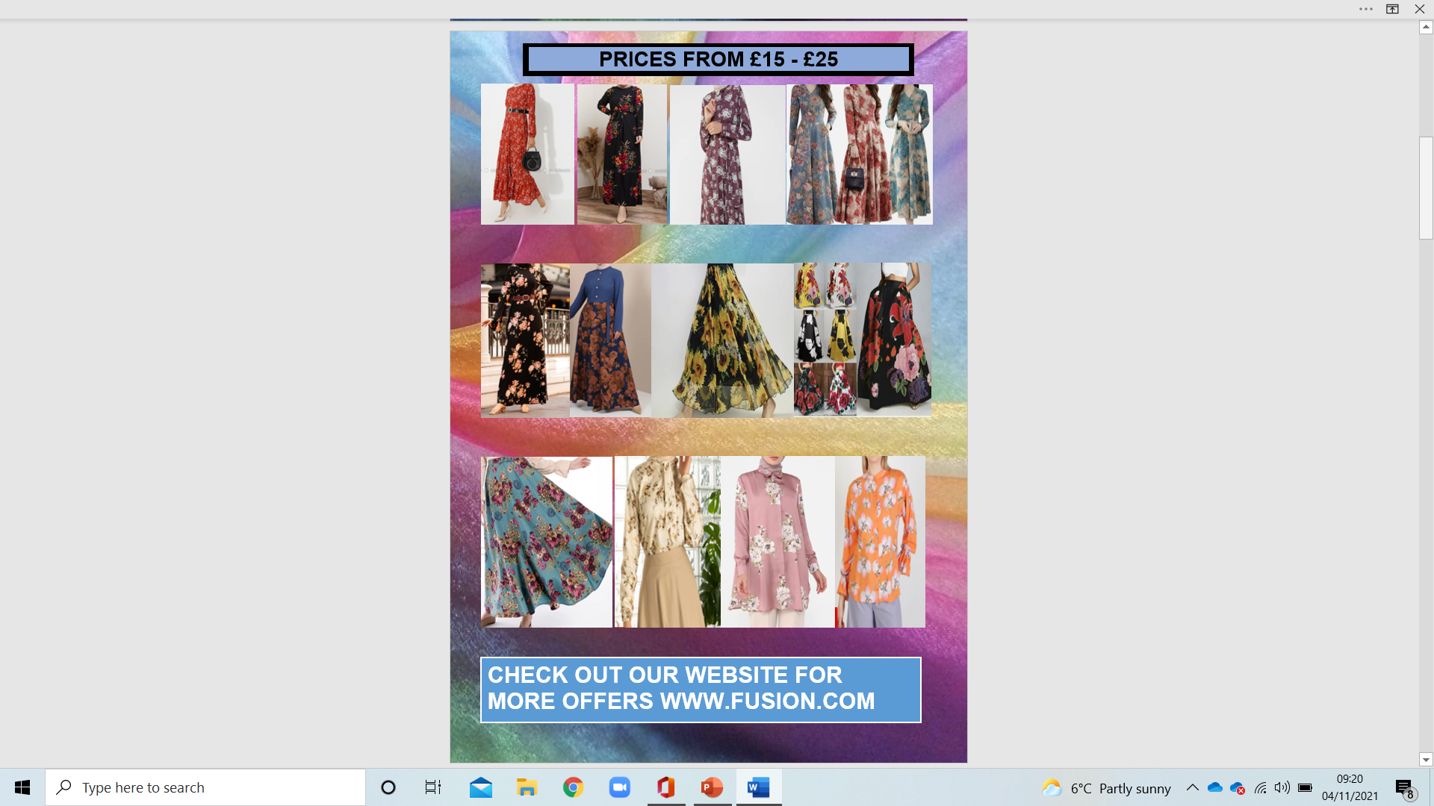
Leaflet

Slide 16
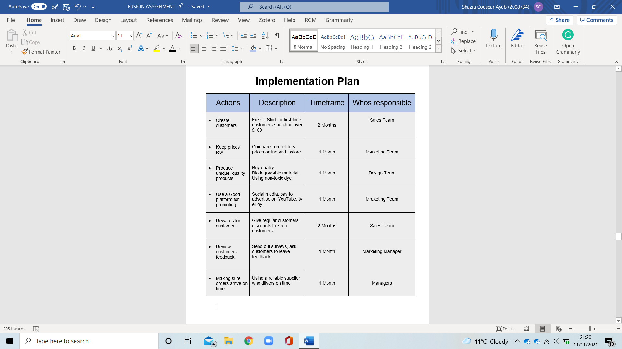

Slide 17
MANAGEMENT TEAM
Luminita Marinela – sales manager
Aalia ali raja – clothing designer
Shazia cousear ayub – marketing manager
Nicolae-catalin – accountant
Alberto castillo - supervisor

Slide 18
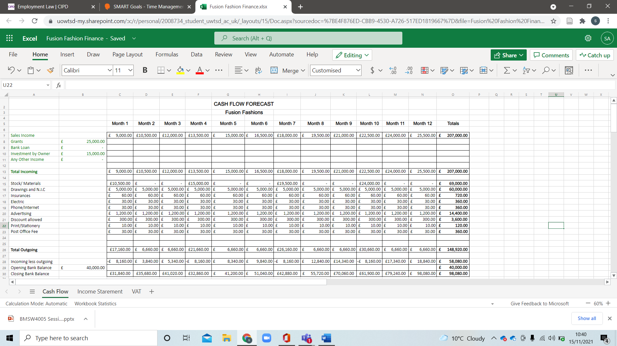
FINANCIAL REPORT

Slide 19
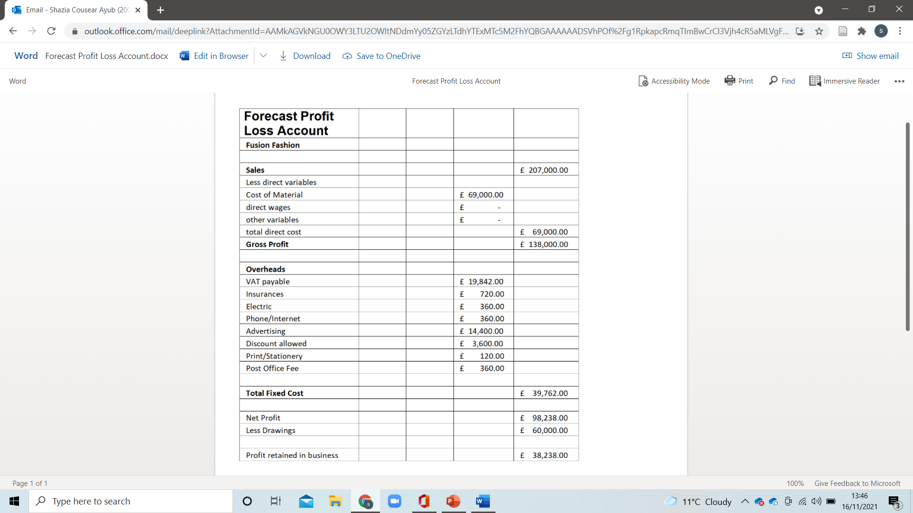
Profit/Loss

Slide 20
CONCLUSION
-Product gives us a key place in the market
-Internal and External factors are considered in detail
-Attractive and targeted advertising plan
-Financial Forecast reports to confirm its profit generating capacity

Slide 21
REFERENCE
Alibaba, 2021. Organic Pure 100% hemp mesh fabric jersey- buy organic. [Online]
Available at: https://www.alibaba.com/product-detail/Organic-Pure-100-Hemp-Mesh-Fabric_60739892747.html?spm=a2700.galleryofferlist.normal_offer.d_image.2f9326e8rBDNUb
Circular, 2020 UK named fourth largest textile waste producer in Europe Available at: https://www.circularonline.co.uk/news/uk-named-fourth-largest-textile-waste-producer-in-europe/
(Accessed: 04 November 2021)
colorifix, 2021. Our Impact - colorifix. [Online]
Available at: https://colorifix.com/why-colorifix/
[Accessed 09 11 2021].
(Accessed: 04 November 2021)
Lightinthebox, n.d. Lightinthebox. [Online]
[Accessed 31https://www.lightinthebox.com/c/men-s-clothing_5585/2.html?prm=1.2.58.0#prodSortBar October 2021].
Matthew D. Vollrath, S. G. V., 2021. Avoiding digital marketing analytics myopia: revisiting the customer decision journey as a strategic marketing framework. Journal of Marketing Analytics (2021), Issue https://doi.org/10.1057/s41270-020-00098-0, p. 1.
Mogilireddy, V., 2018. Sustainable dyeing innovations: Greener ways to colour textiles. [Online]
Available at: https://www.prescouter.com/2018/11/sustainable-dyeing-innovations-greener-ways-color-textiles/
[Accessed 09 11 2021].
Ebay, n.d. eBay. [Online]
Available at: https.//www.ebay.co.uk
[Accessed 31 October 2021].
Famous Fashion Designers, (n.d), Elsa Schiaparelli, Available at: https://www.famousfashiondesigners.org/elsa-schiaparelli

Slide 22
Mondanisa, 2021. Mondanisa. [Online]
Available at: https://www.modanisa.com/en/plus-size-dresses.htm
[Accessed 2021 October 2021].
My Therapy, 2017. Depression in the UK: The facts and figures you should know. Available at: https://www.mytherapyapp.com/blog/overcome-depression-uk-infographic-2017#:~:text=Depression%2C%20anxiety%20or%20phobias%20%E2%80%93%20each%20year%2C%201,this%20mental%20disorder%2C%20and%20that%20number%20is%20increasing.
(Accessed: 04 November 2021)
NICABM- National Institute for the Clinical Application of Behavioural Medicine, Depression: The Connection between Colour Perception and Mood, Available at: https://www.nicabm.com/depression-the-connection-between-color-perception-and-mood/
(Accessed: 04 November 2021)
Robert Mora Cortez, A. H. C. P. V. F., 2021. B2B market segmentation: A systematic review and research agenda. Journal of Business Research, 126(2), p. 422.
Unknown, n.d. live.staticflickr.com. [Online]
Available at: https://live.staticflickr.com/3385/3582897494_3f5eeea575.jpg
[Accessed 21 oct 2021].
Vogue, 2017. Elsa Schiaparelli’s Closet is up for grabs this Paris Fashion Week
Available at: https://www.vogue.com/article/designer-elsa-schiaparelli-vintage-clothing-for-sale
(Accessed: 04 November 2021)
UK Integrated Online Tariff, (2021) Geographical area 2027-GSP-Enhanced Framework
Available at: https://www.trade-tariff.service.gov.uk/geographical_areas/2027?country=PK
Accessed on (13 November 2021)
ro.outlet, 2020. ro.outlet. [Online]
Available at: https://ro.outletshop2021.ru/category?name=bluza%20barbati%20camasa
[Accessed 31 October 2021].

