Slide 1
CELEBRITY
ENDORSEMENTS
IN MARKETING

Slide 2





WHAT IS IT
A marketing strategy where a company uses a familiar face to endorse their product or service
Mainly done through commercials or social media platforms
The goal is to transfer the star’s positive image onto what is being endorsed
Any scandal the star could face, will reflect onto the brands image
Will be extremely pricey for the company to find and hold an A list celebrity for their campaign
Notes:
Celebrity endorsements in marketing is a method where companies or brands will use a widely familiar face to endorse their product or service. Companies use something called Meaning Transfer, a model created by Gillian McCracken in the late 80s. They use this in the hopes that the star’s personality and positive image will transfer onto whatever it is they are endorsing. The main method companies reach audiences are through commercials or social media platforms, as this is where Millennials and Gen Z are most likely to be on, and these are the demographics they want to target the most. Some of the main issues of this approach is the extreme cost of hiring and keeping an A list celeb for their marketing campaign, it takes away money from other sections of the business such as innovation or other marketing campaigns. Another issue is if the star faces a public scandal, it will instantly reflect onto the business and could worsen the image of the business, even more so if the company refuses to cut ties with the star after.

Slide 3




WHY IT MATTERS
The use of a familiar face is instantly recognisable
Differentiation from competition, tying a famous face to a company/brand helps them differentiate from others
Helps build brand equity with long term partnerships like Nike with Michael Jordan
The use of someone famous helps brand recall, making it more likely for viewers to remember the brand or company
Notes:
The use of a recognisable face such as Ryan Reynolds for Mint Mobile, helps users recall the brand every time they see their face, even if its on another brand or companies advert. It also helps give brands give a one up over competition in their field, such as Nike who have built a major reputation for Michael Jordan over the last 40 years, compared to other sport brands like Puma or Adidas who don’t have as rememberable celebrities. In addition to aiding brand recall and an edge over the competition it helps build major equity, if done successfully. A prime example is Air Jordan, making $7 billion alone in 2024.

Slide 4
EXAMPLES
OF CELEBRITIES
IN MARKETING
(THE GOOD AND BAD)

Slide 5
THE GOOD

Slide 6
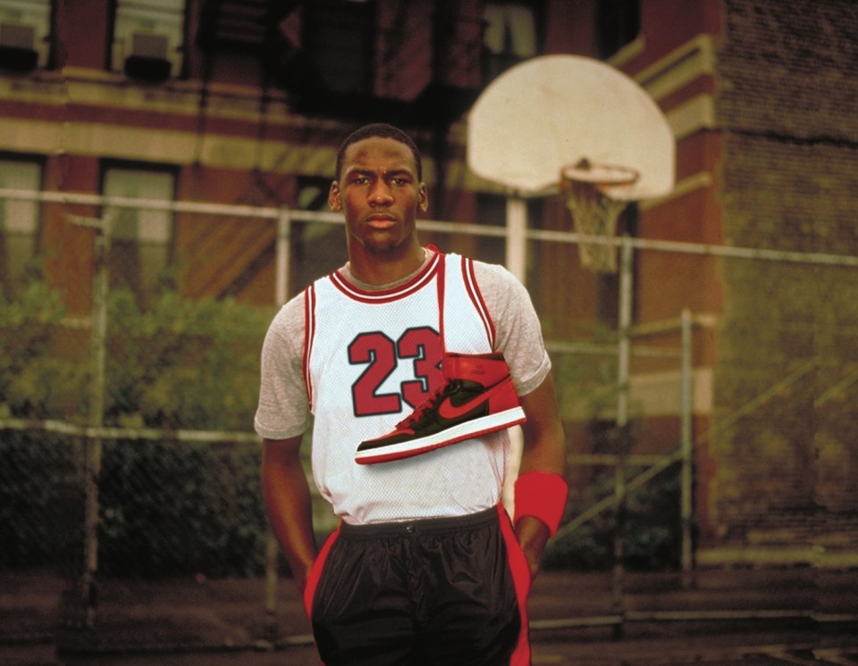
MICHAEL JORDAN NIKE DEAL
Signed in 1984, Michael Jordan signed a 5-year, $2.5 million deal establishing the Air Jordan brand. It generated $100 million in its first year. It eventually led to becoming a billion-dollar brand within Nike, generating millions every year for the company
Notes:
In 1984 Nike signed Michael Jordan to them quickly after he signed onto the Chicago Bulls. During this time Nike was a struggling basketball shoe brand, significantly behind other competitors Adidas and Converse, Michael Jordan himself preferred Adidas at the time and could have possibly signed onto them, had the offer arose. Nike took the gamble and put in their entire basketball marketing budget into Jordan. Jordans parents themselves played a massive role into the creation of the shoe, aiding him to listen to Nike’s pitches, of which Nike offered him a massive $2.5 million deal, which was never seen before for a rookie, Jordan’s mother herself negotiated Michael get a share of the revenue of Jordan shoes sold.

Slide 7
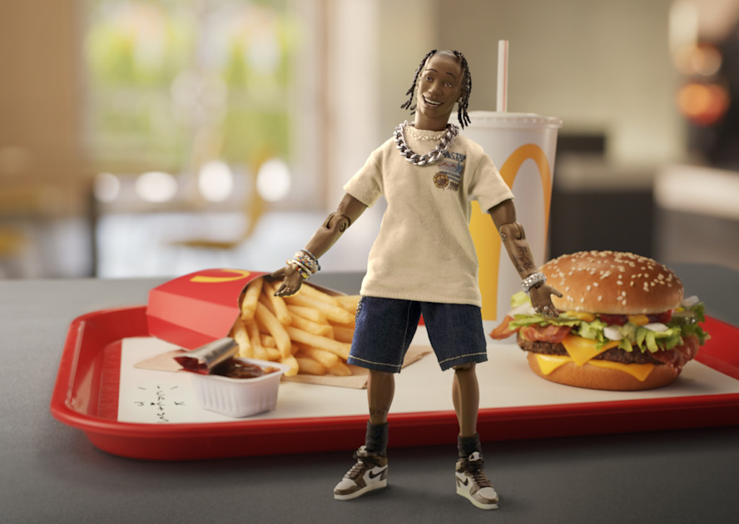
TRAVIS SCOTT MEAL
The Travis Scott McDonald’s collab was one of the first celebrity meals in many decades. The meal was a major success, especially in younger audiences, primarily because of Travis Scott’s extreme presence in Gen Z audiences.
The campaign cause widespread stock shortages as well as drove significant sales
Notes:
The 2020 release of McDonald’s collab with Travis Scott was met with major success, especially in Gen Z audiences due to several factors. Travis Scott’s music is majorly successful in young audiences, so when it released it sparked a major response from their demographic. Online videos on social media platforms like TikTok spiked, further creating more exposure for the meal, causing stock levels to drop across America.

Slide 8
THE BAD

Slide 9
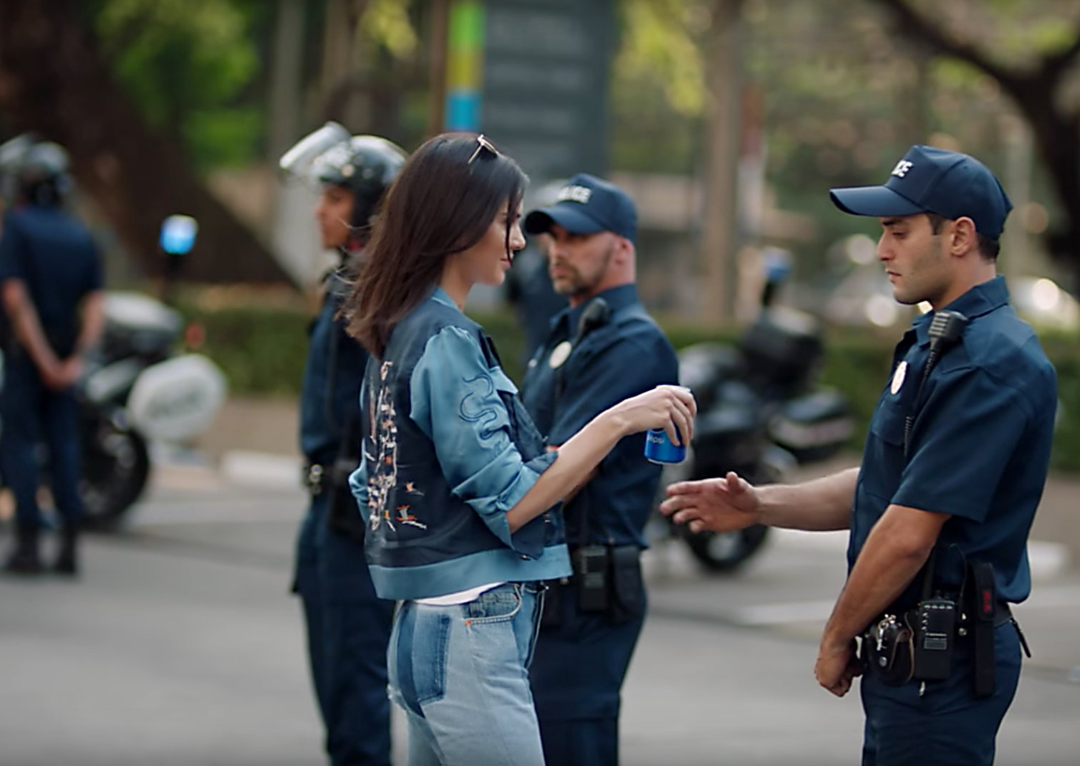
KENDALL JENNER PEPSI
In 2017 Pepsi released an AD featuring Kendall Jenner handing a Pepsi can over to a police officer amidst a BLM protest.
The AD was seen as tone deaf and culturally insensitive implying the issues BLM faced could be simply solved.
Notes:
In 2017 Pepsi released an AD featuring Kendall Jenner amidst a BLM protest and fixing the issues ongoing. After releasing the AD, Pepsi immediately faced backlash and fierce feedback online, prompting them to pull the AD from the internet but not before it was downloaded and reposted by thousands of people. People believed that the message of simply handling a pepsi can to a police officer and all the issues being resolved diminished the real world social and political issues BLM faced with police brutality, the use of a famous white supermodel didn’t help pepsi’s case either.

Slide 10
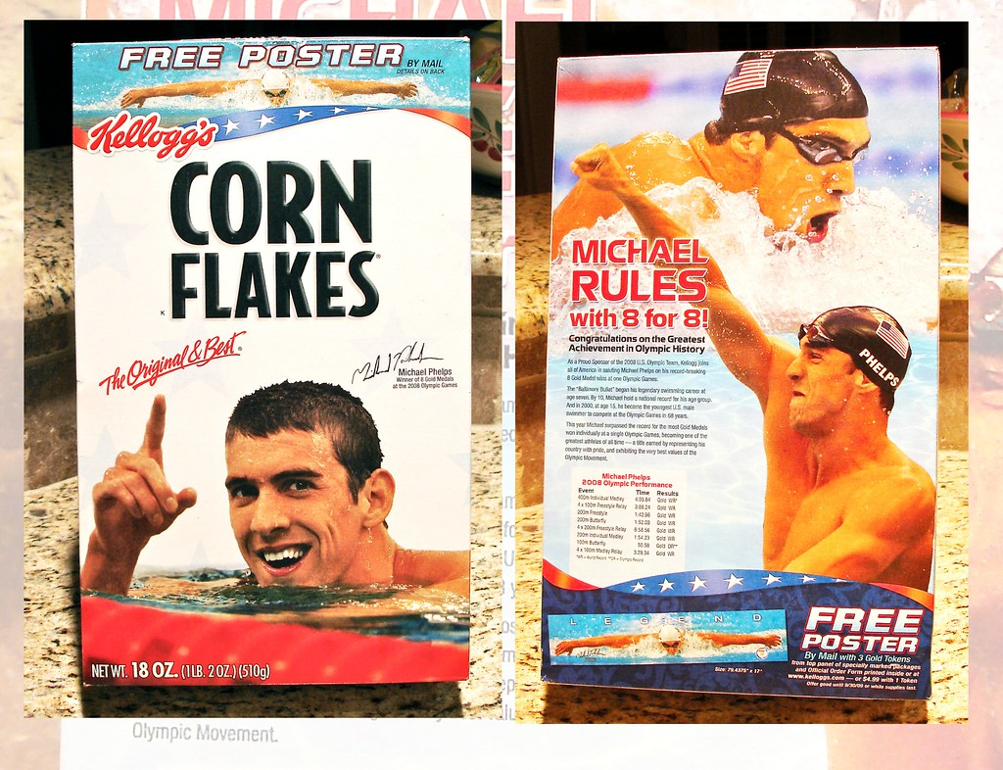
MICHAEL PHELPS KELLOGS
In 2009 a photo was published by a British Tabloid posted a photo of Michael Phelps inhaling a marijuana pipe, prompting brands tied with him to drop him almost immediately.
Michael Phelps was one of America’s “Golden Boys” , a perfect poster boy for Kellog's as they aimed to target a young demographic
Notes:
In 2009, after Phelps had won a record breaking 8 gold medals at the 2008 Beijing Olympics, Kellogs quickly signed him on to be a major face of their brand. However, after a photo published by a British Tabloid, News of the World, of Phelps smoking a marijuana pipe, all brands associated with him promptly dropped him, his biggest being Kellog’s. Being a cereal, their main demographic being children and having their main brand image being associated with drugs, they dropped him immediately. After the incident Phelps issued a public apology for the incident stating “his actions to be regrettable and demonstrating bad judgement”. On top of the financial set back of losing Kellog’s endorsement, USA Swimming penalised Phelps by withdrawing financial support and suspending him from competitions for 3 months.

Slide 11



CONCLUSION
Celebrity endorsements are vital in today’s modern age; it helps brands reach broader demographics and aid in brand recall and potential high return on profit
Companies must be careful when choosing their star to endorse their product or service, if the celebrity’s own values don’t align with the company it can seem disingenuous
Many companies nowadays use stars to endorse their product, so it is beginning to become highly saturated. Audiences, especially young ones, prefer new and smart marketing campaigns over just using a famous face
Notes:
Overall, using celebrities to endorse products or services is an extremely effective way for companies or brands to endorse their products or services because of the familiar face consumers see on the advertisement. However, even though it is effective, companies must be extremely careful when choosing the star. If they choose the wrong celebrity and their values don’t align with the company, consumer’s will see this as disingenuous and that the star is only doing it for a quick paycheck, in turn it lowers a brands image to consumers. Nowadays many companies use celebrities to endorse them, that it is starting to become saturated to consumers. Audiences, particularly those in younger generations, would prefer newer and fresher marketing campaigns over just using a famous face.

Slide 12
REFERENCES
Dwivedi, A. and Johnson, L. (2013) 'CELEBRITY ENDORSEMENT AND IT'S EFFECTIVENESS: A LITERATURE REVIEW', Journal of Modern Management & Entrepreneurship
Laddha, M.S. (2025) 'Celebrity Endorsement: Exploring the Effects of Celebrity Attractiveness & Credibility on Ad-Recall & Purchase Intention', Advances in Consumer Research
Lu, G. (2023) Michael Jordan's Nike Contract: The Richest Athlete Endorsement Deal In History
PR News (2025) The Fiasco of Pepsi's Kendall Jenner Ad: A Case Study in Tone-Deaf PR
SK Agency (n.d.) The Benefits And Risks Of Using Celebrities In Marketing

