Slide 1
Studying Human Resource Management
Chapter 6
Developing the Knowledge and Skill of the HR professional

Slide 2
Contents
The CIPD HR Profession Map
The concept of continuous professional development (CPD)
Managing your CPD activities
Identifying support
Barriers to CPD
Sources to support your learning

Slide 3
The CIPD HR Profession Map

Slide 4
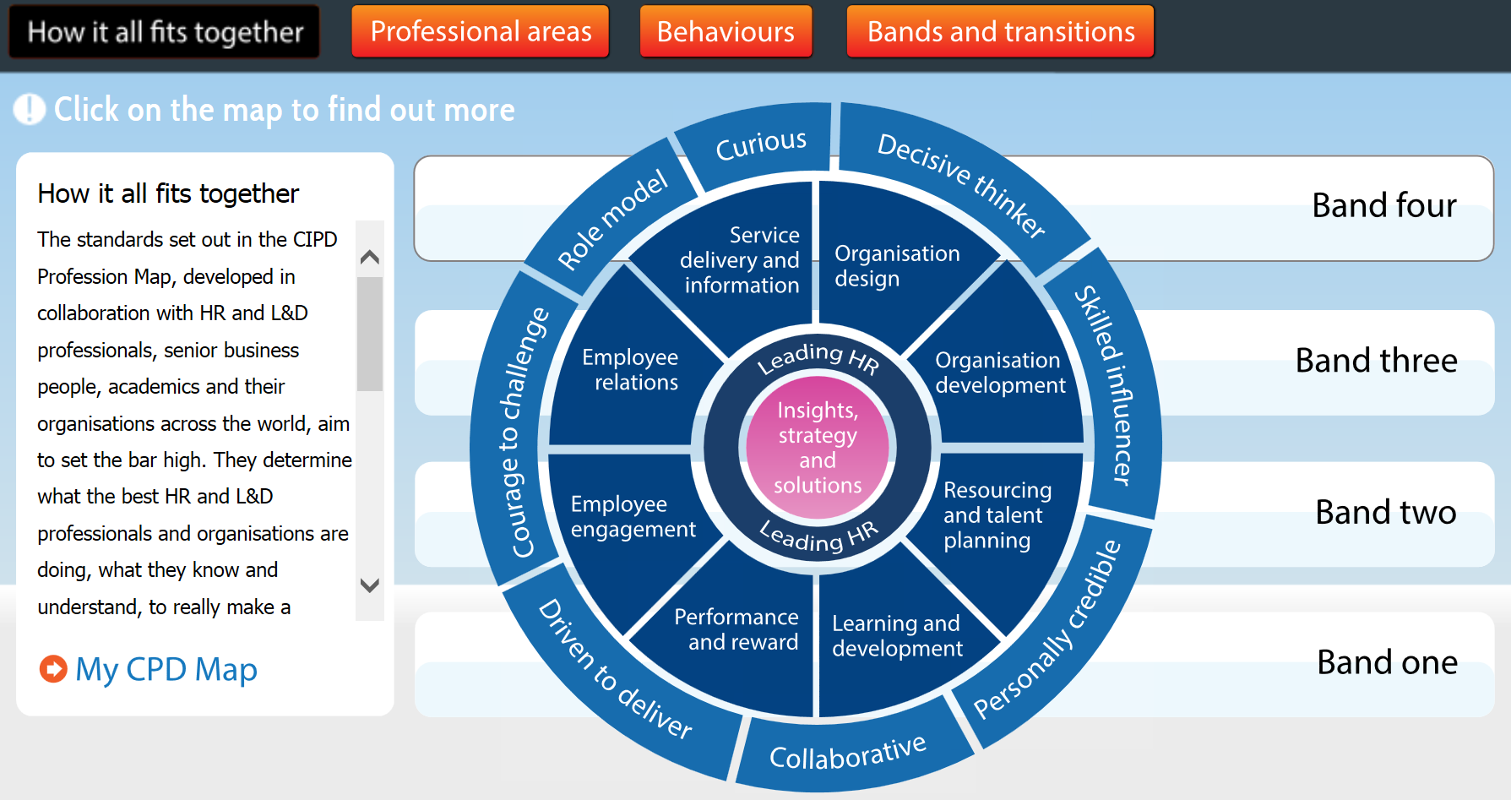
The CIPD HR Profession Map
Source: CIPD (2015)

Slide 5
Professional Areas
Insights, strategy and solutions
Leading HR
Organisation design
Organisation development
Resourcing and talent planning
Learning and development
Performance and reward
Employee engagement
Employee relations
Service delivery and information

Slide 6
Behaviours
Curious
Decisive thinker
Skilled influencer
Personally credible
Collaborative
Driven to deliver
Courage to challenge
Role model

Slide 7
Bands and Transitions (1)
Band one
  Supports colleagues with administration and processes. Effectively manages information and data and is customer orientated
Band two
  Advises on and/or manages HR related issues relating to an individual or a team. Has a clear understanding of the evaluation process and the solutions available

Slide 8
Bands and Transitions (2)
Band three
  Leads a professional area acting as a consultant or partner, addresses key HR challenges at an organisational level for the medium and long-term
Band four
  Leads and manages a professional area(s) and/or the organisation. Responsible for developing and delivering organisational and HR strategy

Slide 9
Continuing Professional Development (CPD)

Slide 10
What is CPD?
“the maintenance and enhancement of the knowledge, expertise and competence of professionals throughout their careers according to a plan formulated with regard to the need of the professional, the employer, the profession and society”
Source: Madden and Mitchell (1993) p12

Slide 11
The Importance of CPD
A means of continuously improving your knowledge, skills and abilities
Some professional associations (e.g. Law Society) require engagement with CPD on an annual basis
Continuous change in the external environment enhances the importance of CPD activity

Slide 12
Sources of CPD
Formal study (e.g. CIPD programmes)
Vocational training
Seminars (e.g. employment law update sessions)
CIPD branch events and conferences
Sector / industry events
Literature (e.g. academic/professional journals)
Networking events
Work shadowing
Coaching and mentoring at work

Slide 13
Reflective Practice
CPD is built on a foundation of reflective practice
Schön (1983) argued that ‘reflection in action distinguishes the truly outstanding professional’
Reflecting on our own learning enables us to link our development activity with practical outcomes
We must reflect on how we learn best, i.e. through private study, networking, formal courses, mentoring etc.

Slide 14
Managing Your CPD
The management of CPD involves five key stages:
identifying learning needs
drawing up personal development plans
embedding reflective practice
identifying support
overcoming barriers

Slide 15
Identifying Learning Needs
A situational approach considers where we have been, where we are now and where we want to be in the future
Benchmarking maps our abilities against set professional standards or the abilities of role models
Observing the behaviour of others allows us to identify core competencies, attitudes and knowledge
Obtaining feedback from different sources allows us to build a rounded picture of ourselves

Slide 16
Developing a Personal Development Plan
Developing a personal development plan involves six steps:
conduct a personal skills audit
set objectives
select opportunities
identify actions
implement and progress
assess outcomes

Slide 17
Embedding Reflective Practice
A key tool which is useful in reflective practice is the ‘learning log’
A learning log is more than a diary or list of activities, it requires a structured approach to the recording and analysis of learning events
Different approaches can (and should) be taken
A learning log might be structured as follows:
  learning experience
  conclusions
  actions
  deadline

Slide 18
Identifying Support
Effective HR professionals will be able to identify sources of assistance that will enable them to successfully reach their ultimate goals
Support can be useful in helping us to identify goals, sustain development activity and help us to put our learning into practice
We may draw support from:
  colleagues and line managers
  friends and family
  college or university tutors
  professional networks

Slide 19
Barriers to CPD
We can encounter a number of barriers in our efforts to engage with CPD activity
Barriers can include:
  lack of time
  lack of opportunities
  lack of resources
  low expectations
  previous negative experiences
  lack of enthusiasm
  personality factors

Slide 20
Levels of CIPD Membership
Associate
  Working in a support role to key HR areas
Chartered Member
  Able to demonstrate the expertise needed to plan and manage generalist or specialist HR operations
Chartered Fellow
  Holding a strategic position and able to demonstrate the expertise to lead the key areas of HR

Slide 21
Sources to Support Your Learning (1)
Textbooks
Academic journals
  Human Resource Management
  British Journal of Industrial Relations
  Work, Employment and Society (plus many others)

Slide 22
Sources to Support Your Learning (2)
Online information
  Office for National Statistics
  CIPD
  People Management
The press
  The Times
  The Independent
  The Guardian
  The Daily Telegraph
Professional associations and advice bodies (e.g. ACAS)

Slide 23
Conclusion
In a changing environment it is important that HR professionals keep their skills, knowledge and abilities up to date via engagement with CPD
The CIPD HR Profession Map can assist you in identifying your areas of strength and weakness
It is important that we take a planned and considered approach to CPD
We may encounter barriers to our CPD practice and must understand how these can be overcome

Slide 24
Bibliography
CIPD (2015) CIPD Profession Map. [Online] Available: http://www.cipd.co.uk/cipd-hr-profession/profession-map/. Accessed: 5th November 2015.
Madden, C. & Mitchell, V. (1993) Professions, standards and competence: a survey of continuing education for the professions. Bristol: University of Bristol, Department for Continuing Education.
Schön, D. (1983) The reflective practitioner: how professionals think in action. New York: Basic Books.

