Slide 1
Marketing Plan for Six Senses Resort
Eunice Gredia Tumi
2214171 BMH4005
Presentation

Slide 2
CONTENT
INTRODUCTION---------------------------------------------------------------------------------------------2
MARRIOT HOTEL AND SIX SENSE MOROCCO--------------------------------------------------------3
MISSION STATEMENTS AND OBJECTIVES--------------------------------------------------------------4
VISION--------------------------------------------------------------------------------------------------------5
ORGANIZATION--------------------------------------------------------------------------------------------6
ETHICAL VALUES-------------------------------------------------------------------------------------------7
STRATEGY---------------------------------------------------------------------------------------------------8
S.W.O.T ANALYSIS-----------------------------------------------------------------------------------------9
SOSTACT MODEL-----------------------------------------------------------------------------------------10
3D BUILDING OF SIX SENSES--------------------------------------------------------------------------11
MARKET OPPORTUNITIES----------------------------------------------------------------------------12
COMMUNICATION STRATEGY------------------------------------------------------------------------13
REFERENCES-----------------------------------------------------------------------------------------------14

Slide 3
SOSTAC MODEL
Situation - This session emphasises on finding the current state of affairs in an organization and seeks to answer the question ‘Where are we now?’ The present place of Six Sense hotel and Spa will be located in Accra.
Objective – We would partner with interested companies where possible to deepen our environmental goals, invite consumers, suppliers and our contractors to partake in our efforts -
Strategy – We would utilise the various marketing tactics available, including group bookings, direct booking, destination marketing, cross promotion sales, guest rewards strategies and revenue management strategies.
Tactics- Six Sense sales strategies are: group bookings, direct bookings, destination marketing, varied promotional sales, guest/customer rewards promotions, revenue management policies. Other room selling techniques would include upselling, cross-selling, travel & sleep packages, promotional sales, re-marketing, and local sales and business partnerships.
Action Plan - This chapter presents the make-up of the action plan - the final outcome/product of the project, is to help the case-study hotel to apply revenue management in a simplified format. The chapter is divided into two sub-chapters. The first sub-chapter is discusses the visions, desirable results and the key principles of the action plan. The second sub-chapter describes the various stages, strategic objectives and their key activities groups within the action plan.

Slide 4
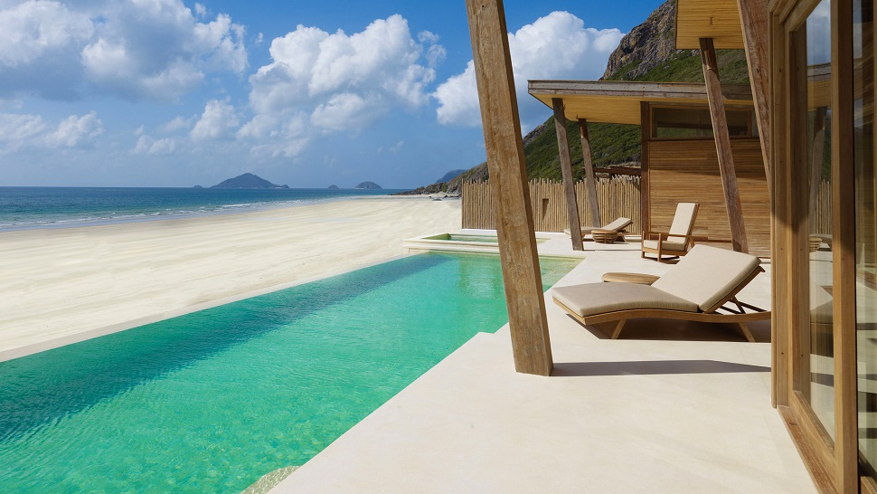
INTRODUCTION
Six Senses Hotel Resorts Spas operates eleven (11) resorts and twenty-nine (29) spas within 20 different nations under the brand name of Six Senses, Evason and Six Senses Spas. Six Senses Resort and Spa have grown since the story began back in 1995, but have since based each step on the same ambition: to journey beyond destinations into new experiences and cultures (SixSenses, 2023).
The aggressive development plans could triple their current portfolio over the next five (5) years and could have resorts, hotels and spas openings in countries such as Austria, Bhutan, Cambodia, China, Egypt, Fiji, France, India, Indonesia, Italy, Nicaragua, Switzerland, Taiwan, Thailand, Tunisia, United Arab Emirates and United States (SixSenses, 2023).
In the process of expansion of Six Senses Resorts and Spas, it would be purposeful to consider a location in the Sub-Saharan Region of Africa, e.g. Ghana, West Africa. The Sub-Sahara African region enjoys the similar climatic conditions like it occurs in Morocco of which Six Senses is already established. A marketing plan for Six Senses to be established in Ghana, West Africa would also allow Six Senses to be in competition with a brand like Marriot International Hotel which has recently establish a branch in Accra – Ghana.

Slide 5
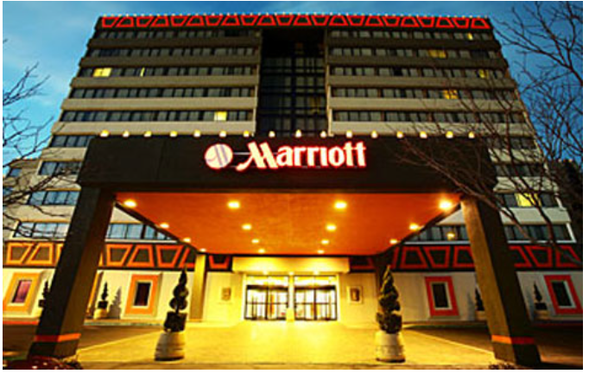
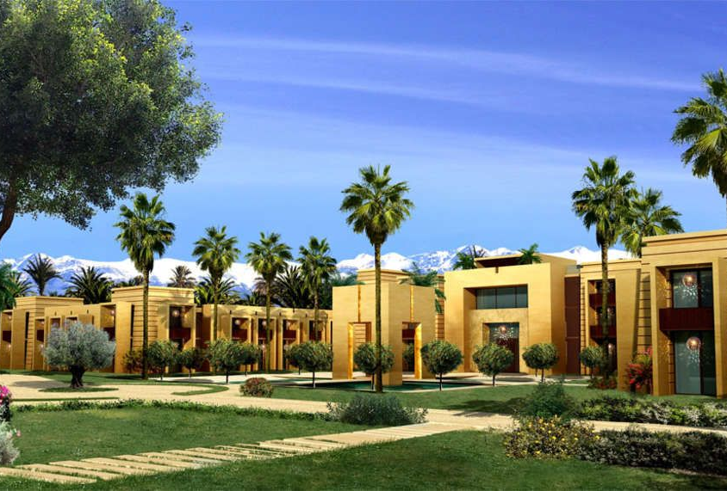
Marriot Hotel-Accra Ghana
Six Sense-Morocco

Slide 6
MISSION STATEMENT & OBJECTIVES
"The mission of our hotel is to provide outstanding lodging facilities and services to our cherished guests. We focus across individuals, businesses and leisure travellers, as well as the travel needs of groups meetings .
As with any other profit-oriented entity, the hotel industry seeks to make a profit. We cater to a wide range of clientele, with emphasis on high quality delivery in our rooms, foods and beverages services divisions.

Slide 7
VISION
Our vision is to continuously keep and set the highest standards of service delivery quality as a justification of upholding our reputation that we have amongst our varied clientele, business partners, competitors and the communities we operate in. We actively seek and implement environmentally friendly processes and systems in order to remain in harmony with nature and also meet the needs of modern society. Our time-tested traditions are a testament to our success but in the future we also want to embrace the changes that modern time brings and stay attractive in the market, our guests and partners.

Slide 8
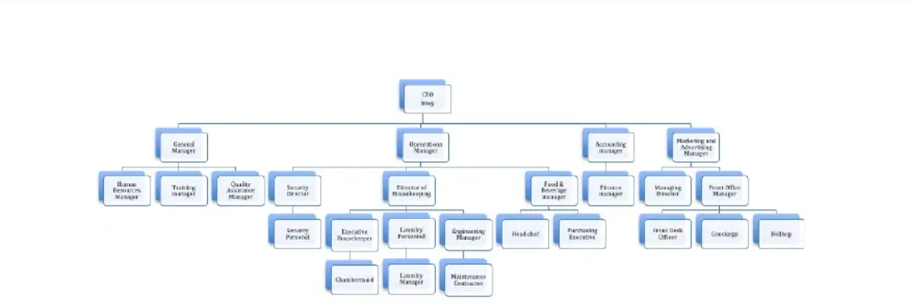
ORGANIZATION CHART
Six Senses Resort Spar would consist of two levels of management with further sub-divisions of the employees to aid easy administration. With business growth, more employees would be added on for our operations.

Slide 9
ETHICAL ISSUES
Our services would be provided with the highest quality at reasonable prices. Environmental friendliness is a priority within our operations.
(a). Customers - We would treat all our customers friendly, fairly and gently by charging them verifiable reasonable prices. We would consider our clients as our guests and serve them with delight and pleasure to have them feel homely.
(b). Quality - We would focus on quality as a sure way for profits. Each of our products and services would be of high quality, safe and hygienic. We seek to serve our customers from the heart as an obligation and delight.
(c). Environment - We would fix environmental friendliness within our service delivery as a way to promote “Green marketing awareness” to our customers.

Slide 10
STRATEGY-Our Strategy is based on
PARTNERSHIP WITH GUESTS- Guests satisfaction would be the core of our service delivery and would be aligned with our quality of services plan to exceed their expectations. Our aim is to make every client/guest feel at home and by this reason they would choose Six Senses Resort and Spa for repeat visitations. We would provide services at the highest level of quality delivery that would meet and surpass the needs and expectations of our cherished clients and take their candid feedback through open communication, satisfaction monitoring and analysis of compliments and complaints received.
EMPLOYEES – Being receptive to new knowledge, systems and technologies is a necessary condition for sustained progress aligned with quality training and education. Due to this, our strategy is based on the continuous education and training of all employees and constant communication between all departments of the hotel. We support teamwork and team building, personal responsibility and initiative of each employee.
RELATIONSHIP WITH SUPPLIERS – The Purchases Department which is one of the most important departments within the hotel requires a choice of very reliable suppliers that allows us to provide our cherished guests, clients and customers, who are the end-users of our services, with the highest quality. We would keep our relationship with these key suppliers on a mutually beneficial interests basis and strive for the development of good partnerships.
SATISFACTION OF INTERESTED PARTIES – Six Senses Resort and Spa would improve the sizes and structures of our hospitality services, with the aim of satisfying the expectations of our various stakeholders: clients, guests, business partners, travel agencies, NGOs, governmental and recreational institutions, employees, among others.

Slide 11
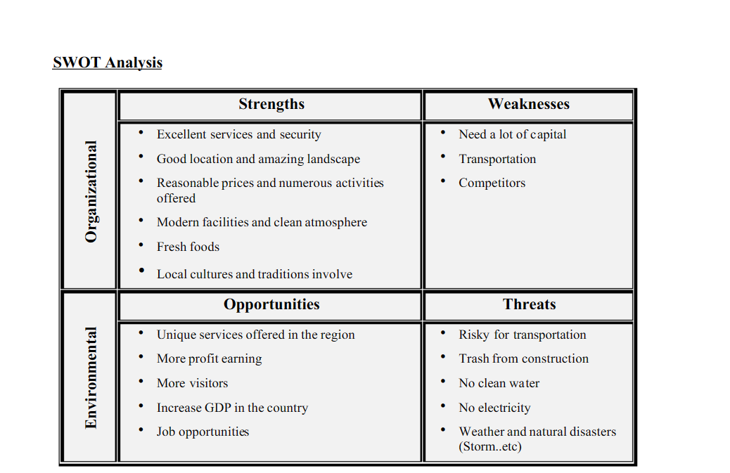
S.W.O.T ANALYSIS

Slide 12
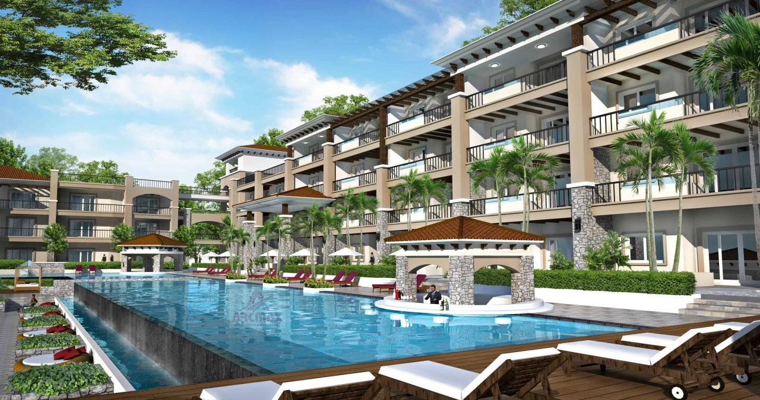
BUILDING OF SIX SENSES RESORT SPA

Slide 13
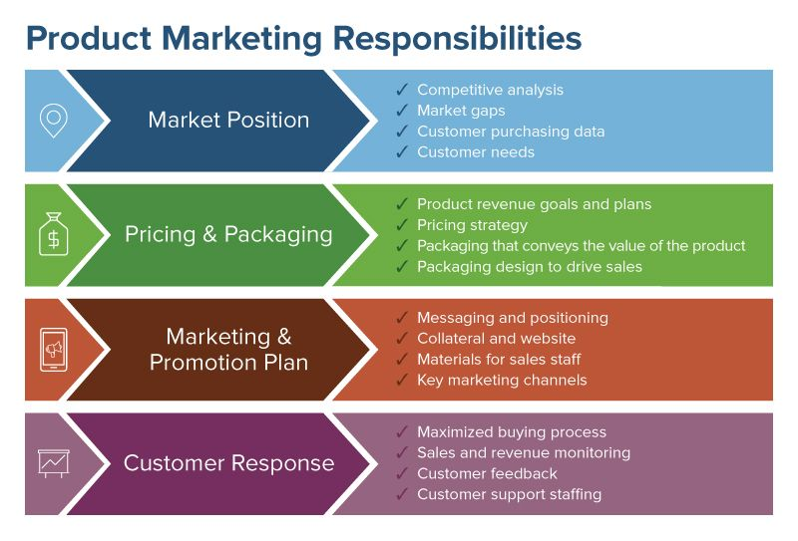
MARKET OPPORTUNITIES

Slide 14
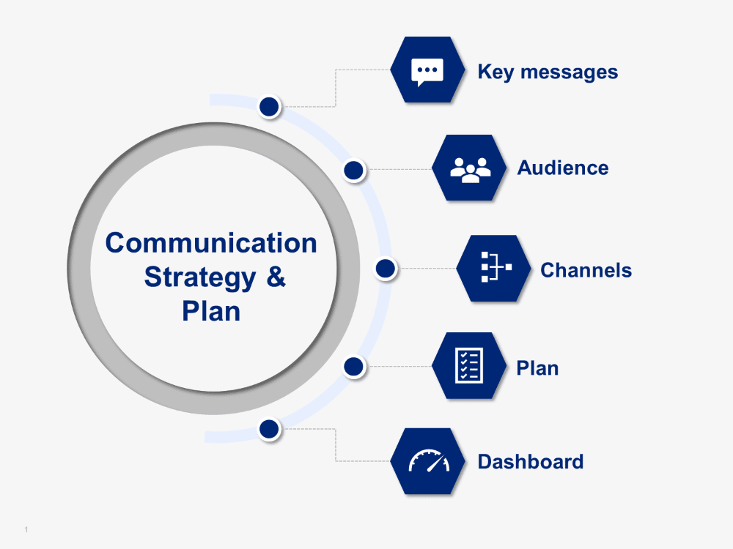
COMMUNICATION STRATEGY

Slide 15
APPENDIX
Fig.1. MARRIOTE HOTEL, ACCRA - GHANA
Fig.2. SIX SENSE - MOROCCO

Slide 16
APPENDIX Continuation
Fig.3. ORGANIZATION CHART
Fig.4. SWOT ANALYSIS

Slide 17
APPENDIX Continuation
Fig.5. SIX SENSE RESORT, GHANA PROPOSED
Fig.6. PRODUCT MARKETING RESPONSIBILITIES

Slide 18
APPENDIX Continuation
Fig.8

Slide 19
REFERENCES
https://arcmaxarchitect.com/hotel-design-and-hotel-building-plans.
(6) Paradise Island Resort_ A Completed Business Plan | Charaxine Pich - Academia.edu
hhttps://www.siteminder.com/r/hotel-distribution/hotel-revenue-management/strategies-increase-hotel-room-sales/#:~:text=Six%20essential%20hotel%20sales%20strategies,%2Dmarketing%2C%20and%20local%20partnerships.
ttps://www.smartsheet.com/sites/default/files/styles/full_width_desktop/public/IC-Product-Marketing-Responsibilities.jpg?itok=0RQ_adYD
www.hotelgrand.com
Vision, Mission & Objective - Fort George Hotel (fortgeorgebelize.com)
https://www.diplomacyandcommerce.rs/marriott-hotels-debut-in-west-africa-with-the-opening-of-accra-marriott-hotel-ghana/
https://www.hospitalitynet.org/news/4044145.html

