Slide 1
Advocacy
and
Person-Centered
Practice
Toni Simlett
1807466

Slide 2
Contents
Person - Centred approaches in socially inclusive practice
Ideology relating to Advocacy, being a person centred practice
Different types of Advocacy with PCP in mind
Applications of different types of Advocacy and different types of service settings with different client groups
Advocacy with vulnerable adults

Slide 3
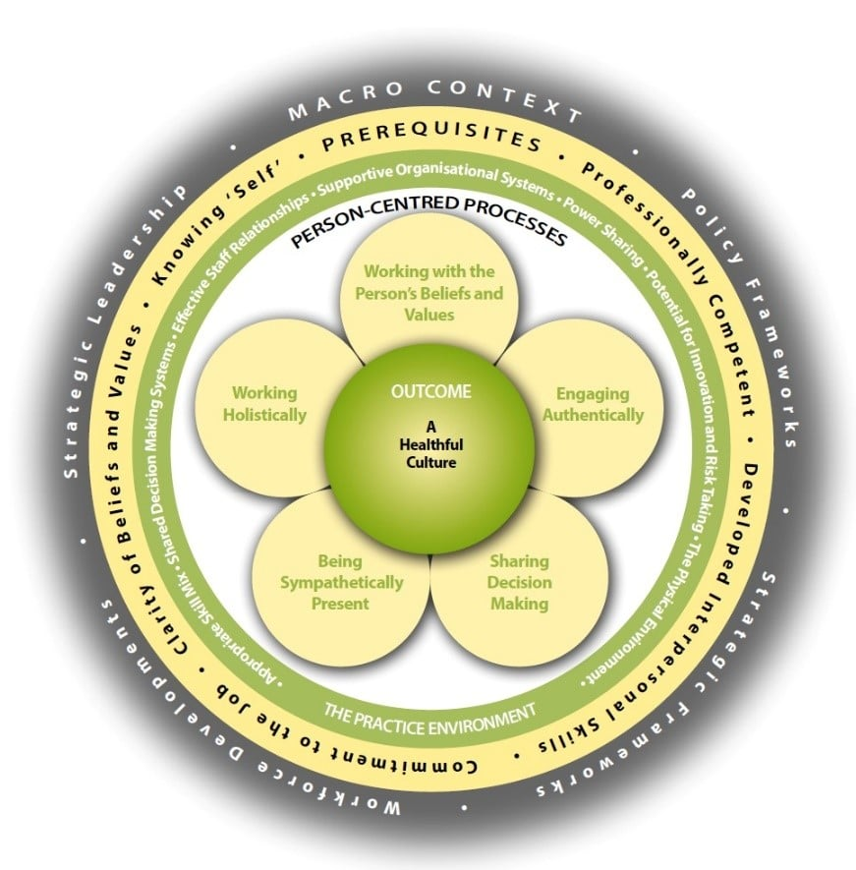
What is person centred Practice?
(Helpinghands Home Care (2020)

Slide 4



Health and Social Care
(Community care.co.uk (March 2020)
(Image 1:Jones L (May 2015)
(Clipart-library.com(N/D)

Slide 5
What is Advocacy?
‘…… taking action to support people to say what they want, secure their rights, purse their interests and obtain services they need’
(National Development Team for Inclusion, May 2018)

Slide 6



SUPPORTING
ADVOCACTES
SAFEGUARDING
CLARITY
OF PURPOSE
ACCOUNTABILITY
INDEPENDENCE
The
Advocacy
Charter
ACCESSIBILITY
CONFIDENTIALITY
EQUALITY & DIVERSITY
PERSON LED
EMPOWERMENT
(National Development Team for Inclusion, May 2018)

Slide 7
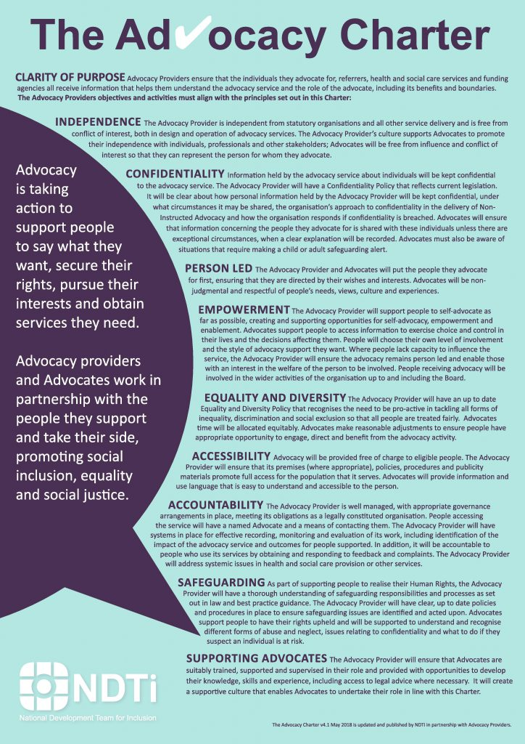
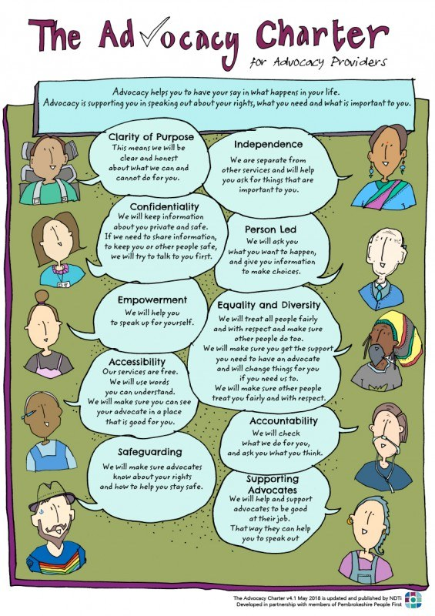
(NDIT.org.uk(2014)
(NDIT.org.uk(2014)

Slide 8

Advocacy at what cost?
(NDIT.org.uk(2021)

Slide 9

SELF ADVOCACY
DIFFERENT
TYPES
OF ADVOCACY
MENTAL
HEALTH
ADVOCACY(IMHA)
INDEPENDENT
PEER ADVOCATES
(Mind, 2021)
Notes:
.

Slide 10

Advocacy for Vulnerable people
Access to groups for peer advocacy
Access to social groups
Access to health and independent advocates
Access to empowerment
(Carmarthenshire People First, ND)

Slide 11
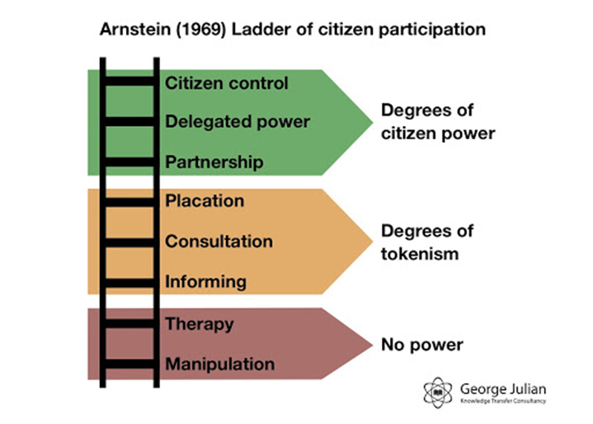
(Arnstein S (1969)
(Georgejulian.co.uk(2013)

Slide 12



EQUALITY
(Information Commissioner’s Office (March 2018)
(GOV.WALES (2014)
(UHMB.NHS.UK(may 2015)

Slide 13
References
Advocacy QPM National Development Team for Inclusion(NDTI), (May 2018) Recognising Quality in in Independent Advocacy ; Available : https://i1.wp.com/qualityadvocacy.org.uk/wp-content/uploads/2018/05/Website-Logo.png?fit=181%2C151&ssl=1 Accessed 3 January 2021
Arnstein S (1969) A Ladder of Citizen Participation, Journal Of The American Planning Association
Carmarthenshire People First, ND, Available at: http://www.carmarthenshirepeoplefirst.co.uk/page3.htm , Accessed 03 January 2021
Clip art Library.com (N/D)Collection of stop watch Picture, Available at : http://clipart-library.com/stopwatch-picture.html ,accessed 10 January 2021

Slide 14
References
Georgejulian.co.uk(2013) Social Media and Citizen Engagement (2013) at : http://www.georgejulian.co.uk/2013/01/22/social-media-and-citizen-engagement/ accessed 4 January 2021
Gov.Wales (2019) Social Services and Well Being (Wales) Act 2014, Available at: https://gov.wales/sites/default/files/publications/2019-06/social-services-and-well-being-wales-act-easy-read.pdf Accessed 7 January 2021
Gov.Uk, (November 2020) How to work safely in Domiciliary care, Available at: https://assets.publishing.service.gov.uk/government/uploads/system/uploads/attachment_data/file/931636/How_to_work_safely_in_domiciliary_care_v7_2_11_2020.pdf ,Accessed 13 January 2021
Gov.Uk, (2008),Health and Social Care Act 2008: code of practice on the prevention and control of infections, Available at : https://www.gov.uk/government/publications/the-health-and-social-care-act-2008-code-of-practice-on-the-prevention-and-control-of-infections-and-related-guidance ,Accessed 13 January 2021

Slide 15
References
Helpinghandshomecare.org.uk (June 2020) Person Centredness and person centred Practice, Available at : https://www.helpinghandshomecare.co.uk/blog/person-centredness-and-person-centred-practice/,Accessed 6 January 2021
Helpinghandshomecare.co.uk (2021) What is Domiciliary care ? , Available at : https://www.helpinghandshomecare.co.uk/home-care-services/domiciliary-care/#:~:text=Domiciliary%20care%20is%20provided%20to,independence%20and%20quality%20of%20life.&text=Helping%20to%20mobilise%20in%20and%20around%20the%20home , Accessed 10 January 2021
Information Commissioner’s Office, General Data Protection Regulations, (2018) Available at: https://assets.publishing.service.gov.uk/government/uploads/system/uploads/attachment_data/file/711097/guide-to-the-general-data-protection-regulation-gdpr-1-0.pdf , Accessed 3 January 2021

Slide 16
References
Martechtoday.com (2021) (GDPR),Available at :General Data Protection Regulation , Available at https://martechtoday.com/library/gdp, Accessed 7 January 2021
Markallassests.blog.core (2019) Recruiters in Care Image: Available at : https://markallenassets.blob.core.windows.net/communitycare/2019/06/Blog-1-recruiters-in-care-Image.png Accessed 10 january 2021
Mc Cormack B & Mc Cane T (2017) Person Centred Practice in Nursing and Health Care, Theory and Practice, Second Edition, John Wiley &Sons LTD: available at : https://academicresearchbureau.com/wp-content/uploads/2019/04/Person_Centred_Practice_in_Nursing_and_Health_Care.pdf#page=53 , Accessed 6 January 2021

Slide 17
References
Mind.Org(2021), Advocacy In Mental Health ,Available at : https://www.mind.org.uk/information-support/guides-to-support-and-services/advocacy/types-of-advocacy/ ,Accessed 4 January 2021
National Development Team for Inclusion(NDTI), (May 2018), New Advocacy Charter, Available at : https://www.ndti.org.uk/resources/new-advocacy-charter , Accessed 3 January 2021
Quality of Advocacy (2021) ,How much does the QPM cost available at : https://qualityadvocacy.org.uk/about-the-qpm/how-much-does-the-qpm-cost/ Accessed 3 January 2021
Quality of Advocacy(2021) The History of the Advocacy QPM, Available at : https://qualityadvocacy.org.uk/about-the-qpm/the-history-of-the-advocacy-qpm/ ,Accessed 3 January 2021

Slide 18
References
UK Government. Equality Act 2010 UK Government: Available at:
https://www.gov.uk/definition-of-disability-under-equality-act-2010 accessed 3 January 2021
University Hospitals of Morecambe Bay (UHMB)NHS Foundation Trust ,Jones L (May 2015) Equality, Diversity and Human Rights Week ,Available at : https://www.google.com/url?sa=i&url=https%3A%2F%2Fwww.freshthinking.uhmb.nhs.uk%2Fequality-diversity-and-human-rights-week%2F&psig=AOvVaw1ADsd-fU89mNNnWgPdV4uY&ust=1609782556653000&source=images&cd=vfe&ved=0CAMQjB1qFwoTCND7nLmpgO4CFQAAAAAdAAAAABAK Accessed 3 January 2021

