Slide 1
Psychopathological Classifications and Provisions
BMHP6029
WEEK 3
Mental Health Legislation
in the UK

Slide 2
This week’s learning objectives:
Discuss legislation related to mental health in the UK context.
Apply legislation related to mental health in healthcare practice.

Slide 3
The Mental Health Act 1983 (Amended in 2007)
Purpose: Provides a legal framework for the treatment and care of individuals with mental disorders in England and Wales.
Key Provisions:
  Compulsory Treatment Orders (CTOs): Enables the compulsory treatment of individuals with mental disorders either in the community or in hospital.
  Emergency Detention: Allows for the temporary detention of individuals who are in need of urgent care due to a mental disorder.
  Mental Health Tribunals: Independent bodies that review cases of detention and compulsory treatment to ensure they are justified and legal.

Slide 4
Cont.
Independent Mental Health Advocates: Places a duty on the appropriate authority to make arrangements for help to be provided by independent mental health advocates (IMHAs).
Supervised Community Treatment (SCT): Introduces measures for patients to receive treatment in the community under a CTO, providing more flexibility than inpatient care.
Who It Applies To: Individuals diagnosed with a mental disorder in England and Wales who may need compulsory treatment or detention.

Slide 5
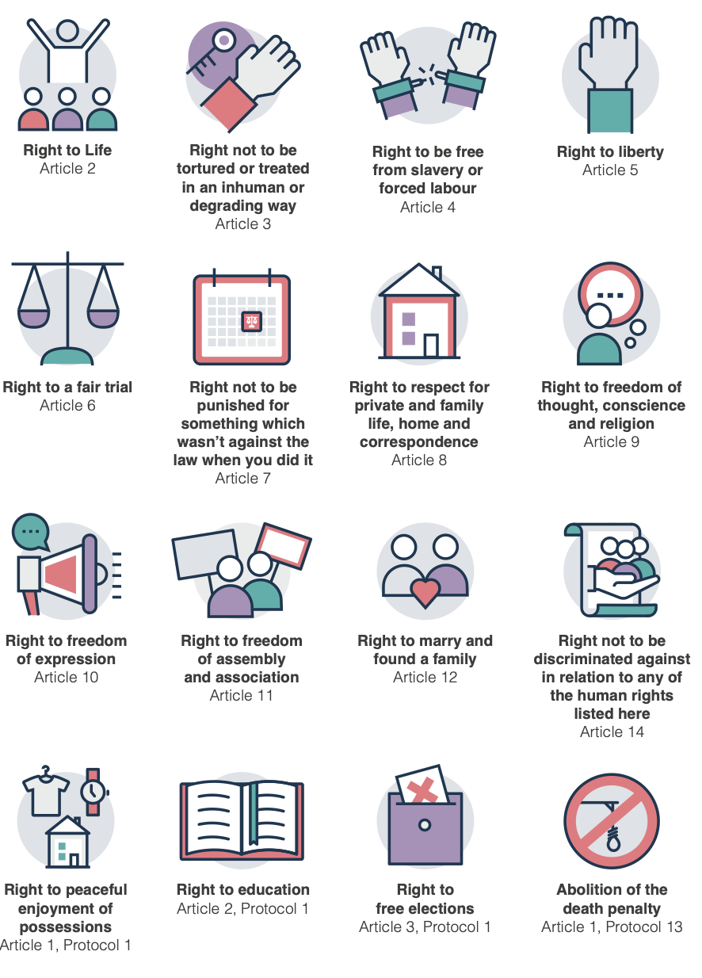
Human Rights Act 1998
The Human Rights Act puts a legal duty on public services and all those who work for them, to respect and protect human rights across their actions, decisions, policies and services.
The Human Rights act contains 16 key rights, called articles.
Source: https://www.mentalhealth.org.uk/explore-mental-health/a-z-topics/human-rights-and-mental-health

Slide 6
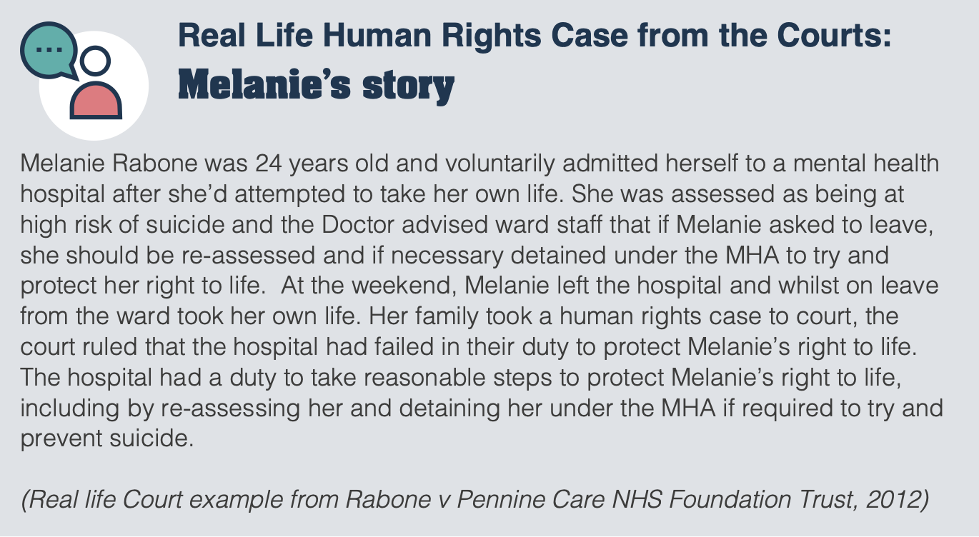

Slide 7

Video: What is the Mental Health Act?
Source: https://youtu.be/Y8B5mymEiqg?si=ZvaMD8phkl81VKiR

Slide 8
Mental Capacity Act 2005
  Purpose: Provides a framework for making decisions on behalf of individuals who lack capacity.
  Key Provisions:
    Best Interests Decisions.
    Deprivation of Liberty Safeguards (DoLS).
    Introduced the role of the independent mental capacity advocate (IMCA).
    Who It Applies To: Individuals who may lack the capacity to make certain decisions.

Slide 9
Deprivation of Liberty Safeguards (DoLS)
Under the Mental Capacity Act 2005, healthcare practitioners must ensure that any deprivation of a patient’s liberty (e.g., keeping someone in a hospital against their will) is lawful, necessary, and proportionate.
They must follow specific procedures to authorize and review such decisions.

Slide 10
The independent mental capacity advocate (IMCA)
The Mental Capacity Act 2005 introduced the role of the independent mental capacity advocate (IMCA).
IMCAs are a legal safeguard for people who lack the capacity to make specific important decisions: including making decisions about where they live and about serious medical treatment options.

Slide 11

Video: the role of the IMCA (Independent Mental Capacity Advocate)
Source: https://youtu.be/uYbSHbS0dEw?si=imhbVKzYU6Grj7Vf

Slide 12
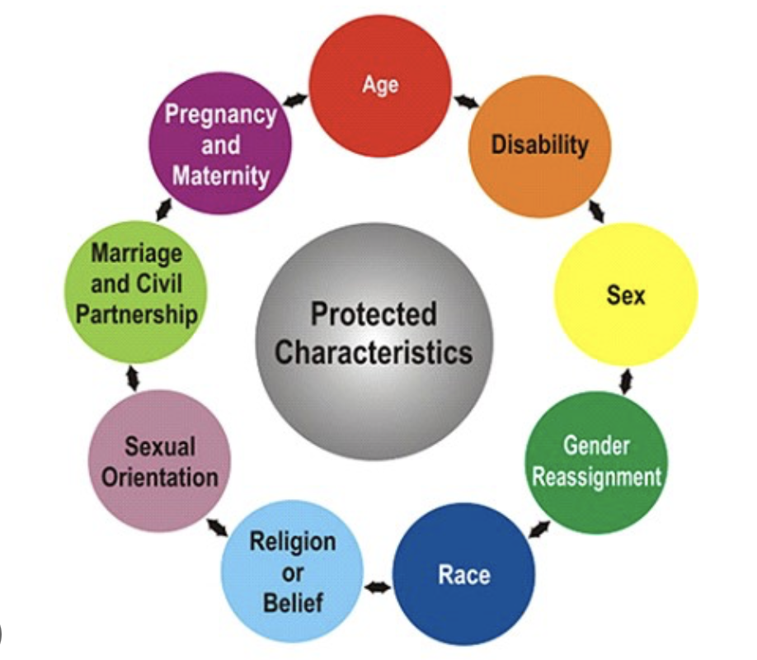
Definition of disability under the Equality Act 2010
A person is considered to have a disability under the Equality Act 2010 if they have a physical or mental impairment that has a ‘substantial’ and ‘long-term’ negative effect on their ability to carry out normal daily activities.
Source: https://www.gov.uk/definition-of-disability-under-equality-act-2010

Slide 13
If an individual is detained, their rights under the Equality Act include the following:
Personalised Support: Staff are required to get to know the individual and understand how best to support them, particularly if they have a disability or other protected characteristic.
Reasonable Adjustments: Staff may need to alter their usual procedures or practices to accommodate the individual's needs. These necessary changes, known as "Reasonable Adjustments," are designed to ensure that the individual is not disadvantaged because of their disability.

Slide 14
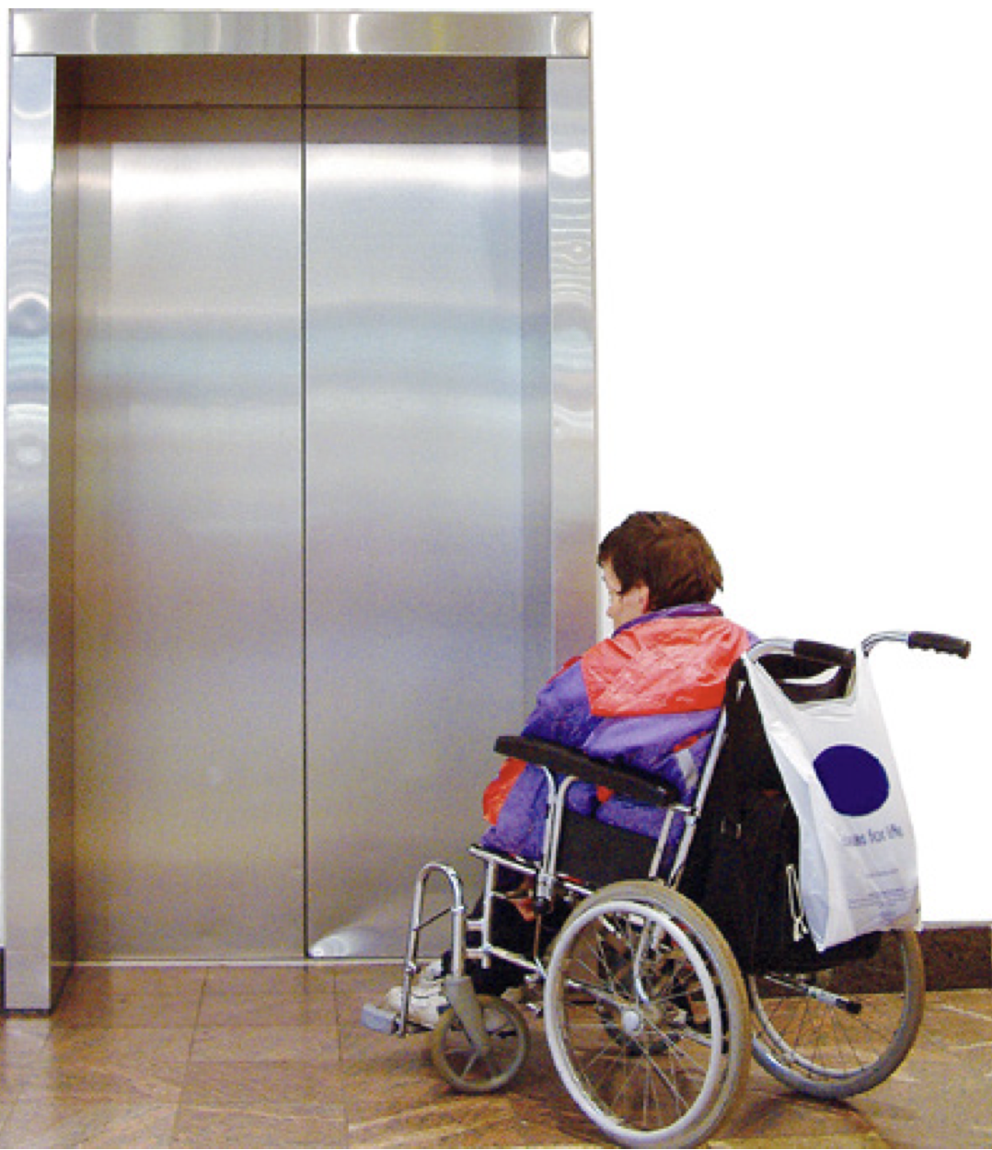
Here are some examples of Reasonable Adjustments:
Jane is deaf and uses sign language to communicate. Staff need to provide an interpreter or look at having a staff member who also knows sign language.
Dean uses a wheelchair to get around. The hospital will need to make sure that the building has lots of space and flat surfaces.

Slide 15
The Care Act 2014
The Care Act 2014 emphasises the importance of integrating mental health into broader social care, placing a duty on local authorities to promote individual well-being, including mental health.
It also stresses the importance of safeguarding adults at risk of abuse or neglect.

Slide 16
Ethical Considerations
Ethical dilemmas in applying these laws, such as:
Autonomy vs. protection
Informed consent and the role of healthcare professionals.

Slide 17
Activity
Based on your chosen mental disorder for the Poster presentation - Component 1:
Briefly research the main UK laws that apply to mental health, such as the Mental Health Act 1983, Mental Capacity Act 2005, or Care Act 2014. Focus on how these laws relate to the chosen disorder.
Legislation Overview: Summarise how key legislation impacts patients with this disorder.
Evaluation: Briefly assess the benefits of this legislation for individuals with the disorder. Consider patient rights, care quality, and any challenges.

Slide 18
References
GOV.UK (2010) Definition of disability under the Equality Act 2010. Available at: https://www.gov.uk/definition-of-disability-under-equality-act-2010 (Accessed: 20 august 2024).
Mental Health Foundation (2021) Human rights and mental health
Available at: https://www.mentalhealth.org.uk/explore-mental-health/a-z-topics/human-rights-and-mental-health (Accessed: 20 august 2024).

