Slide 1
Cancer

Slide 2
context
1, Introducing the disease,
Explaining how cancer works,
Explain how it effects the body system.
2, Explain the anatomy.
3, Explain the physiology.
4, explain the person cared centred – main risk of their health lifestyle/ to also consider the risk factors for this disease.
5, provide a care plan on evidence-based recommendations such as [care planning, communications, and ethical considerations]

Slide 3
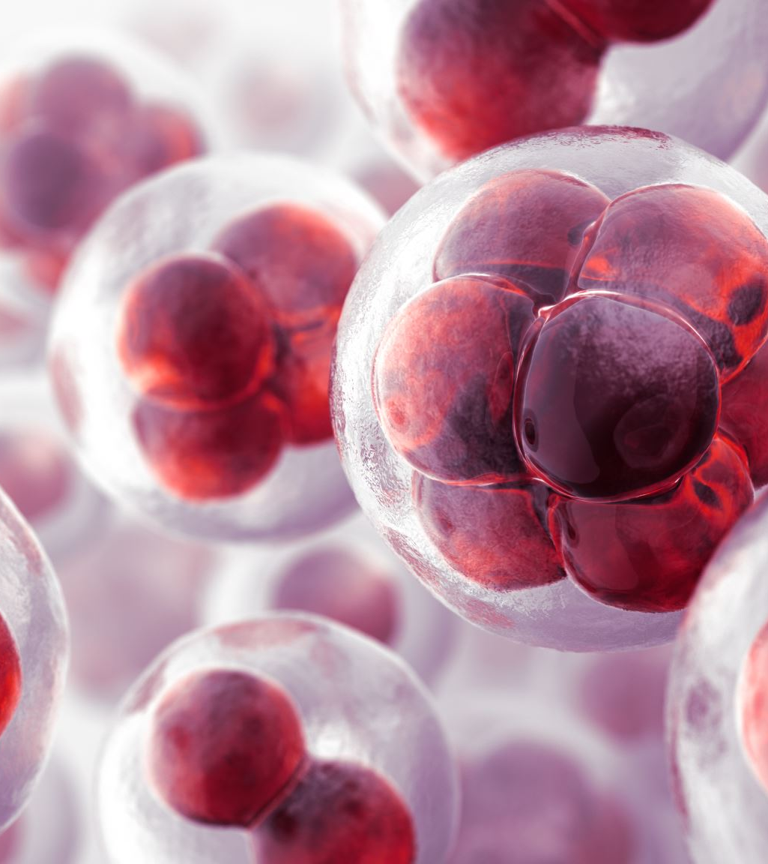

Cancer introduction
Cancer is a complex genetic cell, which is characterized of un-controlled of abnormal cells. Cancer can develop it disease through a multi step process and eventually manages to float around the body normal regulatory system.
Cancer is a disease in which some of the body’s cells grow uncontrollably and spread to other parts of the body. [National cancer innsuitute, October, 2021.]

Slide 4
How does cancer spreads?
The steps of how cancer spreads:
1, Cancer cells push forcefully through a nearby normal human tissue and this become the basement where the membrane holds it in place.
2, Then eventually the cancer starts to evaporate through the walls of the blood vessels to enter the circulation.
3, As they start to float. The cancer then starts to move around the human body and targets the blood stream and this will clump against the immune system.
4, The surviving cells eventually get stuck into very small blood vessels then into a new location and then pushes back out and creates a new tissue.
5, The cells starts to divide into new organs, then gradually forms into a new tumor.
Cancer cells can be carried in the bloodstream or lymphatic system to other parts of the body. There they can start to grow into new tumours. [how can cancer spread, 2025]

Slide 5
The anatomy – cancer
The anatomy of cancer is a breakdown of how can cancer can be involved in the body cells and tissue. The cancer cells can look very different from the healthy ones. This is because the are irreguleray from shape and have a enlarge control center cells. Often these cells do grow eventually but they just do not form into a simple clump. They cause a complex envioriment which is called the tumor. This tumor can act like a [fake – organ] and lets say if this fake organ can hijack the human body resources, in addition this ill make sure that it forces to grow new blood vessels to allow it to feed to cancer. Eventually, there is a time where the cells attend to lose their sickness and eventually will break through the borders of the human bored tissues. The. Cancer is most likely to invade into healthier areas or the cancers attend to travel through the blood and lymph system.
Cancer is an illness wherein cells multiply and grow abnormally, invading other tissues and organs via the bloodstream and lymphatic systems. (Thiagalingam, 2015)

Slide 6
Physioloigy of cancer
On this section of topic I will discuss the physiology of cancers and the background detailed information.
in the physiology section, it will be mentioned as a function and the behaviour changes towards the disease of cancer, where the anatomy it was discussing more of the human cells structure. The physiology of cancer is where it is a loss of a human normal biological control, where it also controls the cells life and death. While there is healthy cells which can divide when they recivie specific chemical signals the cancer cells can grow their own growth signals. This is to survive and attend to grow larger, cancer cells do have the power to hijack the body’s metabolism through angiogenesis, which will have it forcing through the recruitment of new blood vessels to provide an endless supply of nutrients and oxygen towards the human body. Essentially, cancer physiology is such an important shift from a cooperative system to a selfish one, this is where cells attend to prioritize their own survival and expansion over the health of the organism.
The body has different types of blood cells that cancer or its treatment can affect. Some cancers may spread to other parts of the body through the blood circulatory system.[ Cancer Research, 2023]

Slide 7
Person centered care towards cancer
With many paiteints who suffer from this horrific diseae of cancer the best care that the [Doctors, nurses, and the health and social care services] can offer the best solution towards the poorly paiteints.
Emotional well-being: [ giving their best support, being into their shoes, how can they expect the best comfort].
Improves quality of life: even though they may have to deal with cancer by ensuring this support this will benefit the poorly mentally and physically. [Motivation]
Builds trust with the healthcare professinals
Encourage the paiteints
Treatment planning care with the paiteint

Slide 8
Main risk of their lifestyle – cancer
The main risk of cancer which can an effect on you’re day to day life will be:
tobacco – damaging lungs, increasing the chances of cancer, destroying you’re cells]
Alcohol - Alcohol causes 7 types of cancer, including breast, mouth and bowel cancer. Whatever you drink, cutting down can lower your risk. Find out about how alcohol causes cancer and how to reduce your risk. [ Cancer Research, 2023]
overweight [ not excersing as you need to be doing, being lazy, not having a strong mind-set for fitness]
poor diet Eating a healthy, balanced diet can reduce cancer risk, mainly because it can help you keep a healthy weight. Find out about how to eat a healthy diet, how certain foods affect risk and common myths. [Cancer research, 2023]

Slide 9
Care plan recommendation
a care plan recommendation towards the people who suffer from cancer
Clinical management
Nutritional support
Physical rehabilitation
Physcohology and social support
Financial support
Recovery during and after treatment is called rehabilitation. Cancer and its treatment may cause physical and psychological issues which can affect your quality of life and everyday tasks. [Nhs,2025]

Slide 10
References
https://www.cacerresearch
ncer.gov/about-cancer/understanding/what-is-cancer
https://www.cancerresearchuk.org/about-cancer/what-is-cancer/how-cancer-start-grow-spread/how-cancer-can-spread
https://link.springer.com/chapter/10.1007/978-3-031-31852-8_11
https://www.canuk.org/about-cancer/what-is-cancer/body-systems-and-cancer/cancer-the-blood-and-circulation
https://www.cancerresearchuk.org/about-cancer/causes-of-cancer/diet-and-cancer
https://www.cancerresearchuk.org/about-cancer/causes-of-cancer/alcohol-and-cancer
https://www.nbt.nhs.uk/our-services/a-z-services/cancer-care/cancer-prehabilitation-rehabilitation

