Slide 1

Module Code: LCBB6001
Module Lecturer’s Name: Toyin Adisa
Assignment Title: Group Presentation -British - Chinese Joint Venture
Students’Names
Diana Paula Stratulat - Student ID 2024156
Mariana Cocos -Student ID 2024061
Maria Hagiu -Student ID 2024157
Georgiana Ilie -Student ID 2024158

Slide 2
Agenda of the presentation
Introduction to the context
Chinese culture-short introduction
Success and failure factors of the joint venture
Cultural sensitivity in China / The differences from the UK
Hofstede cultural Dimensions: Analysis of the UK and China
Recommendations
Conclusion
References

Slide 3
Introduction
ABC Ltd is a UK company that is going to China to do business based on a joint venture agreement with a General Electric, Chinese business.
The joint venture which needs close collaboration and communication between parties to take effective decisions ,will allow possibilities for both companies to benefit, particularly financial growth and expansion on international market.
The presentation is structured in four parts and its aim is to shed light on intercultural communication between UK and China.
The objectives are to evaluate and interpret divergent international cultures within business, evaluate success and failure factors, analyse cultural sensitivity in China apply Hofstede's Cultural Dimension Theory in UK/China business and last but not least, provide useful recommendations to maximise the efficiency of the joint venture.

Slide 4
The Chinese Culture
Main Differences China vs British culture
The social values of China are derived from Confucianism and Daoism religions combined with conservatism (Hennig, 2014 ).
The UK is a diverse in term of religions, however, the largest religion is Christianity.
British culture is more social compared to Chinese where the employees are more conservative.
The structure of UK workplace is less hierarchical compared to China and it considered less formal whereas Chinese culture is more prone to follow protocols and formal communication.

Slide 5

The Chinese Culture
Example
(Example 1) For example in term of verbal communication greeting each other in China is by bowing or nodding, direct eye contact which is common in UK is uncommon in China and is considered disrespectful. Also, when addressing people in China their title and surname must be used.
(Example 2) Another example in term of appreciation is that British often say “thank you” to the other no matter what he did for them. For example: 1) “Are you ok?” “Yes/No, thank you.” The Chinese on the other hand, express appreciation mostly to strangers or unfamiliar friends, but they do not think it necessary to say it if what the other did for them belongs to a common job (Sun & Tian, 2017).
Source: iStock

Slide 6

Success and failure factors of joint ventures
International joint ventures encounter various issues from initial to final stages of a project not only in term of communication but also in term of compatibility, funding, and expectations.
According to Nippa, et al., (2007) one of the main failure factors of joint venture are in term of management which leads to higher failure rates. Anticipating potential issues in advance and taking necessary actions to minimize the negative impact can be a game changer.

Slide 7
Success factors
careful planning (essential aspects are considered including cultural differences that can either trigger conflict or improve performance )
sharing control (According to Mjoen & Tallman (1997) specialized control provides both protection and exploitation of key resource inputs and is gained through increased bargaining power )
effective cooperation (careful consideration of all essential components related to the project )
cultural sensitivity (acknowledging the differences in communication, behaviour of different groups to secure effective interaction )
(Gewis & Oestersporksmann, 2017)

Slide 8
Failure factors
Different goals
Poor Compatibility
Different expectations
Legal variances
Different management style
Cultural Differences
Challenges in term of conflict resolution
As discussed by Rich (1981) to create joint venture in China it is important to implement the joint law through China International Trust and Investment Corporation.
As per Deloite (2010), the participants in a joint venture usually have issues in term of governance, cultural differences, and practicability of conflict resolutions.
Careful consideration of success and failure factors increases the chance of a successful project completion. A high level of cooperation, commitment to the common objectives, trust between British corporation with Chinese the chances to succeed are much higher.

Slide 9
Cultural sensitivity in China
Definition
Cultural sensitivity is the awareness of the variances and similarities in individual behaviour, communication, attitude of people from different cultural backgrounds. It is the competence and willingness to learn about other cultures and the ability to accept other cultures. Harris (2007) stated that “culture provides people a sense of who they are, a sense of belonging, direction for their behaviour, and guidance for their actions”. Therefore, understanding their culture will provide a better clarity on what motivates their actions and decisions.

Slide 10
Cultural Differences British versus Chinese
Variances | Major Languages and dialects | Communication Style | Behaviors and Orientation | Punctuality | Cultural Values
UK | English. Welsh | Direct | Self- Orientated | On Schedule | Stoicism Equity Regional diversity Informality Humour Diligence
China | Mandarin, Cantonese, Taiwanese, Shanghainese | Indirect | Group Orientated | Flexible | Success, Harmony, Seniority, Etiquette Loyalty Wisdom

Slide 11
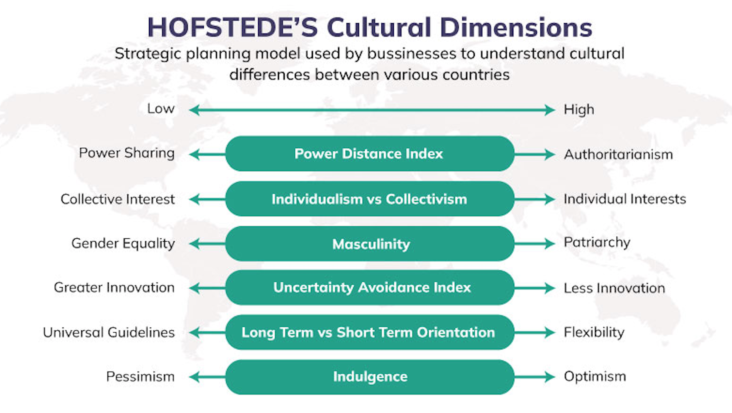
Hofstede cultural Dimensions
Source: iCrowJack

Slide 12
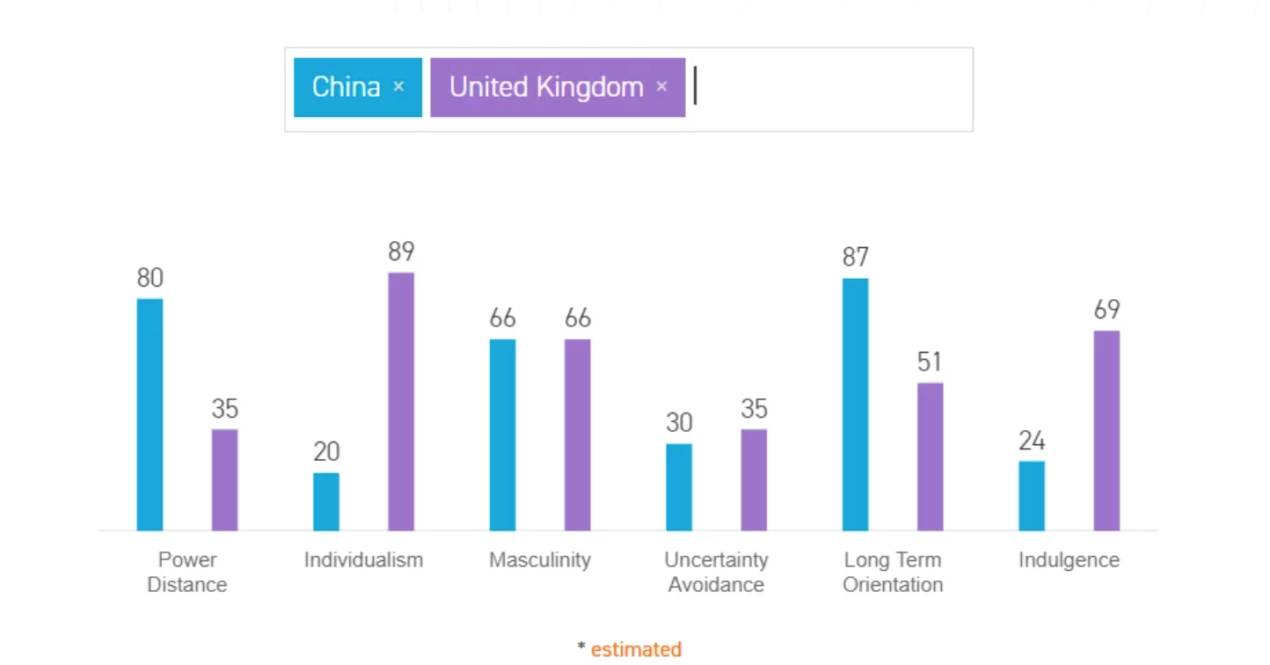
Hofstede cultural Dimensions: UK and China
Hofstede cultural Dimensions:

Slide 13
Recommendations
To conduct in-depth research on the cultural differences it will help communication and collaboration between companies
Developing cultural sensitivity and encourage learning
Build trust between parties though transparency
Collaborate closely with partners
Build constructive leadership in governance, involve all parties in decision making
Establishing clearly defined initiatives and performance measures

Slide 14

Recommendations
Business Communication Solutions
Making use of translators or technological developments as necessary
Use a clear and a professional communication
Avoiding slangs, jargons, humor and other terms that can be misunderstood
Establishing potential communication barriers in advance
Use appropriate channels of communication to suit a diverse team

Slide 15
Conclusion
In conclusion, for the joint venture to be successfully intercultural communication is an important determinant. Considering major differences between British culture and Chinese there is a high need for an effective cooperation which is the most prominent success factor, significant contributor whether the project is going in the right direction. The different working practices and management styles existent can create major difficulties unless these are addressed on time. The Holstead’s theory allows a detailed understanding of cultures with highly relevant connotations of each dimension which supports in a better planning, management of these differences in order to maximise the benefits for the organisation. The Holstead’s theory can be applied to maximise the positive outcome. Additionally, focusing on improving business communication, developing cultural sensitivity, build trust between parties and facilitate collaboration are among important aspects to be considered in the joint venture between a Chinese and British company.

Slide 16
References
CFI, 2022. Joint Venture. [Online]
Available at: https://corporatefinanceinstitute.com/resources/valuation/what-is-joint-venture-jv/
[Accessed 9 March 2023].
Deloite, 2010. A study of Joint Ventures The challenging world of alliances. [Online]
Available at: https://www2.deloitte.com/content/dam/Deloitte/fr/Documents/finance/Publications/Etude_Joint_Venture_juillet%202010.pdf
Ditillo, A. &. C. A. ,., 2008. Controlling Collaboration Between Firms : How to Build and Maintain Successful Relationships with External Partners. Oxford: Elsevier Science & Technology.
Evans, N., 2021. British Culture. [Online]
Available at: https://culturalatlas.sbs.com.au/british-culture/british-culture-core-concepts
[Accessed 10 March 2023].
Gewis, T. & Oestersporksmann, J., 2017. Key Sucess factors of international ventures operating in China- a sino-german perspective. Advances in Economics, Business and Management Research, International Conference on Transformations and Innovations in Management , Volume 37, pp. 852-867.

Slide 17
References
Harris, P. M. R. &. M. S., 2007. Managing Cultural Differences; Global Leadership Strategies for the 21st Century,. Burlington: Routledge.
Hennig, A., 2014 . How „Confucian“ is Chinese Culture today?. Internationales Hochschulinstitut Zittau.
Hofstede , G., 2003. Culture Consequences. 2nd Edition ed. s.l.:Sage Publications.
Li, J., Xin, K. & Tsui, A., 1999. Building Effective International Joint Venture Leadership Teams in China. Journal of World Business, Volume 34, pp. 52-68.
Mei , S. & Zhao-xia, T., 2017. The Cultural Differences Between English and Chinese Courtesy Languages. Journal of Literature and Art Studies, March , 7(3), pp. 340-344.
Mjoen, H. & Tallman, S., 1997. Control and Performance in International Joint Ventures.. Organization Science: A Journal of the Institute of Management Sciences, 8(3), pp. 257-74.
Nippa, M., Beechler, S. & Klossek, A., 2007. Success Factors for Managing International Joint Ventures: A Review and an Integrative Framework. Management and Organization Review. Cambridge University Press, 3(2), pp. 277-310.
Rich , F. C., 1981. Joint Ventures in China: The Legal Challenge. American Bar Association, 15(2), pp. 183-211.
Rinaudo, E. K. & Roswig , J., 2016. Negotiating a better joint venture. [Online]
Available at: https://www.mckinsey.com/~/media/McKinsey/Business%20Functions/Strategy%20and%20Corporate%20Finance/Our%20Insights/Negotiating%20a%20better%20joint%20venture/Negotiating%20a%20better%20joint%20venture.pdf
[Accessed 20 April 2022].
Sun , M. & Tian, Z.-x., 2017. The Cultural Differences Between English and Chinese Courtesy Languages. Journal of Literature and Art Studies, 7(3), pp. 340-344.
Xiuhua, W. & Xiaonan, C., 2013. Chinese Culture Communication Approaches: Intercultural Hermeneutics. Cross-Cultural Communication, 9(5), pp. 39-42.

